Slide 1
Software Engineering Project (Name:Undecided)
Project by:
Ajay Singh
Akshay Bajpai

Slide 2
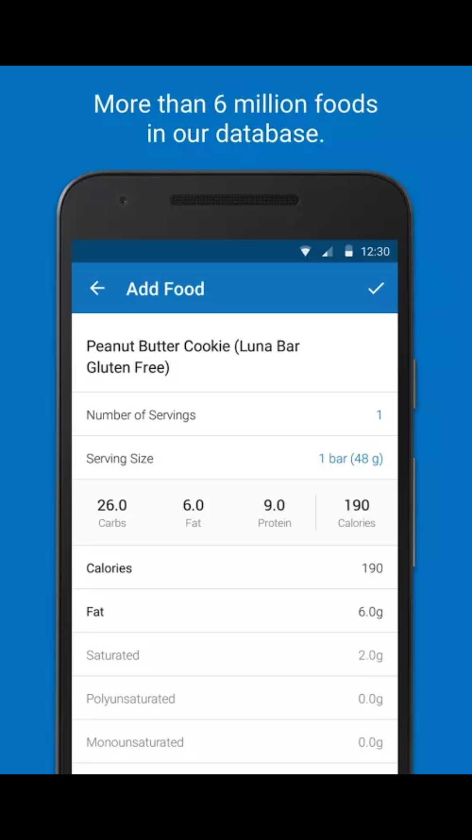
Existing Applications and features

Slide 3
How is it new?
Tracks the amount of calories burned during daily activities/exercise
Maintains the amount of calories intake and calories burned
Warning the user if it’s eating pattern is unhealthy

