Slide 1
Model-based image synthesis on humans
Unconstrained adversarial attacks on humans

Slide 2
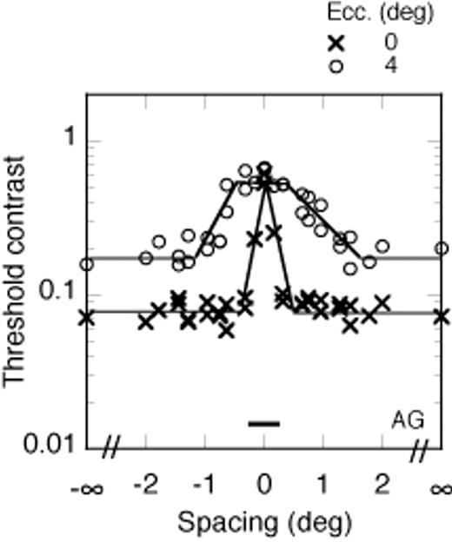
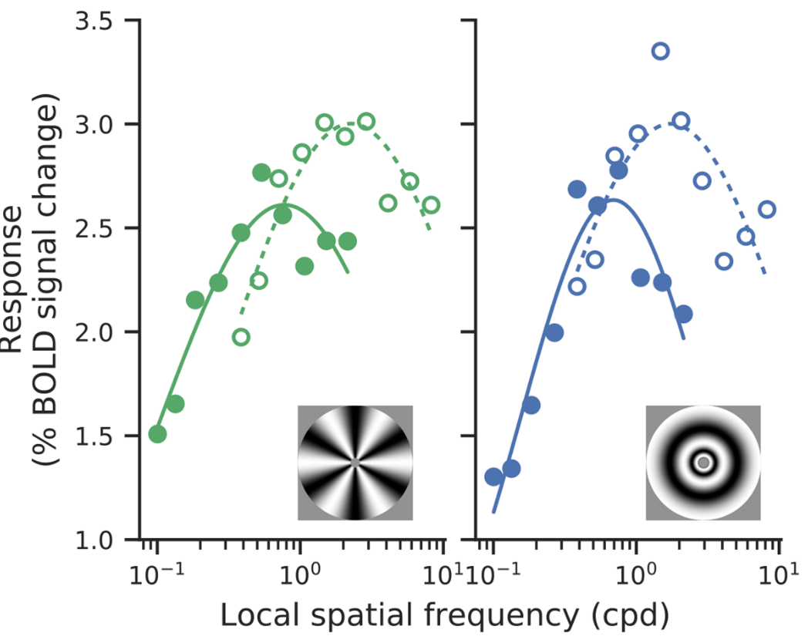
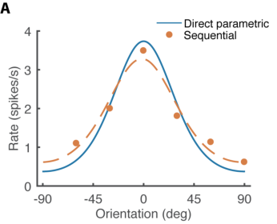
What visual features do people use?
Possible to study for low dimensional feature spaces
But not tractable for higher dimensional features (shape, texture)

Slide 3
Alternative: what features do models use? and how do they compare to humans?
Look at model representations. E.g., feature maps for a neural network. Very difficult to compare with humans!

Slide 4
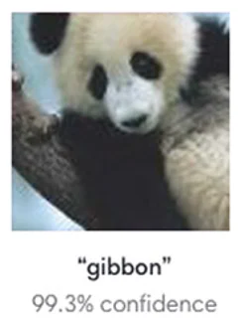
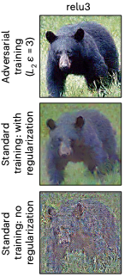
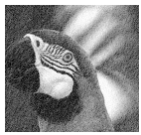
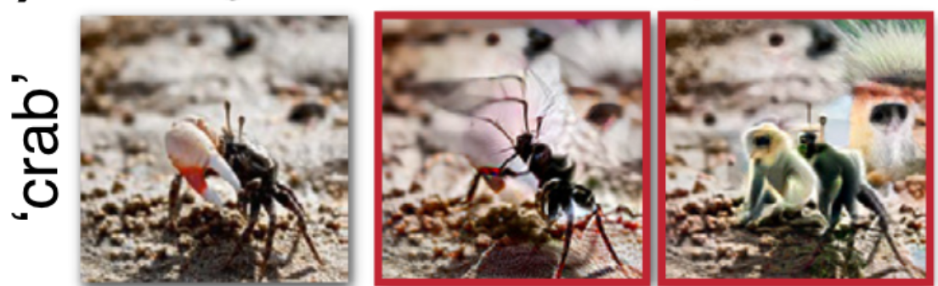
Alternative: what features do models use? and how do they compare to humans?
Look at model representations. E.g., feature maps for a neural network. Very difficult to compare with humans!
Model-based image synthesis: Generate images that yield “extreme” model performance and test if they affect humans. A way of shrinking human test space by constraining it with a model.
Adversarial attacks
Model metamers
Eigendistortions
These images help us study what features models use. But
Do they affect humans? Usually the answer is No.
Even if the answer is Yes, we cannot study humans independent of a model.

Slide 5


Model-based image synthesis on humans.
Starting with adversarial attacks.
Would be a way to study what visual features people use, even in high dimensions!
Challenges:
Adversarial attack methods need access to computations + gradients of the system (white-box).
Black-box/gradient-free attacks are available. But they need a lot of trials (1000s per image).
Gradient descent in image space until Prediction is wrong
System (human/model)
Image
Prediction

Slide 6
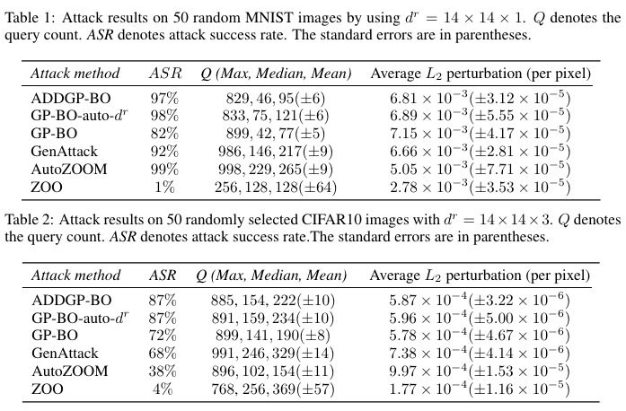
Bayesian gradient-free attacks
Seemingly fix the query/trial efficiency problem.

Slide 7
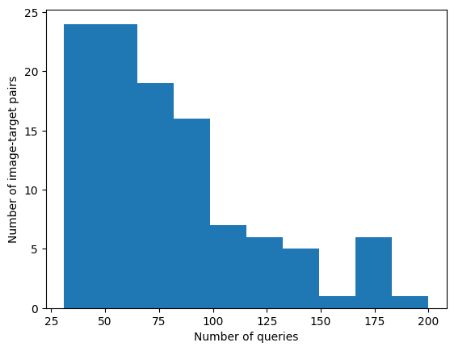
Bayesian gradient-free attacks
Seemingly fix the query/trial efficiency problem (according to paper)
My replication
16 MNIST images, targeted attacks on 9 other classes for each = 144 attacks
Success rate: Total attacks: 144, Number successful: 109 (75.69%), Number failed: 35
Number of queries: Min=31, Max=200, Mean=79.33, Median=67.00, SD=39.08
Can run on CPU!

Slide 8




Problem #1: Category concept might change over trials.
Solution: Odd-one-out task instead of recognition. If original cat is 2 and target cat is 0:
- Click on the odd one out.
the 2 image is adversarially attacked. The others will have different shuffled versions of the same noise so that the observer can’t tell just from noise pattern.

Slide 9
Problem #2: We need p(fooled), not just decision to run BayesOpt
Asking participant for their confidence won’t help here because that’s not a smooth function over images. I ran myself.
Potential solution: Can we use reaction time as a measure of confidence?
We have a block of 25 trials initially with no noise and just one clear odd one out. Use average RT over those as RT for p(fooled) = 0. tmin
If p(fooled) = 1, they will take a lot more time. Add in 5 trials during training time where all images are from same category, and measure their average response time. tmax
Then on test trials, p(fooled) = (t – tmin) / (tmax – tmin)
If they get it wrong, then p(fooled) = 1, forget abt rt.
Notes:
Make the task continuous instead of discrete.
To make sure they really respond the all-same trials, lie to them

Slide 10
