Slide 1
Software Design Document (SDD) Vision-Language Model for Out-of-Label Hazard Detection in Autonomous Driving
Version : 1.1
Presented By:
Abhiram K Aravind
Ajay Suseel
Kishan P K
Pranav I B

Slide 2
Introduction
Purpose
This document outlines the design of a vision-language model for detecting hazards in autonomous driving scenarios that are not covered by standard dataset labels. The system combines BLIP (Bootstrapped Language-Image Pre-training) with NLP-based semantic analysis to identify novel hazards (e.g., "fallen tree," "oil spill").
Scope
The system:
Fine-tunes BLIP on the NuScenes dataset to generate hazard oriented captions.
Uses spaCy for entity extraction and Sentence-BERT for semantic similarity analysis.
Flags hazards with low similarity to predefined labels.

Slide 3
System Overview
High-Level Architecture
The system comprises:
Data Preparation: NuScenes dataset preprocessing and hybrid caption generation.
Model Training: BLIP fine-tuning on hazard-oriented captions.
Hazard Detection: Entity extraction and semantic similarity analysis.

Slide 4
Architecture Diagram
Inference & Detection
- Image Input
- Generate Caption using Fine-Tuned BLIP
Alert & Output Interface (Alerts, Dashboard, etc.)
NuScenes Dataset (Images,Annotations,)
Hazard Detection Engine
- Named Entity Recognition (NER) - Semantic Similarity Computation - Identify Out-of-Label Hazards
Data Preparation Module
- Preprocessing & Labeling
- Hazard-oriented Captions
BLIP Fine-Tuning Module
Base BLIP Pretrained Model
- Fine-Tuned on Hazard-Enriched Captions
Hazard Logs Database
(Stores Detected Hazard Information, Confidence Scores, etc.)

Slide 5
System Components
Functional Components
Component | Technology | Description
Data Processor | Python | Preprocesses NuScenes images and annotations
BLIP Model | HuggingFace Transformers | Generates hazard-aware captions
Hazard Detector | spaCy, Sentence-BERT | Extracts entities and computes semantic similarity
User Interface |  | Simple UI to test performance

Slide 6
Subsystems & Modules
Data Preparation Module
Hybrid Captioning: Combines BLIP-generated captions with manual hazard annotations.
Dataset Splitting: 70-20-10 split (train-val-test).
Model Training Module
BLIP Fine-Tuning: Trains on hazard-oriented captions (10 epochs, batch size=8).
Loss Function: Cross-entropy with label smoothing.
Hazard Detection Module
Entity Extraction: spaCy NER to identify objects/actions in captions.
Semantic Analysis: Flags entities with <0.3 cosine similarity to known labels.
Evaluation Module
Metrics: SPICE (Semantic Propositional Image Caption Evaluation)
Benchmark : COOOL Benchmark
Tools: TorchMetrics

Slide 7
Data Design
Data Structures
Training Data Schema
Used for fine-tuning vision-language model.
JSON
{ "image_id": "CAM_FRONT_0001", "caption": "Car swerves near fallen tree", "hazards": ["fallen tree"], "known_labels": ["car", "pedestrian"] }
Hazard Log Schema
Used for storing detected hazards and their risk assessment.
JSON
{ "timestamp": "2025-03-04T12:00:00Z", "entity": "fallen tree", "similarity": 0.18, "alert_level": "high" }

Slide 8
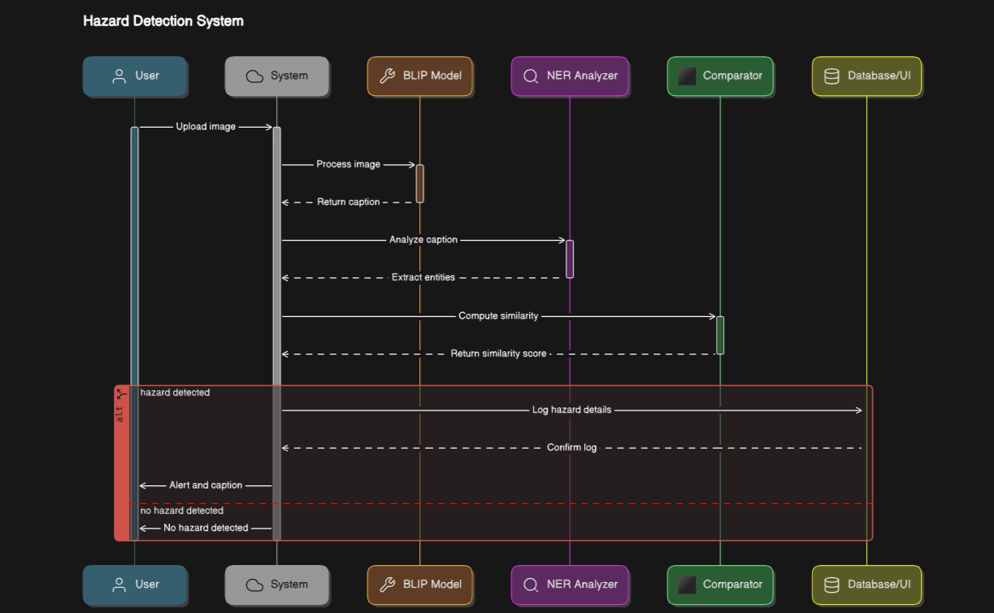
Workflow & Interactions
Sequence Diagram

Slide 9
Testing Strategy
Unit Testing
Performance Testing
Latency: <3s per image (NVIDIA T4 GPU).
Throughput: 50 images/sec (batch mode).
Test Type | Tools Used
Data Loading Tests | PyTest
Model Forward Pass | PyTorch Lightning
Integration Testing
Benchmark
Hazard caption generation
Metrics:BLEU Score ,CIDEr Score
Semantic Similarity
Metrics:BERTScore
Out of label hazard detection
COOOL benchmark
Component | Tool Used
End-to-End Pipeline | Docker

Slide 10
Thank You

