Slide 1
Vision Language Model based
Out of Label Hazard Detection
in Autonomous Driving
Group 3
Team Members -
Abhiram K Aravind(TKM22CS006)
Ajay Suseel(TKM22CS016)
Kishan P K(TKM22CS088)
Pranav I B(TKM22CS114)

Slide 2
Contents
Introduction
Literature review & Research Gap
Problem statement
Proposed System Design
System Architecture
Dataset
Data Preprocessing
Implementation
Testing
Result
Evaluation
Conclusion and Future Scope
Project Timeline
References

Slide 3
Abstract
Out-of-label hazards—unseen or unexpected risks like sudden obstructions, unusual weather conditions, or erratic pedestrian behavior—pose a major challenge for autonomous driving systems. This project presents a two-stage approach to detect such hazards by combining fine-tuned scene captioning with graph-based reasoning. A BLIP model, fine-tuned on the DPHR dataset along with rare driving scenarios, generates descriptive captions for each input image.
The captions are processed to extract linguistic triplets, compute keyword-based scores, semantic embeddings, and graph-aware heuristics. These features are passed to a GraphSAGE-based classifier, which incorporates both the scene context and structural knowledge from a prebuilt driving-related graph. The system outputs a hazard rating—low, medium, or high—enabling detection of anomalies that were not explicitly covered during training. This hybrid framework improves the system’s ability to generalize, supporting safer autonomous decision-making.

Slide 4
Introduction
Background
Autonomous driving systems must operate reliably in dynamic, unpredictable environments.
Key challenge: Detecting "out-of-label" hazards (unusual obstacles, rare events, unseen conditions).
Traditional systems struggle due to:
- Limited training data
- Rigid classification boundaries
Solution:
Use scene-level understanding and semantic reasoning
Leverage Vision-Language Models (VLMs) to generate flexible, descriptive image captions.

Slide 5
Objectives
Fine‑tuned hazard caption generation Adapt BLIP to generate context-aware captions highlighting potential hazards, even in out-of-distribution scenarios.
Multi‑modal graph‑augmented detection Combine textual features, semantic similarity, and graph-based knowledge to detect unseen hazards from scene descriptions.
Transparent GNN‑based explainability Leverage attention mechanisms and interpretable heuristics to provide insight into the model’s hazard predictions.

Slide 6
Literature Survey
Title | Author | Description | Issuance year
HazardVLM | Dannier Xiao, Mehrdad Dianati, Paul Jennings, Roger Woodman | Video language model designed for real-time hazard description. | IEEE - 2024
BLIP: Bootstrapping Language-Image Pretraining for Unified Vision-Language Understanding and Generation | Junnan Li, Dongxu Li, Caiming Xiong, Steven Hoi | Introducing BLIP architecture for image captioning | 2022
Inductive Representation Learning on Large Graphs | William L. Hamilton, Rex Ying, Jure Leskovec | Use of GraphSAGE architecture to efficiently generate node embeddings for previously unseen data. | 2017
DriveVLM | Xiaoyu Tian, Junru Gu, Bailin Li, Yicheng Liu, Yang Wang, Zhiyong Zhao, Kun Zhan, Peng Jia, Xianpeng Lang, Hang Zhao | Leverages Vision-Language Models (VLMs) for enhanced scene understanding and planning capabilities. | 2024

Slide 7
Research gaps
Limited Generalization: Existing object detectors struggle to generalize to novel or unseen hazards not present in training datasets.
Insufficient Scene-Level Understanding: Current models focus on object detection, not holistic scene understanding via captions, which limits their ability to reason about unseen or out-of-label hazards.
Lack of Caption Generation Models for Hazard Contexts : Most captioning models are trained on general-purpose datasets , which lack domain-specific driving hazard context and semantics.
Poor Interpretability in Hazard Detection Pipelines: Many deep learning models are black-box in nature, making it difficult to explain or justify decisions made about hazard classification.

Slide 8
Problem Statement
Autonomous vehicles struggle to detect out-of-label hazards—unseen or novel risks not included in their training labels—creating serious safety gaps. Existing detection models also lack interpretability, offering little insight into their decision-making when faced with these novel threats.

Slide 9
Proposed System Design
Our proposed system consists of three key parts:
Hazard-Centric Caption Generation: A BLIP-based vision-language model is fine-tuned on an extended DHPR dataset with annotated anomalous scenes, enabling generation of captions that capture hazards beyond the original label space.
Multi-Modal Hazard Detection: Generated captions are analyzed using keyword heuristics and semantic similarity with a curated set of hazard descriptors, allowing identification of unseen risks through lexical and contextual alignment.
Graph-Based Interpretability: A graph neural network (GNN) represents relationships between visual entities and caption elements, enabling structured reasoning and transparent explanations for hazard detection.
This approach helps in generalizing hazard detection in autonomous driving as well as enables interpretable decision making.

Slide 10
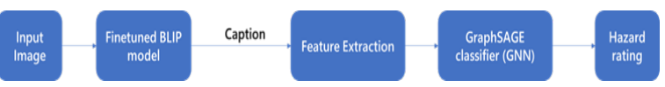
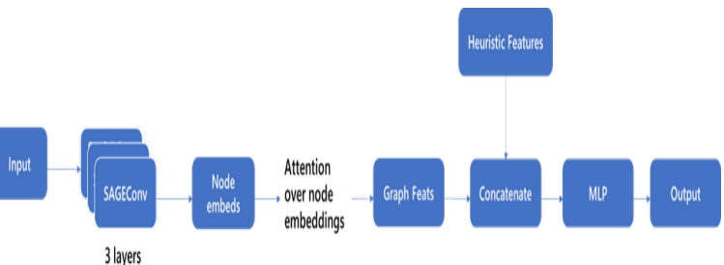
System Architecture
Figure : Overall System Architecture
Figure : Architecture of GNN

Slide 11
Dataset
DHPR(Driving Hazard Prediction and Reasoning) : 10,000 single dashcam images, each captured in diverse driving scenarios
Road Anomaly Dataset : Contains 1,126 real driving‐scene images representing anomalous driving scenarios
Custom Dataset Augmentation: Builds upon images from both DHPR and the Road Anomaly Dataset and incorporates self-annotated, hazard-aware captions to enhance contextual reasoning and model training.

Slide 12
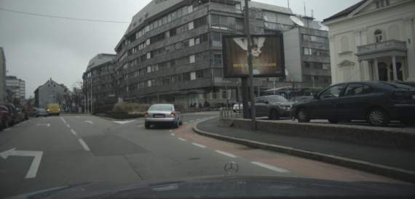
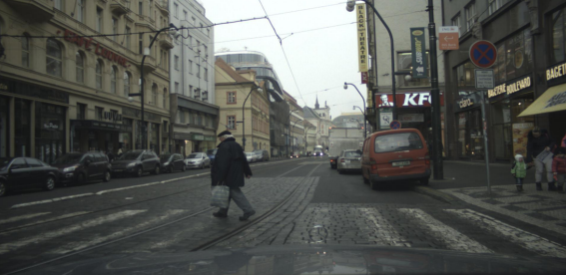
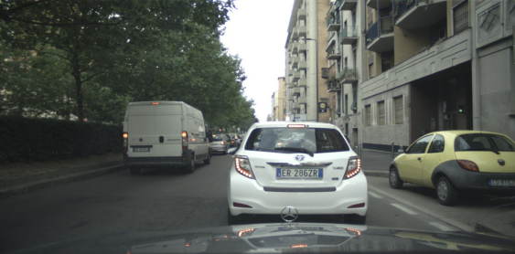
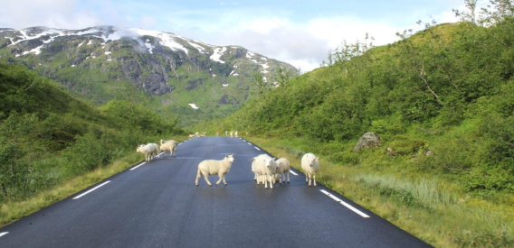

Slide 13
Data Preprocessing
The DHPR and Road Anomaly datasets provide a wide range of normal and hazardous driving scenarios.
Currently, there is no dataset available that includes captions specifically tailored to describe potential hazards in autonomous driving contexts.
To address this, we fine-tune BLIP to generate captions that are focused on identifying and describing hazards in driving scenes.
Hazard-aware captions are automatically generated using structured prompt templates designed to emphasize risk factors and safety-relevant elements.
A process of random manual verification is applied to ensure the accuracy and relevance of the generated captions

Slide 14
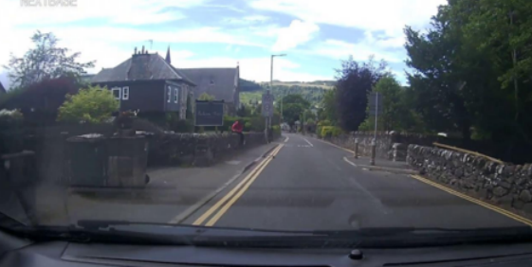
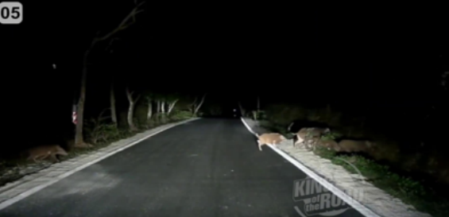
Ground Truth: Straight residential street, daytime, good visibility, with a person sitting on the wall to the left at a near distance.
Ground Truth: traight road at night with poor visibility, several animals are crossing from the right at a near distance and one is on the left side of the road

Slide 15
Implementation
Caption Generation (BLIP Fine-Tuning)
Model: BlipForConditionalGeneration (HuggingFace)
Processor: BlipProcessor
Loss: Cross-entropy
Optimizer: AdamW, LR = 5e-5
Freezing: Vision embeddings + first 6 encoder layers
Framework: PyTorch Lightning (GPU-accelerated)
Epochs:3
Feature Extraction & Reasoning
Keyword Matching: Weighted scores via severity-based keyword lists
Graph Context: Triplets mapped to a knowledge graph; scored via centrality/connectivity
Semantic Similarity: Caption embeddings vs. hazard phrases (sentence-transformers)

Slide 16
Implementation
Hazard Classification (GNN)
Model: 3-layer GraphSAGE + Attention
Features: GNN output (128D) + heuristic vector (9D)
Classifier: MLP → LayerNorm → ReLU → Dropout → Output
Output: 3-class hazard prediction (Low/Medium/High)
Loss: Cross-entropy, Optimizer: AdamW
Epochs:30

Slide 17
Testing
Test Cases
Functional Testing: Validate each module (BLIP, keyword, GNN, classifier)
Performance Testing: Real-time classification on varied hazard scenes
Caption Evaluation:
BLEU: N-gram precision
ROUGE: Recall-based overlap
METEOR: Synonyms + word order matching
Metrics:
Captions: BLEU, ROUGE, METEOR
Classification: Accuracy, Precision, Recall, F1-score
Test Data
Diverse real driving scenarios
Hazards: potholes, debris, construction, etc.
Includes edge cases unseen during training

Slide 18
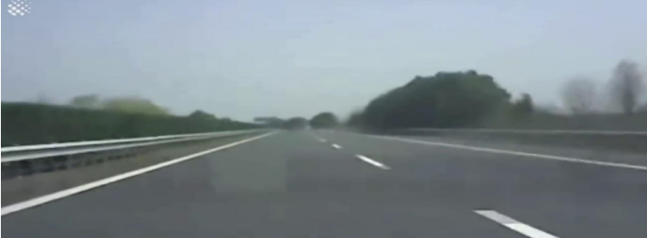
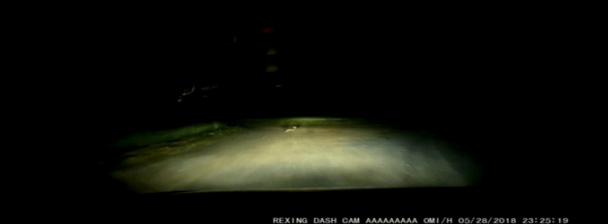
Results
Caption Generation
Caption: straight highway, daytime, good visibility, with a vehicle moderately distant ahead.
Ground Truth: Straight highway, daytime, moderate visibility, vehicles are moderately distant ahead.
BLEU: 0.1228 METEOR: 0.7426 ROUGE-L: 0.7619
Caption: straight road, nighttime, poor visibility, with a vehicle in the distance ahead and a ball on the left side of the road.
Ground Truth: Straight road, nighttime, poor visibility, the road ahead is barely lit by headlights.
BLEU: 0.1197 METEOR: 0.4838 ROUGE-L: 0.4000

Slide 19
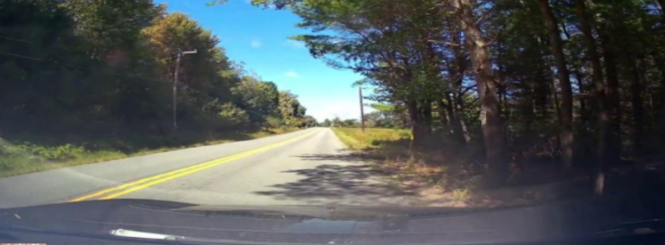
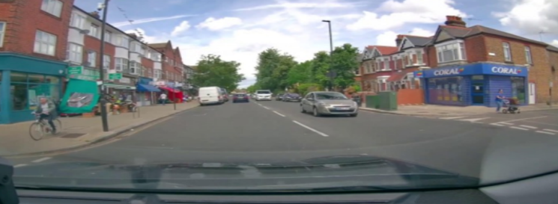
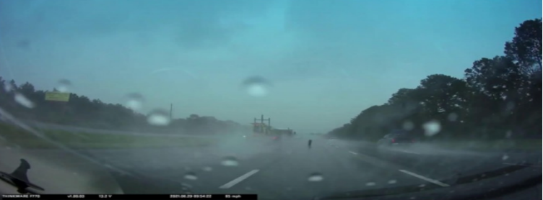
Hazard Detection
Caption:straight rural road, daytime, good visibility, with a vehicle moderately distant ahead.
Predicted: low | Ground Truth: low
Caption: straight residential street, daytime, good visibility, with a vehicle ahead at a moderate distance and a pedestrian on the left sidewalk.
Predicted: medium | Ground Truth: medium
Caption: straight highway, dusk, poor visibility due to heavy rain, with a vehicle ahead at a moderate distance.
Predicted: high | Ground Truth: high

Slide 20
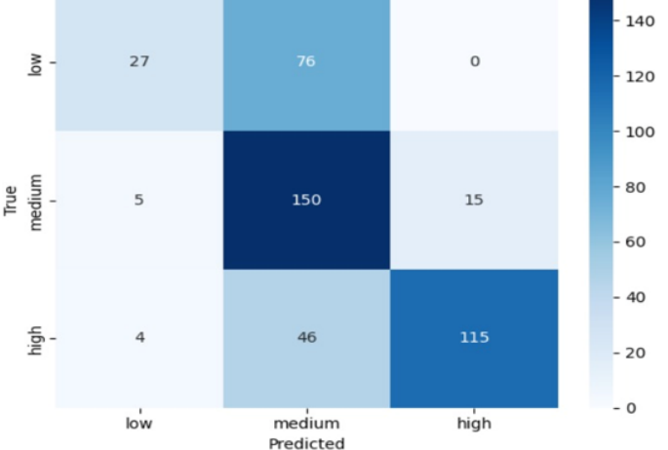
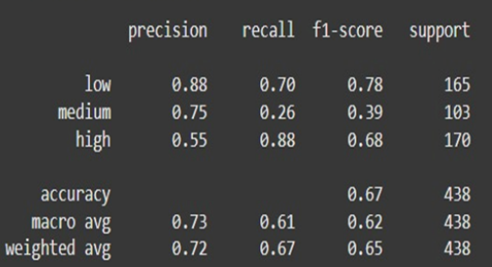
Evaluation
Corpus BLEU Score: 0.4755
Average METEOR Score: 0.4836
Average ROUGE-L Score: 0.53
Caption Generation
Hazard Detection
Figure : Confusion Matrix
Figure :Classification Report

Slide 21
Conclusion and Future Scope
Autonomous Driving is a rapidly evolving field with continuous innovation.
Model performance depends on several factors: dataset quality, optimization algorithms, and compute resources (e.g., GPUs).
Our proposed system effectively integrates:
Vision-Language modeling (BLIP) for rich image captioning
Graph-based learning (GraphSAGE) for interpretable hazard classification
Output: Classifies hazards as Low, Medium, or High with improved context awareness and interpretability.
Future Scope
Real-time Deployment on edge devices or in-car systems
Multimodal Fusion: Integrating LiDAR, radar, and audio data
Continuous Learning from newly encountered scenarios
Scaling with Larger and More Diverse Datasets

Slide 22
Project Timeline
 | Jan | Feb | Mar | Apr
Literature survey
Requirement Analysis
Architecture Design
Implementation
Testing

Slide 23
References
1. Inductive Representation Learning on Large Graphs by William Hamilton et. al,
2. HazardVLM: A Video Language Model for Real-Time Hazard Description in Automated Driving Systems by Dannier xiao et. al
3. BLIP: Bootstrapping Language-Image Pretraining for Unified Vision-Language Understanding and Generation by Junnan Li et. Al
4. DriveVLM: The Convergence of Autonomous Driving and Large Vision-Language Models bi Xiayu Tian et.al
5. Zero-shot hazard identification in Autonomous Driving: A Case Study on the COOOL Benchmark by Lucas Picek et.al

Slide 24
THANK YOU

