Slide 1
Software Requirements Specification for Vision Language Model for Out of Label Hazards in Autonomous Driving Version 1.2
Prepared by
Abhiram K Aravind
Ajay Suseel
Kishan P K
Pranav I B
Notes:
3/12/2025
1
1

Slide 2
PROJECT SCOPE
Fine-tuning of Pretrained Model: Enhancing pretrained model’s capability using the NuScenes dataset for improved image captioning.
Uses entity extraction and semantic similarity analysis to identify out-of-label hazards in autonomous driving.
Flags hazards with similarity to predefined labels.
Notes:
3/12/2025
2
2

Slide 3
FUNCTIONAL REQUIREMENTS
Hazard-Oriented Caption Generation – Generates captions highlighting hazards from NuScenes dataset images.
BLIP Fine-Tuning – Adapts BLIP model using hazard-enriched captions for improved detection.
Hazard Detection Engine – Uses NER and semantic similarity to identify known and out-of-label hazards.
Alert & Output Interface – Displays hazard captions and triggers visual/audio alerts.
Notes:
3/12/2025
3
3

Slide 4
NON FUNCTIONAL REQUIREMENTS
Performance Requirements
P1: Efficient image caption generation with minimal latency
P2: High accuracy in entity extraction and similarity analysis
P3: Seamless integration with existing autonomous vehicle perception modules.

Slide 5
Software Quality Attributes
Scalability: The system is designed to be adaptable to new datasets and advancements in VLM architectures, ensuring future compatibility and updations.
Maintainability: The modular design allows easy updates and debugging without impacting the whole system.
Reliability:The system reliably detects hazards in different conditions, reducing errors and improving accuracy in various driving situations.

Slide 6
Use Case Diagram
Hazard detection
Image
Generate hazard captions
Display hazard alerts
User
Extract entities and compute semantic similarity
Flag and log hazards
Notes:
3/12/2025
6
6

Slide 7
Overall Working Diagram
Hazard Detection
Fine-Tuning
Fine-tuned Model
Dataset
Caption Generation
Data Preparation Module
Hazard Detection Engine
Alert & Output
Fine-Tuning
Hazard Logs Database
7

Slide 8
Data Preparation module
Finetuning
Hazard detection Engine
Dataset
Image
Finetuned model
Data Preprocessing
Extracting Key entities
Sample caption generation using captioning model
Loading Pretrained VLM
Comparing extracted entities to hazard labels
Enhancing generated caption
Finetuning Process
Detected output
Storing caption as JSON file
Saving best model
8

Slide 9
USER INTERFACE
Real-Time Captioning Dashboard:Displays generated captions and identified hazards.
Hazard Flagging System:Highlights novel hazards with confidence scores.
Performance Monitoring:Tracks model efficiency and accuracy over time.

Slide 10
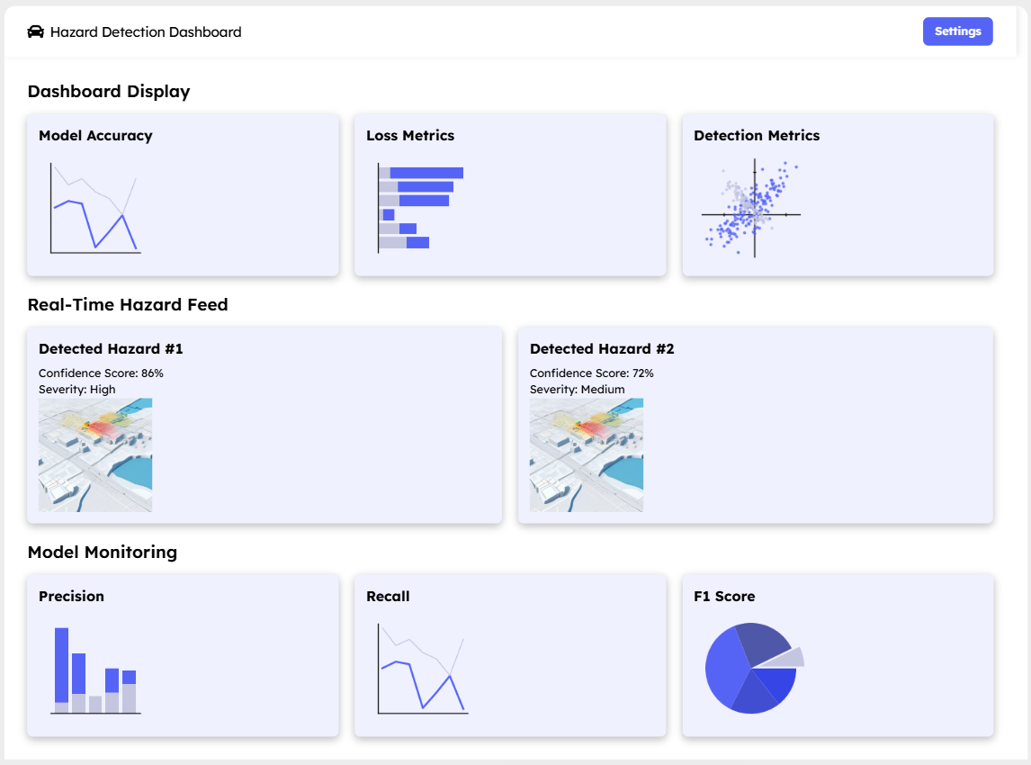

Slide 11
TEST PLAN
Metrics: Caption accuracy and Out of label hazard detection
Evaluation Metrics: BLEU Score ,CIDEr Score to assess image captioning quality . COOOL benchmark for assessing out of label hazard detection.
Execution Plan:
Fine-tune the BLIP model on the NuScenes dataset for enriched hazard captioning.
Evaluate captioning performance using BLEU Score ,CIDEr Score.
Assess the model’s performance on COOOL benchmark

Slide 12
THANK YOU

