Slide 1
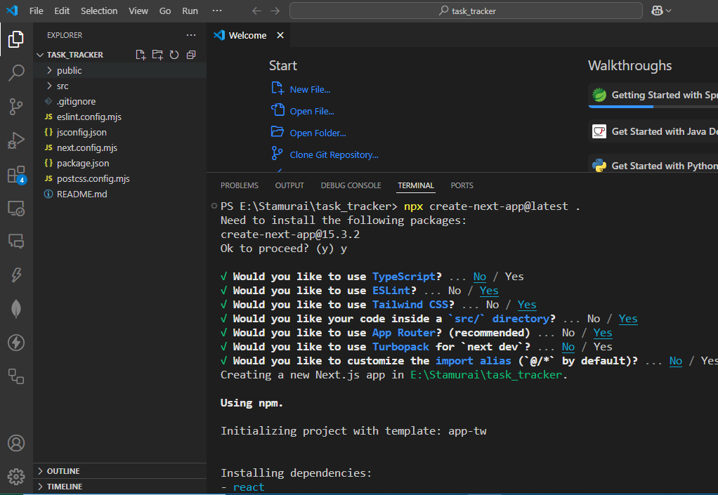
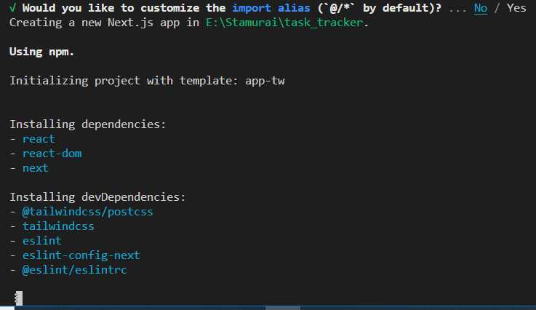
Task_tracker- 07-05-2025
PS E:\Stamurai\task_tracker> npx create-next-app@latest .
{
"name": "task_tracker",
"version": "0.1.0",
"private": true,
"scripts": {
"dev": "next dev",
"build": "next build",
"start": "next start",
"lint": "next lint"
},
"dependencies": {
"react": "^19.0.0",
"react-dom": "^19.0.0",
"next": "15.3.2"
},
"devDependencies": {
"@tailwindcss/postcss": "^4",
"tailwindcss": "^4",
"eslint": "^9",
"eslint-config-next": "15.3.2",
"@eslint/eslintrc": "^3"
}
}

Slide 2
Task_tracker- 07-05-2025
package.json
{
"name": "task_tracker",
"version": "0.1.0",
"private": true,
"scripts": {
"dev": "next dev",
"build": "next build",
"start": "next start",
"lint": "next lint"
},
"dependencies": {
"react": "^19.0.0",
"react-dom": "^19.0.0",
"next": "15.3.2"
},
"devDependencies": {
"@tailwindcss/postcss": "^4",
"tailwindcss": "^4",
"eslint": "^9",
"eslint-config-next": "15.3.2",
"@eslint/eslintrc": "^3"
}
}
PS E:\Stamurai\task_tracker> npx create-next-app@latest
PS E:\Stamurai\task_tracker> npm run dev
PS E:\Stamurai\task_tracker> npm i axios@1.4.0
PS E:\Stamurai\task_tracker> npm i mongoose
PS E:\Stamurai\task_tracker> npm i bcryptjs
Task_tracker- 10-05-2025
PS E:\Stamurai\task_tracker> npm i jsonwebtoken
Task_tracker- 11-05-2025
MIDDLEWARE
https://nextjs.org/docs/app/building-your-application/routing/middleware

Slide 3
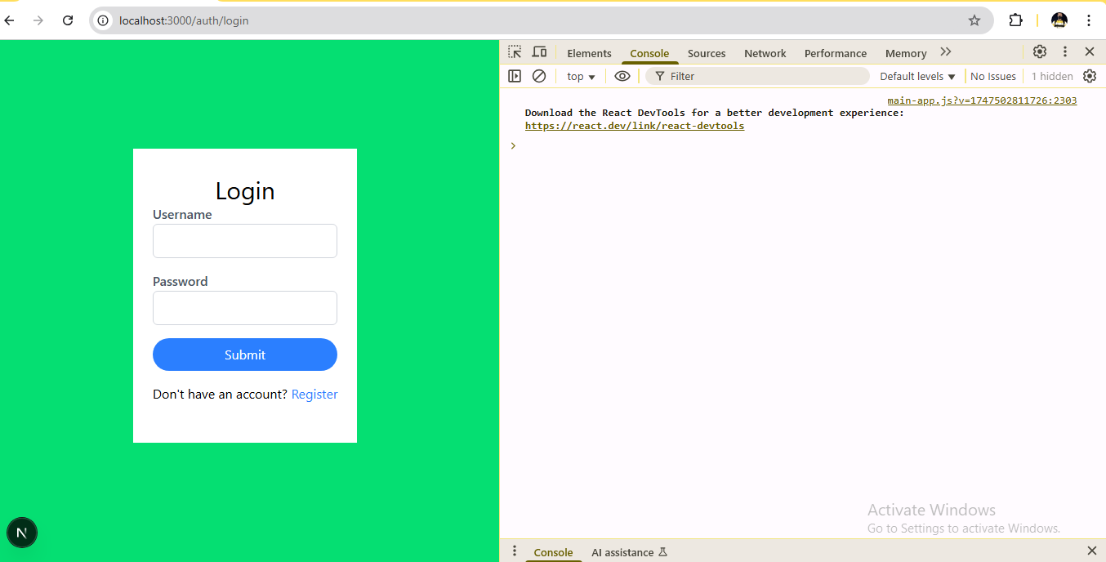

Slide 4
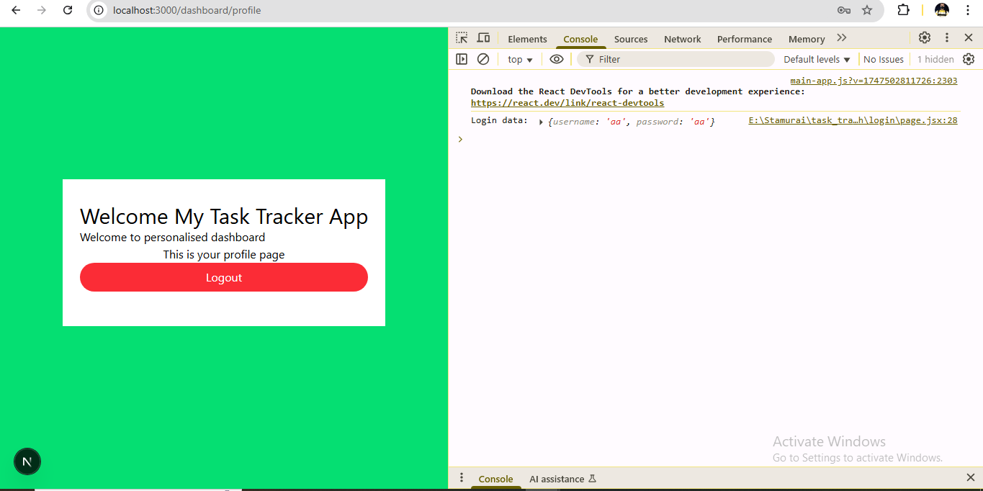

Slide 5
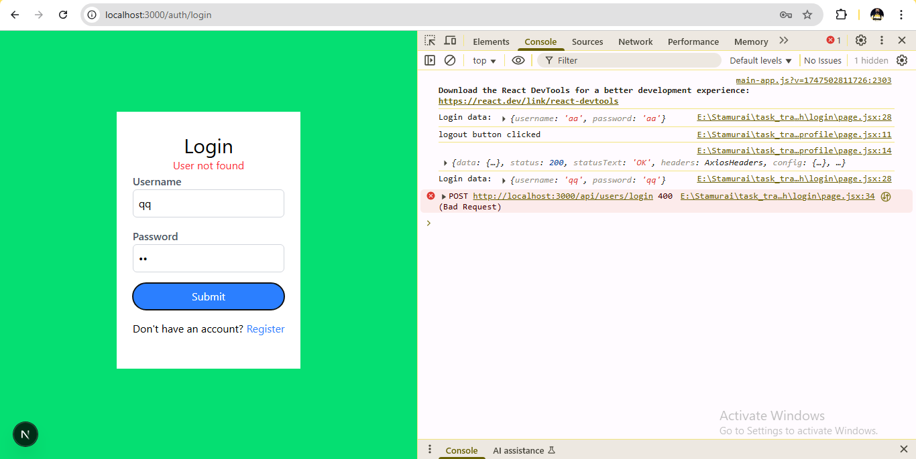
This error should be not visible?

Slide 6
