Slide 1
Consumer good Ad-hoc Insight
By – Ajay Titarmare

Slide 2
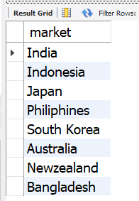
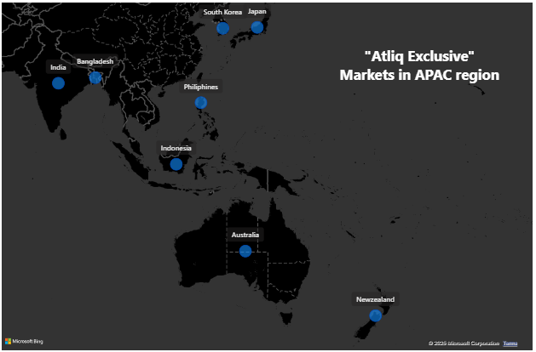
Request 1. Provide the list of markets in which customer "Atliq Exclusive" operates its business in the APAC region.
SELECT distinct market from dim_customer where customer="Atliq Exclusive" and region="APAC";

Slide 3
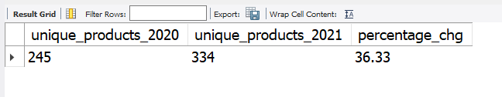
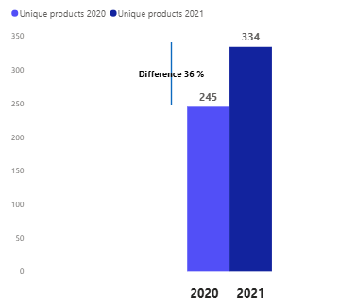
Request 2. What is the percentage of unique product increase in 2021 vs. 2020? The final output contains these fields, unique_products_2020 unique_products_2021 percentage_chg
with unique_products_2020 as (select count(distinct product_code) as unique_products_2020 from fact_sales_monthly where fiscal_year=2020), unique_products_2021 as
(select count(distinct product_code) as unique_products_2021 from fact_sales_monthly where fiscal_year=2021) select *,ROUND((unique_products_2021-unique_products_2020)/unique_products_2020*100,2) as percentage_chg from unique_products_2020 c1cross join unique_products_2021 c2

Slide 4
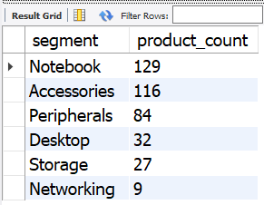
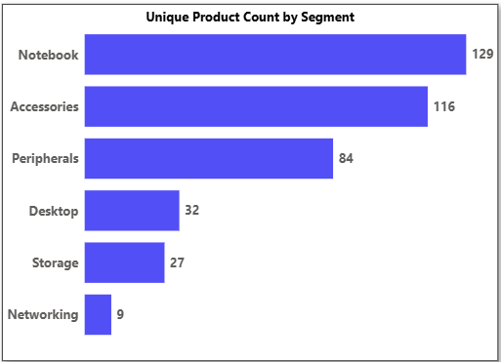
Request 3. Provide a report with all the unique product counts for each segment and sort them in descending order of product counts. The final output contains 2 fields, segment product_count
Select segment,count(distinct product_code) as product_count from dim_product group by segment order by product_count desc ;

Slide 5
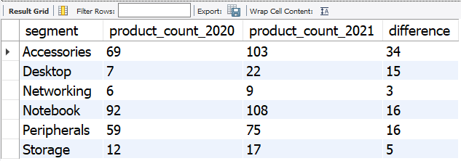
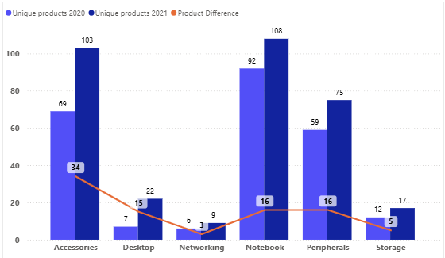
Request 4. Follow-up: Which segment had the most increase in unique products in 2021 vs 2020? The final output contains these fields, segment product_count_2020 product_count_2021
difference
with unique_products_2020 as (select p.segment, count(distinct f.product_code) as product_count_2020 from fact_sales_monthly f join dim_product p on f.product_code=p.product_code where fiscal_year=2020 group by p.segment), unique_products_2021 as (select p.segment,count(distinct f.product_code) as product_count_2021 from fact_sales_monthly f join dim_product p on f.product_code=p.product_code where fiscal_year=2021 group by p.segment) select c1.segment,c1.product_count_2020,c2.product_count_2021, (c2.product_count_2021-c1.product_count_2020) as difference from unique_products_2020 c1 join unique_products_2021 c2 on c1.segment=c2.segment

Slide 6
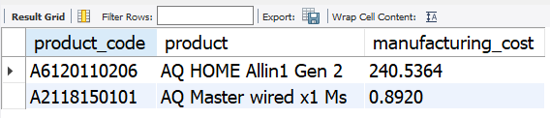
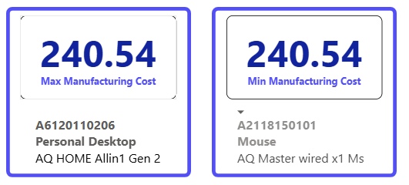
Request 5. Get the products that have the highest and lowest manufacturing costs. The final output should contain these fields, product_code product manufacturing_cost
select p.product_code,p.product, mc.manufacturing_costfrom dim_product p join fact_manufacturing_cost mcon p.product_code=mc.product_codewhere mc.manufacturing_cost in
(select MAX(manufacturing_cost) as min_cost from fact_manufacturing_cost union select MIN(manufacturing_cost) as max_cost from fact_manufacturing_cost )
order by mc.manufacturing_cost desc;
(select p.product_code,p.product,MAX(manufacturing_cost) as manufacturing_cost from dim_product p join fact_manufacturing_cost mc on p.product_code=mc.product_code group by p.product_code,p.product order by manufacturing_cost desc limit 1) UNION (select p.product_code,p.product,MIN(manufacturing_cost) as manufacturing_cost from dim_product p join fact_manufacturing_cost mc on p.product_code=mc.product_code group by p.product_code,p.product order by manufacturing_cost asclimit 1)

Slide 7
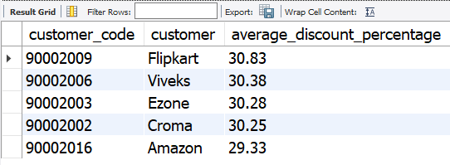
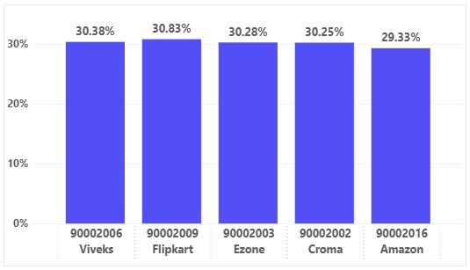
Request 6. Generate a report which contains the top 5 customers who received an average high pre_invoice_discount_pct for the fiscal year 2021 and in the Indian market. The final output contains these fields, customer_code customer average_discount_percentage
with cte1 as
(select customer_code,ROUND(avg(pre_invoice_discount_pct)*100,2) as average_discount_percentage
from fact_pre_invoice_deductions
where fiscal_year=2021
group by customer_code)
select c.customer_code,c.customer, pre.average_discount_percentage
from dim_customer c join cte1 pre on c.customer_code=pre.customer_code
where c.market="India“
order by pre.average_discount_percentage desc
limit 5

Slide 8
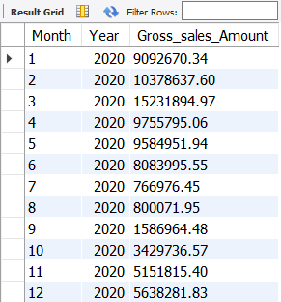
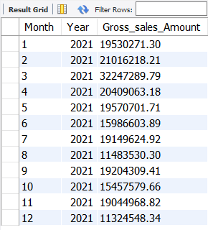
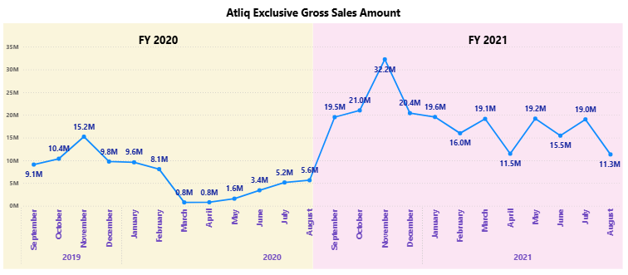
Request 7. Get the complete report of the Gross sales amount for the customer “Atliq Exclusive” for each month. This analysis helps to get an idea of low and high-performing months and take strategic decisions. The final report contains these columns: Month Year Gross sales Amount
select month(date_add(fm.date, INTERVAL 4 MONTH)) as Month,
fm.fiscal_year as Year , round(SUM(fm.sold_quantity*fp.gross_price),2) as Gross_sales_Amount
from fact_sales_monthly fm join fact_gross_price fp on fm.product_code=fp.product_code join dim_customer c on fm.customer_code=c.customer_codewhere c.customer="Atliq Exclusive“
group by fm.date,fm.fiscal_year
order by month

Slide 9
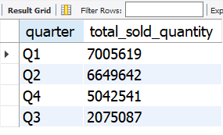
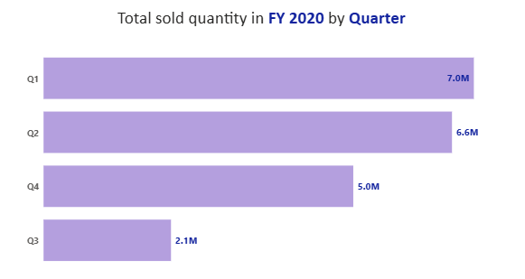
Request 8. In which quarter of 2020, got the maximum total_sold_quantity? The final output contains these fields sorted by the total_sold_quantity, Quarter and total_sold_quantity
with cte1 as
(select date,case
when month(date) in (9,10,11) then "Q1" when month(date) in (12,1,2) then "Q2" when month(date) in (3,4,5) then "Q3" when month(date) in (6,7,8) then "Q4" end as quarter, sold_quantity
from fact_sales_monthly
where fiscal_year=2020 )
select quarter, SUM(sold_quantity) as total_sold_quantity
from cte1
group by quarter
order by total_sold_quantity desc;

Slide 10
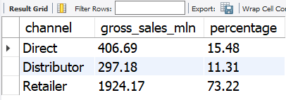
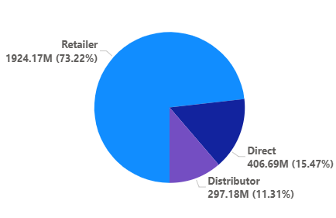
Request 9. Which channel helped to bring more gross sales in the fiscal year 2021 and the percentage of contribution? The final output contains these fields, channel gross_sales_mln percentage
with cte1 as
(select c.channel, ROUND(sum(fm.sold_quantity*fg.gross_price)/1000000,2) as gross_sales_mln
from fact_sales_monthly fm join fact_gross_price fg on fm.product_code=fg.product_code
join dim_customer c on c.customer_code=fm.customer_code
where fm.fiscal_year=2021
group by c.channel)
select channel,gross_sales_mln, ROUND(gross_sales_mln*100/sum(gross_sales_mln) over() ,2) as percentage from cte1

Slide 11
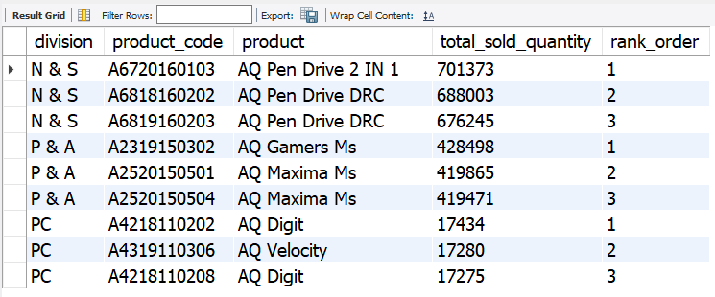
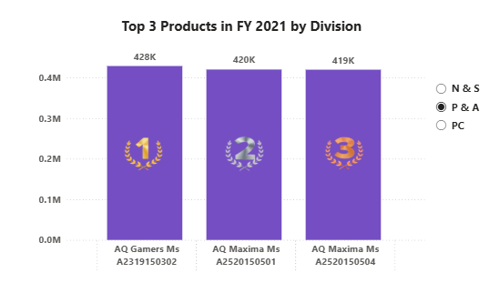
Request 10. Get the Top 3 products in each division that have a high total_sold_quantity in the fiscal_year 2021? The final output contains these fields, division product_code
with cte1 as
(select p.division,p.product_code,p.product, sum(f.sold_quantity) as total_sold_quantity from fact_sales_monthly f
join dim_product p on p.product_code=f.product_code
where f.fiscal_year=2021
group by p.division,p.product_code,p.product),
cte2 as
(select *, rank() over(partition by division order by total_sold_quantity desc) as rank_order from cte1)
select* from cte2 where rank_order<=3

