Slide 1

Project Name : Toys Give Away
Project members:
Ajay Sheelwant | 210543181097
Shubham Bachkar | 210543181012
Sachin Patil | 210543181064
Shankar Sure | 210543181110

Slide 2

Objective:
The purpose of Toys Give Away is to provide a platform where we can sell old toys . The potential seller will have to upload his/her old toys along with the description and with the excepted price.on the other hand a potential buyer can view the toy and can decide whether to buy it.

Slide 3

Flow:
Seller::
Seller will login to the portal or will have to register if he is not a registered.
After registration Seller will login and home page will be displayed where he can see all the toys.
From that seller can go to seller dashboard.
In seller dashboard he can view his profile where seller Id,E-mail Id and mobile number is displayed.
In seller dashboard he can also view all the toys which is uploaded by the seller.
Also there is a option to Add new toys where seller can enter new toy name, can add toy description,toy price and finally the image of the toy.
There is also a chat tab where seller and buyer can communicate with each other.

Slide 4
Buyer:
Buyer will login to the portal or will have to register if he is not registered
After registration Buyer will login and home page will be displayed where he can see all the toys.
From that Buyer can go to Buyer dashboard..
In Buyer dashboard he can view his profile where Buyer Id,E-mail Id and mobile number is displayed.

Slide 5
Admin:
Admin will login as Admin where Admin will be able to see all the toys which are posted by the seller.
In Admin Dashboard will have different options like View toys, view seller,view Buyer which are registered on the portal.
Admin has the authority to delete a toy if admin feels that the toy is faulty or defective.
In View Buyer and View Seller section admin will be able to see all the details of Buyer and Seller

Slide 6
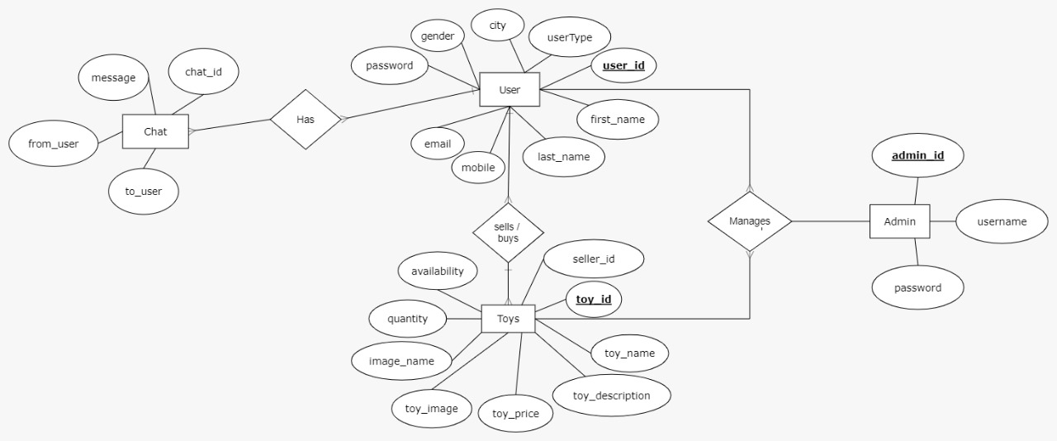
Flow Diagram:

Slide 7

Schema:-
1)Collection name : user
User_id , first_name ,last_name ,email ,password,gender,city,user_type,mobile
2)Collection name : Admin
Admin_id , username, password
3)Collection name :Toys
Toys_id,toy_name,toy_description,toy_price,quantity,availability,toy_image,image_name,seller_id

Slide 8
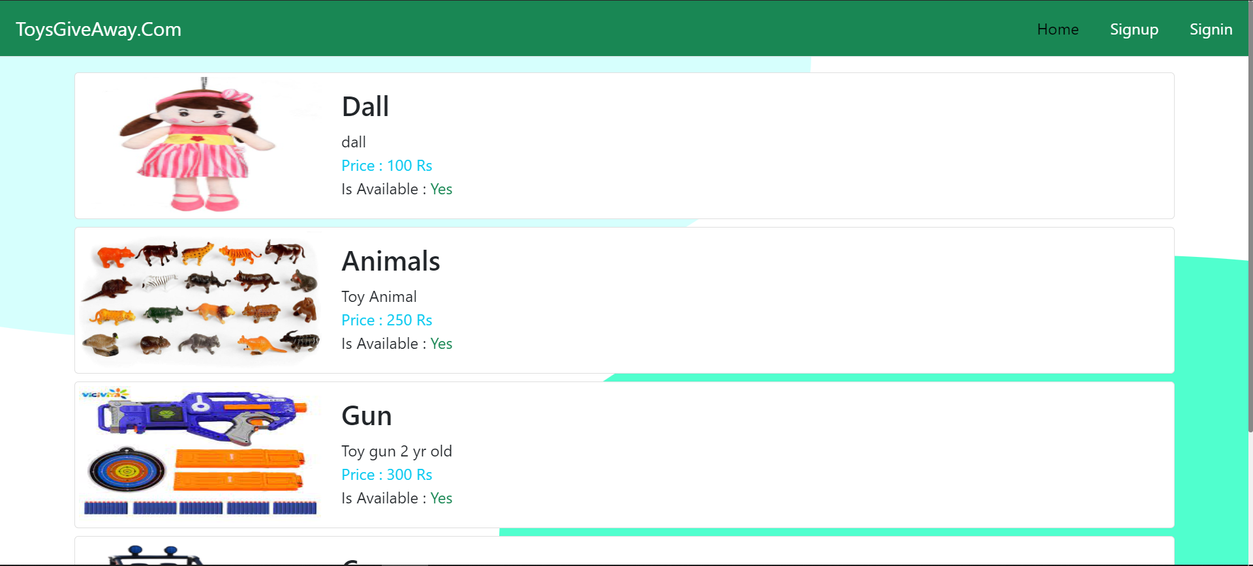
Home page:

Slide 9
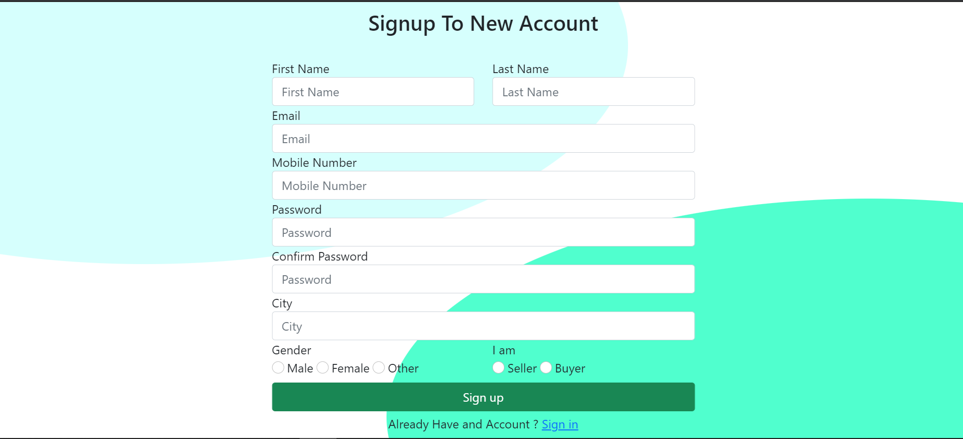
Signup page:

Slide 10
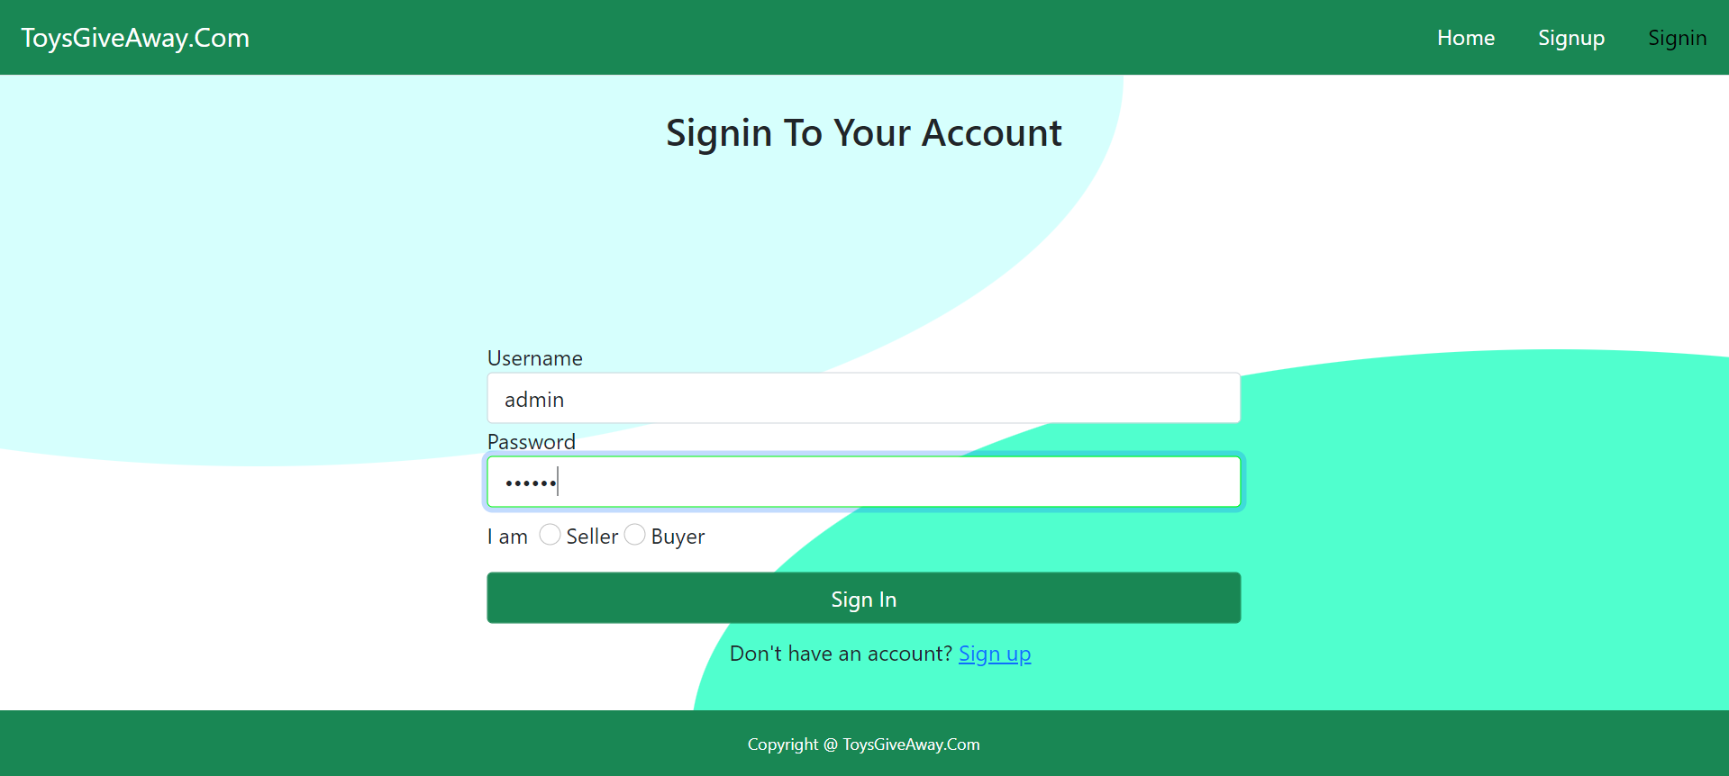
Admin login:

Slide 11
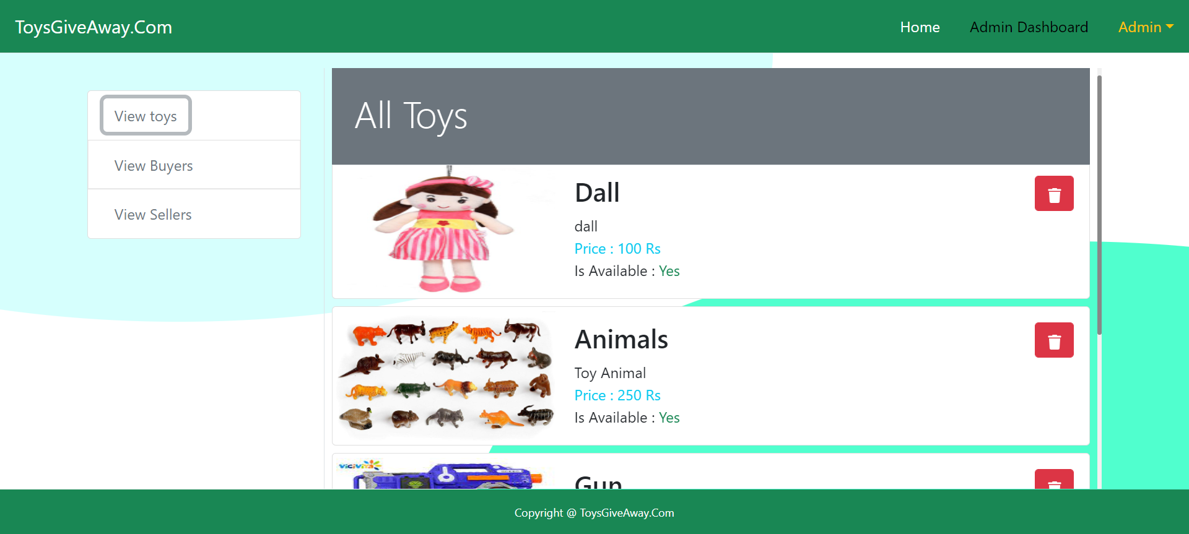
Admin Dashboard

Slide 12
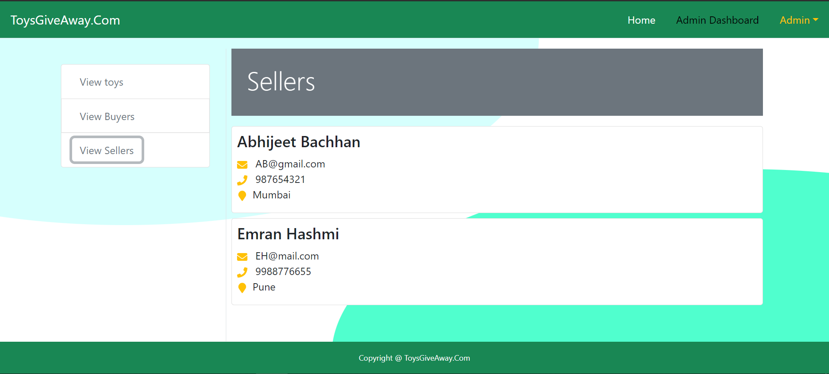
Admin View Seller

Slide 13

Admin View Buyer

Slide 14
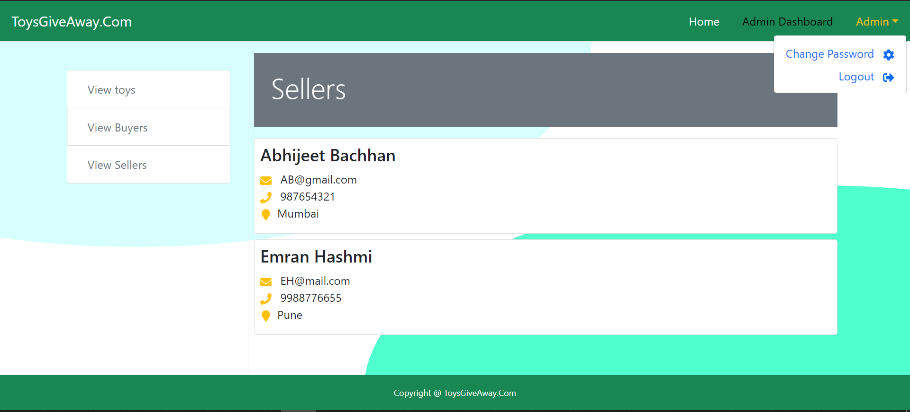
Admin Logout

Slide 15

Seller Login:

Slide 16
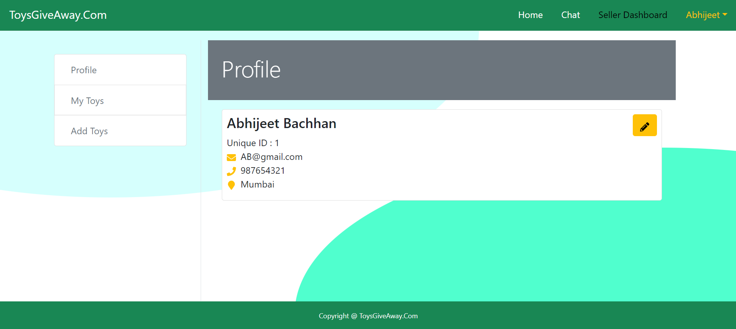
Seller Dashboard

Slide 17
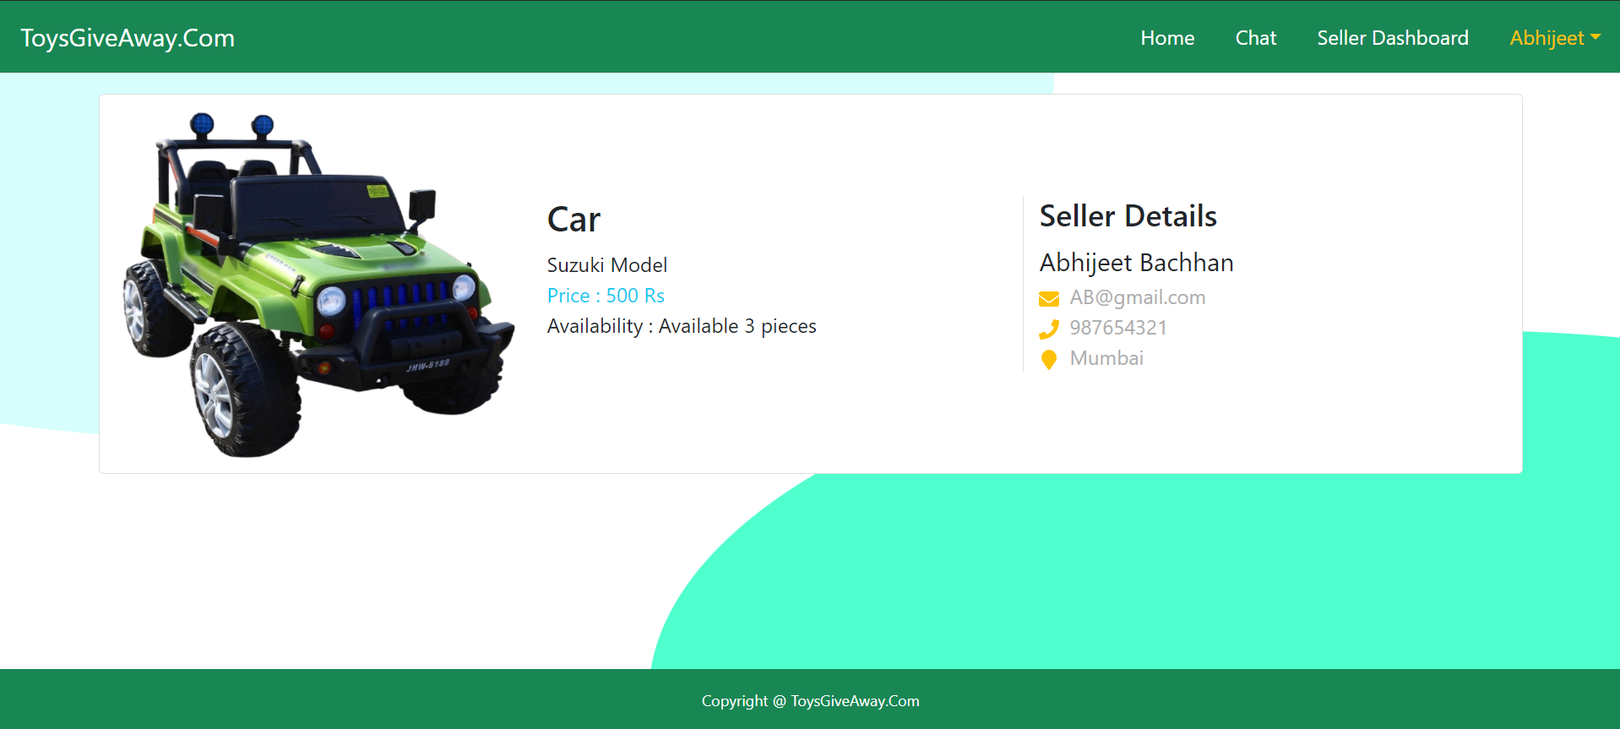
Seller Details:

Slide 18
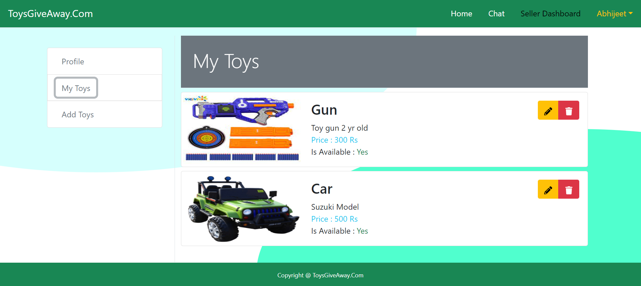
Seller toys:

Slide 19
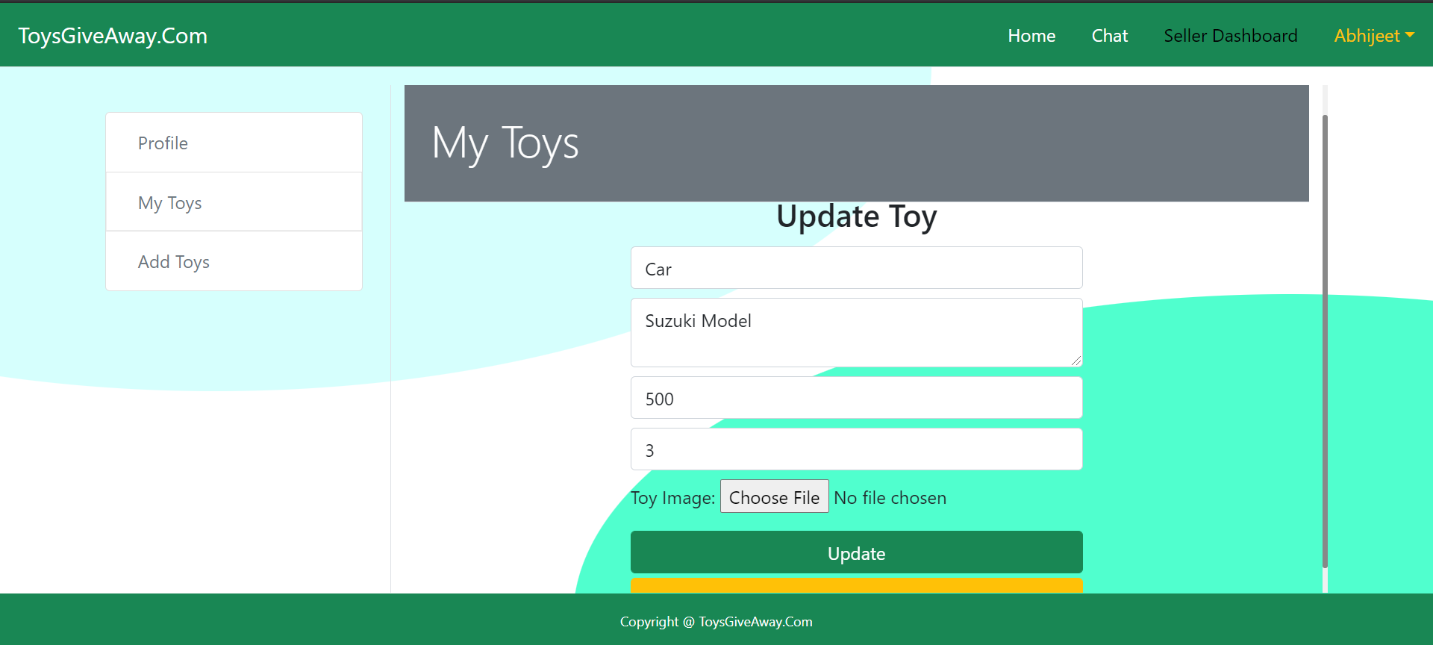
Update toys:

Slide 20
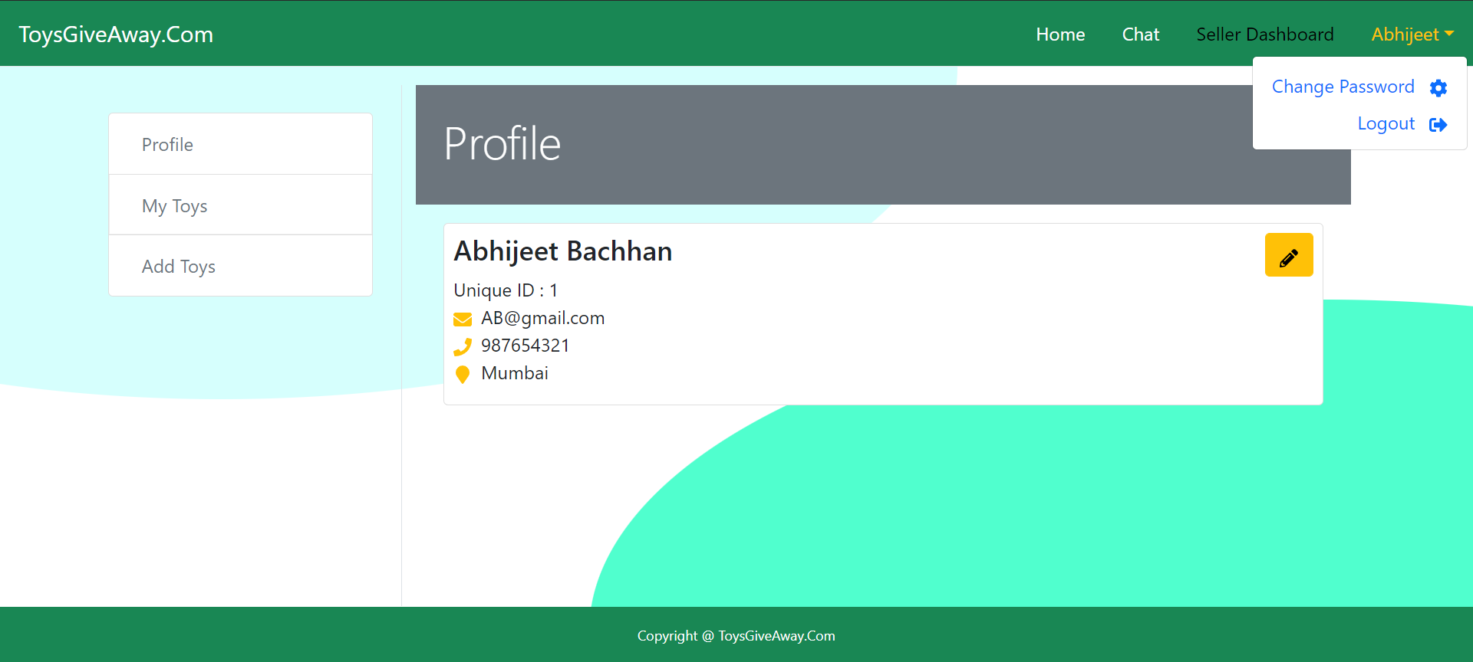
Seller Logout:

Slide 21
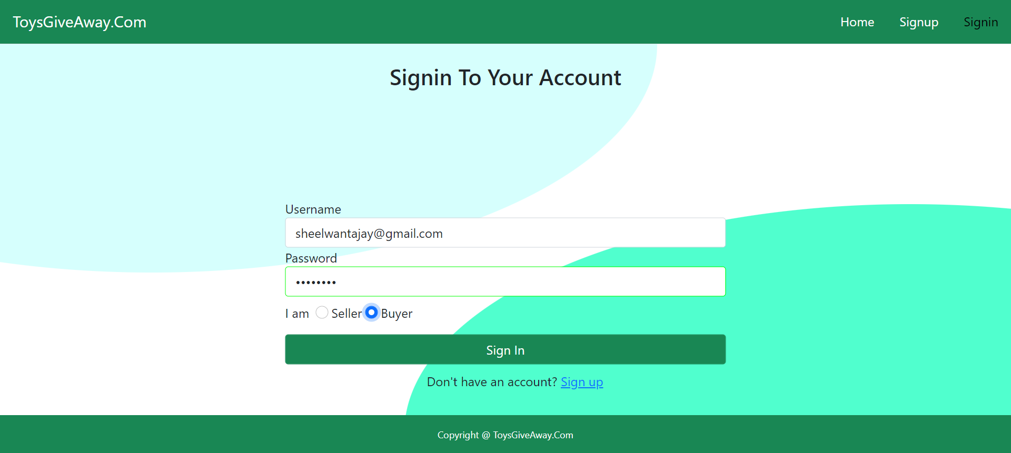
Buyer Login

Slide 22
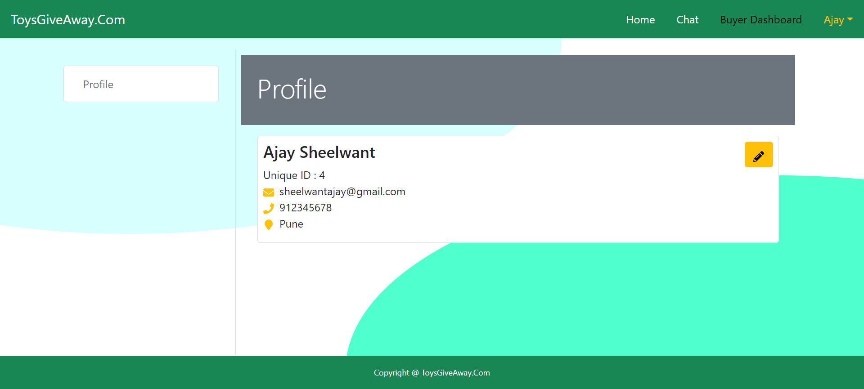
Buyer Dashboard:

Slide 23
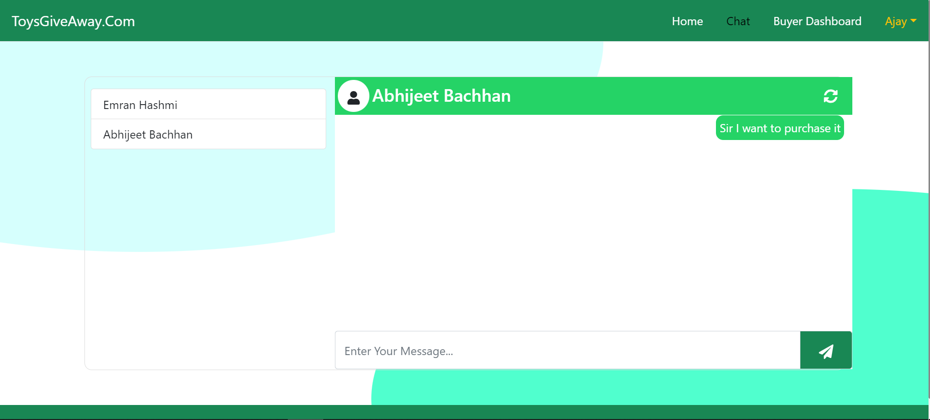
Buyer and Seller Chat:

Slide 24
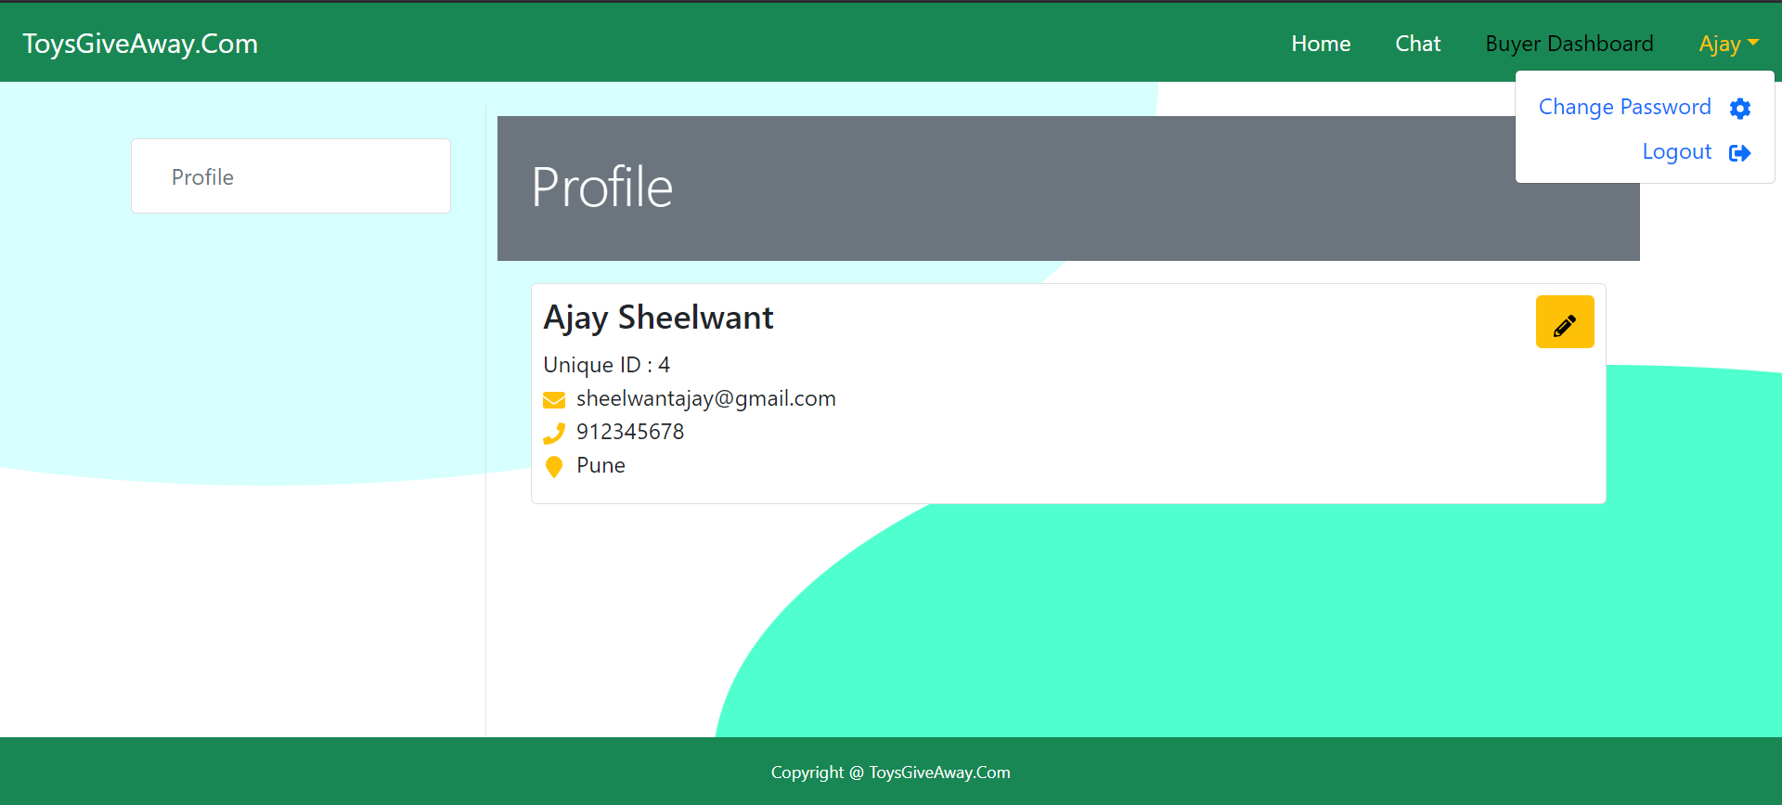
Buyer Logout & change Password:

Slide 25
Thank You.

