Slide 1
IBM University Engagement Project Submission
“Exploring the Power of Agentic AI with IBM Granite and IBM Bob”

Slide 2

Project Tile – [SignalSense AI – Intelligent Signal Quality Analyzer]
Domain of Project – Telecommunications / Networking
Student Name | Recent Passport Photo | Email ID | Mobile number [WhatsApp]
Ajay Verma |  | av9553569827@gmail.com | 9553569827
Recommended font style and size: Font Style: Arial Font Size (Heading): 28
Font Size (Content): 20

Slide 3
Problem Statement -
Problem Statement : SignalSense AI
The Challenge
Telecom engineers, network architects, and field technicians must constantly evaluate signal parameters such as SNR, BER, latency, throughput, RSSI, and jitter to keep networks healthy. This data is scattered across logs, dashboards, and CSV exports, making it slow to spot anomalies, interference, or early signs of failure, and even harder to translate raw readings into clear engineering action.
The Objective
Build an AI-powered Agentic system, SignalSense AI, that delivers real-time signal quality analysis and predictive network intelligence for telecom engineers, network architects, and students. The solution should:
Signal Quality Analysis – Evaluate SNR, BER, latency, throughput, packet loss, RSSI, and jitter against engineering thresholds.
Anomaly & Interference Detection – Identify root causes such as noise, congestion, or attenuation and classify severity.
Optimization Recommendations – Generate ranked, actionable engineering fixes for RF, antenna, and network configuration issues.
Predictive Failure Forecasting – Project 7/30/90-day degradation trends and flag at-risk links before they fail.
Multi-Agent System –
Signal Data Analysis Agent (evaluates live signal metrics)
Signal Issue Detection Agent (root cause & anomaly detection)
Intelligent Insight & Recommendation Agent (optimization strategies)
Predictive Signal Failure Agent (failure forecasting & maintenance schedule)
Visualization Dashboard – Live Chart.js views of SNR, latency, throughput, and packet-loss trends.

Slide 4
Proposed Solution -
Proposed Solution: SignalSense AI
The proposed solution is a multi-agent AI-powered signal quality platform built using Python Flask and IBM watsonx.ai to deliver real-time telecom signal analysis, anomaly detection, and predictive maintenance. The system addresses challenges in network monitoring and preventive maintenance through a modular, agent-based architecture.
At its core, the solution routes structured signal data through a central orchestrator to one of four specialized agents, each calling the meta-llama/llama-3-3-70b-instruct model on IBM watsonx.ai with a purpose-built, engineering-grade prompt.
The system consists of four key agents:
Signal Data Analysis Agent evaluates SNR, BER, latency, throughput, RSSI, and jitter, and produces a full quality report.
Signal Issue Detection Agent identifies anomalies, interference, and congestion, with root-cause and severity analysis.
Intelligent Insight & Recommendation Agent generates prioritized engineering optimization strategies for RF, antenna, and network configuration.
Predictive Signal Failure Agent forecasts 7/30/90-day degradation trends and produces a preventive maintenance schedule.
The solution includes a dark-themed, responsive dashboard (built with Bootstrap 5 and Chart.js) that visualizes SNR, latency, throughput, and packet-loss trends live.
A Flask orchestrator routes requests to the correct agent, while IBM watsonx.ai ensures scalable, governed model inference via the Llama 3.3 70B Instruct model.
Overall, this solution delivers an end-to-end intelligent network engineering assistant that promotes proactive maintenance through real-time analysis, root-cause detection, and predictive insight.

Slide 5
Technology Used
Python Flask - Backend web framework serving the app and REST API endpoints
IBM watsonx.ai model - e.g. – meta-llama/llama-3-3-70b-instruct – For reasoning, root-cause analysis, and report generation
IBM Cloud – Hosts the watsonx.ai platform (Sydney region – au-syd.ml.cloud.ibm.com), providing a reliable, secure, and scalable environment for AI inference.
ibm-watsonx-ai SDK– Python SDK used to authenticate and call watsonx.ai, enabling structured prompt-based inference.
Bootstrap 5 & Chart.js - For the dark-themed responsive dashboard and live signal visualizations
Agent Orchestrator (Flask routing map) – Directs each API call to the correct specialized signal agent

Slide 6
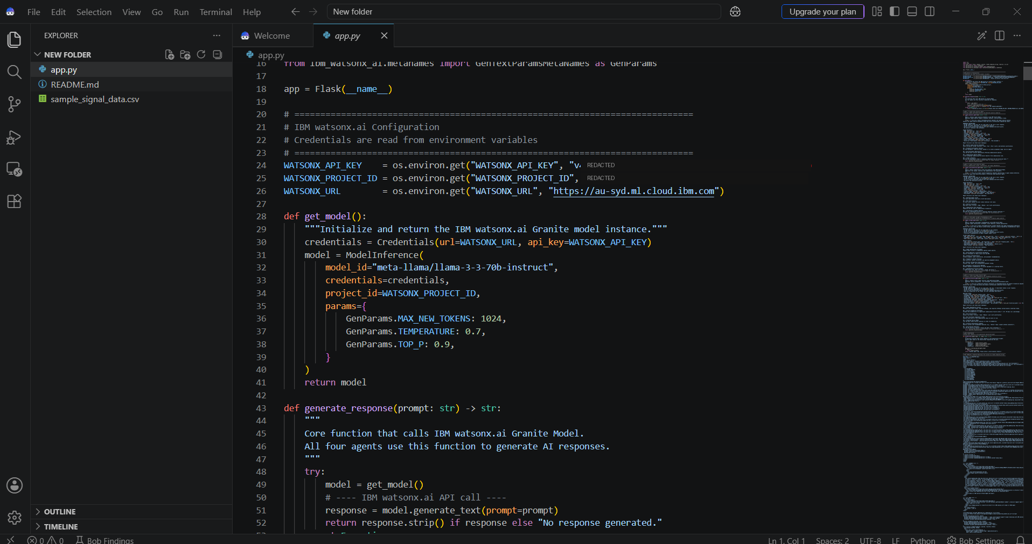
Required Files created using IBM bob -
App.py
sample_signal_data.csv
README.md
Inline HTML/CSS/JS

Slide 7
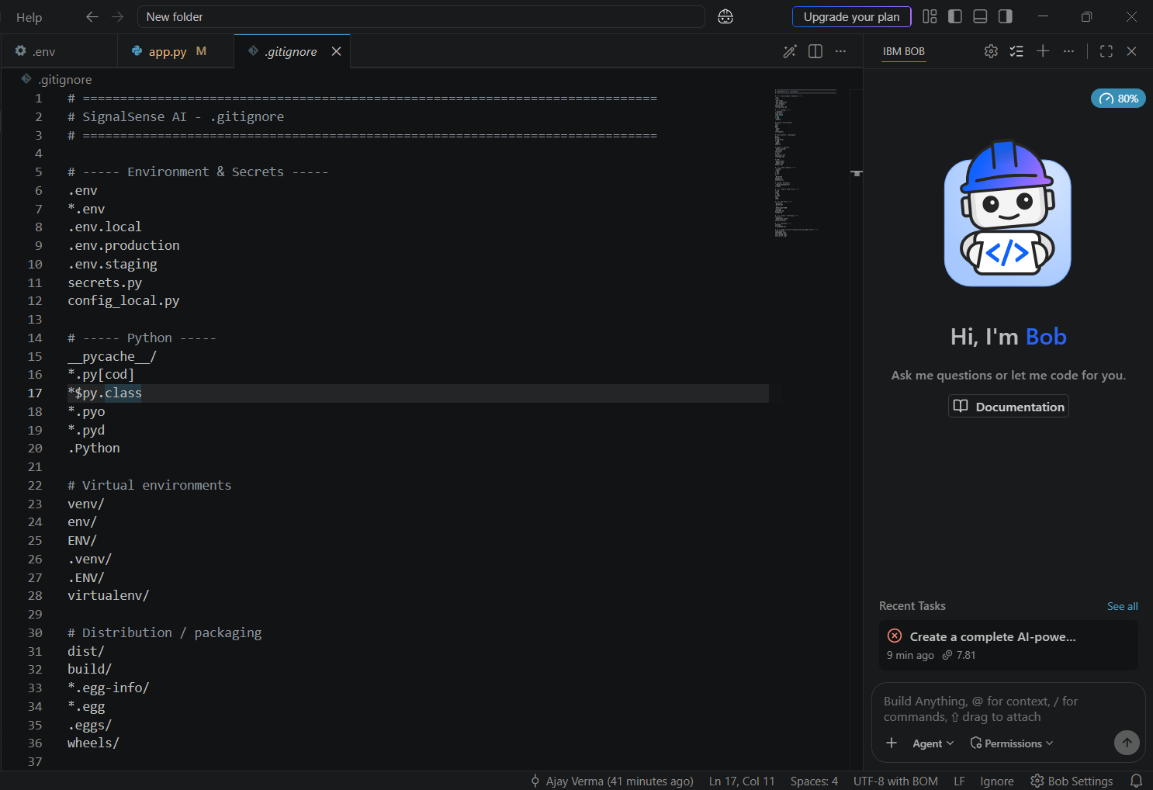
IBM Bob Screenshots:

Slide 8
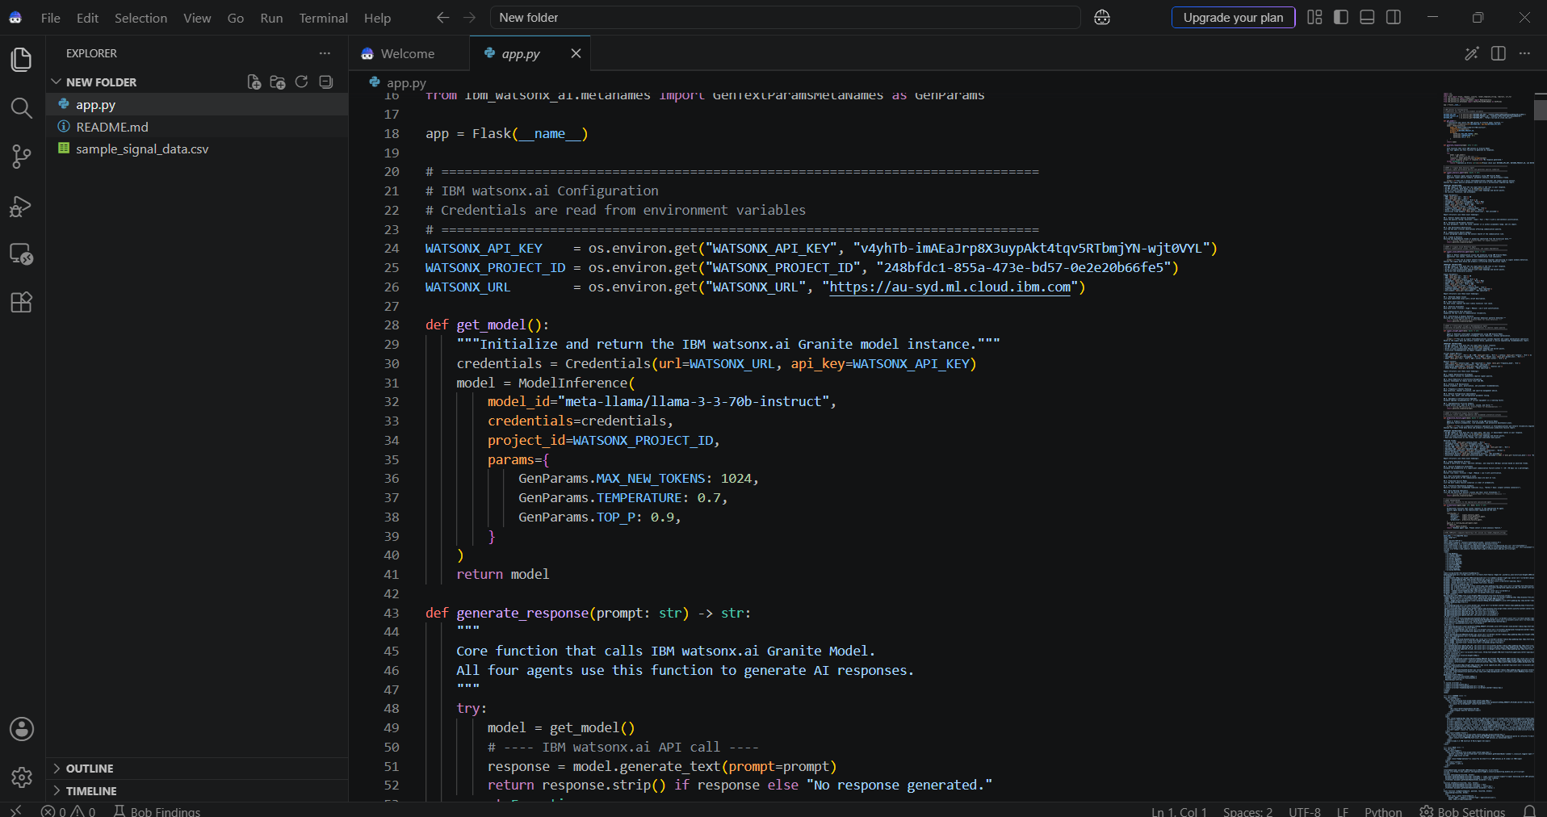

Slide 9
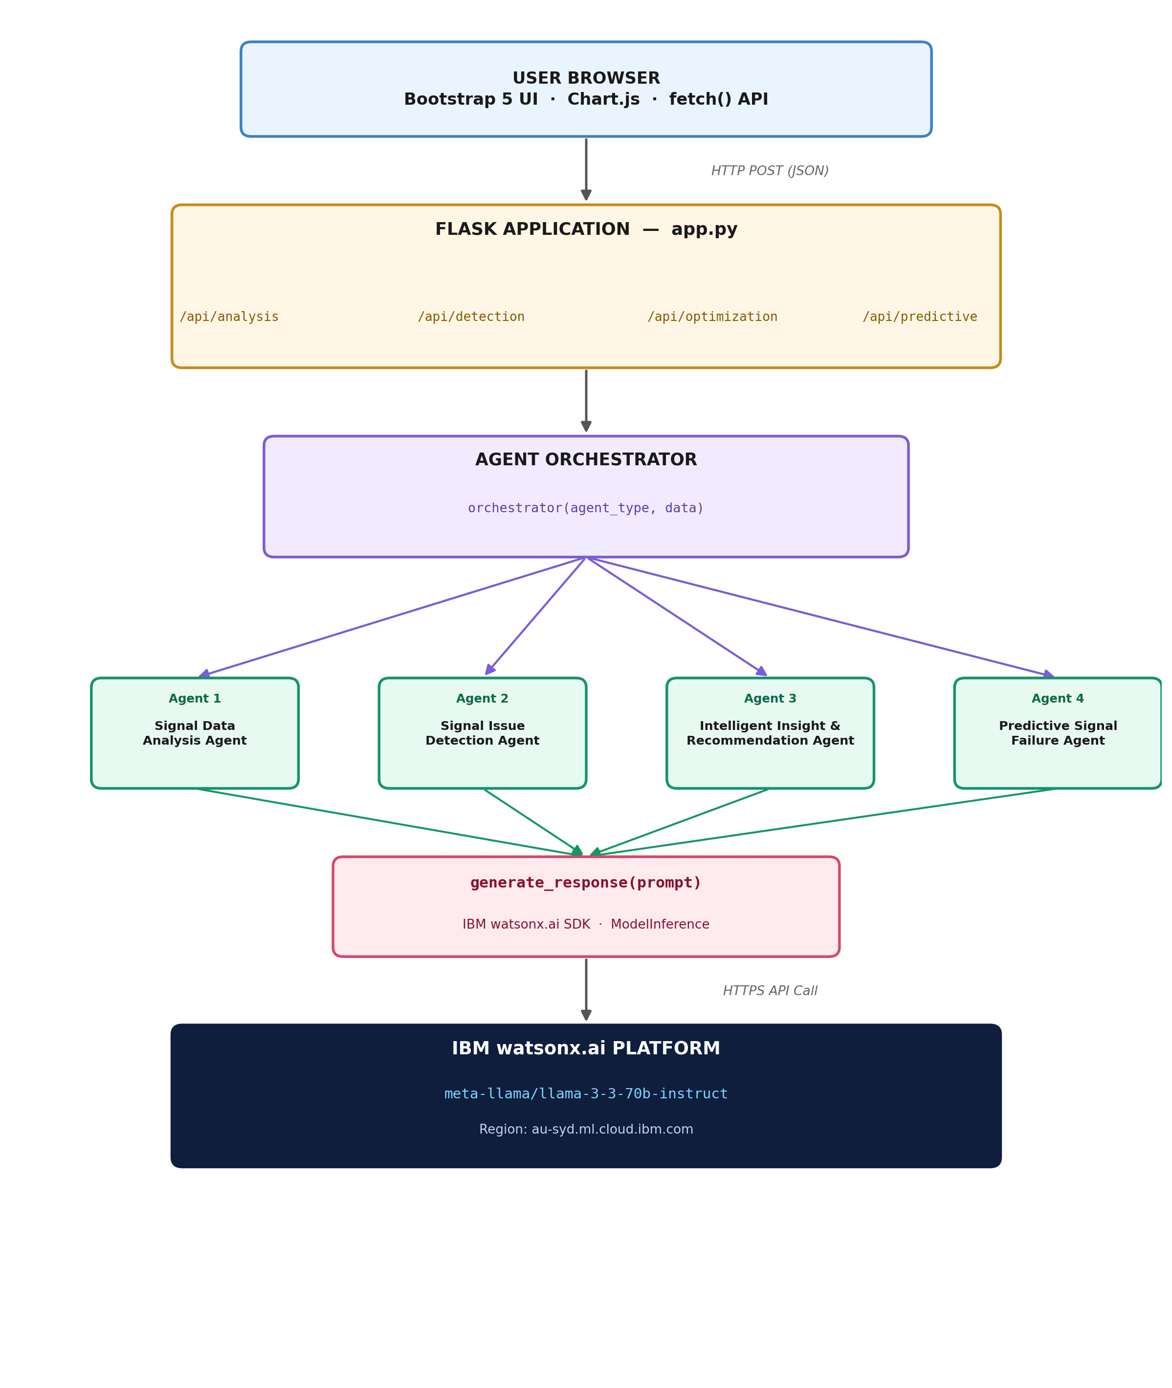
Architecture blueprint for IBM bob:

Slide 10

Role of Agentic AI in the solution
Role of Agentic AI in SignalSense AI
Agentic AI enables SignalSense AI to function as an intelligent, autonomous network engineer rather than a simple chatbot. Using IBM watsonx.ai and the Llama 3.3 70B Instruct model, it coordinates four specialized agents to deliver end-to-end signal intelligence.
Each agent performs a specific role—such as analyzing signal quality, detecting anomalies, generating optimization strategies, and forecasting failures—while working collaboratively through a central orchestrator. This multi-agent approach ensures accurate, efficient, and specialized responses.
Agentic AI also brings context awareness, understanding network type, frequency band, and deployment environment to generate tailored recommendations. It supports real-time adaptation, continuously updating forecasts based on newly uploaded historical signal data.
Additionally, agents are routed through a shared orchestrator, enabling consistent decision-making and reliable outcomes across every analysis type.
Overall, Agentic AI makes the system proactive, specialized, and insight-driven, acting like a smart digital network engineer that helps teams keep telecom infrastructure healthy.

Slide 11
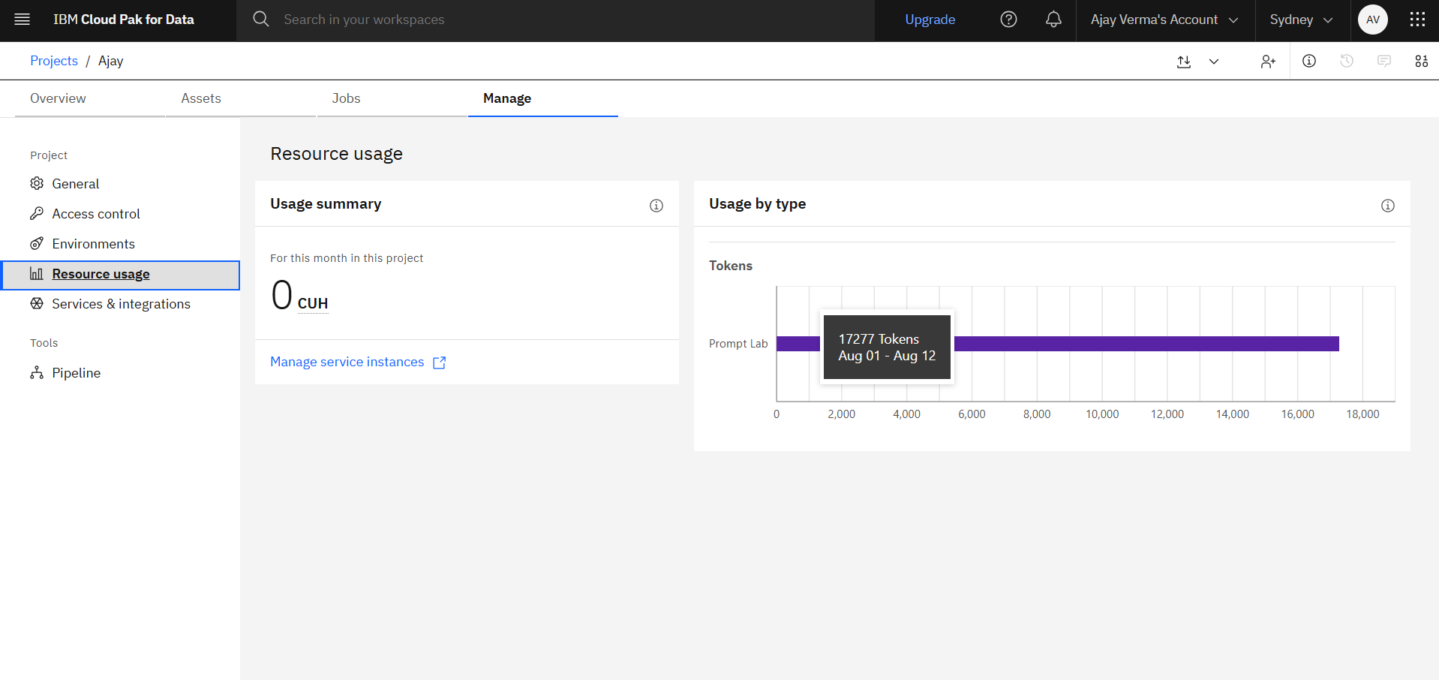
Token Usage
17,277 tokens used (Aug 01 - Aug 12)
·
·
·

Slide 12
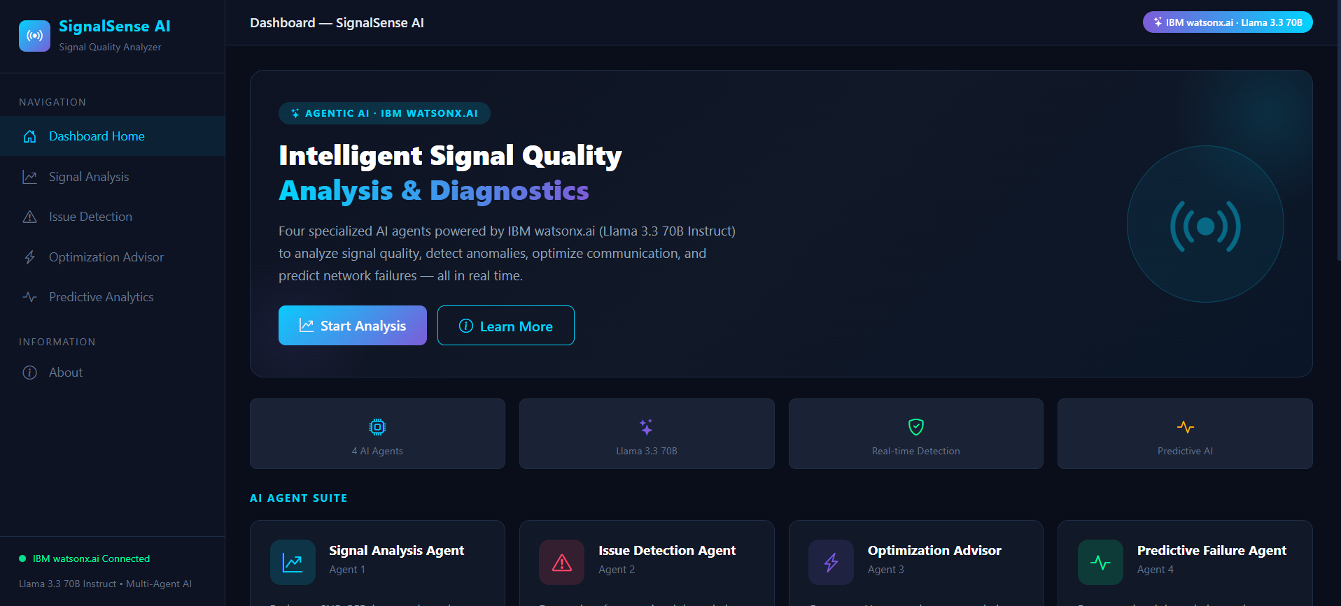
Project Output — Dashboard Home
·
·
·

Slide 13
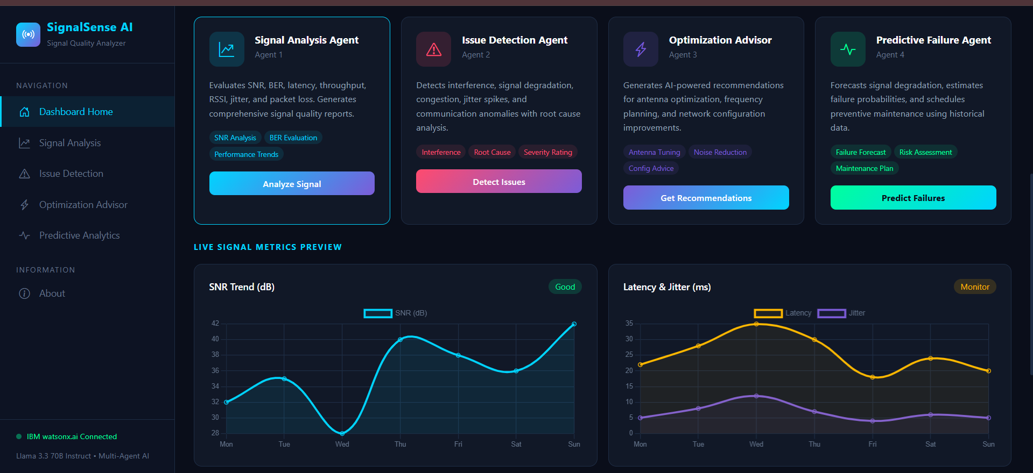
Project Output — Agent Suite & Live Charts
·
·
·

Slide 14
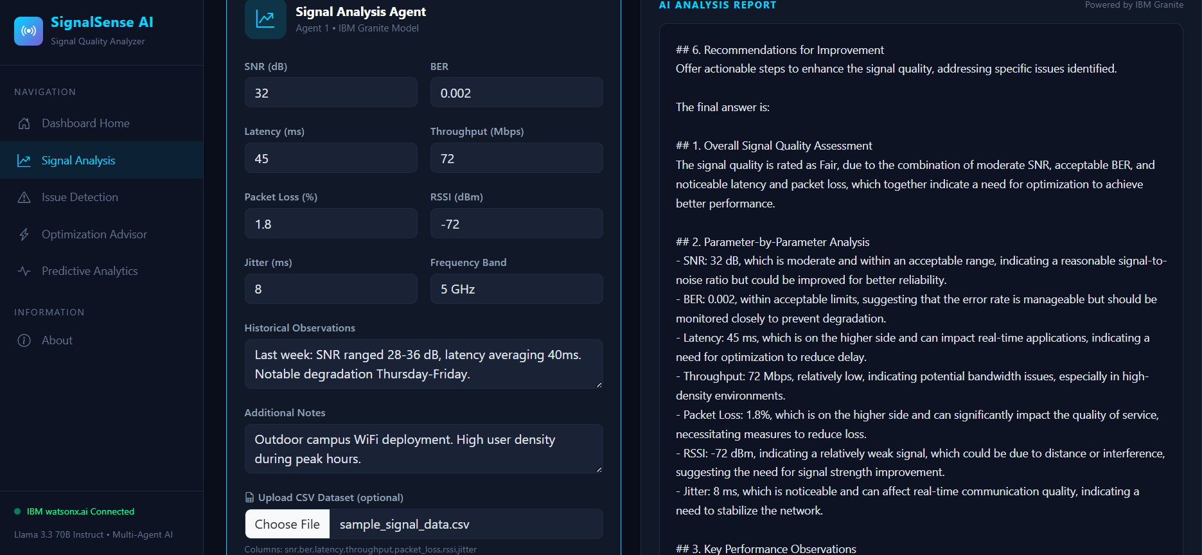
Project Output — Signal Analysis Report
·
·
·

Slide 15
Novelty and Uniqueness
SignalSense AI stands out by combining Agentic AI, telecom domain expertise, and predictive analytics into a single intelligent platform.
Multi-Agent Specialization – Four purpose-built agents, each an expert in one part of the signal lifecycle, instead of one generic chatbot.
Engineering-Grade Prompting – Each agent uses a senior-telecom-engineer persona with exact output headings and anti-echo guards for clean, professional reports.
Predictive, Not Just Reactive – Forecasts 7/30/90-day degradation trends and failure probability, not just current status.
Flexible Data Ingestion – Accepts manual entry or full CSV uploads for batch historical analysis.
Actionable, Prioritized Output – Recommendations are ranked by impact and ease of implementation, not just listed.
Root-Cause Aware – Goes beyond flagging issues to explain interference, congestion, and attenuation causes.
Enterprise-Grade Backbone – Built on IBM watsonx.ai with the Llama 3.3 70B Instruct model, ensuring reliable, governed inference.
This makes the solution a smart, adaptive, proactive network intelligence assistant, not just a static monitoring dashboard.

Slide 16
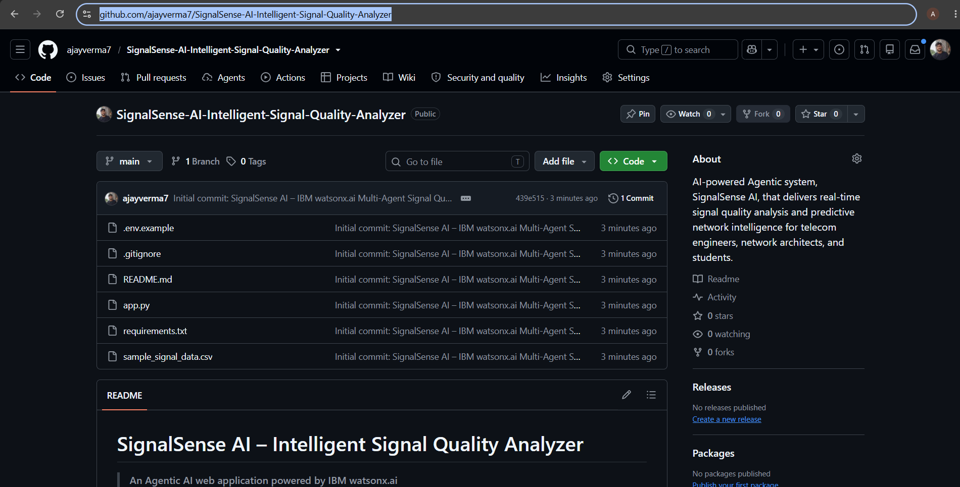
Git Hub Link
·Working Git hub URL – https://github.com/ajayverma7/SignalSense-AI-Intelligent-Signal-Quality-Analyzer
·
·
·

Slide 17
Future Scope
1.Integration with Live Network Monitoring & IoT Sensors –
The system can connect directly to SNMP feeds, base-station telemetry, and IoT sensors to ingest signal data automatically, instead of manual entry or CSV upload. This will let SignalSense AI run continuous, real-time monitoring and alerting across an entire network.
2.AI-Powered Voice Alerts & Multilingual Support –
Adding voice-based alerts and multilingual reporting will help field technicians and engineers across regions get critical signal warnings quickly, in their preferred language, even while on-site away from a screen.
·
·
·

Slide 18
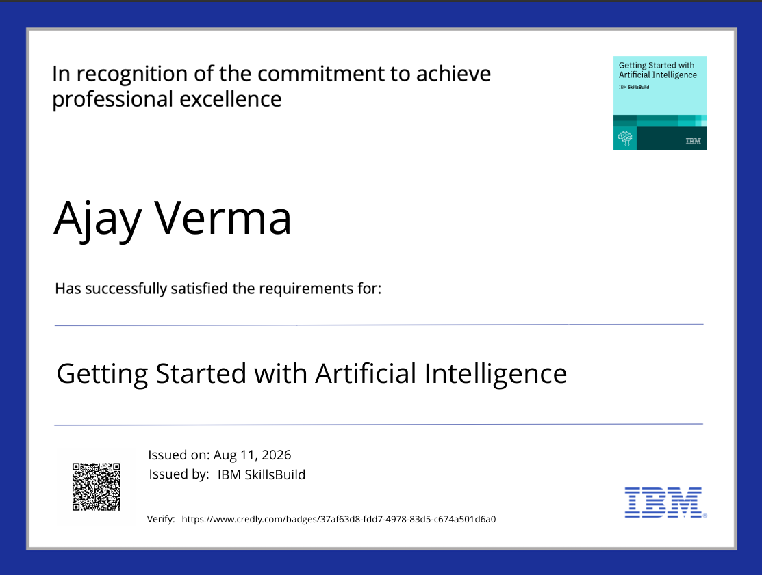
Certificates Earned:
Credly — Getting Started with AI

Slide 19
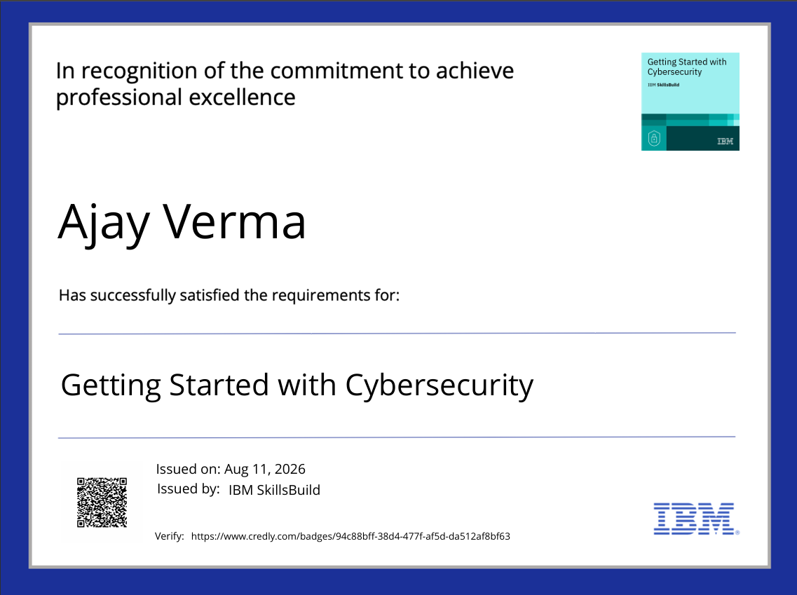
Certificates Earned:
Credly — Getting Started with Cybersecurity

Slide 20
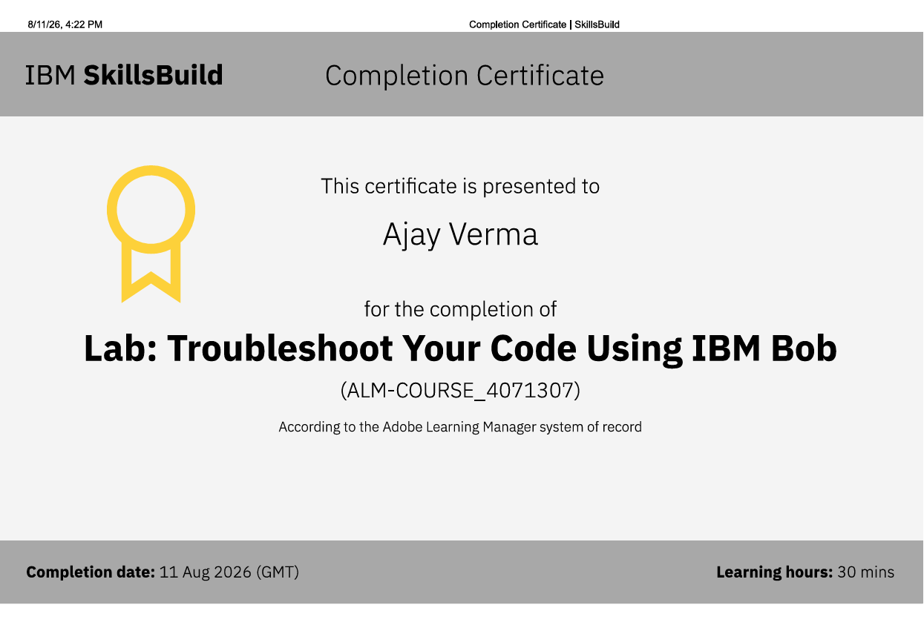
Certificates Earned:​
IBM SkillsBuild — Troubleshoot Your Code Using IBM Bob

Slide 21


