Slide 1

E-Commerce Sales Analytics Dashboard
A chart-by-chart guide: why each visual is used and what it reveals
INSIGHTS | TRENDS | GROWTH
Notes:
Opening: this deck walks through every visual on the E-Commerce Sales Analytics dashboard, explaining the purpose of each chart type and the insights it gives.

Slide 2
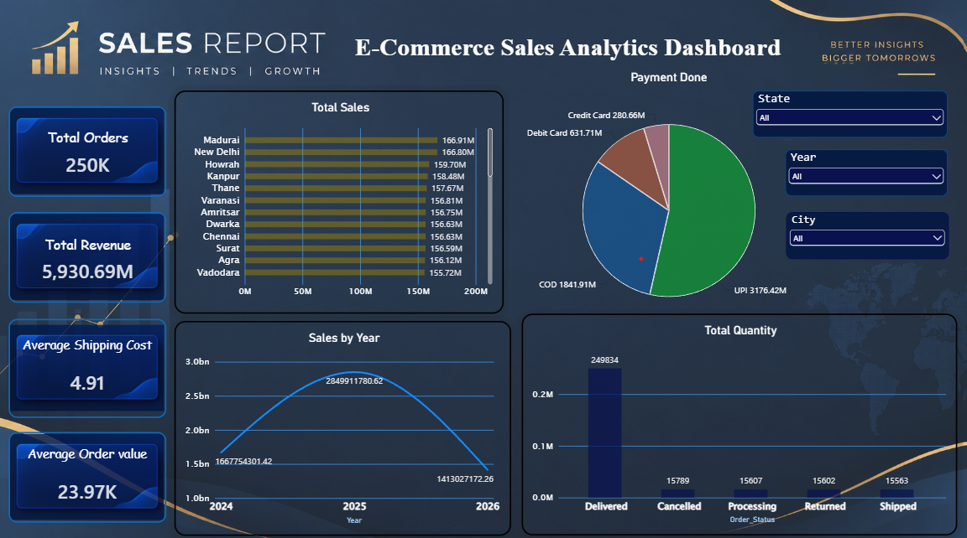
Dashboard at a glance
1
KPI cards: headline numbers
2
Total Sales by city
3
Payment Done by method
4
Sales by Year trend
5
Total Quantity by status
6
State, Year, City filters
Each slide that follows explains one visual: why that chart type is used and what the data says.
Notes:
The dashboard has four KPI cards, four charts and three filters. We take them in that order.

Slide 3




KPI cards: the health check
250K
5,930.69M
4.91
23.97K
Total Orders
Total Revenue
Avg Shipping Cost
Avg Order Value
WHY KPI CARDS
WHAT IT TELLS US
Headline numbers answer "how are we doing?" in seconds, and they update as filters are applied.
250K orders generated 5,930.69M in revenue
Shipping (4.91) is tiny next to order value (23.97K)
Check: 5,930.69M ÷ 250K ≈ 23.7K, close to 23.97K
Notes:
KPI cards give a one-glance summary. Shipping cost is a very small share of order value, so logistics is not squeezing margins. 250K is a rounded figure, so the implied average differs slightly from 23.97K.

Slide 4
Total Sales by city
WHY THIS CHART
A ranked bar chart compares revenue across cities and shows which markets lead.
WHAT IT TELLS US
Madurai (166.9M) and New Delhi (166.8M) lead the ranking
The top 12 cities sit within 7% of each other: sales are evenly spread
These 12 bring in about 32% of revenue; the long tail holds the rest
Notes:
Bars start at zero, so the near-identical bar lengths are the real story: no single city dominates. The dashboard scrolls to show more cities. Top 12 total is about 1,905M, roughly 32% of 5,930.69M.

Slide 5
Payment Done: how customers pay
WHY THIS CHART
A pie shows each payment method's share of the whole.
WHAT IT TELLS US
UPI leads with 53.6% of revenue (3,176M)
Cash on Delivery is a large 31.1%, a cost and return risk
Debit and credit cards together are only 15.4%
Notes:
Pie charts work here because there are only four parts that add up to 100% of revenue (5,930.7M). UPI plus other digital methods account for about 69% of revenue; COD is the large offline share.

Slide 6
Sales by Year: the growth trend
WHY THIS CHART
A line chart reveals the direction and pace of sales over time.
WHAT IT TELLS US
2025 peaked at 2.85bn, up 71% from 1.67bn in 2024
2026 shows 1.41bn, about half of 2025
Verify 2026 covers a full year before calling it a decline
Notes:
Axis starts at zero so the change is not exaggerated. 2024 to 2025 growth is 70.9%; 2025 to 2026 is -50.4%. The date is October 2026, so the 2026 total may be partial. Compare like-for-like periods before drawing conclusions.

Slide 7
Total Quantity by order status
WHY THIS CHART
A column chart splits units by status to show how healthy fulfilment is.
WHAT IT TELLS US
Delivered: 249,834 units, 80% of the total
Cancelled + Returned is about 31K units (10%): a leakage risk
Processing and Shipped are even at ~15.6K each
Green = fulfilled · Red = lost · Blue = in progress
Notes:
Total units across statuses is about 312K. Delivered is 80.0%; cancelled plus returned is 10.0%; processing plus shipped is 10.0%. Check whether revenue includes cancelled and returned orders.

Slide 8



Filters: State, Year, City
State
Year
City
Narrow every visual to one state to compare its cities and payment mix.
Switch between 2024, 2025 and 2026 to spot growth and seasonality.
Zoom into a single city to see its orders, payments and delivery status.
HOW TO USE
Pick a value from a dropdown (each starts at "All"). The KPI cards and charts recalculate together. Combine filters, such as State + Year, for a precise view.
Notes:
Slicers make the dashboard interactive. Every filter starts on All. Combining filters answers questions like how did one state perform in 2025.

Slide 9
Key takeaways and next steps
WHAT THE DATA SAYS
WHAT TO DO NEXT
5,930.69M revenue from 250K orders
Sales are balanced: top 12 cities within 7%
UPI and COD drive about 85% of revenue
2025 was the peak; 2026 is at half that level (check coverage)
80% of units delivered; 10% cancelled or returned
Grow UPI and prepaid; add incentives to move COD buyers
Find the causes of cancellations and returns
Confirm 2026 data is complete, then compare like-for-like periods
Study the long tail of cities using the State filter
Track delivery rate and order value as monthly KPIs
Notes:
Close with the five findings and five actions. The two data-quality checks (2026 coverage and whether revenue includes cancelled/returned orders) should be resolved first.

