Slide 1
Azure AKS Kubernetes (Helm)
Ajay Yadav

Slide 2
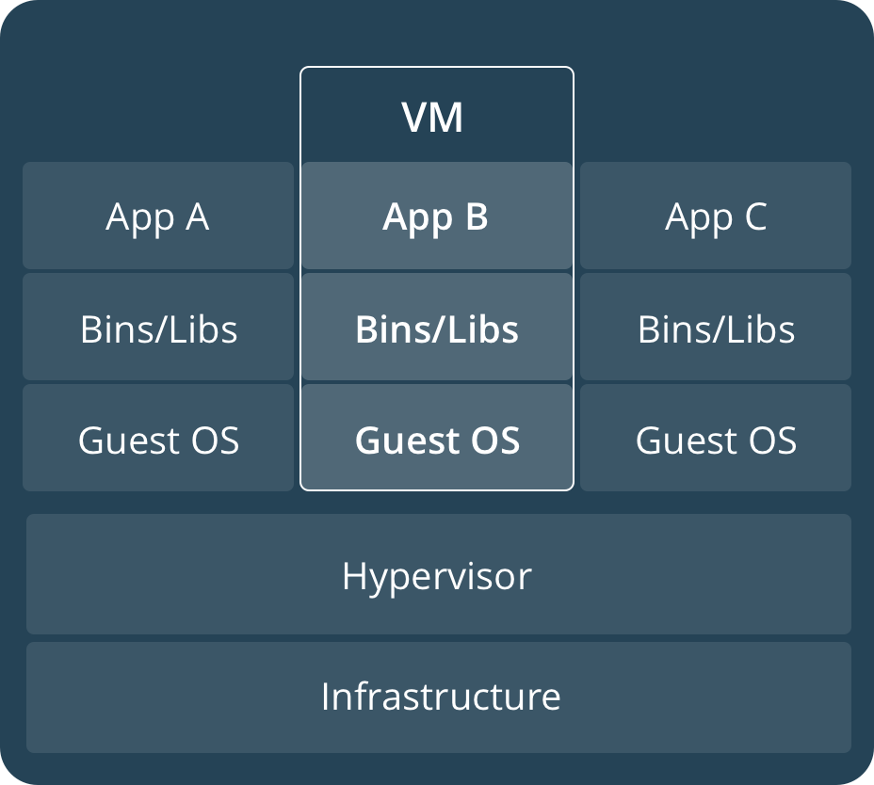
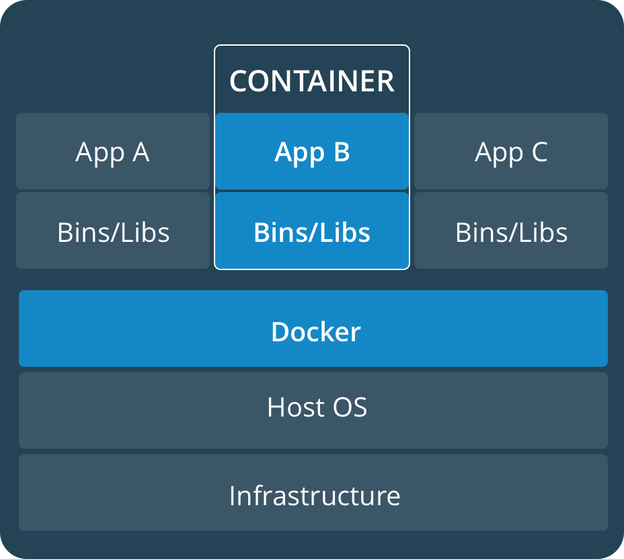
What is a container?
Container ≠ VM
Isolated
Share OS
and sometimes bins/libs

Slide 3
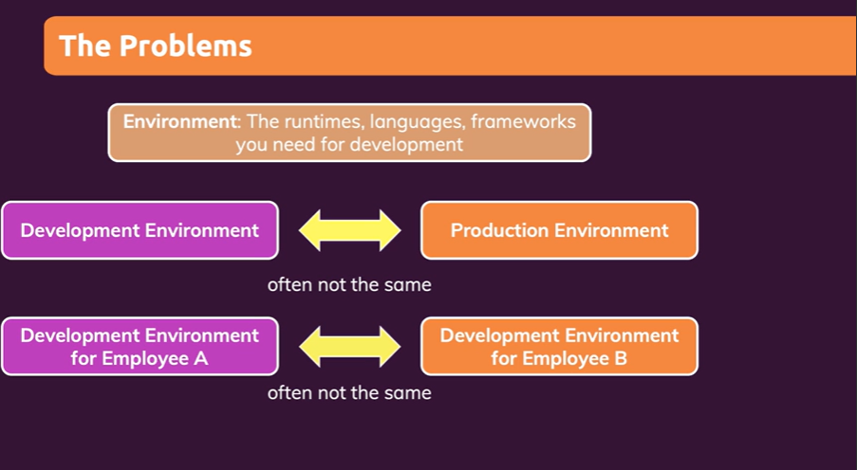

Slide 4
Docker - Fundamentals
nginxdemos/hello
Docker Daemon
Docker Registry
(Docker Hub)
nginxdemos/hello
Container-11
Images
Containers
Docker Host
docker pull nginxdemos/hello
Docker Registry or Docker Hub
A Docker registry stores Docker images.
Docker Hub is a public registry that anyone can use, and Docker is configured to look for images on Docker Hub by default.
We can even run our own private registry.
When we use the docker pull or docker run commands, the required images are pulled from our configured registry.
When we use the docker push command, our image is pushed to our configured registry.
docker run -p 82:80 -d nginxdemos/hello
Docker Client (My Desktop or Docker Host)

Slide 5
Dockerfile
It is possible to build your own images reading instructions from a Dockerfile
FROM centos:7
RUN yum install -y python-devel python-virtualenv
RUN virtualenv /opt/
RUN pip install
COPY entrypoint.sh /opt/entrypoint.sh
EXPOSE 8000
CMD [“”,””]

Slide 6









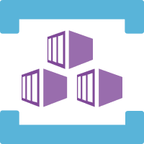









Azure Services Integrated with AKS
Azure
Disks
Azure
Public IP
Azure
AD
Azure
Container
Registry
Azure
Kubernetes
Service
Standard
Load
Balancer
AD
Groups
AKS
Linux & Windows
Nodepools
Azure
MySQL
Azure
DevOps
Azure
Files
Virtual
Network
AD
Users
Azure
Build & Release
Pipelines
Azure
VM
ScaleSets
Azure
DNS
Zones
Azure
Managed
Service
Identity
Storage
Account
Azure
Container Instances
Virtual Nodes
Subnets

Slide 7









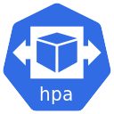
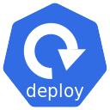






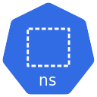



Imperative way using kubectl
Declarative way using YAML
Init Containers
Annotations
Ingress SSL with LetsEncrypt
Ingress Context Path based Routing
Ingress Domain Name based Routing
Ingress with External DNS
Virtual Kubelet

Slide 8
Kubernetes - Imperative & Declarative
Kubernetes Fundamentals
Imperative
Declarative
kubectl
YAML & kubectl
Pod
Pod
ReplicaSet
ReplicaSet
Deployment
Deployment
Service
Service

Slide 9

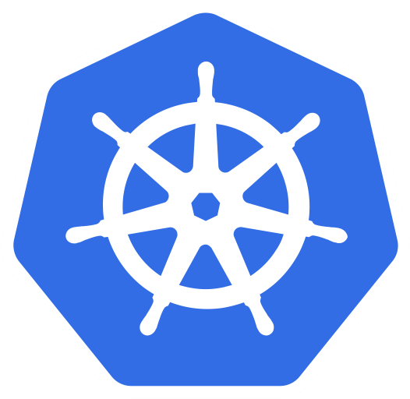
Azure AKS Cluster
http://<External-IP-from-get-service-output>
UserMgmt – LoadBalancer Service
Users
Load Balancer Service
Deployment
Web
App
Environment Variables
POD
ReplicaSet
Init Containers
Azure Disks
Deployment (UserMgmt)
MySQL – ClusterIP Service
Config Map
Storage Class
Environment Variables
Persistent Volume Claim
Volumes
MySql
AKS Storage Azure Disks
Persistent Volumes
Volume Mounts
POD
ReplicaSet
Deployment
Deployment (mysql)
ClusterIP Service

Slide 10
http://<External-IP-from-get-service-output>/app1/file1.html
Azure AKS Cluster
LoadBalancer Service
Users
Load Balancer Service
AKS Storage Azure Files
Deployment
NGINX
NGINX
NGINX
POD
POD
POD
Volumes
ReplicaSet
Deployment
Volume Mounts
Storage Class
Key Advantage with Azure File Shares:
Multiple pods can access the single file share
Azure Storage Account
Persistent Volume Claim
file1.html
file2.html
Persistent Volumes
</>
HTML
</>
HTML
Azure File Shares

Slide 11
Thank You

