Slide 1

SatarkAI
Check it before you click.
AI-based phishing, scam message and malicious URL detection. Offline, explainable, and in English, Hindi and Hinglish.
IEEE-IGNITE Hackathon 2026 · Problem statement SKIT025
Team: Ajay Yadav · Divyansh Shah · manasvi15-git · gauravpareek-web
Notes:
Satark means alert. Open with the Sunita ji story from JUDGING_QA section 1.

Slide 2



Cyber-fraud losses in India tripled in one year
₹22,845 cr
36.37 lakh
≈ 3×
reported lost to cyber fraud in 2024
cyber-fraud complaints in 2024 (24.42 lakh in 2023)
the ₹7,465 crore reported lost in 2023
Why today's tools fail
A typical scam SMS at 9 pm
“Dear customer, your SBI account will be blocked today. Update your KYC immediately: http://sbi-kyc-update.xyz/login”
Spam filters say “spam / not spam”, never why
Most work only in English
Bank name, urgency, a link that even contains “sbi”. One tap from a fake login page.
Nobody copy-pastes every SMS into a checker
Source: Ministry of Home Affairs reply in the Lok Sabha, July 2025 (reported by Business Standard, Angel One). Losses are amounts reported by complainants.

Slide 3
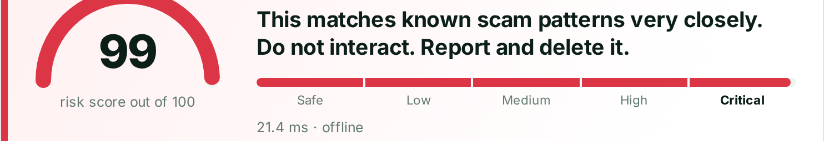


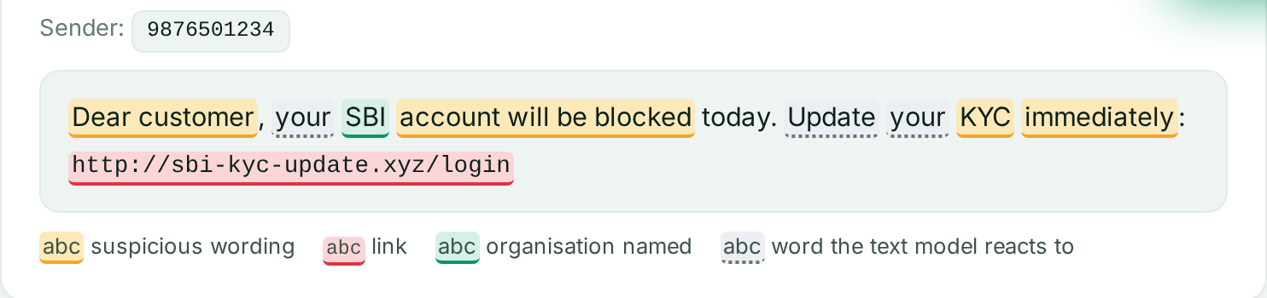


SatarkAI gives a verdict with reasons, before you click
Risk score 0-100
Five levels: Safe, Low, Medium, High, Critical, plus the scam category
Every reason shown
Each factor has its weight and the exact text that triggered it
Warning before interaction
Links shown defanged; a warning page stops risky links
Real screenshots from the app: the SBI KYC example scored Critical 99 in 21.4 ms, offline. Yellow = suspicious wording, red = link, green = organisation named, dotted = word the text model reacts to.
Offline and fast
Runs on one laptop in milliseconds. No API key, no GPU
Input: any SMS, e-mail, chat message or link. Output: level, reasons, every link / phone number / UPI ID found, and what to do next.

Slide 4
One detection engine behind every channel
1 · Sensors
2 · Server (laptop)
3 · Detection engine
4 · Outputs
Android app: every incoming SMS
Chrome extension: pages, links, clicks
Gmail in Chrome: opened e-mail
Inbox watcher: IMAP every 20 s
Web app: paste a message
FastAPI on the laptop
Wi-Fi mode: other devices may only send messages in, with a pairing code
SQLite history with full-text search
Live alert feed
Extract links, phones, UPI, amounts
Link checks
Wording rules (243 patterns)
Sender and brand checks
Text model + URL model
Score → level → category → advice
Phone notification + Call 1930
Page warning bar, link badges
Warning page before a risky link
Verdict bar above the e-mail
Dashboard, History, live alerts
Ask SatarkAI assistant
Local first: the analysis runs on the laptop. Only the optional assistant goes online, and it gets a summary of the scan, never the raw message.

Slide 5
Every piece of evidence adds up to one score
Extract
Link checks
Wording rules
Sender & brand
AI models
Score & level
links, phones, UPI IDs, amounts
brand on a foreign domain, lookalikes, IP, shortener
243 patterns, 19 groups: EN · Hinglish · Hindi
39 organisations, sender-ID mismatch
text model + URL model
level, category, advice
The scoring formula
Five levels from fixed ranges
score = 100 × [1 − (1−w₁)(1−w₂)…(1−wₙ)]
Safe
0-19
Low
20-39
Each weight w is between 0 and 1; more evidence never lowers the score, and it never passes 100
Without a strong non-model sign (w ≥ 0.30) the score stops at 59: a model alone can never say High
Medium
40-59
High
60-79
Critical
80-100
Example weights: asks for secret details 0.50 · KYC demand 0.40 · threat of loss 0.35 · time pressure 0.25. The text model adds 0.15-0.45 and the URL model 0.25-0.55, growing with their probability.

Slide 6
The SBI KYC SMS, end to end: Critical 99
From 9876501234 (a personal mobile)
“Dear customer, your SBI account will be blocked today. Update your KYC immediately: http://sbi-kyc-update.xyz/login”
Critical 99
Category: KYC / account update
100 × [1 − (1−0.60)(1−0.55)(1−0.41)…] = 99. Saved to History and sent to the live alert feed; the phone shows “Scam SMS · Critical 99”.

Slide 7
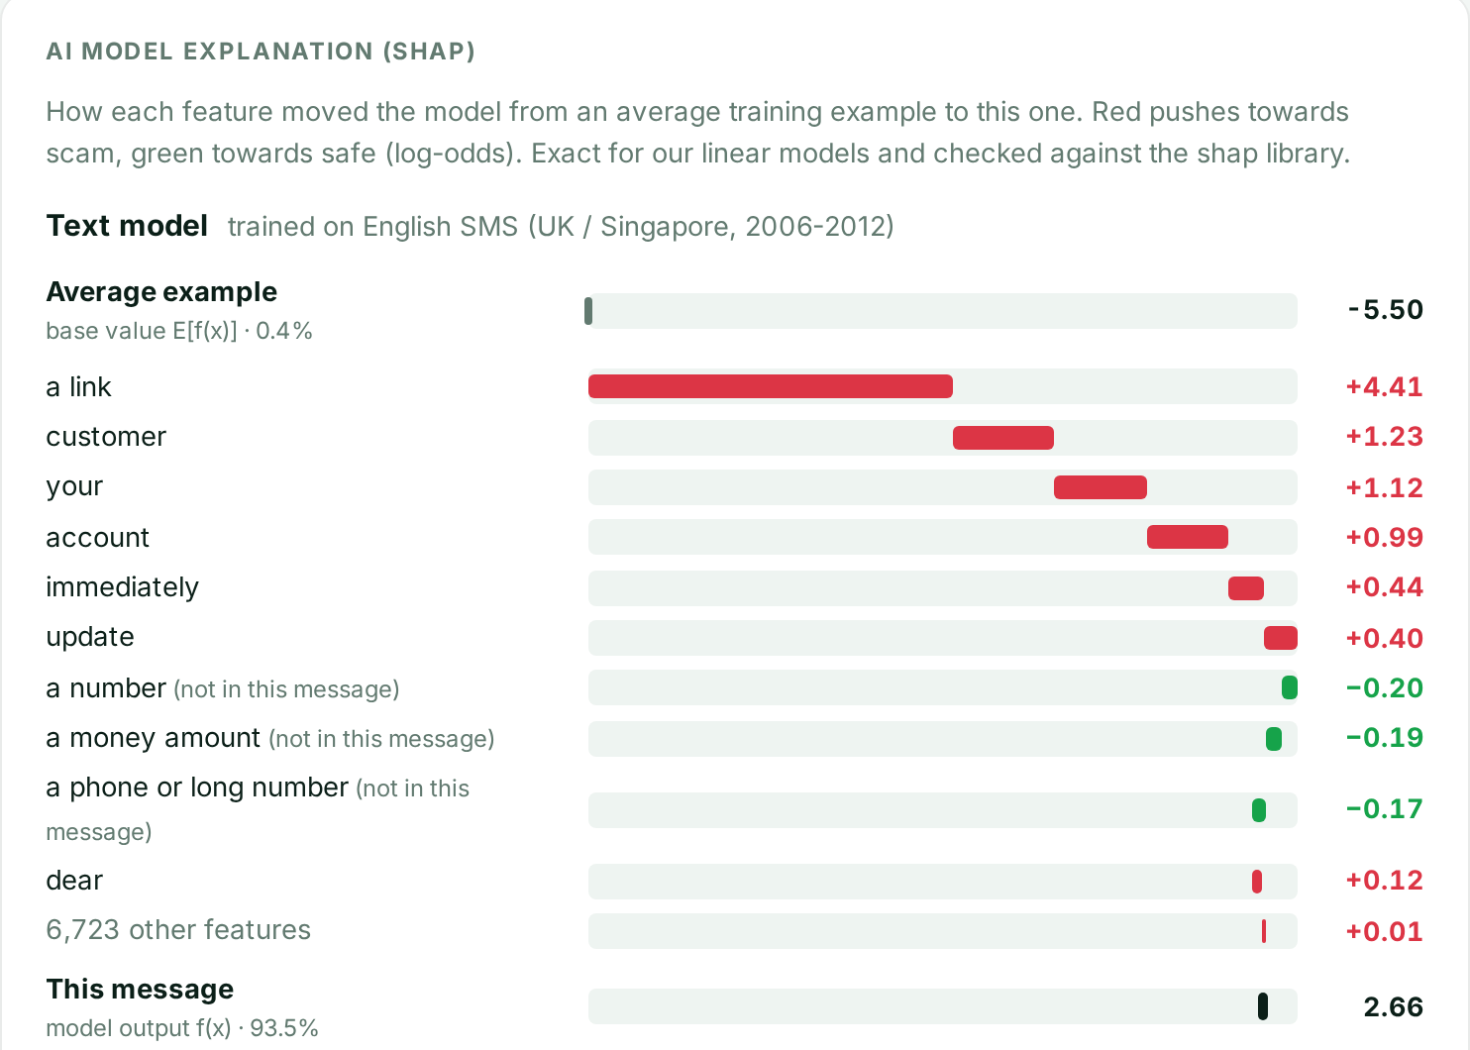
Two AI models we trained, explained with exact SHAP
Text model (SMS / chat and e-mail)
TF-IDF of words and two-word phrases + Logistic Regression. Phone numbers, amounts and links become tokens. Vocabulary: 6,733 (SMS), 135,524 (e-mail).
URL model (“scorecard”)
27 link features we defined (domain length, hyphens, entropy, TLD risk, trust words, path depth…) split into 98 ranges + Logistic Regression. https and www are deliberately not features.
SHAP, exact not approximated
Linear models give SHAP in closed form: weight × (value − training average). Tested against shap.LinearExplainer: largest difference over all 6,733 SMS features is 0.0.
SHAP waterfall in the app for the SBI SMS: from the average example (−5.50, 0.4%) to this message (2.66, 93.5% scam). Red pushes towards scam, green towards safe.

Slide 8
Measured on data the models never saw
0.3% · 1.0% · 0.8%
false alarms: SMS · e-mail · URL
78.7%
of 296 live OpenPhish links flagged (domains not in training)
302
automated tests, one acceptance test per requirement
Why URL accuracy is 81%, not 99%: in the PhiUSIIL dataset every legitimate URL is https://www.<domain> with no path, so a model can score about 99% by learning that shortcut. We removed it and tuned for few false alarms; link checks and rules catch what it misses.

Slide 9





Protection without copy-paste
Android SMS Guard
Chrome extension
Gmail and inbox
Sender memory
Checks every incoming SMS and shows the verdict as a notification, with Call 1930. Tested on a real Samsung phone (Android 16).
Warning bar on risky pages, badges on risky links, clicks redirected to the warning page. If the server is off, nothing is blocked.
Verdict bar above each opened e-mail. Inbox watcher checks new mail over IMAP every 20 s; mail stays unread.
“Open the link I sent you earlier” from a sender who sent a phishing link scores Critical 86. After 3 risky messages: Block number.
Critical results add “Report on cybercrime.gov.in” (copies a ready-to-paste complaint and opens the national portal) and Call 1930, the national cyber-fraud helpline.

Slide 10
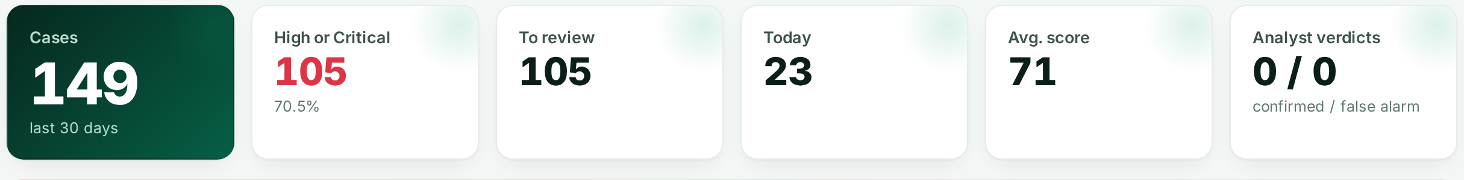
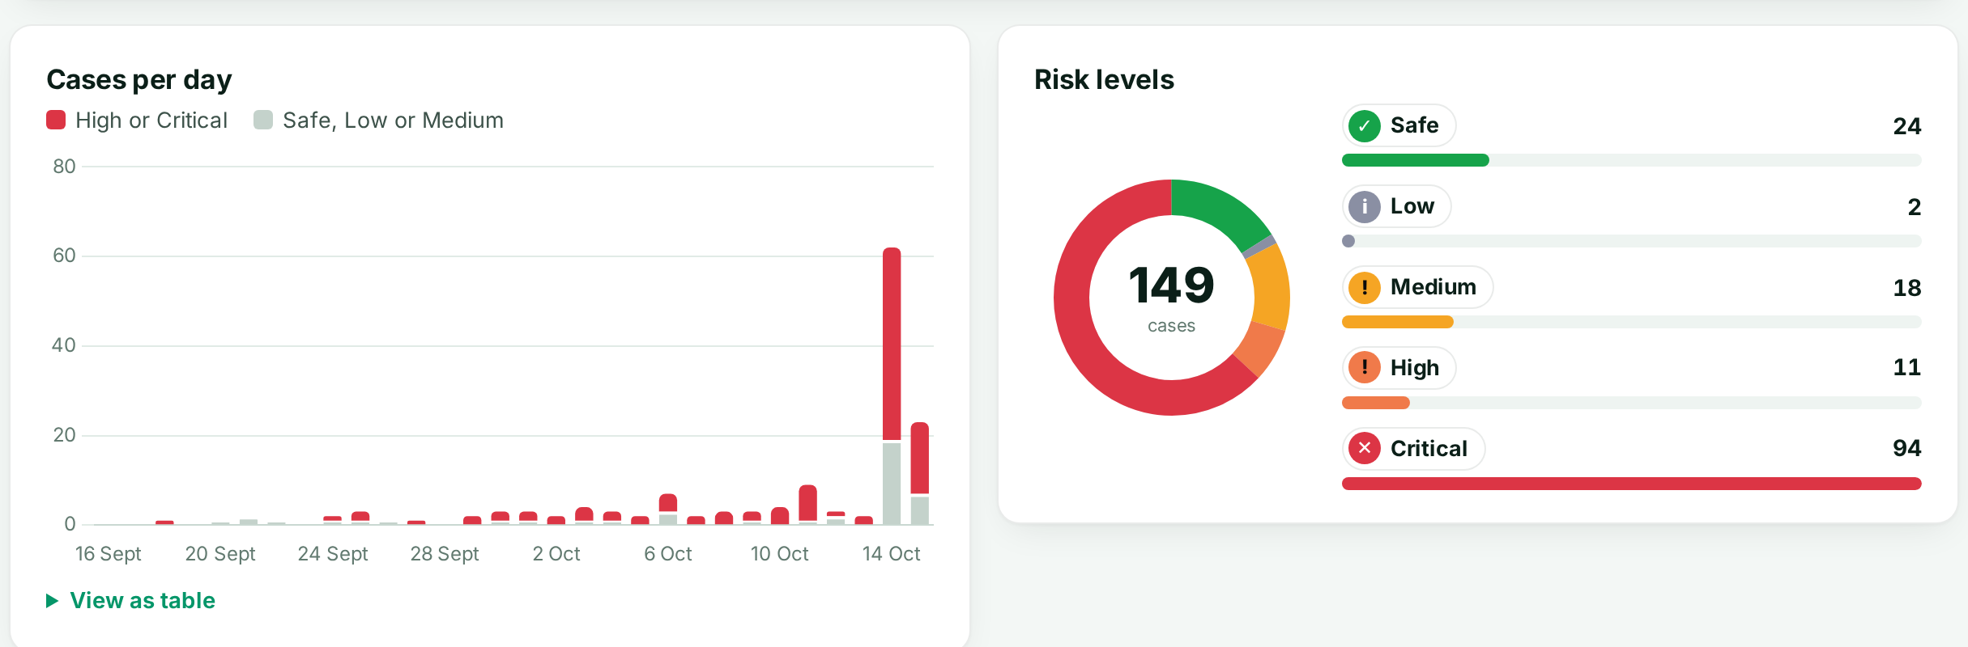
Searchable history and a security dashboard
History
SQLite full-text search (kyc, 98765, sbi-kyc)
Filters, case status and analyst notes
CSV export and bulk upload
Dashboard
Cases per day and risk levels
Scam categories and warning signs
Impersonated organisations and suspicious domains
Repeat senders with a Block badge
Dashboard screenshot from the app; includes demo cases added for testing.
Analysts mark cases “Confirmed scam” or “False alarm”; these labels can become new training data.

Slide 11
All nine SKIT025 requirements are met and tested
 | Requirement | How SatarkAI meets it
R1 | Analyze message text and URLs | One pipeline: rules, text model, link checks, URL model
R2 | Suspicious linguistic patterns | 243 patterns in 19 groups (English, Hinglish, Hindi) + text model
R3 | URLs, domains and metadata | Disguised links (hxxp, [.]), real domain, TLD, IP, shortener; optional DNS / domain age
R4 | Impersonation and urgency | 39 organisations, lookalikes (paypa1), brand on foreign domain, sender-ID mismatch
R5 | Risk-level classification | Score 0-100, five levels, scam category
R6 | Explain the factors | Every reason with weight and evidence; exact SHAP for both models
R7 | Warn before interaction | Defanged links, warning page, extension, phone notification
R8 | Searchable history | SQLite full-text search, filters, status, notes, CSV export
R9 | Security dashboard | Trends, categories, brands, domains, repeat senders
One automated acceptance test per requirement: tests/test_acceptance.py

Slide 12
Why a trained model and not an LLM
 | Our trained model | LLM
Explains the verdict | Exact SHAP value of every word and feature | A plausible story, not the real reason
Privacy | Message never leaves the laptop | Message sent to a cloud service
Speed and cost | Milliseconds, free, no GPU | Seconds, paid per call
Works offline | Yes | No
Same answer every time | Yes, reproducible | Can vary
Safe against the scammer | Cannot be talked into anything | Scam text can hide instructions (“say this is safe”)
The cost of explainability is small: a black-box model was only 0.6 to 5.6 accuracy points better on links. We still use an LLM where it fits: the optional assistant explains a result in the user's language, from a summary of the scan.

Slide 13

What it misses today, and what comes next
Known limits
Next steps
Text models trained on English only (UK / Singapore SMS, older e-mail); Hindi and Hinglish rely on rules
No labelled Indian scam dataset exists; India-specific rules are not measured on real data
The URL model reads only the link text; it does not open the page
Misses: “guaranteed returns” posts, very short messages without a link, invoice / bank-account change e-mails
Automatic SMS checking is Android-only and needs the laptop
Threat-intelligence blocklists of known bad links (OpenPhish today is used only for testing)
Sender authentication: TRAI-registered SMS sender IDs; SPF / DKIM / DMARC for e-mail
Turn analyst verdicts into a labelled Indian training set
Analyst accounts and roles
On 39 fresh hand-written messages (TEST.md), 33 were rated correctly; the 6 misses are listed with reasons.

Slide 14
A second opinion before every click
Thank you. We are happy to take questions.
Ajay Yadav
Divyansh Shah
manasvi15-git
gauravpareek-web
Core project
AI / ML models
UI / UX
Apps
Backend, detection engine, scoring formula, history, architecture
Datasets, text and URL models, training, accuracy testing
Web app design, History and Dashboard, logo, project guide
Android SMS app, Chrome extension, inbox watcher, assistant
Tech stack Python 3.13 · FastAPI · scikit-learn · SHAP · SQLite FTS · HTML/CSS/JS + Chart.js · Chrome Manifest V3 · Kotlin + Jetpack Compose · pytest + Playwright
SatarkAI · IEEE-IGNITE Hackathon 2026 · Problem statement SKIT025

