Slide 1
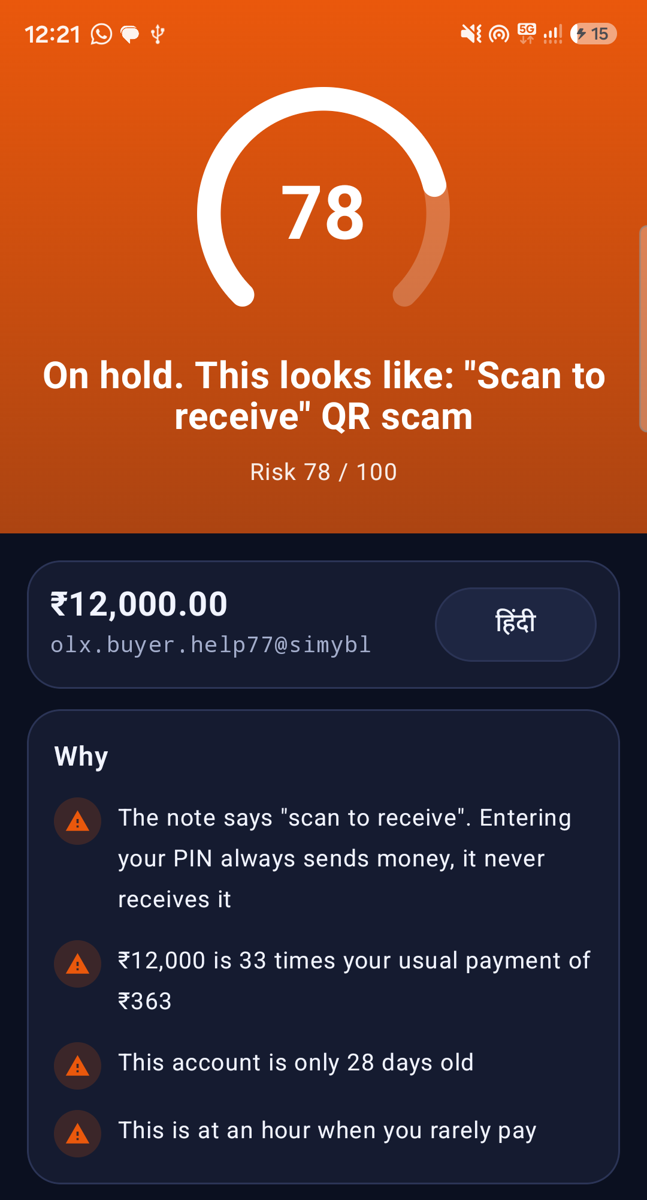
A second opinion before you pay
SatarkPay stops a scam UPI payment before the money is gone, and says why, in English and Hindi.
SPHINX'26 · Problem statement 3.2 · MNIT Jaipur
Team: Ajay Yadav · Abhimanyu2211 · SaloniTrivedi11 · Harsh Verma
Notes:
One line to open: every Indian should get a second opinion before they pay. Then say your team name and move straight to the story on the next slide.

Slide 2



Sunita ji has moments to decide
A request arrives
Without SatarkPay
With SatarkPay
"Refund of ₹2,999. Approve to receive." It sounds like money coming in, and the caller says to hurry.
She enters her PIN. That sends the money out, and a mule can move it on within minutes.
Before the PIN: stopped, and why, in Hindi. "Entering your PIN always sends money." 1930 is one tap away.
Sunita ji is fictional. The scam is not.
Notes:
This is the whole product in one slide. Tell it as a story, slowly. Sunita ji is a retired teacher in Jaipur, a fictional person. A request appears: Refund of Rs 2999, approve to receive. It sounds like money coming in. Entering her PIN would send it out. SatarkPay steps in before the PIN and explains why in her language.

Slide 3



The scam is approved by the victim's own PIN
Right phone, right PIN, right person
₹981 crore
Many scams look like normal payments to a model that only reads the numbers. The give-away is often what the person was just told.
reported lost to UPI fraud in FY 2024-25
Fake collect moved, it did not vanish
NPCI ordered P2P collect requests stopped by 1 October 2025. Merchant collect continues, so scammers now need merchant-style accounts.
12.64 lakh
reported incidents in the same year
People find out too late
Today's alert usually comes after the money has gone. By then a mule can have moved it on.
MoS Finance, Lok Sabha reply, 15 Dec 2025, as reported by IANS.
Notes:
Many UPI scams are authorised by the victim. That is why looking only at amounts and times is not enough. The problem statement still lists fake collect requests. Say out loud that NPCI ended P2P collect, because it shows you understand the problem as it is today. The scam moved to merchant-style accounts, QR codes and payment links.

Slide 4




We read the money and the words
Every payment, before it goes through
XGBoost
Learns known scam patterns from behaviour and payee signals. Exact SHAP reasons.
One score, one decision
Allow
goes through
Isolation Forest
Trained with no labels at all. Notices what is unusual, for scams nobody has seen.
Warn
reasons, then a pause
Context engine
Reads the note, the link, the UPI ID and the SMS that came just before.
Hold
a cooling-off, analyst queue
Block
two layers agree, or a plain fact
Hard rules
Plain facts, such as: entering a PIN never receives money.
A model alone can never refuse a payment.
Python, FastAPI, XGBoost, Isolation Forest, a stream simulator, a plain JS dashboard. On one laptop, offline. p95 5.06 ms.
Notes:
Four layers. XGBoost is strong on what it has seen. The Isolation Forest needs no labels. The context engine reads the words around the payment. Hard rules state plain facts. They combine with one formula: more evidence never lowers the risk. Scores are bands measured on validation data, so a level has a known meaning. Kafka is not built: the problem statement allows a stream simulator, and a stream simulator keeps the demo on one laptop with nothing else to install. The Bus class is where Kafka would go.

Slide 5
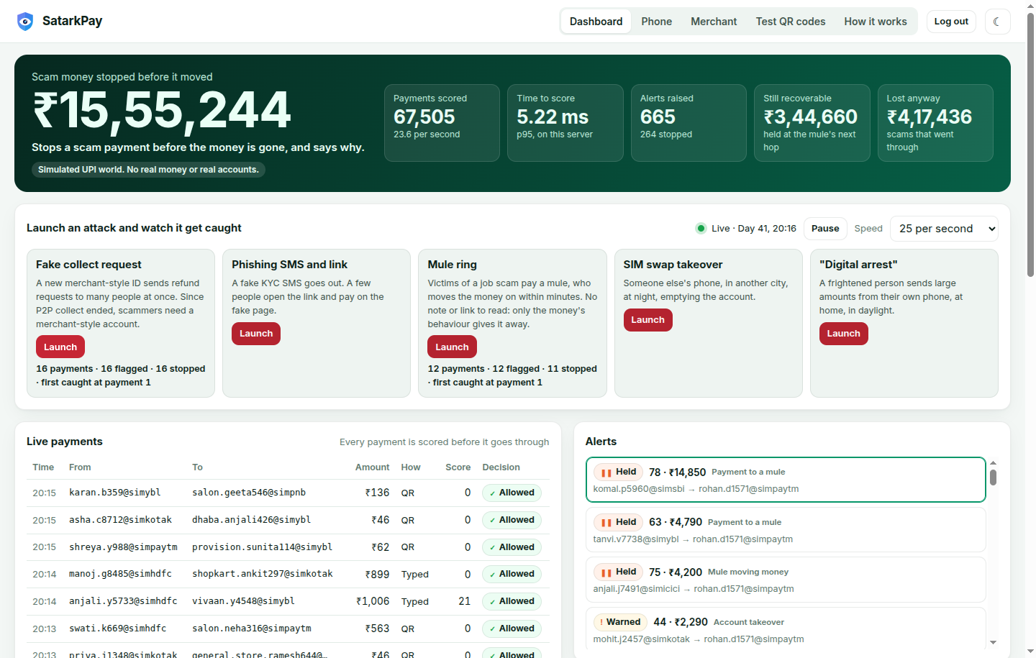
Now, the live demo
Launch a fake collect attack
1
The open phone stops it and says why, in Hindi too
2
A report protects the next person
3
A mule ring forms; its next hop is held, so the money can still be recovered
4
You play the scammer on your own phone
5
Notes:
Switch to the live app here: the dashboard is at http://127.0.0.1:8000 and the phone at /pay. Follow docs/DEMO_SCRIPT.md. If the laptop fails, use https://satarkpay.vercel.app with the test logins. If everything fails, this screenshot and the phone screenshot on the first slide carry the story.

Slide 6
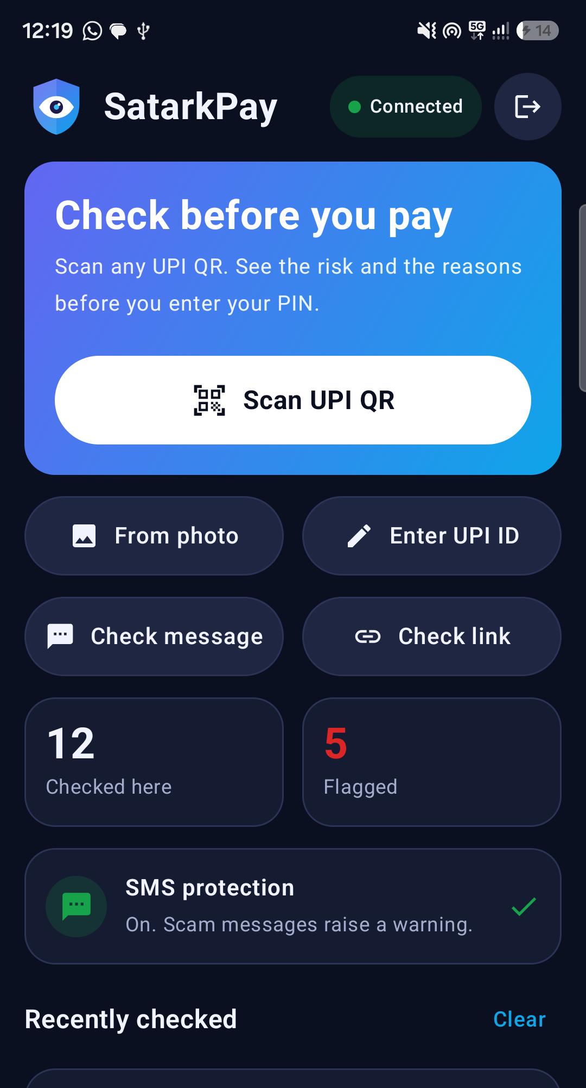
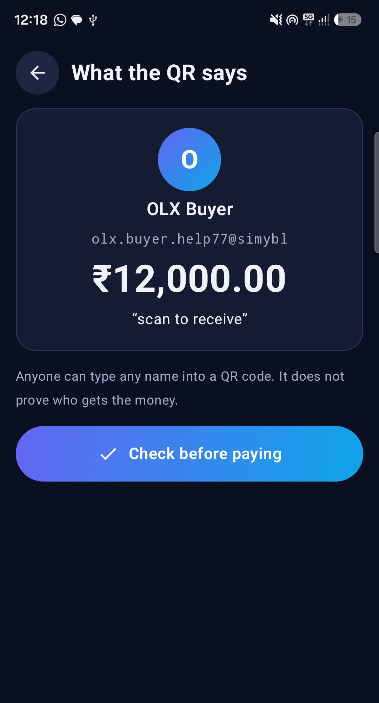
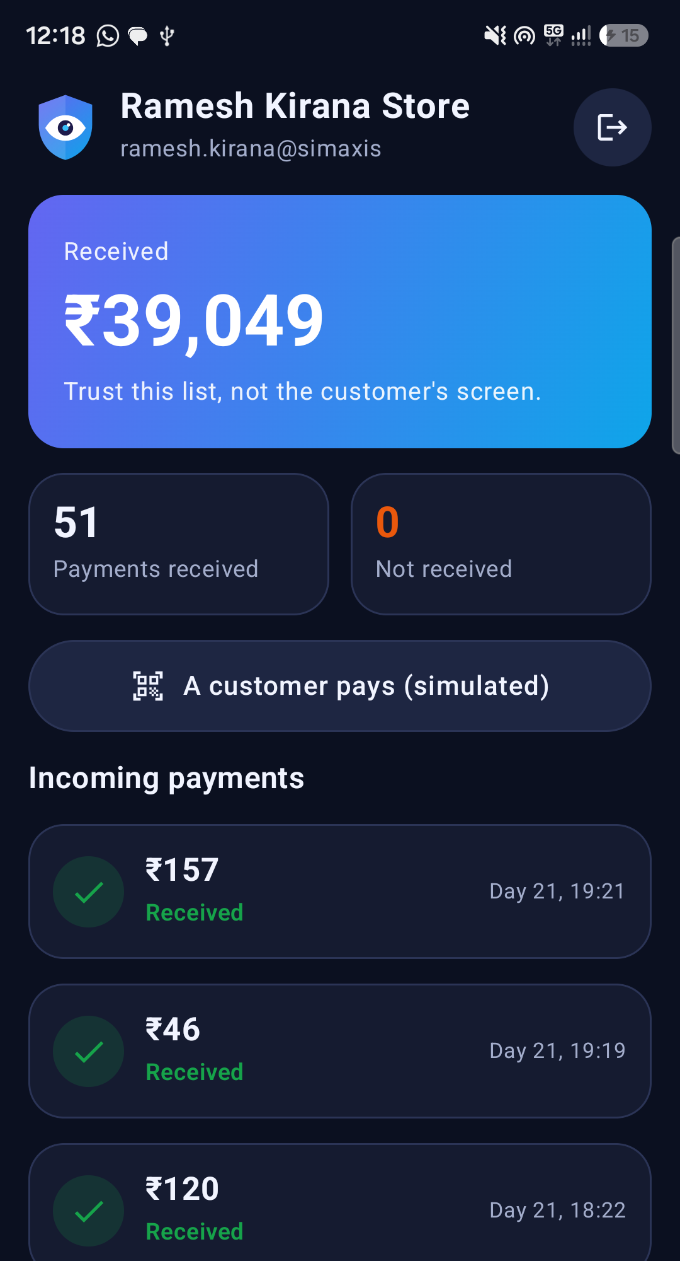
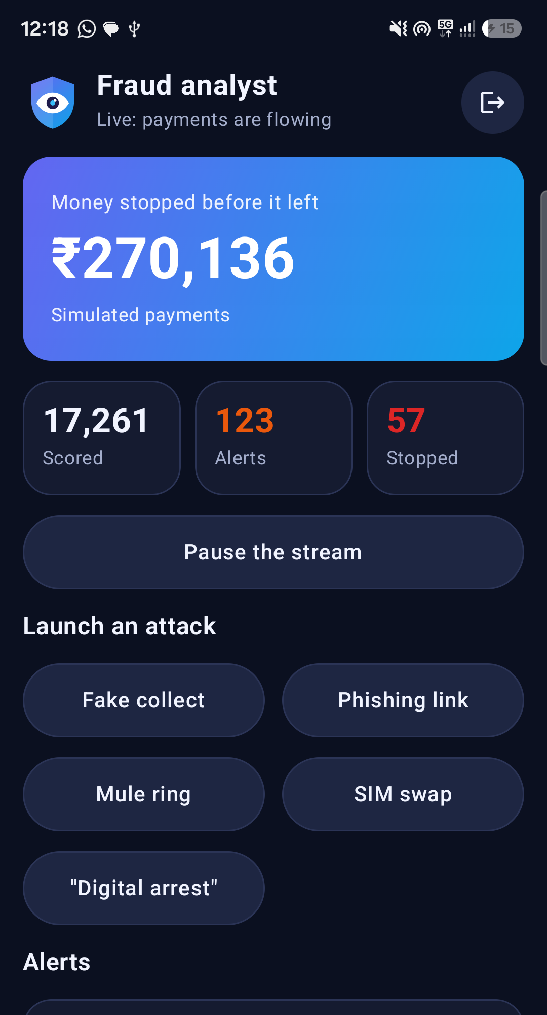
Three portals, one phone app that scans
User: scan a QR, check a message or link
See what the QR really says
The decision and why, before any PIN
Merchant: what really arrived
Admin: live numbers, attacks, alerts
One tap test logins for every portal. The server checks every request. Real payments open in the person's own UPI app.
Notes:
The phone app and the website share the same three logins. Test login buttons let judges try each portal with no password, on simulated data. Open payment app hands a checked payment on a real UPI ID to the person's own UPI app, and they enter the PIN there. Only say this works if you tested it with a Rs 1 payment.

Slide 7
People warn each other, and an admin decides
Scam feed
Reports warn
Admin blocks
Post, vote and comment. Real UPI IDs and phone numbers are masked, because a report is unverified.
3 accounts reporting an ID add a warning to the next payment to it.
Only an admin blocks, so a group cannot get an honest shop blocked. The server enforces it.
History and export
6 languages
No cable needed
Each account sees its own checks and downloads CSV or JSON.
English, Hindi, Bengali, Marathi, Tamil and Telugu for buttons, decisions and reasons.
Online by default, with Wi-Fi or USB to the laptop as choices. SMS stay off the cloud.
Future plan, not built: compare offers published by UPI apps, once real offer data exists.
Notes:
Security comes first. Reports alone can never block anyone. After the scan, the app lists the UPI apps really installed on the phone and shows no made-up offers. The translations have not yet been checked by native speakers.

Slide 8
It still catches scams it has never seen
93%
of scam payments flagged
84%
stopped before the money moved
0.59%
of genuine payments flagged
Test: 3,87,688 synthetic payments, 2,434 scams, including a world nothing was tuned on. New scammer accounts only.
Notes:
How do you test for new scams? Remove one scam type from training completely, then see what still catches it. Fake collect: XGBoost alone 7%, the full system 81%. That is why the other layers exist. On scams it has seen, XGBoost alone is slightly better, and we say so. Careful scams, which try to look normal, are flagged 80% of the time, against 99% for obvious ones.

Slide 9

Accuracy is the wrong number
99.999%
929 to 1
0.998 to 0.697
the "accuracy" of a model that never flags anything
false alarms per real scam, if real fraud is that rare
PR-AUC on public PaySim, with and without balance columns
Reported UPI fraud is about 7 in a million payments. We report recall at a fixed false-alarm budget instead.
So a warning must be cheap, a block must be rare, and a person always has a way out. The budget is a dial a bank sets.
In 97.8% of its fraud rows the amount equals the whole balance. We removed that shortcut and report the lower number.
What we do not know
All of this is synthetic, and we wrote the simulator. Performance on real payments is unknown. The first PR-AUC we got was 0.99: we treated that as a bug, found two leaks in our own data, and fixed them.
Notes:
Say the limits before the judges ask. Precision on our test looks far better than real life would, because the simulation has about 923 times more fraud than reality so that the model has examples. The false-alarm number is what you would get if the model were this good on real data, which is unproven. It explains the whole design: warnings are cheap, blocks need two layers.

Slide 10
QR codes, measured on their own
13 of 20
7 of 20
1 of 20
scam QRs flagged
scam QRs stopped
safe QRs flagged
Weaker than the main results, and we report it that way
Caught: "scan to receive", fake refunds, fake KYC, "digital arrest", large plain payments to new IDs
Missed, among others: prize and lottery wording, a power-cut threat, and small payments with no words
The set is small and hand-written, was fixed before the first run, and nothing was tuned on it
It tests what a QR says, not reading one through a camera
Notes:
Say this before anyone asks. The headline numbers do not cover QR scans, so we measured QR contents separately on a small hand-written set. The misses tell us which rules to add next, and any new rules need a fresh test set.

Slide 11



Why this, and not just another fraud model
Reads the words too
Says why, in Hindi too
The note, the link, the UPI ID and the SMS from just before, not only amounts and times.
Every reason comes from a fact or a measured signal. No language model, so nothing is invented.
Gives a second chance
Measures itself honestly
Warnings pause and holds cool off. Even a mule's next hop can be held while money is recoverable.
Tested on scam types left out of training, and on public PaySim: 0.697 after we removed a shortcut.
FRI rates phone numbers and MuleHunter rates accounts. SatarkPay decides on one payment and could use both as inputs.
Notes:
Do not claim nobody else does this. FRI, MuleHunter and the UPI apps' own checks exist. Say what we add: context, an explanation a person can read, a second chance, and evaluation we can defend.

Slide 12
One API call before the money moves
How a bank or app would adopt it
A real answer from this system
POST /api/v1/score
{ "payee": "refund-sbi@simybl",
"amount": 2999,
"kind": "COLLECT",
"note": "Refund of Rs 2999 ..." }
→ { "action": "BLOCK",
"score": 93,
"headline": "Stopped....",
"reasons": [ ... ],
"latency_ms": 3.5 }
1
Shadow mode
Score consented real payments. Stop nothing. Find out how good it really is.
2
Warnings only
Show reasons and a pause. Measure false alarms and what people do.
3
Holds and blocks
Only once a bank has chosen its false-alarm budget from those numbers.
Needs next: consented real data, and a view across banks, because fan-in cannot be seen from one bank alone.
Notes:
Viability is our weakest point, so be direct. Everything so far is simulated and there is no bank integration. What exists: one API call, about 5.06 ms at p95 on this laptop, and a clear safe path to adoption. Shadow mode risks nothing, because it stops no payment. Banks, fintech apps, merchants and consumers each have a screen today. Do not claim real-world numbers.

Slide 13
Every Indian gets a second opinion before they pay
Try each portal in one click, on simulated data:
satarkpay.vercel.app
github.com/ajayyadav432/SatarkPay
Team: Ajay Yadav · Abhimanyu2211 · SaloniTrivedi11 · Harsh Verma
Notes:
End on the line. Stop talking. Then ask for questions. If they want to try it, give them the link: every portal has a test login.

