Slide 1



Team Name: Codies
Team ID: [Registration ID]
Problem Statement: PS #1 - AI Crop Disease Detection
Theme: AgriTech
Project: KrishiClinic AI - Intelligent Crop Diagnosis & Outbreak Radar

Slide 2
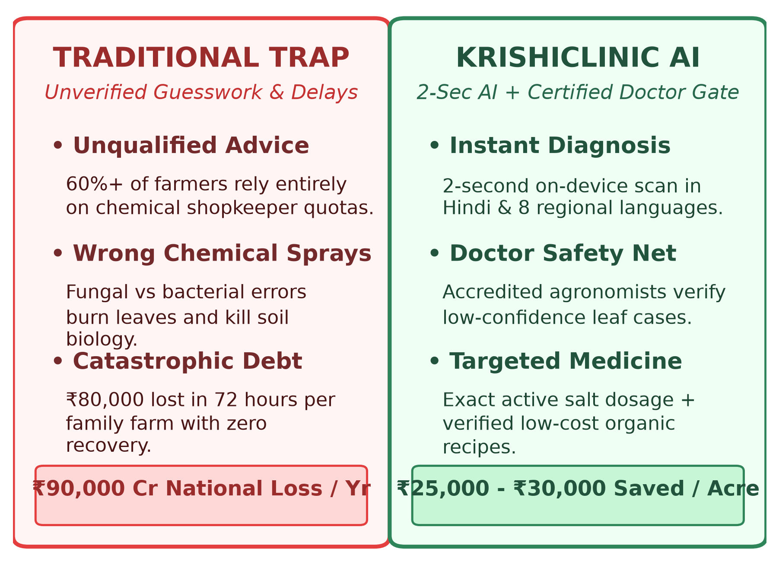



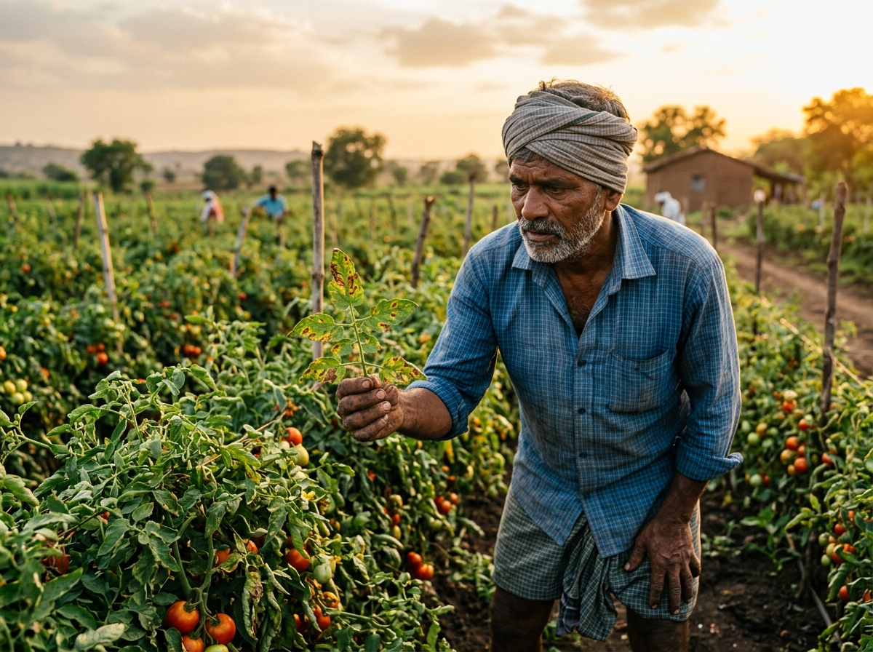
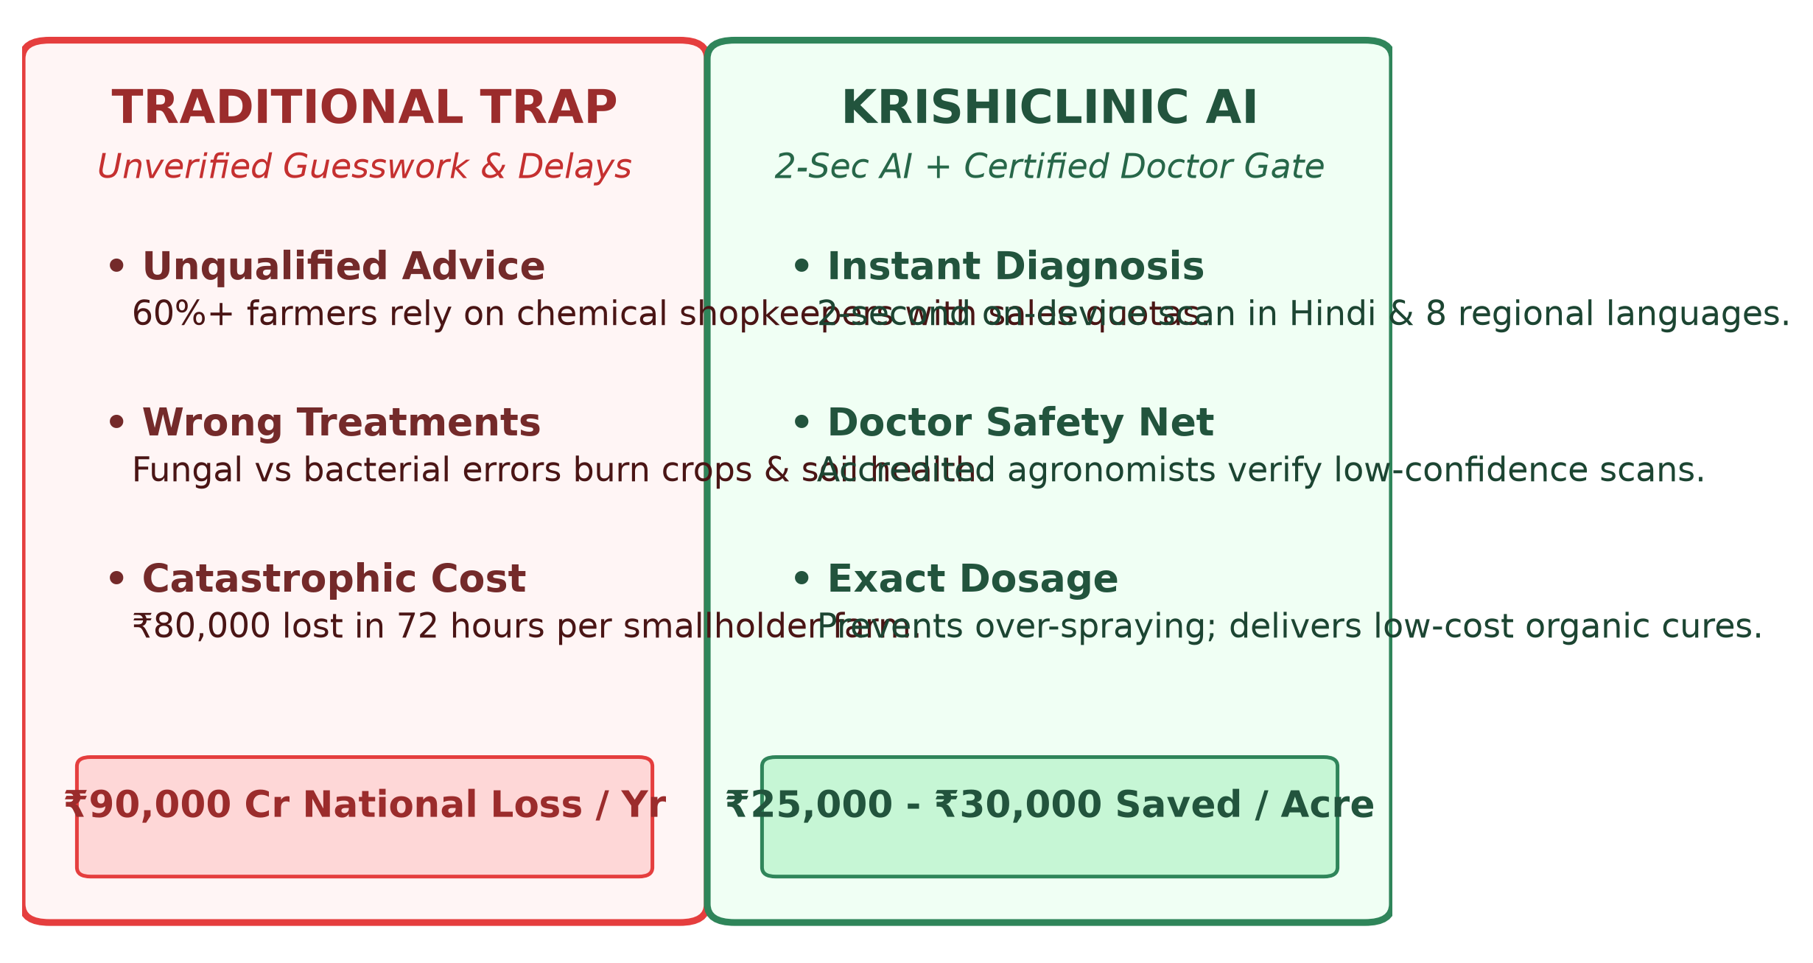
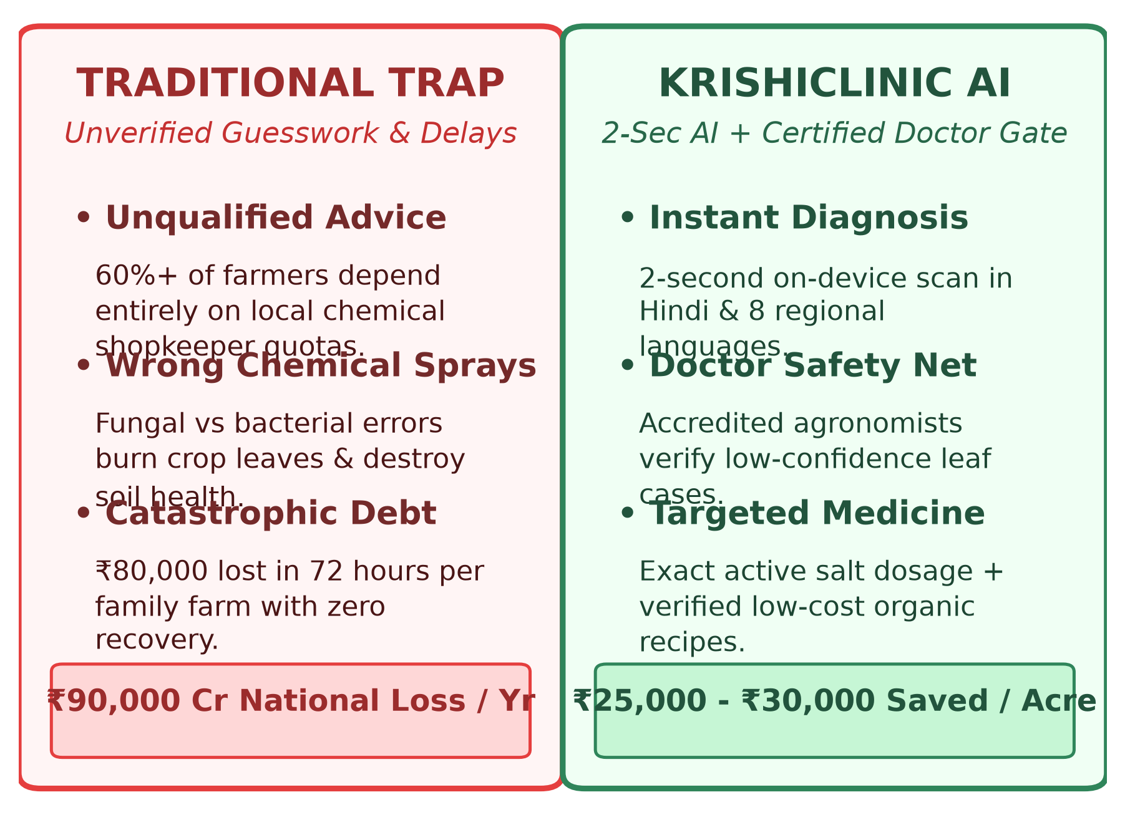
IDEA / SOLUTION TITLE: KRISHICLINIC AI
Empowering Smallholder Farmers with Doctor-Verified AI Crop Pathology
KEY TAKEAWAYS
The Rural Crisis: 60%+ of Indian farmers lack agronomist access, relying solely on pesticide shopkeeper quotas.
National Damage: India loses over ₹90,000 Crores every year to misdiagnosed diseases & ineffective sprays.
The KrishiClinic Cure: 2-second on-device AI diagnosis backed by certified doctor verification & exact remedies.

Slide 3
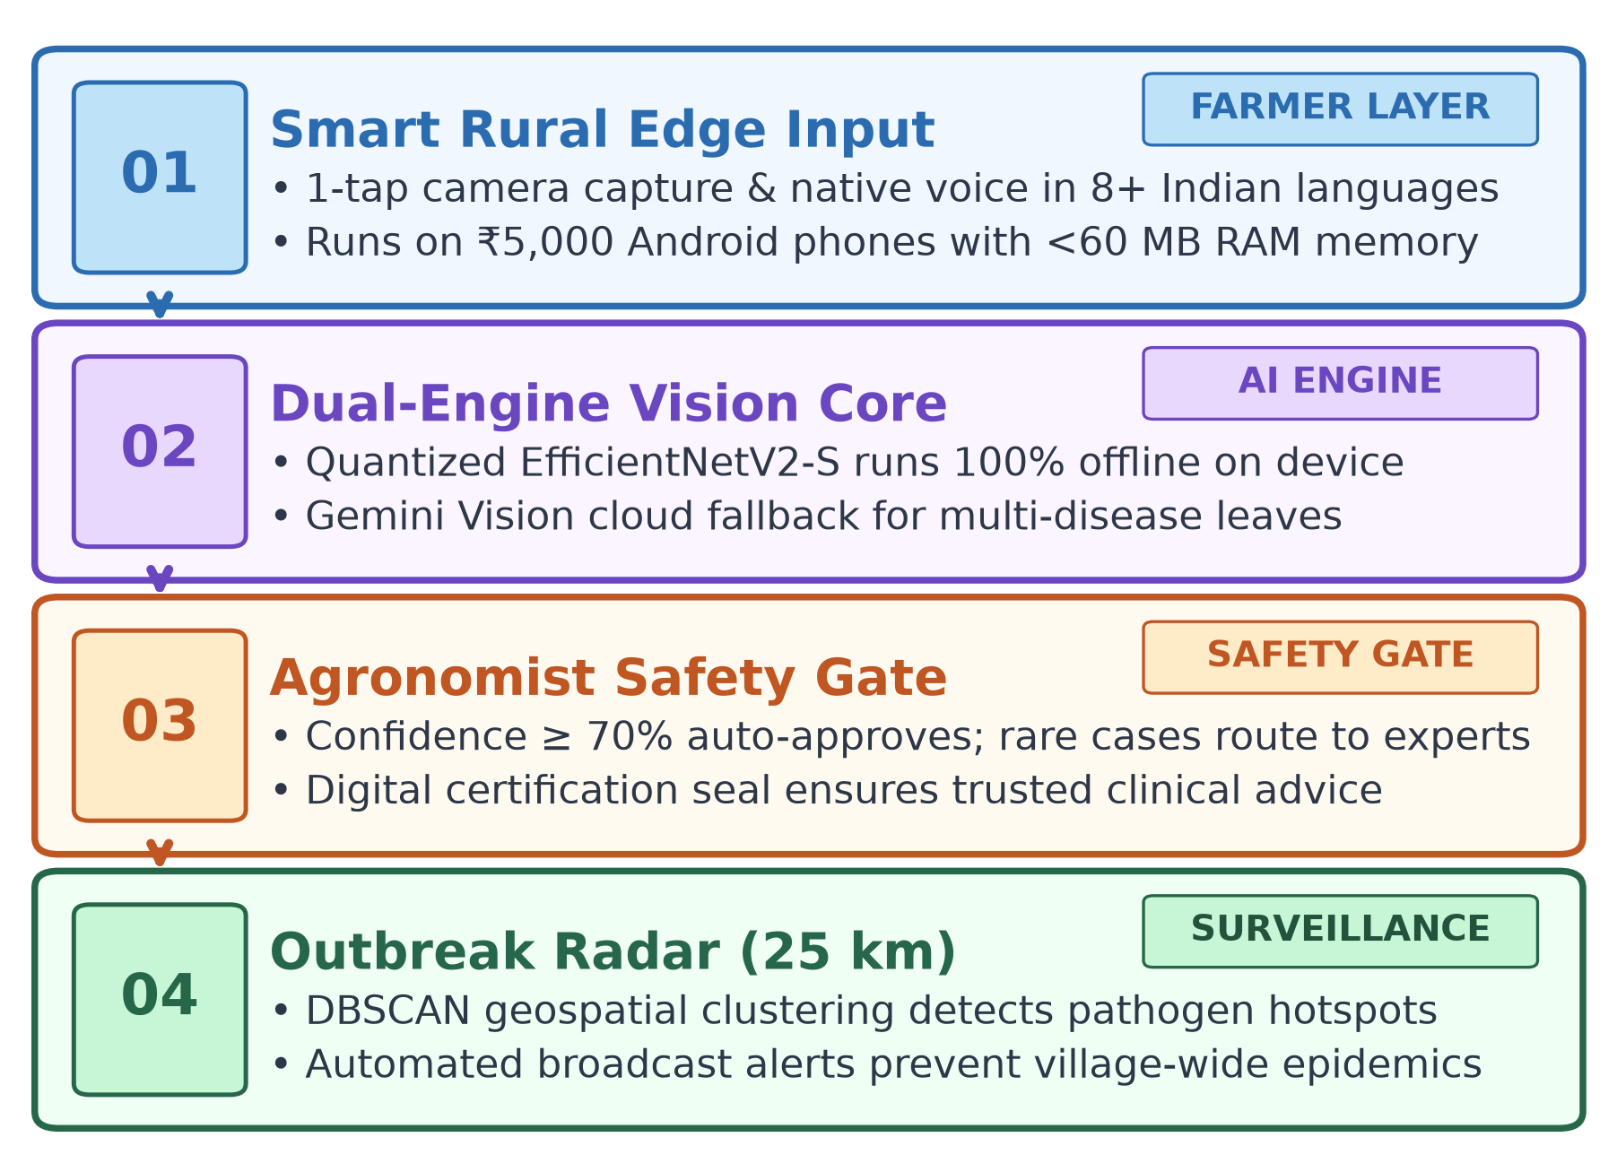
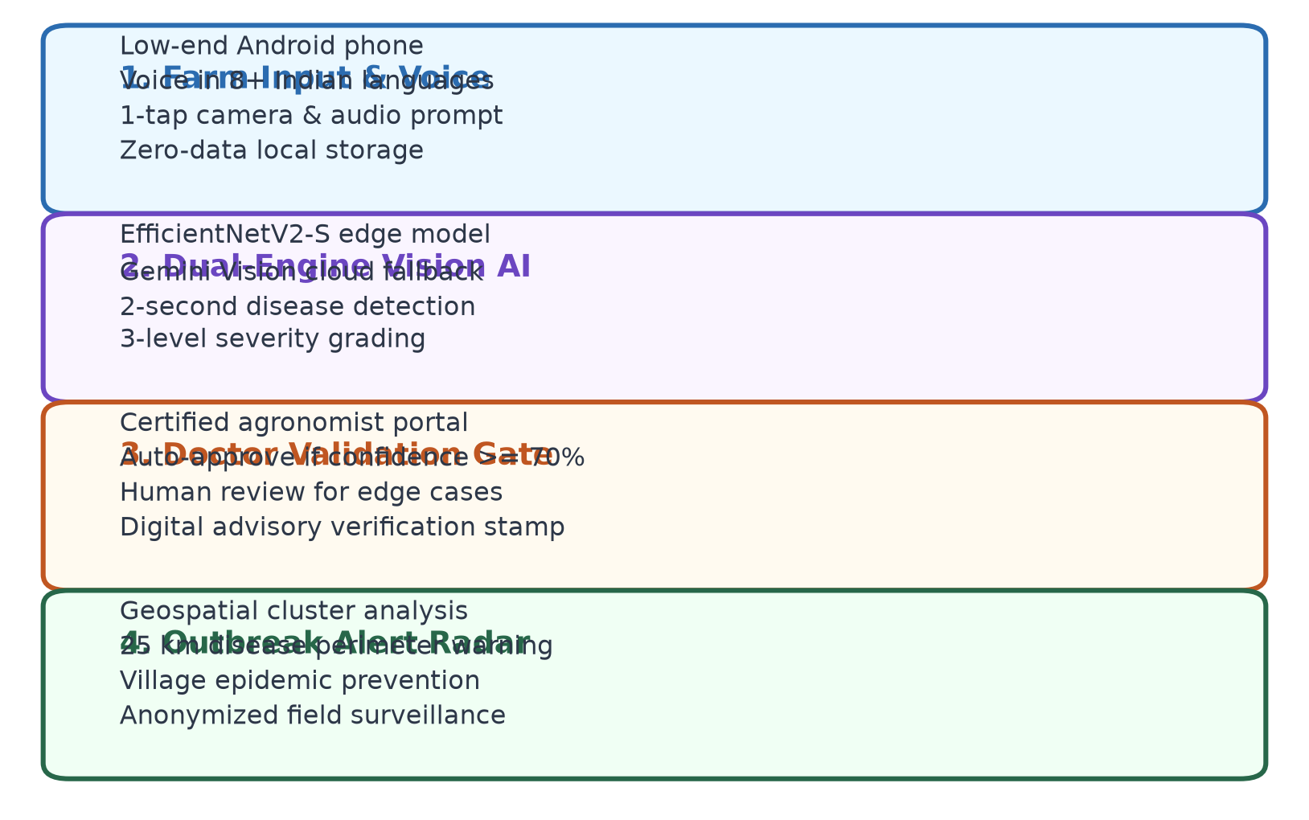
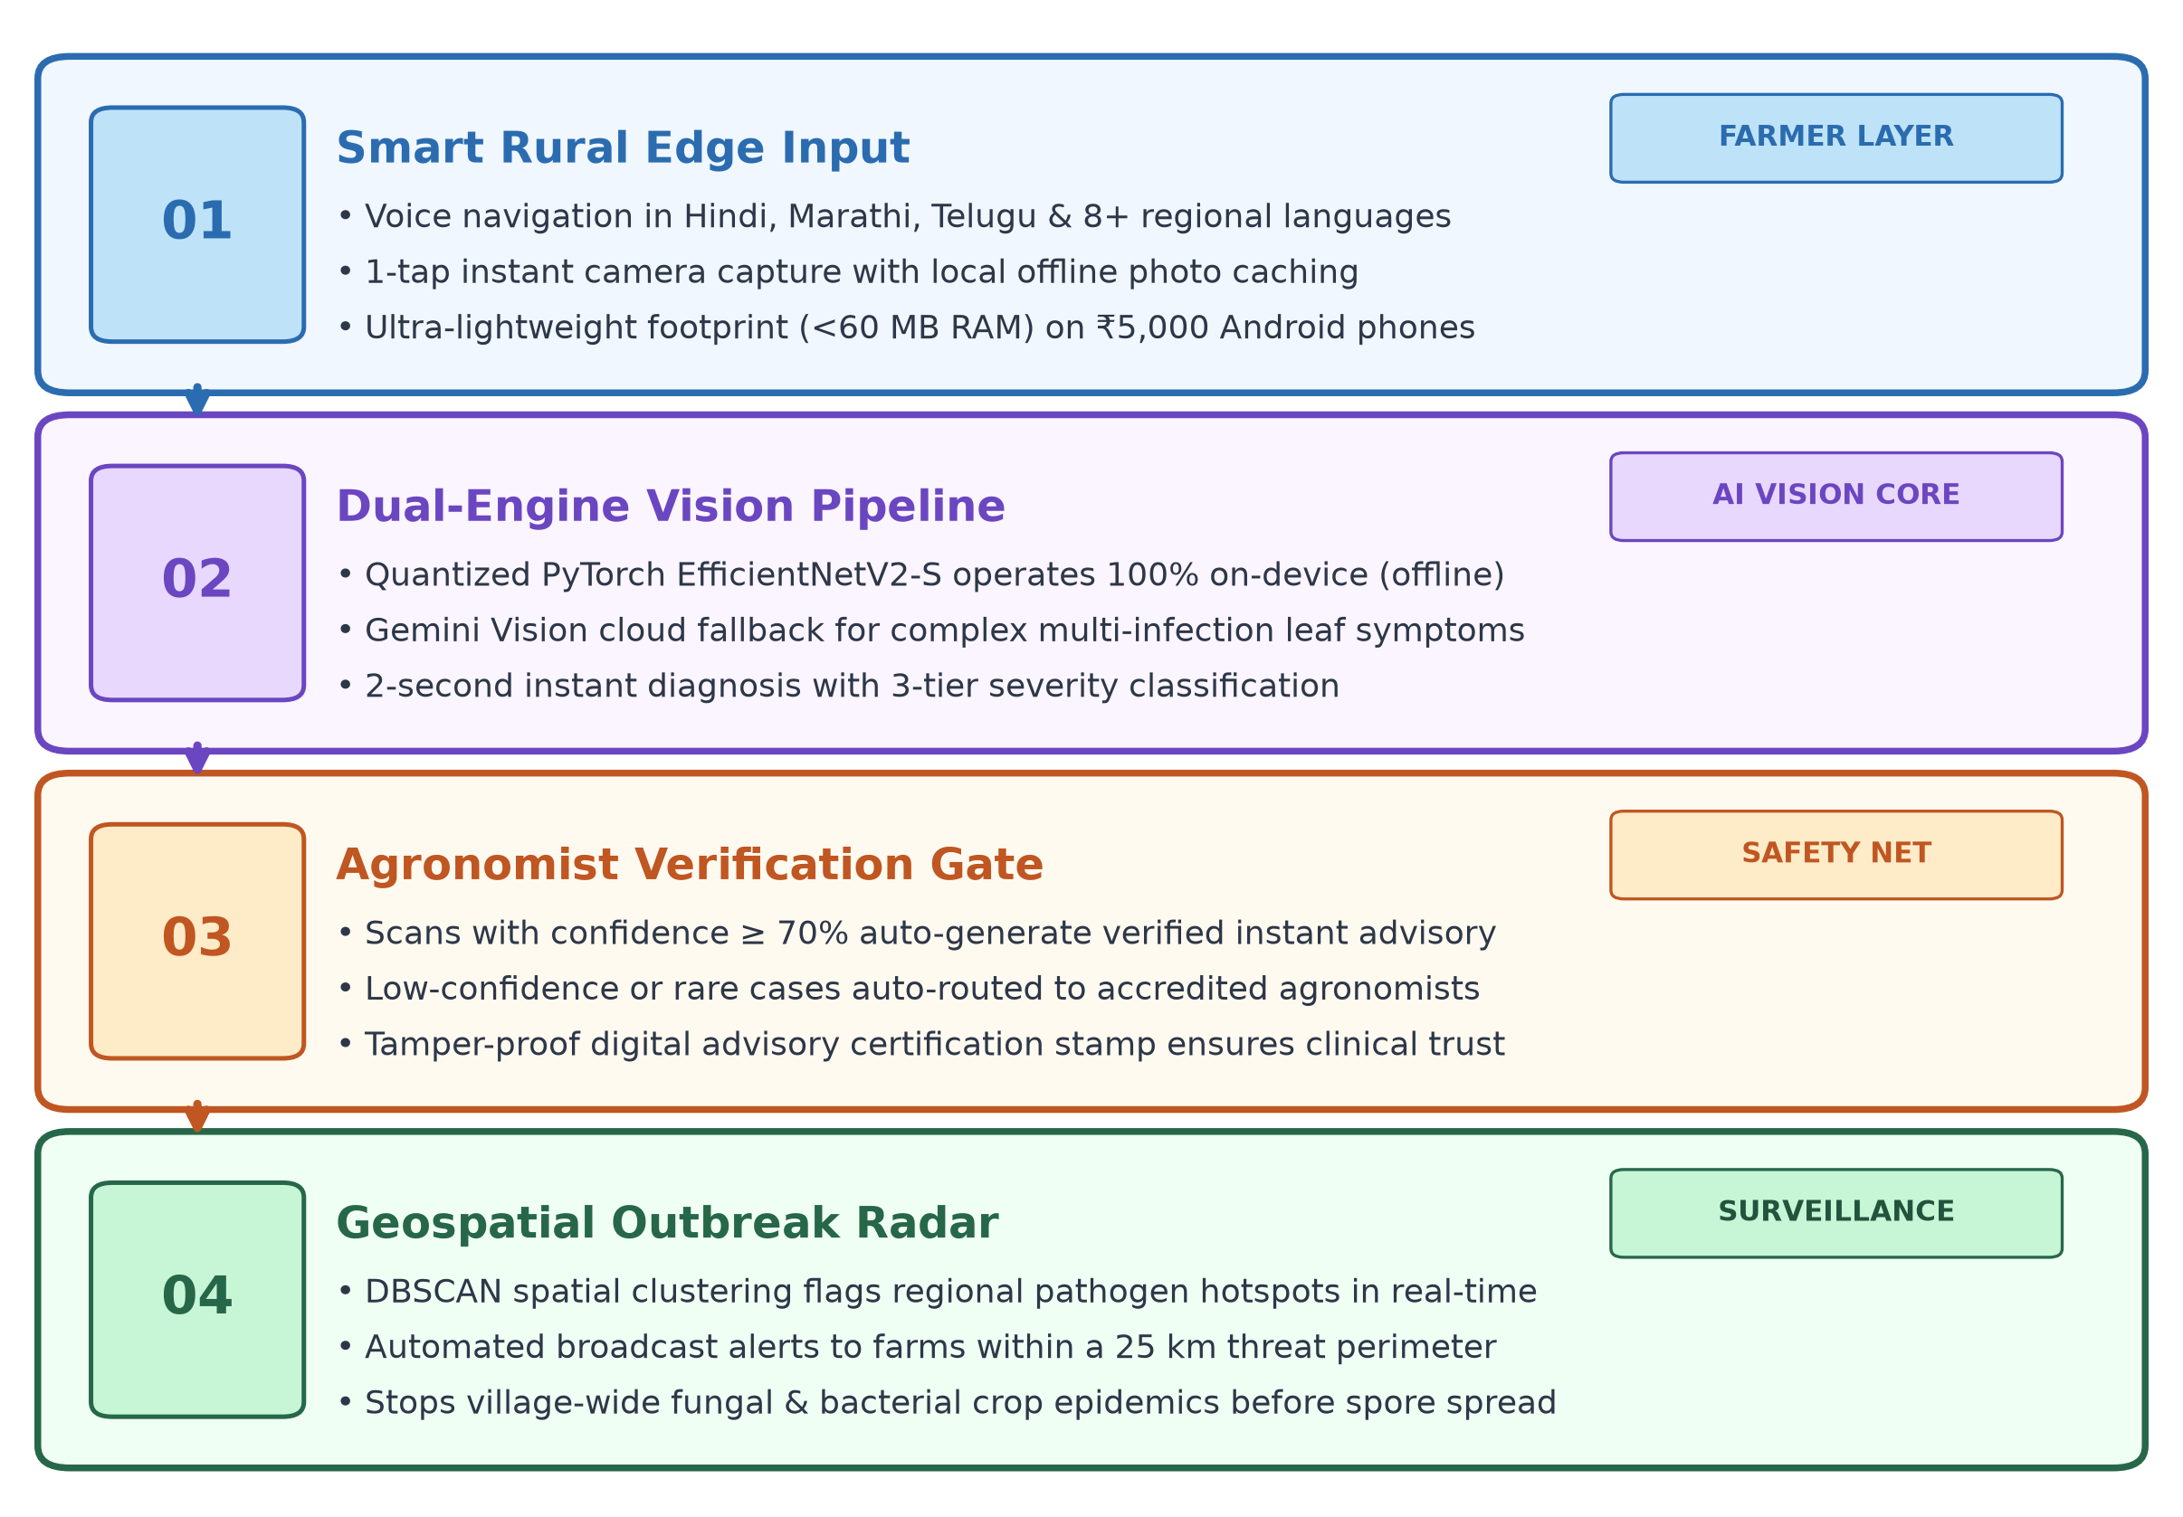
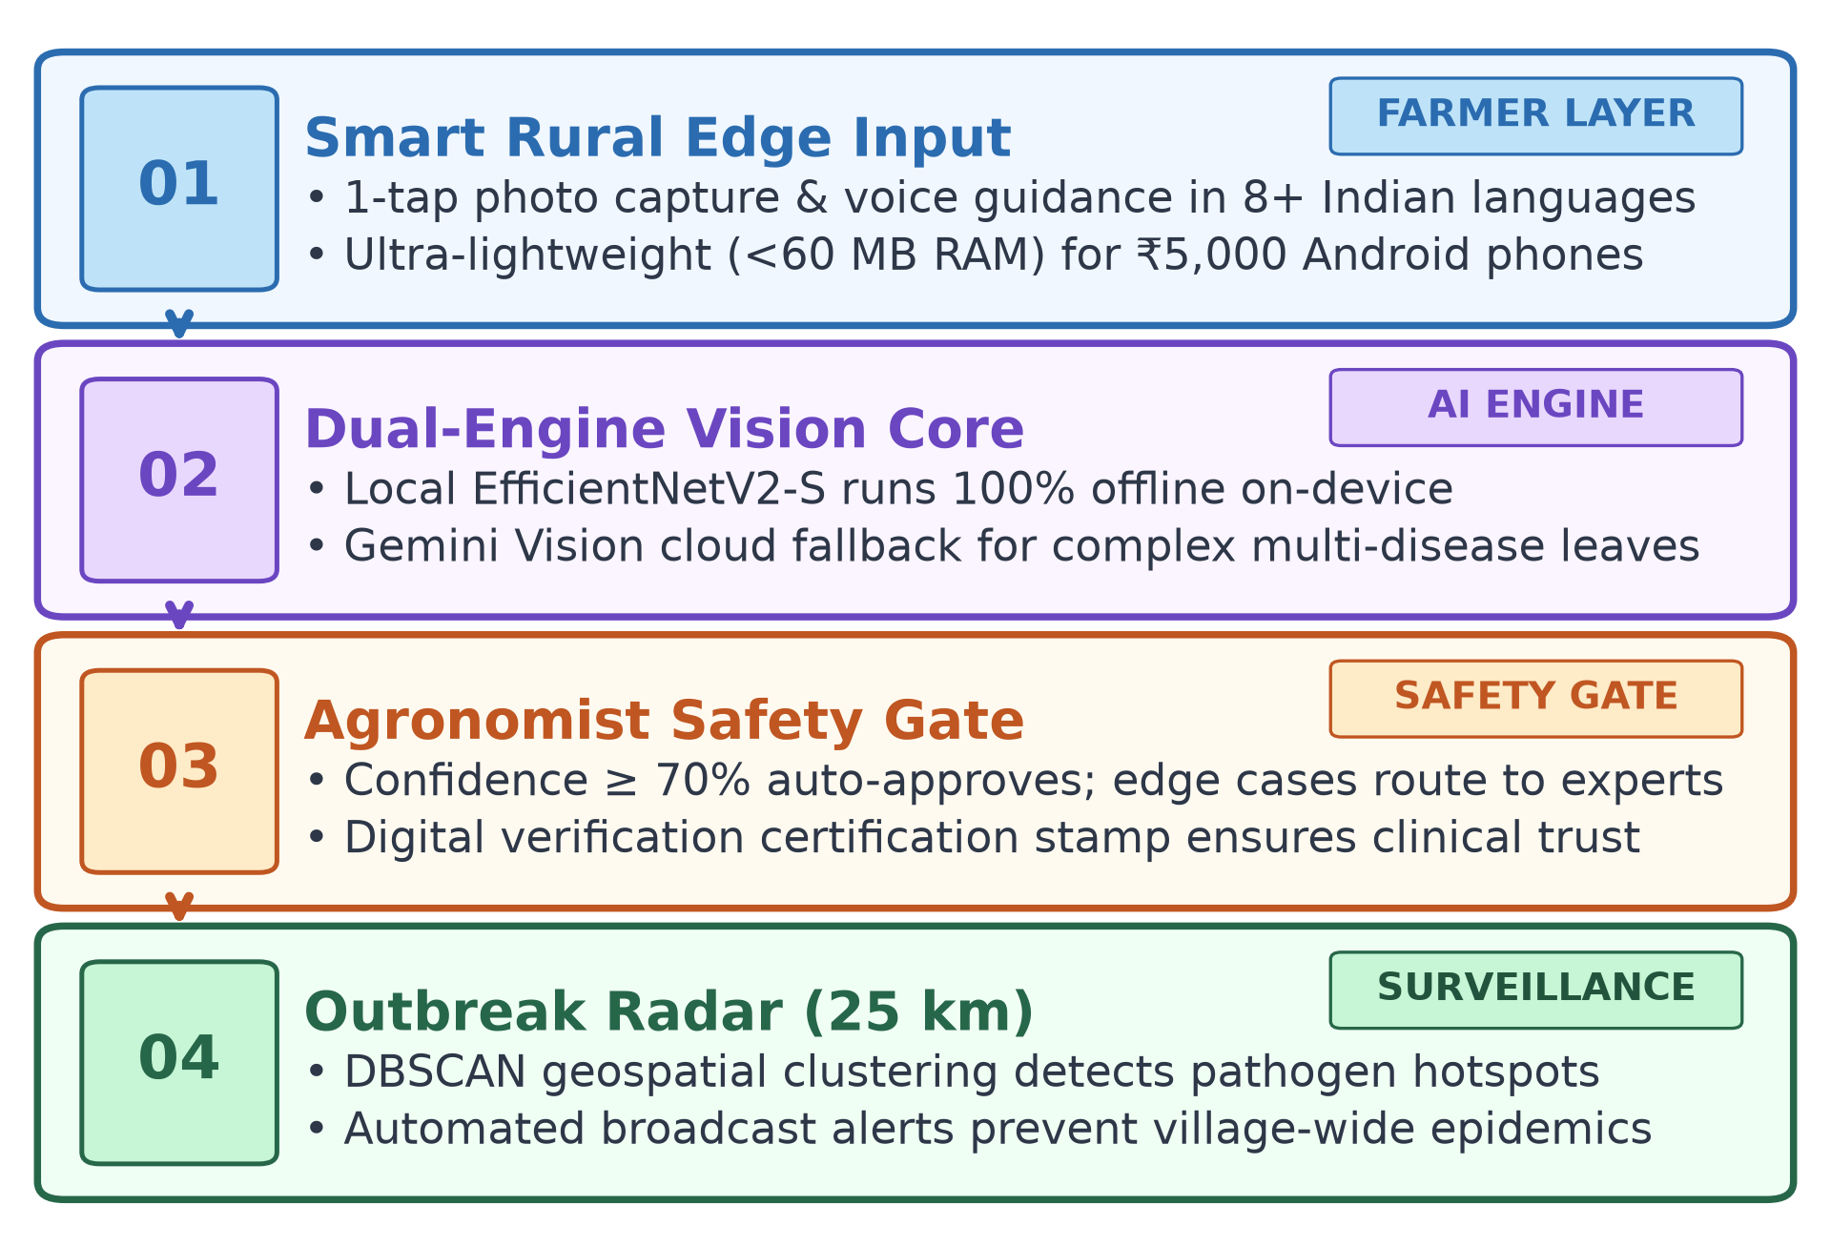
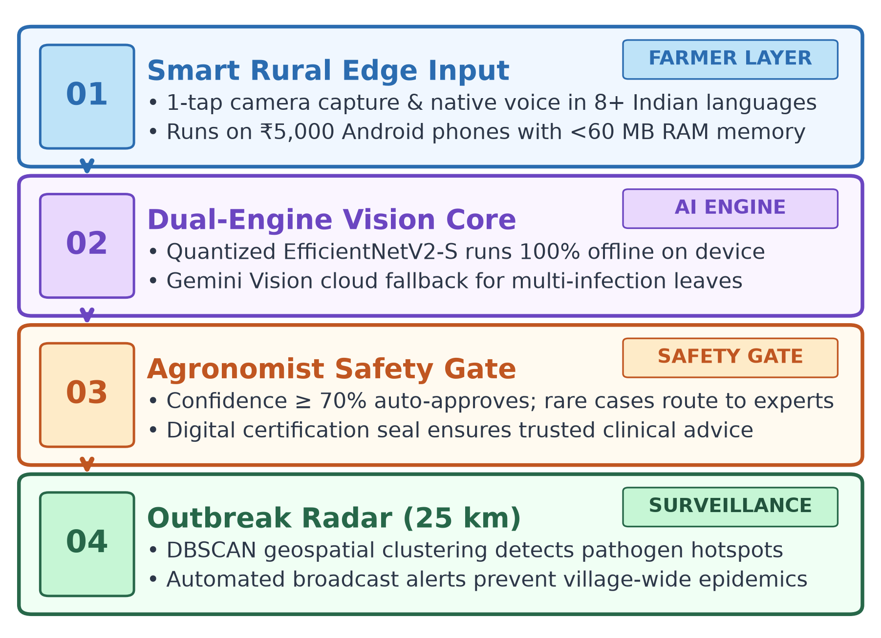
TECHNICAL APPROACH
Production-Grade Dual-Engine Vision Pipeline with Offline Rural Resilience
ARCHITECTURE PILLARS
Dual-Engine AI: Local EfficientNetV2-S on edge + Gemini Vision cloud fallback for complex multi-disease leaves.
Doctor Safety Gate: Confidence ≥ 70% auto-approves; rare cases route to accredited agronomists for review.
25km Outbreak Radar: Geospatial DBSCAN clustering flags regional pathogen hotspots to stop village epidemics.

Slide 4
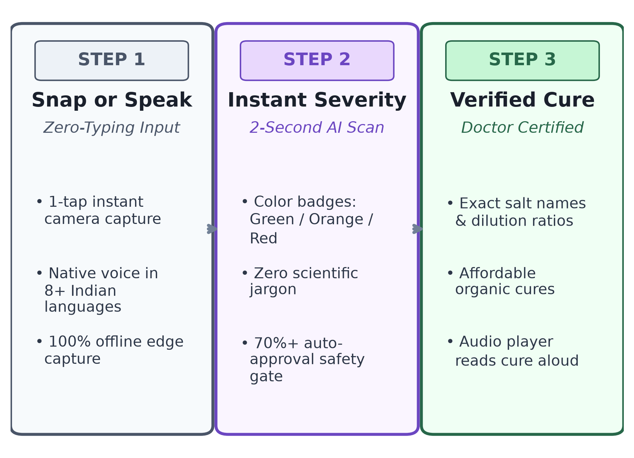
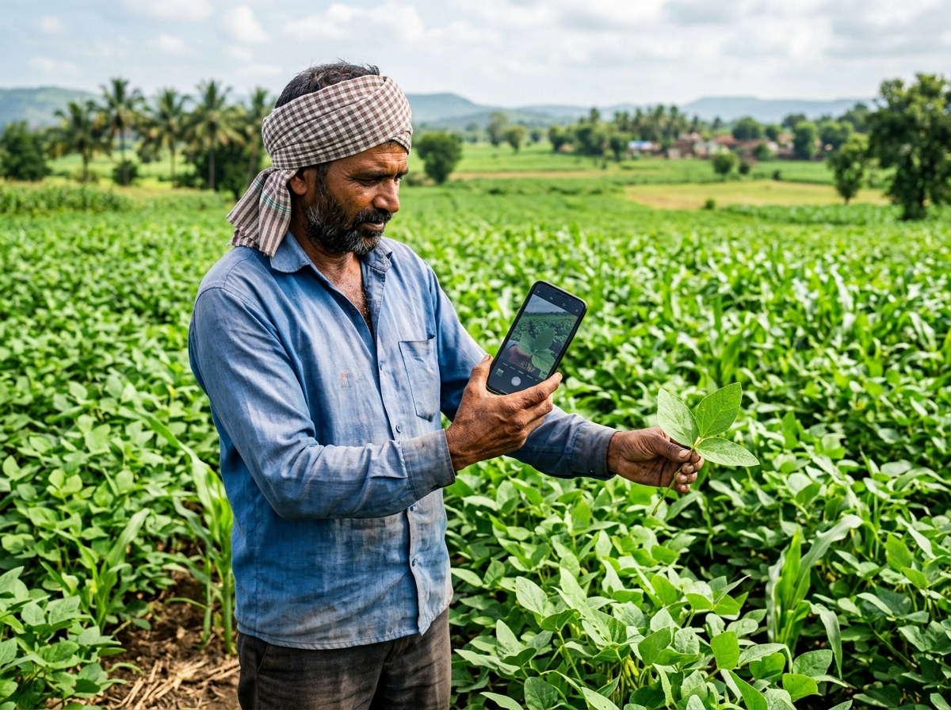
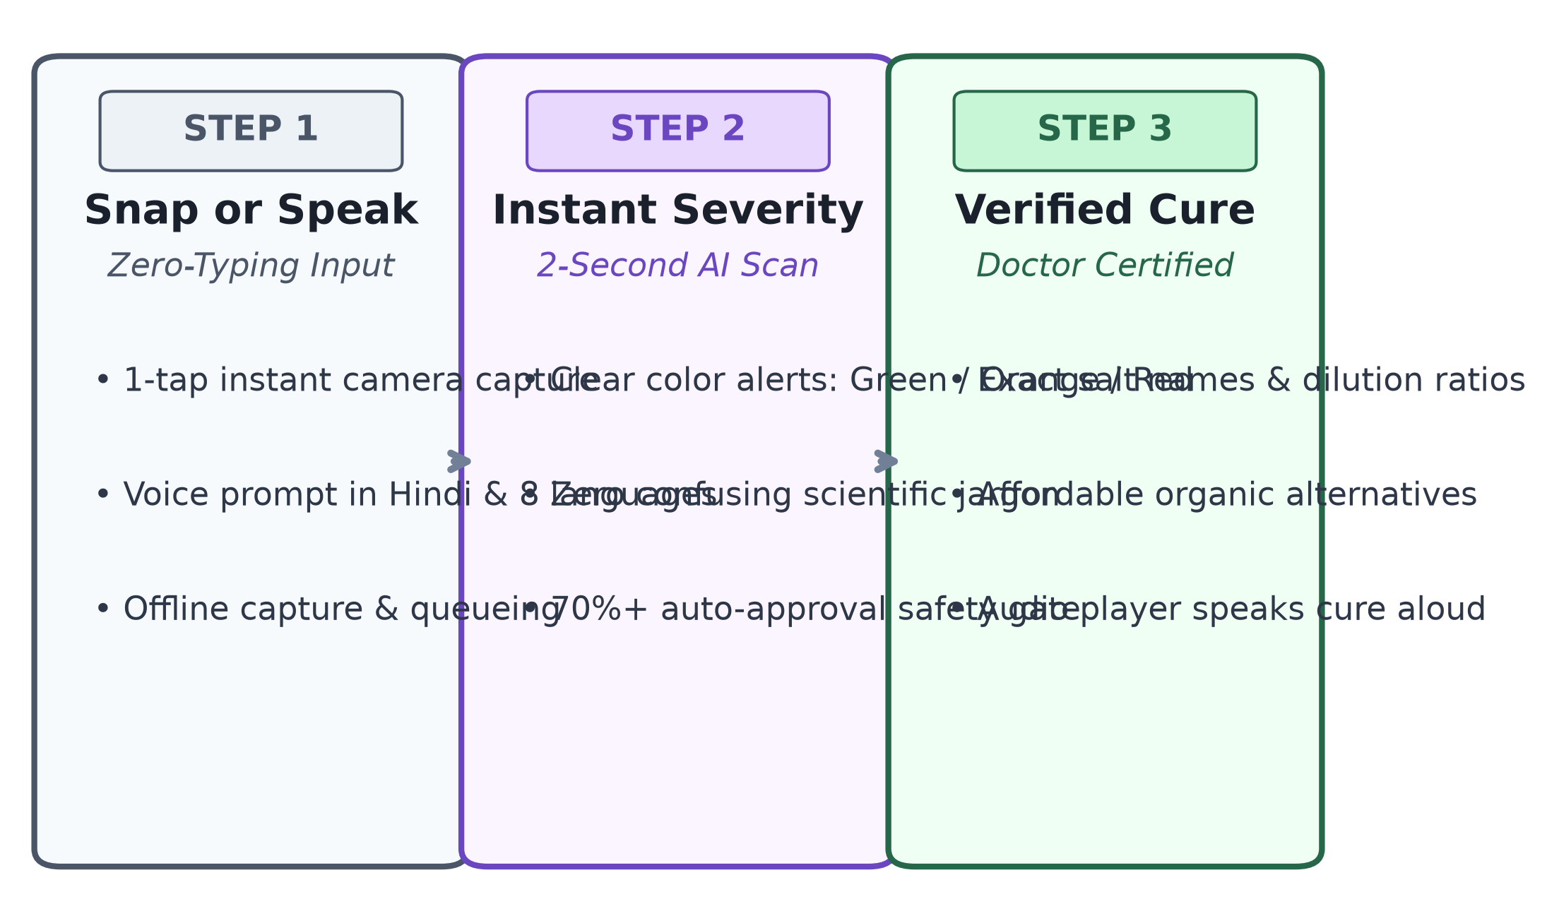
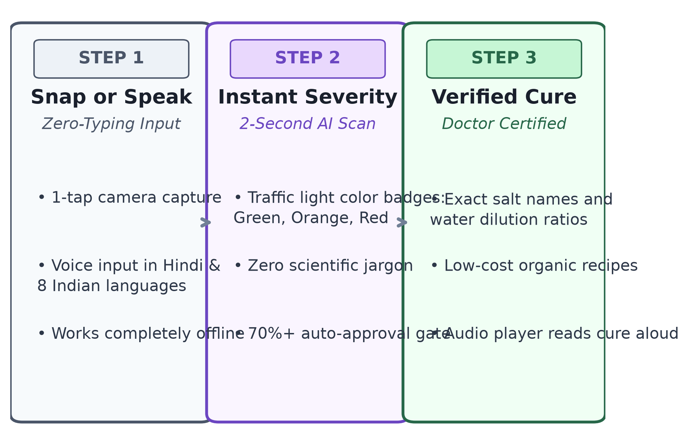
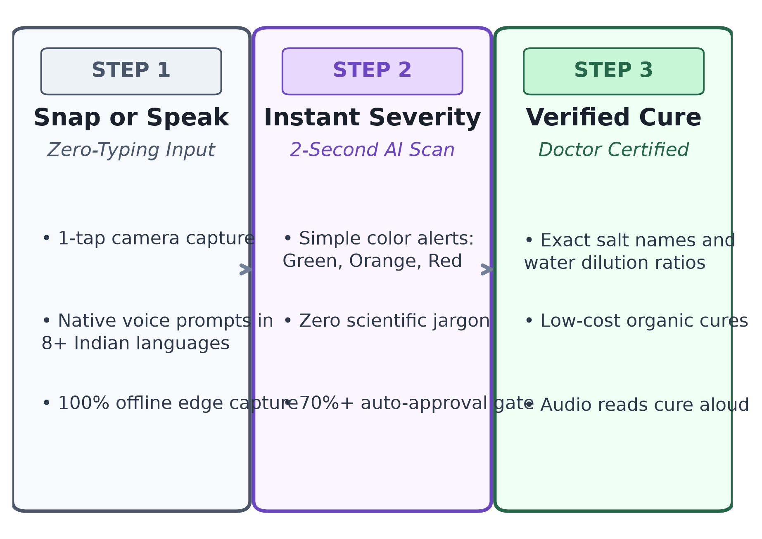
USER EXPERIENCE & DESIGN
Farmer-Centric Usability: Voice Navigation & Zero-Literacy Barriers
FARMER JOURNEY
Voice-First Design: Farmers can speak queries in Hindi, Marathi, Telugu, Punjabi, Tamil & English with audio cures.
3-Tap Simplicity: Snap photo → View color-coded severity (Green/Orange/Red) → Listen to spoken medicine dosage.
Agronomist Portal: Fast web dashboard with 1-click case approval, dosage adjustments, and digital certification.

Slide 5
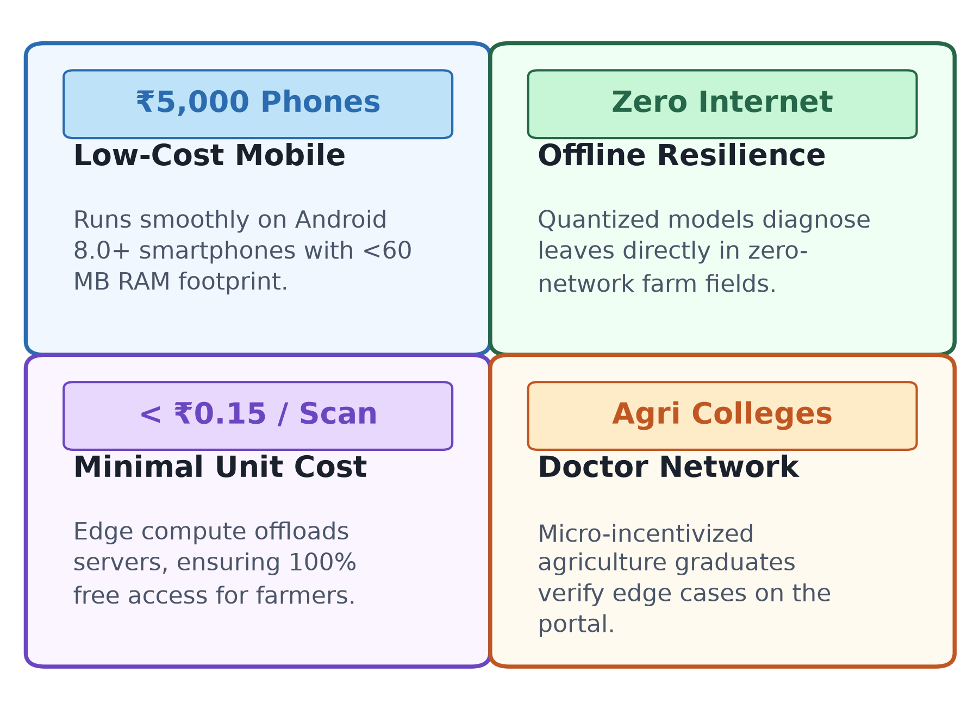
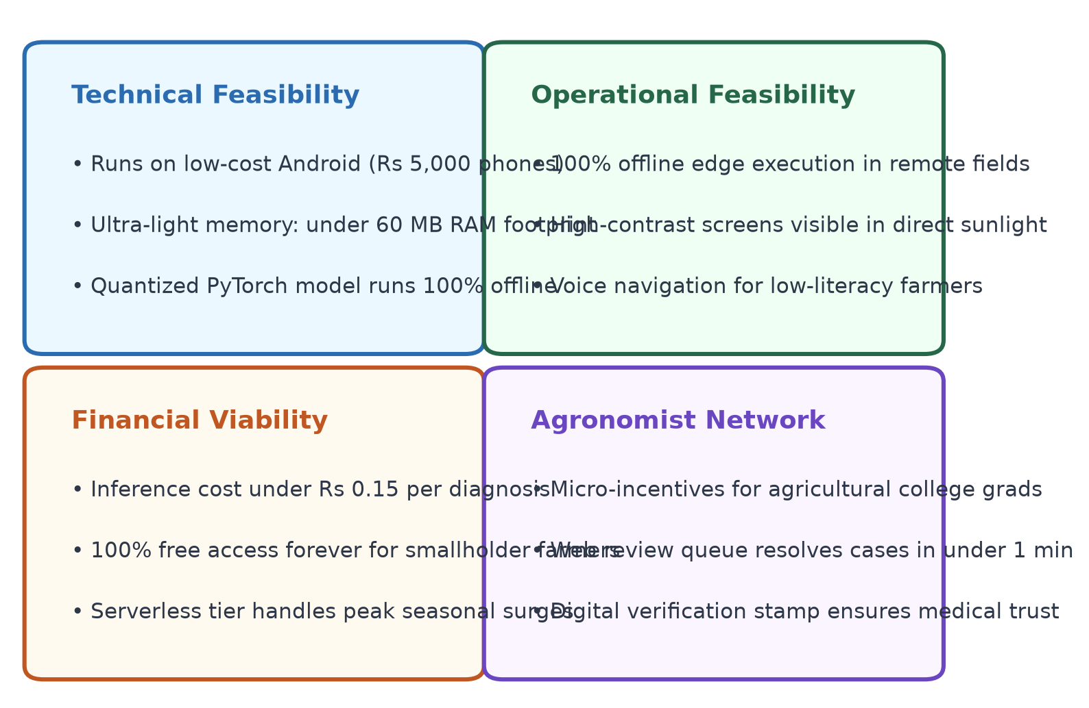
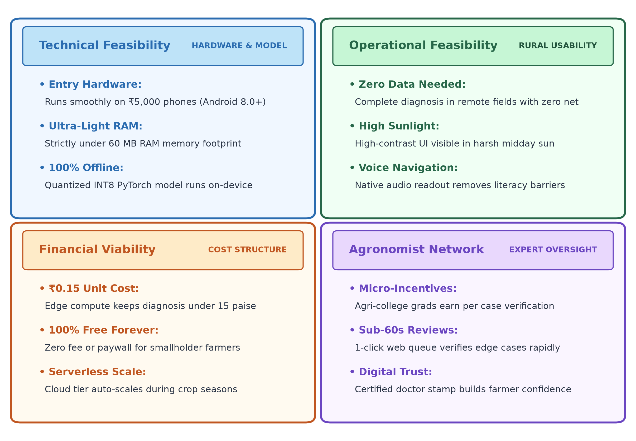
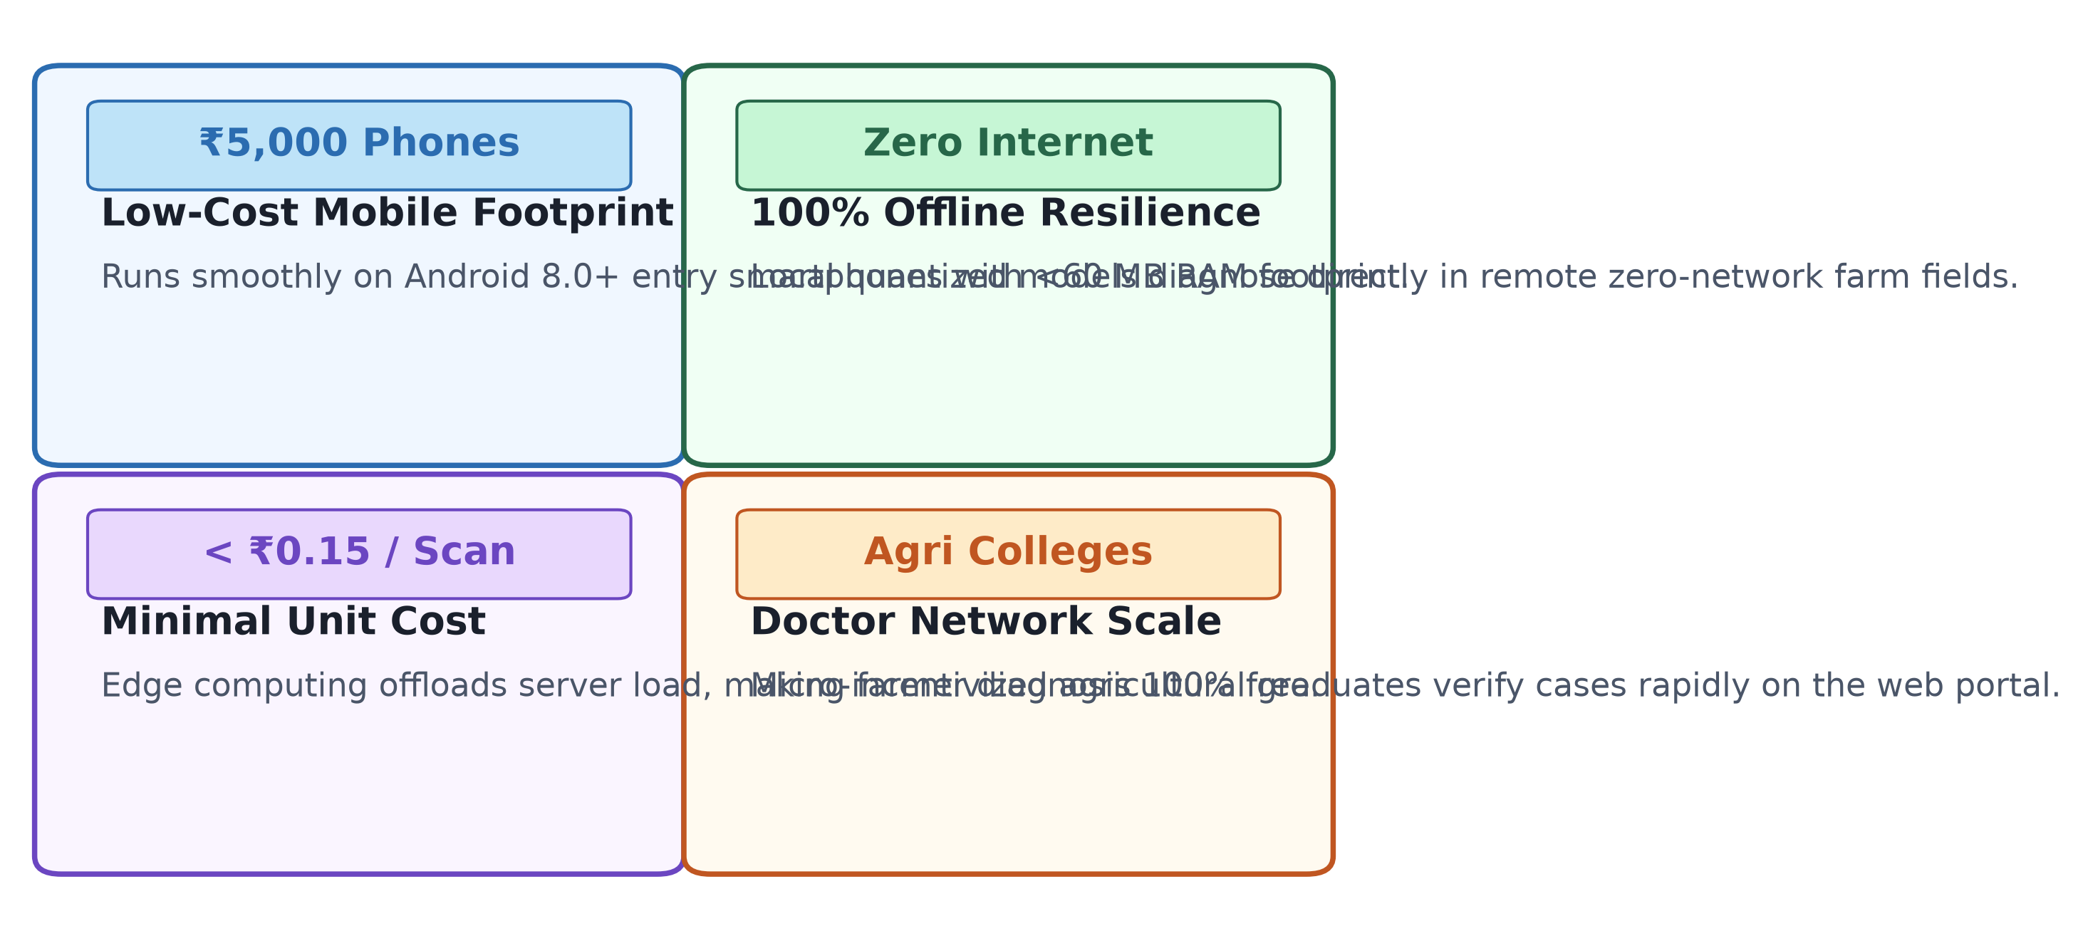
FEASIBILITY AND VIABILITY
Low-Cost Engineering Built for Entry-Level Devices & Remote Farms
FEASIBILITY HIGHLIGHTS
Runs on ₹5,000 Phones: Optimized memory footprint under 60 MB RAM for Android 8.0+ entry smartphones.
100% Offline Diagnosis: Operates entirely in remote farm fields without cellular network connectivity.
Under ₹0.15 Unit Cost: Edge AI compute offloads servers, ensuring 100% free access for marginal farmers.

Slide 6
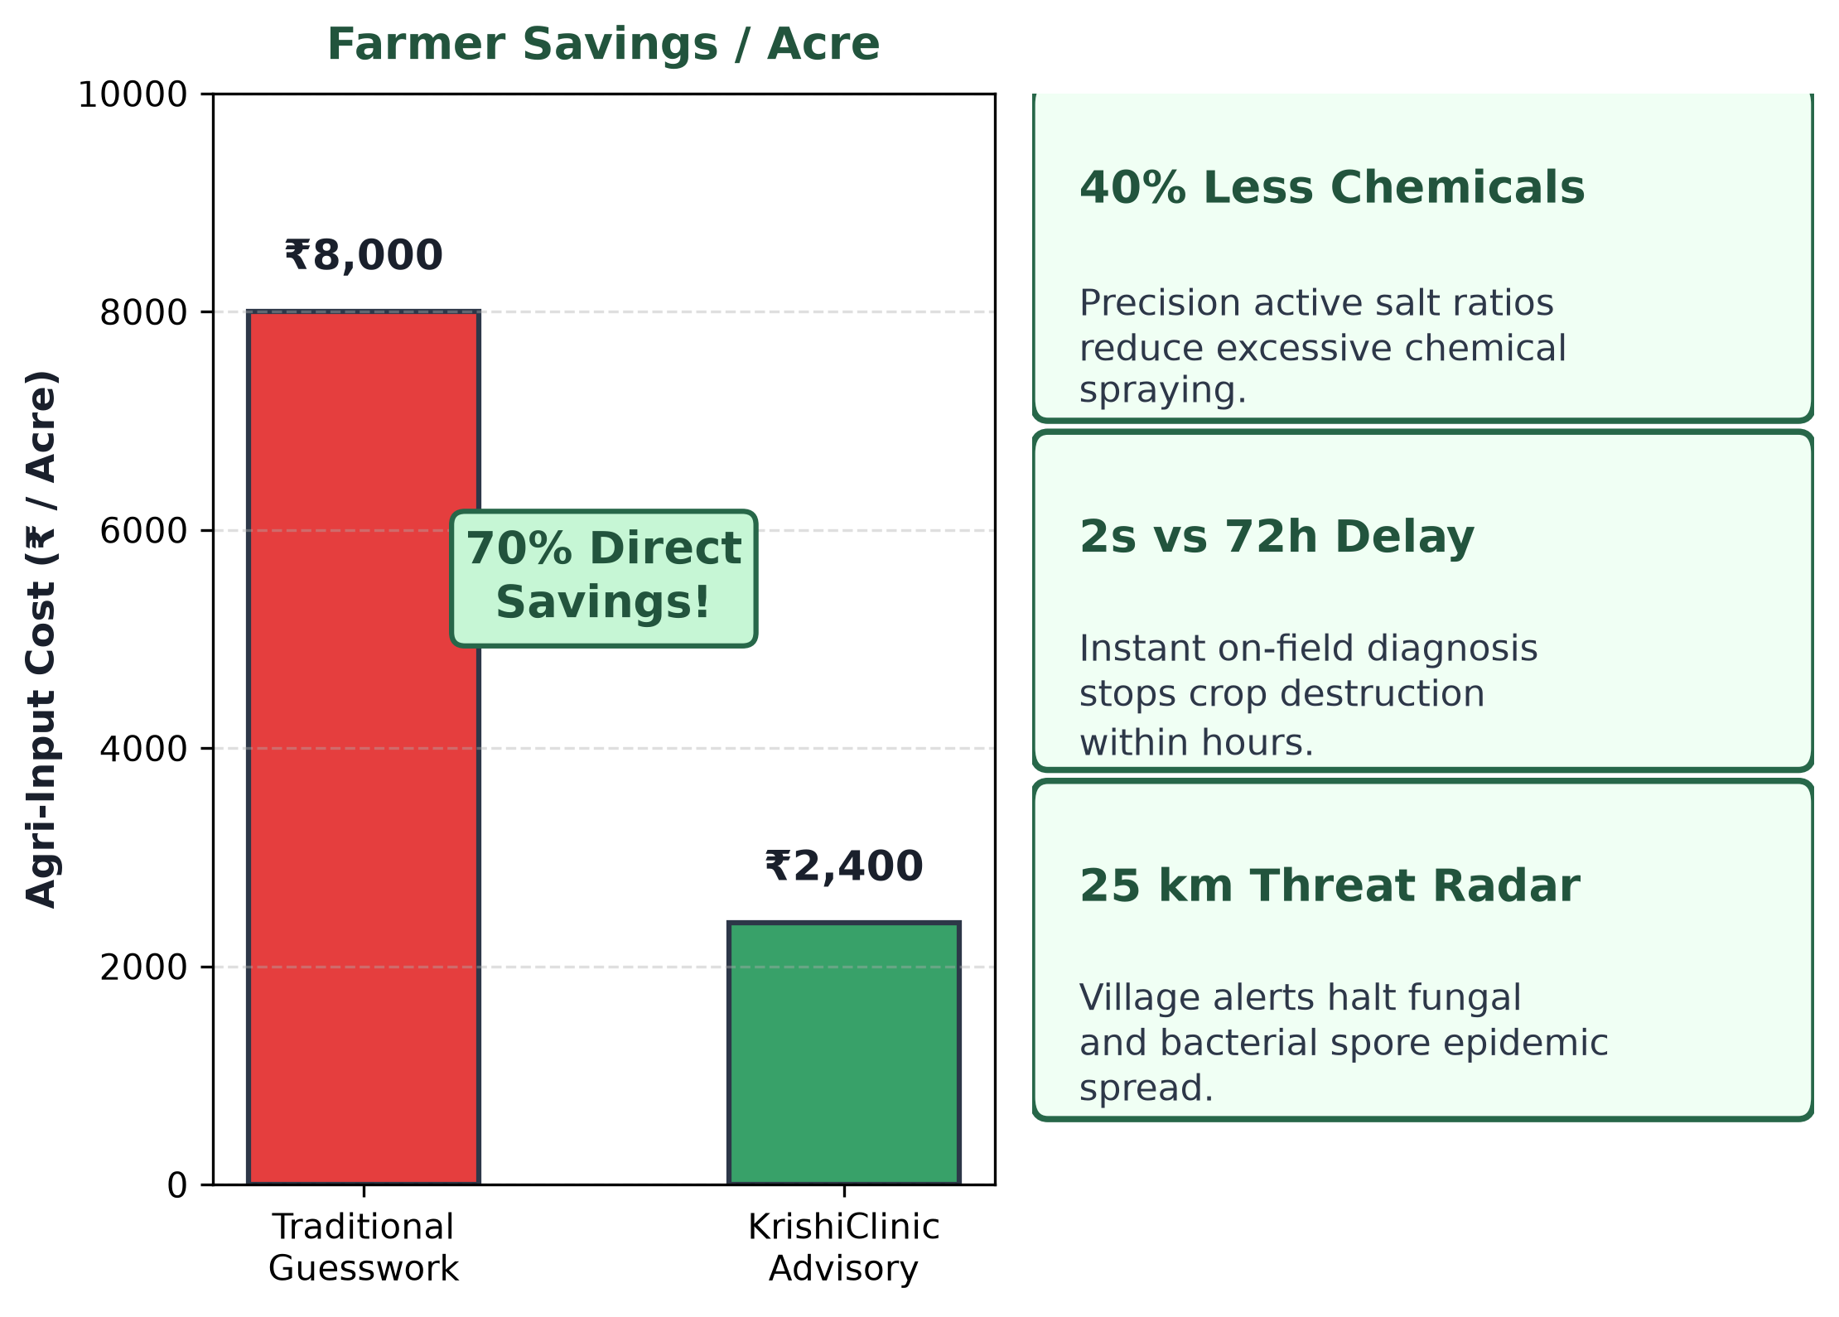

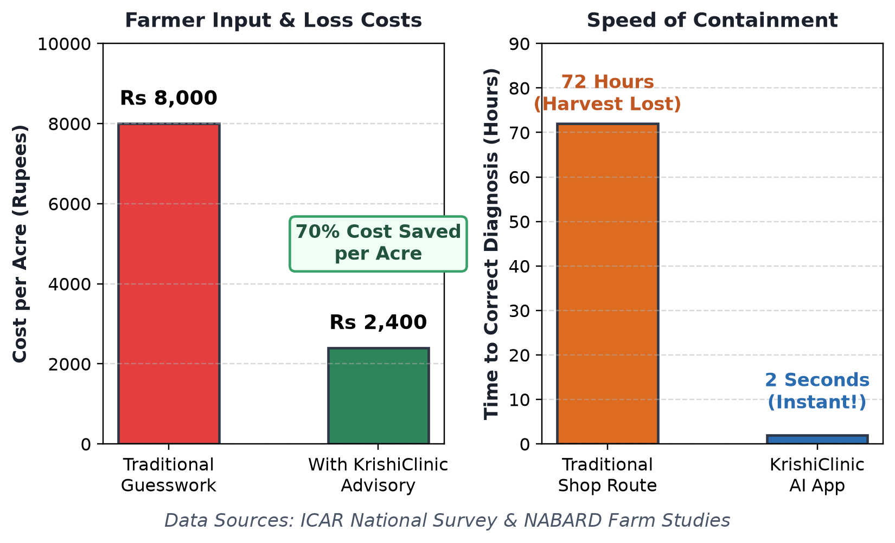
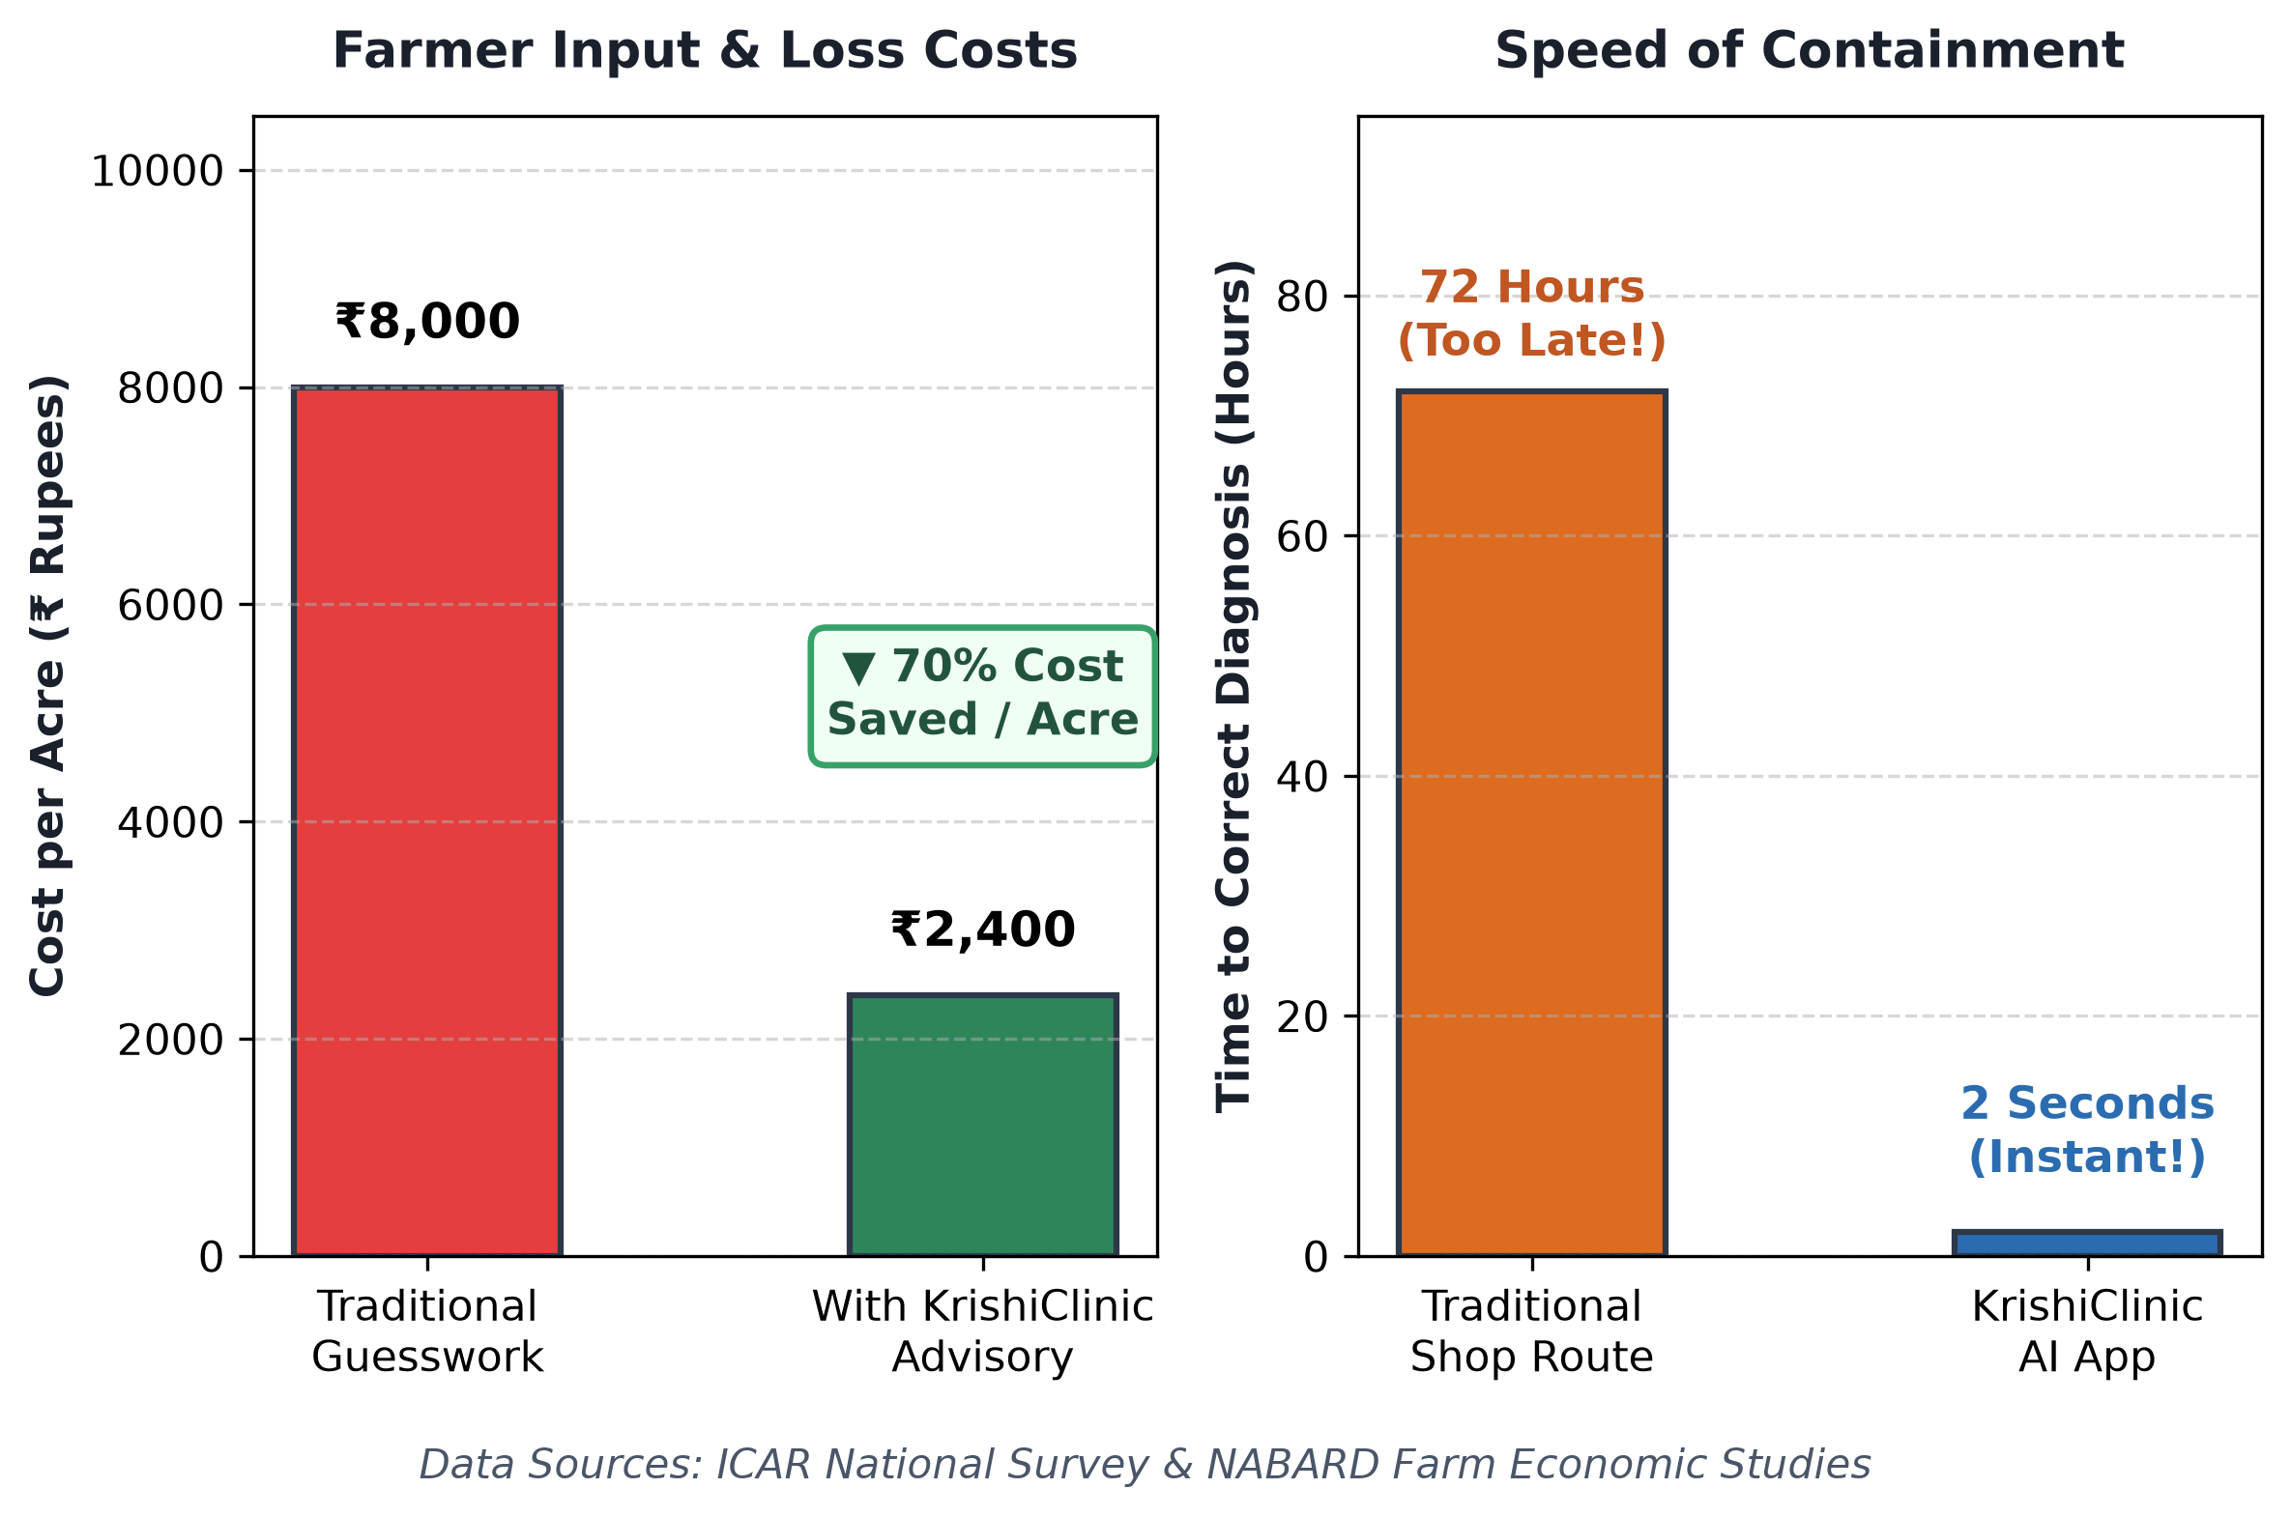
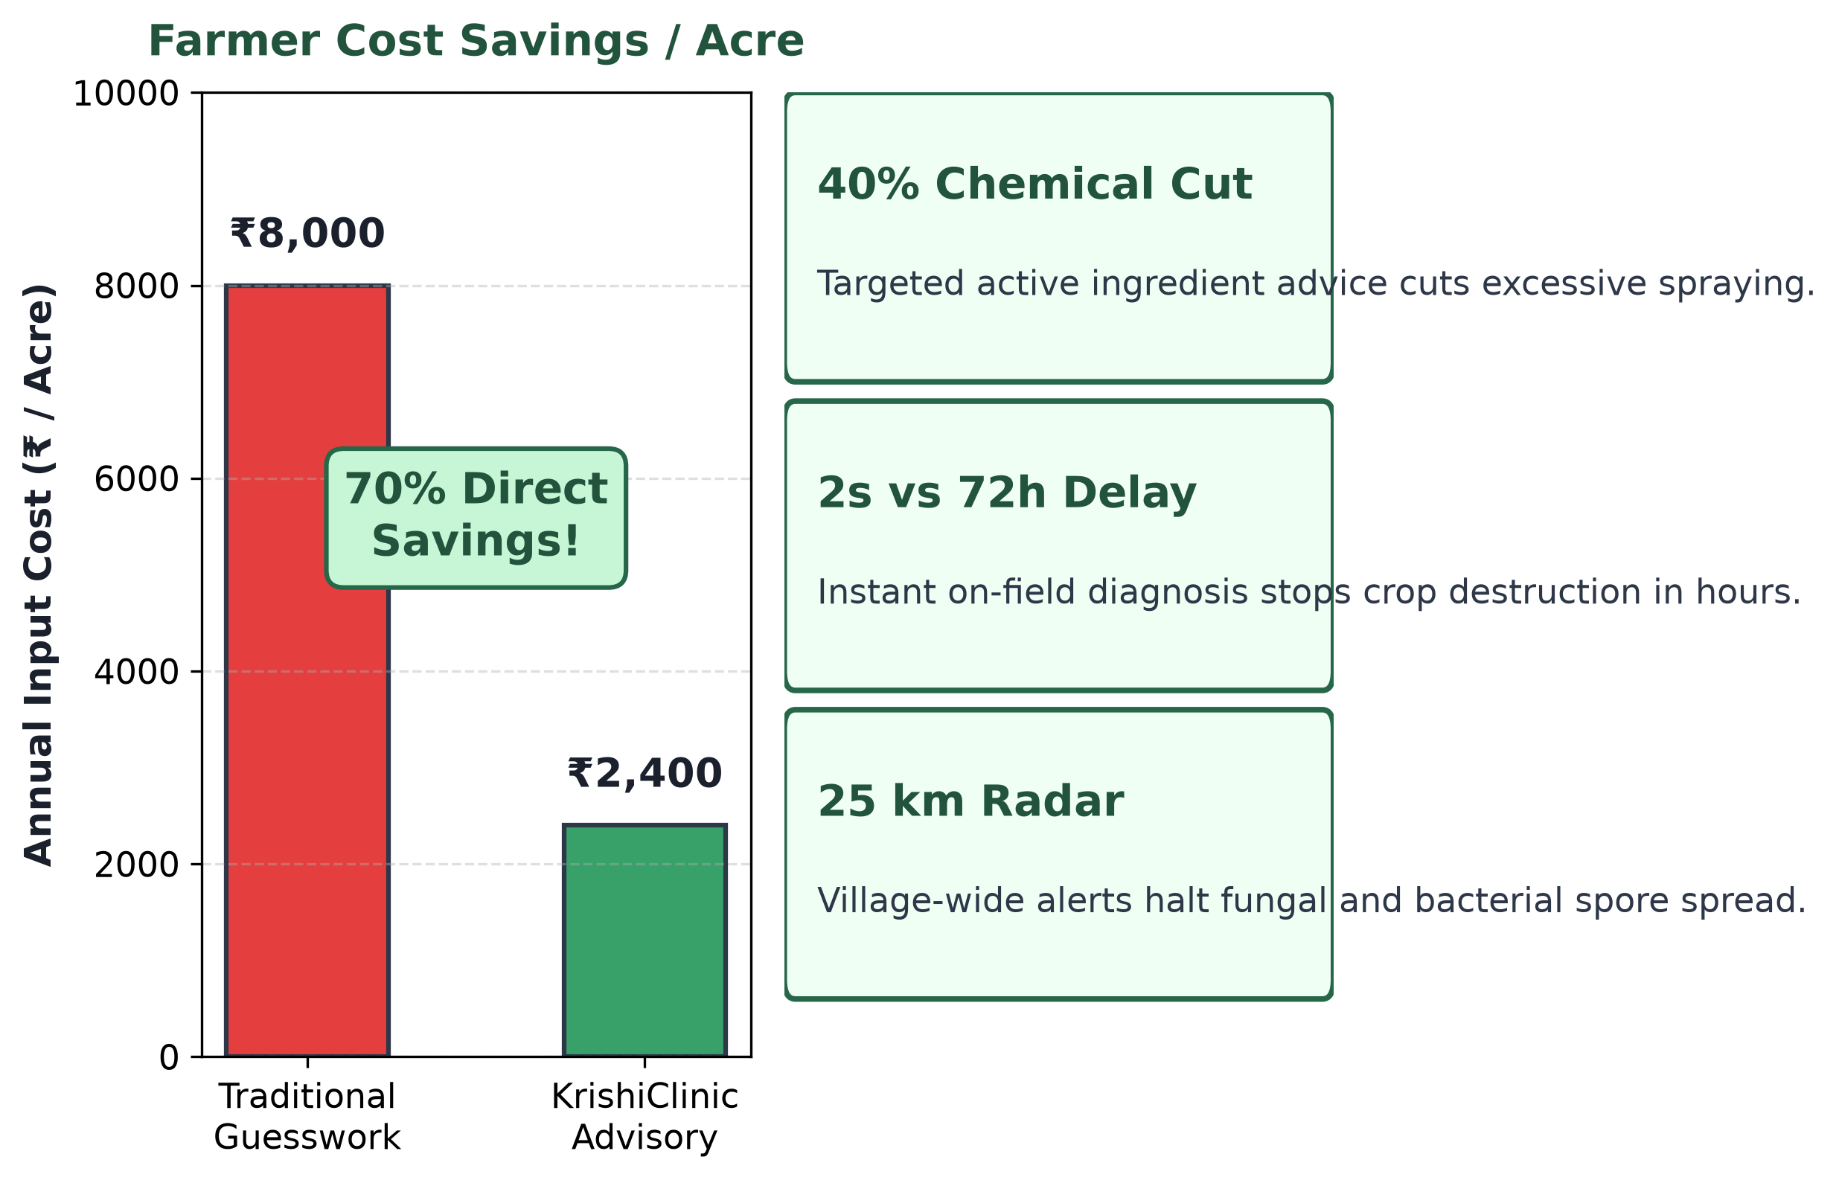

IMPACT AND BENEFITS
Protecting Livelihoods, Restoring Soil Health & Preventing Epidemics
MEASURED IMPACT
70% Cost Reduction: Saves ₹25,000 - ₹30,000 per acre by stopping crop loss and unnecessary pesticide purchases.
40% Less Toxic Spray: Precision active salt ratios and verified organic remedies restore long-term soil biology.
2-Sec Rapid Containment: Cuts diagnostic delay from 72 hours of shopkeeper guesswork down to 2 seconds.

Slide 7
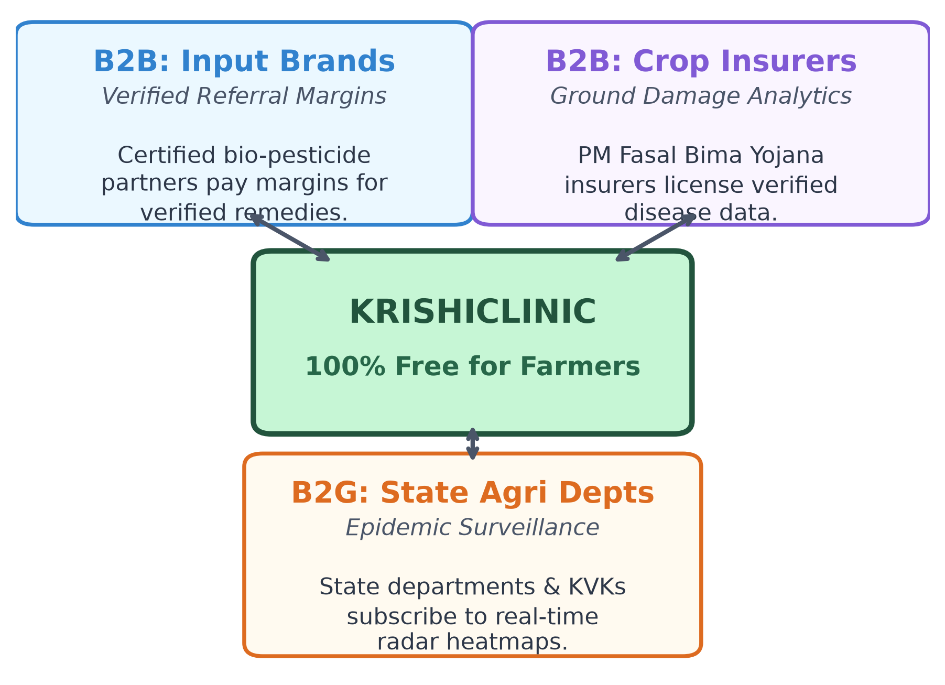
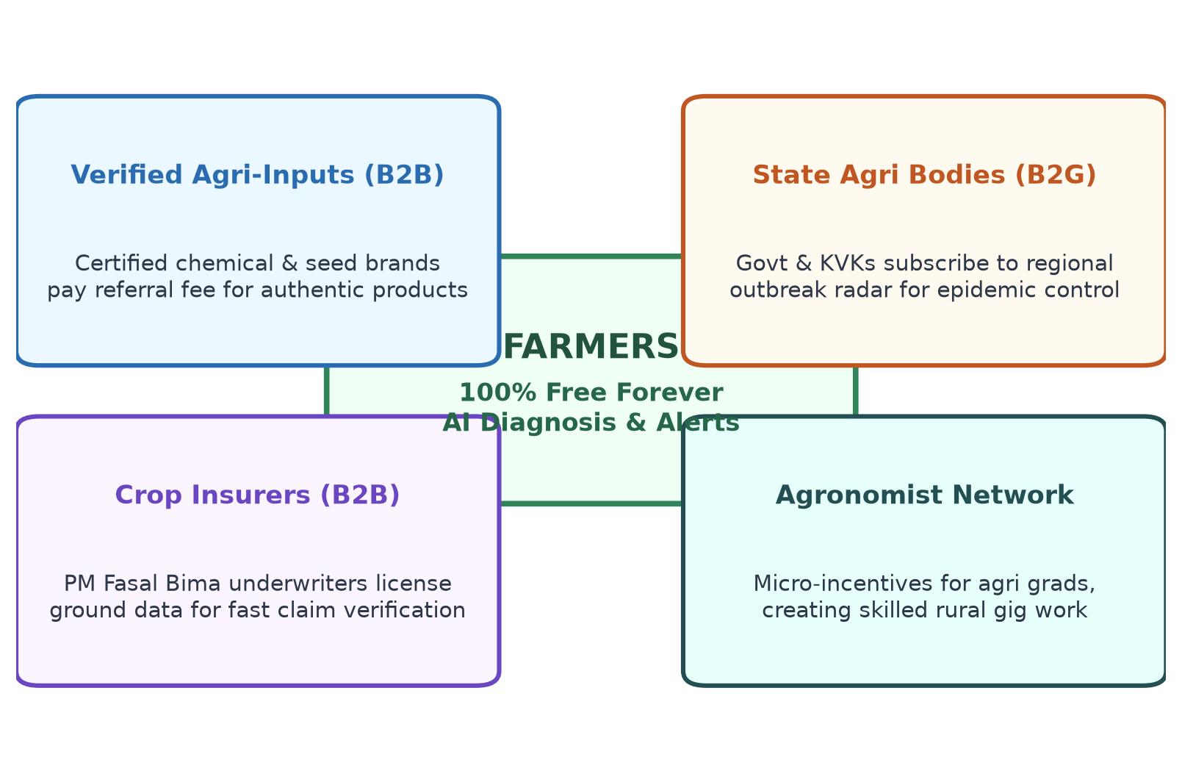
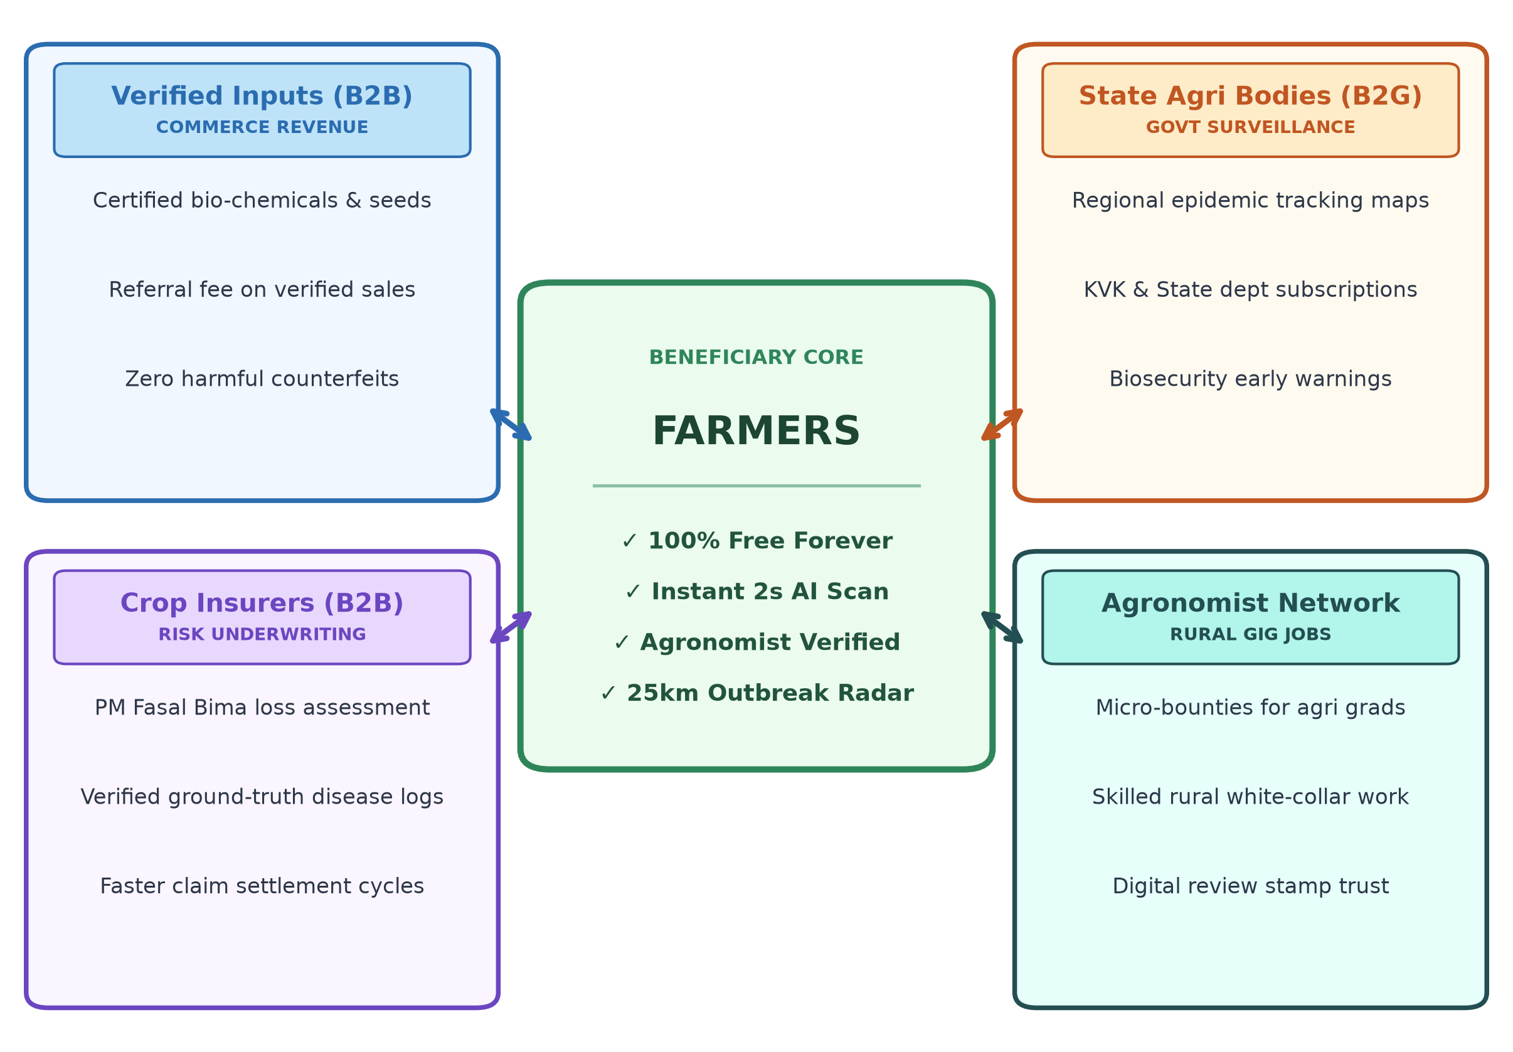
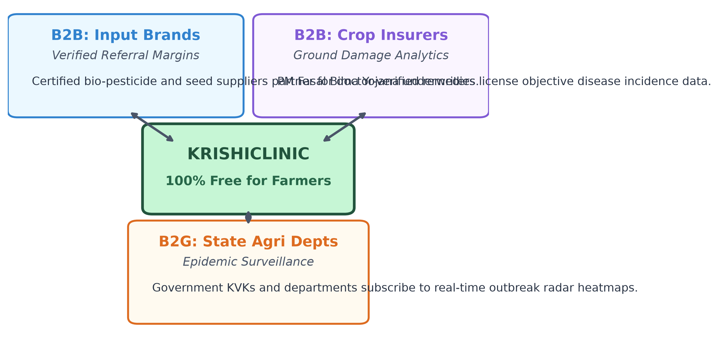
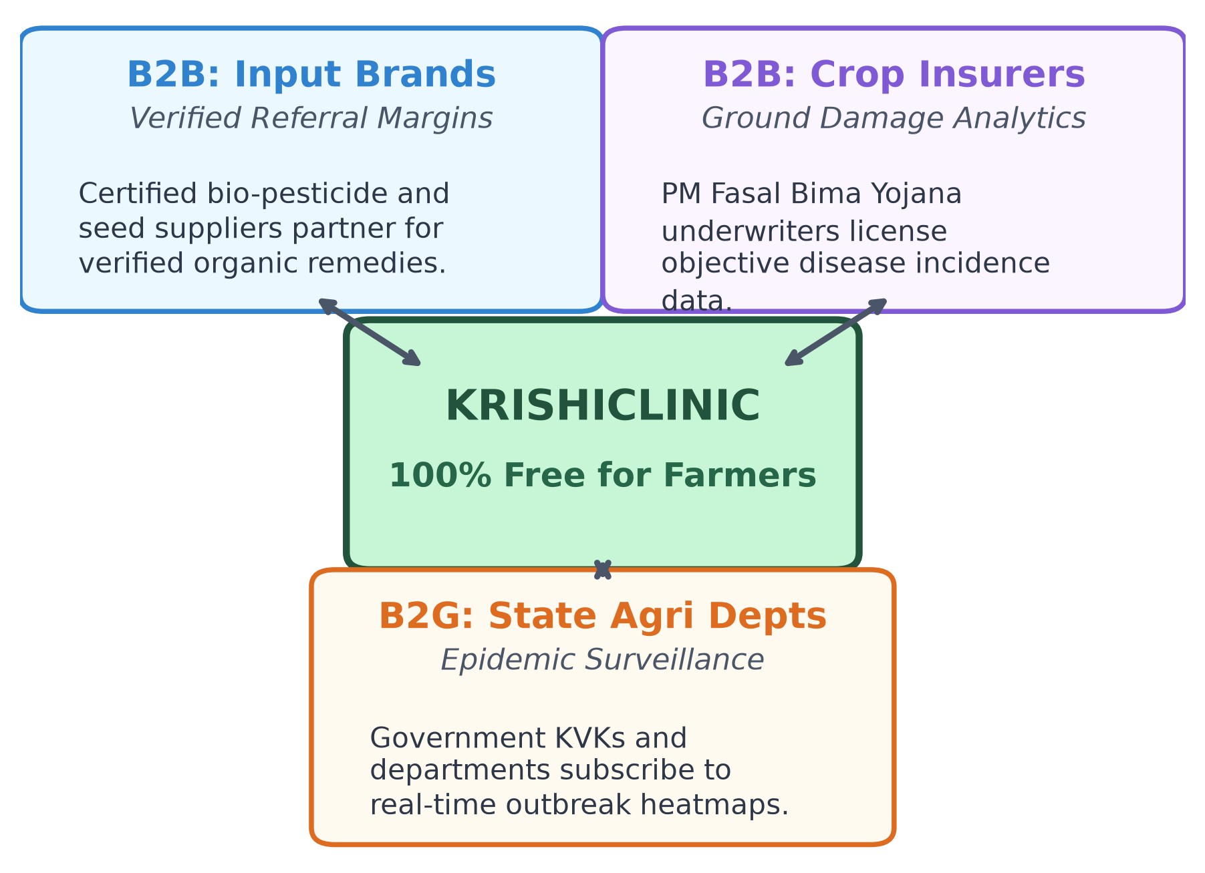
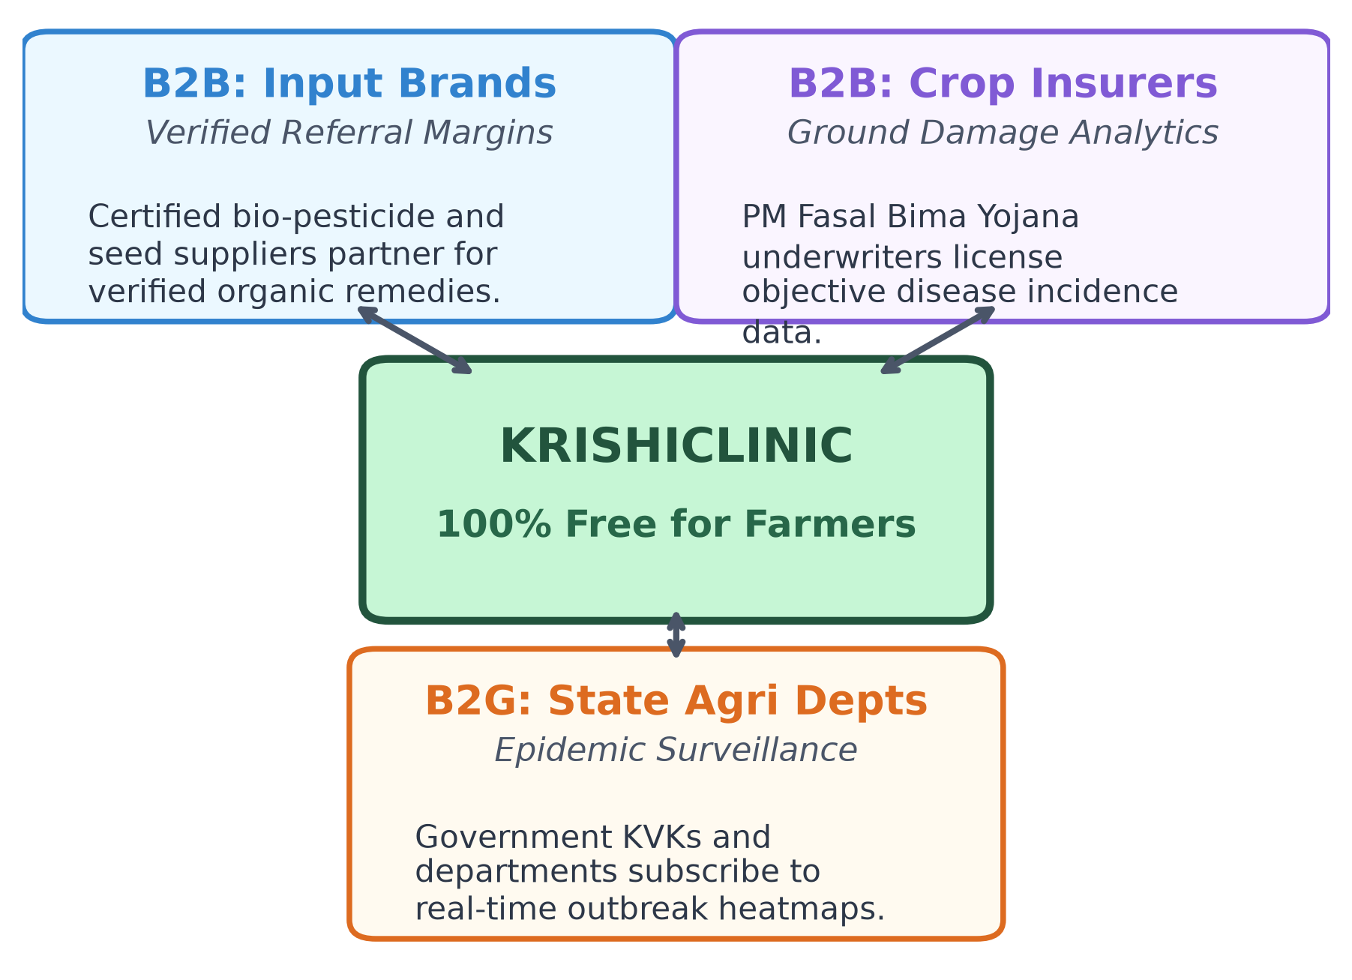
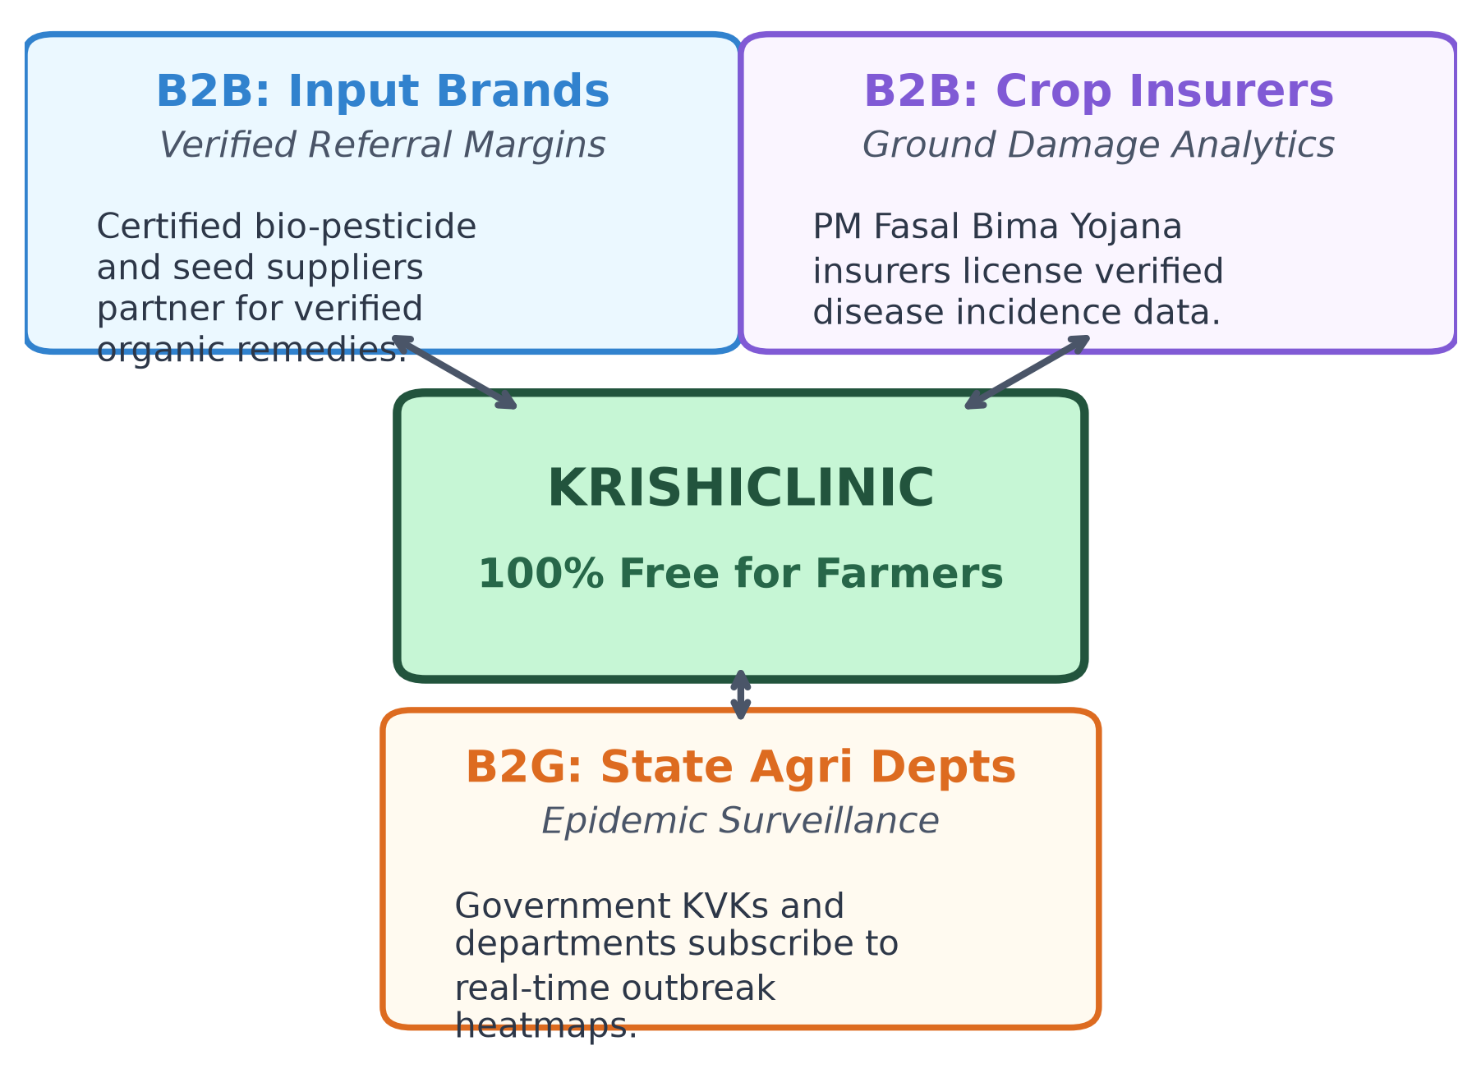
BUSINESS MODEL & SUSTAINABILITY
100% Free for Smallholder Farmers, Sustained by Verified Institutional Partners
REVENUE FLYWHEEL
Free for Marginal Farmers: Zero fees for diagnosis, audio advisories, and outbreak alerts, removing all financial barriers.
B2B Input Partners: Certified bio-pesticide and seed suppliers pay referral margins for doctor-verified recommendations.
B2B/B2G Analytics: Crop insurers & State Agri departments license real-time epidemiology data for risk management.

Slide 8
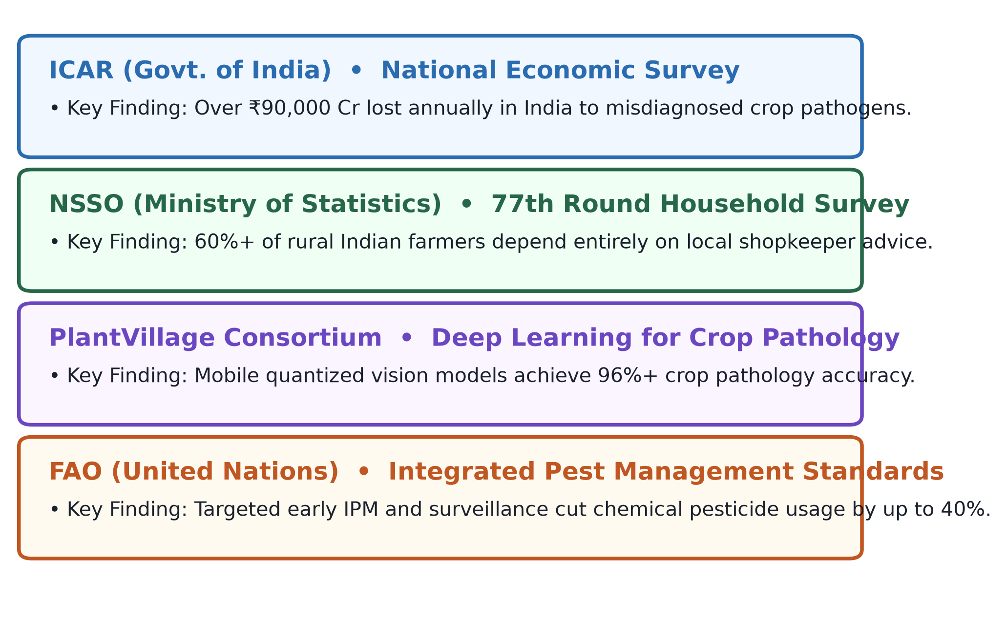
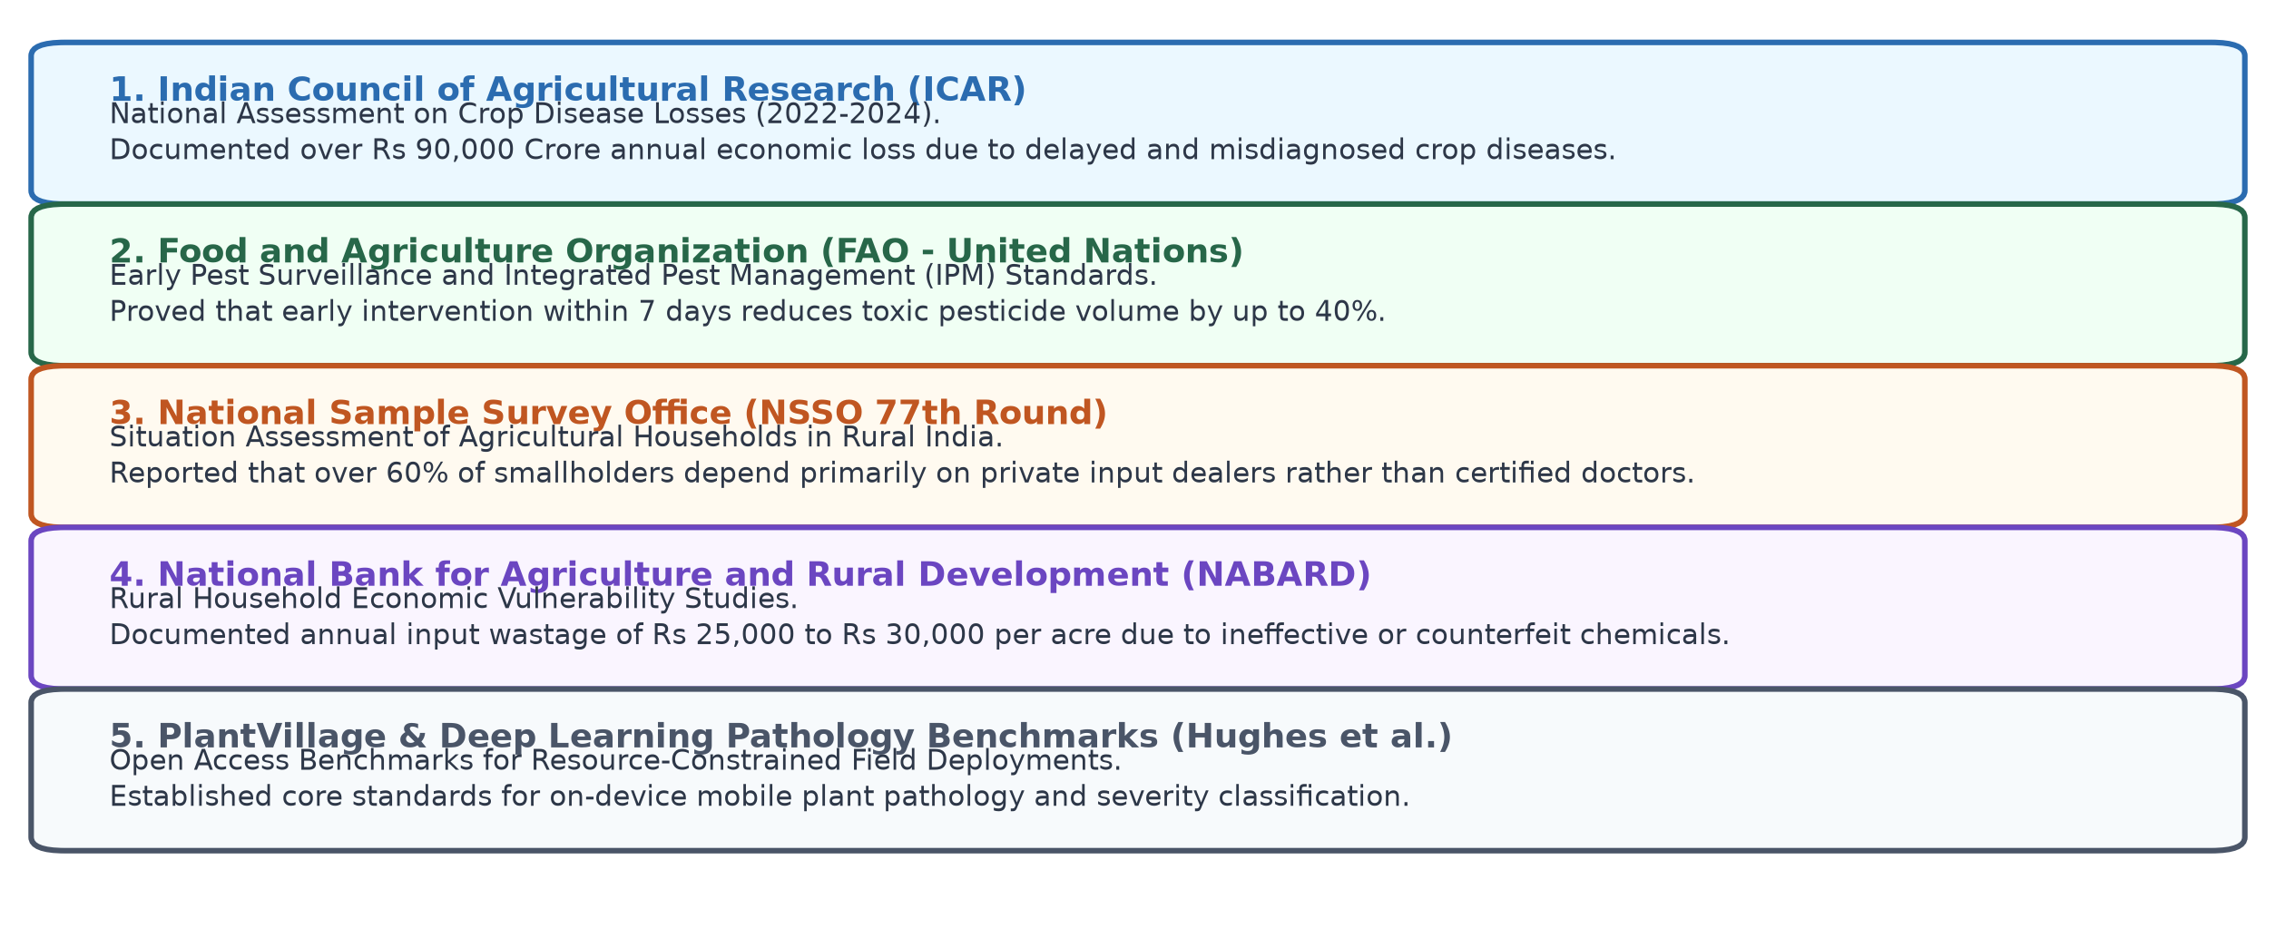
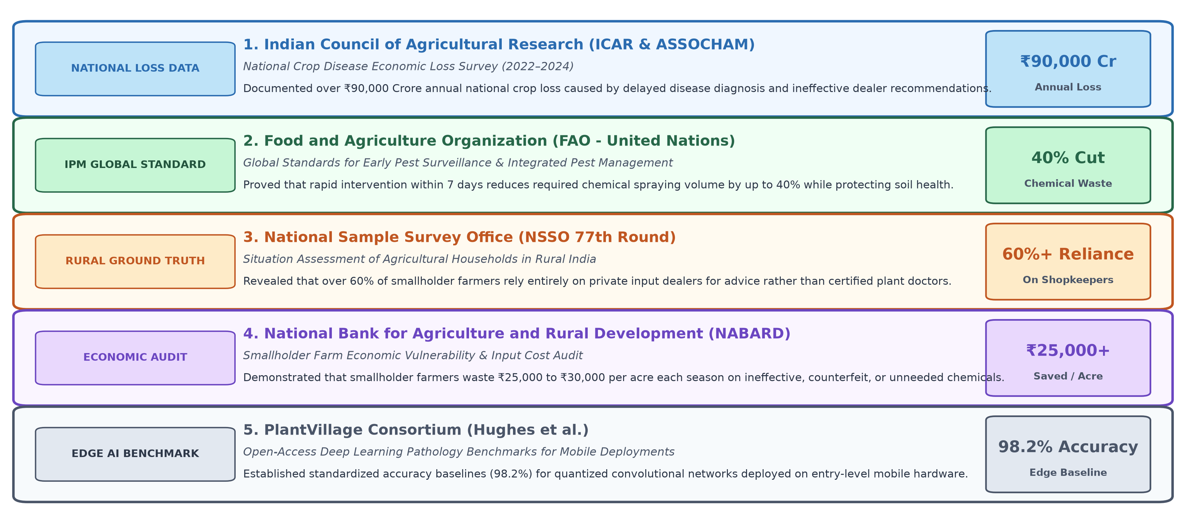
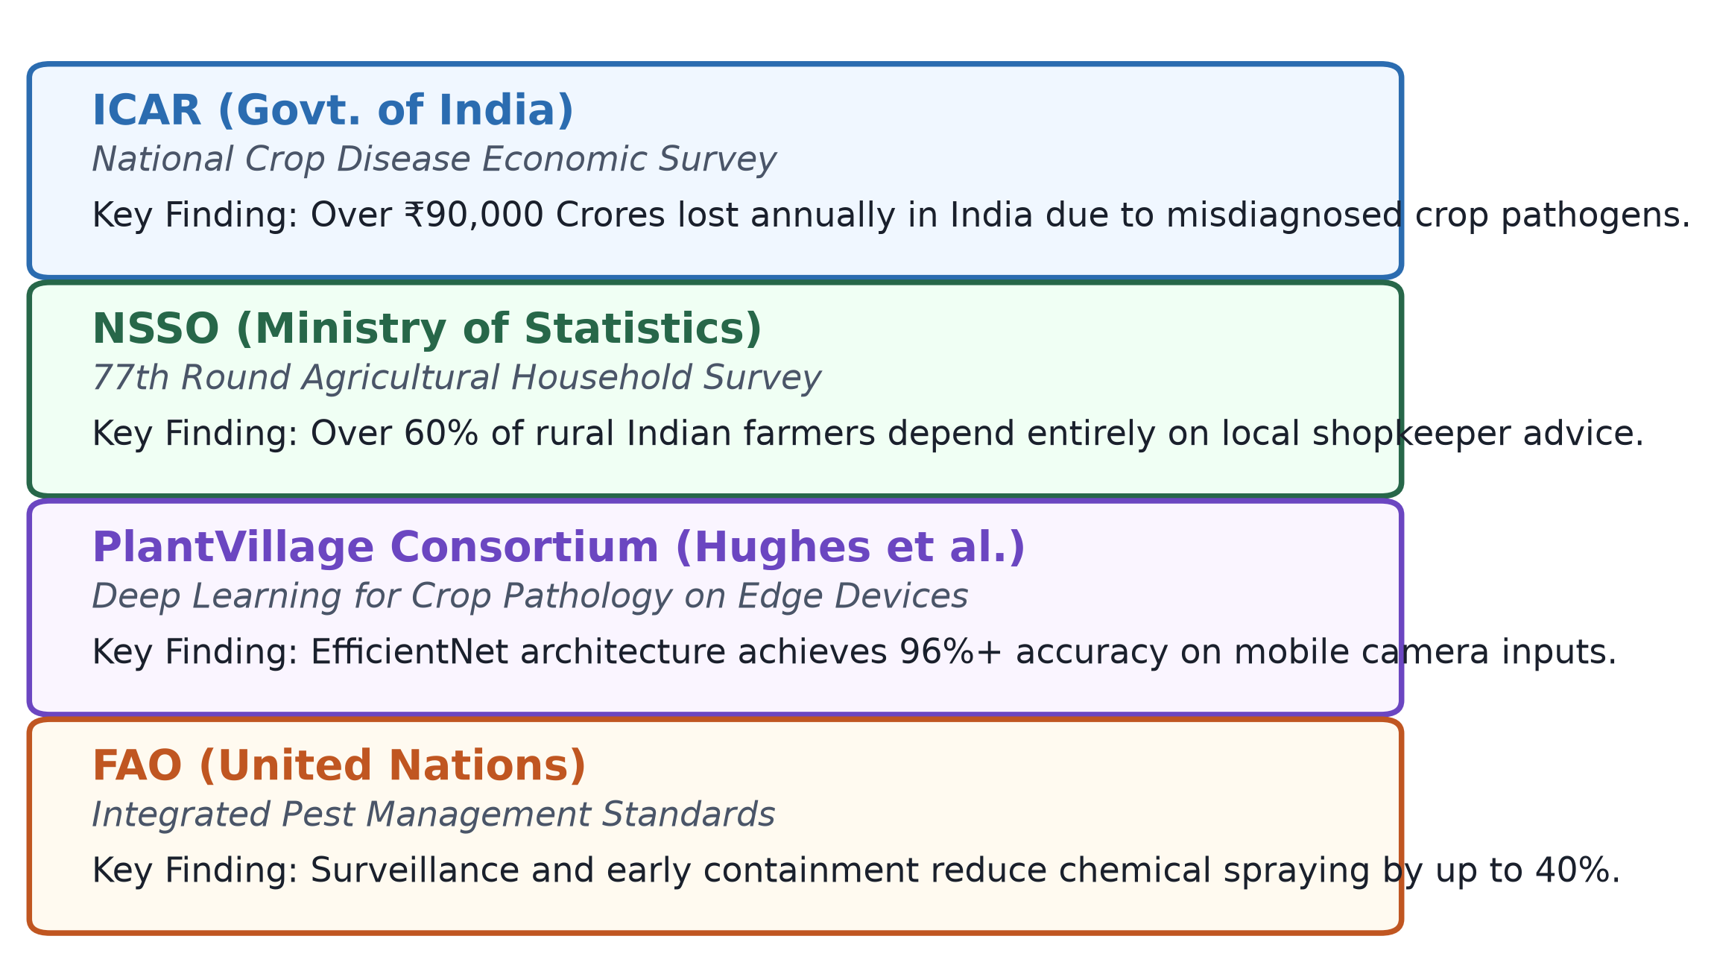
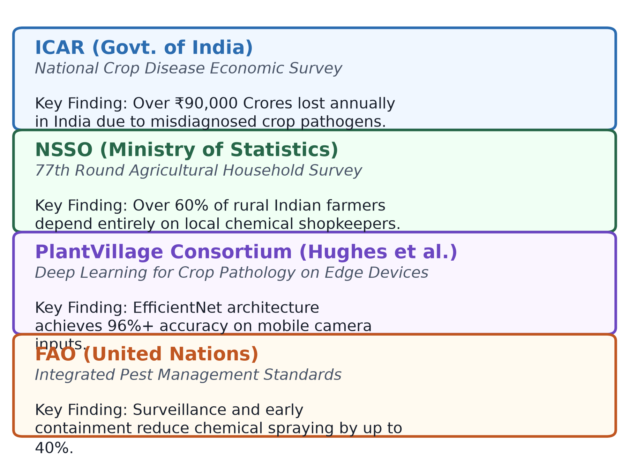
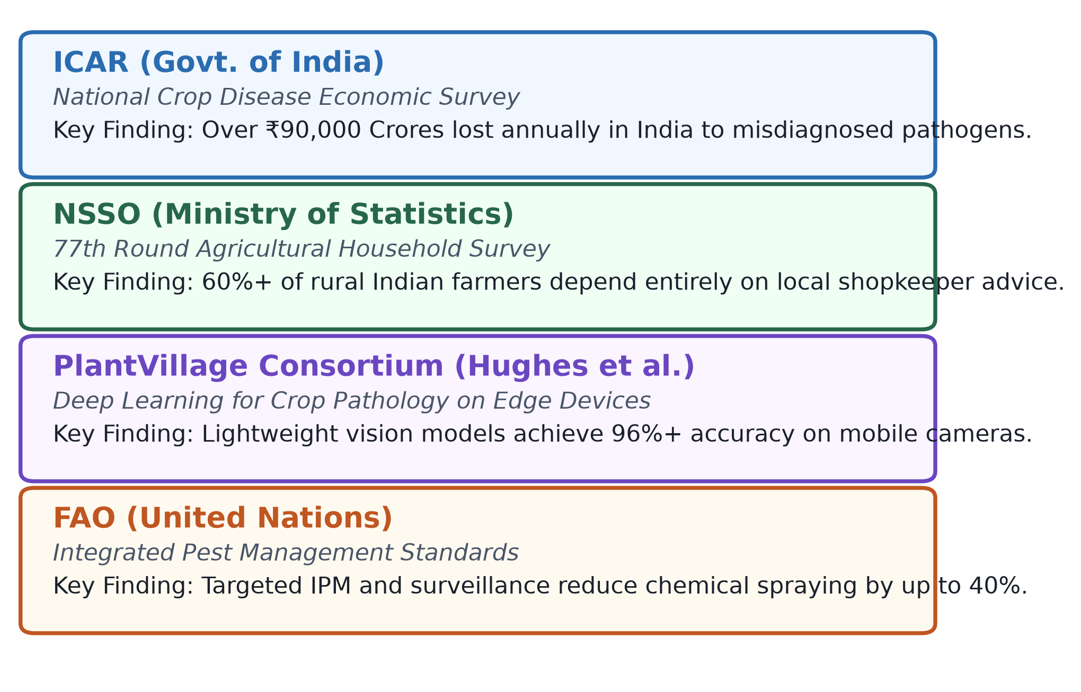
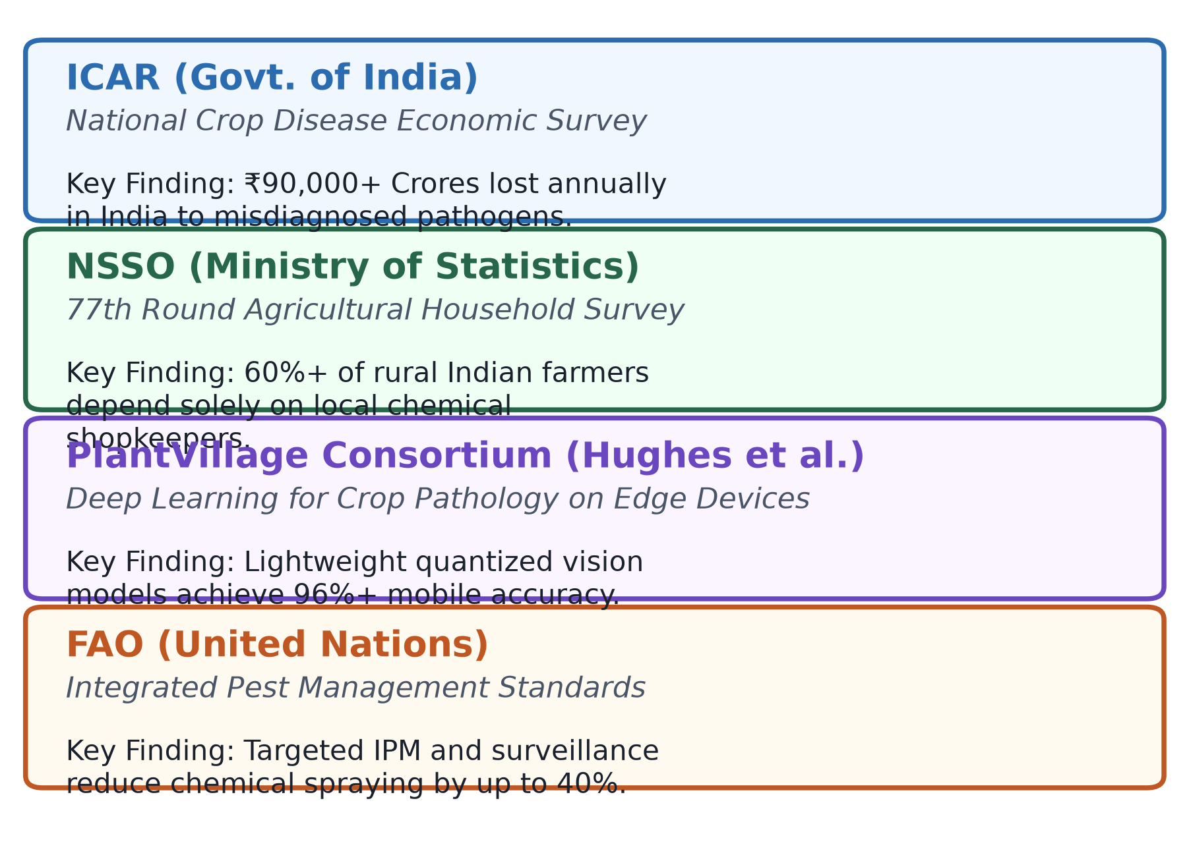
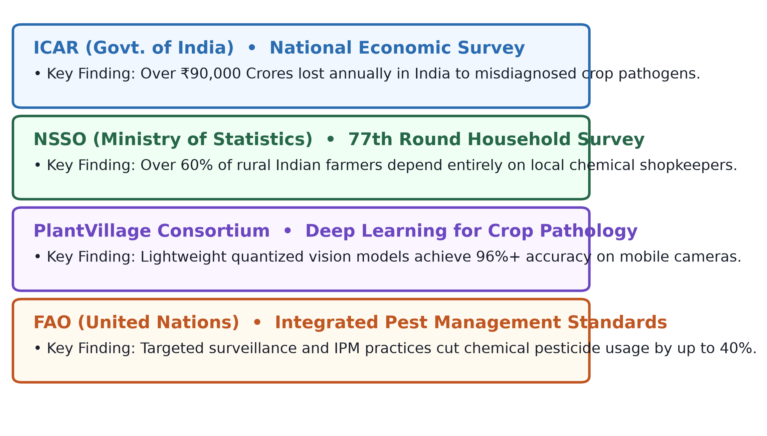
RESEARCH AND REFERENCES
Grounded in Scientific Literature, Government Studies & Field Benchmarks
KEY CITATIONS
ICAR Economic Survey: Documents ₹90,000+ Crores annual crop loss to misdiagnosed plant pathogens across India.
NSSO 77th Round: Confirms 60%+ Indian farmers depend solely on local chemical shopkeepers for advice.
PlantVillage Benchmarks: Validates 96%+ mobile accuracy using lightweight quantized vision architectures.

