Slide 2
Raw data available to analysts is so they can perform self­service analytics.
The self­ service trend continues with data preparation tools that help analysts shape the data for analytics, and catalog tools that help analysts find the data that they need and data science tools that help perform advanced analytics.
big challenge with self-service is governance and data security
it is illegal to give analysts access to all data.
The question becomes, how do we make data available to the analysts without violating internal and external data compliance regulations? This is sometimes called data democratization

Slide 3
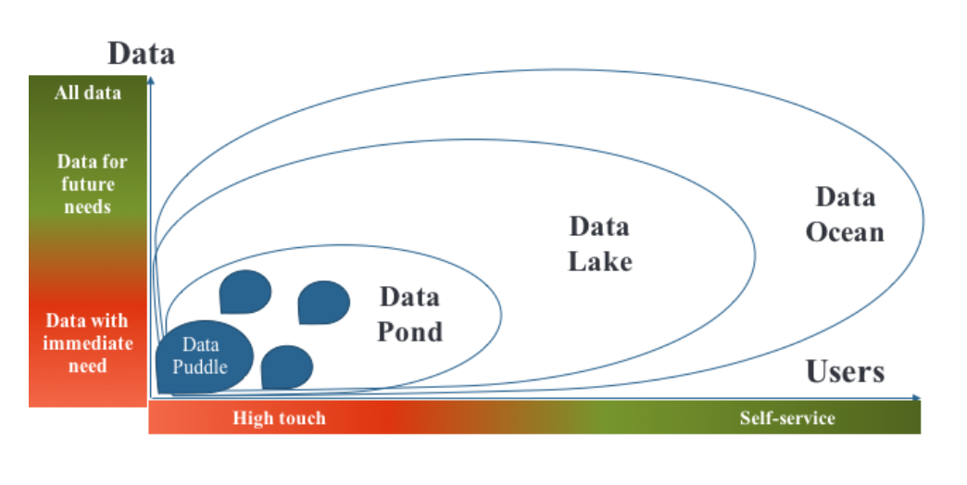
Data Lake Maturity
Four stages of Data Lake Maturity

Slide 4
Raw data available to analysts is so they can perform self­service analytics.
The self­ service trend continues with data preparation tools that help analysts shape the data for analytics, and catalog tools that help analysts find the data that they need and data science tools that help perform advanced analytics.
big challenge with self-service is governance and data security
it is illegal to give analysts access to all data.
The question becomes, how do we make data available to the analysts without violating internal and external data compliance regulations? This is sometimes called data democratization

Slide 5
Creating a Successful Data Lake
So what does it take to have a successful data lake? As with any project, aligning it with the company’s business strategy and having executive sponsorship and broad buy­in are a must. In addition, based on discussions with dozens of companies deploying data lakes with varying levels of success, three key prerequisites can be identified:
The right platform
The right data
The right interfaces

Slide 6
The Right Interface
Once we have the right platform and we’ve loaded the data, we get to the more difficult aspects of the data lake, where most companies fail—choosing the right interface. To gain wide adoption and reap the benefits of helping business users make data­driven decisions, the solutions companies provide must be self­service, so their users can find, understand, and use the data without needing help from IT. IT will simply not be able to scale to support such a large user community and such a large variety of data.
There are two aspects to enabling self­service: providing data at the right level of expertise for the users, and ensuring the users are able to find the right data.

Slide 7
PROVIDING DATA AT THE RIGHT LEVEL OF EXPERTISE
To get broad adoption for the data lake, we want everyone from data scientists to business analysts to use it. However, when considering such divergent audiences with different needs and skill levels, we have to be careful to make the right data available to the right user populations.

Slide 8
The Data Swamp
While data lakes always start out with good intentions, sometimes they take a wrong turn and end up as data swamps. A data swamp is a data pond that has grown to the size of a data lake but failed to attract a wide analyst community, usually due to a lack of self­service and governance facilities.
When data lakes first came onto the scene, a lot of companies rushed out to buy Hadoop clusters and fill them with raw data, without a clear understanding of how it would be utilized. This led the creation of massive data swamps with millions of files containing petabytes of data and no way to make sense of that data.

Slide 9
Roadmap to Data Lake Success
Now that we know what it takes for a data lake to be successful and what pitfalls to look out for, how do we go about building one? Usually, companies follow this process:
Stand up the infrastructure (get the Hadoop cluster up and running).
Organize the data lake (create zones for use by various user communities and ingest the data).
Set the data lake up for self­service (create a catalog of data assets, set up permissions, and provide tools for the analysts to use).
Open the data lake up to the users.

Slide 10
ACCESSING AND PROVISIONING THE DATA
A more practical approach is to publish information about all the data sets in a metadata catalog, so analysts can find useful data sets and then request access as needed. The requests usually include the justification for access, the project that requires the data, and the duration of access required. These requests are routed to the data stewards for the requested data. If they approve access, it is granted for a period of time. This period may be extended, but it is not indefinite, eliminating the legacy access problem. An incoming request may also trigger the work to deideintify sensitive data, but now it is done only if and when needed.

Slide 11
Provisioning or physical access can be granted to the data in a number of ways:
Users can be granted read access to the entire data set.

Slide 12
Logical Data Lakes
Once enterprises realized that having one centralized data lake wasn’t a good solution, the idea of the logical data lake took hold. With this approach, instead of loading all the data into the data lake just in case someone may eventually need it, it is made available to analysts through a central catalog or through data virtualization software.
Logical data lakes address the issues of completeness and redundancy, as illustrated in 2.

Slide 13
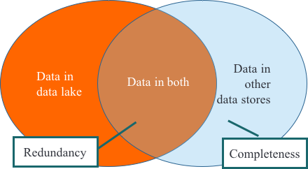
Logical data lakes address the issues of completeness and redundancy, as illustrated in Figure Completeness and redundancy issues Figure 1

Slide 14
These issues can be summarized as follows:
Completeness
How do analysts find the best data set? If the analysts can find only data that is already in the data lake, other data that has not been ingested into the data lake won’t be found or used (the crescent area on the right in Figure.
Redundancy
If we ingest all the data into the data lake, we will have redundancy between the sources of data and the data lake (illustrated as the area of overlap between the two circles in Figure 1­
2). With multiple data lakes, to achieve completeness we would need to ingest the same data into each data lake.

Slide 15
To solve the completeness problem, create a catalog of all the data assets, so the analysts can find and request any data set that is available in the enterprise.
To solve the redundancy problem, follow the process shown in igure 1­13:
Store data that is not stored anywhere else in the data lake.
Bring data that is stored in other systems into the data lake if and when it is needed, and keep it in sync while it is needed.
Bring each data set in only once for all users.

Slide 16
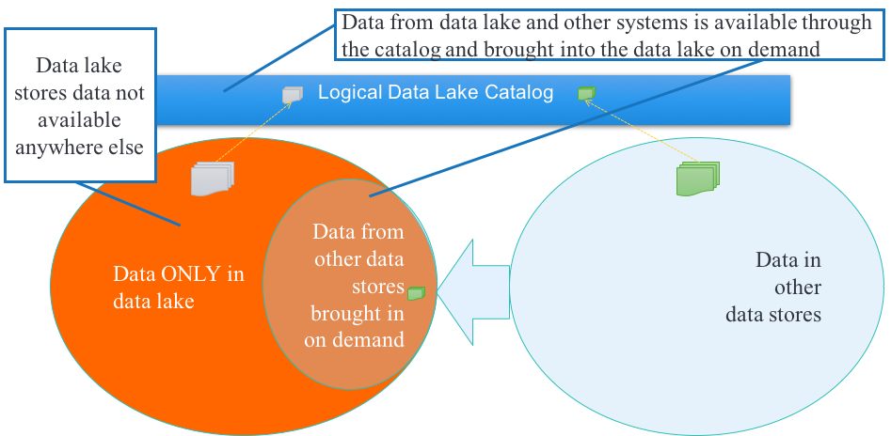

Slide 17
VIRTUALIZATION VERSUS A CATALOG-BASED LOGICAL DATA LAKE
Virtualization (sometimes also called federation or EII, for enterprise information integration) is a technology developed in 1980s and improved through several generations into the 2010s. It

Slide 18
Current Problem
Basically creates a virtual view or table that hides the location and implementation of the physical tables. In Figure, a view is created by joining two tables from different databases. The query would then query that view and leave it up to the data virtualization system to figure out how to access and join the data in the two databases.

Slide 19
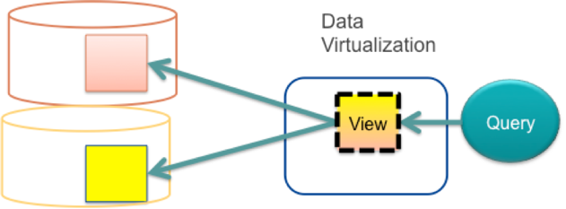

Slide 20
Although this technology works well for some use cases, in a logical data lake, to achieve completeness, it would require every data set to be published as a virtual table and kept up to date as underlying table schemas change.

Slide 21
Even if the initial problem of publishing every data asset were solved, views still present significant problems:
Creating a virtual view does not make data any easier to find.
Joining data from multiple heterogeneous systems is complex and compute­intensive, often causing massive loads on the systems and long execution cycles. These so­ called distributed joins of tables that don’t fit into memory are notoriously ere source intensive.

Slide 22
Catalog­ driven approach
Only metadata about each data set is published, in order to make it findable. Data sets are then provisioned to the same system (e.g., Hadoop cluster) to be processed locally, as demonstrated in Figure

Slide 23
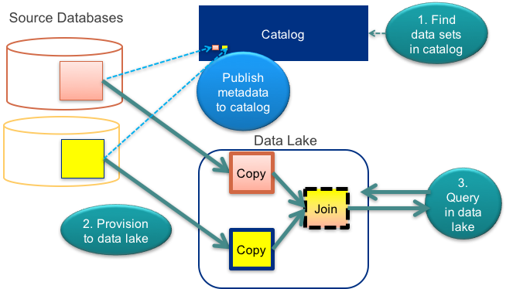

Slide 24
In addition to making all the data findable and accessible to analysts, an enterprise catalog can serve as a single point of access, governance, and auditing, as shown in igure
On the top, without a centralized catalog, access to data assets is all over the place and difficult to manage and track. On the bottom, with the centralized catalog, all requests for access go through the catalog. Access is granted on demand for a specific period of time and is audited by the system.

Slide 25
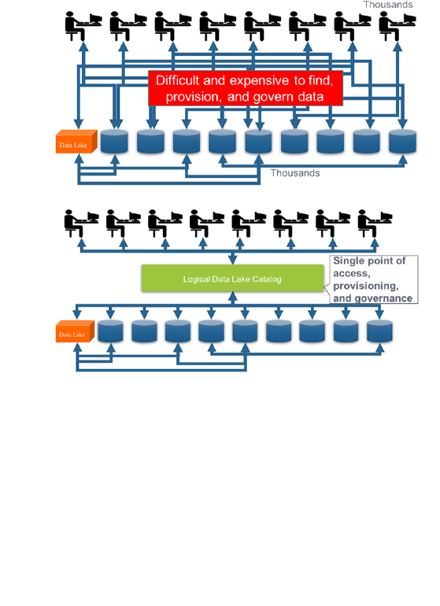

Slide 26
Next, because data warehouses typically contain data from many sources and applications, each with its own schema, data from these sources has to be normalized to convert it to a single schema.
A popular data model used by data warehouses is the star schema

Slide 27
Figure illustrates a typical partitioning schema used for daily loads of transaction data. A transactions directory contains all the transactions. The files are organized by year (for instance, /transactions/Year=2016), inside a year by month (e.g., with /transactions/Year=2016/Month=3 containing all transactions for March 2016), and inside a month by day (with /transactions/Year=2016/Month=3/Day=2 containing all the transactions for March 2, 2016). Because Hadoop does a lot of parallel processing, to avoid contention for a single file, it generates multiple files in a /transactions/Year=2016/Month=3/Day=2 directory. These files are all concatenated to form a single file of transactions for that day.

Slide 28
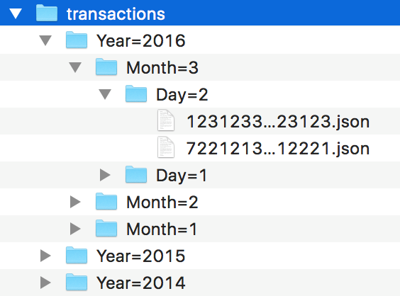

Slide 29
DENORMALIZING ATTRIBUTES TO PRESERVE STATE
Another option is to denormalize the data and add all the important attributes to the file containing the transaction data. For example, when we load transactions from operational systems, we add information about customer demographics, marital status, etc. at the time of the transaction. This avoids the need for expensive and complicated joins. To save space and processing, we can optimize by adding attributes only where state information is important—in other words, we can add only the fields for which we would provide slowly changing dimensions in a data warehouse.

Slide 30
The big drawback of this approach is that including these attributes in a data set with transaction data makes them available for use with the data in that particular data set, but not with other data. For example, we may have a separate data set for returns, a separate one for warranties, and so forth. To apply this technique, we would have to add all the customer attributes to each of these data sets, increasing storage and processing costs and adding complexity to our ingestion process. We would also have to remember to update all these data sets whenever we introduced a new customer attribute or made changes to the use of an existing attribute.

Slide 31
While catalogs are critical to enabling self­service for business analysts, they are challenging to build and maintain. This is because in most enterprises the knowledge about where data is, which data sets to use for what, and what data means is locked in people’s heads—this is commonly referred to as “tribal knowledge.”
The best practices for overcoming these challenges are: Crowdsourcing all tribal knowledge and making it available to everyone Automating annotation of data sets

Slide 32
The answer to this problem is automation. New tools effectively combine crowdsourcing and automation to do “automated data discovery”—the automated tagging and annotation of data sets based on the tags provided by SMEs and analysts. These tools leverage artificial intelligence (AI) and machine learning to identify and auto­tag elements in dark data sets, so analysts can find and use them. Waterline Data’s Smart Data Catalog and IBM’s Watson Data Catalog are good examples of this approach.

Slide 33
Establishing Trust
Once an analyst finds the pertinent data set, the next question becomes whether the data can be trusted. While analysts sometimes have the luxury of access to clean, trusted, curated data sets, more often than not they have to independently ascertain whether they can trust the data. Trust is usually based on three pillars:
Data quality—how complete and clean the data set is
Lineage (aka provenance)—where the data came from
Stewardship—who created the data set, and why

Slide 34
DATA QUALITY
Data quality is a wide and complex topic. In practice, quality can be defined as compliance of data to policies, which can range from simple (e.g., the customer name field should never be empty) to complex (e.g., sales tax must be correctly calculated based on purchase location). The most common data quality rules are:
Completeness The field is not empty.
Data type The field is of the correct type (for example, age is a number).
Range The field is in a specified range (for example, age is between 0 and 125).
Format
The field has a specific format (for example, a US postal code is composed of either five digits, nine digits, or five digits followed by a dash and four digits).

Slide 35
The most common way to check data quality is called data profiling.
Cardinality
The field has a specific number of unique values. (For example, if a US states field has more than 50 unique values, we know there is a problem. We may still not know whether every value is a legal state name, but if we already have every legal state name represented, checking the cardinality is enough of a sanity check to catch any illegal names because they will push the number of values above 50.)
Selectivity
The values for the field are unique (for example, customer IDs should be unique in a customer list).
Referential integrity
The values for the field are in the reference value set. (For example, all the customer status codes are legal, and each customer ID in the order list refers to one of the customers in the customer list. While for some values, like states, we may get away with a cardinality check, customer status codes may have significant implications for how we treat the customer, what we charge, and so on, so when making sure each customer has a legitimate status code it’s important to check every value.)

Slide 36
LINEAGE (PROVENANCE)
While data quality checks tell the analysts how good the data is, lineage tells them where the data came from.
In some industries, such as financial services, lineage is required as part of regulatory compliance. For example, the Basel Committee on Banking Supervision’s rule 239 requires that financial services companies demonstrate to auditors the lineage of the data used for financial reporting. So, if data in the gold zone is used for financial reporting, it is imperative to document its lineage and keep it up to date.

Slide 37
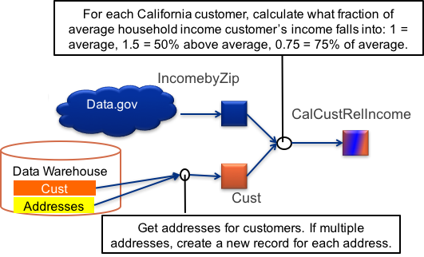
Business­level lineage

Slide 38
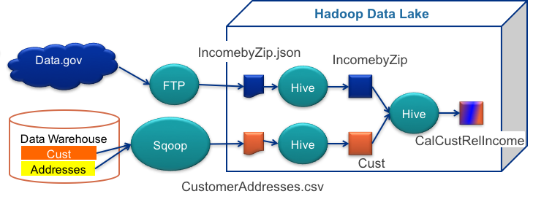
Data set–level technical lineage

Slide 39
STEWARDSHIP
There is a strong social aspect to trust. Analysts rely on word of mouth to find trusted SMEs. Just as some bloggers, YouTubers, and industry experts stand out by developing credibility and a large following, some users’ annotations and curation in a modern data lake may be more credible than others. These trusted users may have organizational responsibility for the data, they may be official data stewards, or they may be widely recognized and respected experts. Even in organizations with a mature governance structure and officially designated data stewards, some data stewards may be more knowledgeable than others, and sometimes analysts can have better insight and knowledge—especially about data sets they’ve created or use all the time—than the official data stewards. To address the distributed and unofficial nature of expertise, some enterprises are turning to paradigms used by consumer websites such as TripAdvisor and Yelp to identify credible reviewers by allowing users to rate whether they found the information helpful and accurate.

Slide 40
Provisioning
Once the right data set is identified, the analyst needs to make it available for use, or “provision” it. Provisioning has two aspects: getting permission to use the data and getting physical access to the data.
Ideally, the analysts should be able to request access to the data they need. However, if they cannot find the data without having access to it, we have a catch­22.
The solution is a more agile approach to access control that some enterprises are beginning to adopt. They create metadata catalogs that allow the analysts to find any data set without having access to it. Once the right data sets have been identified, the analysts request access to them and nd the data steward or data owner decides whether to grant access, for how long, and for which portions of the data. Once the access period expires, the access can be automatically revoked or an extension requested.

Slide 41
There are many advantages to this approach:
No work has to be done detecting and protecting sensitive data inside a data set until someone requests this data set.
The analysts can find any data in the data lake, including the newly ingested data sets, without having access to it.
The data stewards and owners do not have to invest time in figuring out who should have access to what data unless there is an actual project requiring it.
Access requests can require justification, creating an audit trail of who is requesting what data sets and why.
Access may be granted to a portion of a data set and for a specific period of time.
It is always clear which data sets are in use, so data quality and governance efforts can be focused on those data sets. For example, ETL jobs can update only the data sets that are currently in use, and sensitive data deidentification and data quality rules may be applied just to those data sets.

Slide 42
Preparing Data for Analysis
While some data is usable as is, more often than not it requires some preparation. Preparation may be as simple as selecting the proper subset of data, or it may involve a complex cleansing and transformation process to get the data into the right form. The most common data preparation tool is Microsoft Excel. Unfortunately, Excel has significant limitations that make it impractical to use for working with large data lake files. Fortunately, new tools that scale better have been brought to market by newer companies like Alteryx, Datameer, Paxata, and Trifacta, as well as more established data integration vendors such as Informatica and Talend. Even some of the data visualization vendors, like Tableau and Qlik, are incorporating common data prep capabilities into their tools. Excel is evolving too—Microsoft is working on a Hadoop interface for Excel running in Azure.

Slide 43
Modern self­service analytics, and especially data science, are more agile and exploratory. Analysts can leverage more of the data that’s available in the data warehouse and often seek out the original or raw data to work with, so they can prepare it in the way that fits their specific needs and use cases.
This need to create “fit for purpose” data is impossible for IT to accommodate. Fortunately, a set of tools called data preparation or data wrangling tools have become popular that make it easy for analysts to convert raw data into a format suitable for analytics without needing deep technical skills. These data preparation tools present a visual spreadsheet­like interface for the analysts to work with. The following essay by Bertrand Cariou describes different use cases for data wrangling and describes how one of the modern data preparation tools, Trifacta, provides sophisticated machine learning interfaces that try to guess and automatically suggest operations based on the user’s data selections.

Slide 44
Architecting the Data Lake
In response to this speedup of data use, enterprises have started applying the concept of bimodal data governance, defined by artner as follows: “Bimodal is the practice of managing two separate but coherent styles of work: one focused on predictability; the other on exploration.” To support this bimodal approach, the data lake is usually divided into multiple zones with different degrees of governance. In this section we will cover best practices for organizing a data lake into zones, helping users understand the governance levels of data, and protecting sensitive data.

Slide 45
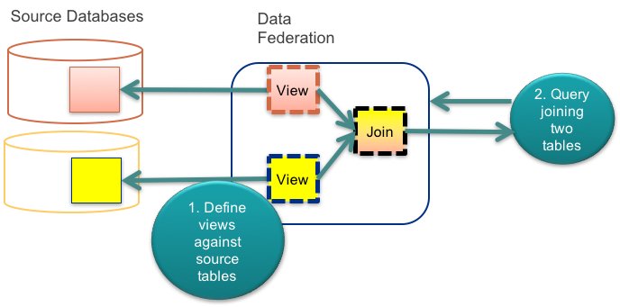
Virtual Data Lakes

Slide 46
Virtual Data Lakes
There are several significant challenges to applying this technology to data lakes. The biggest challenge is that you have to manually configure each virtual table and map it to the physical data sets, be they files or tables. In a data lake with millions of files loaded through frictionless ingestion, that’s simply not practical. Then there’s the traditional distributed join problem: combining or joining large data sets from different physical systems requires very sophisticated query optimization and lots of memory and compute power. Finally, you have the schema maintenance problem: when the schema changes, the virtual tables have to be updated as well. Since a schema is applied only when data is read (so­called “schema on read”), the users may not know that the schema has changed until their queries fail. And even then, it may not be clear whether the problem was caused by a schema change, a data problem, human error, or any combination of these.

Slide 47
Big Data Virtualization
Just as data lakes arose as a way to cope with the massive growth in volume and variety of data, big data virtualization applies the big data principles of schema on read, modularization, and future­proofing to create a new approach to data virtualization that can cope with the massive volume and variety of data in the enterprise. At the heart of the new approach is a virtual filesystem that represents physical data sources as virtual folders and physical data sets as virtual data sets. This approach mirrors how staging zones are organized in data lakes, as described earlier in this chapter. This virtualization allows the data to stay in its original data source, while being exposed to other business users.
Because such a virtual filesystem can be massive and potentially contain millions of data sets, a search mechanism is needed to find and navigate them. This role is usually played by a data catalog that presents all the data in the enterprise, including the data lakes. With this approach, only the metadata (information describing the data) is in the catalog, so the users can find the data sets they need quickly. Once a data set is found, it can be provisioned to give the user access either by copying it to the user’s project area or by giving the user permissions to access it in place.

Slide 49
Because both tables in igure 7­8 have been copied to the same physical system, the joins are local, much easier to implement, and faster to execute. Provisioning can involve an approval process where the user requests access for a period of time and specifies a business justification. The request is reviewed and approved by the data owners, and the data is then copied over. Finally, the copy of the data is kept up to date by ETL tools, customer scripts, or open source tools like Sqoop that connect to a relational database, execute a user­specified SQL query, and Create an HDFS file with the results of the query.
Because the catalog is the main interface for finding and provisioning data in the data lake, it enables a very elegant solution to building a virtual data lake. When users look for a data set, it really does not matter to them where it is physically located—it looks the same and can be found exactly the same way. An intelligent provisioning system can be provided so if the user wants to use a data set in a tool, it may be provisioned in place (i.e., opened directly in the tool), while if it needs to be joined with other data sets or modified, it can be transparently copied over to the physical data lake and made accessible there.

