Slide 1


STARBURST
The Enterprise Presto Company
Presto: SQL-on-Anything
Ashish Jha

Slide 2
STARBURST
Talk Agenda
➔ What is Presto?
➔ Why Presto?
➔ Presto Demo?

Slide 3





STARBURST
What is Presto?
➔ 100% open source distributed ANSI SQL engine for Big Data
Modern code base
Proven scalability
➔ Key Differentiators:
Performance & Scale
Cross platform query capability, not only SQL on Hadoop
➔ Optimized for low latency, Interactive querying
Cross platform query capability, not only SQL on Hadoop

Slide 4
Presto is not a database!
STARBURST
Presto is a query execution engine (storage independent)
Pluggable custom user functionalities
Connectors
Functions
Types
System access controllers
Resource group configuration managers
Event listeners
– …
Built-in core functionalities:
parser, execution, types, sql functions, monitoring

Slide 5
Presto in Production
STARBURST
Facebook
Multiple production clusters (100s of nodes total)
- 300PB in HDFS, sharded MySQL, SSD-based Raptor
1000s of internal daily active users
10s-100s of concurrent queries
Netflix
250+ node on EC2, 40+ PB in S3 (Parquet format)
Over 650 active users and 6K+ queries daily
Twitter
200+ nodes on-premises over Parquet nested data
Uber
200+ nodes (2 dedicated clusters) with 25K+ & 3K+ queries daily
FINRA
120+ nodes in AWS, 2PB is S3, 200+ users (supported by Teradata)

Slide 6
STARBURST
Starburst in a nutshell
Starburst offer:
a production-ready distribution of Presto
professional enterprise support
custom development, services and training

Slide 7
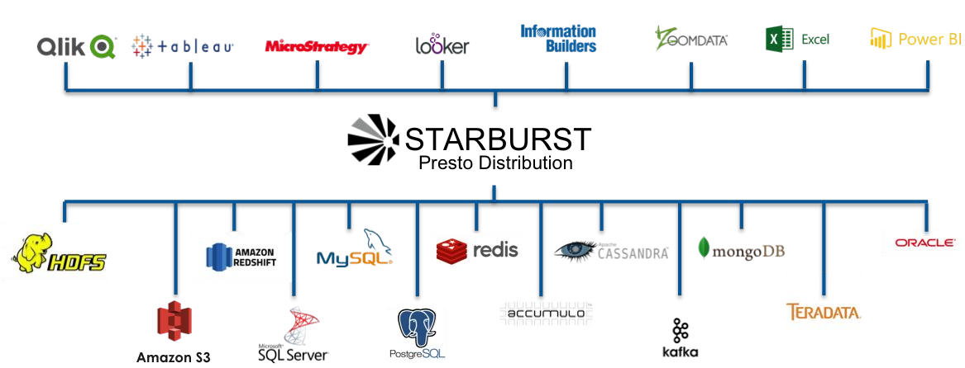
STARBURST
Presto is SQL-on-Anything.
Deploy Anywhere , Query Anything
Analyst Tools
Data Sources

Slide 8
STARBURST
Why Presto?
100% open source distributed ANSI SQL engine
Originally developed by Facebook
Introduced to Fortune 500 by Teradata
Commercialized by Starburst
Presto is SQL-on-Anything:
Deploy anywhere
Query anything

Slide 9
STARBURST
Presto Highlights
Community-driven open source project
No vendor lock-in
No Hadoop distro vendor lock-in
No storage engine vendor lock-in
No cloud vendor lock-in
Query data where it lives
No ETL or data integration necessary to get to insights
Proven scalability
High concurrency
Interactive ANSI SQL queries

Slide 10
STARBURST
Facebook - Data warehouse
Hive + HDFS + ORC
multiple clusters
Thousands of users, 300PB, 1000s nodes
PBs of data scanned, O(100k) queries every day
100s of concurrent queries

Slide 11

STARBURST
Ingest
Storage
Compute
Visualisation
Spark
Events
Superset
Hive
Azure/ MapR DW
Cassandra
Tableau/Power BI
Netezza

Slide 12
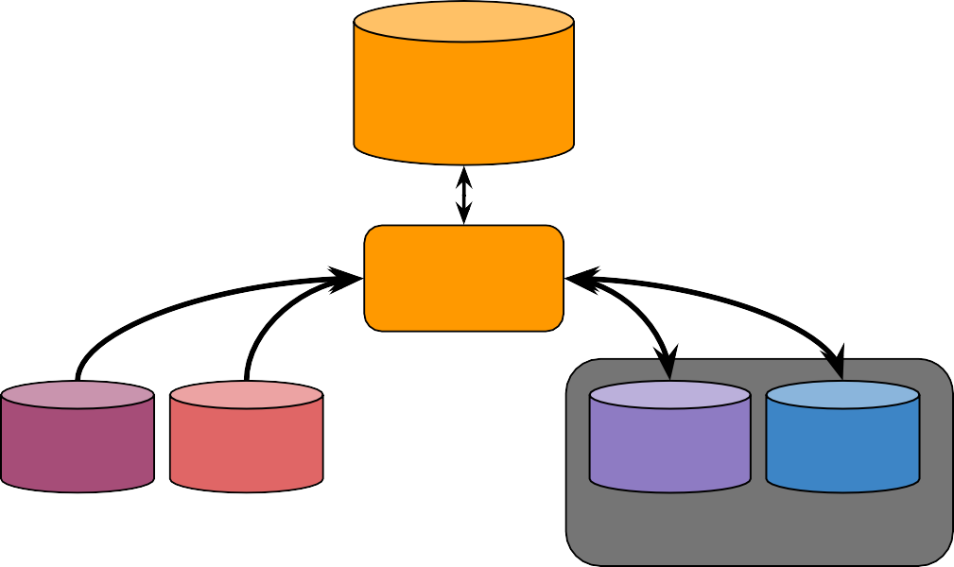
STARBURST
OptumRx DWH
MapR DWH
Logical
Data Warehouse
MapR DWH
Copy & Load
Presto
ETL
Netezza (RDBs)
Data Lake (Hadoop)
RDBs NoSQL
Operational
Hadoop Azure
Data Lake

Slide 13





STARBURST
Coordinator
Architecture
Metadata
Data location
Parser/
analyzer
Client
Planner
Scheduler
Worker
Worker
Data I/O
Worker
Data I/O

Slide 14









Query Execution
STARBURST
Coordinator
Pluggable
Metadata API
Data Location
API
Parser/
analyzer
Client
Planner
Scheduler
Worker
Worker
Data stream API
Worker
Data stream API

Slide 15
Query Execution
STARBURST
Coordinator
Pluggable
Metadata API
Data Location
API
Parser/
analyzer
Client
Planner
Scheduler
Worker
Worker
Data stream API
Worker
Data stream API

Slide 16
Query Execution
STARBURST
Coordinator
Pluggable
Metadata API
Data Location
API
Parser/
analyzer
Client
Planner
Scheduler
Worker
Worker
Data stream API
Worker
Data stream API

Slide 17
Query Execution
STARBURST
Coordinator
Pluggable
Metadata API
Data Location
API
Parser/
analyzer
Client
Planner
Scheduler
Worker
Worker
Data stream API
Worker
Data stream API

Slide 18

Query Execution
STARBURST
Coordinator
Pluggable
Metadata API
Data Location
API
Parser/
analyzer
Client
Planner
Scheduler
Worker
Worker
Data stream API
Worker
Data stream API

Slide 19
Query Execution
STARBURST
Coordinator
Pluggable
page 1
Page 2
Metadata API
blockA
blockA
blockB
blockB
Parser/
analyzer
Client
Planner
Worker
Worker
Data stream API
Worker
Data stream API

Slide 20
STARBURST
Coordinator
Metadata API
Parser/
analyzer
Pluggable
Architecture
Data location API
Client
Planner
Scheduler
Worker
Worker
Data stream API
Worker
Data stream API

Slide 21
STARBURST
Presto Extensibility – plugins
Plugins
connectors - data+metadata
user defined functions
event listeners
authentication and authorization

Slide 22
Presto Extensibility – connector interfaces
STARBURST
Coordinator
Worker
Cassandra
Cassandra
Cassandra
Hive
Kafka
MySQL
…
Kafka
MySQL
…
Kafka
MySQL
…
Hive
Hive
Metadata API
Data location API
Da
ta
stream API
Parser/ analyzer
Planner
Scheduler

Slide 23
STARBURST
Hardware agnostic
Infrastructure agnostic
on premise (appliance or commodity clusters)
VM (OpenStack, etc.)
cloud (Amazon, Azure, etc)
pure EC2
EMR
AWS Athena (pay-as-you-go)
Docker image: https://hub.docker.com/r/starburstdata/presto/

Slide 24











Presto Connectors
STARBURST
Amazon S3

Slide 25
STARBURST
Connectors - Hive
Table metadata read from Hive catalog
Multiple filesystems
HDFS, S3
Supported file formats
ORC (optimized reader, optimized writer)
RCFile (optimized reader, optimized writer)
Parquet (optimized reader)
Avro
all other Hive formats

Slide 26
STARBURST
Connectors - Hive
Client
Presto
Coord
Hive Metastore
HDFS
NameNode
Presto Worker
Presto Worker
HDFS
DataNode
Hive metadata
HDFS Block locations HDFS data
Presto Worker
HDFS
DataNode

Slide 27
STARBURST
SQL support
ANSI SQL support
all standard data types
complex subqueries support (eg. correlated)
Structural types
map, array, row
JSON
Lambda expressions
SELECT transform(ARRAY['dog', 'whale'], x -> length(x))
[3, 5]
SELECT reduce(ARRAY[5, 20, 50], 0, (s, x) -> s + x, s -> s)
75

Slide 28
ANSI SQL Support
STARBURST
[ WITH with_query [, ...] ]
SELECT [ ALL | DISTINCT ] select_expr [, ...]
[ FROM table1 [[ INNER | OUTER ] JOIN table2 ON (…)]
[ WHERE condition ]
[ GROUP BY expression [, ...] ] [ HAVING condition]
[ UNION [ ALL | DISTINCT ] select ]
[ ORDER BY expression [ ASC | DESC ] [, ...] ] [ LIMIT [ count | ALL ] ]
In addition:
Windowing functions
UNNEST, TABLESAMPLE
ROLLUP, CUBE, GROUPING SETS
UNION, EXCEPT, INTERSECT
Subqueries (EXISTS, IN)

Slide 29
STARBURST
Presto = Performance
➔ Data stays in memory during execution and is pipelined across nodes MPP- style
➔ Vectorized columnar processing
➔ Presto is written in highly tuned Java
Efficient in-memory data structures
Very careful coding of inner loops
Bytecode generation
➔ Optimized ORC reader
➔ Predicates push-down
➔ Query optimizer

Slide 30








BI Tool Support
STARBURST

Slide 31
STARBURST
Security
User authentication (CLI/ODBC/JDBC)
Basic
Kerberos
LDAP
Pluggable user authorization schemes (access control)
Connector level authorization
E.g. grants information stored in Hive catalog
Support for kerberized HDFS/Hive metastore
SSL on the wire
client to Presto
between Presto nodes

Slide 32

STARBURST
Demo Time!

Slide 33
STARBURST
A Benchmark Test on Presto, Spark SQL and Hive for Medium Data

Slide 34
STARBURST
HIVE VS PRESTO
HIVE | PRESTO
Large data aggregations | Interactive queries (where you want to wait for the answer)
Large Fact-to-Fact joins | Quickly exploring the data (e.g. what types of records are found in the table)
Hive is great tool for variety of ETL jobs. Batch-processing nature makes it slow | Presto - faster due to architectural difference (in-memory)
Presto replaces Hive? No

Slide 35
STARBURST
Spark Sql VS PRESTO
Spark Sql | PRESTO
Spark is a fast query execution engine that can execute batch queries as well. It is supposed to be 10-100 times faster than Hive with MapReduce | Presto is a distributed SQL query engine for processing peta bytes of data and it runs on a cluster like set up with a set of machines.
Spark SQL gives flexibility in integration with other data sources using the data frames and JDBC connectors. | Presto allows data querying over many data sources; For example, Data might be residing in data stores: Hive, Cassandra, RDBMS, and some other proprietary data stores.

Slide 36
STARBURST
Spark Sql VS PRESTO
Spark Sql | PRESTO
Presto supports pluggable connectors. These connectors provide data sets for queries. Below are several pre-existing connectors available in presto, while Presto provides the ability to connect with custom connectors, as well. Below are some of the connectors it support Hadoop/Hive Cassandra Teradata PostgreSQL Oracle etc | A Data Frame interface allows different Data Sources to work on Spark SQL. Spark SQL includes a server mode with industry-standard JDBC and ODBC connectivity.

Slide 37
STARBURST
Spark Sql VS PRESTO
Spark Sql | PRESTO
Presto supports the Federated Queries. Presto can be configured to connect with different DBs and once configured; its CLI can be used to launch ‘Federated Queries’. In one Presto query user can combine data from multiple data sources and run the query. | Spark SQL comes with an inbuilt feature to connect with other databases using JDBC that is “JDBC to other Databases”, it aids in federation feature.
Presto is very helpful when it comes to BI-type queries, a | Spark SQL leads performance-wise in large analytics queries.

