Slide 1
Comic book characters
THE PRESENTATION COMIC SANS WAS MADE FOR

Slide 2
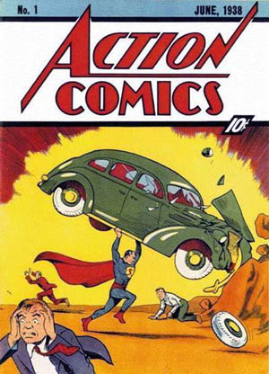
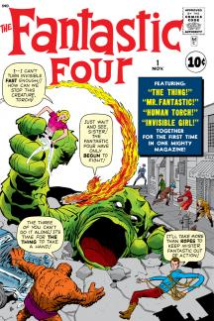
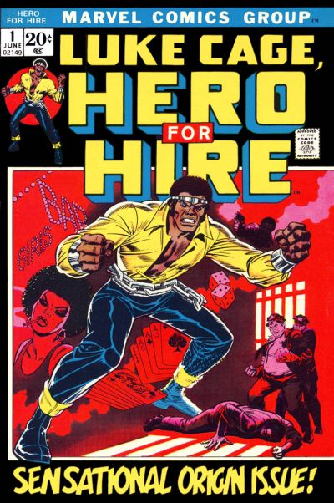

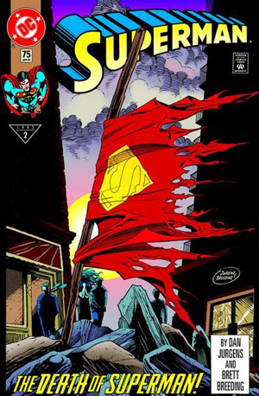
Comics through the ages
Golden Age (1938-1950)
WW II
Superman
Batman
Wonder Woman
Captain America
Silver Age (1950-1970)
CCA
Marvel established
Fantastic Four
Spider-man
Thor
Hulk
Iron Man
X-Men
Avengers
Underground Comix
Bronze Age (1970-1985)
Social Issues
Stories darker.
Gwen Stacey
Black / female protagonists
Luke Cage
Storm
Watchmen
Dark Knight Returns
Copper Age (1985-1992)
Increasing Realism
Glut
Colleges offer courses
Media consolidation
Modern Age (1992-present)
Death of Superman
Big budget movies & TV
Digital books

Slide 3
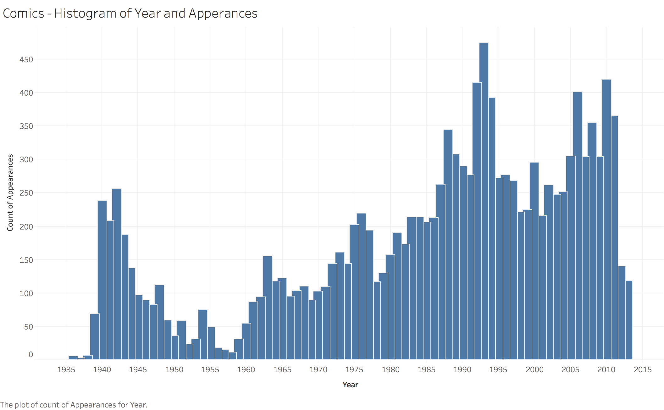
Character longevity

Slide 4
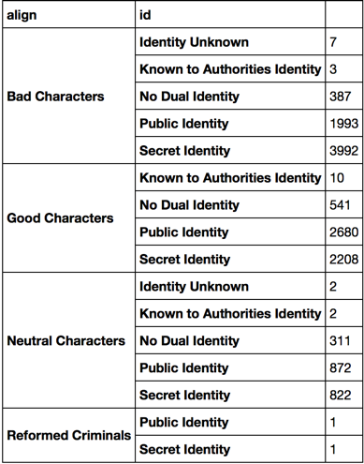
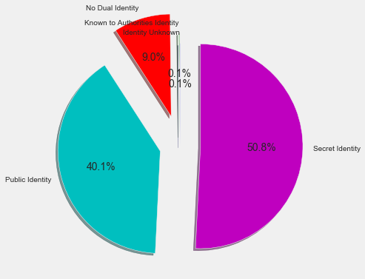
Masks
Good guys and neutral characters are 50/50 in having their identity known while bad guys are much more interested in anonymity.

Slide 5
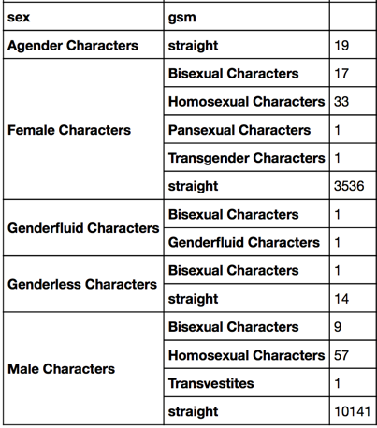
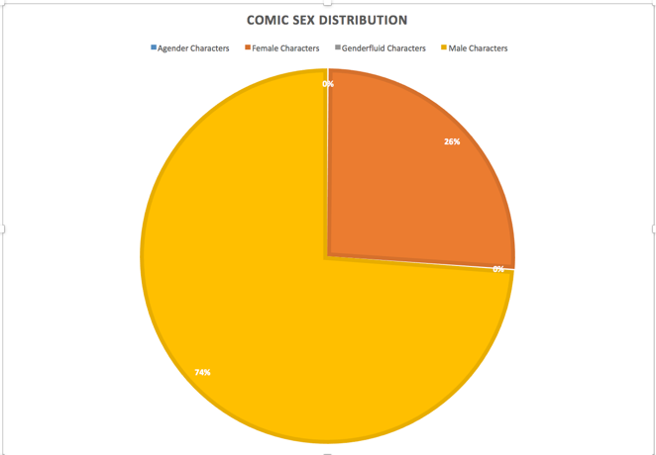
It’s a man’s world

Slide 6
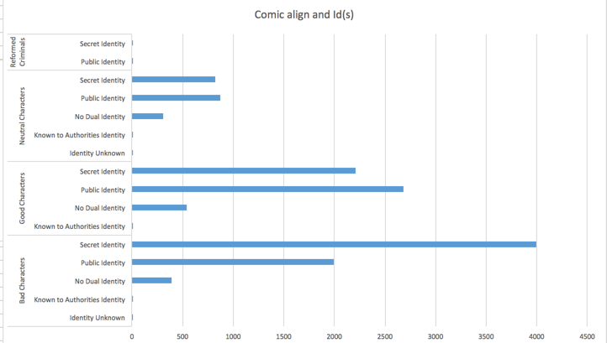
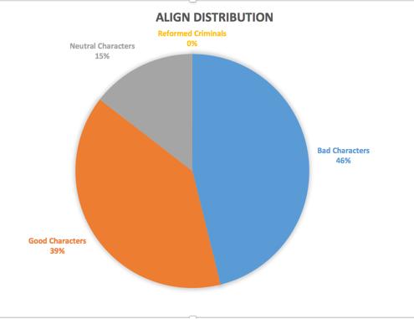
Born to be bad

Slide 7
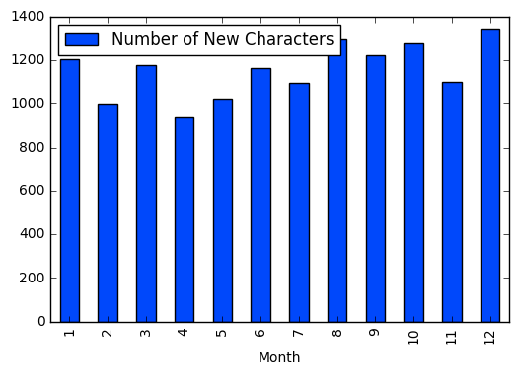
introductions

Slide 8
