Slide 1
Probability of Accelerated Approval
of Insurance Claims
By,
Debjani Palit

Slide 2
Goal of the Project:
During Unforeseen catastrophic events, people expect to get paid by the insurance companies as soon as possible
Claims department needs to check several things before accelerated approval
Machine Learning in Data Science can play an important role in making the process more automated

Slide 3
About the Data: The dataset is anonymized in order to protect the privacy. It has two parts:
Train set: A total of 133 columns and 114321 rows.Target, ID and 131 anonymized columns.
Test set: A total of 132 columns and 114393 rows. ID and 131 anonymized columns.
Float type | 108
Object type | 19
Integer type | 6

Slide 4
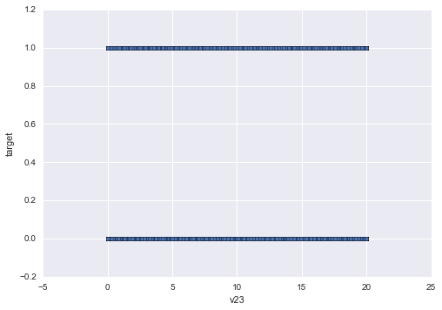
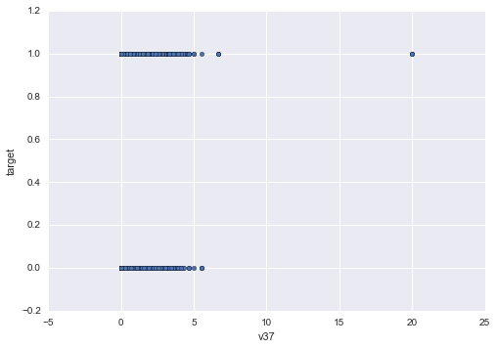
Train Set:
Target column is classified into 0 (no accelerated approval) and 1 (accelerate approval)

Slide 5
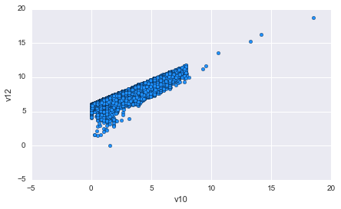
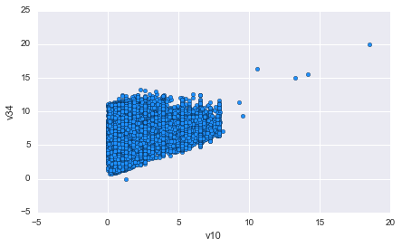
Plot between the columns:
Linear relation between columns v10 and v12; v10 and v34

Slide 6
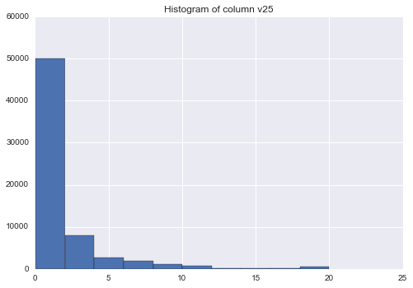
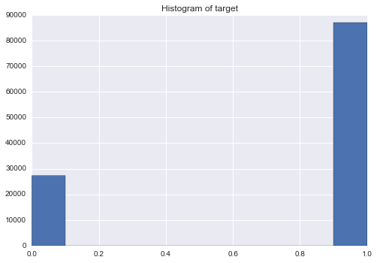
Histogram of the columns:
Most of the columns values are not normally distributed
The target column had 76% accelerated approvals

Slide 7
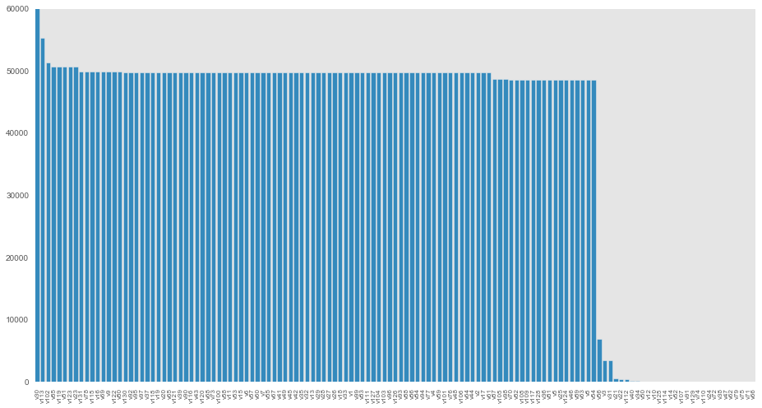
Grouping and Replacement of NaN:
The data had many NaN values. I have replaced the NaN with an unique integer w.r.t the data and have grouped the NaN values

Slide 8
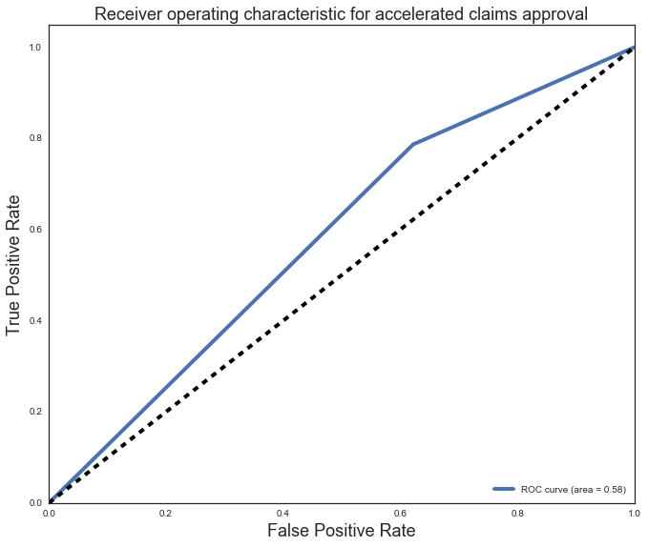
Decision Tree Classifier:
Mean Score of the Model | 0.68
log_loss | 10.7
Area Under the ROC curve | 0.58
Feature Importance | v50, v21, v22, v66, v125

Slide 9
Random Tree Classifier:
Bagging Decision Tree Classifier:
Mean Score of the Model | 0.74
log_loss | 0.98
Area Under the ROC curve | 0.68
Feature Importance | v50, v12, v10, v34, v114
Mean Score of the Model | 0.74
log_loss | 1.07
Area Under the ROC curve | 0.69
Precision, recall, F1 for 1 | 0.81, 0.87, 0.84

Slide 10
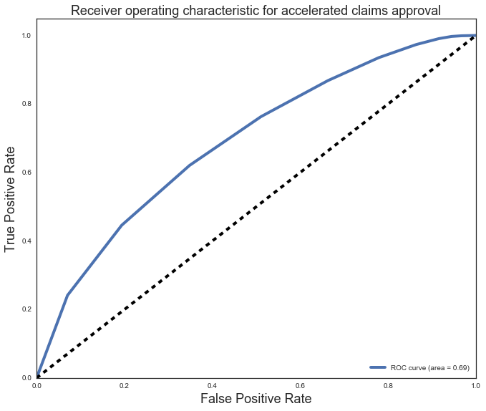
ROC for Bagging Decision Tree Classifier:

Slide 11
Extra Tree Classifier:
Parameters of the classifiers: ExtraTreesClassifier(bootstrap=False, class_weight=None, criterion='gini',max_depth=None, max_features='auto', max_leaf_nodes=None,min_samples_leaf=1, min_samples_split=2,min_weight_fraction_leaf=0.0, n_estimators=10, n_jobs=1,oob_score=False, random_state=None, verbose=0, warm_start=False)
Grid Search on Extra Tree Classifier:
Mean Score of the Model | 0.74
log_loss | 0.94
Area Under the ROC curve | 0.68
Feature Importance | 50, 12, 10, 114, 34
log_loss | 0.54
Area under the ROC curve | 0.58

Slide 12
Extra Tree Classifier with a few set of parameters:
n_estimators = 851, max_features = 60, criterion = 'entropy', min_samples_split = 4, max_depth = 40, min_samples_leaf = 2, n_jobs = -1
Mean Score of the model | 0.78
log_loss | 0.46
Area under the ROC curve | 0.76
Accuracy score | 0.78
Feature Importance | V50, v52, v12, v10, v125

Slide 13
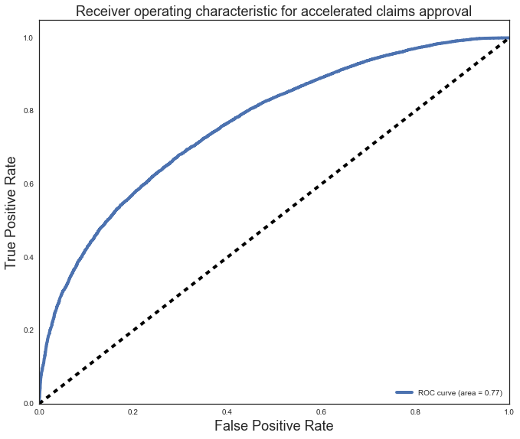
Classification Report
precision recall f1-score support 0 0.68 0.22 0.33 9073 1 0.80 0.97 0.87 28653 avg / total 0.77 0.79 0.74 37726

Slide 14
Dropping a few selective features sometimes improves the performance of the model
I have tried dropping a few selective features that had large number of NaN values, with low feature importance and average feature importance
No significant effect on model performance
Default Extra Tree Model
Extra Tree Model with said parameters

Slide 15
I have used the Extra Tree Classifier model with the above parameters to make probability predictions on the test set for accelerated claims approval
[[ 0.39717979 0.60282021] [ 0.14185272 0.85814728] [ 0.17557775 0.82442225] ..., [ 0.10340776 0.89659224] [ 0.16466902 0.83533098] [ 0.33029769 0.66970231]]

Slide 16
Discussion:
There is no fixed model that would perform equally well on every data set
In classification problem, performance of a model can be analyzed from the log_loss value and the ROC curve
In this project, depending upon the log_loss value and the ROC curve, using the Extra Tree Classifier model is recommended.

