Slide 1
Machine Learning:
TensorFlow
Bolous AbuJaber

Slide 2
Outline
ML Introduction
Supervised deep learning
Neural network models
Back-propagation
Training procedures
Supervised DL for images
Neural network architectures for images.
Coding

Slide 3
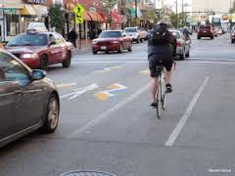
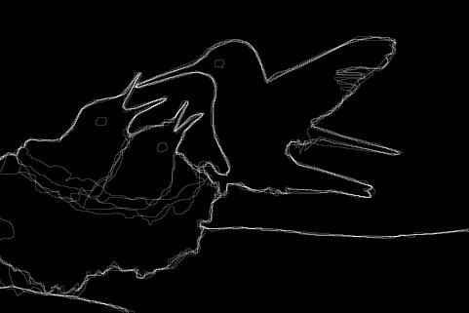

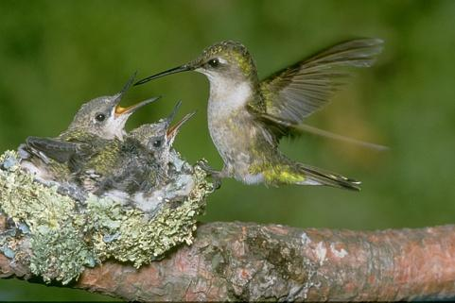
What do we want ML to do?
Given image, predict complex high-level patterns:
“Cat”
Object recognition
Detection
Segmentation
[Martin et al., 2001]

Slide 4
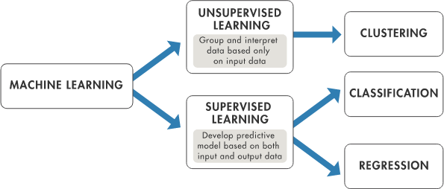
Types of ML
Unsupervised learning
Supervised learning (Focus)
Reinforced Learning

Slide 5
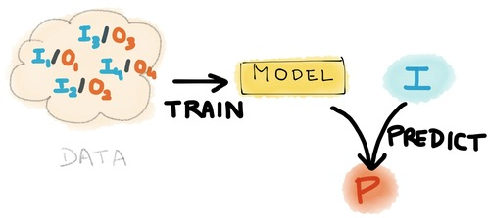
Supervised Learning
We train a model
Learn from training examples
Need labeled dataset
Lots of examples

Slide 6

How is ML done?
Machine learning often uses common pipeline with hand-designed feature extraction.
Better models use End to End Approaches ( CNN )
Feature Extraction
Machine Learning
Algorithm
“Cat”?
Prior Knowledge,
Experience

Slide 7
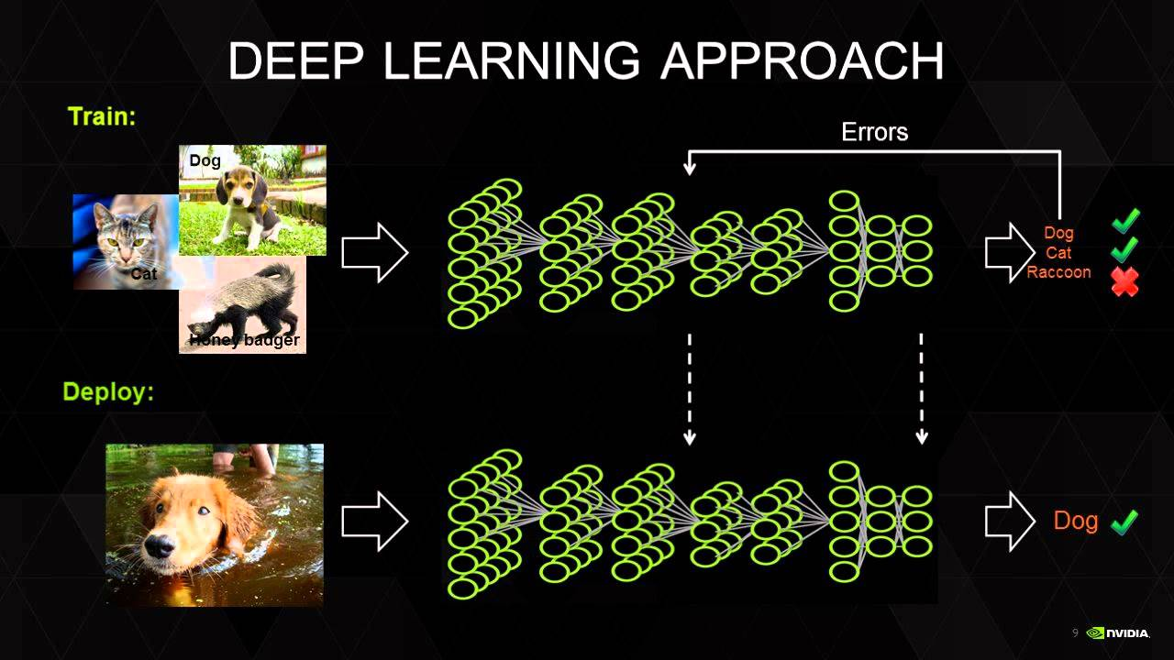
Supervised Learning

Slide 8
Supervised Learning
Given labeled training examples:
Goal: find f(x) to predict y from x on training data.
Hopefully: learned predictor works on “test” data.
0
0
1
0
…
255
98
93
87
…
f(x)
Cat

Slide 9
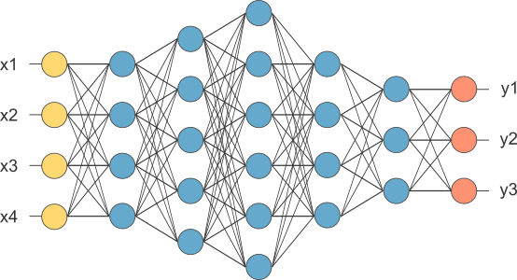
Neural network

Slide 10
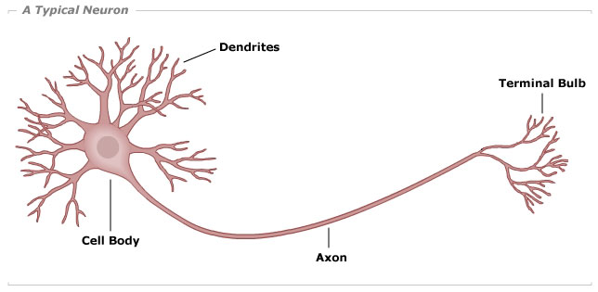
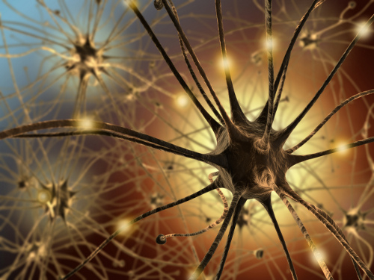
Neurons, Inspiration

Slide 11
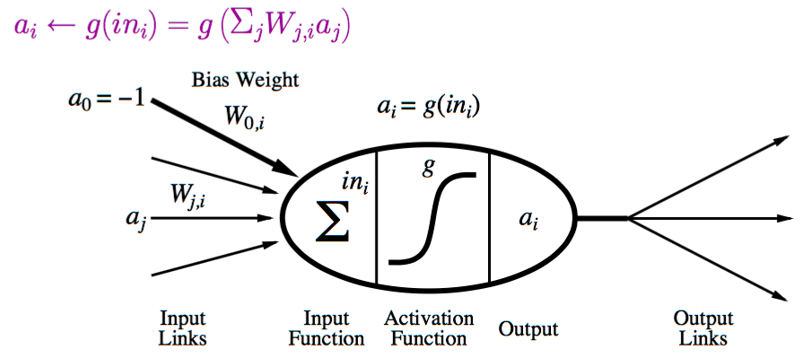
Neuron (Perceptron)

Slide 12
Activations
tanh(z)
abs(z)
ReLu(z) = max{0, z}
1
1
1
-1
“Rectified Linear Unit”
→ Increasingly popular.

Slide 13
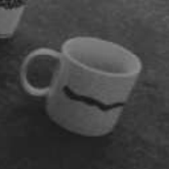

Why is vision so hard?
“Coffee Mug”
Pixel Intensity
Pixel intensity is a very poor representation.

Slide 14
Neural network
Can stack up several layers:
Must learn multiple stages
of internal “representation”.

Slide 15



TensorFlow
Deep Learning framework developed by Google
The idea is to give a simple Framework for building Neural Networks
Python
C++ Acceleration
CUDA + GPU acceleration
Open source
Tip
TensorFlow has amazing tutorials online on YouTube

Slide 16
Installation
Install Python3.5 (Windows), add Environment variables
Use pip3 to install packages
pip3 install --upgrade tensorflow
pip3 install --upgrade tflearn
Tip
TensorFlow has amazing tutorials online on YouTube

Slide 17
Steps
Build a model
First we need to define our model, using TFLearn classes
Train the model
We will use the MNIST dataset in-order to train our model to recognize digits
Use the model
Use our trained model to detect digits.

Slide 18
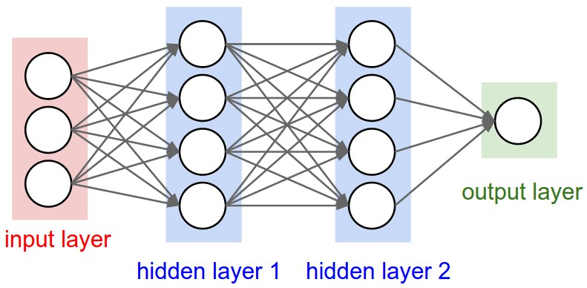
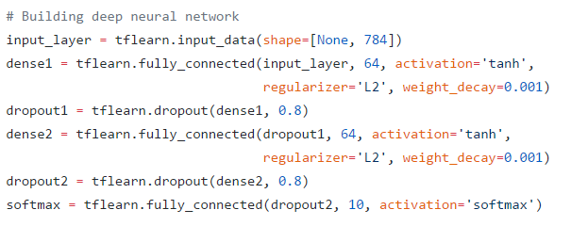
Building the model
Tip
Deeper and larger networks tend to give better results, but that is not always the case. Start small and build up.
Input Layer (28*28 = 784)
Fully Connected (64), tanh
Fully Connected (64), tanh
Fully Connected (10), softmax

Slide 19

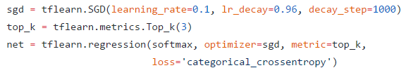
Training the model
Tip
Try our different learning_rates, large rates may cause the network to diverge really fast. Low rates may slow the learning process
Use MNIST dataset - we download it from the web
55k Images - labeled and separated to training and validation
One-hot : Labels are encoded as binary vectors
SGD Optimizer: Loss update function (Training)
Cross Entropy loss: Loss calculation function

Slide 20
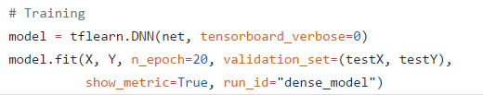
Running the session
Tip
The more epochs we do the better the model becomes, up to a certain point. Then we might risk the situation of over fitting the data. ( we dont want that)
Training set: our Training dataset. Images and labels
Validation set: Small part of the data for validation
N_epoch: Number of times we train the model

Slide 21

Saving the network
Tip
Large networks may take a huge space on the disk.
Save a model to a .model file ( Saves network + weights)
Load model weights from a file

Slide 22
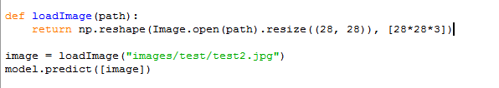
Using the network
Tip
Scaling the images too small may reduce the quality of the prediction.
Load a trained model
Load a new image for detection
Reshape image to suit our input
Use the trained model to predict the image label

