Slide 1
ALLDET
Automated Liquid
Level Detection
Jesse Tutor - Embedded development/web development
Zach Fauver - Signal processing/development
Khara Robinson - Web development/electrical & mechanical design
Andrew Bullington - Application & embedded development
Ryan Ladd - Team lead/electrical & mechanical design
Everyone - Research/documentation

Slide 2
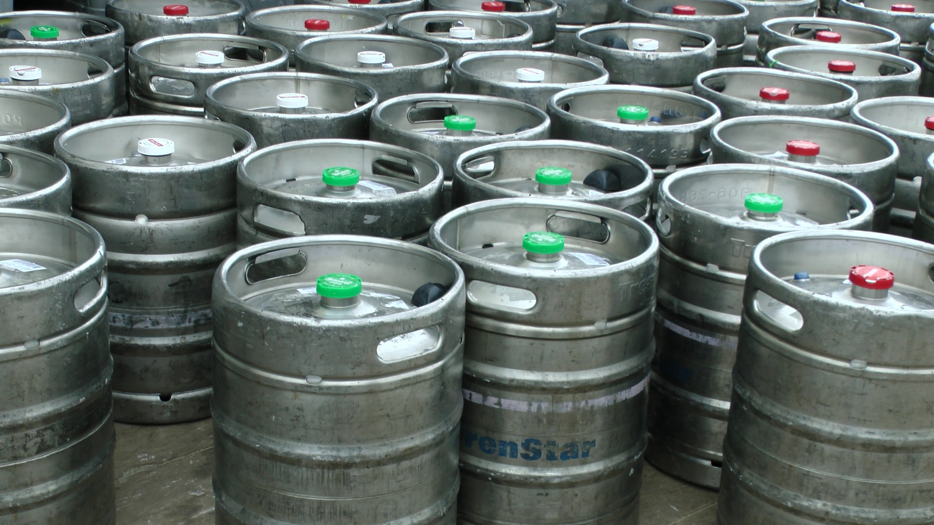
What problem are we solving?
Currently no convenient way for restaurants and bars to determine how much liquid is left in containers such as beer kegs
Not being able to easily measure liquid levels can lead to under/overstocking which can cut into profits
Improve inventory tracking

Slide 3
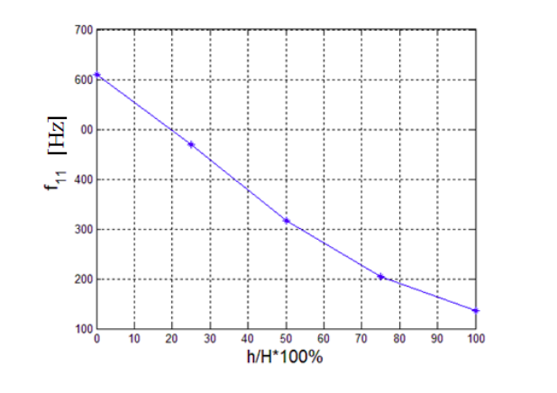
Our Solution
Utilize the natural resonance of the container
Attach a device to strike the side of the container
Use vibration sensors to detect the vibration frequency
Interpret the liquid level based on frequency
Record that data and transmit it to a mobile device
Display the data to the customer via mobile application
*Farid, M., Levy, N., Gendelman, “Vibration mitigation in partially liquid-filled vessel using passive energy absorbers,” Journal of Sound and Vibration vol. 406, pp. 21–22, Oct. 2017.

Slide 4
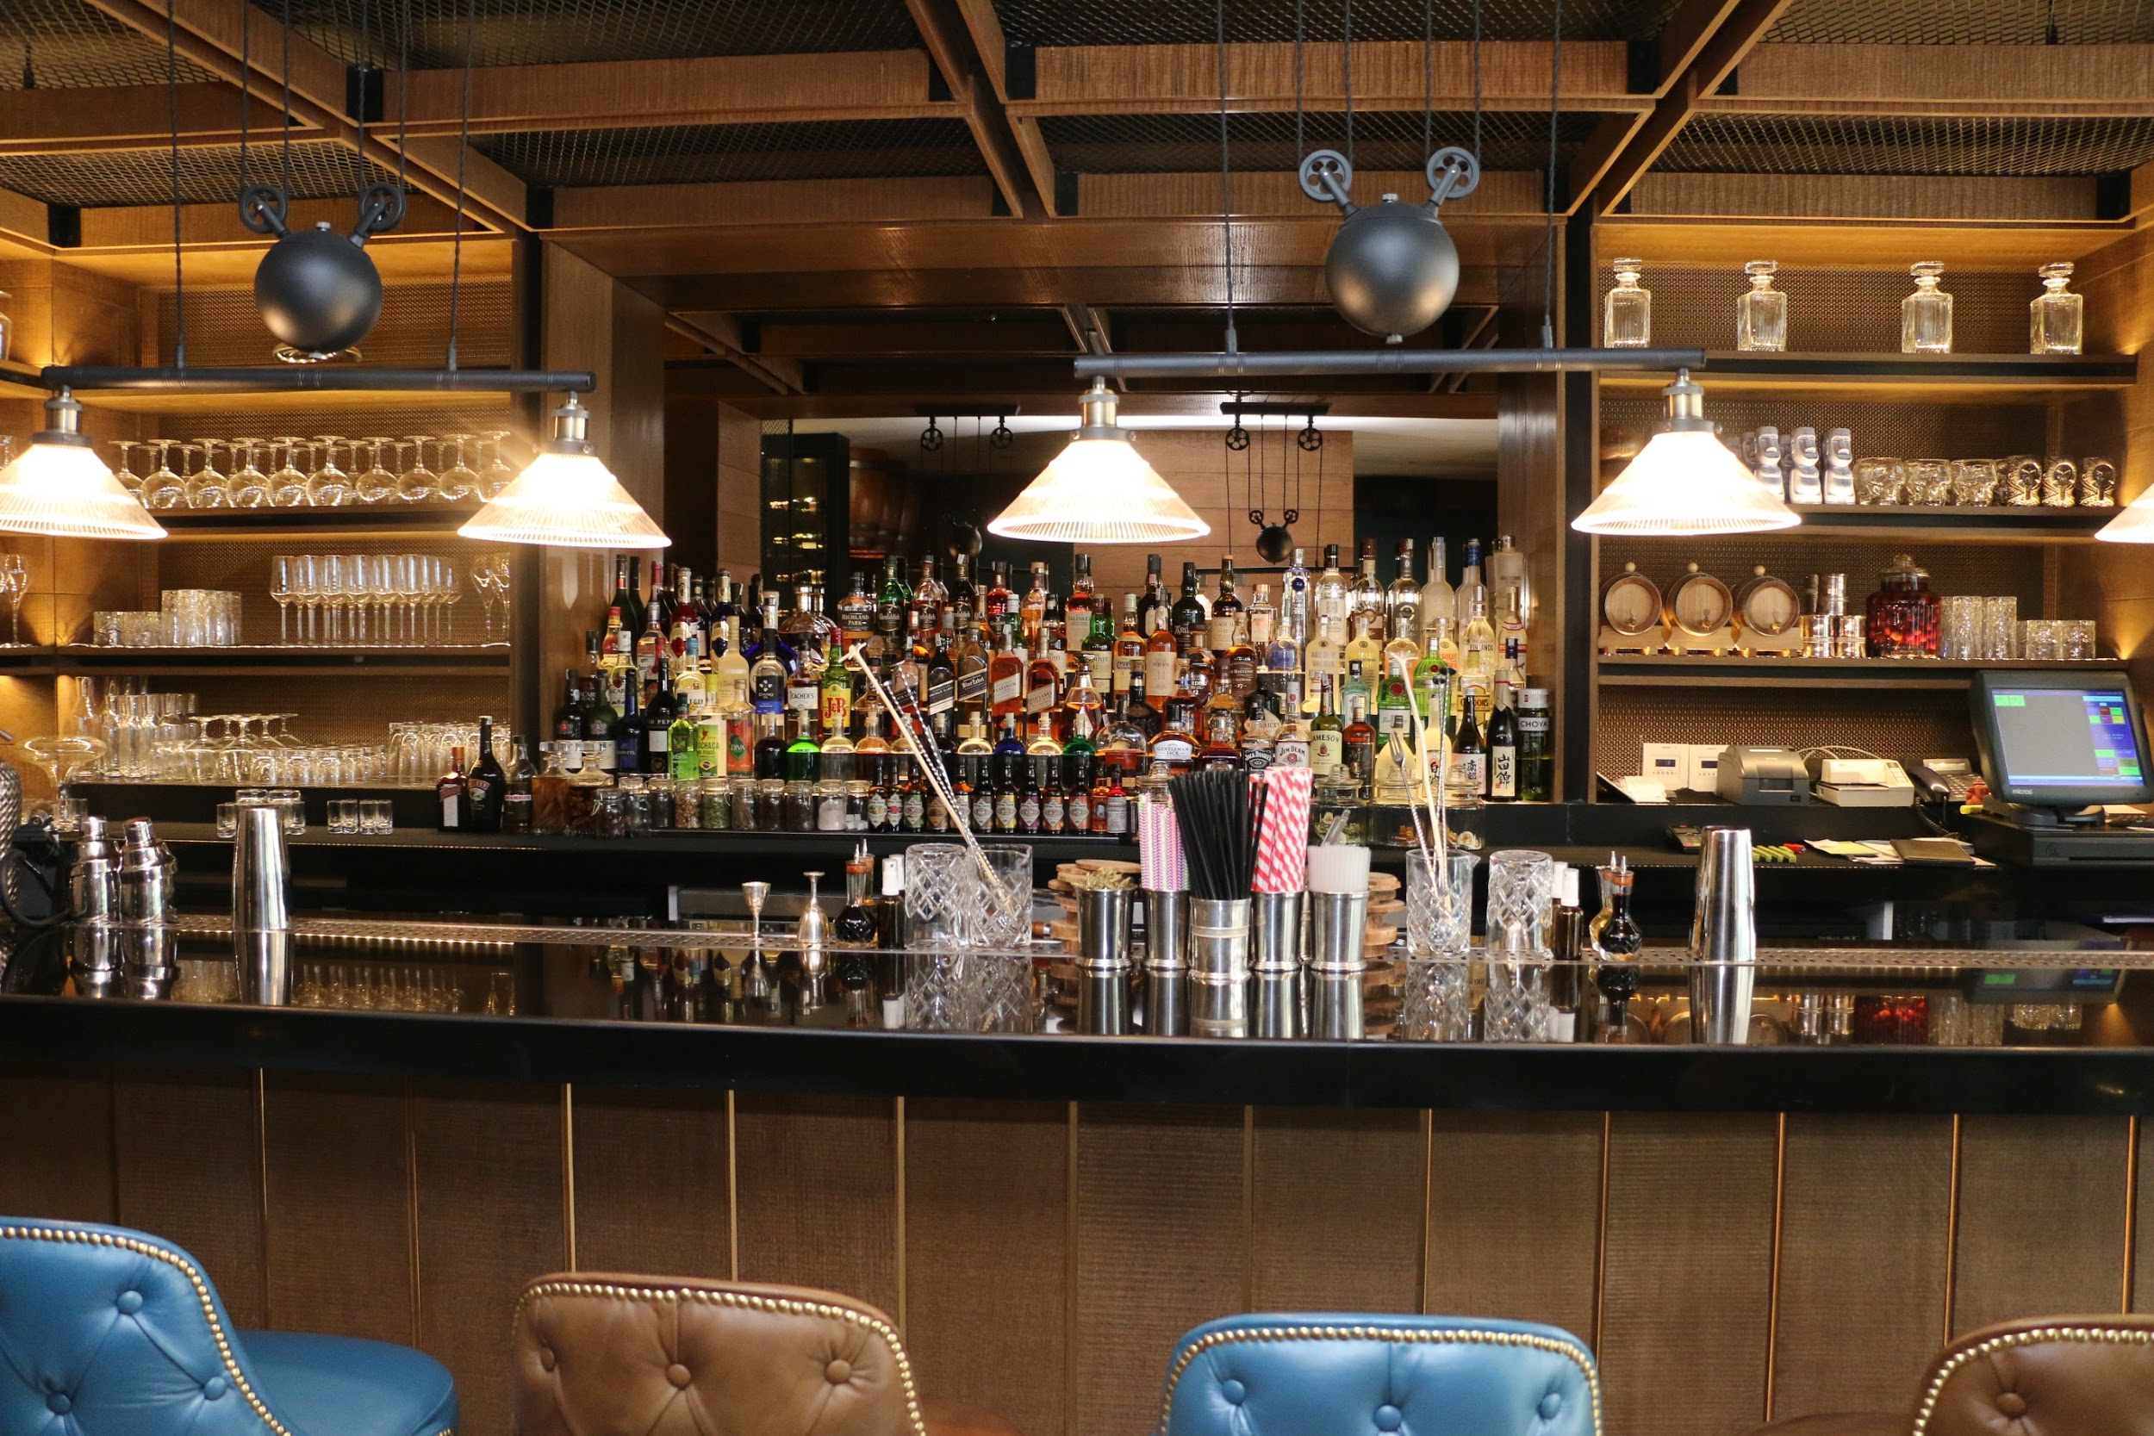
Target customers
We plan to adapt both business-to-business & business-to-consumer sales
Main customers include: Restaurants, bars, breweries, and home-brewer
Future development would allow opening up to other industries not related to food service (i.e. oil drums, flammable chemicals, etc.)

Slide 5



Sales & Marketing Strategy
Allow initial customers to use the device at no charge to gain valid feedback
We will mainly rely on word of mouth, live demos, social media advertising, and cold calls
Premium subscription to app would allow the user access to advanced inventory and monitoring solutions

Slide 6
Competitive Advantage
Current methods involve placing the keg on a scale and calculating liquid level by hand
No competitors measure using vibration sensing
Our non-invasive solution requires no physical lifting and the capability to measure multiple containers remotely

