Slide 1
Group5 Use Learned-based Model to Predict Airbnb Rent Price - NYC
Adam Camerer, Sung-Heng Wu, Shreen Gul, Usman Tariq

Slide 2
Outline
Teamwork
Background
Data Collection
Data Analyses and Results
Conclusions

Slide 3
Teamwork
Member name | Percent contribution | Activities completed by the member
Adam Camerer | 25% | Summarization and visualization of data
Sung-Heng Wu | 25% | Refining and manipulating data
Shreen Gul | 25% | Report writing and GitHub repository management
Usman Tariq | 25% | Report writing and general organization

Slide 4
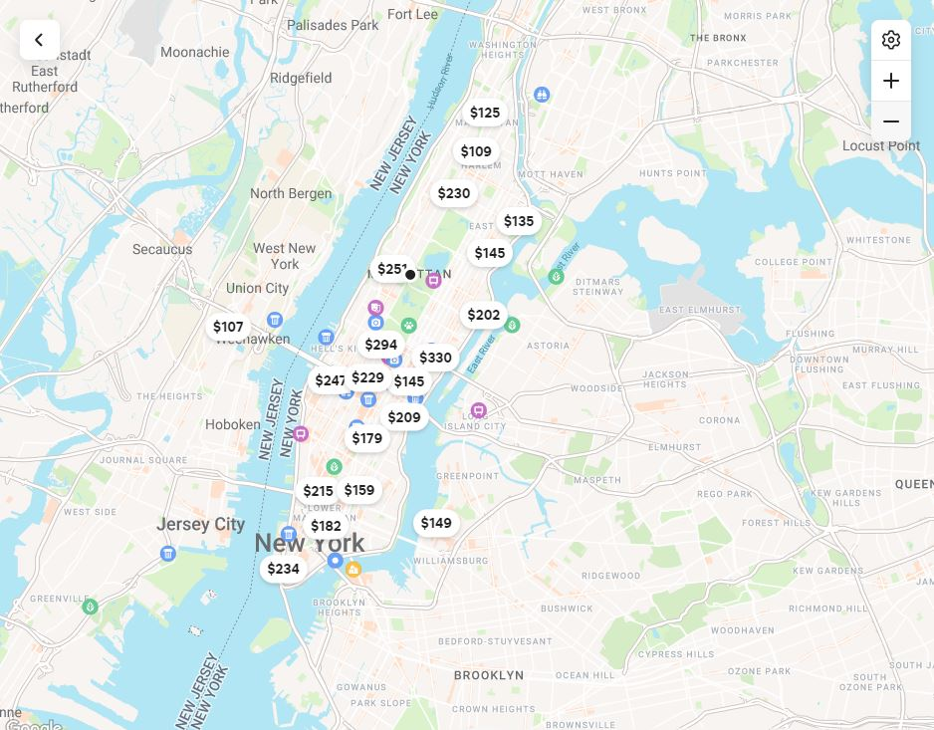

Background
Airbnb is an online marketplace that connects people who want to rent out their homes with people who are looking for accommodations.
Customer: Looking for reasonable rent
Landlord: Trying to rent their properties
How to win-win?
Exploratory & Predictive analysis
Notes:
It’s close to the end of semester, I guess some people have already booked the room for christmas
Booking.com; Hotel.com; Third party
Mentioned objectives for customer and landlord

Slide 5
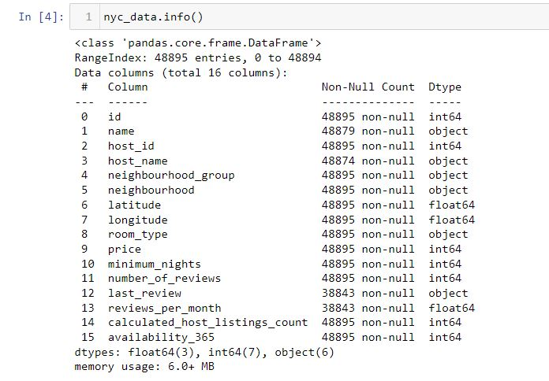
Data Collection
Airbnb website & Kaggle – AB_NYC_2019.csv
Object: Categorical type
Availability_365
Notes:
The data we select, and use is the version which better for visualization and analysis.
The availability of the listing 365 days in the future as determined by the calender

Slide 6
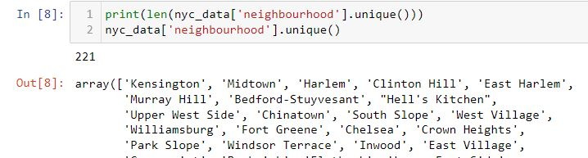

Data Analyses and Results
Data processing and manipulation
Drop the row with nan data
Drop unnecessary column – id, name, host_id,
host_name, neighborhood
Neighborhood is kind of the subset of
neighborhood_group
Notes:
We did not use mean or average to fill up the blank because what we need is the exact data.

Slide 7
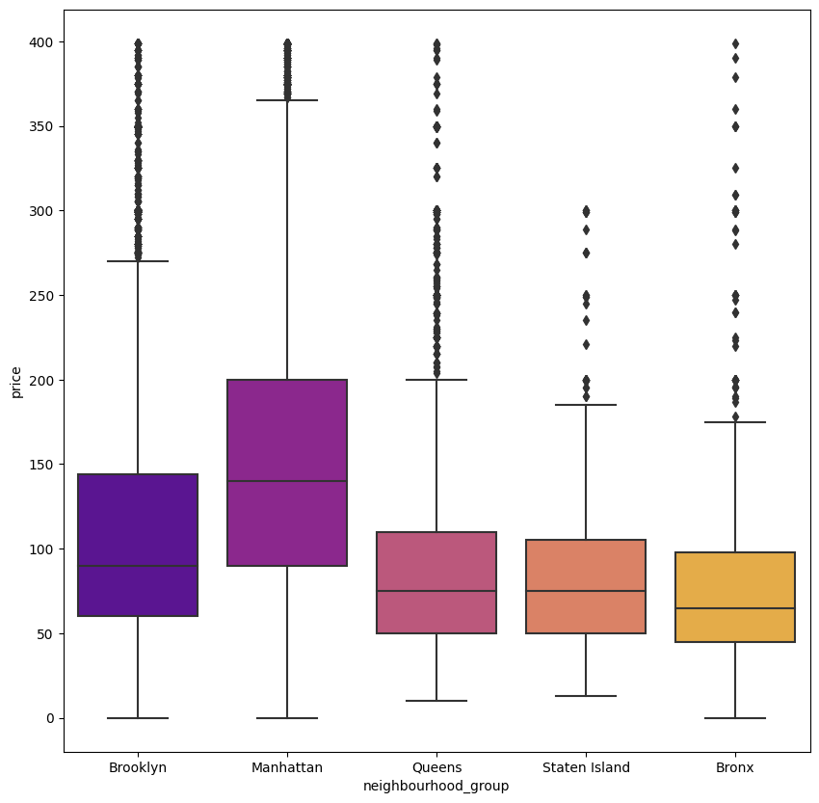
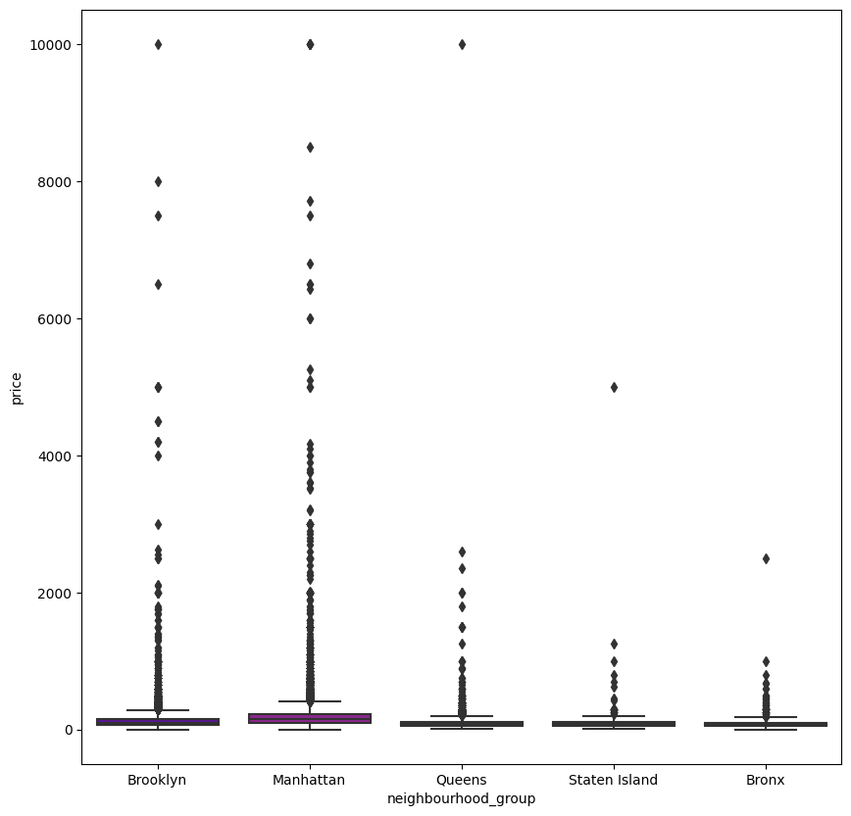
Data Analyses and Results
Data processing and manipulation
Use get_dummy to deal with
the categorical data.
Analysis outliers by boxplot
Mid and low range are our target
Notes:
Don’t tell me you want to spend over 400 dollars for one night in NYC. We are just student.
Manhattan are reasonable with higher price

Slide 8
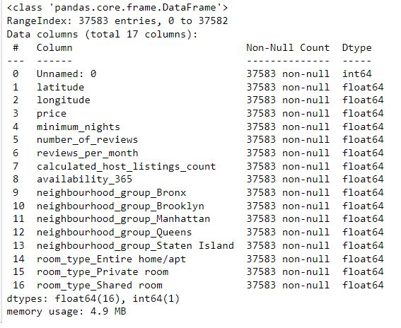
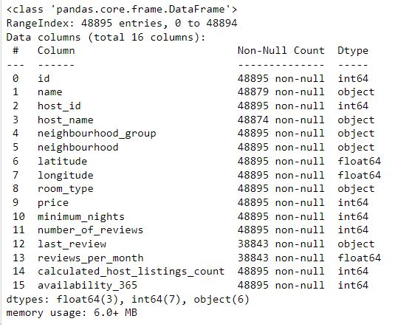
Data Analyses and Results
Data processing and manipulation
Do comparison with outliers and w/o outliers in OLS analysis
After Cleaning
Before Cleaning

Slide 9
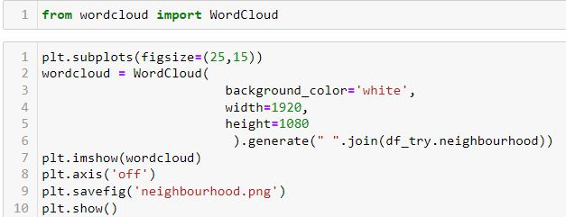
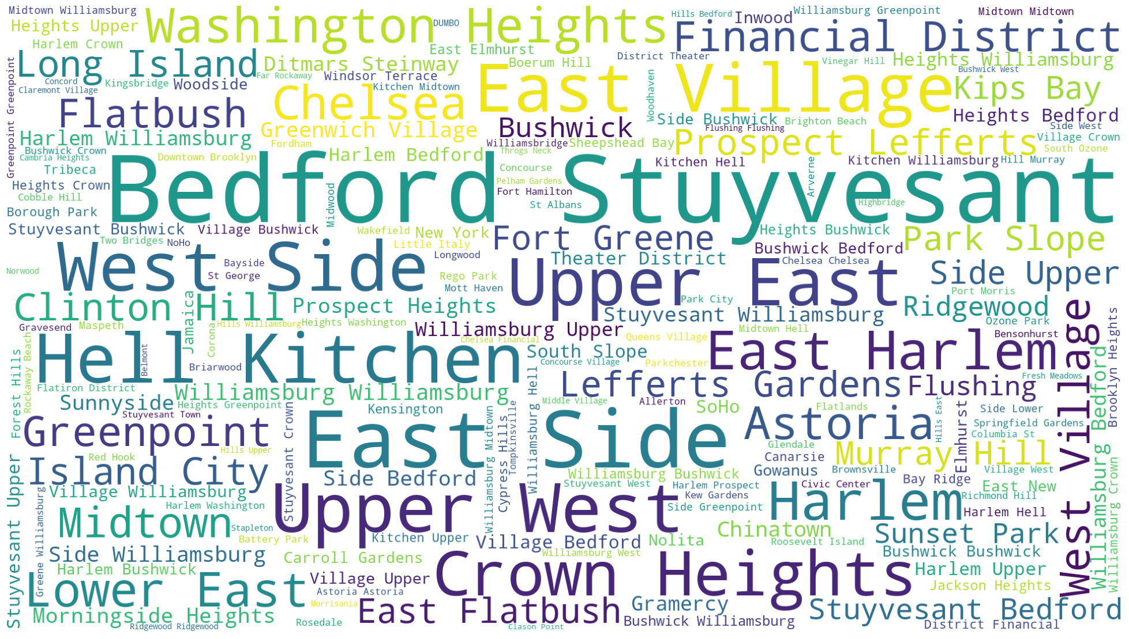
Data Analyses and Results
WorldCloud
Notes:
Just something interested
Hell Kitchen

Slide 10
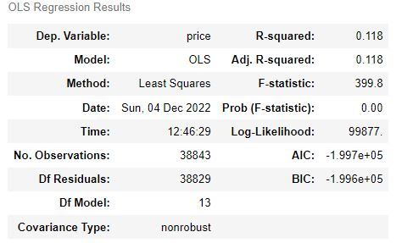
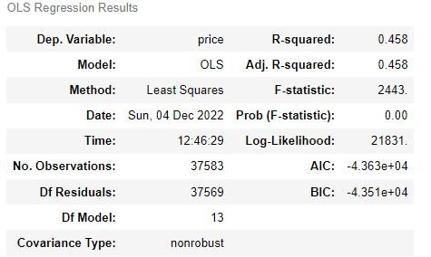
Data Analyses and Results
OLS Regression Results -1
Before Cleaning
After Cleaning
Notes:
Emphasized R-Square

Slide 11
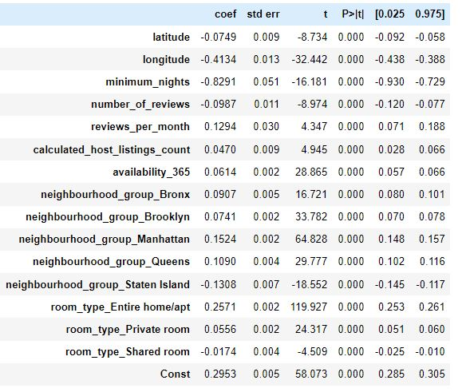
Data Analyses and Results
OLS Regression Results -2
All features are statistically significant
Notes:
Add constant term in the ols regression
Longitudw, minimum_nights, room_type_entire home/apt are very effective

Slide 12
Data Analyses and Results
Predictive analysis – 80% train & 20% test
Linear regression
Ridge Regression (add penalty term)
Lasso Regression (add penalty term)
ElasticNet Regression (add penalty term)
XGBoost Regression
Random Forest Regression
Notes:
Mention penalty term a little bit

Slide 13
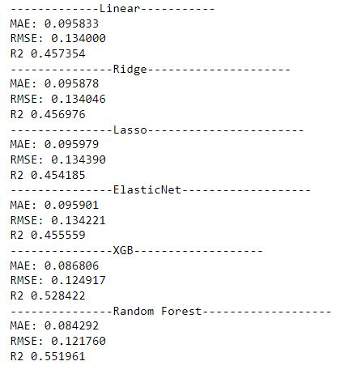
Data Analyses and Results
Model Scores – MAE; RMSE; R-Square
Notes:
Penalty term does not affect too much !!
XGB and Random Forest have better performance among above mention algorithm

Slide 14
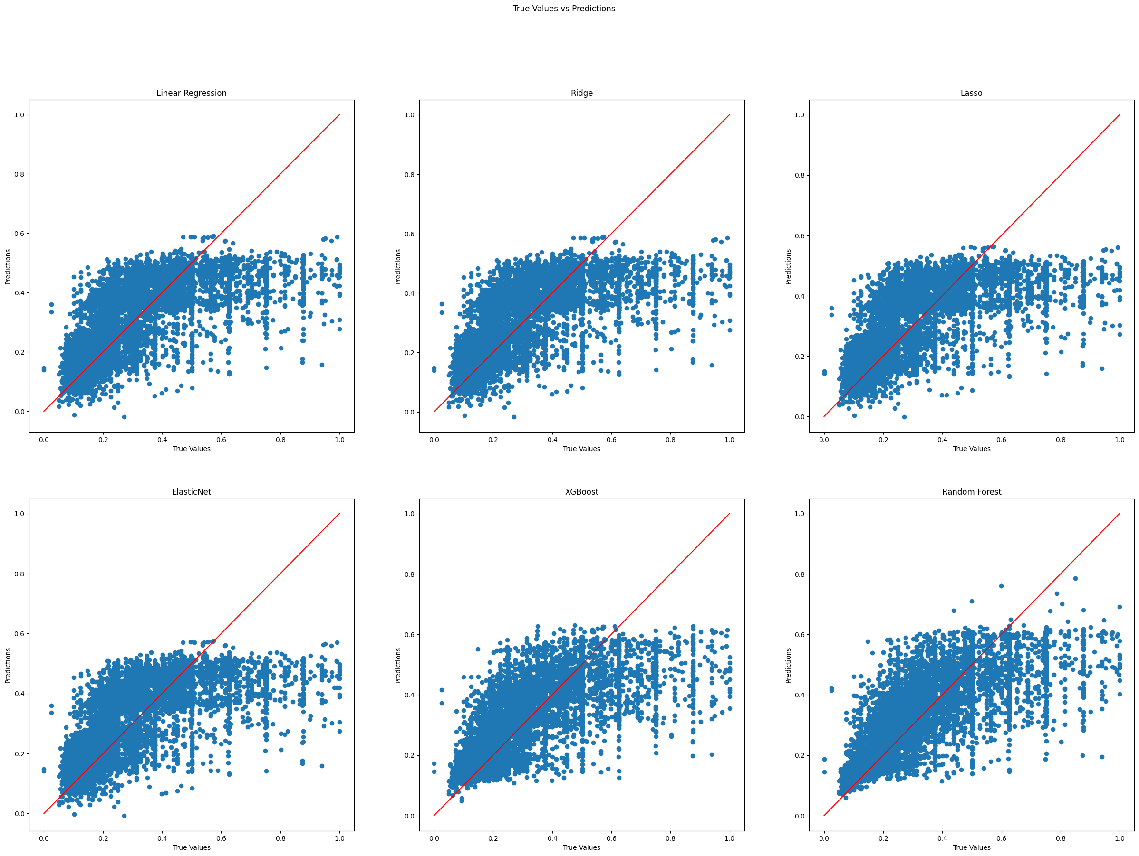
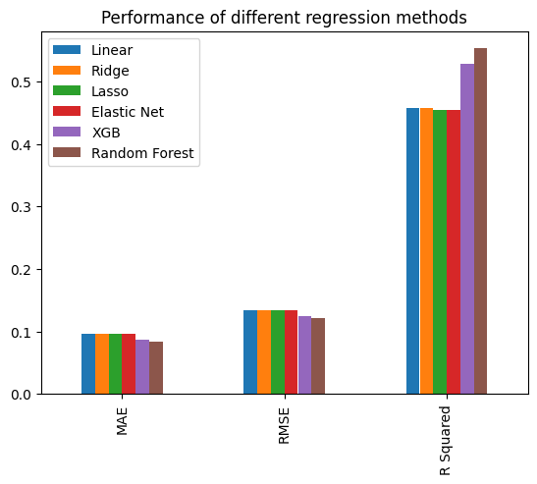
Data Analyses and Results
Model Scores – Visualization by scatter plot & bar chart
Notes:
If r-square between each algorithm are large, scatter plot would be good;
Otherwise, using bar chart is a good idea.

Slide 15
Conclusion
OLS results are better if we use data without outliers
Random forest and XGB model are better to perform on our model
If there is very less visual effect in scatter plot, bar chart can be an good option to present results
Notes:
If r-square between each algorithm are large, scatter plot would be good;
Otherwise, using bar chart is a good idea.

Slide 16
Thank You
Notes:
If r-square between each algorithm are large, scatter plot would be good;
Otherwise, using bar chart is a good idea.

Slide 17
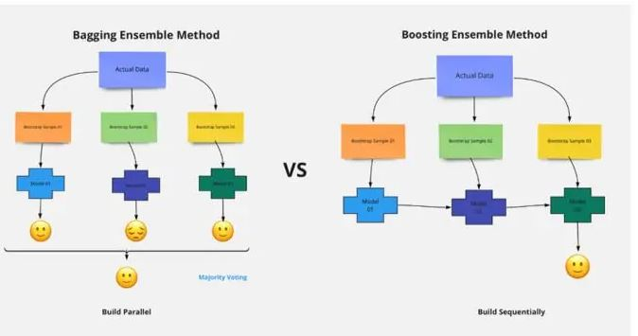
Notes:
If r-square between each algorithm are large, scatter plot would be good;
Otherwise, using bar chart is a good idea.

