Slide 1
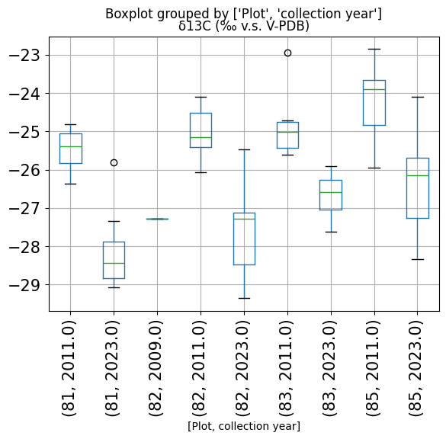
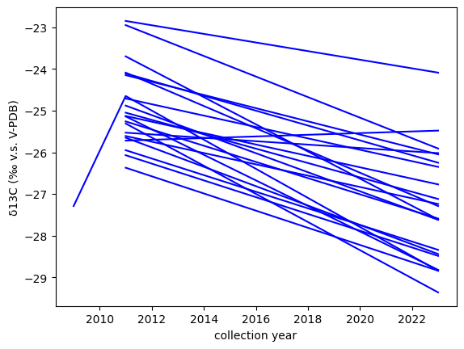
Oyacachi Plots
Oyacachi boxplots
Decreasing tendency of d13 with years in all plots.
Below a graphic connecting the same trees through the years.
2009 outlier needs to be assessed.

Slide 2
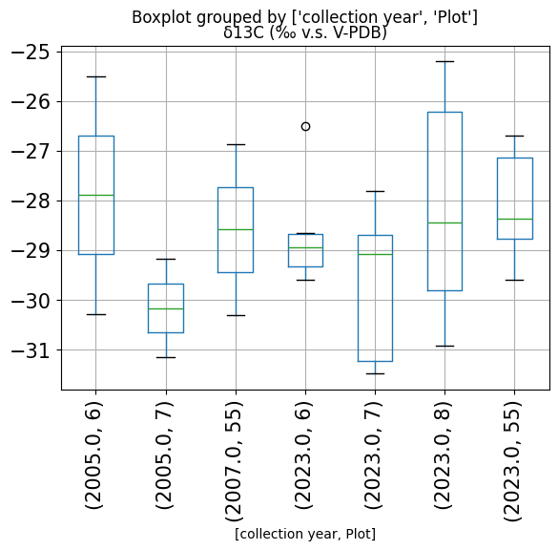
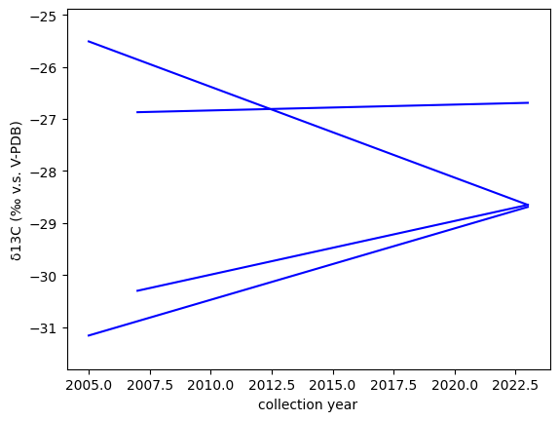
Guacamayos boxplots
Not enough samples to make comparisons between years. Only 6 and two need to be remeasured due to issues with IRMS.
Below graphic connecting trees diferent years. Not conclusive.
Obs. Herbarium collections vs pulverized samples sources of variation.

Slide 3
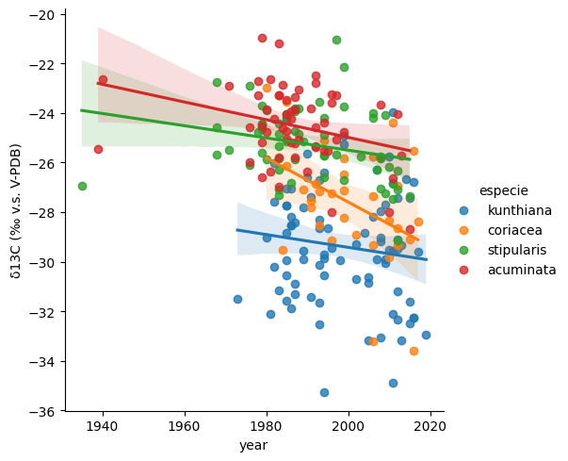
Herbarium samples scatter plot.

Slide 4
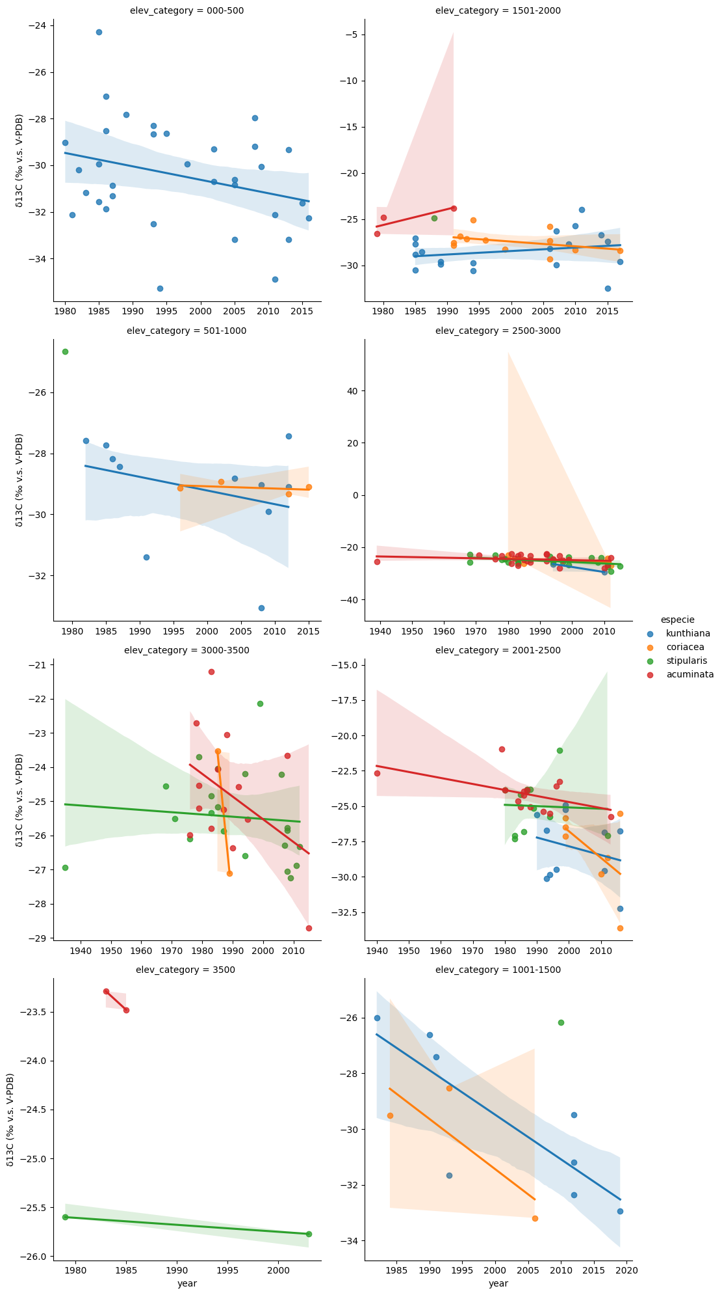
Herbarium samples scatter plot.
Each square is an elevation group.
Each color a specie.
X axis is time.

