Slide 1
Chapter 1: iWUE variation between NUMEX experiment manipulation

Slide 2
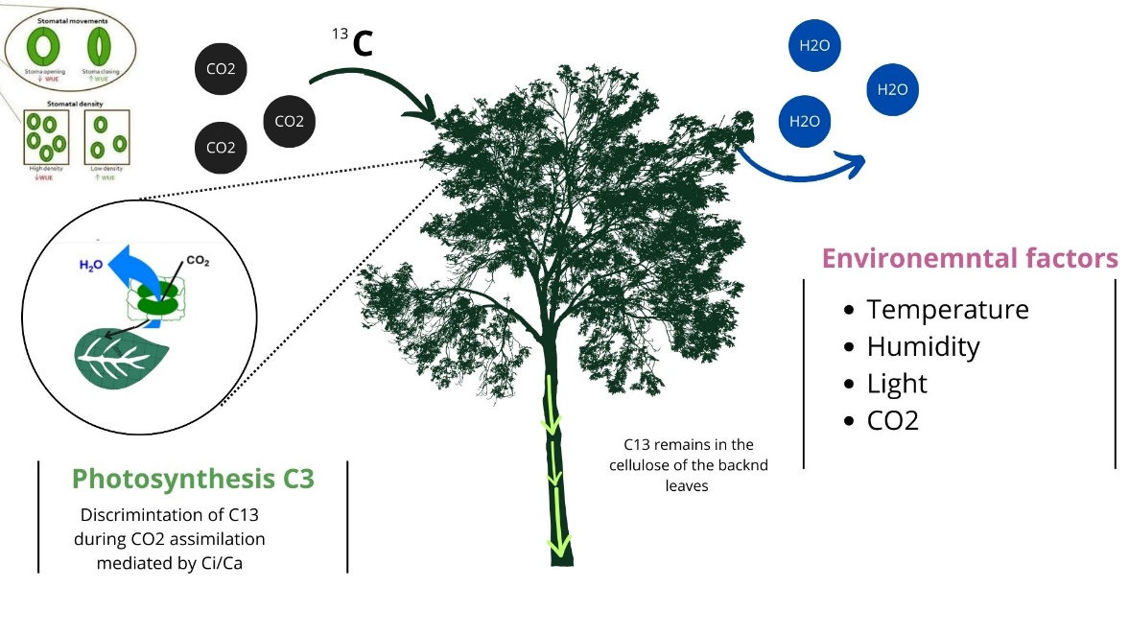
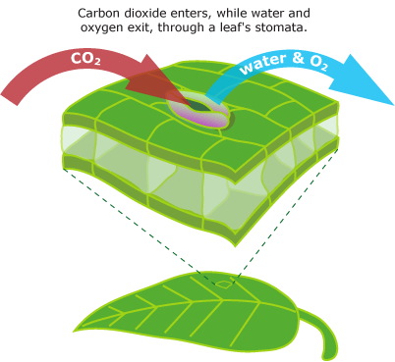
Nutrient addition experiment
N, P, N*P
Leaf functional traits
Thoughness
Thickness
SLA / LA
Carea / Narea
Leat water content
Climatic – Using Elevation as proxy
1000, 2000, 3000
iWUE = A/g

Slide 3
Site | Elevation (m.s.n.m) | N° Plots | Individuals per plot | Status
Cajanuma | 3000 | 16 2024 | Between 7-10 per experimental group Pouteria torta Clarisia racemosa | SLA, thickness, punch resistance, C:N, 15N, 13C, 18O, nutrients – pack to send Jürgen.
San Francisco | 2000 | 16 2023 | Between 10 per experimental group Myrcia y Alchornea | C:N, 15N, 13C, 18º, nutrients
Bombuscaro | 1000 | 16 2024 | Between 7-10 per experimental group Weinmania = Hedyosmum purpurascens = | SLA, thickness, punch resistance, dry matter, C:N, 15N, 13C, 18O, nutrients – pack to send Jürgen
Notes:
Data collected and processed in green. In red, the missing data.

Slide 4
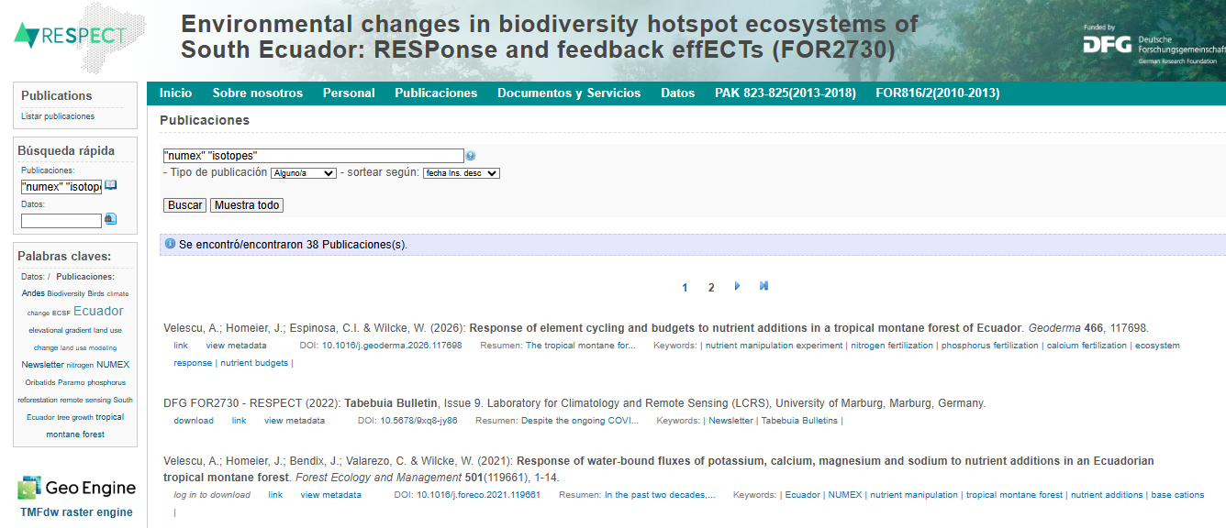

Available Info from NUMEX

Slide 5
RQ:
What are the differences in the ecophysiological – iWUE - responses between treatments on al elevational gradient (temperatura and N-limitation)?
Ho:
Nutrients will have an effect on photosyntethic capacity to increase iWUE specially in N limited areas (higher elevation).
- Nitrogen addition decreases iWUE on P-limitated areas (Huang et al, 2016).
- Increase of water transpiration with N → more enrichment of dO18.

Slide 6
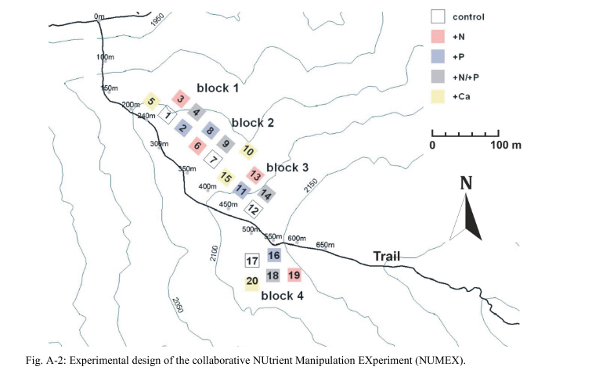
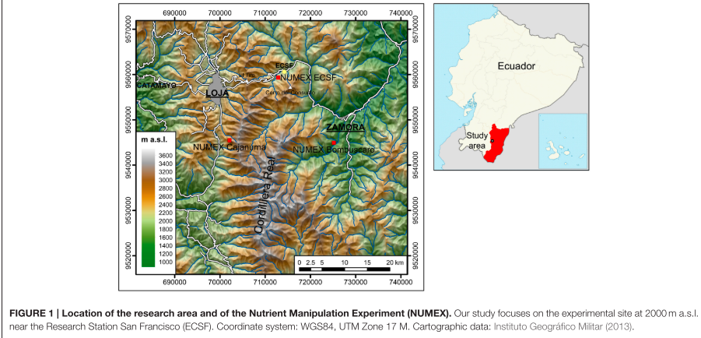

Slide 7
 |  | C | N | NxP | P
elevation | especie
1000 | Clarisia racemosa | 3 | 1 | 4 | 4
 | Pouteria torta | 11 | 10 | 7 | 8
2000 | Alchornea lojaensis | 12 | 9 | 8 | 15
 | Myrcia sp nov | 15 | 10 | 13 | 11
3000 | Hedyosmun purpurascens | 5 | 6 | 3 | 7
 | Weinmania loxensis | 5 | 5 | 2 | 6

Slide 8
 |  | δ18O in ‰ vs DeltaSMOW |  | δ13C (‰ v.s.V-PDB) |  | force to punch (kN/m) |  | thickness (mm) |  | Leaf area (cm²) |  | dry matter content (mg/g) |  | iWUE (μmol/mol) |  | Specific leaf area (g/cm²) |  | leaf water content |  | C:N |  | Narea |  | Carea
 |  | mean | std | mean | std | mean | std | mean | std | mean | std | mean | std | mean | std | mean | std | mean | std | mean | std | mean | std | mean | std
Alchornea lojaensis | C | 29.67 | 1 | -26.51 | 0.9 | 1.58 | 0.14 | 0.51 | 0.06 | 437.2 | 148.92 | 458.84 | 40.17 | 106.54 | 11.75 | 35.39 | 4.16 | 0.54 | 0.04 | 43.02 | 6.87 | 0.33 | 0.05 | 14 | 1.57
 | N | 29.73 | 1.2 | -26.74 | 1.1 | 1.67 | 0.11 | 0.52 | 0.07 | 585.8 | 208.63 | 436.5 | 43.22 | 103.5 | 13.97 | 35.34 | 4.79 | 0.56 | 0.04 | 37.95 | 4.98 | 0.37 | 0.07 | 14 | 2.09
 | NP | 29.51 | 1.1 | -26.77 | 1.5 | 1.69 | 0.15 | 0.51 | 0.03 | 526.3 | 151.86 | 443.24 | 46.75 | 103.12 | 19.23 | 36.46 | 3.96 | 0.56 | 0.05 | 40.44 | 4.32 | 0.33 | 0.06 | 13.3 | 1.15
 | P | 29.54 | 1.6 | -27.06 | 1.5 | 1.61 | 0.15 | 0.51 | 0.06 | 569.4 | 157.74 | 445.05 | 31.92 | 99.32 | 20.01 | 35.91 | 3.67 | 0.55 | 0.03 | 44.34 | 5.43 | 0.31 | 0.07 | 13.7 | 1.51
Clarisia racemosa | C | 26.51 | 0.5 | -30.63 | 0.4 | 0.96 | 0.09 | 0.21 | 0.02 | 789.2 | 252.02 | 462.21 | 25.6 | 51.71 | 5.65 | 92.05 | 10.83 | 0.54 | 0.03 | 24.51 | 2.92 | 0.19 | 0.02 | 4.61 | 0.41
 | N | 31.23 |  | -31.8 |  | 0.87 |  | 0.2 |  | 827 |  | 444.58 |  | 36.04 |  | 112.1 |  | 0.56 |  | 22.29 |  | 0.18 |  | 3.99
 | NP | 30.74 | 2.3 | -30.88 | 0.4 | 0.97 | 0.2 | 0.22 | 0.02 | 705.8 | 95.02 | 461.81 | 65.73 | 48.44 | 4.83 | 91.5 | 38.65 | 0.54 | 0.07 | 18.28 | 1.73 | 0.33 | 0.22 | 6.11 | 4.46
 | P | 29.77 | 2.7 | -29.84 | 1.2 | 0.98 | 0.09 | 0.22 | 0.01 | 720.4 | 70.29 | 452.38 | 16.12 | 62.23 | 16.55 | 95.65 | 6.27 | 0.55 | 0.02 | 22.65 | 3.13 | 0.21 | 0.03 | 4.59 | 0.24
Hedyosmun purpurascens | C | 26.34 | 0.7 | -26.81 | 1.4 | 0.85 | 0.2 | 0.46 | 0.03 | 360.5 | 26.75 | 276.6 | 45.98 | 102.66 | 19.17 | 68.88 | 16.18 | 0.72 | 0.05 | 30.78 | 2.77 | 0.21 | 0.04 | 6.66 | 1.65
 | N | 27.66 | 2 | -26.35 | 2.1 | 0.9 | 0.19 | 0.46 | 0.03 | 294.3 | 117.09 | 303.57 | 21.05 | 108.64 | 27.31 | 60.87 | 6.61 | 0.7 | 0.02 | 25.77 | 5.26 | 0.28 | 0.03 | 7.21 | 0.81
 | NP | 26.68 | 1.5 | -24.85 | 1.3 | 0.9 | 0.19 | 0.46 | 0.02 | 310 | 55.44 | 263.47 | 4.56 | 128.58 | 16.73 | 65.98 | 5.04 | 0.74 | 0 | 26.1 | 2.81 | 0.26 | 0.02 | 6.74 | 0.56
 | P | 27.25 | 1.3 | -27.29 | 1.6 | 0.69 | 0.05 | 0.45 | 0.05 | 431.7 | 97.78 | 248.34 | 11.95 | 96.24 | 21.08 | 75.91 | 12.42 | 0.75 | 0.01 | 28.12 | 2.51 | 0.21 | 0.05 | 5.89 | 1
Myrcia sp nov | C | 30.63 | 0.5 | -27.79 | 1.2 | 1.49 | 0.13 | 0.48 | 0.04 | 441.6 | 138.78 | 479.82 | 36.04 | 89.53 | 15.32 | 37.13 | 3.92 | 0.52 | 0.04 | 51.73 | 11.71 | 0.28 | 0.17 | 12.9 | 1.47
 | N | 31.75 | 1.7 | -27.24 | 0.9 | 1.58 | 0.2 | 0.5 | 0.05 | 403.4 | 141.02 | 465.81 | 30.98 | 96.87 | 12.23 | 34.39 | 1.95 | 0.53 | 0.03 | 47.43 | 4.13 | 0.29 | 0.03 | 13.7 | 0.76
 | NP | 30.97 | 0.9 | -27.27 | 1 | 1.5 | 0.14 | 0.49 | 0.04 | 441 | 241.41 | 472.77 | 38.37 | 96.48 | 13.26 | 35.38 | 3.41 | 0.53 | 0.04 | 47.79 | 4.16 | 0.28 | 0.03 | 13.3 | 1.3
 | P | 30.31 | 0.9 | -27.34 | 0.7 | 1.55 | 0.19 | 0.48 | 0.04 | 403.9 | 144.57 | 467.3 | 24.91 | 95.52 | 9.23 | 34.58 | 4.01 | 0.53 | 0.02 | 58.87 | 5.8 | 0.23 | 0.02 | 13.8 | 1.88
Pouteria torta | C | 30.32 | 1.5 | -31.55 | 0.8 | 0.78 | 0.08 | 0.2 | 0.01 | 1384 | 423.28 | 517.2 | 36.65 | 39.35 | 10.18 | 80.27 | 8.75 | 0.48 | 0.04 | 31.55 | 2.43 | 0.19 | 0.02 | 6.05 | 0.74
 | N | 29.32 | 1.4 | -30.37 | 1.8 | 0.85 | 0.18 | 0.2 | 0.03 | 1482 | 393.07 | 567.65 | 103.37 | 55.19 | 24.44 | 77.51 | 15.42 | 0.43 | 0.1 | 30.55 | 2.74 | 0.21 | 0.03 | 6.38 | 1.34
 | NP | 28.45 | 1.2 | -31.74 | 1.4 | 0.85 | 0.13 | 0.19 | 0.02 | 1332 | 479.13 | 498.3 | 49.19 | 36.88 | 18.06 | 101.5 | 52.75 | 0.5 | 0.05 | 29.27 | 1.73 | 0.18 | 0.05 | 5.37 | 1.53
 | P | 28.93 | 1.2 | -31.27 | 0.9 | 0.81 | 0.13 | 0.2 | 0.03 | 1416 | 289.8 | 497.57 | 47.07 | 43.17 | 12.5 | 78.02 | 10.48 | 0.5 | 0.05 | 28.9 | 2.18 | 0.22 | 0.03 | 6.25 | 0.94
Weinmania loxensis | C | 26.56 | 1.7 | -27.7 | 0.3 | 0.81 | 0.07 | 0.27 | 0.04 | 29.36 | 4.07 | 458.37 | 24.12 | 90.8 | 3.58 | 70.1 | 5.89 | 0.54 | 0.02 | 43.15 | 5.79 | 0.15 | 0.01 | 6.37 | 0.5
 | N | 26.46 | 0.8 | -28.06 | 0.9 | 0.81 | 0.1 | 0.25 | 0.03 | 35.25 | 12.72 | 484.91 | 63.86 | 86.06 | 11.93 | 69.55 | 9.63 | 0.52 | 0.06 | 39.49 | 5.23 | 0.17 | 0.03 | 6.51 | 0.96
 | NP | 25.62 | 0.8 | -29.03 | 0.8 | 0.87 | 0.09 | 0.25 | 0.02 | 38.68 | 3.7 | 447.24 | 11.29 | 73.08 | 10.56 | 72.21 | 6.39 | 0.55 | 0.01 | 41.18 | 0.31 | 0.16 | 0.01 | 6.39 | 0.44
 | P | 26.12 | 0.9 | -28.38 | 1.1 | 0.86 | 0.08 | 0.26 | 0.04 | 35.36 | 2.13 | 450.2 | 29.2 | 81.74 | 15.03 | 72.58 | 4.07 | 0.55 | 0.03 | 41.73 | 5.19 | 0.15 | 0.03 | 6.09 | 0.37

Slide 9
Summary of the response variables analyzed to the date
 |  | δ15N (‰ v.s.AIR) |  | δ18O in ‰ vs DeltaSMOW |  | δ13C (‰ v.s.V-PDB) |  | iWUE (μmol/mol) |  | C:N
 |  | mean | std | mean | std | mean | std | mean | std | mean | std
Alchornea lojaensis | C | -5.27 | 1.16 | 29.67 | 1.02 | -26.51 | 0.89 | 93.16 | 10.84 | 43.02 | 6.87
 | N | -2.57 | 1.57 | 29.74 | 1.14 | -26.57 | 1.13 | 92.47 | 13.88 | 37.7 | 4.76
 | NP | -2.44 | 0.69 | 29.51 | 1.12 | -26.77 | 1.45 | 90 | 17.73 | 40.44 | 4.32
 | P | -5.08 | 0.96 | 29.54 | 1.57 | -27.06 | 1.51 | 86.5 | 18.45 | 44.34 | 5.43
Clarisia racemosa | C | 0.61 | 0.82 | 26.51 | 0.53 | -30.63 | 0.42 | 42.6 | 5.21 | 24.51 | 2.92
 | N | 0.47 |  | 31.23 |  | -31.8 |  | 28.14 |  | 22.29
 | NP | 2.04 | 0.62 | 30.74 | 2.31 | -30.88 | 0.36 | 39.57 | 4.45 | 18.28 | 1.73
 | P | 0.6 | 0.51 | 29.77 | 2.73 | -29.84 | 1.24 | 52.29 | 15.26 | 22.65 | 3.13
Hedyosmun purpurascens | C | -2.58 | 2.62 | 26.34 | 0.71 | -26.81 | 1.44 | 89.58 | 17.68 | 30.78 | 2.77
 | N | -1.13 | 1.59 | 27.66 | 1.99 | -26.35 | 2.06 | 95.09 | 25.19 | 25.77 | 5.26
 | NP | -0.77 | 0.64 | 26.68 | 1.48 | -24.85 | 1.27 | 113.48 | 15.43 | 26.1 | 2.81
 | P | -1.42 | 1.6 | 27.25 | 1.31 | -27.29 | 1.59 | 83.66 | 19.44 | 28.12 | 2.51
Myrcia sp nov | C | -3.58 | 1.98 | 30.63 | 0.52 | -27.79 | 1.15 | 77.47 | 14.13 | 51.73 | 11.71
 | N | -2.79 | 0.43 | 31.75 | 1.73 | -27.24 | 0.92 | 84.24 | 11.28 | 47.43 | 4.13
 | NP | -1.64 | 0.76 | 30.97 | 0.94 | -27.27 | 1 | 83.88 | 12.23 | 47.79 | 4.16
 | P | -4.48 | 0.91 | 30.44 | 0.95 | -27.34 | 0.66 | 83.09 | 8.12 | 58.04 | 6.25
Pouteria torta | C | 1.28 | 0.85 | 30.32 | 1.47 | -31.55 | 0.76 | 31.19 | 9.39 | 31.55 | 2.43
 | N | 1.49 | 1.06 | 29.32 | 1.39 | -30.37 | 1.83 | 45.8 | 22.53 | 30.55 | 2.74
 | NP | 1.79 | 0.92 | 28.45 | 1.16 | -31.74 | 1.35 | 28.92 | 16.66 | 29.27 | 1.73
 | P | 1.01 | 0.76 | 28.93 | 1.24 | -31.27 | 0.93 | 34.72 | 11.53 | 28.9 | 2.18
Weinmania loxensis | C | -4.45 | 2.16 | 26.56 | 1.65 | -27.7 | 0.27 | 78.64 | 3.3 | 43.15 | 5.79
 | N | -3.05 | 0.59 | 26.46 | 0.77 | -28.06 | 0.9 | 74.27 | 11 | 39.49 | 5.23
 | NP | -4.53 | 1.52 | 25.62 | 0.75 | -29.03 | 0.79 | 62.3 | 9.74 | 41.18 | 0.31
 | P | -5.05 | 1.96 | 26.12 | 0.88 | -28.38 | 1.13 | 70.28 | 13.86 | 41.73 | 5.19

Slide 10
ANALYSIS PER SPECIE
I ran ANOVA interaction tests per species – not showed- but decided to go with glmm for their statistic power.
lmer(Response variable~ N * P + (1 | Block))
Q-Q plots evaluation but also integrating DHARMa analysis- more strict.

Slide 11
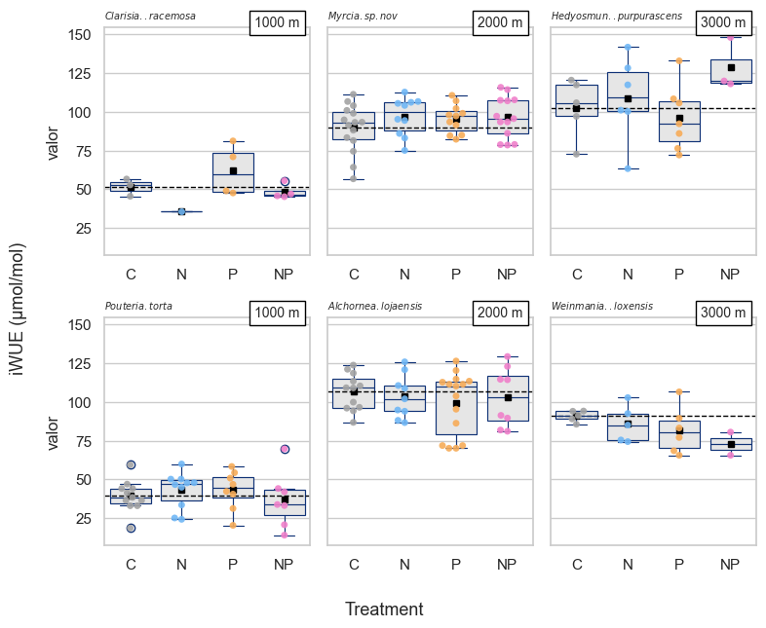
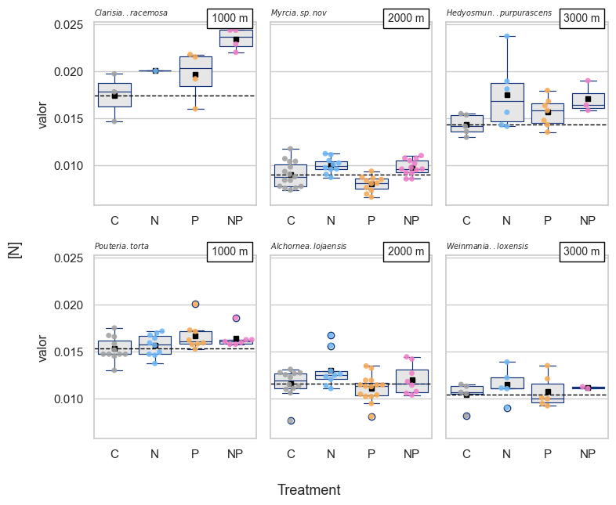
* *
* * * *
*
*
Notes:
The dotted line is the mean of the control.
Weinmania looks that NP has an strong effect on iWUE, but it is not statistical significant.
What I see: With N the iWUE increases, with P iWUE increases as well but less strongly. The interaction has a positive effect on some species (Puteria, Myrcia, Hedyosmum) and negative (less tan control on others (Alchornea, Weinmania).

Slide 13
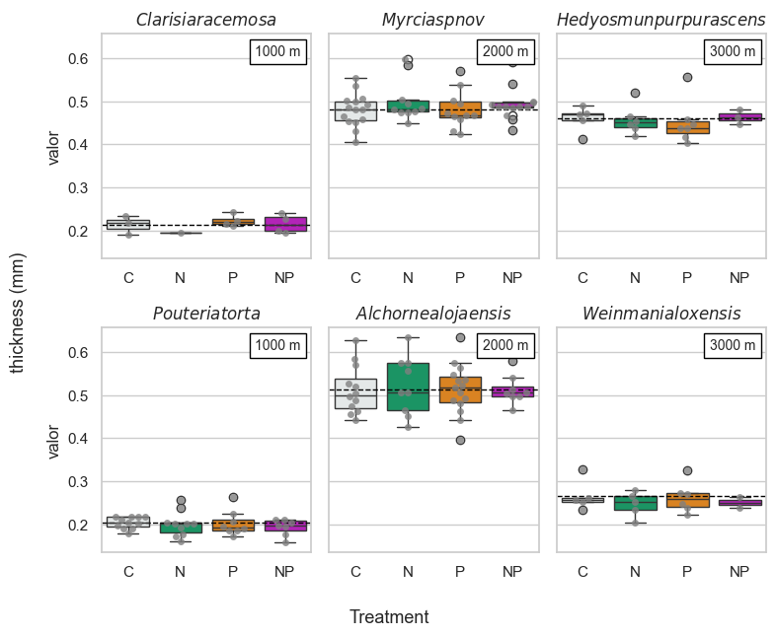
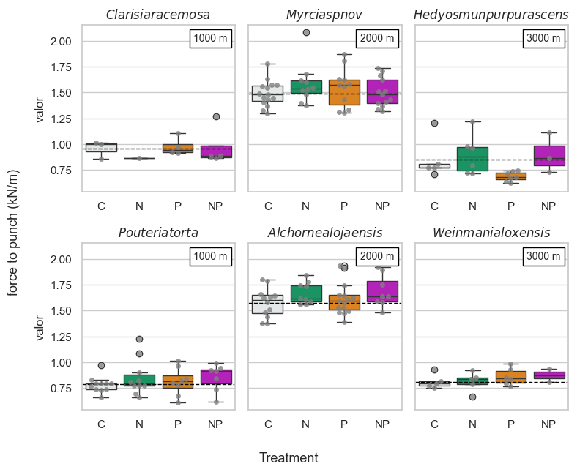
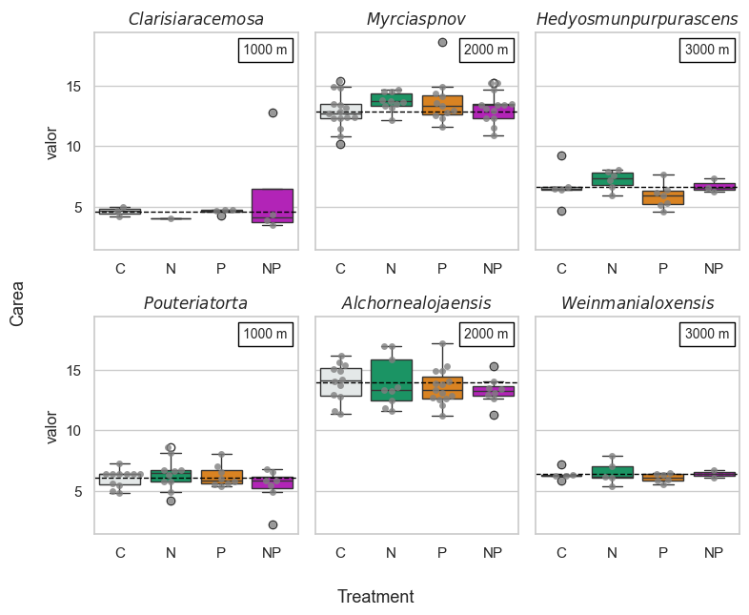
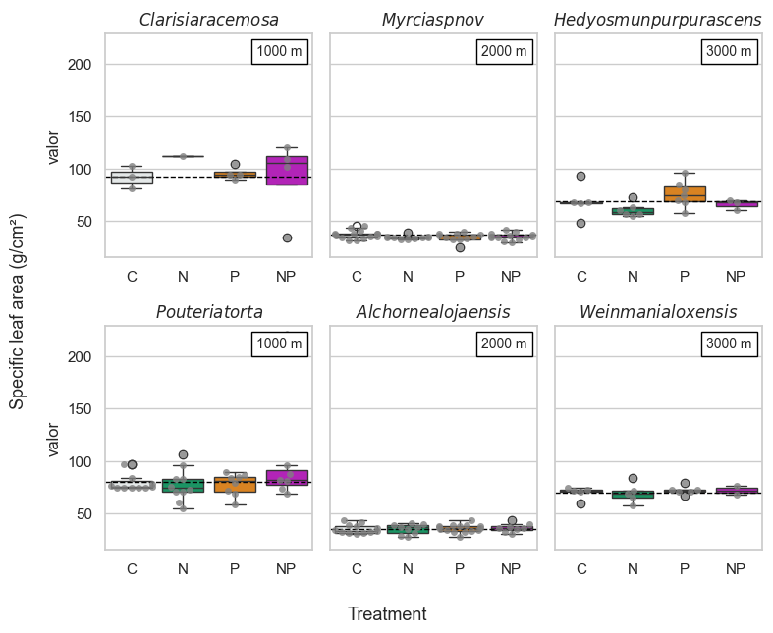
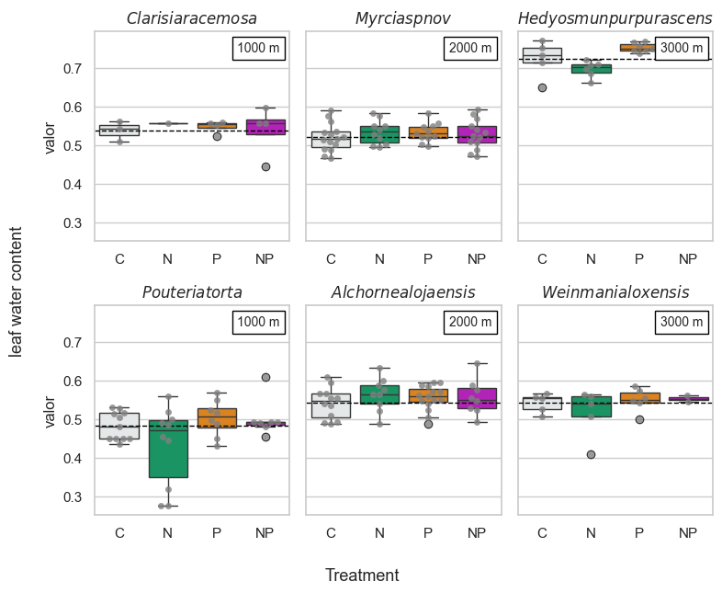
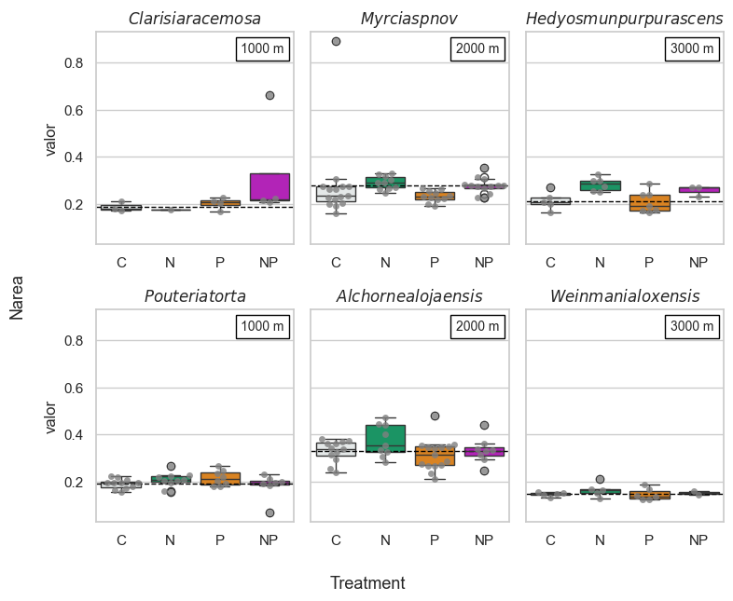
Additional – Leaf morpho traits

Slide 14
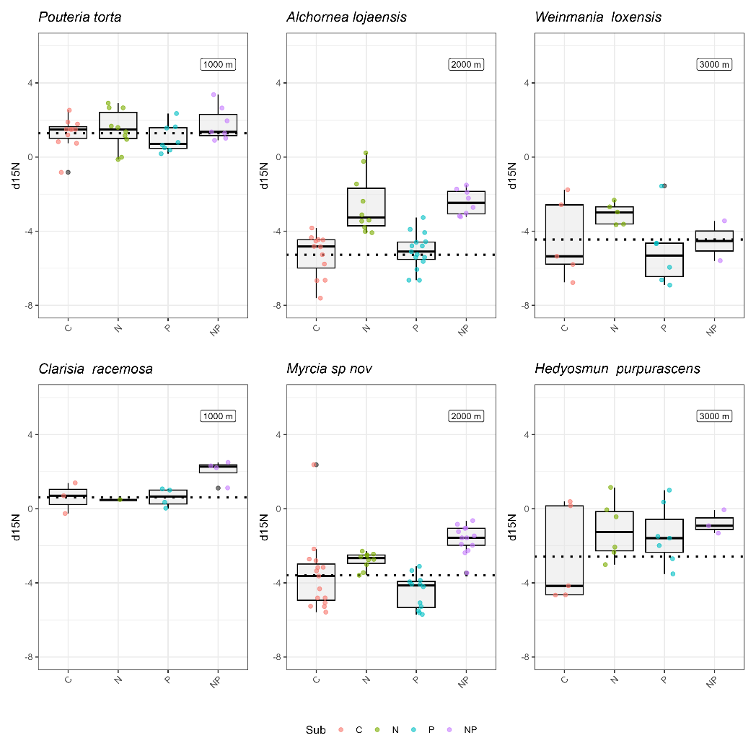
Notes:
None of them are nitrogen fixing species.
How to interpret this one better.

Slide 15
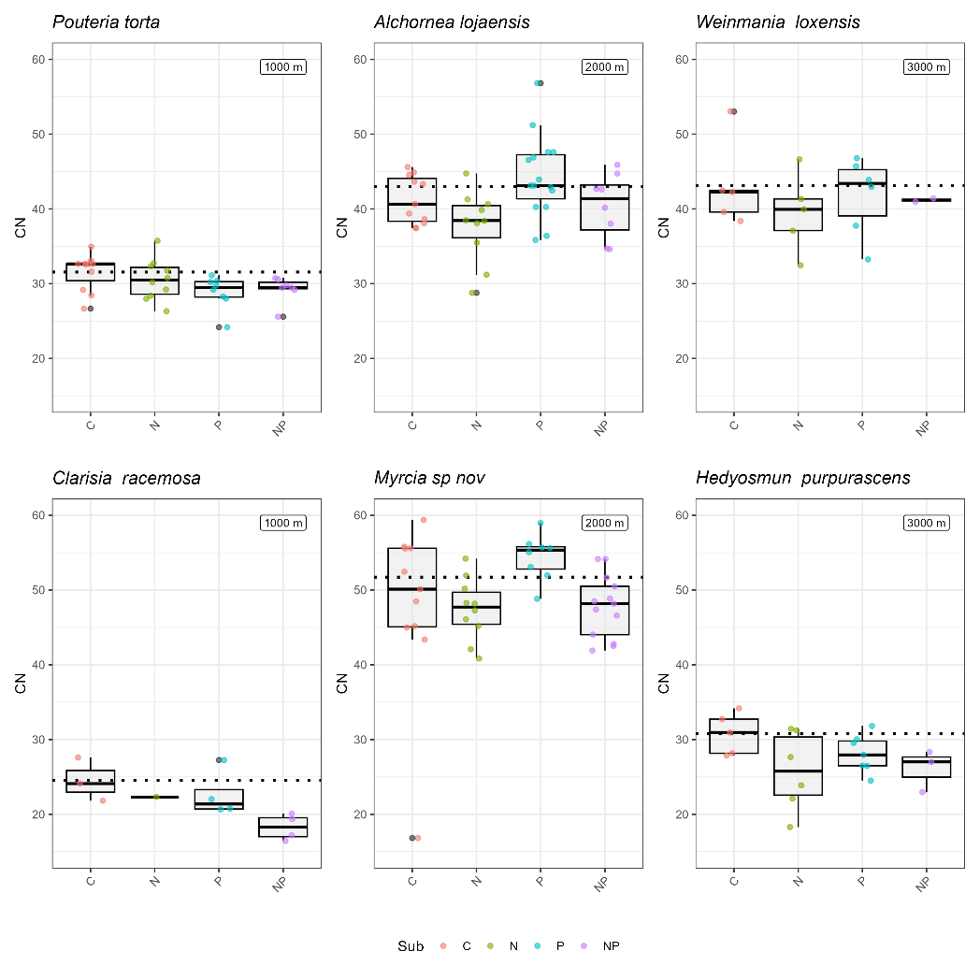

Slide 16
lmer(Response variable~ N * P + (1 | Block/Plot))
Notes:
Pouteria torta, effect of the N and N*P on iWUE, and effect of P o d18O. This is the only specie giving a statistical signal response to nutrient addition on iQUE.
Alchornea, effect of the N on d15N and C:N.
Myrcia, effect of N on d18O, d15N, C:N
Hedyosmum, effect of d15N and C:N. (+ p <0.1)

Slide 17
ANALYSIS PER EACH ELEVATION
lmer(Response variable~ N * P + (1 | specie)+ (1 | Block/Plot)).
Specie only two per elevation. Model too complex.

Slide 18
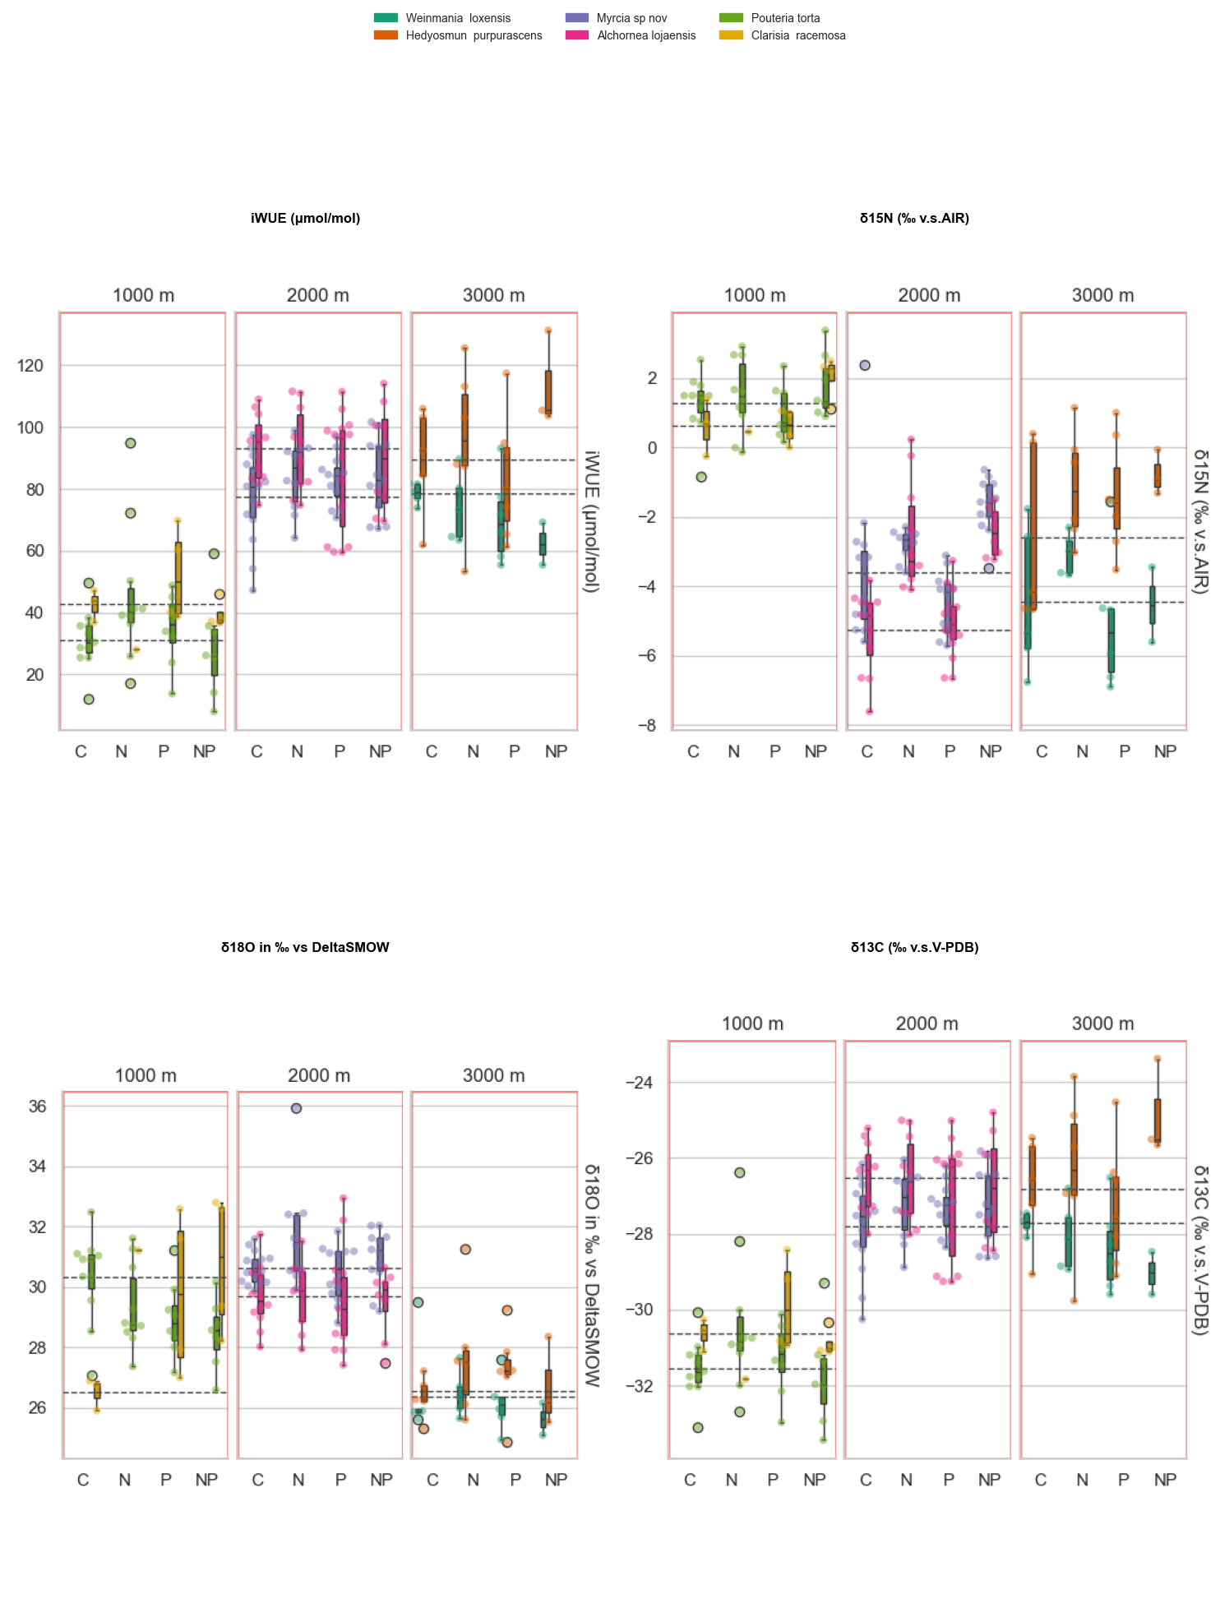
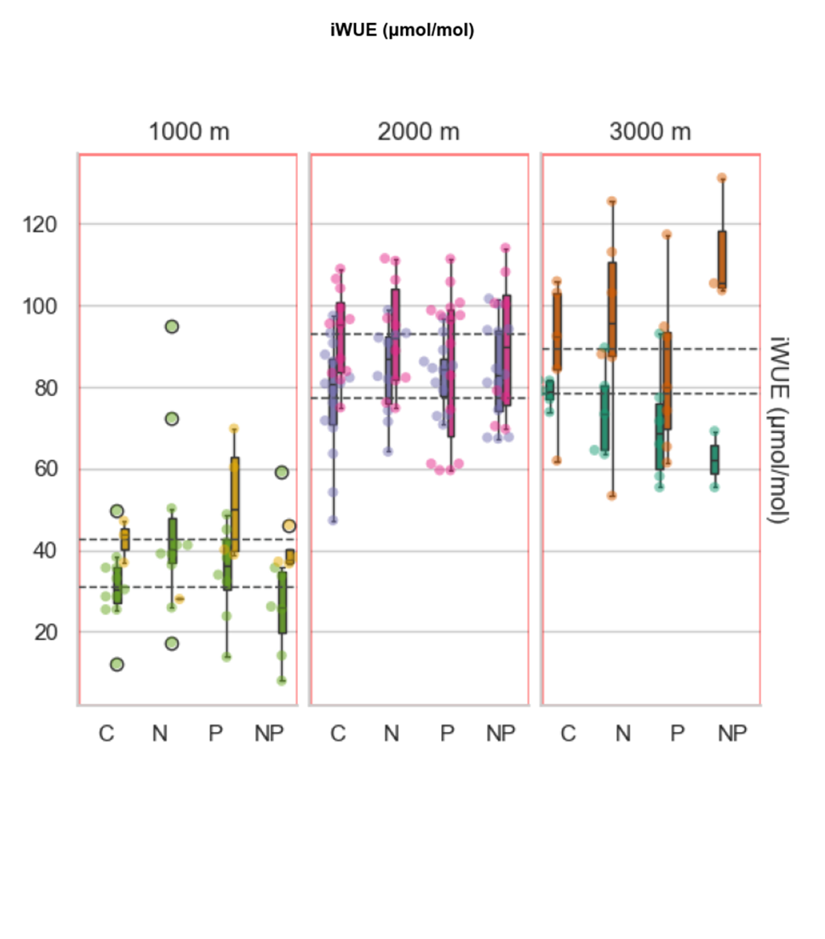
*
*
Notes:
U shaped.

Slide 19
term | (Intercept) | (Intercept) | N | N | P | P | N × P | N × P | SD (Intercept name) | SD (Observations) | SD (Intercept PlotBloque) | SD (Intercept Bloque) | SD (Intercept Plot) | Num.Obs. | AIC
statistic | estimate | std.error | estimate | std.error | estimate | std.error | estimate | std.error | estimate | estimate | estimate | estimate | estimate
3000 m - iWUE (μmol/mol) | 96.643*** | -11.665 | 1.11 | -8.173 | -7.574 | -7.851 | 14.668 | -12.749 | 14.051 | 18.633 | 0 | 3.199 |  | 39 | 332.1
3000 m - O18 | 26.436*** | -0.543 | 0.629 | -0.675 | 0.362 | -0.652 | -1.205 | -1.023 | 0.346 | 1.196 | 0.598 | 0 |  | 39 | 143.2
2000 m iWUE | 98.039*** | -6.548 | 3.31 | -5.619 | -1.388 | -5.34 | -2.517 | -7.944 | 6.72 | 13.685 | 5.269 | 4.985 |  | 93 | 759.2
2000 m O18 | 30.148*** | -0.646 | 0.634 | -0.41 | -0.168 | -0.382 | -0.368 | -0.578 | 0.832 | 1.145 |  |  | 0.297 | 91 | 303.8
1000 m iWUE | 41.272*** | -7.528 | 16.923* | -8.077 | 9.378 | -8.299 | -24.480* | -11.407 | 6.473 | 14.983 | 7.592 | 0 |  | 48 | 396.7
1000 m O18 | 29.272*** | -0.565 | 0.323 | -0.748 | -0.172 | -0.704 | -0.128 | -1.044 | 0 | 1.777 | 0 | 0.54 |  | 48 | 203.5

Slide 20
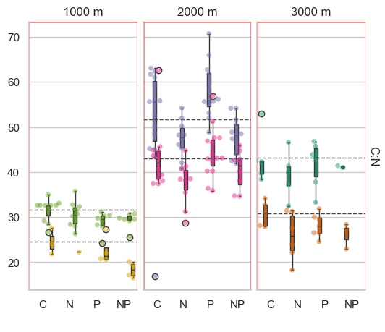
Notes:
Not sure how to model them.

Slide 21
Notes:
Con flecha errores

Slide 22
“COMPLETE” MODEL
lmer(Response variable~ N * P + elevation + (1 | specie)+ (1 | Block/Plot))
lmer(Response variable~ N * P + elevation + (elevation | specie)+ (1 | Block/Plot))
lmer(Response variable~ N * P + leaf traits + elevation + (1 | specie)+ (1 | Block/Plot))
For iWUE and d18O the model with elevation as a quadratic factor worked the best.
A I used DHARMa package for diagnosis.

Slide 23
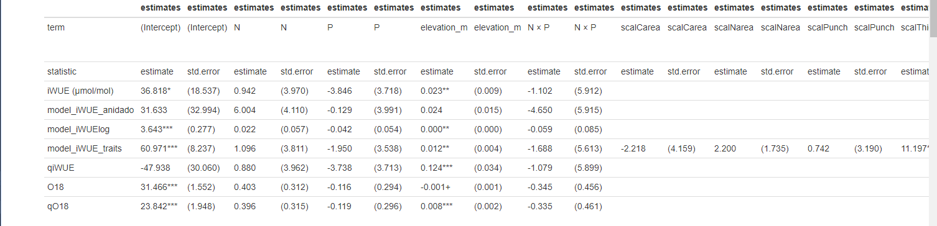
MODEL FOR ALL ELEVATIONS
I need help here:
Still need to define which one is better.
PCA of traits/choose traits.

Slide 24
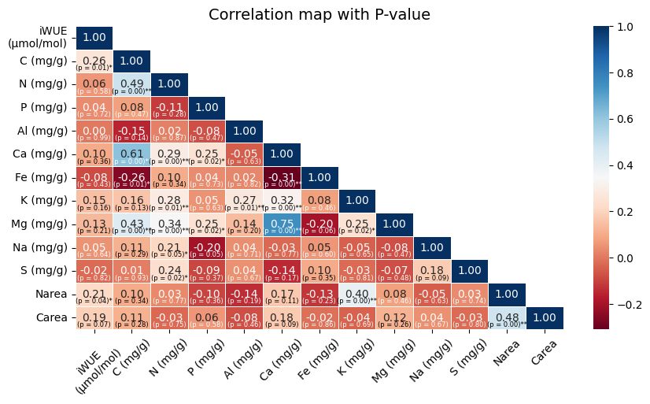
BONUS

Slide 25
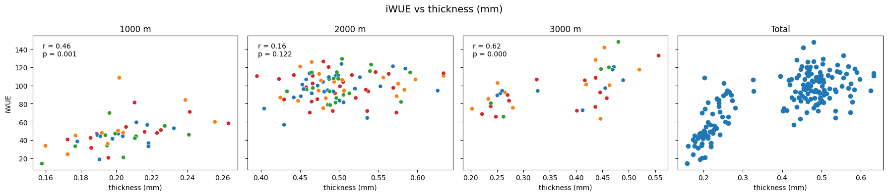
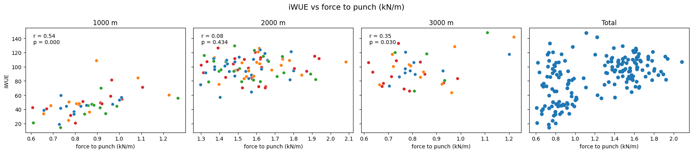
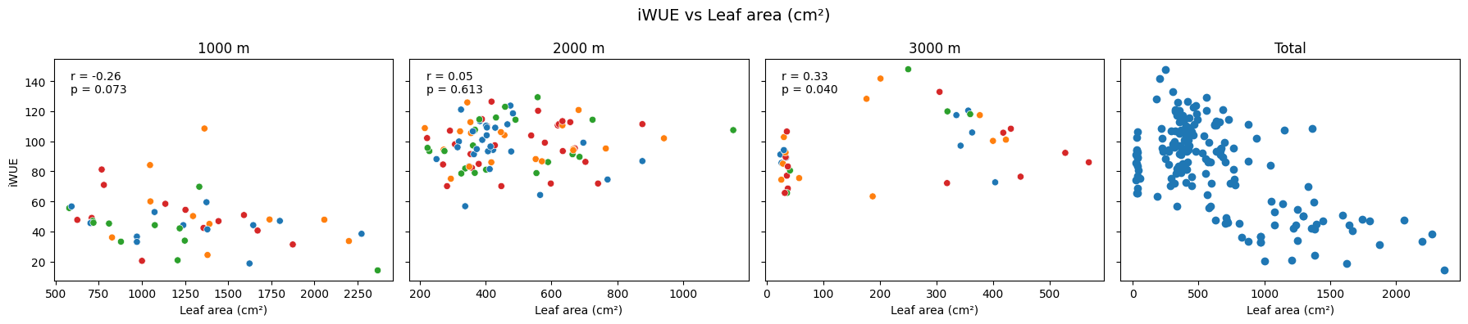

Slide 26
TRENDS IN ELEVATION: DUAL ISOTOPE C AND O
Visual inspection shows clear patterns between the groups according to the elevations.
I created the plots per specie aiming to see clear differences between the treatments. Interesting to check Pouteria, Alchornea, Myrcia, Hedyosmum.
Still need to figure it more how to interpret it.

Slide 27
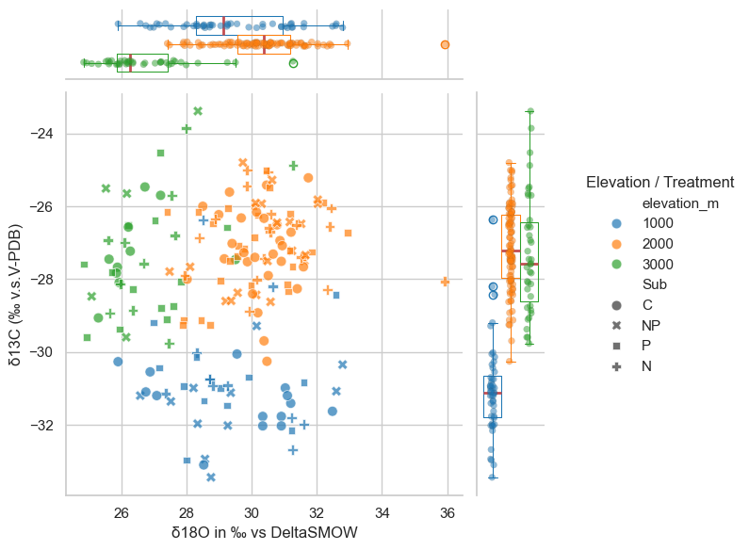
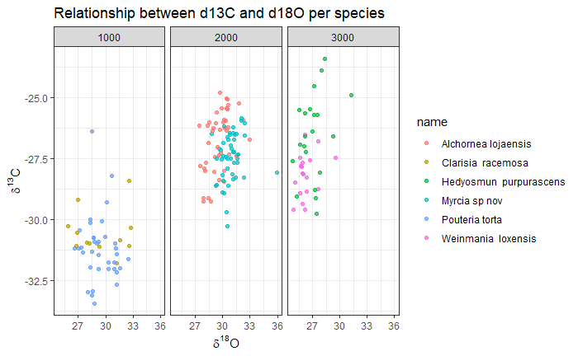
Notes:
Clear differences between elevations. Higher O18 enrichment in the lowlands and at 2000 m – associated with higher transpiration.

Slide 28
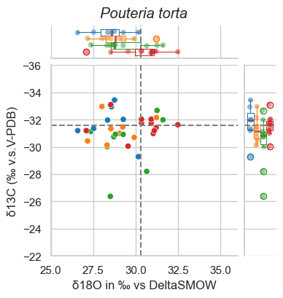
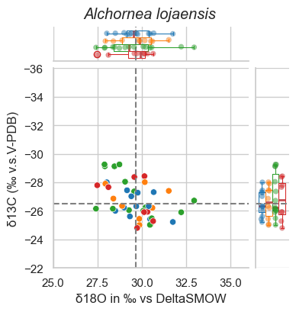
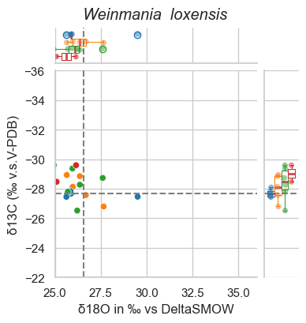
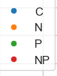
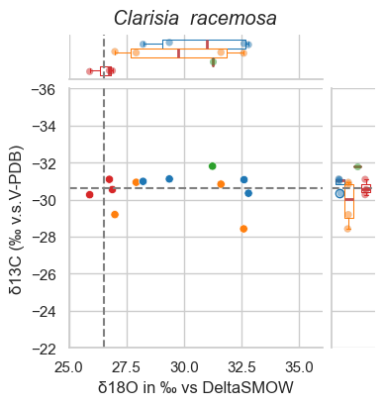
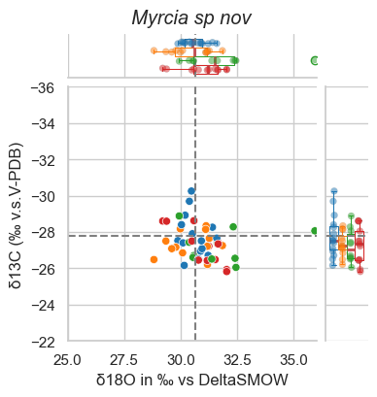
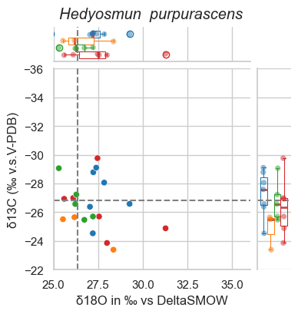
Notes:
Effects of treatment in Pouteria, Alchornea, Hedyosmum. Not sure if these graphics are actually useful. Dotted lines are the means of the control. Maybe I should plot the center instead?

Slide 29
NEXT STEPS AND QUESTIONS
Refining – how better integrate traits. PCA?
The experimental controls from 2009 (n = 9) would be used mainly as a baseline reference due to their limited sample size.
Regarding environmental drivers, elevation has been useful as an integrative gradient, but I would like to discuss the incorporation of explicit climatic variables to improve interpretability or TPI?. I thought on working with PCA dimensions.

