Slide 1
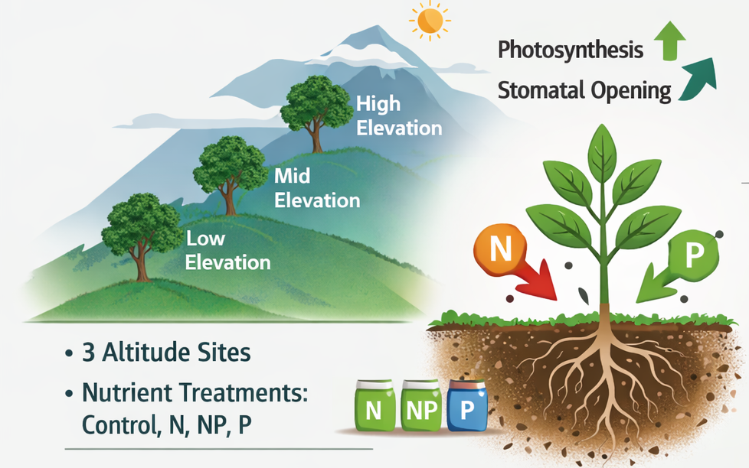

Slide 2
RQ1. Does moderate nutrient addition affect intrinsic water-use efficiency (iWUE) after 15 years of fertilization across treatments in an elevational gradient?
RQ2. What is the effect of moderate nutrient addition to leaf nutrients (Nmass and Narea) and key leaf structural traits (SLA) after 15 years of fertilization across treatments in an elevational gradient?
iWUE does not show changes per treatments (slide 5) although there are differences between groups for leaf nutrients (ex. Narea, or N(mg/g)). (slide 6,7,8). SLA also does not change consistenly just C. racemosa (slide 9)
Responses change per specie -> Working on a chart of species characteristics.
Species at 2000 asl and 3000 asl more similar in their responses tan at 1000. Higher iWUE at mid and higher elevations associated with conservative traits ( smaller SLA, higher N content).

Slide 3
 |  | C | N | NxP | P
elevation | especie
1000 | Clarisia racemosa | 3 | 1 | 4 | 4
 | Pouteria torta | 11 | 10 | 7 | 8
2000 | Alchornea lojaensis | 12 | 9 | 8 | 15
 | Myrcia sp nov | 15 | 10 | 13 | 11
3000 | Hedyosmun purpurascens | 5 | 6 | 3 | 7
 | Weinmania loxensis | 5 | 5 | 2 | 6

Slide 4
 |  |  | δ13C (‰ v.s.V-PDB) |  | iWUE (μmol/mol) |  | Specific leaf area (cm²/g) |  | LCC |  | LNC |  | LPC |  | N:P
 |  |  | mean | std | mean | std | mean | std | mean | std | mean | std | mean | std | mean | std
1000 | Clarisia racemosa | C | -30.63 | 0.42 | 96.61 | 5.19 | 92.05 | 10.83 | 421.37 | 14.36 | 17.39 | 2.56 | 0.79 | 0.05 | 21.87 | 2.18
 |  | N | -31.8 |  | 82.22 |  | 112.06 |  | 447.15 |  | 20.06 |  | 0.96 |  | 20.86
 |  | NP | -30.88 | 0.36 | 93.6 | 4.43 | 108.27 | 8.87 | 430.5 | 14.05 | 23.65 | 1.5 | 1.15 | 0.14 | 20.83 | 3.48
 |  | P | -29.84 | 1.24 | 106.26 | 15.19 | 95.65 | 6.27 | 438.34 | 12.74 | 19.62 | 2.69 | 1.17 | 0.17 | 16.87 | 2.64
 | Pouteria torta | C | -31.55 | 0.76 | 85.26 | 9.34 | 80.27 | 8.75 | 478 | 5.31 | 15.29 | 1.26 | 0.65 | 0.12 | 24.45 | 5.16
 |  | N | -31.27 | 0.87 | 99.8 | 22.43 | 78.19 | 14.39 | 480.5 | 6.22 | 15.69 | 1.16 | 0.64 | 0.2 | 25.95 | 5.44
 |  | NP | -31.74 | 1.35 | 82.99 | 16.58 | 79.48 | 9.22 | 477.95 | 5.16 | 16.38 | 0.98 | 0.73 | 0.07 | 22.58 | 1.81
 |  | P | -31.27 | 0.93 | 88.76 | 11.48 | 78.02 | 10.48 | 479.21 | 5.51 | 16.68 | 1.52 | 0.77 | 0.13 | 22.47 | 5.11
2000 | Alchornea lojaensis | C | -26.51 | 0.89 | 146.94 | 10.79 | 35.67 | 4.22 | 489.94 | 9.19 | 11.61 | 1.5 | 0.78 | 0.12 | 15.07 | 2.24
 |  | N | -26.57 | 1.13 | 146.26 | 13.81 | 36.94 | 3.38 | 487.69 | 10.08 | 13.14 | 1.82 | 0.79 | 0.15 | 16.83 | 1.83
 |  | NP | -26.77 | 1.45 | 143.79 | 17.65 | 34.5 | 3.27 | 490.56 | 10.44 | 12.04 | 1.6 | 1.32 | 0.33 | 9.59 | 2.28
 |  | P | -27.06 | 1.51 | 140.31 | 18.37 | 36 | 5.12 | 486.93 | 5.09 | 11.1 | 1.37 | 1.24 | 0.28 | 8.94 | 2.79
 | Myrcia sp nov | C | -27.79 | 1.15 | 131.33 | 14.07 | 36.24 | 4.23 | 472.37 | 9.44 | 8.82 | 1.17 | 0.43 | 0.17 | 23.28 | 4.17
 |  | N | -27.24 | 0.92 | 138.06 | 11.23 | 35.42 | 2.48 | 470.86 | 6.79 | 9.99 | 0.83 | 0.43 | 0.03 | 23.54 | 2.22
 |  | NP | -27.27 | 1 | 137.71 | 12.18 | 35.88 | 2.64 | 464.64 | 6.03 | 9.79 | 0.81 | 0.88 | 0.36 | 12.42 | 3.68
 |  | P | -27.34 | 0.66 | 136.92 | 8.09 | 34.37 | 3.3 | 469.88 | 9.99 | 8.19 | 0.95 | 1.7 | 0.66 | 6.34 | 5.05
3000 | Hedyosmun purpurascens | C | -26.81 | 1.44 | 143.37 | 17.6 | 68.88 | 16.18 | 438.02 | 6.14 | 14.31 | 1.09 | 0.84 | 0.08 | 17.17 | 1.02
 |  | N | -26.35 | 2.06 | 148.86 | 25.07 | 60.87 | 6.61 | 434.85 | 10.11 | 17.47 | 3.63 | 0.8 | 0.05 | 21.78 | 4.15
 |  | NP | -24.85 | 1.27 | 167.17 | 15.36 | 65.98 | 5.04 | 442.68 | 6.62 | 17.08 | 1.68 | 1.07 | 0.08 | 15.94 | 0.42
 |  | P | -27.29 | 1.59 | 137.48 | 19.36 | 75.91 | 12.42 | 436.7 | 5.99 | 15.65 | 1.54 | 1.42 | 0.44 | 11.12 | 4.43
 | Weinmania loxensis | C | -27.7 | 0.27 | 132.49 | 3.29 | 70.1 | 5.89 | 444.08 | 7.83 | 10.43 | 1.34 | 0.56 | 0.05 | 18.65 | 1.67
 |  | N | -28.06 | 0.9 | 128.13 | 10.95 | 69.55 | 9.63 | 445.46 | 14.2 | 11.47 | 1.77 | 0.61 | 0.05 | 18.89 | 1.99
 |  | NP | -29.03 | 0.79 | 116.22 | 9.7 | 72.21 | 6.39 | 460.1 | 9.12 | 11.17 | 0.14 | 0.72 | 0.07 | 15.57 | 1.25
 |  | P | -28.38 | 1.13 | 124.17 | 13.8 | 72.58 | 4.07 | 440.55 | 11.17 | 10.73 | 1.7 | 1.64 | 0.44 | 7.31 | 3.43

Slide 5
Main figures

Slide 6
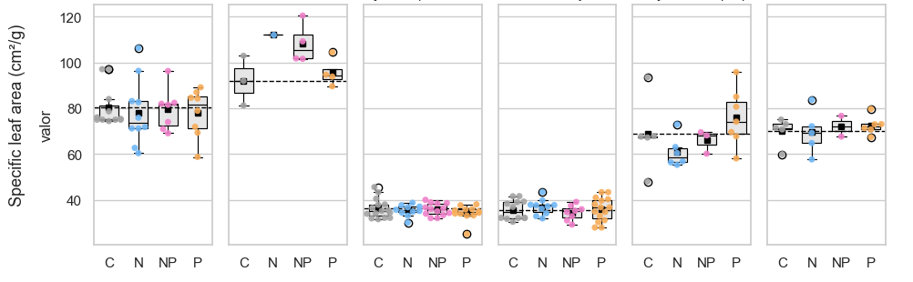
1000 m
2000 m
3000 m
P.torta C. racemosa M. sp. Nov. A. lojaensis H. purpurascens W. loxensis
*
term | (Intercept) | (Intercept) | SUBN | SUBN | SUBNP | SUBNP | SUBP | SUBP | SD (Intercept Bloque) | SD (Observations) | Num.Obs. | R2 Marg. | R2 Cond. | AIC
statistic | estimate | std.error | estimate | std.error | estimate | std.error | estimate | std.error | estimate | estimate
SLA | 1000 | Pouteria | 80.265*** | (3.333) | -2.075 | (4.829) | -0.783 | (5.344) | -2.247 | (5.136) | 0.000 | 11.053 | 36 | 0.008 |  | 265.3
SLA | 1000 | Clarisia | 92.055*** | (5.532) | 24.498* | (7.724) | 14.369* | (4.867) | 7.687 | (5.135) | 7.217 | 6.303 | 12 | 0.374 | 0.729 | 71.2
SLA | 2000 | Alchornea | 35.554*** | (1.365) | 1.260 | (1.762) | -1.368 | (1.875) | 0.383 | (1.592) | 1.357 | 4.087 | 45 | 0.038 | 0.133 | 255.7
SLA | 2000 | Myrcia | 36.240*** | (0.859) | -0.816 | (1.359) | -0.361 | (1.261) | -1.871 | (1.289) | 0.000 | 3.329 | 50 | 0.045 |  | 263.2
SLA | 3000 | Hedyosmum | 68.883*** | (5.136) | -8.013 | (6.954) | -2.907 | (8.387) | 7.024 | (6.725) | 0.000 | 11.484 | 21 | 0.222 |  | 149.7
SLA | 3000 | Weinmannia | 70.102*** | (3.009) | -0.552 | (4.255) | 2.106 | (5.629) | 2.477 | (4.074) | 0.000 | 6.728 | 18 | 0.040 |  | 110.8

Slide 7
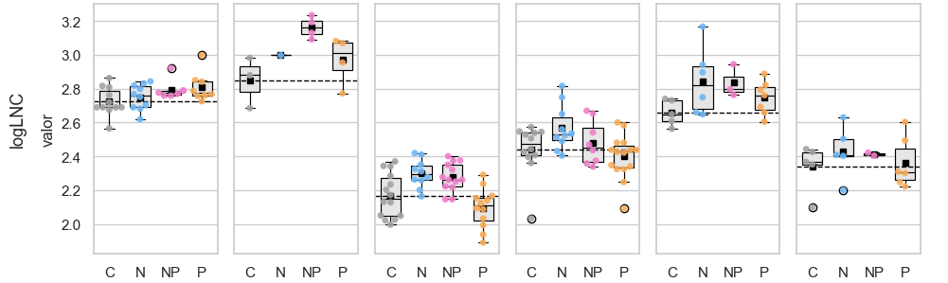
1000 m
2000 m
3000 m
P.torta C. racemosa M. sp. Nov. A. lojaensis H. purpurascens W. loxensis
*
 | (Intercept) | (Intercept) | N | N | NP | NP | P | P | SD (Intercept Bloque) | SD (Observations) | Num.Obs. | R2 Marg. | R2 Cond. | AIC
Modelo | estimates | estimates.1 | estimates.2 | estimates.3 | estimates.4 | estimates.5 | estimates.6 | estimates.7 | estimates.8 | estimates.9 | gof | gof.1 | gof.2 | gof.3
logNmass | 1000 | Pouteria | 2.728*** | (0.030) | 0.021 | (0.036) | 0.049 | (0.036) | 0.082* | (0.034) | 0.038 | 0.071 | 36 | 0.132 | 0.324 | -54.8
logNmass | 1000 | Clarisia | 2.849*** | (0.070) | 0.150 | (0.141) | 0.313* | (0.093) | 0.120 | (0.093) | 0.000 | 0.122 | 12 | 0.520 |  | 4.9
logNmass | 2000 | Alchornea | 2.442*** | (0.039) | 0.125* | (0.058) | 0.038 | (0.061) | -0.043 | (0.052) | 0.000 | 0.134 | 45 | 0.182 |  | -26.6
logNmass | 2000 | Myrcia | 2.168*** | (0.032) | 0.132** | (0.043) | 0.102* | (0.041) | -0.071+ | (0.041) | 0.031 | 0.104 | 49 | 0.350 | 0.405 | -52.1
logNmass | 3000 | Hedyosmum | 2.648*** | (0.065) | 0.201** | (0.065) | 0.163+ | (0.078) | 0.088 | (0.062) | 0.089 | 0.106 | 21 | 0.243 | 0.557 | -5.4
logNmass | 3000 | Weinmannia | 2.338*** | (0.064) | 0.092 | (0.091) | 0.076 | (0.121) | 0.026 | (0.087) | 0.000 | 0.144 | 18 | 0.067 |  | 3.2

Slide 8
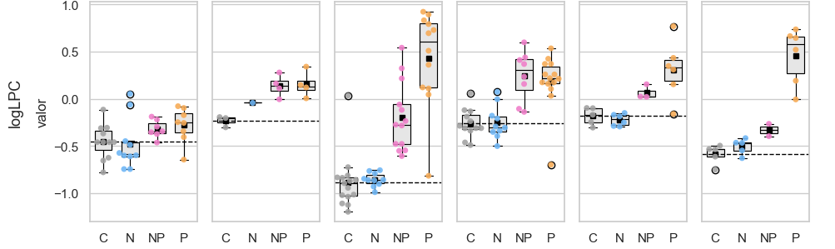
1000 m
2000 m
3000 m
P.torta C. racemosa M. sp. Nov. A. lojaensis H. purpurascens W. loxensis
*
 | (Intercept) | (Intercept) | N | N | NP | NP | P | P | SD (Intercept Bloque) | SD (Observations) | Num.Obs. | R2 Marg. | R2 Cond. | AIC
logLPC | 1000 | Pouteria | -0.446*** | (0.076) | -0.038 | (0.093) | 0.121 | (0.096) | 0.178+ | (0.091) | 0.086 | 0.189 | 36 | 0.153 | 0.298 | 7.5
logLPC | 1000 | Clarisia | -0.233* | (0.067) | 0.194 | (0.134) | 0.370** | (0.088) | 0.386** | (0.088) | 0.000 | 0.116 | 12 | 0.684 |  | 4.1
logLPC | 2000 | Alchornea | -0.257** | (0.081) | -0.019 | (0.092) | 0.489*** | (0.098) | 0.428*** | (0.085) | 0.106 | 0.213 | 44 | 0.491 | 0.592 | 14.9
logLPC | 2000 | Myrcia | -0.883*** | (0.090) | 0.027 | (0.143) | 0.687*** | (0.132) | 1.315*** | (0.135) | 0.000 | 0.349 | 50 | 0.707 |  | 55.8
logLPC | 3000 | Hedyosmum | -0.183* | (0.082) | -0.039 | (0.111) | 0.249+ | (0.134) | 0.492*** | (0.111) | 0.000 | 0.183 | 20 | 0.622 |  | 9.4
logLPC | 3000 | Weinmannia | -0.585*** | (0.086) | 0.081 | (0.122) | 0.255 | (0.162) | 1.043*** | (0.117) | 0.000 | 0.193 | 18 | 0.858 |  | 11.4

Slide 9
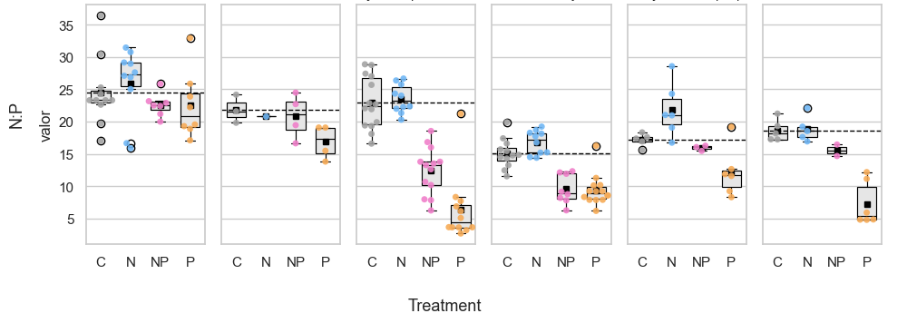
1000 m
2000 m
3000 m
P.torta C. racemosa M. sp. Nov. A. lojaensis H. purpurascens W. loxensis
*
 | (Intercept) | N | NP | P | Num.Obs. | R2 Marg. | R2 Cond. | AIC
Leaf N:P | 1000 | Pouteria | 24.474*** | 1.444 | -1.987 | -2.163 | 36 | 0.087 | 0.140 | 211.6
Leaf N:P | 1000 | Clarisia | 21.867*** | -0.995 | -1.076 | -4.953+ | 12 | 0.356 | 0.374 | 55.5
Leaf N:P | 2000 | Alchornea | 15.015*** | 2.175* | -5.308*** | -5.939*** | 45 | 0.653 | 0.769 | 203.1
Leaf N:P | 2000 | Myrcia | 23.224*** | 0.308 | -11.021*** | -16.982*** | 50 | 0.772 | 0.788 | 279.1
Leaf N:P | 3000 | Hedyosmum | 17.046*** | 4.648* | -1.420 | -6.056** | 21 | 0.599 | 0.645 | 109.1
Leaf N:P | 3000 | Weinmannia | 18.652*** | 0.234 | -3.078 | -11.345*** | 18 | 0.823 |  | 83.1

Slide 10
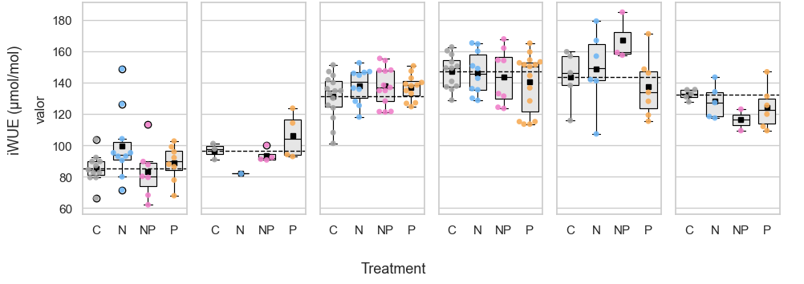
1000 m
2000 m
3000 m
P.torta C. racemosa M. sp. Nov. A. lojaensis H. purpurascens W. loxensis
term | (Intercept) | SUBN | SUBNP | SUBP | SD (Intercept Bloque) | SD (Observations) | Num.Obs. | R2 Marg. | R2 Cond. | AIC
statistic | estimate | estimate | estimate | estimate | estimate | estimate
iWUE | 1000 | Pouteria | 85.255*** | 14.543* | -2.266 | 3.506 | 0.000 | 15.786 | 36 | 0.152 |  | 288.1
iWUE | 1000 | Clarisia | 96.605*** | -14.388 | -3.010 | 9.652 | 0.000 | 10.033 | 12 | 0.353 |  | 75.5
iWUE | 2000 | Alchornea | 146.959*** | 0.066 | -2.984 | -7.104 | 7.294 | 14.158 | 45 | 0.039 | 0.241 | 359.2
iWUE | 2000 | Myrcia | 131.326*** | 6.731 | 6.381 | 5.593 | 0.000 | 11.800 | 50 | 0.057 |  | 379.7
iWUE | 3000 | Hedyosmum | 143.373*** | 5.491 | 23.798 | -5.890 | 0.000 | 20.438 | 21 | 0.188 |  | 169.3
iWUE | 3000 | Weinmannia | 132.195*** | -4.230 | -14.820 | -7.505 | 3.322 | 10.186 | 18 | 0.155 | 0.236 | 123.3

Slide 11
Narea and Parea (optional)

Slide 12
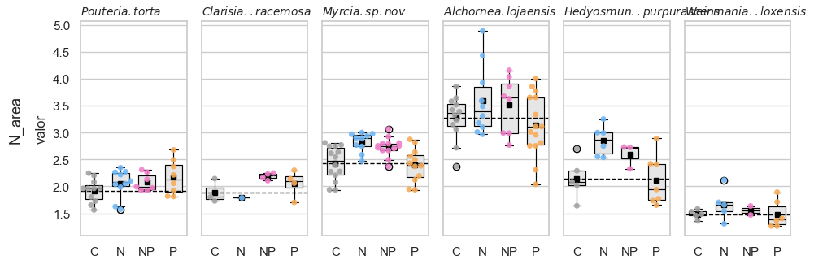
1000 m
2000 m
3000 m
P.torta C. racemosa M. sp. Nov. A. lojaensis H. purpurascens W. loxensis
*
 | (Intercept) | (Intercept) | N | N | NP | NP | P | P | SD (Intercept Bloque) | SD (Observations) | Num.Obs. | R2 Marg. | R2 Cond. | AIC
Modelo | estimates | estimates.1 | estimates.2 | estimates.3 | estimates.4 | estimates.5 | estimates.6 | estimates.7 | estimates.8 | estimates.9 | gof | gof.1 | gof.2 | gof.3
Narea | 1000 | Pouteria | 1.920*** | (0.075) | 0.127 | (0.108) | 0.154 | (0.120) | 0.250* | (0.115) | 0.000 | 0.248 | 36 | 0.123 |  | 22.3
Narea | 1000 | Clarisia | 1.892*** | (0.112) | -0.102 | (0.224) | 0.295+ | (0.148) | 0.159 | (0.148) | 0.000 | 0.194 | 12 | 0.342 |  | 12.3
Narea | 2000 | Alchornea | 3.272*** | (0.161) | 0.320 | (0.231) | 0.243 | (0.247) | -0.133 | (0.209) | 0.079 | 0.539 | 45 | 0.106 | 0.125 | 87.9
Narea | 2000 | Myrcia | 2.882*** | (0.260) | -0.057 | (0.410) | -0.152 | (0.380) | -0.486 | (0.389) | 0.046 | 1.003 | 50 | 0.035 | 0.037 | 153.0
Narea | 3000 | Hedyosmum | 2.136*** | (0.170) | 0.702** | (0.222) | 0.448 | (0.268) | -0.022 | (0.214) | 0.094 | 0.365 | 21 | 0.433 | 0.468 | 33.2
Narea | 3000 | Weinmannia | 1.484*** | (0.102) | 0.182 | (0.144) | 0.069 | (0.191) | -0.000 | (0.138) | 0.000 | 0.228 | 18 | 0.114 |  | 16.1

Slide 13
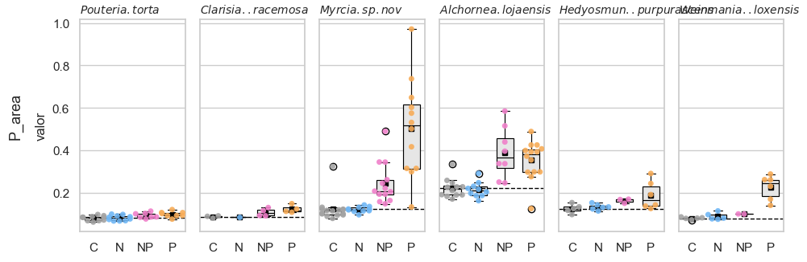
1000 m
2000 m
3000 m
P.torta C. racemosa M. sp. Nov. A. lojaensis H. purpurascens W. loxensis
*
 | (Intercept) | (Intercept) | N | N | NP | NP | P | P | SD (Intercept Bloque) | SD (Observations) | Num.Obs. | R2 Marg. | R2 Cond. | AIC
Modelo | estimates | estimates.1 | estimates.2 | estimates.3 | estimates.4 | estimates.5 | estimates.6 | estimates.7 | estimates.8 | estimates.9 | gof | gof.1 | gof.2 | gof.3
Parea | 1000 | Pouteria | 0.081*** | (0.005) | -0.000 | (0.006) | 0.011+ | (0.006) | 0.018** | (0.006) | 0.005 | 0.012 | 36 | 0.279 | 0.380 | -170.3
Parea | 1000 | Clarisia | 0.087*** | (0.010) | -0.003 | (0.018) | 0.022+ | (0.011) | 0.033* | (0.012) | 0.008 | 0.015 | 12 | 0.437 | 0.579 | -27.6
Parea | 2000 | Alchornea | 0.221*** | (0.036) | -0.008 | (0.052) | 0.167** | (0.056) | 0.174*** | (0.047) | 0.011 | 0.122 | 45 | 0.345 | 0.351 | -34.5
Parea | 2000 | Myrcia | 0.122*** | (0.033) | -0.001 | (0.051) | 0.122* | (0.048) | 0.382*** | (0.049) | 0.000 | 0.126 | 50 | 0.604 |  | -38.1
Parea | 3000 | Hedyosmum | 0.125*** | (0.027) | 0.008 | (0.036) | 0.038 | (0.044) | 0.093* | (0.035) | 0.000 | 0.060 | 21 | 0.319 |  | -29.1
Parea | 3000 | Weinmannia | 0.080*** | (0.016) | 0.009 | (0.023) | 0.020 | (0.030) | 0.145*** | (0.022) | 0.000 | 0.036 | 18 | 0.778 |  | -35.7

Slide 14
Coeficients plot
Still figuring out if work with LNC or Narea

Slide 15
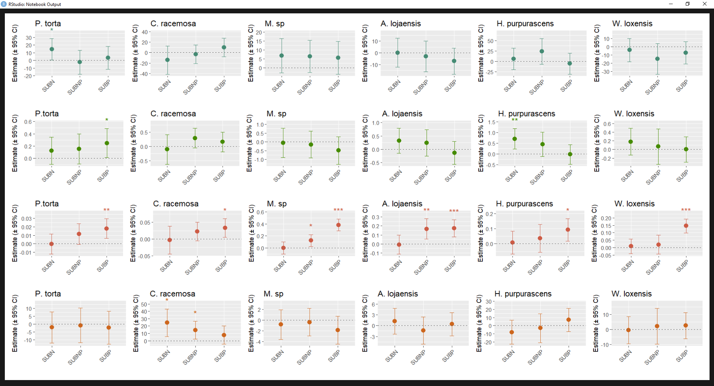
1000 m
2000 m
3000 m
Modelo | estimates | estimates.2 | estimates.4 | estimates.6 | estimates.9 | gof | gof.1 | gof.2 | gof.3
term | (Intercept) | SUBN | SUBNP | SUBP | SD (Observations) | Num.Obs. | R2 Marg. | R2 Cond. | AIC
statistic | estimate | estimate | estimate | estimate | estimate
Nmass | 1000 | Pouteria | 15.336*** | 0.330 | 0.780 | 1.320* | 1.160 | 36 | 0.133 | 0.298 | 124.0
Nmass | 1000 | Clarisia | 17.393*** | 2.667 | 6.259* | 2.227 | 2.277 | 12 | 0.558 |  | 51.7
Nmass | 2000 | Alchornea | 11.606*** | 1.533* | 0.429 | -0.508 | 1.552 | 45 | 0.198 |  | 174.0
Nmass | 2000 | Myrcia | 8.812*** | 1.192** | 0.909* | -0.619 | 0.931 | 49 | 0.347 | 0.402 | 145.4
Nmass | 3000 | Hedyosmum | 14.134*** | 3.403* | 2.589+ | 1.359 | 1.920 | 21 | 0.234 | 0.504 | 92.6
Nmass | 3000 | Weinmannia | 10.434*** | 1.032 | 0.739 | 0.297 | 1.563 | 18 | 0.067 |  | 69.9
logNmass | 1000 | Pouteria | 2.728*** | 0.021 | 0.049 | 0.082* | 0.071 | 36 | 0.132 | 0.324 | -54.8
logNmass | 1000 | Clarisia | 2.849*** | 0.150 | 0.313* | 0.120 | 0.122 | 12 | 0.520 |  | 4.9
logNmass | 2000 | Alchornea | 2.442*** | 0.125* | 0.038 | -0.043 | 0.134 | 45 | 0.182 |  | -26.6
logNmass | 2000 | Myrcia | 2.168*** | 0.132** | 0.102* | -0.071+ | 0.104 | 49 | 0.350 | 0.405 | -52.1
logNmass | 3000 | Hedyosmum | 2.648*** | 0.201** | 0.163+ | 0.088 | 0.106 | 21 | 0.243 | 0.557 | -5.4
logNmass | 3000 | Weinmannia | 2.338*** | 0.092 | 0.076 | 0.026 | 0.144 | 18 | 0.067 |  | 3.2
Narea | 1000 | Pouteria | 1.920*** | 0.127 | 0.154 | 0.250* | 0.248 | 36 | 0.123 |  | 22.3
Narea | 1000 | Clarisia | 1.892*** | -0.102 | 0.295+ | 0.159 | 0.194 | 12 | 0.342 |  | 12.3
Narea | 2000 | Alchornea | 3.272*** | 0.320 | 0.243 | -0.133 | 0.539 | 45 | 0.106 | 0.125 | 87.9
Narea | 2000 | Myrcia | 2.882*** | -0.057 | -0.152 | -0.486 | 1.003 | 50 | 0.035 | 0.037 | 153.0
Narea | 3000 | Hedyosmum | 2.136*** | 0.702** | 0.448 | -0.022 | 0.365 | 21 | 0.433 | 0.468 | 33.2
Narea | 3000 | Weinmannia | 1.484*** | 0.182 | 0.069 | -0.000 | 0.228 | 18 | 0.114 |  | 16.1
Cmass | 1000 | Pouteria | 478.002*** | 2.498 | -0.055 | 1.210 | 5.593 | 33 | 0.036 |  | 202.6
Cmass | 1000 | Clarisia | 421.372*** | 25.773 | 9.125 | 16.973 | 13.655 | 12 | 0.265 |  | 80.4
Cmass | 2000 | Alchornea | 489.936*** | -2.251 | 0.623 | -3.010 | 8.523 | 43 | 0.030 |  | 299.2
Cmass | 2000 | Myrcia | 472.530*** | -1.507 | -7.836* | -2.897 | 8.111 | 50 | 0.118 | 0.177 | 347.0
Cmass | 3000 | Hedyosmum | 438.175*** | -3.352 | 4.616 | -1.430 | 7.329 | 21 | 0.104 | 0.158 | 135.2
Cmass | 3000 | Weinmannia | 444.044*** | 0.897 | 17.429+ | -2.611 | 10.639 | 18 | 0.220 | 0.318 | 124.8
Carea | 1000 | Pouteria | 60.501*** | 2.382 | 0.288 | 2.011 | 9.170 | 36 | 0.014 |  | 253.4
Carea | 1000 | Clarisia | 46.093*** | -8.463* | -5.063* | -2.305 | 2.141 | 12 | 0.274 | 0.817 | 55.3
Carea | 2000 | Alchornea | 139.527*** | -6.085 | 2.265 | -2.010 | 17.610 | 45 | 0.023 | 0.108 | 375.2
Carea | 2000 | Myrcia | 131.985*** | 1.625 | -1.843 | 6.197 | 13.747 | 50 | 0.046 |  | 393.7
Carea | 3000 | Hedyosmum | 66.582*** | 5.565 | 0.796 | -7.692 | 11.044 | 21 | 0.194 |  | 148.4
Carea | 3000 | Weinmannia | 63.680*** | 1.384 | 0.233 | -2.826 | 6.295 | 18 | 0.072 |  | 108.9
logLCCC | 1000 | Pouteria | 6.170*** | 0.005 | -0.000 | 0.003 | 0.012 | 33 | 0.036 |  | -155.4
logLCCC |1000 | Clarisia | 6.043*** | 0.060 | 0.021 | 0.040 | 0.032 | 12 | 0.263 |  | -16.6
logLCCC | 2000 | Alchornea | 6.194*** | -0.005 | 0.001 | -0.006 | 0.018 | 43 | 0.029 |  | -183.4
logLCCC | 2000 | Myrcia | 6.158*** | -0.003 | -0.017* | -0.006 | 0.017 | 50 | 0.119 | 0.177 | -219.7
logLCCC | 3000 | Hedyosmum | 6.083*** | -0.008 | 0.010 | -0.003 | 0.017 | 21 | 0.104 | 0.158 | -71.4
logLCCC | 3000 | Weinmannia | 6.096*** | 0.002 | 0.039+ | -0.006 | 0.024 | 18 | 0.215 | 0.310 | -45.7
LPC | 1000 | Pouteria | 0.650*** | -0.012 | 0.078 | 0.123+ | 0.136 | 36 | 0.131 | 0.238 | -14.2
LPC | 1000 | Clarisia | 0.793*** | 0.169 | 0.359* | 0.381** | 0.134 | 12 | 0.609 |  | 6.5
LPC | 2000 | Alchornea | 0.784*** | -0.015 | 0.526*** | 0.449*** | 0.218 | 44 | 0.518 | 0.593 | 16.4
LPC | 2000 | Myrcia | 0.434*** | -0.008 | 0.444** | 1.263*** | 0.384 | 50 | 0.643 |  | 64.6
LPC | 3000 | Hedyosmum | 0.835*** | -0.034 | 0.235 | 0.581** | 0.250 | 20 | 0.542 |  | 19.3
LPC | 3000 | Weinmannia | 0.559*** | 0.046 | 0.161 | 1.077*** | 0.266 | 18 | 0.781 |  | 20.4
logLPC | 1000 | Pouteria | -0.446*** | -0.038 | 0.121 | 0.178+ | 0.189 | 36 | 0.153 | 0.298 | 7.5
logLPC | 1000 | Clarisia | -0.233* | 0.194 | 0.370** | 0.386** | 0.116 | 12 | 0.684 |  | 4.1
logLPC | 2000 | Alchornea | -0.257** | -0.019 | 0.489*** | 0.428*** | 0.213 | 44 | 0.491 | 0.592 | 14.9
logLPC | 2000 | Myrcia | -0.883*** | 0.027 | 0.687*** | 1.315*** | 0.349 | 50 | 0.707 |  | 55.8
logLPC | 3000 | Hedyosmum | -0.183* | -0.039 | 0.249+ | 0.492*** | 0.183 | 20 | 0.622 |  | 9.4
logLPC | 3000 | Weinmannia | -0.585*** | 0.081 | 0.255 | 1.043*** | 0.193 | 18 | 0.858 |  | 11.4
Parea | 1000 | Pouteria | 0.081*** | -0.000 | 0.011+ | 0.018** | 0.012 | 36 | 0.279 | 0.380 | -170.3
Parea | 1000 | Clarisia | 0.087*** | -0.003 | 0.022+ | 0.033* | 0.015 | 12 | 0.437 | 0.579 | -27.6
Parea | 2000 | Alchornea | 0.221*** | -0.008 | 0.167** | 0.174*** | 0.122 | 45 | 0.345 | 0.351 | -34.5
Parea | 2000 | Myrcia | 0.122*** | -0.001 | 0.122* | 0.382*** | 0.126 | 50 | 0.604 |  | -38.1
Parea | 3000 | Hedyosmum | 0.125*** | 0.008 | 0.038 | 0.093* | 0.060 | 21 | 0.319 |  | -29.1
Parea | 3000 | Weinmannia | 0.080*** | 0.009 | 0.020 | 0.145*** | 0.036 | 18 | 0.778 |  | -35.7
Leaf N:P | 1000 | Pouteria | 24.474*** | 1.444 | -1.987 | -2.163 | 4.690 | 36 | 0.087 | 0.140 | 211.6
Leaf N:P | 1000 | Clarisia | 21.867*** | -0.995 | -1.076 | -4.953+ | 2.859 | 12 | 0.356 | 0.374 | 55.5
Leaf N:P | 2000 | Alchornea | 15.015*** | 2.175* | -5.308*** | -5.939*** | 2.071 | 45 | 0.653 | 0.769 | 203.1
Leaf N:P | 2000 | Myrcia | 23.224*** | 0.308 | -11.021*** | -16.982*** | 3.874 | 50 | 0.772 | 0.788 | 279.1
Leaf N:P | 3000 | Hedyosmum | 17.046*** | 4.648* | -1.420 | -6.056** | 3.337 | 21 | 0.599 | 0.645 | 109.1
Leaf N:P | 3000 | Weinmannia | 18.652*** | 0.234 | -3.078 | -11.345*** | 2.498 | 18 | 0.823 |  | 83.1
SLA (g/m2) Parea(g/m² ) Narea(g/m² ) iWUE (μmol/mol)
Notes:
Efectos modelo lmer contra control. Cual será mejor para publicar?

Slide 16
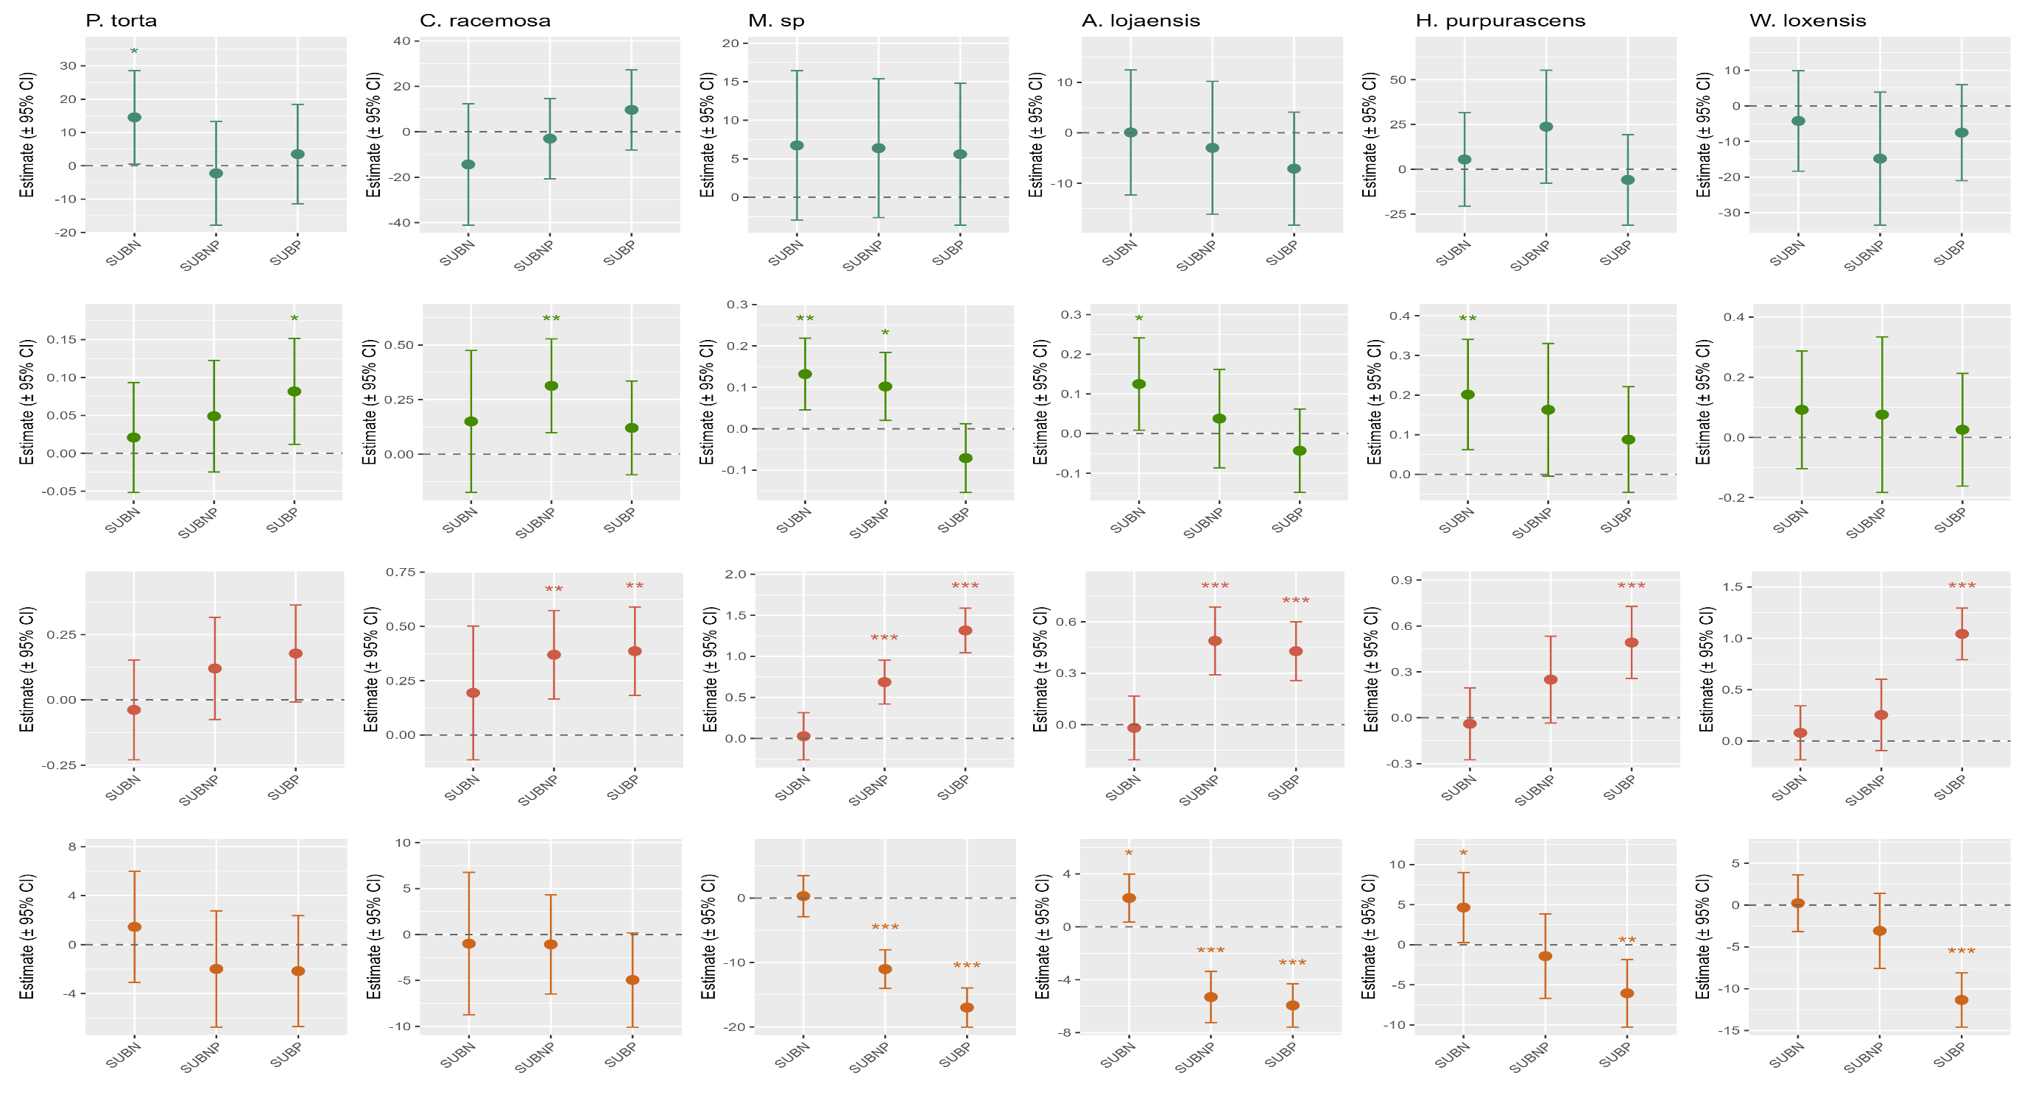
1000 m
2000 m
3000 m
N:P LPC (mg/g ) LNC (mg/g ) iWUE (μmol/mol)
Notes:
Efectos modelo lmer contra control. Cual será mejor para publicar?

Slide 17
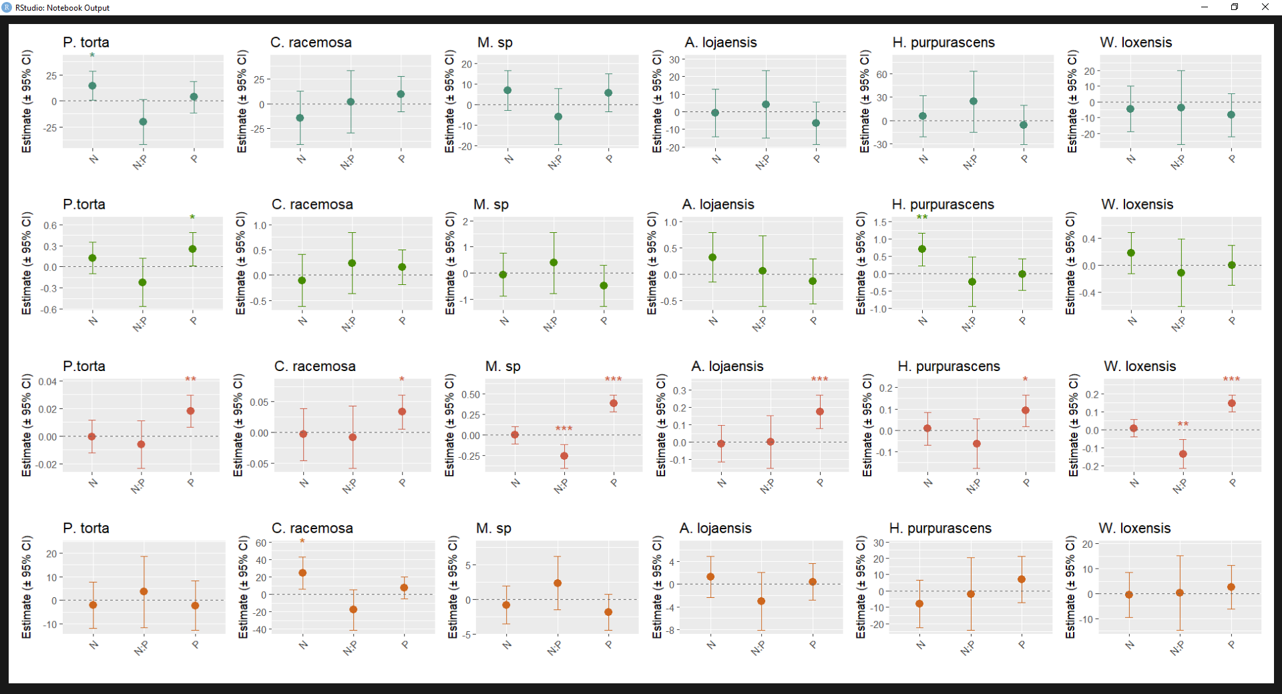
1000 m
2000 m
3000 m
SLA (g/m2) Parea(g/m² ) Narea(g/m² ) iWUE (μmol/mol)
Model using dummies. NxP shows sinergism vs antagonist effects. Different interpretation.
Notes:
DUMMIES. La interpretación del NxP es diferente. Antagonismo

Slide 18
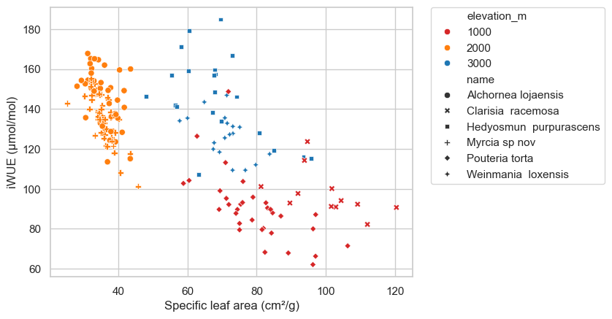
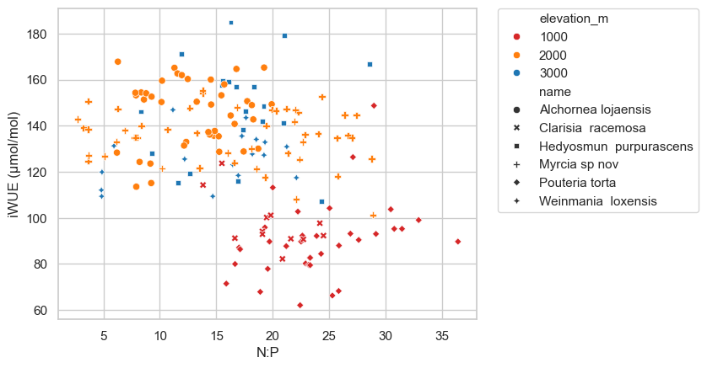
RQ3:What is the relationship between leaf nutrients (Nmass and Narea) and morphology (SLA) to iWUE at the different altitudes? – No treatments? Will explain the trends at different elevations. Which analysis? SMA? Or lmer (R ~ Narea * Treat ) per specie
REVISANDO TODAVIA

Slide 19
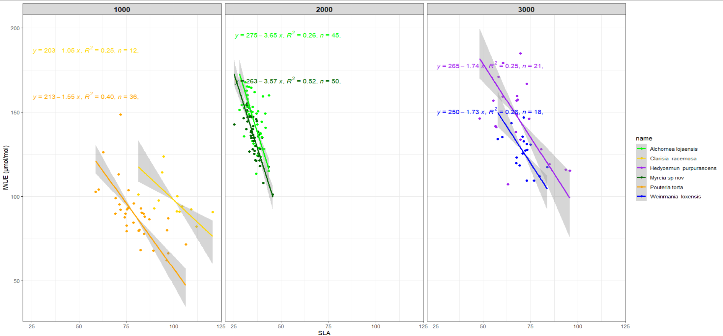
REVISANDO TODAVIA

Slide 20
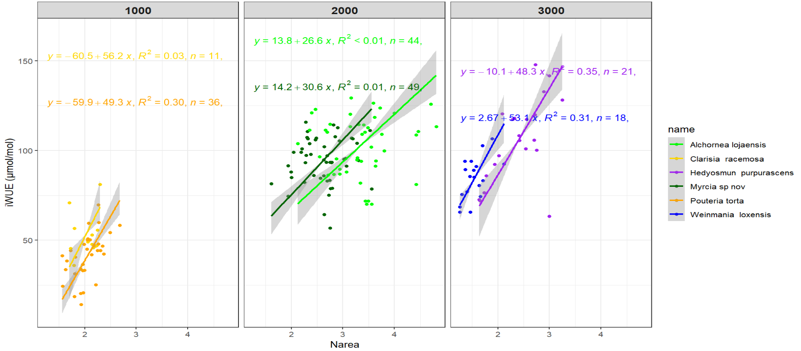
REVISANDO TODAVIA
Notes:
SMA correlation between variables. Scaling relationships between Asat and leaf nutrients were assessed using standardized major axis (SMA) regres- sion (Wright et al. 2004; Warton et al. 2006; Mantlana et al. 2008). SMA regression is a regression method preferred when one is more interested in the true slope of a relation- ship, rather than predicting values for a dependent variable from a predictor variable. It is thus commonly used to establish allometric scaling relationships, especially when the two variables are not measured on comparable scales (Warton et al. 2006). All statistical analyses were done in RStudio (V 1.1.456).
Graphic to depict that although nutrients are not enough to see shifts. At 2000 and 3000 the responses are more similar.
Pouteria, Hedyosmum y Weinmania tienen resultados que se pueden discutir. Solo en estas Narea funciona como predictor, pero no necesariamente en todas.

Slide 21
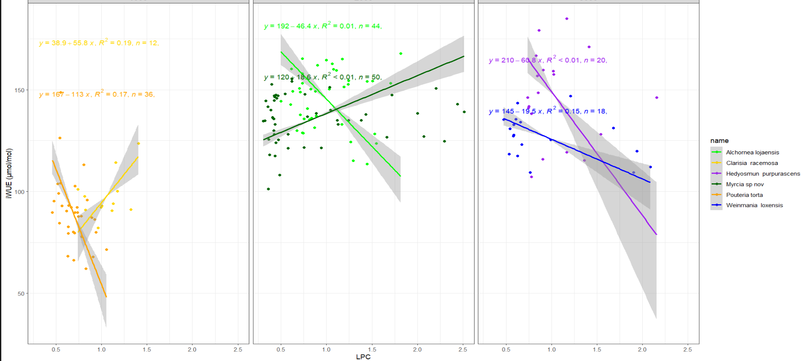
STILL THINKING ABOUT THIS ONE

