Slide 1
Results Keypoints
iWUE does not show changes per treatments although there are differences in leaf nutrients (ex. Narea, or N(mg/g)). (slide 5)
Responses change per specie ( Pioner vs non-pioners?/Acquisitive vs conservative?).- Preguntar Jürgen estrategias de especies.
Species at 2000 asl and 3000 asl more similar in their responses tan at 1000. (slide 6). Higher iWUE at mid and higher elevations associated with conservative traits ( smaller SLA, higher N content).

Slide 2
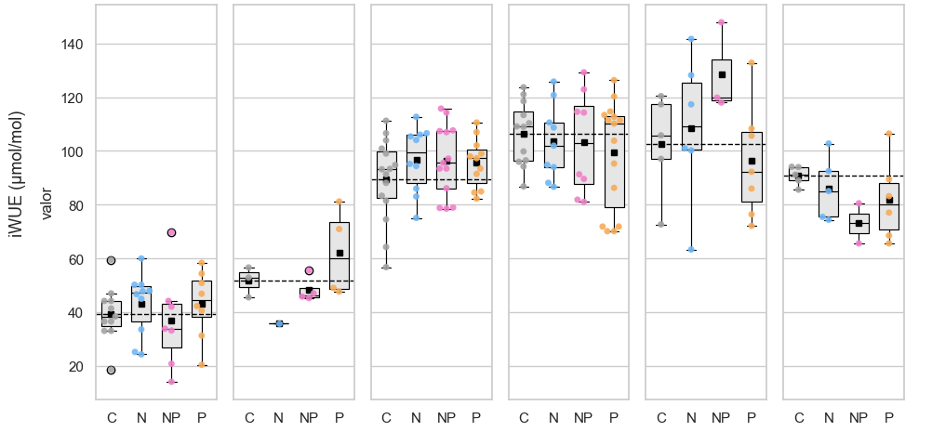
1000 m
2000 m
3000 m
P.torta C. racemosa M. sp. Nov. A. lojaensis H. purpurascens W. loxensis
39.35 3.78 -2.47 3.82 51.71 -15.67 -3.28 -3.28 89.53 7.332 6.950 5.99 106.57 -2.23 -3.50 -7.96 102.66 5.98 25.92 -6.42 90.48 -4.61 -8.18 16.14

Slide 3
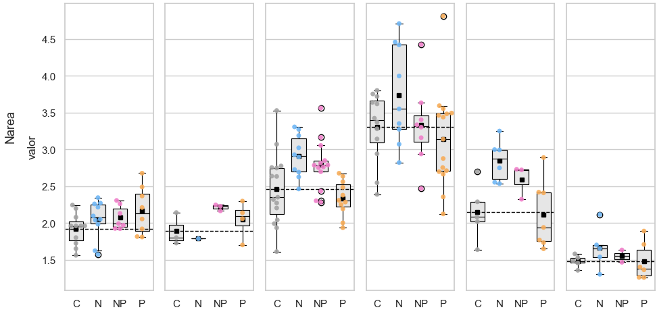
1000 m
2000 m
3000 m
P.torta C. racemosa M. sp. Nov. A. lojaensis H. purpurascens W. loxensis
1.9 0.13 0.15 +0.25 1.89 -0.10 0.32 0.16 2.46 +0.45 -0.12 +0.33 3.30 0.44 -0.16 0.03 2.14 0.70 -0.02 0.45 1.48 0.18 0.00 0.07
39.35 3.78 -2.47 3.82 51.71 -15.67 -3.28 -3.28 89.53 7.332 6.950 5.99 106.57 -2.23 -3.50 -7.96 102.66 5.98 25.92 -6.42 90.48 -4.61 -8.18 16.14
*
** * **
*

Slide 4
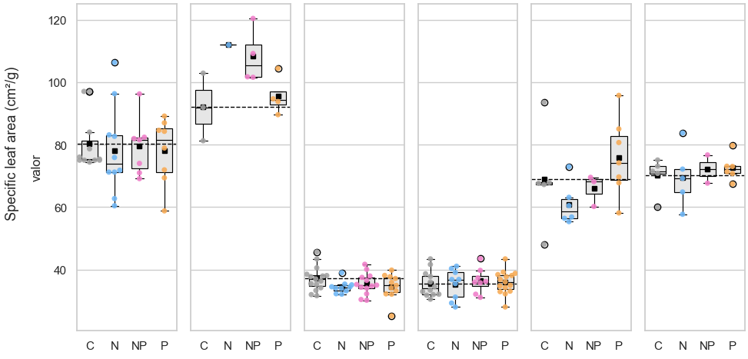
1000 m
2000 m
3000 m
P.torta C. racemosa M. sp. Nov. A. lojaensis H. purpurascens W. loxensis
80.27 -2.08 -0.78 -2.25 92.05 24.50 14.37 7.69 37.13 -2.74 -1.75 -2.55 35.31 -0.00 0.84 0.53 68.88 -8.0 -2.9 7.02 70.10 -0.55 2.11 2.48
1.9 0.13 0.15 +0.25 1.89 -0.10 0.32 0.16 2.46 +0.45 -0.12 +0.33 3.30 0.44 -0.16 0.03 2.14 0.702 -0.02 0.45 1.48 0.182 0.00 0.07
39.35 3.78 -2.47 3.82 51.71 -15.67 -3.28 -3.28 89.53 7.332 6.950 5.99 106.57 -2.23 -3.50 -7.96 102.66 5.98 25.92 -6.42 90.48 -4.61 -8.18 16.14
* * + +
*
** * **
*

Slide 5
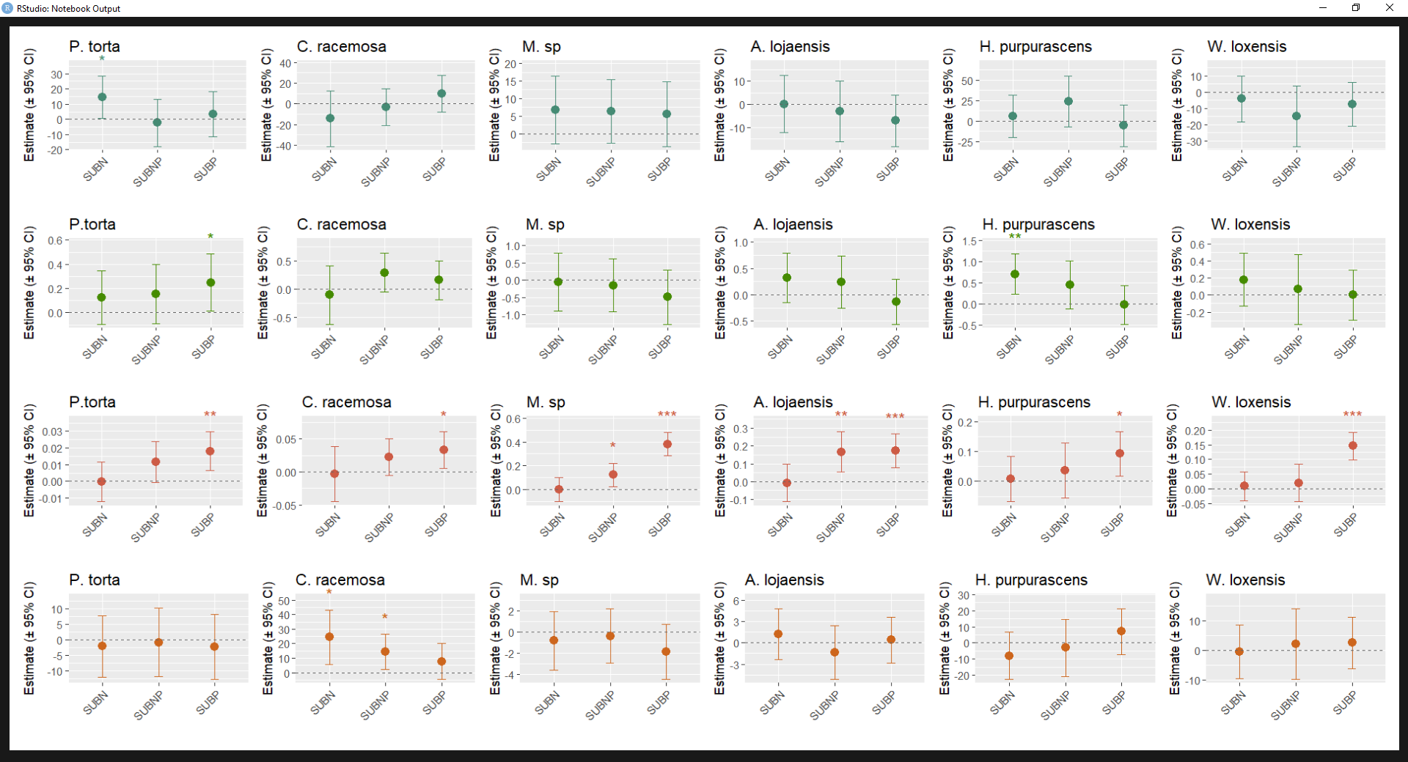
1000 m
2000 m
3000 m
SLA (g/m2) Parea(g/m² ) Narea(g/m² ) iWUE (μmol/mol)
Notes:
Efectos modelo lmer contra control. Cual será mejor para publicar?

Slide 6
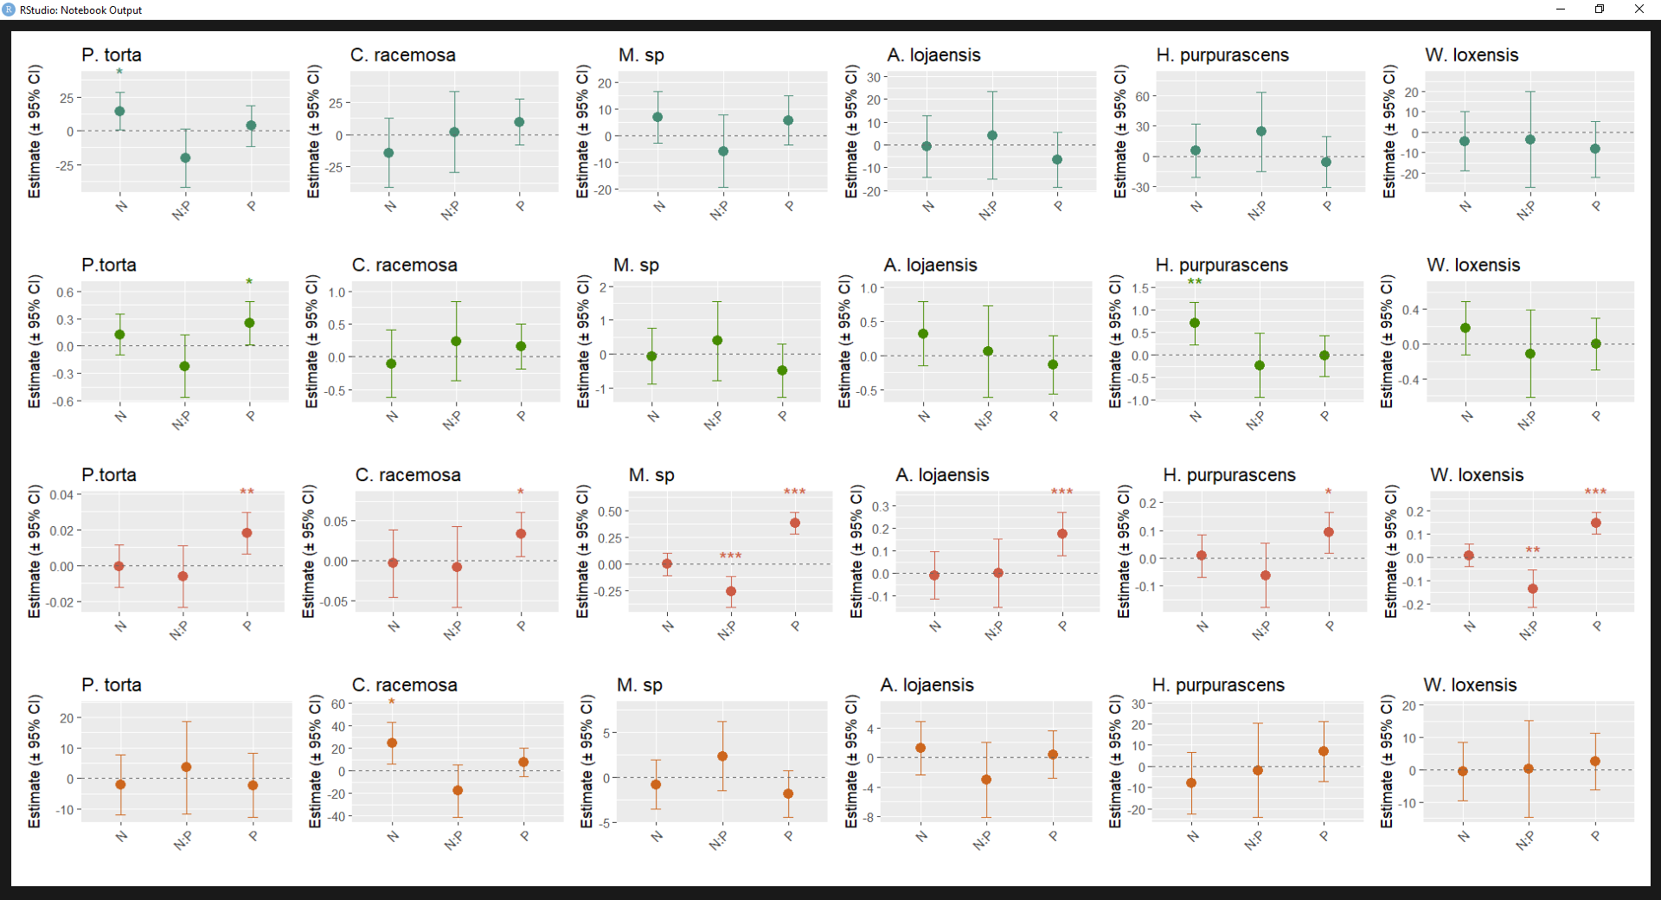
1000 m
2000 m
3000 m
SLA (g/m2) Parea(g/m² ) Narea(g/m² ) iWUE (μmol/mol)
Notes:
DUMMIES. La interpretación del NxP es diferente. Antagonismo

Slide 7
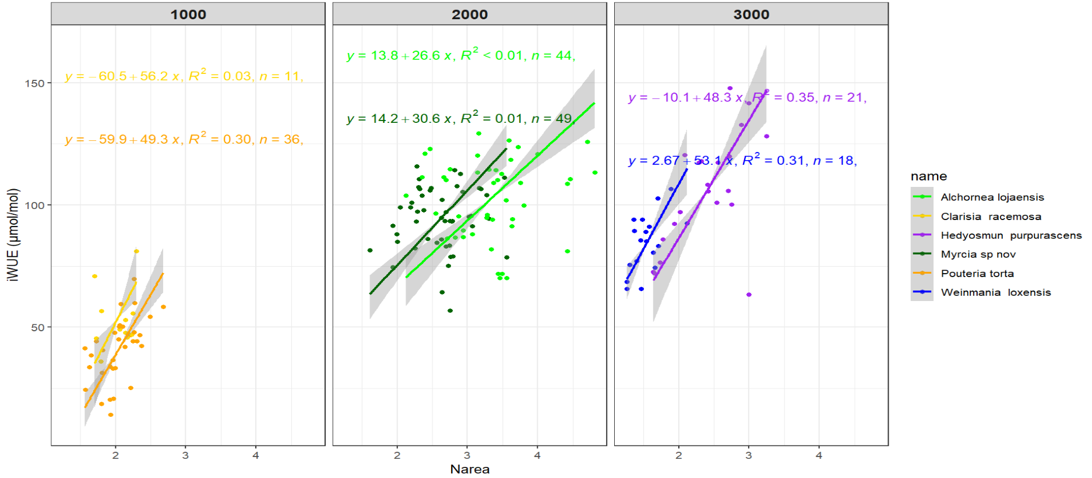
Notes:
SMA correlation between variables. Scaling relationships between Asat and leaf nutrients were assessed using standardized major axis (SMA) regres- sion (Wright et al. 2004; Warton et al. 2006; Mantlana et al. 2008). SMA regression is a regression method preferred when one is more interested in the true slope of a relation- ship, rather than predicting values for a dependent variable from a predictor variable. It is thus commonly used to establish allometric scaling relationships, especially when the two variables are not measured on comparable scales (Warton et al. 2006). All statistical analyses were done in RStudio (V 1.1.456).
Graphic to depict that although nutrients are not enough to see shifts. At 2000 and 3000 the responses are more similar.
Pouteria, Hedyosmum y Weinmania tienen resultados que se pueden discutir. Solo en estas Narea funciona como predictor, pero no necesariamente en todas.

Slide 9
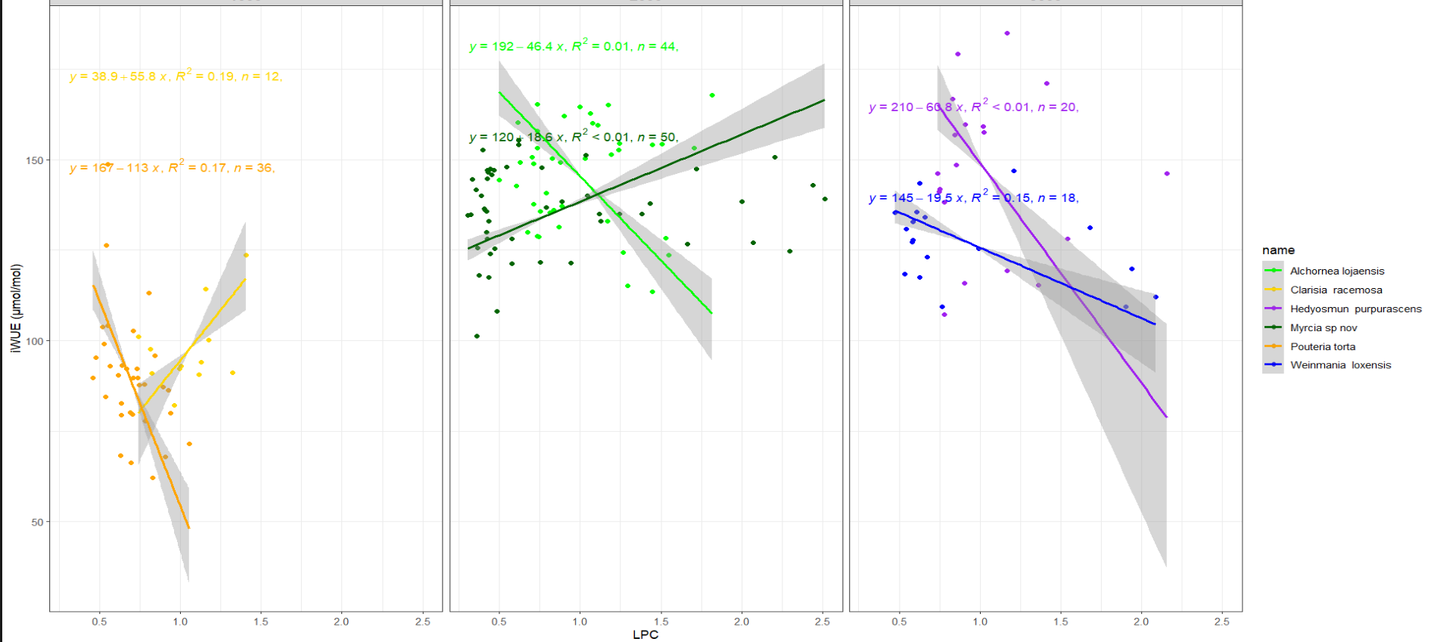
REVISANDO TODAVIA

