Slide 1
Presenting to a General Audience
Kirin Patel

Slide 2
Presenting to a General Audience
This assignment focuses on using R to process data that can then be used to generate a PowerPoint presentation that can be presented to a non-tech or unfamiliar audience.

Slide 3
Getting Started
Before analysis can be conducted, a dataset needs to be obatained. For this assignment, I will be using the BuildBPS: Facilities and Educational Data for Boston Public Schools which was found through Google’s Dataset Search Tool.

Slide 4
Why This Data Should be Analyzed
Current and previous data collected on educational infastructure provides insight as to how money is currently being spent, where it is beign effectively spent, and where spending needs to improve. By investigating this data, insightful conclusions involving future construction of educational facilities can be made.

Slide 5
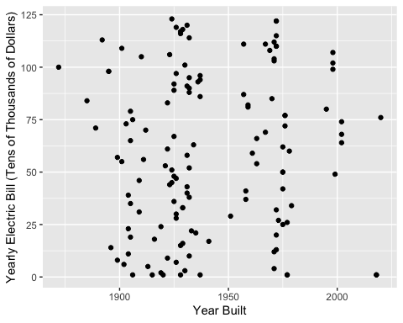
Yearly Electric Bill of Educational Facilities Based on Year Built

Slide 6
Analysing This Data
Upon first analysis of this data, it appears that educational facilities do not become more efficient with electricity consumption. However, the data plotted does not account for school size or type. Both pre-school, elementary, middle, and highschool facilities were plotted.

Slide 7
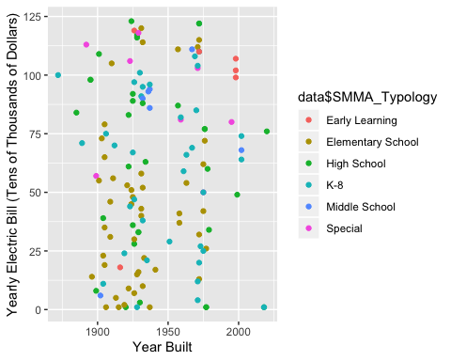
Yearly Electic Bill of Educational Facilities Based on Year Built With Facility Type Highlighted

Slide 8
Analysing the Data Again
Now that educational facility types can be connected to facility costs, analysis on which facilities consume the most electricity can be determined. Generally, lower education level facilities have lower yearly eltrical bills than higher level facilities, with the exception of early learning facilities.

Slide 9
Why Might Higher Level Education Facilities Have Higher Electrical Bills
The most simpilest anwser is that, they are larger facilities. Generally, one would think that as education level of a facility increases, so does its size. However, most educational facilities within Boston remain under 500,000 square feet. Size is not a determining factor for electrical bills.

Slide 10
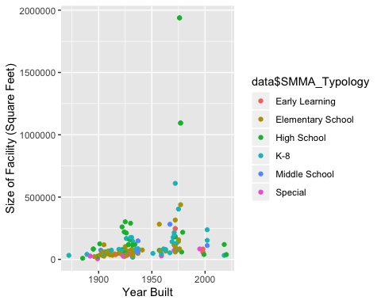
Size of Educational Facilities Based on Year Built With Facility Type Highlighted

Slide 11
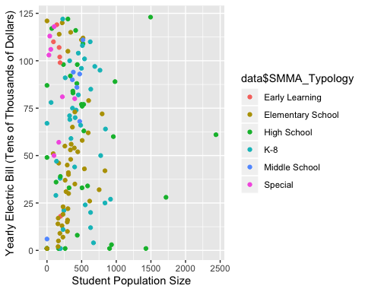
Does Student Population Size Influence Eletrical Bills?

Slide 12
No, Student Population Size Does not Influence Eletrical Bills
Based on the data alone, a single field cannot be attributed to the differences between the eletrical bills of educational facilities. There are likely a multitude of factors that have differing levels of influence over the eletrical bills of educational facilities. Further investigation into the impacts of each factor is required in order to present insightful conclusions involving future construction of educational facilities can be made.

