Slide 1
Presenting to a Technical Audience
Kirin Patel

Slide 2
Presenting to a Technical Audience
This assignment focuses on using R to process data that can then be used to generate a PowerPoint presentation that can be presented to a technical or topic area familiar audience.

Slide 3
Getting Started
Before analysis can be conducted, a dataset needs to be obatained. For this assignment, I will be using two datasets from FRED. The first is the Retail Sales: Used Car Dealers and the second one is the Average Amount Financed for New Car Loans at Finance Companies. Both datasets were found through Google’s Dataset Search Tool.

Slide 4
Why This Data Should be Analyzed
Looking at the financial history of used car sales and average loan amounced of financed cars can help inform individuals about the best times for when to buy or sell a car. This data can help shed light onto when average prices paid for cars can be maximized or minimized.

Slide 5
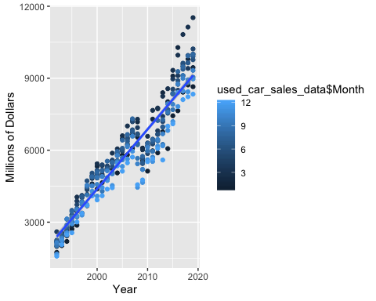
Millions of Dollars Made on Used Cars at Retail Dealers

Slide 6
Reviewing the Data
While only one set of data has been seen, a clear trend can be seen. Months in the beginning of the year result in higher numbers of sales and higher profits. Generally, the months of January, February, and March are the highest selling months per year and have continually resulted in the highest sales year over year. This trend has only continued to grow.

Slide 7
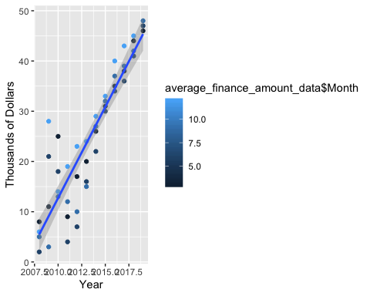
Average Financed Amount for New Car Loans

Slide 8
Reviewing the Data
Following the trend set in the previous dataset, the average financed amount for new car loans increases year after year. However, the later months of the year generally have larger averafe finance amount for new cars.

Slide 9
Combining Datasets
When looking at both the total amount of sales in USD and average finance amount of new car loans over the past decade, there is a rough ideal item presented for when to buy or sell a car. If you are planning on selling a car, you should do so during the beginning of the year to maximize profits as many sales are made during this time. However, you should only buy a new car during the beginning of the year since average finance amounts for new car loans is lower. Should you be buying a used car, do so towards the end of the year to maximize any sales.

