Slide 1
Chapter 15
Basic Asynchronous Network Algorithms
“Distributed Algorithms”
by Nancy A. Lynch
by Melanie Agnew

Slide 2
Outline (15.1-15.3)
Leader-Election in a ring
  LCR Algorithm
  HS Algorithm
  Peterson Leader-Election Algorithm
  general lower bound on communication complexity
Leader-Election in an arbitrary network
Spanning Tree Construction, Broadcast, Convergecast
  AsynchSpanningTree Algorithm
  AsynchBcastAck Algorithm
  STtoLeader Algorithm

Slide 3
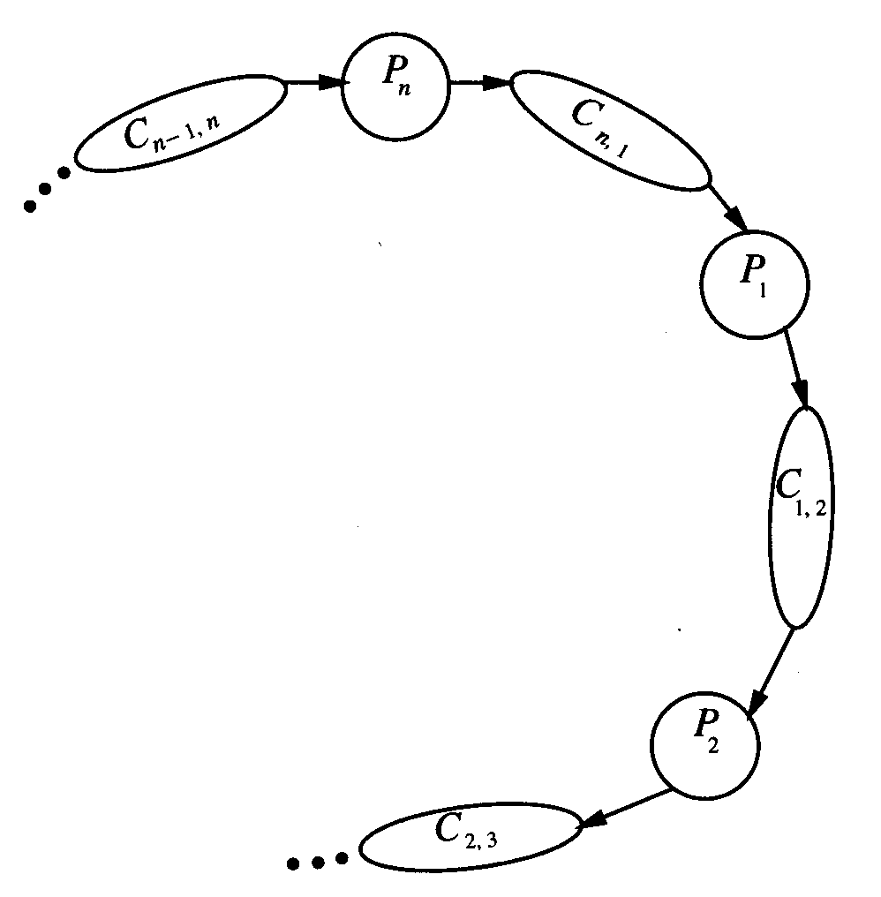
Leader Election in a Ring
Start:
ring of n processes (with UID’s), numbered 1 to n in a clockwise direction
processes do not know their indices, nor those of their neighbors
processes actions: send, receive, leader_{i}
reliable FIFO send/receive channels between processes
Goal:
exactly one process eventually produces the leader output

Slide 4
AsynchLCR
Each process begins by sending its UID to its clockwise neighbor.
Each process checks its UID (u) against the one it just received (v),
  if v > u the process sends v on to the next process
  If v = u the process is chosen and sends out a leader message
i₁
UID=4
I₅
UID=1
i₂
UID=2
i₄
UID=5
i₃
UID=3

Slide 5
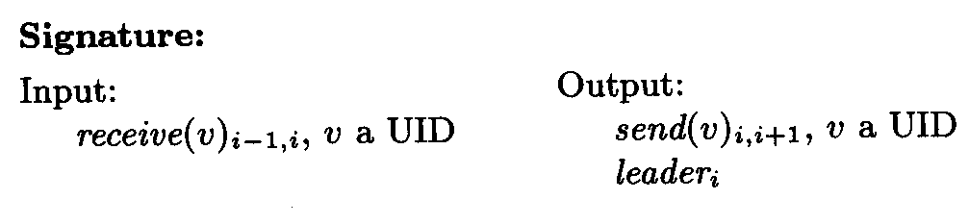
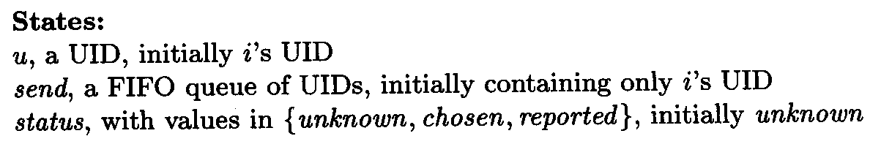
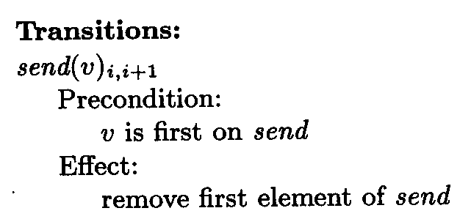
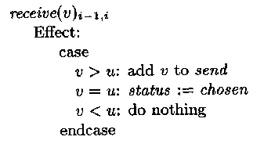
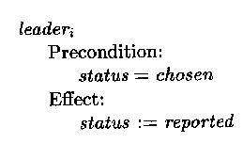
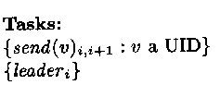
AsynchLCR_{i} automation

Slide 6
AsynchLCR Properties
channels C_{i, i+1} are universal reliable FIFO channels with states queue_{i, i+1}
i_{max} is the process with the maximum UID, and u_{max} is its UID
Safety →
Lemma 15.1 No process other than i_{max} ever performs a leader output.
Assertion 15.1.1 The following are true in any reachable state:
If i ≠ i_{max} and j Є [i_{max},i), then u_{i} does not appear in send_{j} .
If i ≠ i_{max} and j Є [i_{max},i), then u_{i} does not appear in queue_{j, j+1} .
Assertion 15.1.2 The following is true in any reachable state: If i ≠ i_{max} then status_{i} = unknown.
Liveness →
Lemma 15.2 In any fair execution, process i_{max} eventually performs a leader output.
Theorem 15.3 AsynchLCR solves the leader-election problem.

Slide 7
AsynchLCRi properties
Assertion 15.1.1: for any process other than i₄, u_{i} won’t make it past i₄
Assertion 15.1.2: for any process other than i₄, status will remain unknown
i₁
UID=4
I₅
UID=1
i₂
UID=2
i₄
UID=5
i₃
UID=3

Slide 8
AsynchLCR Complexity
Recall: n = number of processes
l = upper bound for each task of each process
d = upper bound on delivery time of oldest message in each channel queue
The number of messages is: O(n²)
Time Complexity:
Lemma 15.4 In any fair execution for any r, 0 ≤ r ≤ n – 1, and for any i, the following are true:
1. By time r(l+d), UID u_{i} either reaches the send_{i+r} buffer or is deleted.
2. By time r(l+d)+l, UID u_{i} either reaches queue_{i+r,i+r+1} or is deleted.

Slide 9
AsynchLCR Complexity
r = 0 | time to reach send₄ = 0 | time to reach queue_{4,5} = l
r = 1 | … send₅ = l + d | … queue_{5,1} = l + d + l
r = 2 | … send₁ = l+d+l+ d | … queue_{1,2} = l+d+l+d+l
r = 3 | … send₂ = 3(l+d) | … queue_{2,3} = 3(l+d)+l
r = n-1 | …send_{n-1} = (n-1)(l+d) | … queue_{n-1,n} = (n-1)(l+d)+l
 | …send_{n} = (n)(l+d)
Theorem 15.6 The time until a leader even occurs in any fair execution is at most n(l+d)+l or O(n(l+d)).

Slide 10
HS Algorithm
Each process sends exploratory messages in both directions, for successively doubled distances.
Communication complexity is O(n log n)
In phase 0 there are 4n messages sent.
After that a process only sends a message in phase l if it has not been defeated by a message within a distace of 2^{l-1}.
So, the max number of processes that initiate messages at phase l is n/(2^{l-1}+1) and the max total number of messages at phase l is 4(2^{l}(n/(2^{l-1}+1)) ≤ 8n.
The total number of phases needed to elect a leader is log n +1
So the total number of messages needed to elect a leader is at most 8n (log n +1) which is O(n log n).
phase | msgs.
0 | 4
1 | 8
2 | 16
l-1 | 2^{l-1}
l | 2^{l}

Slide 11
Peterson Leader-Election Algorithm
Arbitrary election of leader using comparison of UID’s using unidirectional communication
Algorithm runs in phases in which each process is assigned to active or relay mode (all processes start as active)
The number of active processes is reduced by a factor of two during each phase
Summary: At the beginning of each phase each active process i sends its UID two steps clockwise. Then process i compares its own UID to the two UIDs it received.
  If u_{i-1} > u_{i-2} and u_{i-1} > u_{i}, process i remains active adopting the UID of its counterclockwise neighbor
  Otherwise process i becomes a relay

Slide 12
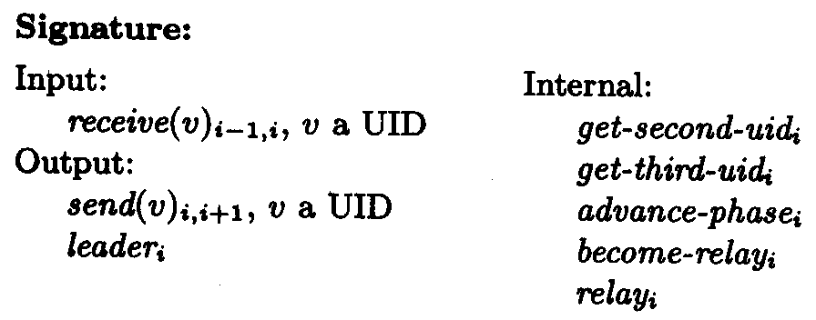
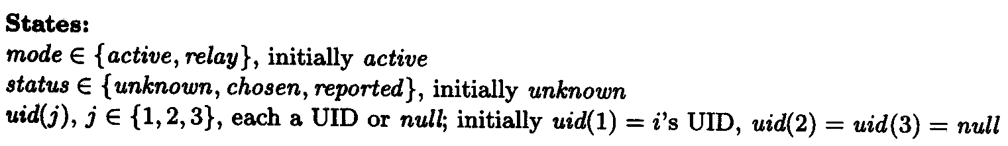
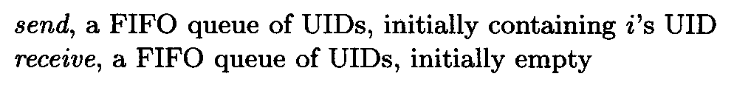
PetersonLeader_{i} Automation

Slide 13
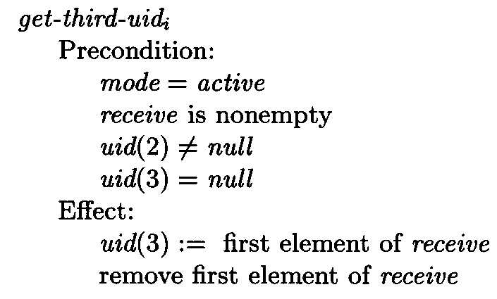
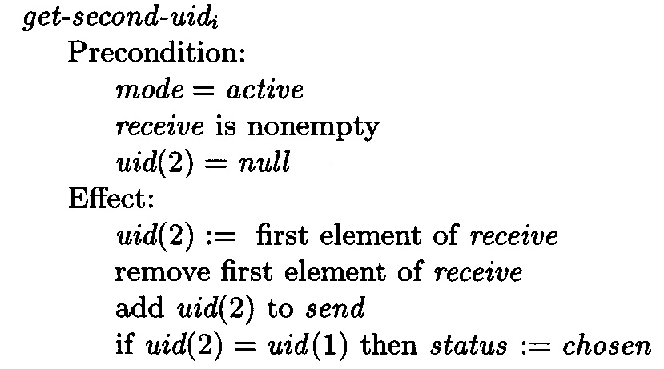
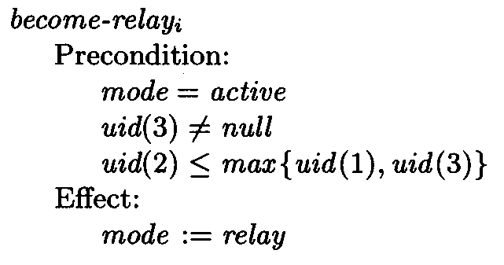
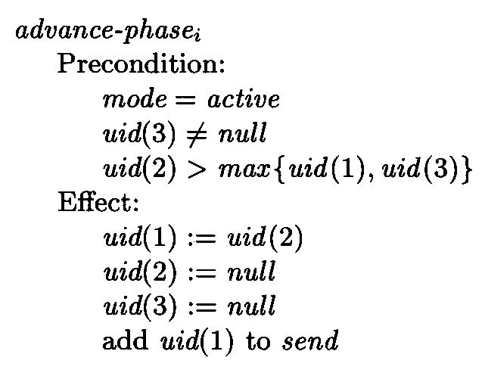
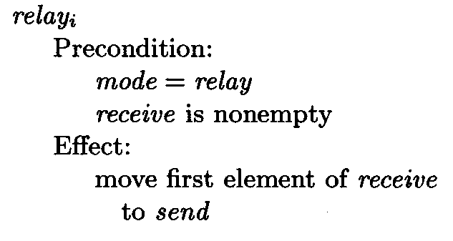
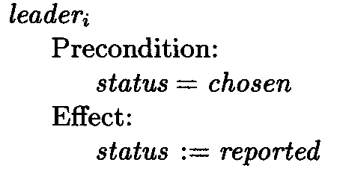
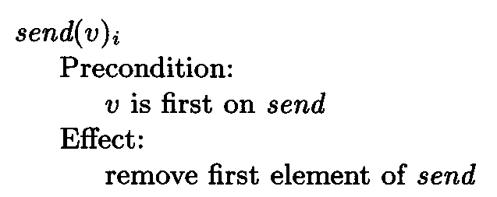
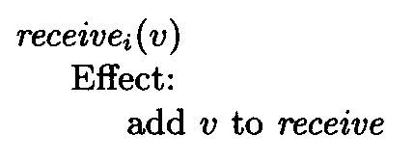
PetersonLeader_{i} Automation

Slide 14
Peterson Leader Election
Example
i₁
UID=8
i₁₂
UID=7
i₂
UID=10
i₁₁
UID=9
i₃
UID=1
i₁₀
UID=4
i₄
UID=6
i₉
UID=5
i₅
UID=2
i₈
UID=11
i₆
UID=3
i₇
UID=12

Slide 15
PetersonLeader Complexity
Theorem 15.8 The time until a leader even occurs in any fair execution of PetersonLeader is O(n(l+d)).
Claim 15.9 If processes i and j are distinct processes that are both active at phase p, then there must be some process k that is strictly after i and strictly before j in the clockwise direction, and such that process k is active at phase p – 1.

Slide 16
Peterson Leader-Election Example
n | Phase 1 |  | Phase 2 |  | Phase 3 |  | Phase 4
1 | 8 | 7,9 |  | - |  | - |  | -
2 | 10 | 8,7 |  | - |  | - |  | -
3 | 1 | 10,8 | 10 | 9,12 |  | - |  | -
4 | 6 | 1,10 |  | - |  | - |  | -
5 | 2 | 6,1 | 6 | 10,9 | 10 | 12,10 | 12 | 12,12
6 | 3 | 2,6 |  | - |  | - |  | -
7 | 12 | 3,2 |  | - |  | - |  | -
8 | 11 | 12,3 | 12 | 6,10 |  | - |  | -
9 | 5 | 11,12 |  | - |  | - |  | -
10 | 4 | 5,11 |  | - |  | - |  | -
11 | 9 | 4,5 |  | - |  | - |  | -
12 | 7 | 9,4 | 9 | 12,6 | 12 | 10,12 |  | -

Slide 17
Lower Bound on Communication Complexity
Theorem 15.12 Let A be any (not necessarily comparison-based) algorithm that elects a leader in rings of arbitrary size, where the space of UIDs is infinite, communication is bidirectional, and the ring size is unknown to the processes. Then there is a fair execution of A in which Ω (n log n) messages are sent.

Slide 18
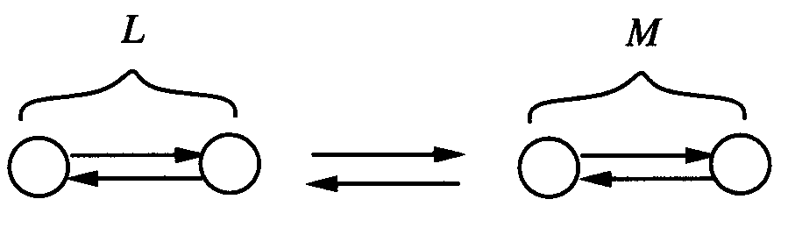
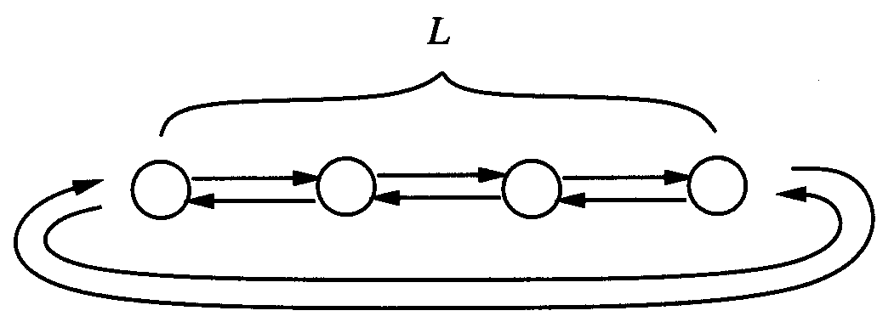
line and ring basics
P is a universal infinite set of identical process automata (with unique UIDs)
Lines: join(L,M) | Rings: ring(L)
C(α) – number of messages sent in α. C(L)=sup{C(α): α is an input free execution of L} | C(R)= sup{C(α):α is an execution of R}
state s of a line is silent if there is no input-free execution fragment starting from s in which any new message is sent | state s of a ring is silent if there is no execution fragment starting with s in which any new message is sent.

Slide 19
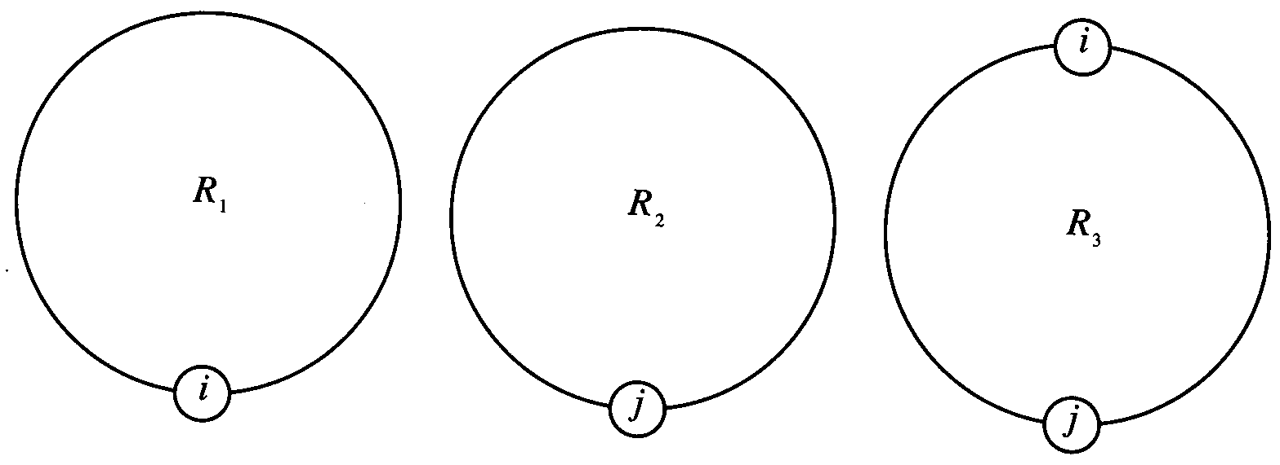
Lower Bound on Communication Complexity
Lemma 15.13 There is an infinite set of process automata in P, each of which can send at least one message without first receiving any message.

Slide 20
Lower Bound on Communication Complexity
Lemma 15.14 For every r ≥ 0, there is an infinite collection of pairwise-disjoint lines, L_{r} , such that for every L Є L_{r} it is the case that |L| = 2^{r} and C(L) ≥ r2^{r-2}.
r = 0, L₀ is the set of single node lines, C(L₀) = 0
r = 1, L₁ is the set of two node lines, C(L₁) ≥ 1 because at least one of the messages must be able to send without first receiving.
Assume for r – 1, r ≥ 2
|L| = 2^{r-1} and C(L) ≥ (r – 1)2^{r-3}.
let n = 2^{r}.
let L, M, and N be any three lines from L_{r-1}. We consider the six possible joins of these three lines: join (L,M), join(M,L), join(L,N)…
Claim 15.15 At least one of these six lines has an input-free execution in which at least n/4 log n = r2^{r-2} messages are sent.

Slide 21
Lower Bound on Communication Complexity
Claim 15.15 At least one of these six lines has an input-free execution in which at least n/4 log n = r2^{r-2} messages are sent.
Let r = 4
|L| and |M| = 2^{r-1} = 8
C(α_{L}) and C(α_{M}) ≥ (r – 1) 2^{r-3} = (n/8)log(n/2)= 6
Total messages sent so far = 2(n/8)log(n/2) = n/4(log n -1)
In order to not contradict our assumption only the first n/4 processes closest to the junction are allowed to take steps, so C(α_{L,M}) < n/4 = 4.
L
M

Slide 22
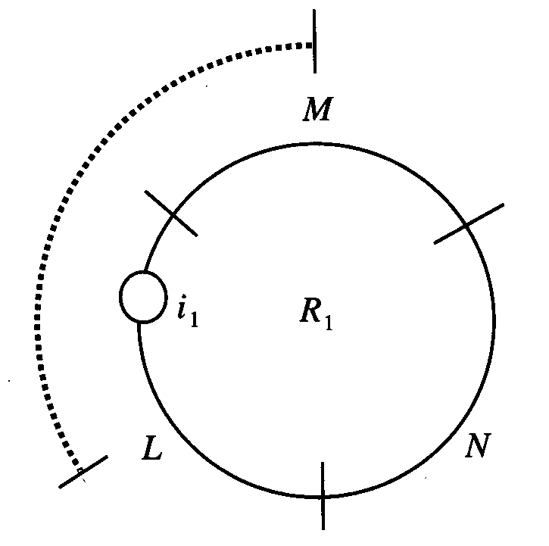
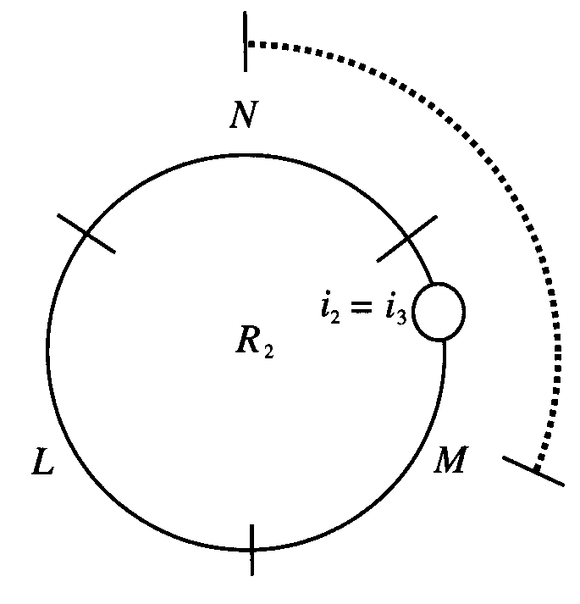
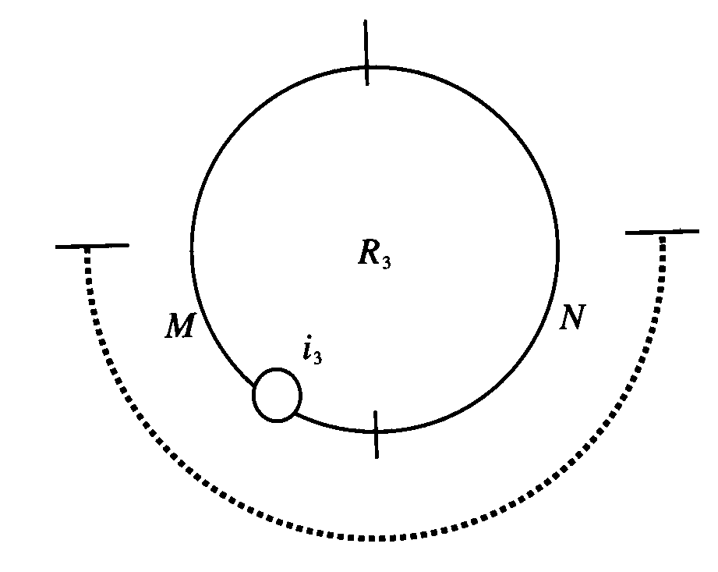
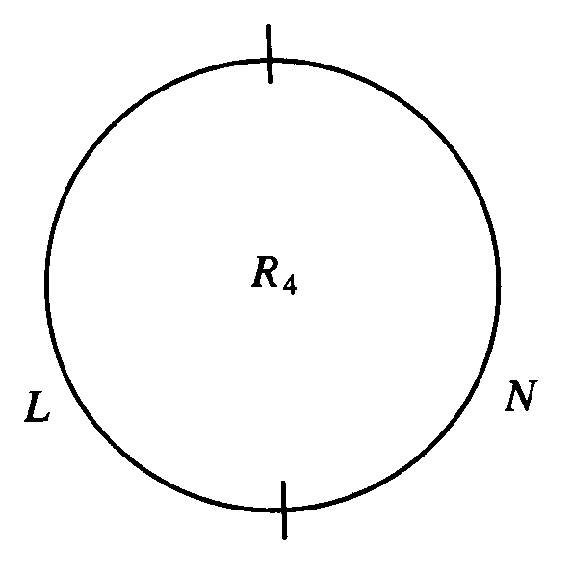
Lower Bound on Communication Complexity

Slide 23
Leader Election in an Arbitrary Network
Assume:
  the underlying graph G = (V, E) is undirected (there is bidirectional communication on all edges)
  the underlying graph is connected
  processes are identical except for UID’s
How do we know when the algorithm should terminate?
  Each process that sends a round r message, must tag it with its round number. The recipient waits to receive round r messages from each neighbor before performing its round r transition. So, by simulating diam rounds, the algorithm can terminate correctly.
  this would require us to send dummy messages between processes that would not otherwise communicate so that a process would know when to enter the next round, but this is inefficient.

Slide 24
Leader Election in an Arbitrary Network
Techniques for optimizing leader election
  Asynchronous broadcast and convergecast, based on breadth-first search
  Convergecast using a spanning tree
  Using a synchronizer to simulate a synchronous algorithm
  Using a consistent global snapshot to detect termination of an asynchronous algorithm

Slide 25
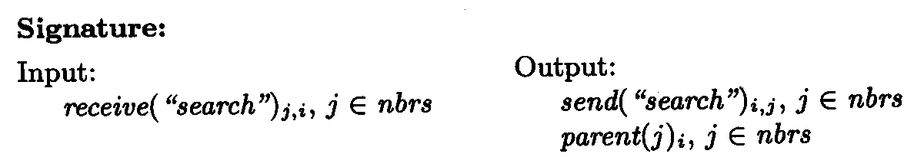
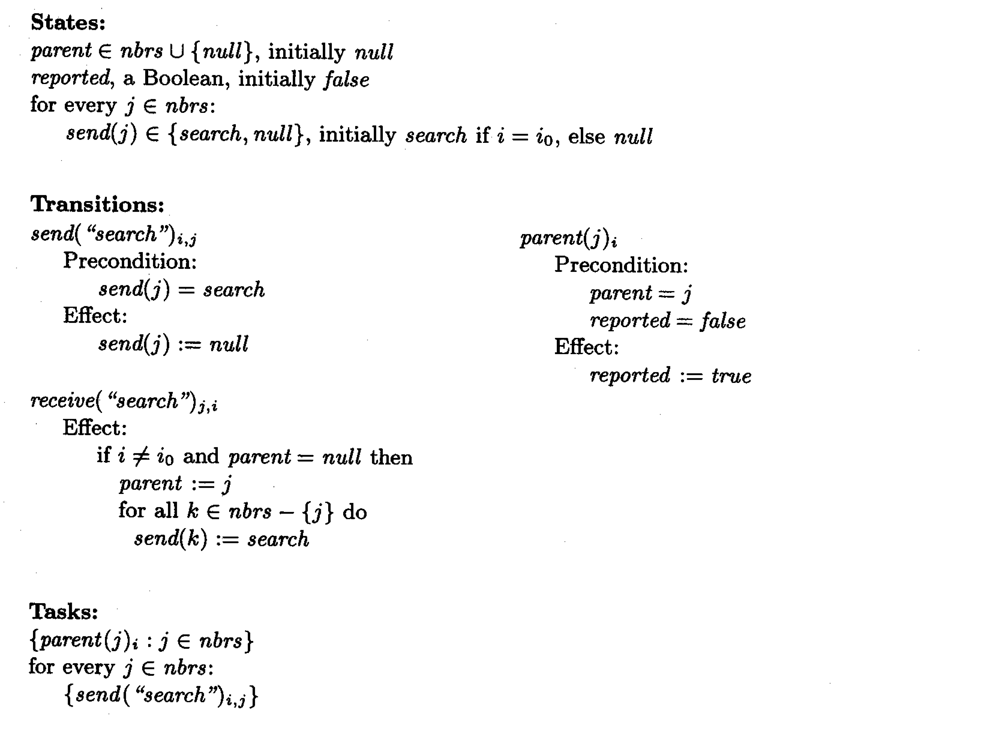
AsynchSpanningTree_{i} automation
Page 496

Slide 26
AsynchSpanningTree
Start with a source node i₀, processes do not know the size or diameter of the network, UID’s are not needed.
Goal: each process in the network should eventually report via a parent action, the name of its parent in a spanning tree of the graph G.
Summary: each non-source process i starts with send = null. When i receives its first search message from a neighbor it sets that neighbor as its parent and sets send = search for all its other neighbors causing search messages to be sent.

Slide 27
AsynchSpanningTree Properties
Theorem 15.6 The AsynchSpanningTree algorithm constructs a spanning tree.
Assertion 15.3.1 In any reachable state, the edges defined by all the parent variables form a spanning tree of a subgraph of G, containing i₀; moreover, if there is a message in any channel C_{i,j} then i is in this spanning tree.
Liveness: →
Assertion 15.3.2 In any reachable state, if i = i₀ or parent_{i} ≠ null, and if j Є nbrs_{i} – {i₀}, then either parent_{j} or C_{i,j} contains a search message or sent(j)_{i} contains a search message.
Then for any i = i₀, parent_{i} ≠ null within time distance (i₀, i) * (l + d) which implies the liveness condition.
Complexity: The total number of messages is O(|E|), and all processes except i₀ produce parent output within diam(l + d) +l.

Slide 28
Child Pointers
broadcast: each message is sent by i₀ to its children, then forwarded from parents to children until it reaches the leaves of the tree
The total number of messages is O(n) per broadcast.
The time complexity is O(h(l+d)) where h is the height.
If the tree is produced with AsynchSpanningTree the time complexity of the broadcast is O(n(l+d)).
convergecast: each leaf process sends its information to its parent, each internal process other than i₀ waits until it receives its children’s messages and sends all the information to the parent, when i₀ receives all its children’s messages it produces the final result.
The total number of messages is O(n).
The time complexity is O(h(l+d)).

Slide 29
AsynchBcastAck
AsynchSpanningTree can also be extended using broadcast and convergecast messages to allow parents to learn who their children are.
AsynchBcastAck summary:
  i₀ initiates a broadcast to all other processes and receives confirmation messages via convergecast
  Total communication: O(|E|)
  Time complexity: O(n(l+d))

Slide 30
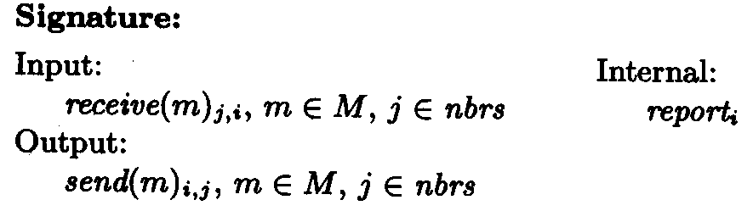
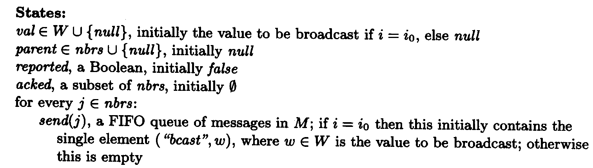
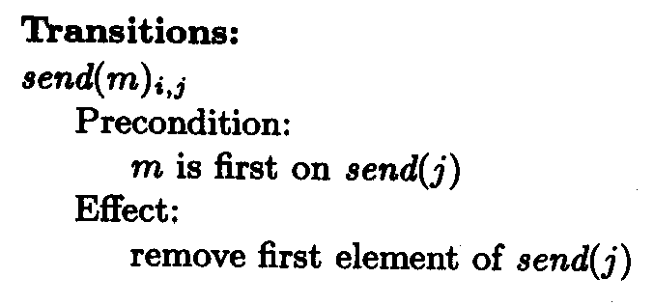
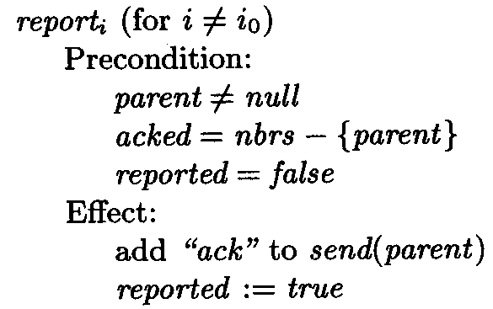
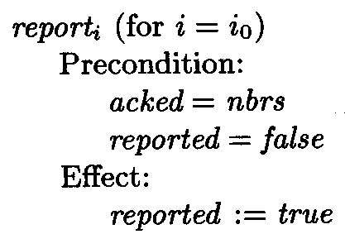
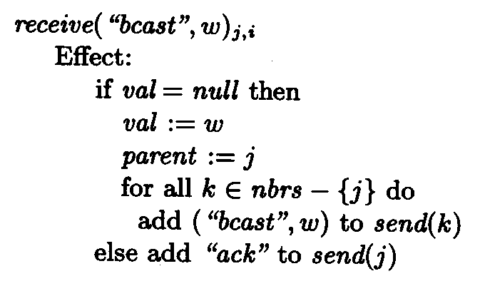
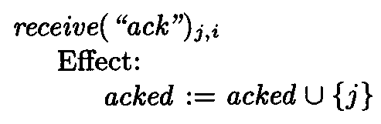
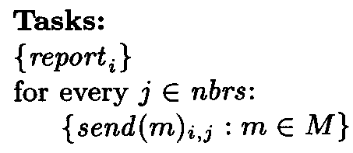
AsynchBcastAck_{i} automation

Slide 31
Application to Leader Election
Asynchronous broadcast and convergecast can be used for leader-election: every node initiates a broadcast-convergecast in order to discover the max UID on the network using O(n|E|) messages.
STtoLeader
Each leaf node sends an elect message to its unique neighbor
If a node receives elect messages from all but one neighbor it sends an elect message to that neighbor
If a node receives elect messages from all its neighbors it is the leader
If elect messages are sent in both directions on the same edge the one with the greater UID is the leader
At most n messages are used in O(n(l+d)) time.

