Slide 1
Distributed Algorithms – 2g1513
Lecture 6 – by Ali Ghodsi
Leader Election and Anonymous Networks

Slide 2
Election Algorithms
Gerard LeLann posed the Election problem in a famous paper 1977
Many distributed systems are client server based, with one server/coordinator (leader), and multiple clients
What happens if the leader fails?
  Elect a new one

Slide 3
Problem
Problem:
  When a process crashes, several processes might detect the crash simultaneously
Cannot assume only one process detects the crash
  The election should get all of the processes to agree that one node is a leader

Slide 4
Who to choose?
Basic idea:
  If each process has a unique identity, and the identities are ordered
    Elect the non-crashed node with minimum/maximum identity

Slide 5
Definition of en Election Algorithm
Formally, an algorithm is an election algorithm iff:
  Each process has the same local algorithm
  The algorithm is decentralized
    It can be initiated by any number of processes in the system
  It reaches a terminal configuration, and in each reachable terminal configuration one process is in state leader and the rest are in the state lost

Slide 6
Assumptions
Fully asynchronous system
  No global clock, transmission times arbitrary
Every process has a unique identity
  Identities are totally ordered
  Because we have finite number of processes:
    Max identity and Min identity available (extreme values)

Slide 7
Using Wave Algorithms for Election
Remember Wave Algorithms (WA)?
WA have three properties:
  Termination
    The algorithm terminates in finite number of steps
  Decide
    Atleast one node executes a decide event
  Dependence
    Every process executes an event which causally precedes the decide event

Slide 8
Wave Properties
Time-space diagram
Causally related chain of events
p1
p2
decide
p3
time

Slide 9
Wave Properties
Time-space diagram
p1
p2
decide
p3
time
Causally related chain of events

Slide 10
Election Waves
Idea:
  Append processor identity in the wave
    Whenever a node decides, an event has causally preceded in each processor where the identity has been added
    The deciding process will know the identity of every process
    Pick the process with least identity as leader
    Broadcast the leader’s identity to all processes

Slide 11
Tree Algorithm augmented with Election
Lets augment the Tree algorithm so that it can perform Election on trees
  Alternative proof: http://www.sics.se/~ali/waveproof.pdf
Problem:
  Tree algorithm assumes every leaf is an initiator
  In leader election, any subset of the processes can be initiator, not necessarily every process

Slide 12
Tree Algorithm augmented with Election
Solution:
  Flood the whole tree with a wakeup token initially so that every process participates
  After that, run the tree algorithm
    Leaf nodes add their identity to the tokens
    Internal nodes only change the identity if they have a lower id
  After decide,
  Make every node decide (on the leader) by letting nodes that have decided sending a message to their children

Slide 13
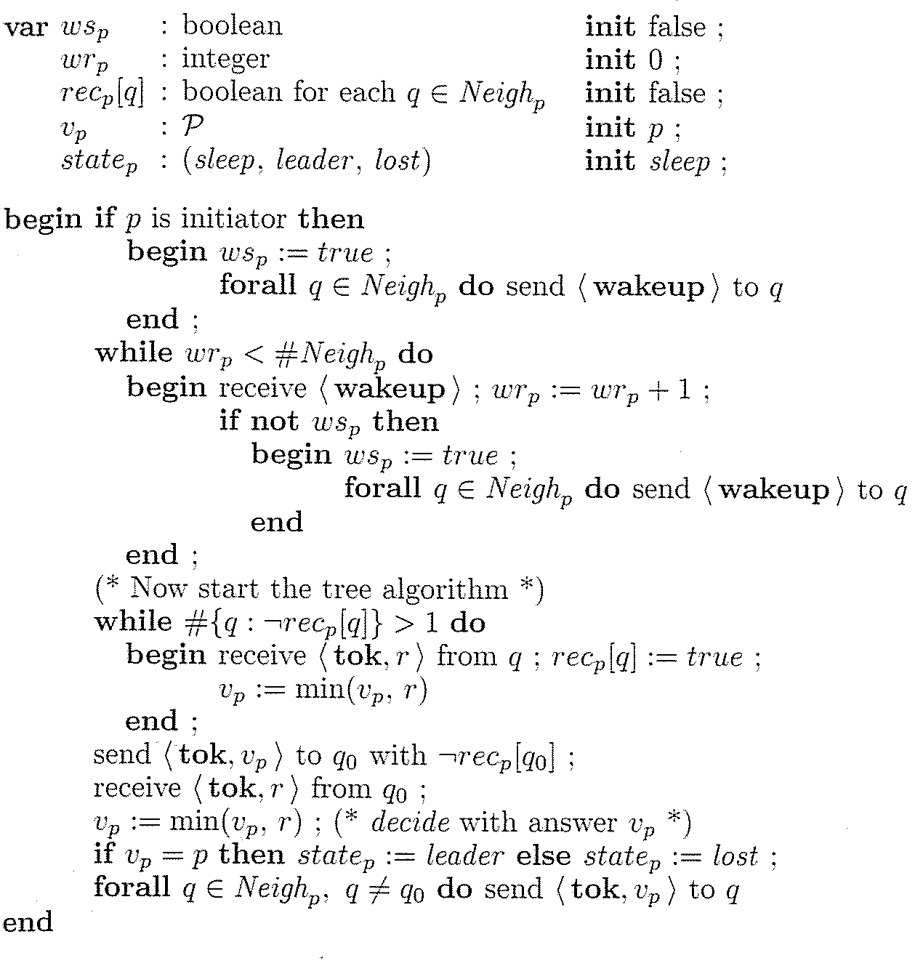
Not received any wakeup
Wakeup Counter 0
Not received from any neighbor
Candidate leader is p (me)
Initial state is sleep
All initiators send a wakeup to every neighbor!
Everyone waits for wakeup tokens from all its neighbors
If this is our first wakeup token ever, send a wakeup token to every neighbor
We have flooded all our neighbors, and received from all our neighbors
Only executed by non-leaves
vp is the minimum identity seen so far
Send minimum value so far to parent
Get lowest value
Maybe deciding node has least id
Am I the leader or not?
Send to all children so everyone can decide

Slide 14
What is the message complexity?
The wakeup is flooded to all neighbors by every node
  Since it is a tree of N nodes, we have N-1 edges, we will have 2(N-1) wake messages
Tokens are passed around be tree algorithm
  All leaves send tokens all the way up to the first deciders (N-1, messages)
  Then N-1 tokens are sent all the way down to the leaves
Leaves us with 4N-4 message complexity

Slide 15
What is the time complexity?
Assume that the tree has diameter D
  Diameter is the longest of the shortest paths between any pair of nodes
Time complexity:
  D messages to flood wakeups, at D+1 everyone has started the tree alg.
  D messages for the tree alg to reach the first decision
  D messages to make everyone decide
Gives 3D+1 message complexity (not tight)

Slide 16
What about elections on rings?
The first ever election algorithm was done for rings by LeLann
Simple idea:
  Let every initiator send a token with their identity around the whole ring
  Nodes are not allowed to initiate after they receive a token (example…)

Slide 17
Example
  Nodes are not allowed to initiate a message after they receive a token (example…)
7
8
9
2
6
5
3
1
initiator

Slide 18
Example
  Nodes are not allowed to initiate a message after they receive a token (example…)
7
8
9
2
6
5
3
1
initiator

Slide 19
Example
  Nodes are not allowed to initiate a message after they receive a token (example…)
7
8
9
2
6
5
3
1
initiator
not allowed to initiate

Slide 20
Example
  Nodes are not allowed to initiate a message after they receive a token (example…)
7
8
9
2
6
5
3
1
not allowed to initiate
initiator
not allowed to initiate

Slide 21
Example
  Nodes are not allowed to initiate a message after they receive a token (example…)
7
8
9
not allowed to initiate
2
6
5
3
1
not allowed to initiate
initiator
not allowed to initiate

Slide 22
Example
  Nodes are not allowed to initiate a message after they receive a token (example…)
7
8
9
not allowed to initiate
2
6
initiator
5
3
1
not allowed to initiate
initiator
not allowed to initiate

Slide 23
Example
  Nodes are not allowed to initiate a message after they receive a token (example…)
7
8
9
not allowed to initiate
2
6
initiator
not allowed to initiate
5
3
1
not allowed to initiate
initiator
not allowed to initiate

Slide 24
Example
  Nodes are not allowed to initiate a message after they receive a token (example…)
not allowed to initiate
7
8
9
not allowed to initiate
2
6
initiator
not allowed to initiate
5
3
1
not allowed to initiate
initiator
not allowed to initiate

Slide 25
LeLann’s ring election
Whenever a node receives back its id, it has seen every other initiators id
  Assuming FIFO channels
Let every node keep a list of every identifier seen (list_{p})
  If non-initiator, state=lost immediately
  If initiator, when own id received:
    state=leader if min{list_{p}}=p
    state=lost otherwise

Slide 26
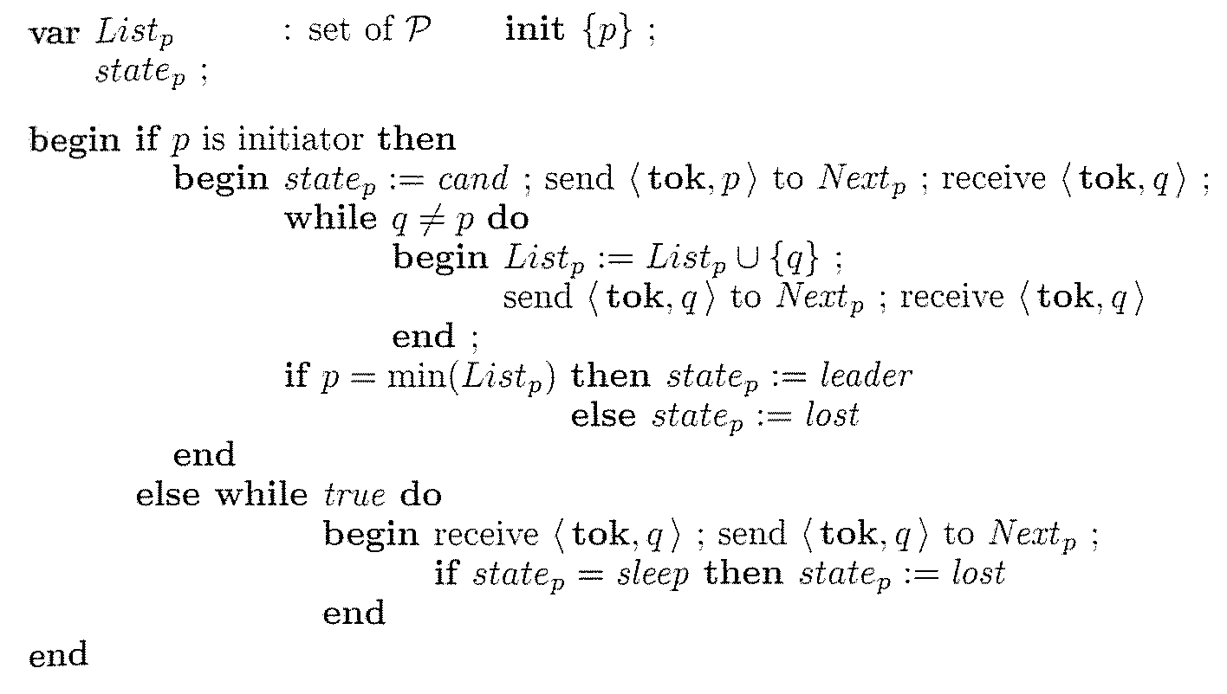
LeLann’s Algorithm
Initially only know myself
Send my id, and wait
Repeat forwarding and collecting ids until we receive our id
Termination:
did we win or lose
Non-initiators just forward and lose

Slide 27
Message Complexity
Worst case is every node is initiator (N)
  Every initiator sends N messages
Gives a total of N² messages

Slide 28
Time Complexity
Assume last initiator f starts at time N-1
  f terminates after its token has circulated the ring, N steps
Time complexity 2N-1
7
8
9
2
6
5
3
1
last initiator
initiator

Slide 29
Chang-Roberts – An improvement
Chang and Roberts came up with a small improvement
Idea:
  When a node receives a token with smaller id than itself, why should it keep forwarding it?
  It is a waste, we know that that id will never win!
  Lets drop tokens with smaller ids than ourselves!

Slide 30
Discussion about election
Are election algorithms of this “type” really useful?
  If a node in the ring breaks down, the circle is broken, election will not work (same for trees)
  The authors assume some external “connector” will fix the ring, and everything will proceed
    Valid assumption?
    In the case of a tree, if we anyway have to construct a new tree, the we could already embed leader information in that process
  Is it reasonable to assume that nodes have ordered finite set of ids?

Slide 31
Surprise: DKS & Chord ☺
They are scalable, keep ordered ids, and have magic “connectors”
If node 2 fails, node 0 uses its successor list to reconnect the ring
Same idea can be applied in trees
0
0
1
15
0
1
15
1
15
14
2
14
2
14
2
13
3
13
3
13
3
12
4
12
4
12
4
11
5
11
5
11
5
10
6
10
6
10
6
9
7
9
7
9
7
8
8
8

Slide 32
How to make it work
But if we drop a token with id s, node s will be waiting forever on its token to come back
How do we solve that?

Slide 33
How to make it work
If node s token token is dropped, it will anyway receive another token with lower id
  In that case, s should set state=lost

Slide 34
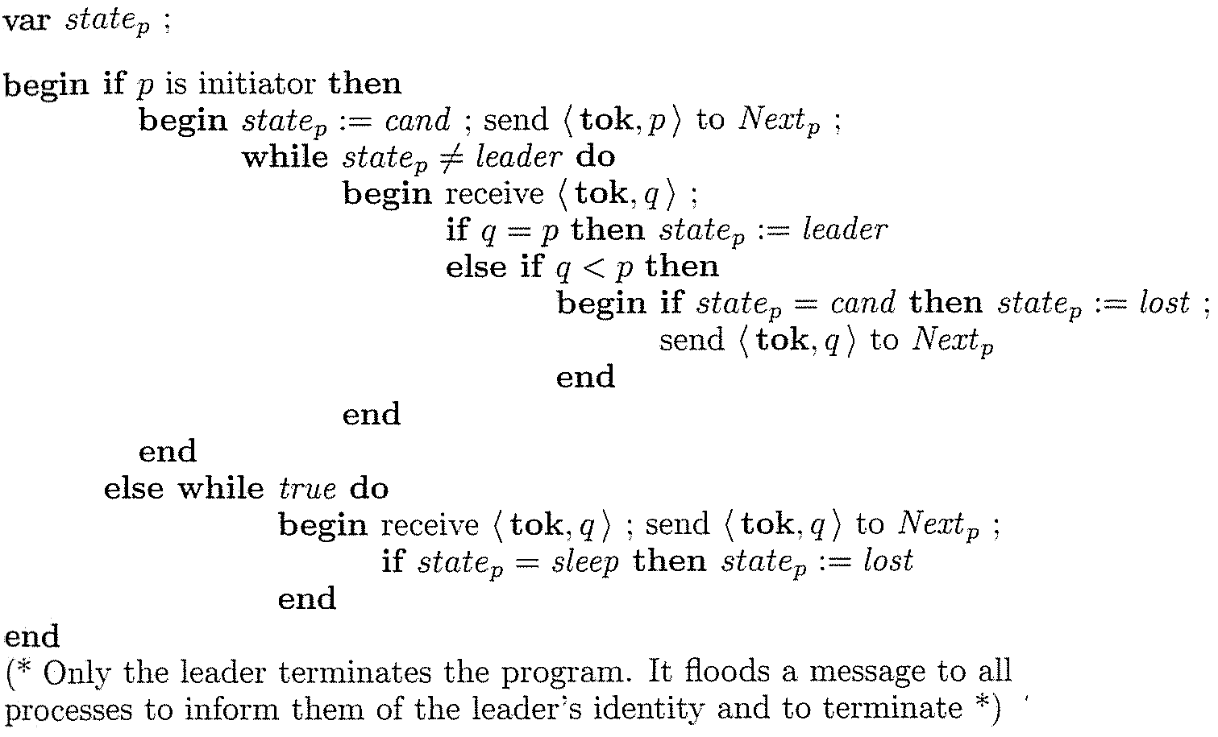
Chang and Roberts Algo
Initiator sends its token
While not leader, keep receiving tokens
If my token comes, then I won
Otherwise, only forward if it’s lower id than me and lose
Non-initiators just forward and lose

Slide 35
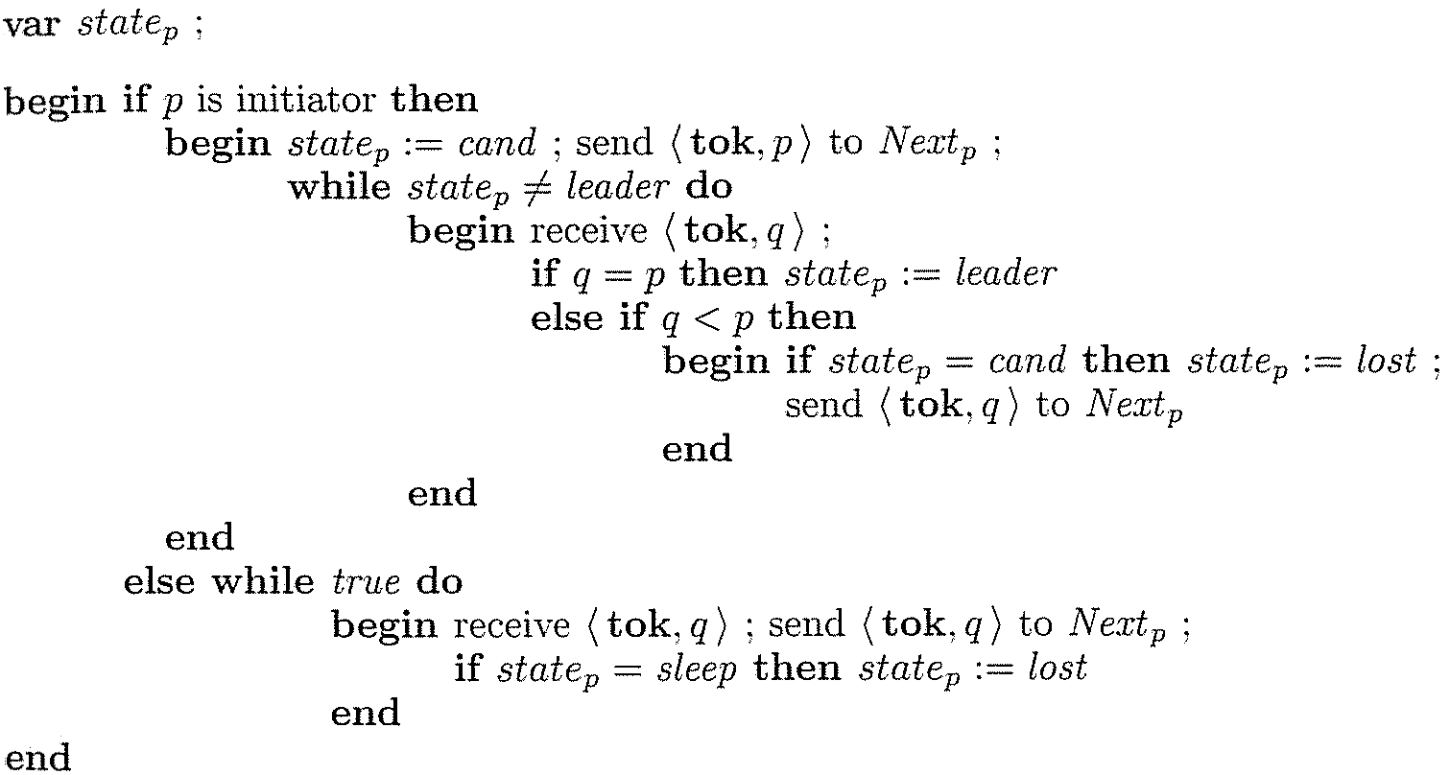
Chang Roberts - Example
Nodes 1, 3, 6 are initiators
Non-initiator
Lost
Won
Initiator
3
1
3
1
6
9
6

Slide 36
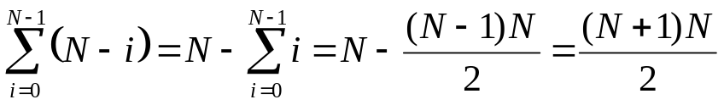
Chang Roberts Analysis
Worst case complexity same as LeLann’s
  Time Complexity: 2N-1
  Message Complexity: O(N²)
    Considered a sorted ring with N initiators
4 times
5 times
4
3 times
3
5
6 times
2
6
2 times
1
0
7
7 times
1 times
8 times

Slide 37
Further improvements?
Break the loop if state!=cand to avoid blocking receive
Do not just compare with your id, compare with the lowest id you have seen!
Let the non-initiators also filter lower ids

Slide 38
Extinction applied to the Echo algo
Remember the Echo algorithm?
  Centralized algorithm
  Constructs a spanning tree rooted at the initiator
  Works on arbitrary connected undirected graphs
Do election by running echo with the initiators id
  If another node is initiator, it will also start an echo with its id
  Since echo covers all nodes in the graph, some nodes will receive waves from both instances
    The node only participates in the wave with the lower id (caw)
    The wave with larger id becomes extinct
    Eventually the wave with smallest id reaches every node and wins the election
    Use the constructed spanning tree to inform everyone about the result

Slide 39
Anonymous Networks
So far, we have assumed every process has a unique identifier
What if they do not?
  Is this an interesting question?
  In some cases, processes do not have ids
    Sensor networks, mass-produced without ids, bought in bulk
    Lego Mindstorm, the CPUs do not have ids
    Some multiprocessors, the processors are arranged in grids, only know their neighbors (left, right, up, down)
  Mostly of theoretical interest though

Slide 40
No names, no size
We have been using ids to break symmetries in all election algorithms
Furthermore, we might not even know the network size

Slide 41
Compute Network size with a Leader
If leader exists, the network size can be computed
  Use the Echo algorithm, start at the leader, it constructs a tree
    All leaves send 1 to their parents
    Internal nodes send the sum the value of their children to their parent
    The root of the tree will know the network size
If leader knows size is N, pick first id in {1,2,…,N}
  Divide the rest of the interval into k parts for k children
  Every child repeats this
  When all leaves have been reached, everyone has a unique identity

Slide 42
Impossibility of Election
Even if network size is known, but no leader is known
  Election is impossible in anonymous networks
Solution:
  Probabilistic algorithms

Slide 43
Probabilistic Election in Anonymous Trees
Run the tree algorithm
  Eventually a decide happens at two neighbors
  Each one picks a random number and sends to other one
  If both pick the same number (low probability)
    Restart again generating random numbers
  Let the one with the lowest value win

Slide 44
Possible or Impossible?
How come this is possible, we proved it cannot be done
In our model, there is no way to generate a random number, in fact external IO is not in the model (keyboard, rnd gen, clock etc)
Extend the model to make it probabilistic
  Deterministic algorithms do not use random numbers
  Probabilistic algorithms can pick random numbers in {1,…,N}

Slide 45
Summary
Deterministic election algorithms (chap 7)
  For trees, using waves
  For rings, LeLanns and Chang/Roberts
  For graphs, Extinction of Echo
Anonymous networks (chap 9)
  Network size can be computed if leader exists
  Unique names can be distributed if leader exists
  Impossible to construct a deterministic election algorithm without a leader
  Probabilistic algorithms using random numbers
    Using the tree algorithm to elect a leader

