Slide 1
DEEP LEARNING PROJECT
ESKİŞEHİR OSMANGAZİ UNIVERSITY
Computer Engineering Departmant
Ajda AKTER 152120161057
Zaurela DIBRA 152120161102

Slide 2
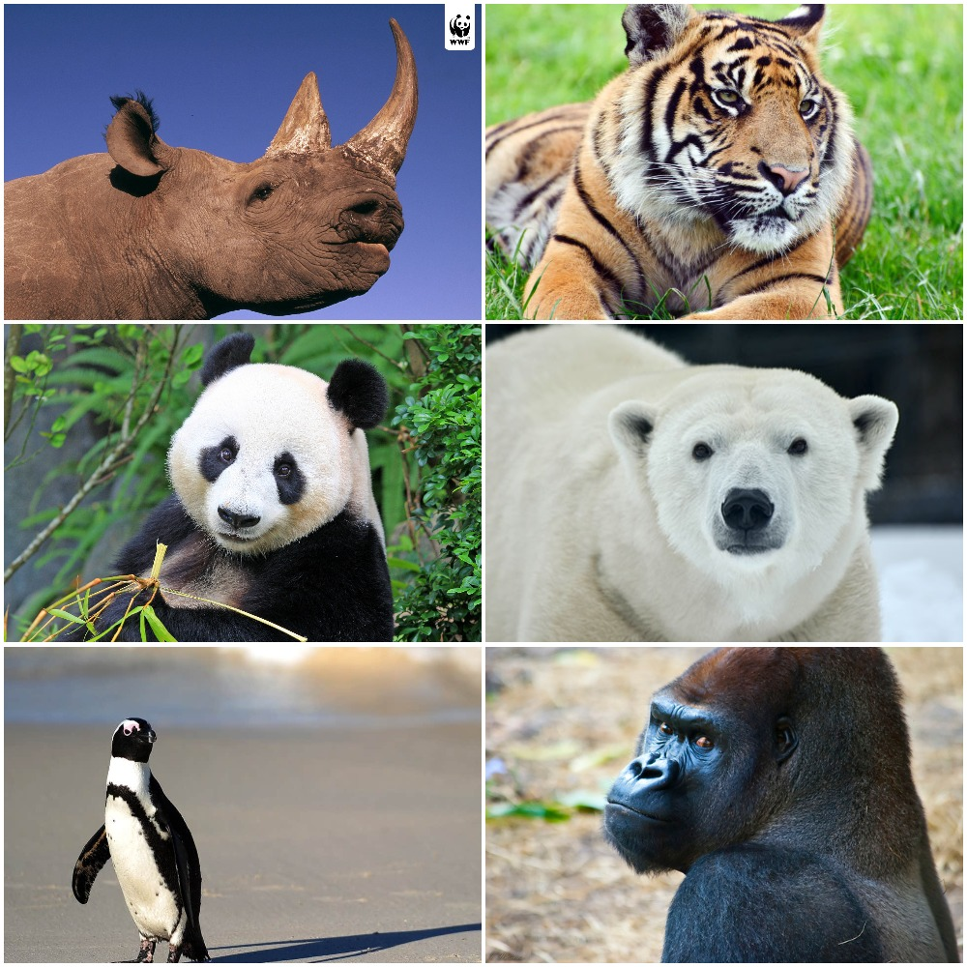
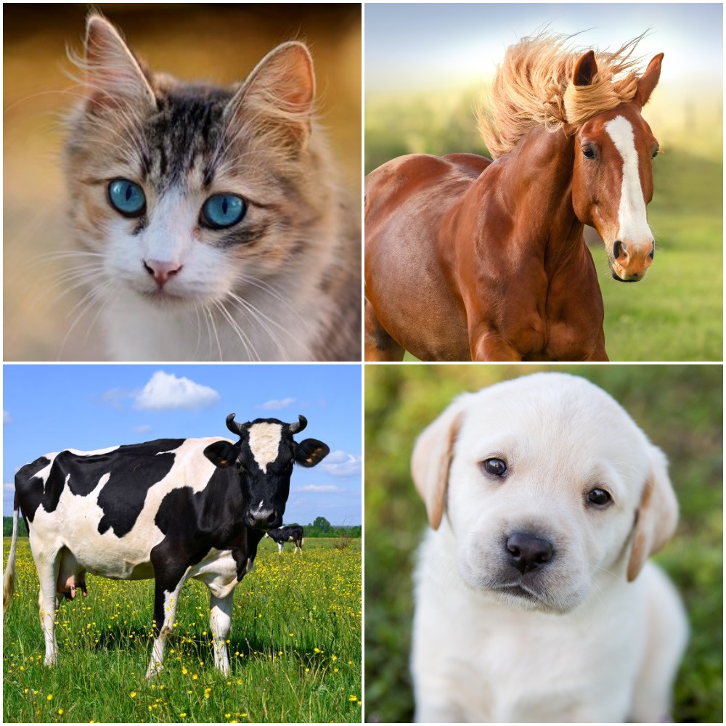
TOPIC
Learning how to classy endangered species and other species of animals using Convolutional Neural Network (CNN)

Slide 3
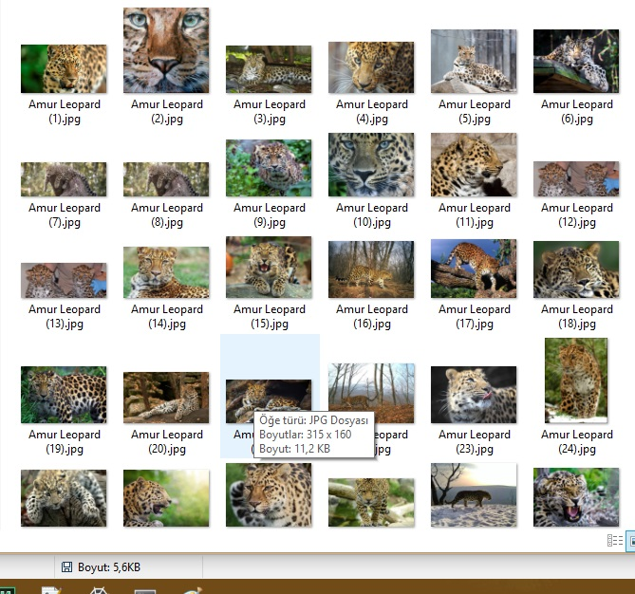
The preparation of the dataset
We created a train and a test folder.
Train folder: Inside of this folder we founded photos of endangered animals such as: Giant panda, Tiger, Eastern Gorilla, Polar Bear etc. There are about 480 photos.

Slide 4
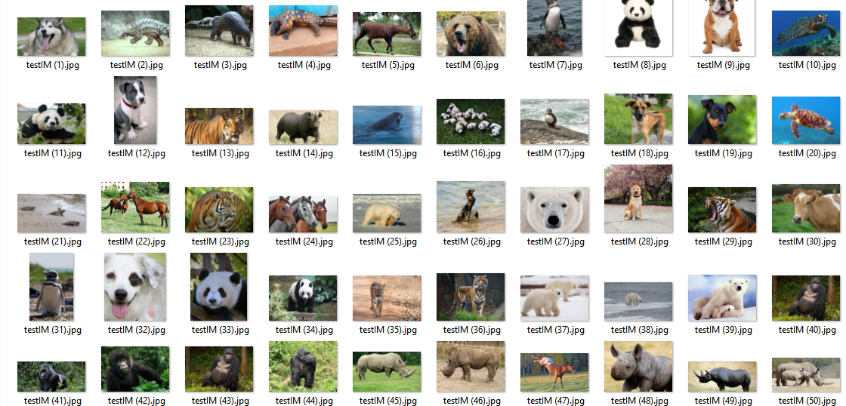
The preparation of the dataset
Test Folder: Inside of this folder there are about 300 photos of endangered and normal species of animals.
DataSet was created by us, using internet as a source and our dataset include 480 endangered and 1040 normal animals images.

Slide 5

Convolutional Neural Network (CNN)
To do our project we used CNN algorithm:
In neural networks, Convolutional neural network (ConvNets or CNNs) is one of the main categories to do images recognition, images classifications.
CNN image classifications takes an input image, process it and classify it under certain categories (Eg., Dog, Cat, Tiger, Lion).

Slide 6
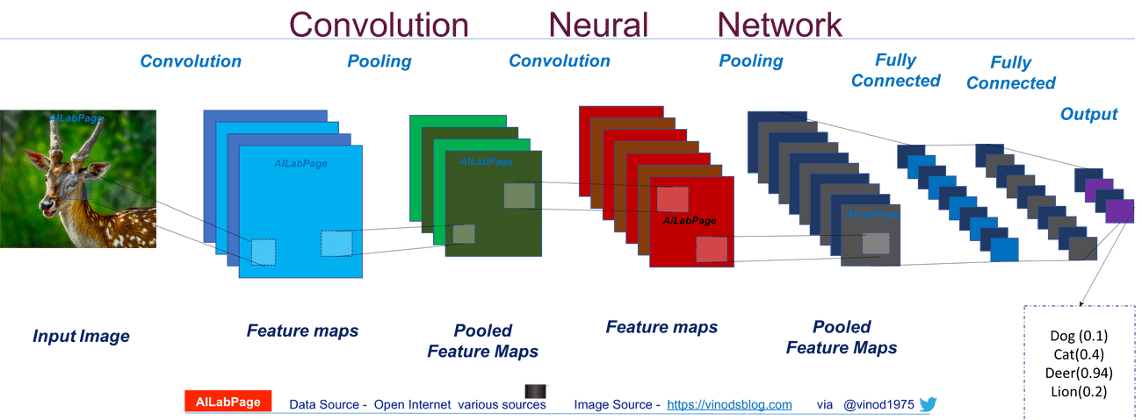
Convolutional Neural Network (CNN)

Slide 7
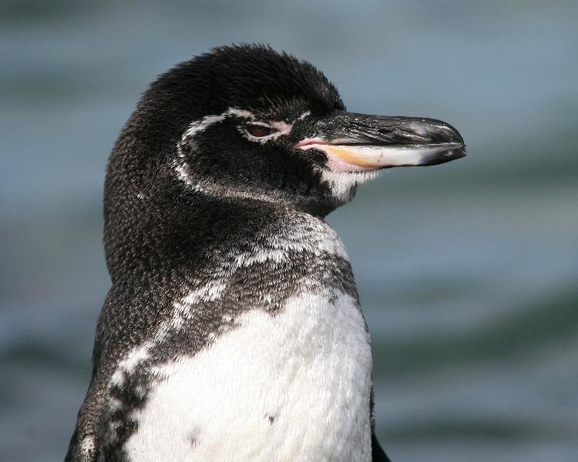
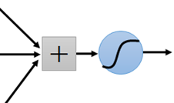
Consider learning an image:
Some patterns are much smaller than the whole image
Can represent a small region with fewer parameters
“break” detector
Endangered specie

Slide 8

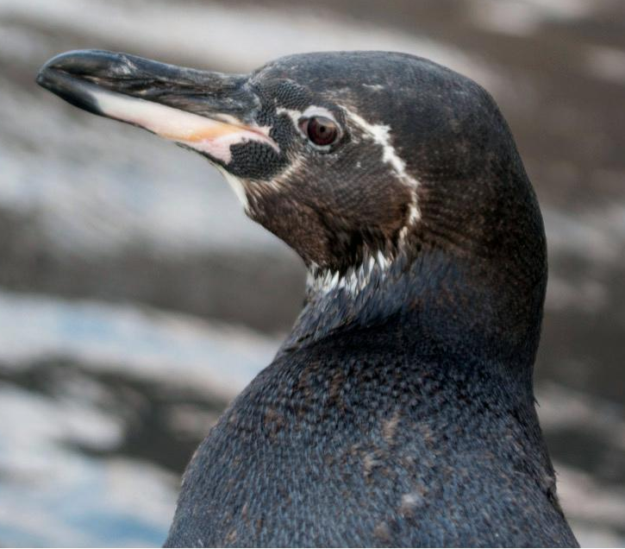
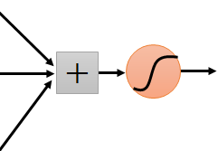
What about training a lot of such “small” detectors and each detector must “move around”
“upper-left” beak detector
They can be compressed to the same parameters.
“middle” beak detactor

Slide 9
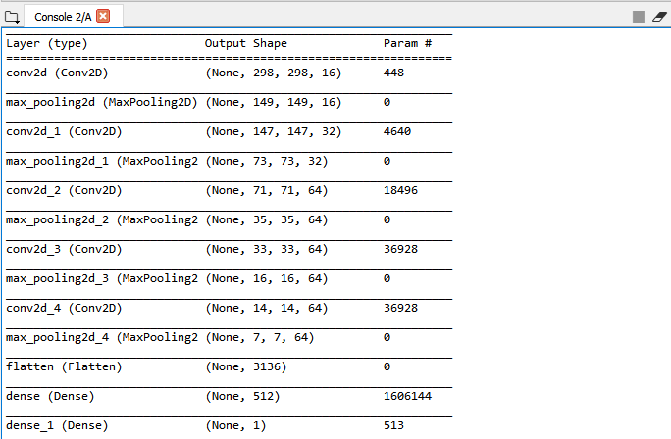
Our Project Model

Slide 10
We use Sigmoid function for loss and number of steps_per_epoch and epochs are 8, 50 respectively.
And then we have 0.8320 acc and 0.3673 loss.

