Slide 1
NHS CUI Design Guide Workstream
Release 4 Decision Support Summary
Wednesday, 28 March 2007
Version 1.0.0.0 Baseline
Contributors
Shruti Kapur
This document was prepared for NHS Connecting for Health which ceased to exist on 31 March 2013. It may contain references to organisations, projects and other initiatives which also no longer exist. If you have any questions relating to any such references, or to any other aspect of the content, please contact cuistakeholder.mailbox@hscic.gov.uk

Slide 2
About This Presentation
Who is it for?
  UI designers and software developers of clinical applications
  Evaluators of clinical applications
Purpose
  To make the user interface of clinical systems consistent and safe
  To guide the integration of recognised usability principles
  To inform the user about decision support services running on their local system
  To provide preferred options at an early stage in the process
  To inform the user about situations that require attention
What you need to know
  These guidelines have been developed in conjunction with the NHS Connecting For Health (NHS CFH) team
Last modified on Wednesday, 28 March 2007
Copyright ©2013 Health and Social Care Information Centre
Slide <number>

Slide 3
Presentation Structure
  Context
  Scope
  Key Principles
  Communication of Decision Support Capability
  Information Window Anatomy
  Choice Lists with Preferences
  Unprompted Notifications
  Next Steps
Last modified on Wednesday, 28 March 2007
Copyright ©2013 Health and Social Care Information Centre
Slide <number>

Slide 4
Context 1 of 4
This presentation describes the Design Guide Entry for Decision Support covering:
    Communication of decision support capability
    Display of choice lists with preferences
    Display of and Interaction with unprompted notifications
This is an initial investigation around the above areas
Further research, user testing, patient safety assessment and supplier participation are required to define the final guidance
During this work, consideration has been given to the wider research material available within this domain
Last modified on Wednesday, 28 March 2007
Copyright ©2013 Health and Social Care Information Centre
Slide <number>
Slide <number>

Slide 5
Context 2 of 4
Knowledge and decision support uses a general messaging capability to deliver communication
The context in which the decision support operates, is closely linked to the:
    user’s role
    user’s organisation
    user’s speciality
    user’s care setting
    electronic patient record (EPR)
The clinical application functions will utilise the messaging framework to communicate between components
Last modified on Wednesday, 28 March 2007
Copyright ©2013 Health and Social Care Information Centre
Slide <number>
Slide <number>

Slide 6
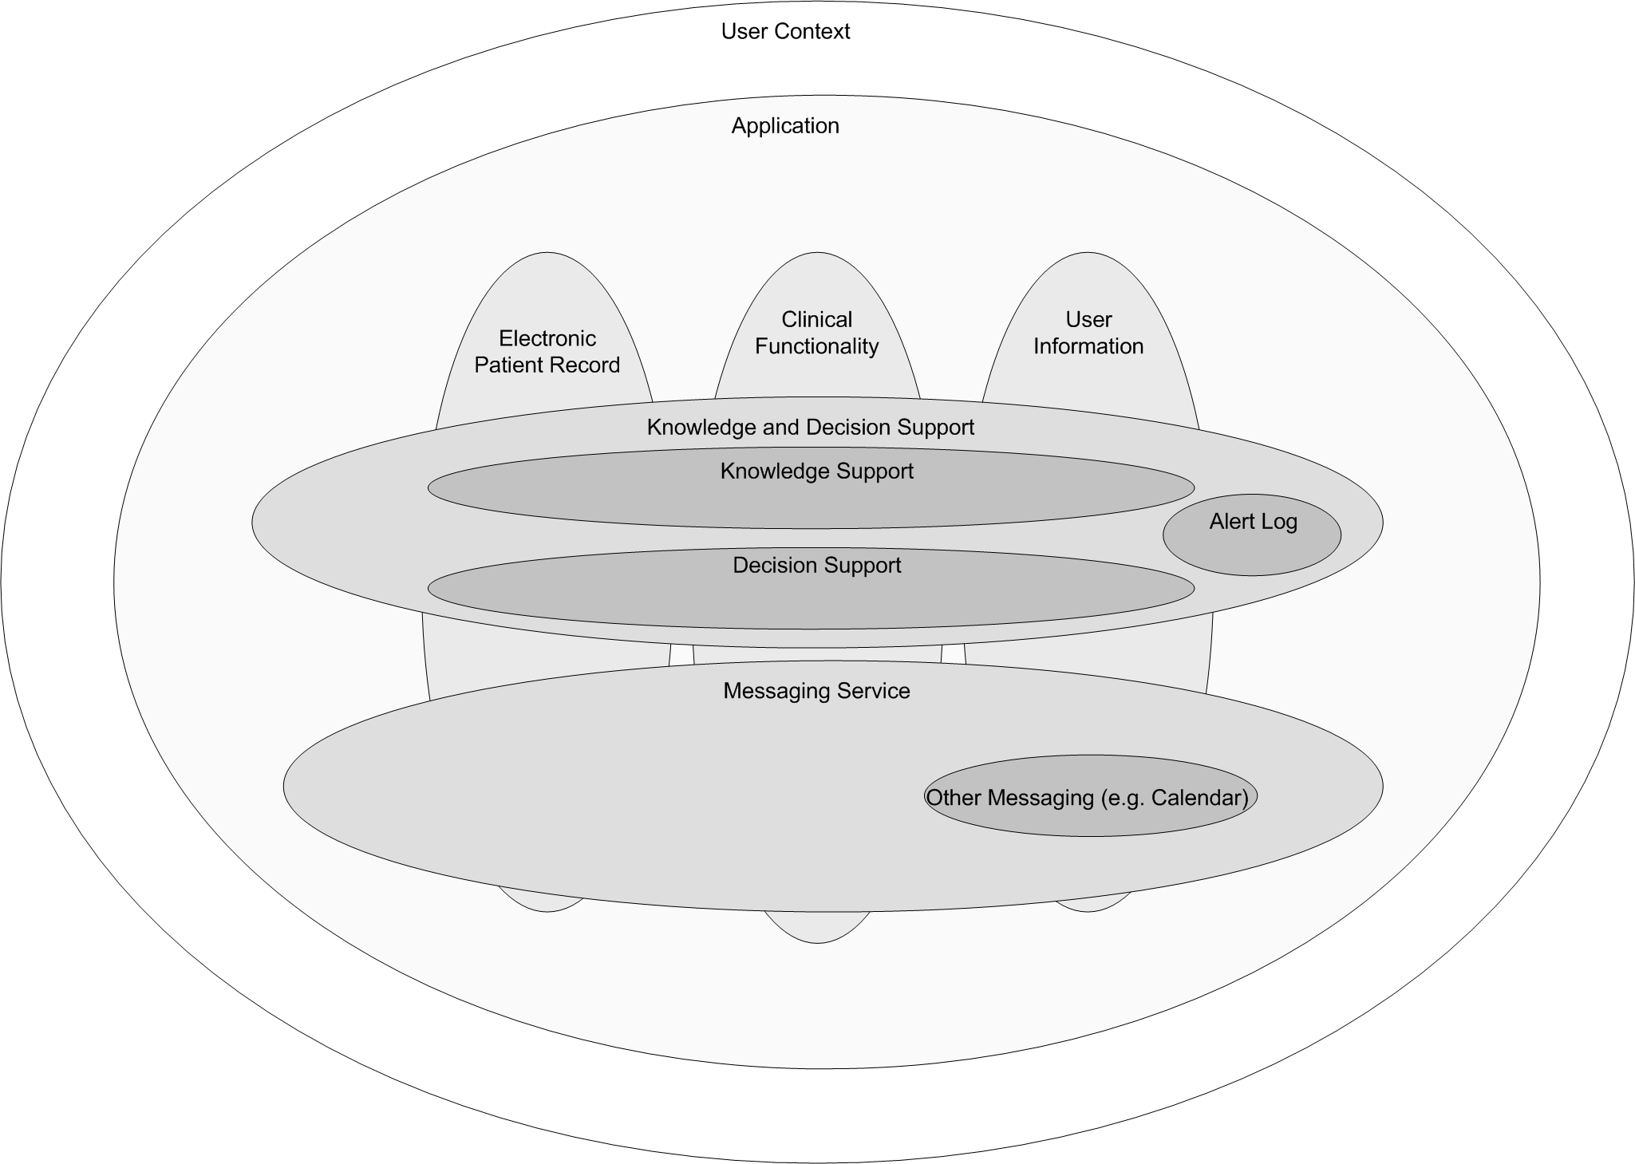
Context 3 of 4
Last modified on Wednesday, 28 March 2007
Copyright ©2013 Health and Social Care Information Centre
Slide <number>
Slide <number>

Slide 7
Context 4 of 4
User interface for knowledge and decision support contains a set of fundamental elements
For a specific patient, these elements provide a mechanism for informing the user of:
  important information
  relevant information
  notifications
  alerts
Last modified on Wednesday, 28 March 2007
Copyright ©2013 Health and Social Care Information Centre
Slide <number>
Slide <number>

Slide 8
Scope
In Scope 1 of 2
  Communication of Decision Support capability
  The communication to the user that decision support is currently active/inactive during the user’s current session within a clinical application
  Display of Choice Lists with Preferences
  Allowing choice from a set of graded recommendations of activities in a patient’s situation
  Display and Interaction with System Generated Alerts
  An alert relevant to this patient generated in response to a change in the information available
Last modified on Wednesday, 28 March 2007
Copyright ©2013 Health and Social Care Information Centre
Slide <number>

Slide 9
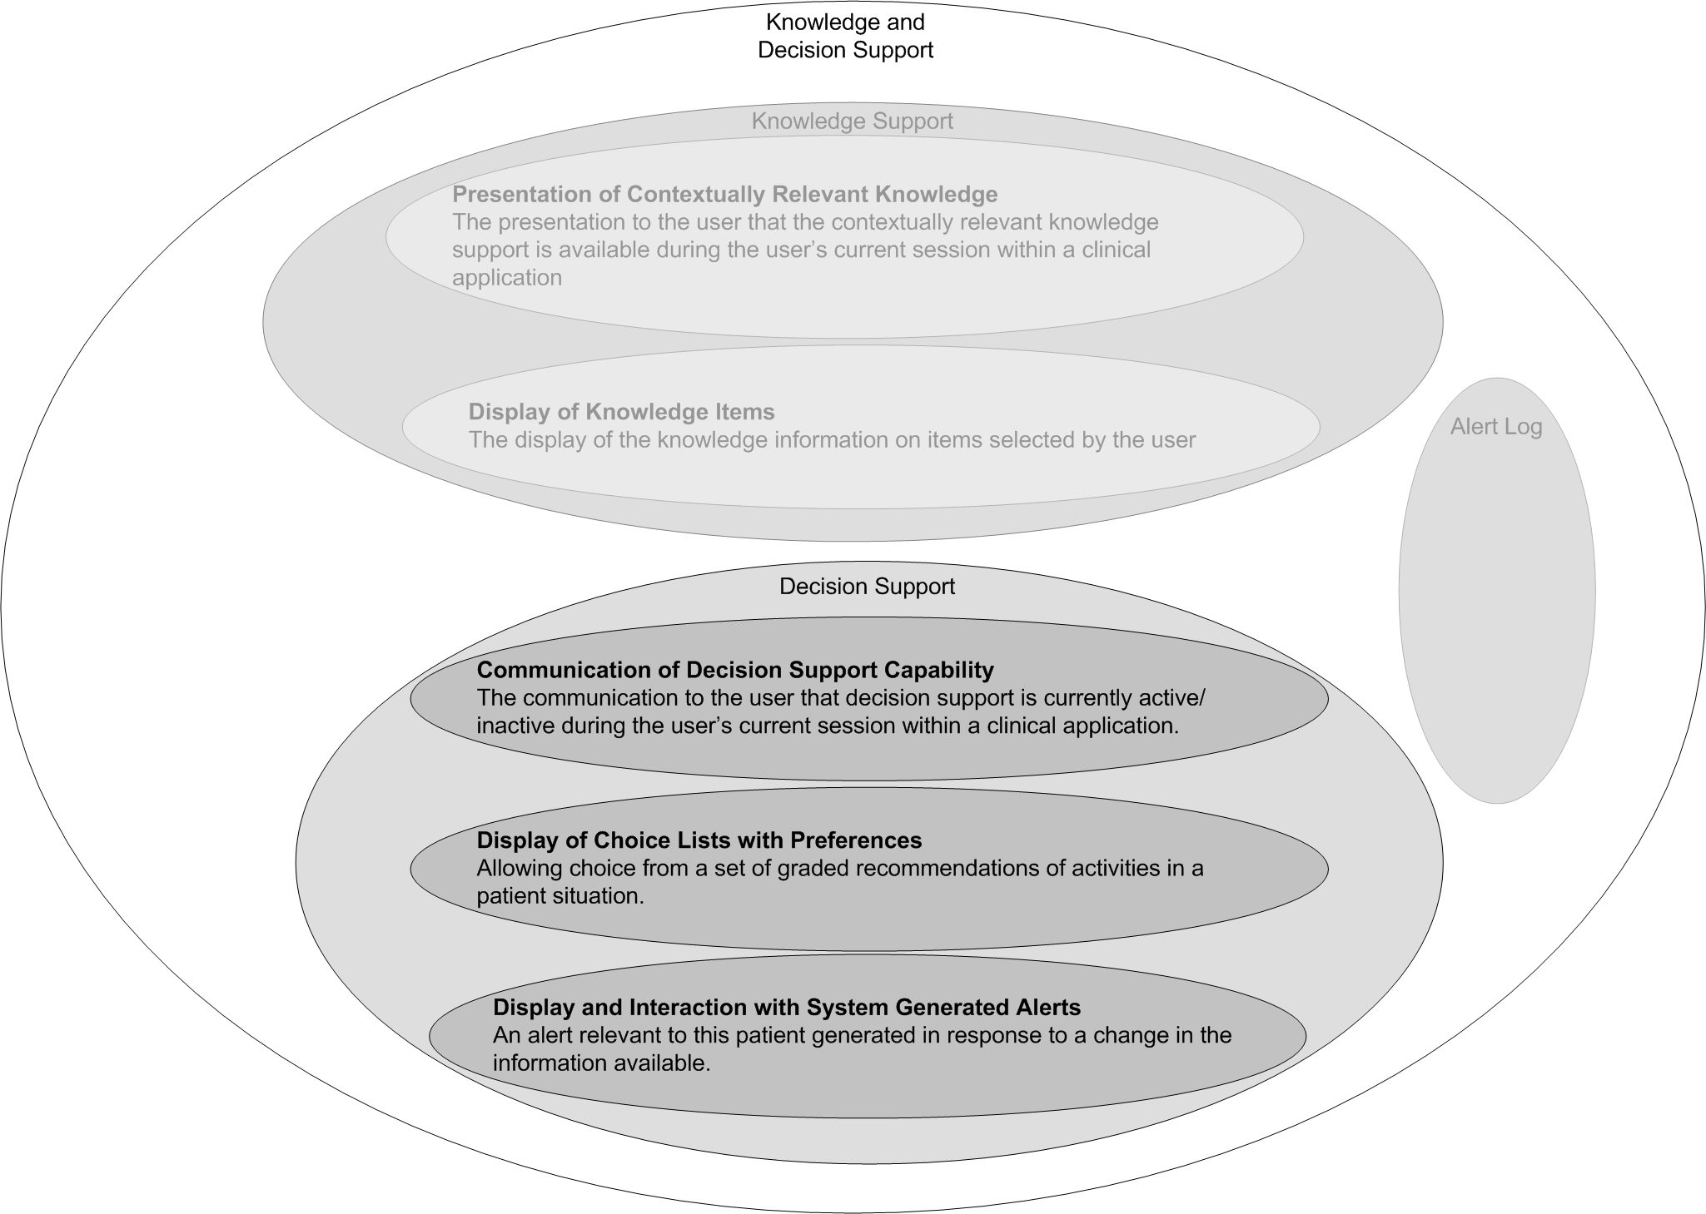
Scope
In Scope 2 of 2
Last modified on Wednesday, 28 March 2007
Copyright ©2013 Health and Social Care Information Centre
Slide <number>
Slide <number>

Slide 10
Scope
Out of Scope 1 of 4
  Forwarding, referring and escalating an alert (part of the bigger picture for clinical notification)
  Design for clinician’s home page
  Handling alerts when a clinician is outside a patient’s EPR
  Handling notification messages, such as: ‘test results are back’
  Ability to turn on/off elements of decision support
Last modified on Wednesday, 28 March 2007
Copyright ©2013 Health and Social Care Information Centre
Slide <number>

Slide 11
Scope
Out of Scope 2 of 4
  Inserting any actions required as a result of an alert
  A state transition diagram required to define alert transition
  Additional ‘monitoring conditions’ to be put in place, to ensure the safety of any particular decision
  At present, any other context but prescribing and investigations
  Designing a library of icons
Last modified on Wednesday, 28 March 2007
Copyright ©2013 Health and Social Care Information Centre
Slide <number>

Slide 12
Scope
Out of Scope 3 of 4
  Audit trail of an alert
  Logging of an alert
  Rating of an alert
  Overriding an alert
  Messaging framework
  View when an alert has been raised
  View the priority of an alert (which can change over a period of time)
Last modified on Wednesday, 28 March 2007
Copyright ©2013 Health and Social Care Information Centre
Slide <number>

Slide 13
Scope
Out of Scope 4 of 4
  Clinical rules for alerts
  Triggers for alerts
  Defining the level of priority and context for an alert
  Configuration of alerts within the configuration of the clinical application
Last modified on Wednesday, 28 March 2007
Copyright ©2013 Health and Social Care Information Centre
Slide <number>
Slide <number>

Slide 14
Key Principles 1 of 3
There are two types of communication in decision support, informing and recommending
When an inform act/recommend act occurs, it is recorded in the electronic patient record
For alerts, the aim is to combine multiple axes of importance, such as criticality and urgency, into one axis of priority
For choices, the aim is to combine multiple axes into a single scale for preference
There needs to be a defined number of priority levels for an alert
Last modified on Wednesday, 28 March 2007
Copyright ©2013 Health and Social Care Information Centre
Slide <number>

Slide 15
Key Principles 2 of 3
The significance of the priority levels must be easily understood by the user
Recommendations for appropriate actions following an alert will be displayed if they are available from a decision support system
Alerts need to be compatible with, and exist within the messaging framework
Explanations will be available for any alert or preference
Last modified on Wednesday, 28 March 2007
Copyright ©2013 Health and Social Care Information Centre
Slide <number>

Slide 16
Key Principles 3 of 3
Where explanations refer to an item in a patient record, it must be possible to view that item in its original context
Consistency of structure in display of information
There is a standard NHS CFH catalogue of all available decision support services
The full set of local decision support functionality will be given at login
The standard care process must not be interrupted
Last modified on Wednesday, 28 March 2007
Copyright ©2013 Health and Social Care Information Centre
Slide <number>

Slide 17
Communication of Decision Support Capability
The communication to the user that decision support is currently active/inactive during the user’s current session within a clinical application
Last modified on Wednesday, 28 March 2007
Copyright ©2013 Health and Social Care Information Centre
Slide <number>

Slide 18
Requirements
Communication of Decision Support Capability
Communicate to the user that decision support services are currently running/not running on the system
    High-level communication
    Detail of individual services
Last modified on Wednesday, 28 March 2007
Copyright ©2013 Health and Social Care Information Centre
Slide <number>

Slide 19
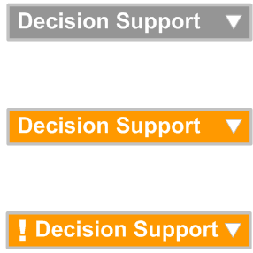
How to Display the Overview of Decision Support Capability 1 of 2
The title of the decision support capability tool should be short
An arrow should suggest detailed information is available on a click
Display the different states in different colours and icons
An icon should suggest a change of state since last viewed
Last modified on Wednesday, 28 March 2007
Copyright ©2013 Health and Social Care Information Centre
Slide <number>

Slide 20
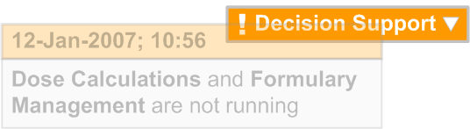
How to Display the Overview of Decision Support Capability 2 of 2
For every change in availability of a decision support service, a pop-up should be displayed which summarises the change
The pop-up should appear in close proximity to the title
The pop-up should display the date and time of the change according to the existing NHS CUI Design Guide Workstream guidance:
Time Display
Date Display
The pop-up should fade out over a period of time
Last modified on Wednesday, 28 March 2007
Copyright ©2013 Health and Social Care Information Centre
Slide <number>

Slide 21
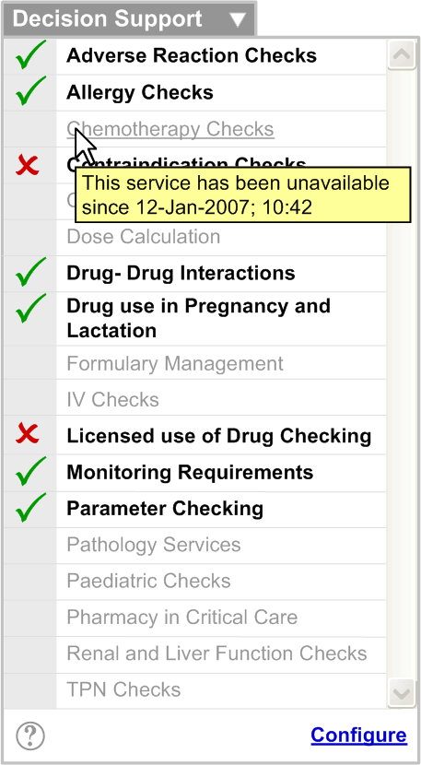
How to Display the Detailed Level of Decision Support Capability 1 of 2
The NHS CFH catalogue of decision support services should be displayed in alphabetical order
Display the different states of services with different textual treatments and icons
Display the detailed status on mouse-over
Access to the Help file should be allowed by clicking on the help icon
A link to configure the states of the services should be provided
Last modified on Wednesday, 28 March 2007
Copyright ©2013 Health and Social Care Information Centre
Slide <number>
Slide <number>

Slide 22
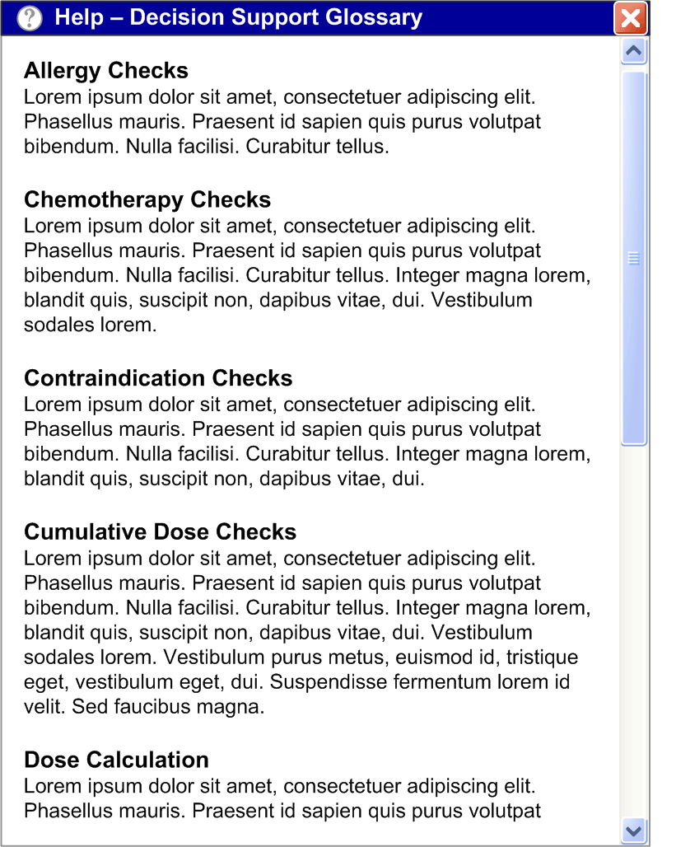
How to Display the Detailed Level of Decision Support Capability 2 of 2
The Help file should display a brief description of each service
Last modified on Wednesday, 28 March 2007
Copyright ©2013 Health and Social Care Information Centre
Slide <number>

Slide 23
Information Window Anatomy
Last modified on Wednesday, 28 March 2007
Copyright ©2013 Health and Social Care Information Centre
Slide <number>

Slide 24
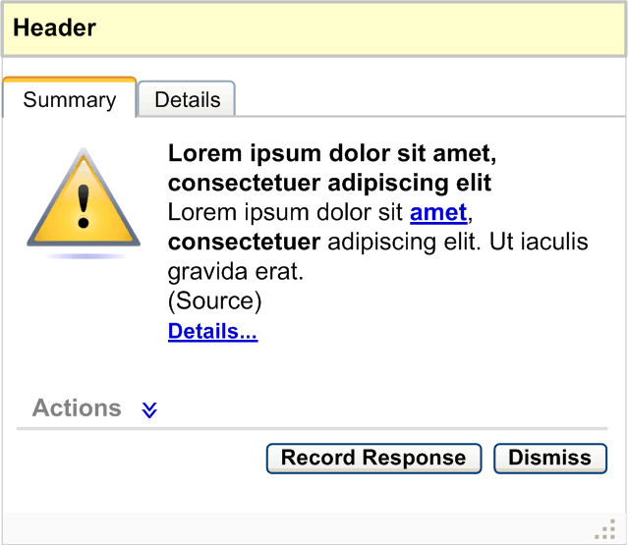
Information Window Anatomy
The information window should be consistent across ‘Choice Lists with Preferences’ and ‘Unprompted Notifications’
Header Area
Details Area: Should be available by clicking Details tab or the Details… link in the summary area
Summary Area: Should be the selected tab by default.
It should capture the following: Icon, Summary Information, Source of Information, Link to details, Recommended Actions, and Buttons
Resizing Control: Should be placed at the bottom right or bottom left corner of the alert box to allow resizing
Last modified on Wednesday, 28 March 2007
Copyright ©2013 Health and Social Care Information Centre
Slide <number>
Slide <number>

Slide 25
Summary Area 1 of 7
Icon
The icon should be placed to the left of the summary information
Information Summary
The information summary should be brief and should summarise the information details (for example, ‘There are potential additive hypotensive effects with Lisinopril and Furosemide, a current medication for this patient’)
Icon
Information Summary
Last modified on Wednesday, 28 March 2007
Copyright ©2013 Health and Social Care Information Centre
Slide <number>

Slide 26
Summary Area 2 of 7
Source of Information
The source of the information should be displayed in brackets, below the summary. The source of information should identify a service from the NHS CFH catalogue
Information Details
A textual link to the information details should be provided. This link should be displayed below the source. This link should display the information details
Information Details
Source of Information
Last modified on Wednesday, 28 March 2007
Copyright ©2013 Health and Social Care Information Centre
Slide <number>
Slide <number>

Slide 27
Summary Area 3 of 7
Button to Record Response
  Takes the user to the area of the clinical application to allow them to record a response
  Should be placed before or to the left of the Dismiss button
  Should be enabled at all times
Record Response Button
Last modified on Wednesday, 28 March 2007
Copyright ©2013 Health and Social Care Information Centre
Slide <number>

Slide 28
Summary Area 4 of 7
Button to Dismiss
  Dismisses the information box
  Should be placed after or to the right of the Record Response button
  Should be enabled at all times
Dismiss Button
Last modified on Wednesday, 28 March 2007
Copyright ©2013 Health and Social Care Information Centre
Slide <number>
Slide <number>

Slide 29
Summary Area 5 of 7
Recommended Actions
Actions should be displayed in a collapsed state by default:
The label Actions with a chevron next to it should be displayed
The chevron should act as an interactive element which should expand the actions area on click
Last modified on Wednesday, 28 March 2007
Copyright ©2013 Health and Social Care Information Centre
Slide <number>

Slide 30
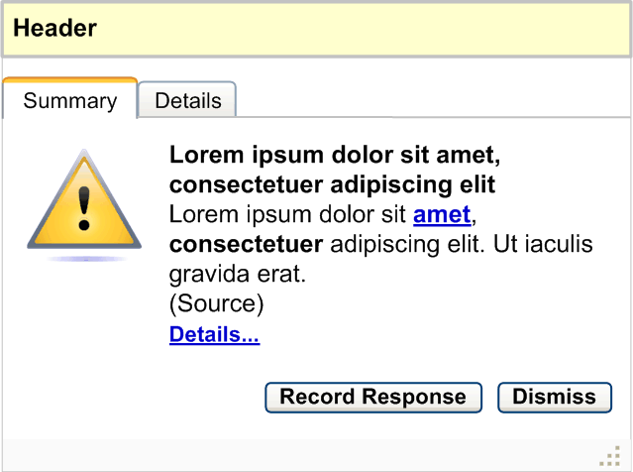
Summary Area 6 of 7
Recommended Actions
If decision support is not recommending any actions, elements including the label and chevron should not be displayed
Last modified on Wednesday, 28 March 2007
Copyright ©2013 Health and Social Care Information Centre
Slide <number>

Slide 31
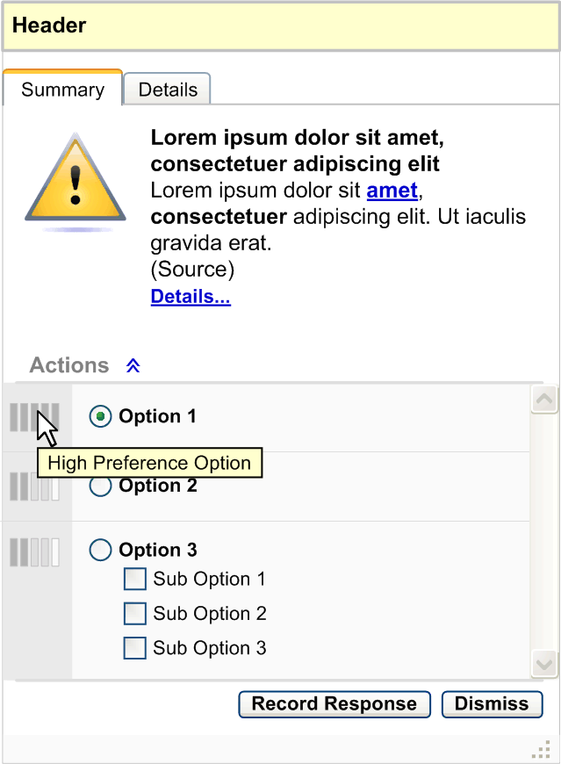
Summary Area 7 of 7
Recommended Actions
The actions should be displayed in order of preference
Select an action by clicking its associated option button
The preference icons represented by the rectangle bars should be placed on the left side of every action
On mouse-over of each icon, a tooltip explaining its significance should be displayed
An action could have multiple options and combinations
Last modified on Wednesday, 28 March 2007
Copyright ©2013 Health and Social Care Information Centre
Slide <number>

Slide 32
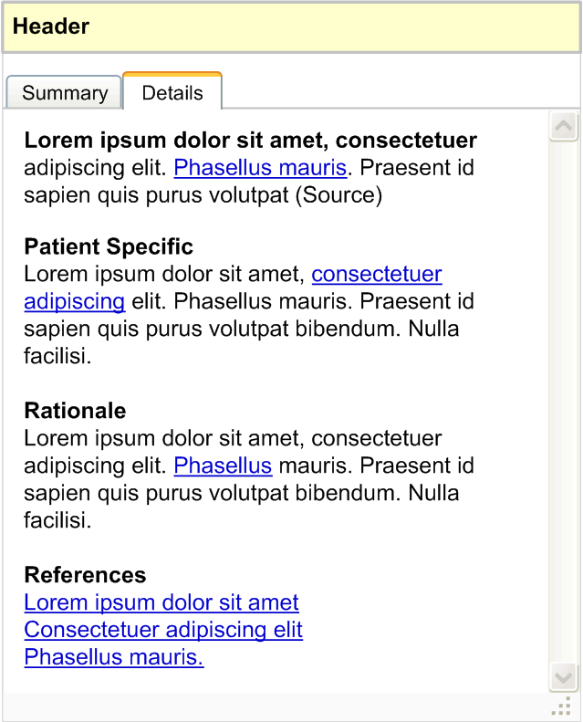
Details Area
Should be available by clicking the Details tab
The Details tab should be placed after the Summary tab
The Details area should also be available on clicking the Details link provided in the Summary area
This area should capture:
A summary of the information
Patient-specific information
Rationale
References
Last modified on Wednesday, 28 March 2007
Copyright ©2013 Health and Social Care Information Centre
Slide <number>

Slide 33
Choice Lists with Preferences
Allowing choice from a set of graded recommendations of activities in a patient’s situation
Last modified on Wednesday, 28 March 2007
Copyright ©2013 Health and Social Care Information Centre
Slide <number>

Slide 34
Requirements
Display of Choice Lists with Preferences 1 of 4
Not to interrupt the standard care process - if interruption is required then this should be minimal, but in all cases the user must be able to override any information
The user must be able to access the information details during the clinical activity without losing/obscuring the context of the current activity
Last modified on Wednesday, 28 March 2007
Copyright ©2013 Health and Social Care Information Centre
Slide <number>

Slide 35
Requirements
Display of Choice Lists with Preferences 2 of 4
Information must contain:
  Icon
  Summary
  Details
  Actions (if any)
Information details (from the above) must contain:
  Summary
  Patient-specific information
  Rationale and references
Last modified on Wednesday, 28 March 2007
Copyright ©2013 Health and Social Care Information Centre
Slide <number>

Slide 36
Requirements
Display of Choice Lists with Preferences 3 of 4
Information must include 5 level indicators for preference
Users must be able to access the reasoning behind the preference
Users must be able to access the knowledge support information about conditions, drugs and so on, within the summary of the information
Last modified on Wednesday, 28 March 2007
Copyright ©2013 Health and Social Care Information Centre
Slide <number>
Slide <number>

Slide 37
Requirements
Display of Choice Lists with Preferences 4 of 4
The recommendation of possible actions within an alert must accommodate a combination of ‘and’ and ‘or’ options
Multiple pieces of information against a single option must be visually treated as a single information box
Users must be able to directly access the relevant patient’s clinical details (such as dosage) through the information summary
Last modified on Wednesday, 28 March 2007
Copyright ©2013 Health and Social Care Information Centre
Slide <number>
Slide <number>

Slide 38
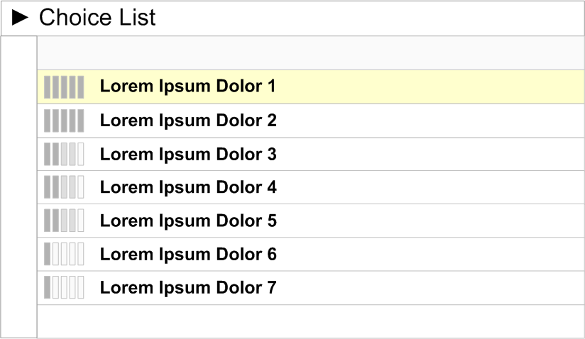
Choice Lists with Preferences 1 of 6
The preference rating should be represented by icons which should be placed to the left of the option
There should be unique icons to represent the different preferential ratings
Last modified on Wednesday, 28 March 2007
Copyright ©2013 Health and Social Care Information Centre
Slide <number>
Slide <number>

Slide 39
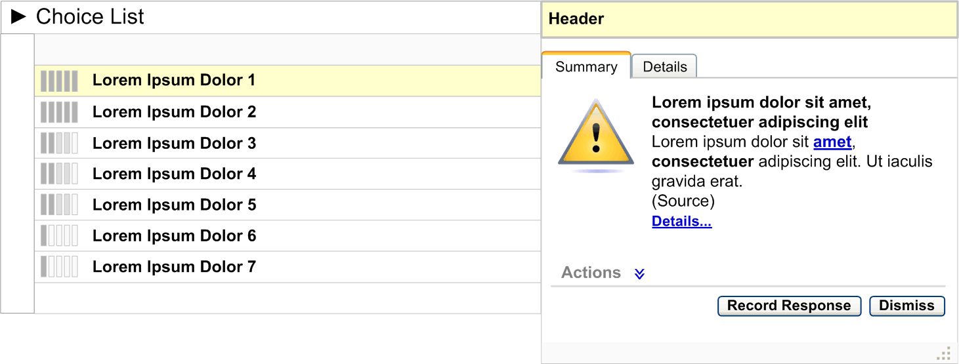
Choice Lists with Preferences 2 of 6
On clicking the preference icon, the information box should be displayed as an overlay
If the user clicks the Record Response button, the user should be taken to the area of the clinical application that allows them to record a response
If the user clicks on Dismiss button, the information box should close
Last modified on Wednesday, 28 March 2007
Copyright ©2013 Health and Social Care Information Centre
Slide <number>

Slide 40
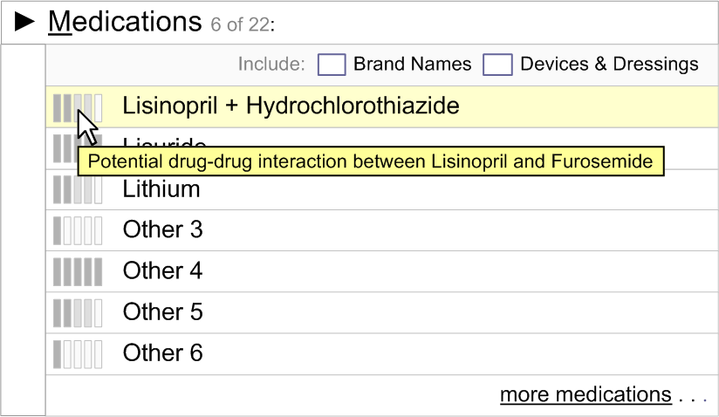
Choice Lists with Preferences 3 of 6
On mouse-over of the preference icon, a summary of the information should be displayed as a tooltip
The summary of the information in the tooltip should be brief and identify the reason for preference
Last modified on Wednesday, 28 March 2007
Copyright ©2013 Health and Social Care Information Centre
Slide <number>

Slide 41
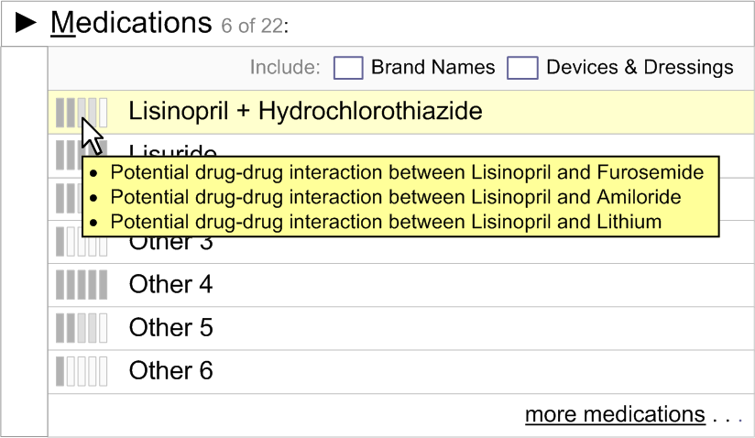
Choice Lists with Preferences 4 of 6
If there are multiple reasons for a particular preference, display all the information summaries on mouse-over
Last modified on Wednesday, 28 March 2007
Copyright ©2013 Health and Social Care Information Centre
Slide <number>

Slide 42
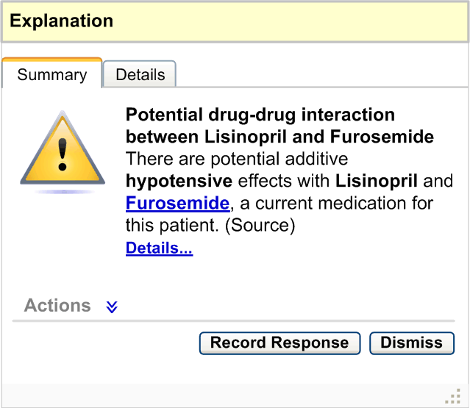
Choice Lists with Preferences 5 of 6
If any wording in the summary is derived from one or more patient items, it should be linked to that record item in its original context
Last modified on Wednesday, 28 March 2007
Copyright ©2013 Health and Social Care Information Centre
Slide <number>

Slide 43
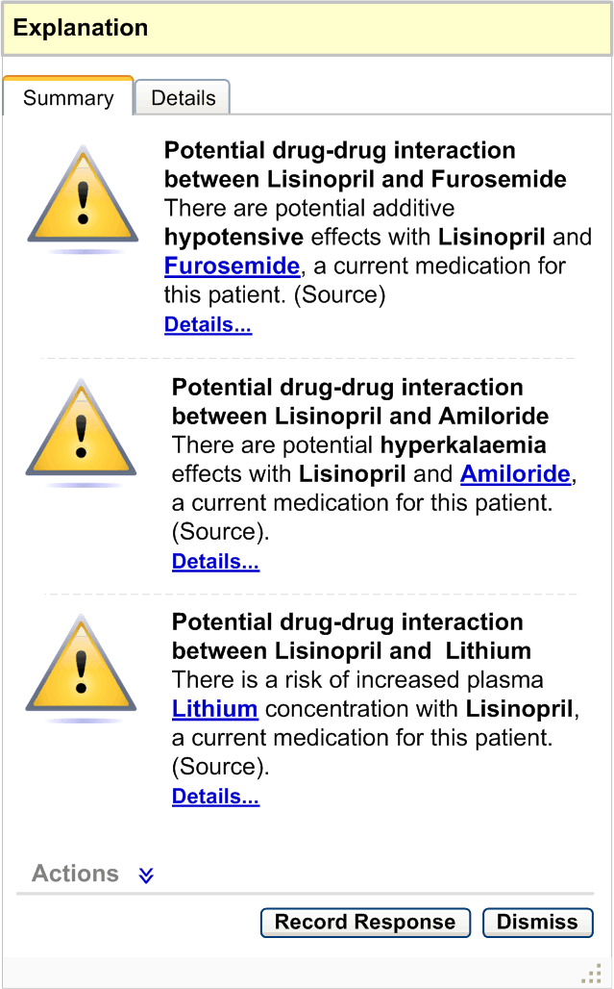
Choice Lists with Preferences 6 of 6
If there are multiple pieces of information against the same option, display all the summaries within the same information box
Details for multiple summaries should be consolidated in the Details area
Actions for multiple summaries should be consolidated as a single list in the actions area
Last modified on Wednesday, 28 March 2007
Copyright ©2013 Health and Social Care Information Centre
Slide <number>

Slide 44
Unprompted Notifications
(System Generated Alerts)
An alert relevant to this patient generated in response to a change in the information available
Last modified on Wednesday, 28 March 2007
Copyright ©2013 Health and Social Care Information Centre
Slide <number>

Slide 45
Requirements
Display and Interaction with Unprompted Notifications 1 of 2
User must be able to access the alert details during the clinical activity
Alert must contain:
    Status of the alert (high/priority)
    Date and time when the alert occurred
    Alert icon
    Alert summary
    Alert details
    Actions (if any)
Last modified on Wednesday, 28 March 2007
Copyright ©2013 Health and Social Care Information Centre
Slide <number>
Slide <number>

Slide 46
Requirements
Display and Interaction with Unprompted Notifications 2 of 2
Alert details must contain:
  Summary
  Patient-specific information
  Rationale and references
Users must be able to directly access the relevant clinical information (such as test results) through the explanation of the alert
Alert must include 5 level indicators for preference (when showing recommendation)
Users must be able to access the reasoning behind the preference
Last modified on Wednesday, 28 March 2007
Copyright ©2013 Health and Social Care Information Centre
Slide <number>
Slide <number>

Slide 47
Unprompted Notifications 1 of 6
In the context of a clinical application, there should be an indicator to suggest system generated alerts, which could be represented by an icon
On clicking the indicator icon, the system should display the alert container which lists all the active system generated alerts for this patient
Last modified on Wednesday, 28 March 2007
Copyright ©2013 Health and Social Care Information Centre
Slide <number>
Slide <number>

Slide 48
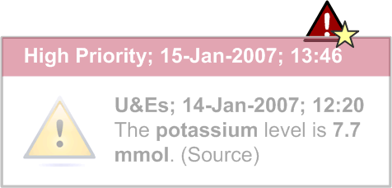
Unprompted Notifications 2 of 6
This pop-up should capture the status, date and time of the alert in its header, according to the existing NHS CUI Design Guide Workstream guidance:
Time Display
Date Display
When a new alert appears, a pop-up should be displayed in close proximity to the indicator icon
If the user clicks on the pop-up, the system should display the alert container
The pop-up should fade out over a period of time
Last modified on Wednesday, 28 March 2007
Copyright ©2013 Health and Social Care Information Centre
Slide <number>

Slide 49
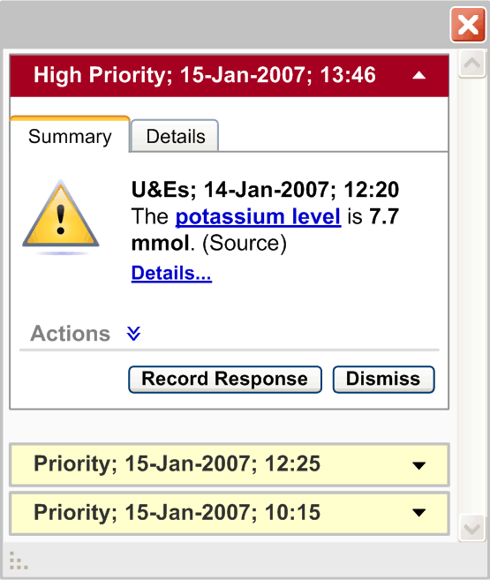
Unprompted Notifications 3 of 6
There should be two types of alert status: High Priority and Priority
All High Priority alerts should be displayed in an expanded state by default, where the alert details are visible
All Priority alerts should be displayed in a collapsed state by default, where only the alert header details are visible
The user should be able to collapse and expand every alert by clicking on the alert header
Last modified on Wednesday, 28 March 2007
Copyright ©2013 Health and Social Care Information Centre
Slide <number>

Slide 50
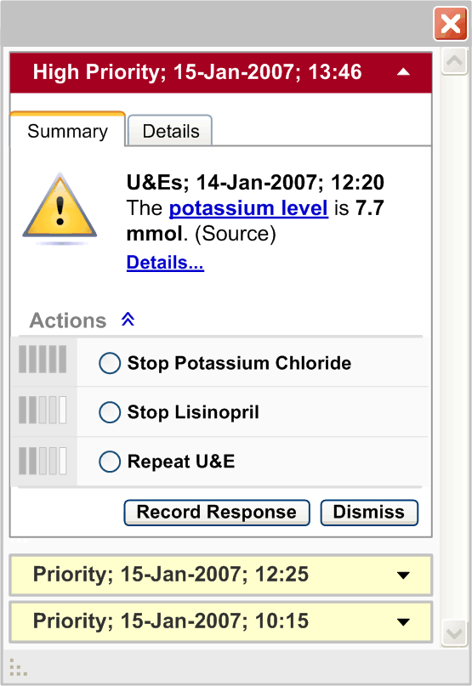
Unprompted Notifications 4 of 6
The alert header should capture the alert status, the date and the time of the alert, according to the existing NHS CUI Design Guide Workstream guidance:
Time Display
Date Display
If the alert summary refers to any record item of the patient, this reference should be linked to that record item
The resizing control should be available on the alert container
On resizing the container area, all the alerts in the container should also be resized
Last modified on Wednesday, 28 March 2007
Copyright ©2013 Health and Social Care Information Centre
Slide <number>

Slide 51
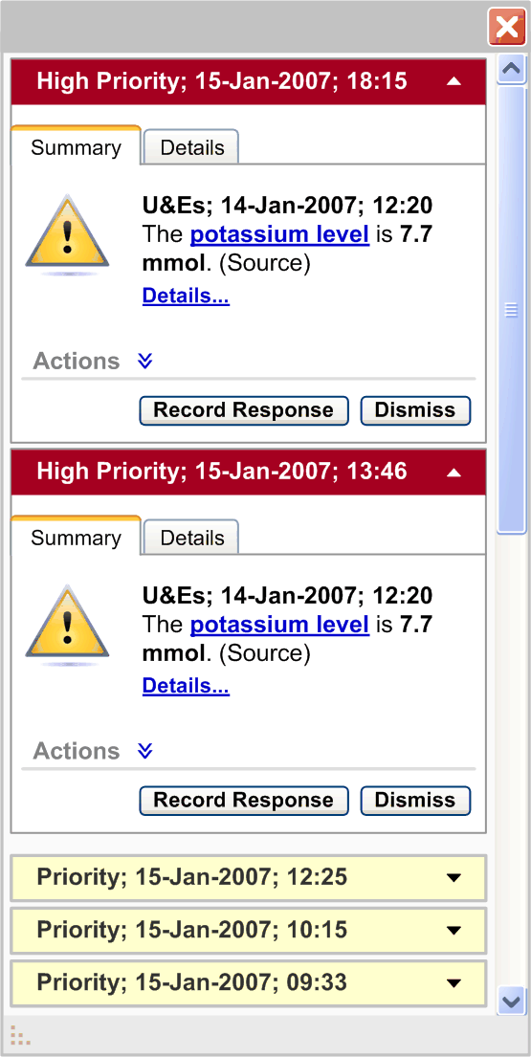
Unprompted Notifications 5 of 6
The alerts should be grouped by status and, within each status group, stacked in reverse chronological order
The group of High Priority alerts should be placed above the group of Priority alerts
The minimum dimensions of the alert container and information box should be fixed
Last modified on Wednesday, 28 March 2007
Copyright ©2013 Health and Social Care Information Centre
Slide <number>

Slide 52





Unprompted Notifications 6 of 6
Exemplar Representation of Indicator Icon | Icon Description
 | Icon suggests there are no active alerts
 | Icon suggests there is one or more active priority alert which has not been viewed
 | Icon suggests there is one or more active priority alert which has been viewed
 | Icon suggests there is one or more high priority active alert and a possible number of priority alerts which have not been viewed
 | Icon suggests there is one or more high priority active alert and a possible number of priority alerts which have been viewed
Last modified on Wednesday, 28 March 2007
Copyright ©2013 Health and Social Care Information Centre
Slide <number>
Slide <number>

Slide 53
Next Steps 1 of 2
In order to progress this work further, the following aspects of decision support require consideration and investigation:
Carrying out further research, user testing and patient safety assessment
Handling multi-patient alerts when a clinician is outside a patient’s record
Designing a library of icons for alerts and the display of preferences
Ability to turn on/off decision support services
Extension of this guidance to have multiple patient views
Last modified on Wednesday, 28 March 2007
Copyright ©2013 Health and Social Care Information Centre
Slide <number>

Slide 54
Next Steps 2 of 2
Work with the software and application providers to refine the guidance
The header information for system generated alerts should be explored further to accommodate summary information of the alert
Research should be conducted on how to summarize an alert to make it meaningful
Design for the look-ahead scroll bar to suggest the number of system generated alerts which are behind the scroll bar
Placement of the system generated alerts container within a clinical application
Last modified on Wednesday, 28 March 2007
Copyright ©2013 Health and Social Care Information Centre
Slide <number>
Slide <number>

