Slide 1
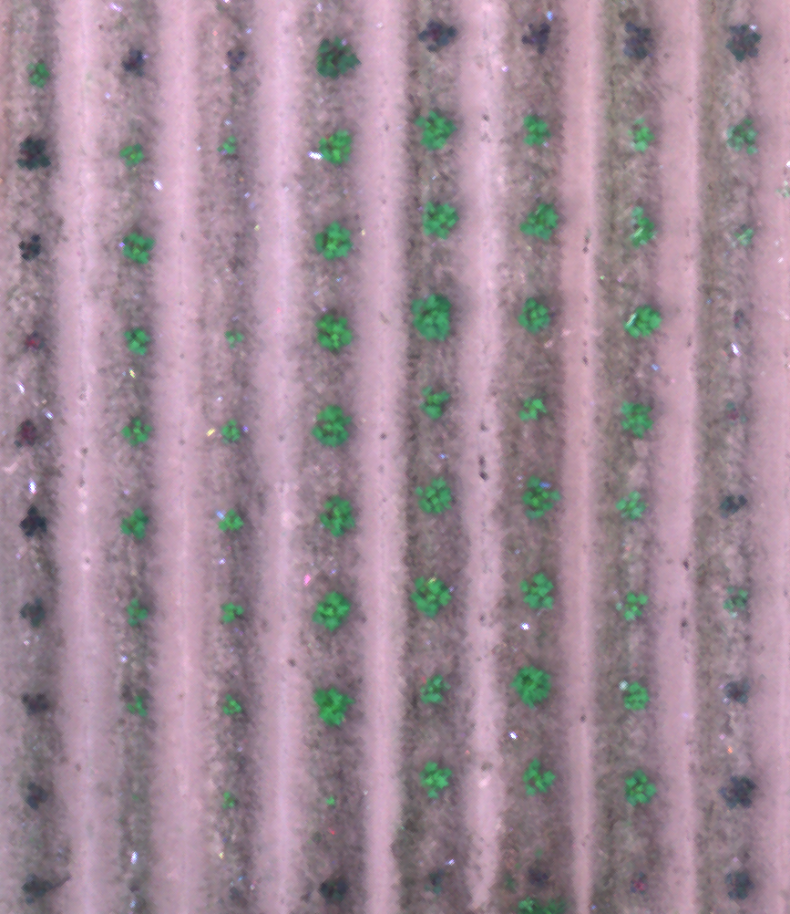
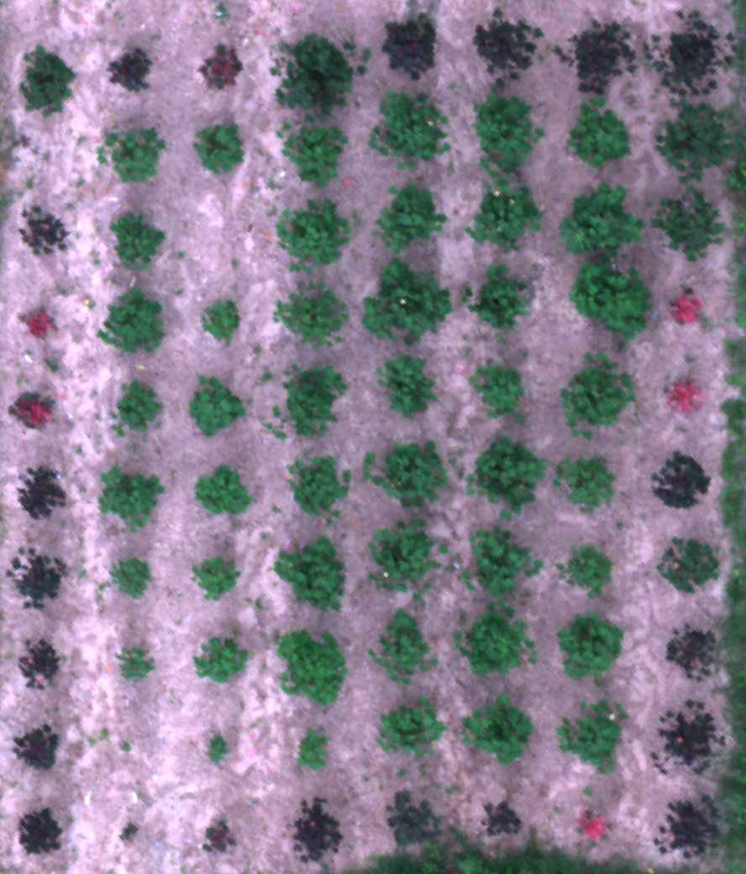
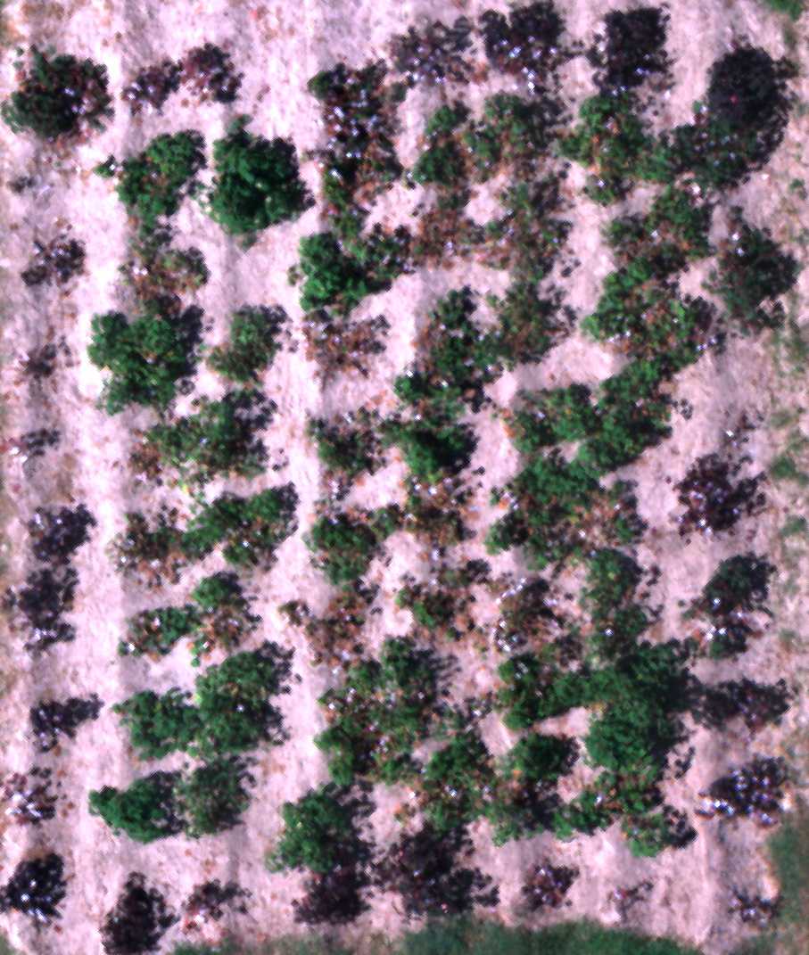
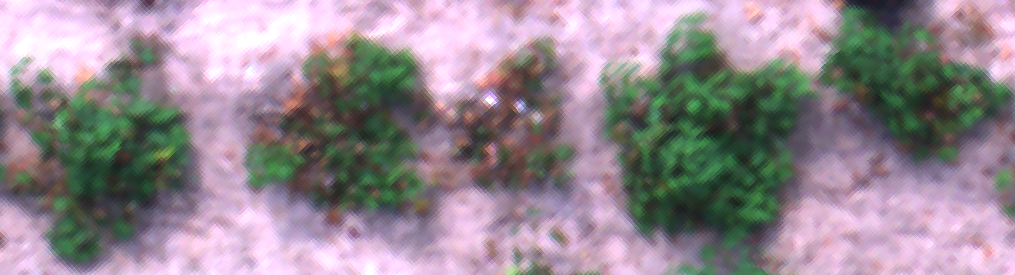
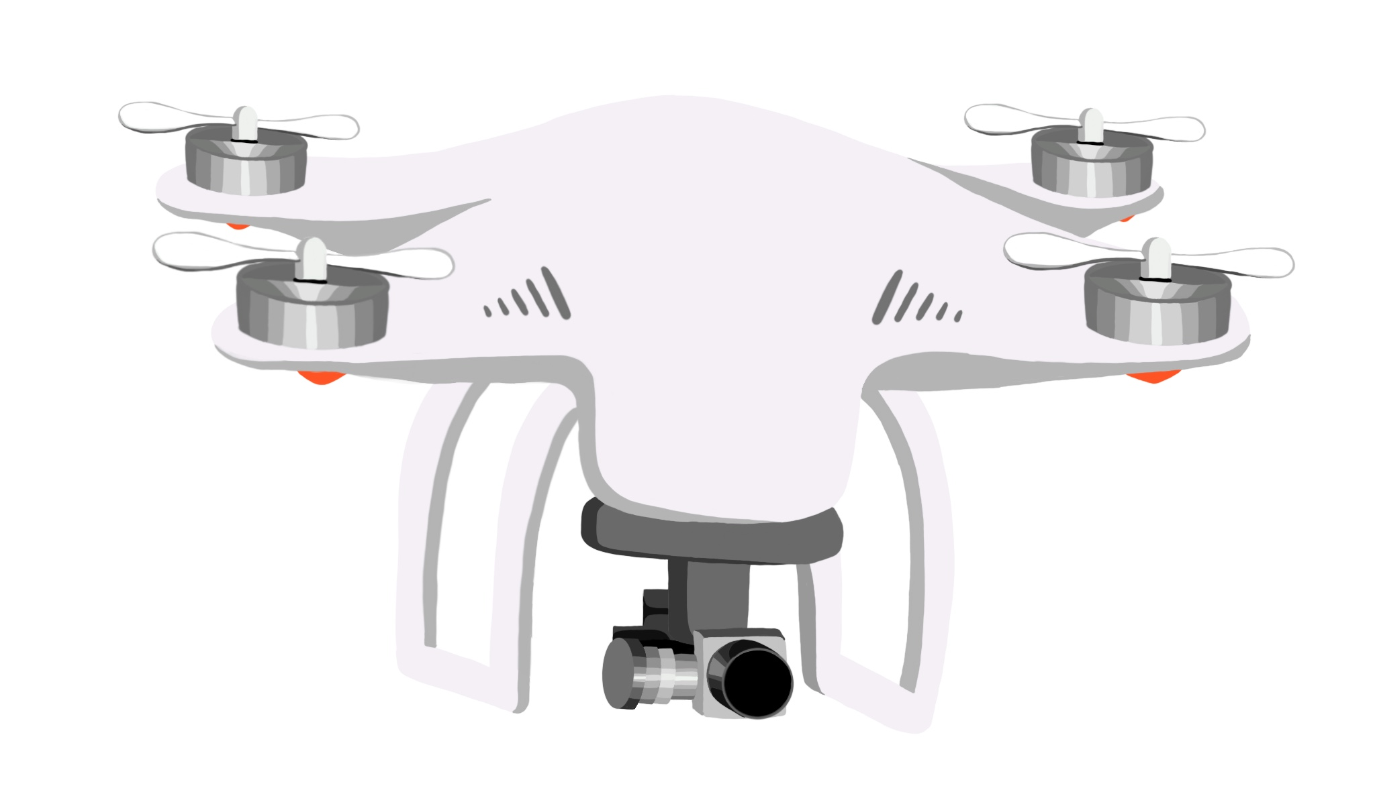
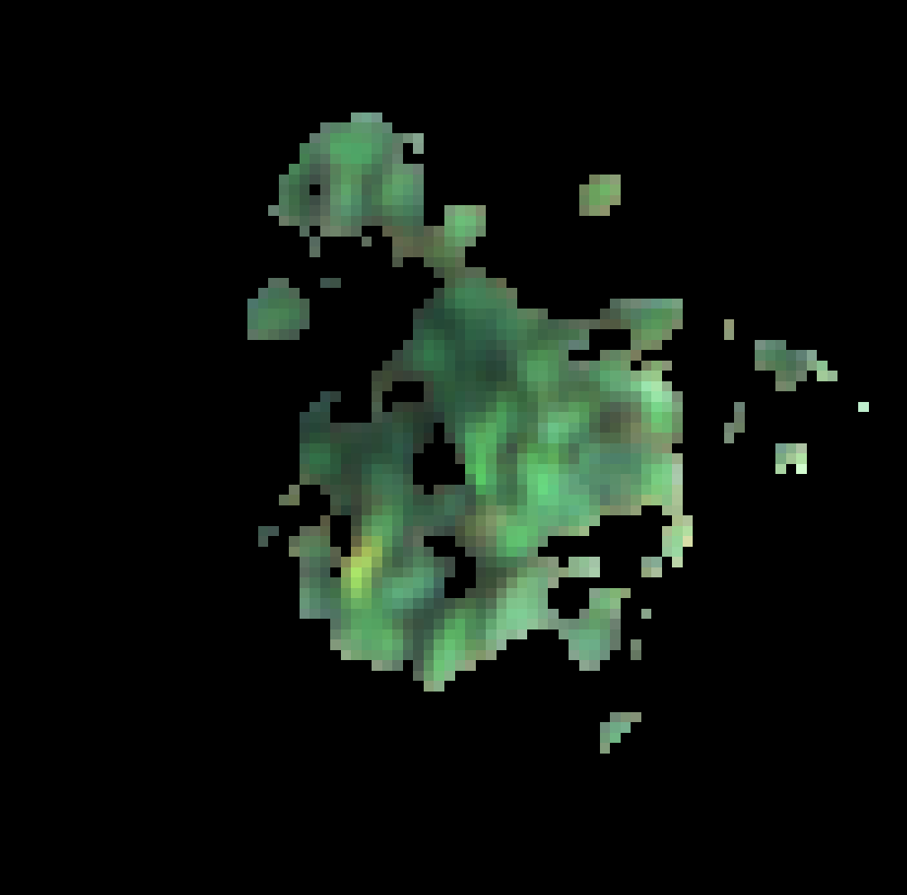
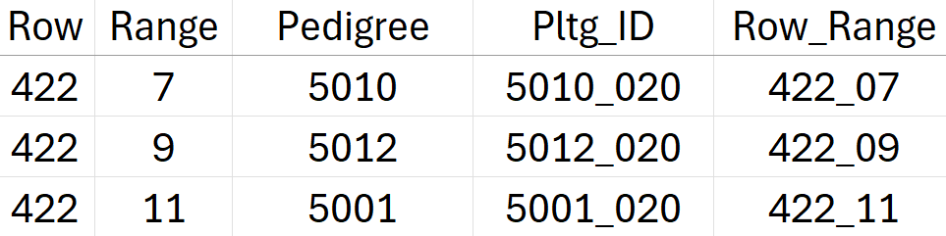
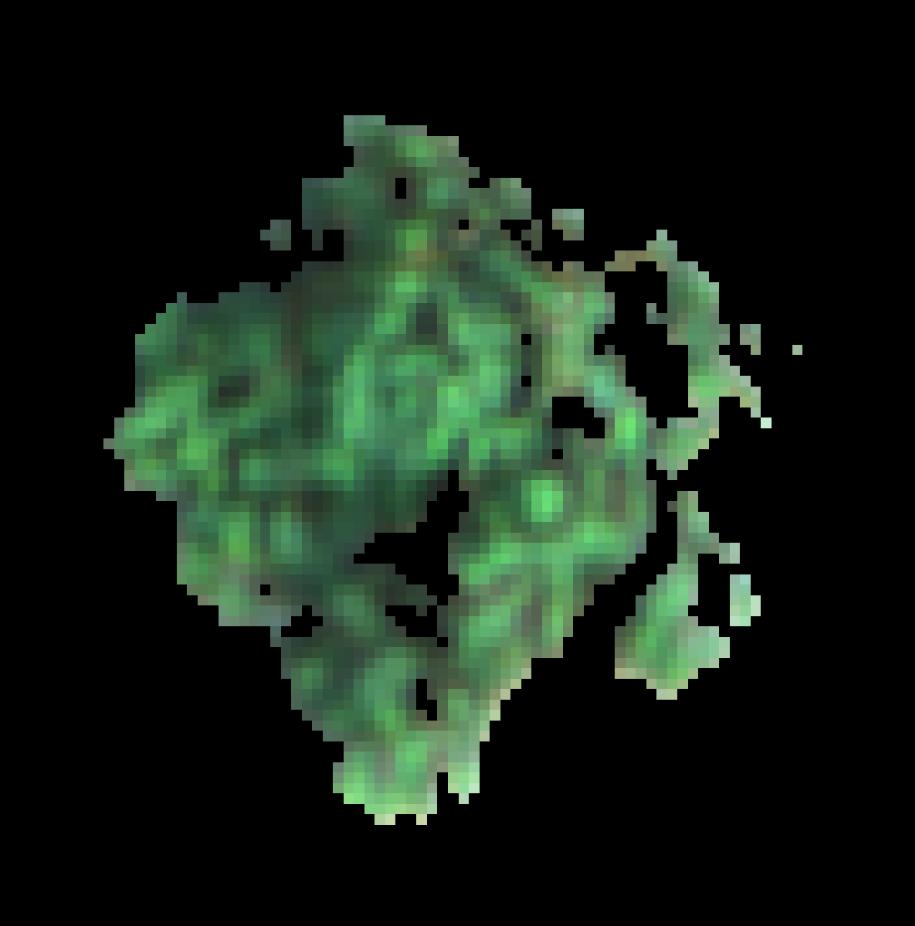
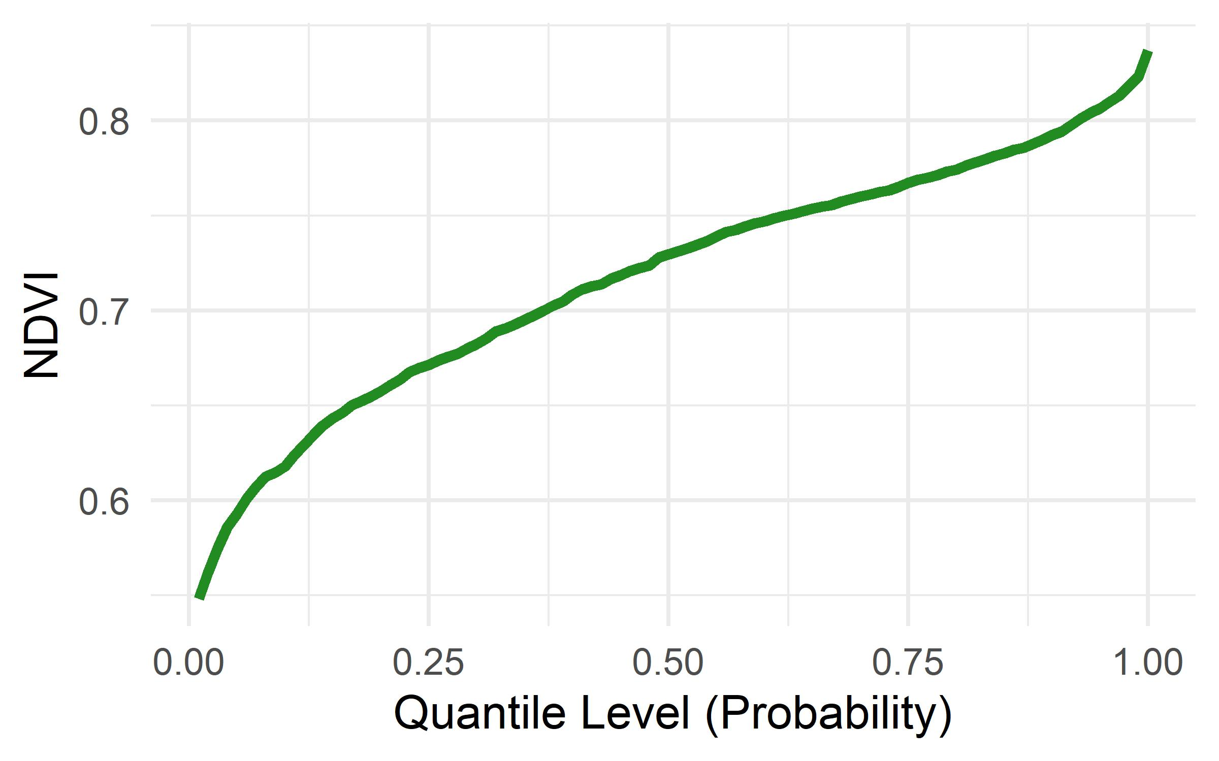
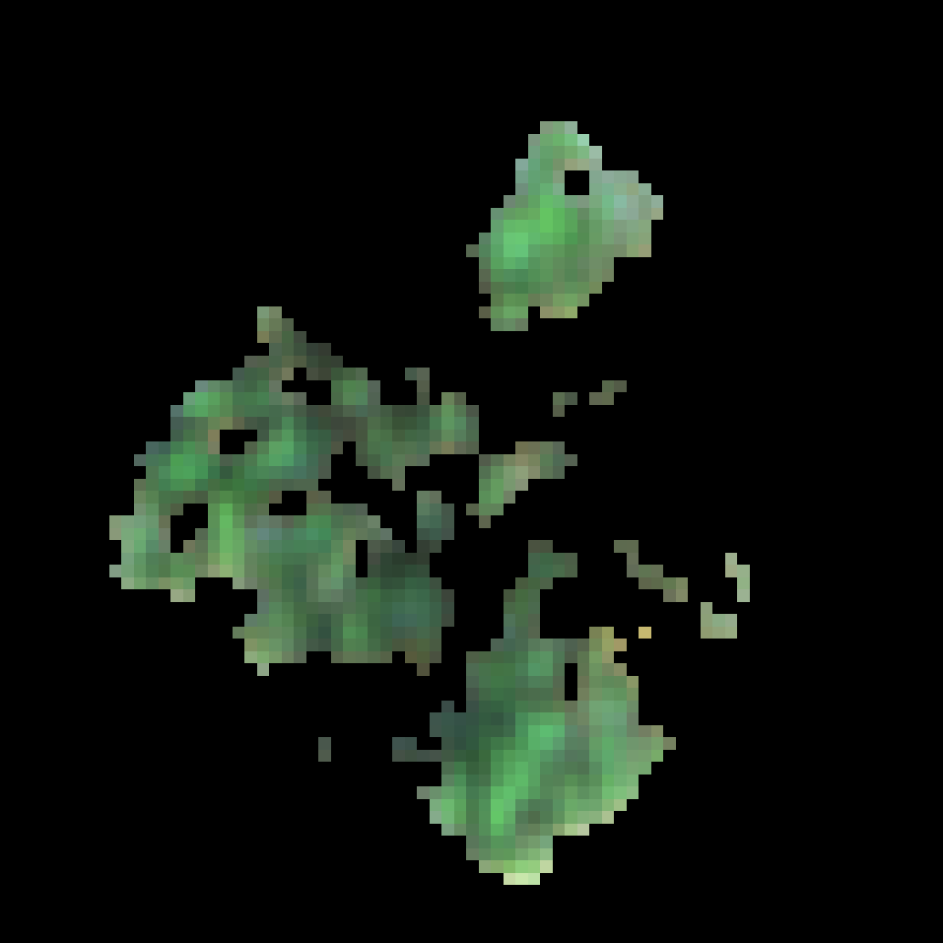
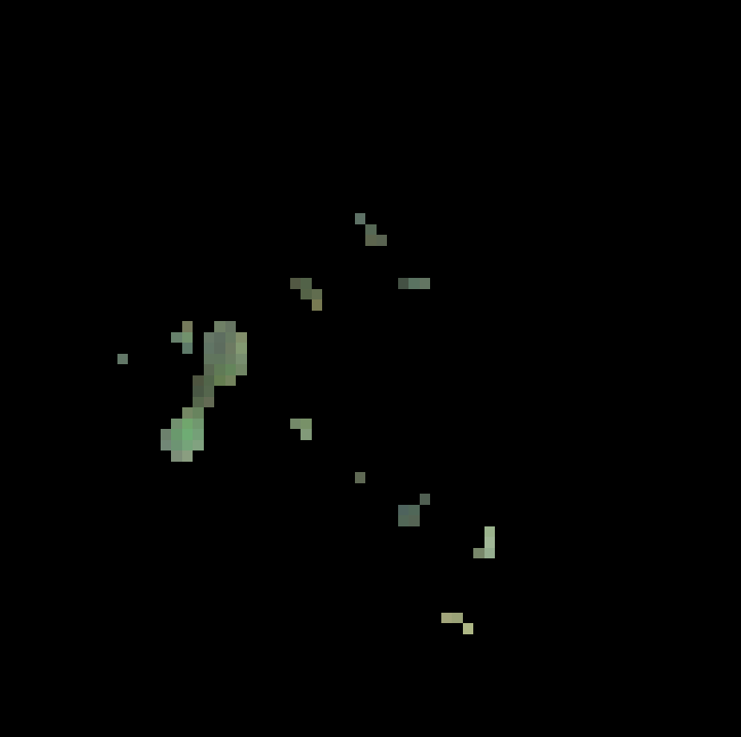
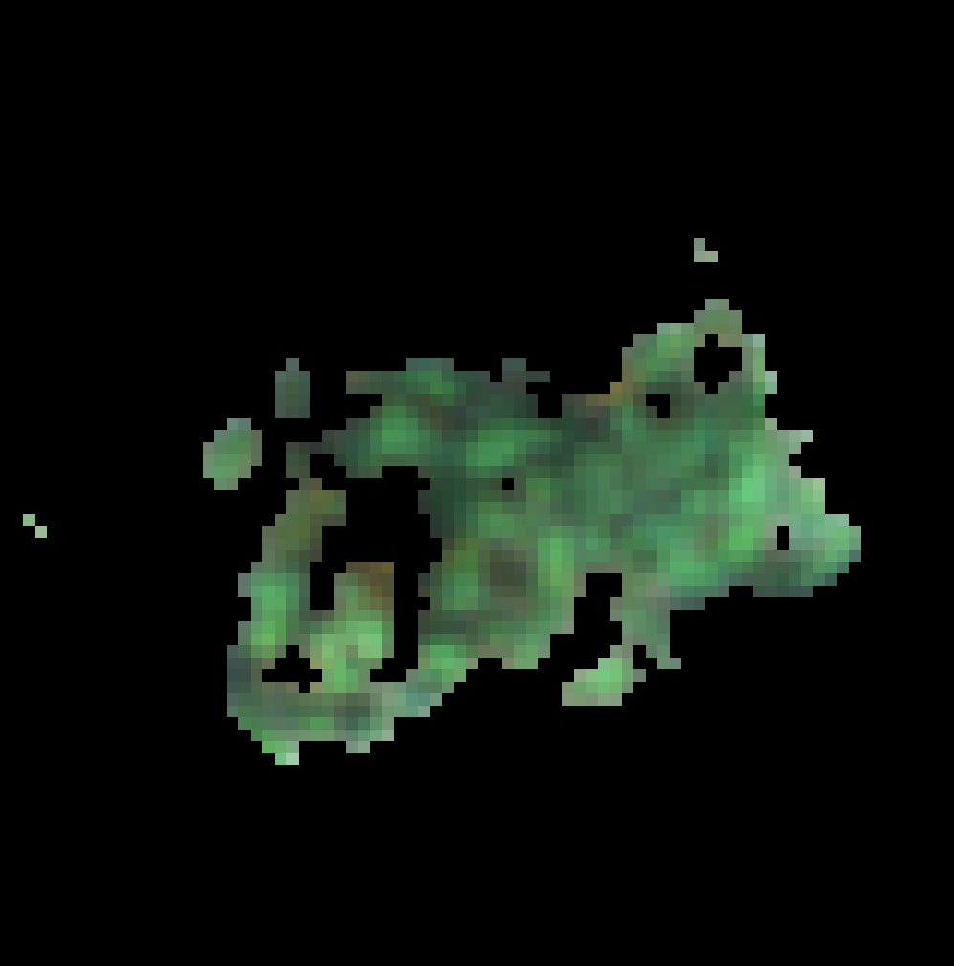
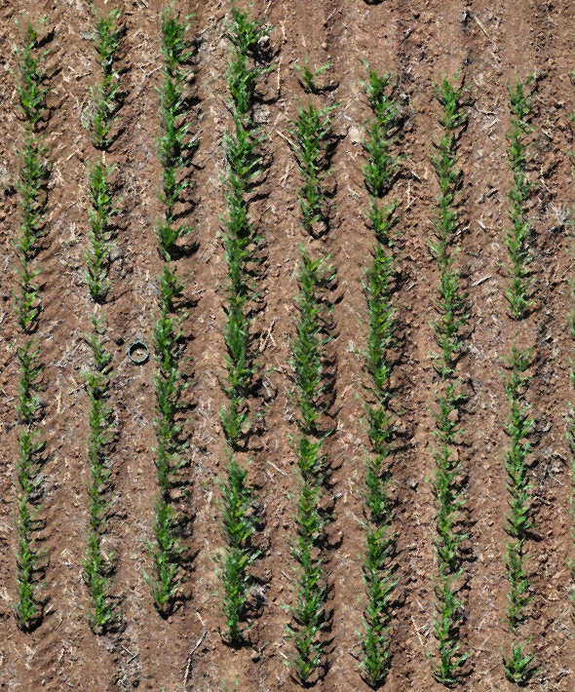
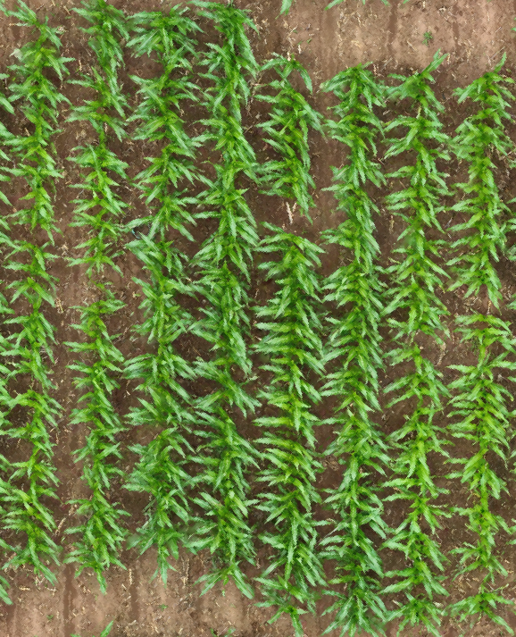
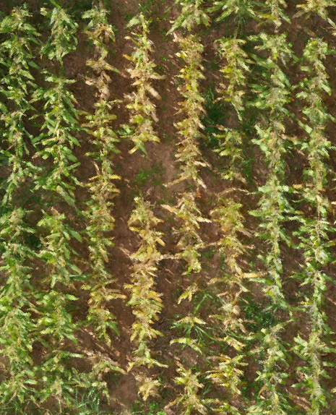
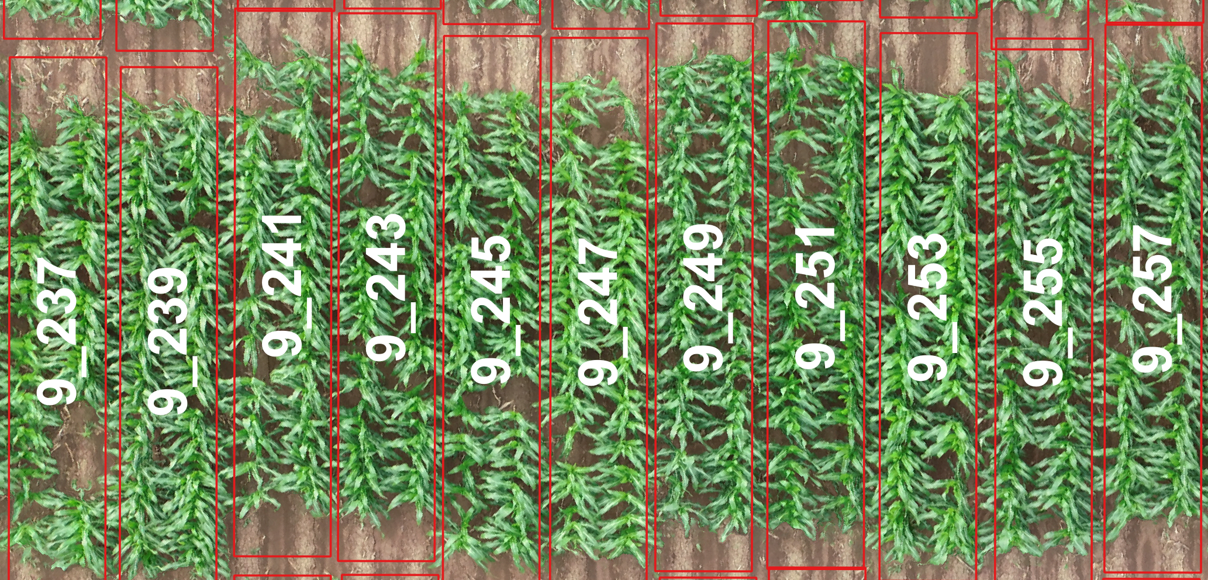
Cotton methods
A – UAS flights and photogrammetry
C – Image extraction from orthomosaics
E – Extraction of Standard VIs and Distributional Data to Explore Genotype Effects
crop_regions_from_ortho()
422_07
422_09
422_11
422_13
422_15
compute_multi_vegetation_indices_parallel()
Daily multispectral flights from 17 April 2024 to 30 Aug. 2024 (senescence)
B – Shapefile creation from CSV file (applied to single plants for cotton)
D – Soil masking
process_and_save_masks_multi()
create_shapefile_from_csv()
422_07
422_09
422_11
422_13
422_15
Maize methods
A – UAS flights and photogrammetry
C – Image extraction from orthomosaics
E – Extraction of Standard VIs and Distributional Data for Grain Yield Prediction
crop_regions_from_ortho()
compute_multi_vegetation_indices_parallel()
Approx. weekly flights across 11 G2F locations ranging from planting through senescence
B – Shapefile creation from CSV file (applied to whole plots for maize)
D – Soil masking
create_shapefile_from_csv()
process_and_save_masks_multi()
Pedigree | Yield BLUE | ExGR FPC1 0.01 | ExGR FPC1 0.02 | ... | ExGR FPC1 1.00
Pedigree_A | 9.3 | 16.9 | 0.618 |  | 5.6
Pedigree_B | 8.7 | 18.4 | -0.479 |  | 3.2
Pedigree_n | 10.1 | 20.1 | 0.592 |  | 1.5

Slide 2
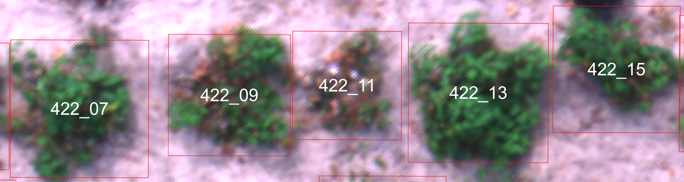

Slide 3
422_07
422_07
422_09
422_11
422_13
422_15
422_15
422_07
422_09
422_11
422_13
422_15
422_13
422_11
422_15

