Slide 1
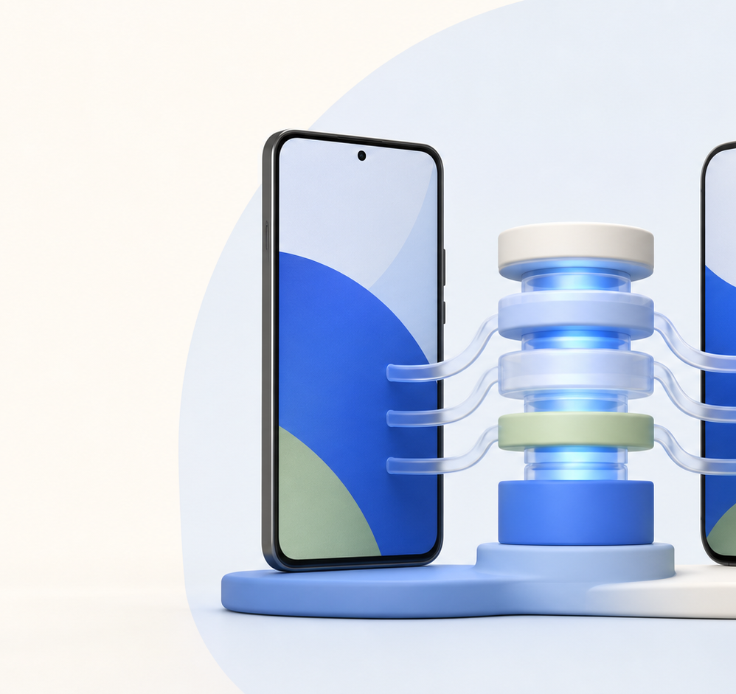
STORY E1.1 / MOBILE FOUNDATION
Activate the mobile
KMP scaffold
A reproducible Android + iOS substrate for every mobile story that follows.
The goal
Make the shared mobile substrate trustworthy before feature agents arrive.
SUPERNUTRITION / MOBILE FOUNDATION
01 / 06
Notes:
Introduce E1.1 as infrastructure with a clear finish line: a pinned, evidence-producing mobile foundation.
[Sources]
- /Users/aj/workspace_ai/SuperNutrition/_bmad-output/planning-artifacts/epics.md (Story E1.1 acceptance criteria)
- /Users/aj/workspace_ai/SuperNutrition/_bmad-output/planning-artifacts/architecture/architecture-SuperNutrition-2026-07-26/implementation-agent-guide.md
- Generated visual: /tmp/supernutrition-story-e11.nsGbks/assets/kmp-scaffold-hero.png

Slide 2
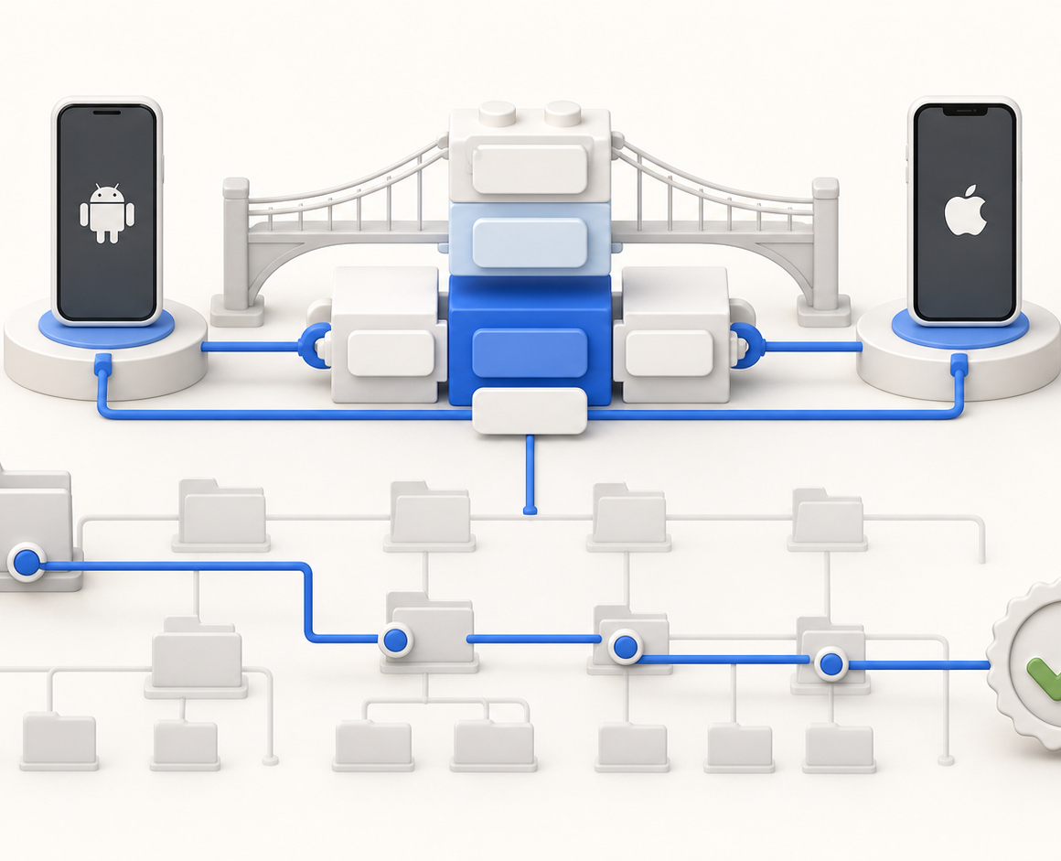
The story turns a blank repo into a shared substrate
One atomic merge creates the pinned surface that independent feature agents can safely extend.
The work is intentionally platform-first: Android and iOS thin hosts sit on the same sharedKit, with proof entrypoints that can be rerun without changing the repository.
Pinned toolchain
AD-16 tuple + version catalog
Independent module roots
SharedKit, hosts, and boundaries are explicit
SUPERNUTRITION / MOBILE FOUNDATION
02 / 06
Notes:
Explain what the story unlocks for other developers: a stable, shared substrate with an explicit boundary inventory.
[Sources]
- /Users/aj/workspace_ai/SuperNutrition/_bmad-output/planning-artifacts/epics.md (Story E1.1 acceptance criteria)
- /Users/aj/workspace_ai/SuperNutrition/_bmad-output/planning-artifacts/architecture/architecture-SuperNutrition-2026-07-26/implementation-agent-guide.md
- Generated visual: /tmp/supernutrition-story-e11.nsGbks/assets/reproducible-evidence.png

Slide 3
The scaffold flow is deliberately boring — and that is the point
Every step reduces ambiguity before product code is allowed to move.
01
02
03
04
05
Pending
Pinned
Hosts
Proof
Ready
scaffold-pending
AD-16 + catalog
boundaries
Android + iOS
sharedKit
bootstrap host
same-SHA entrypoints
feature agents
can start
The merge is atomic: the tuple, plugins, inventory, and evidence path land together.
SUPERNUTRITION / MOBILE FOUNDATION
03 / 06
Notes:
Walk left to right. The story is complete only when the quality proof is attached to the same repository state as the scaffold itself.
[Sources]
- /Users/aj/workspace_ai/SuperNutrition/_bmad-output/planning-artifacts/epics.md (Story E1.1 acceptance criteria)
- /Users/aj/workspace_ai/SuperNutrition/_bmad-output/planning-artifacts/architecture/architecture-SuperNutrition-2026-07-26/implementation-agent-guide.md

Slide 4
Acceptance gates prove the substrate before features arrive
Three checks turn “it builds” into a repeatable handoff.
✓
Atomic inventory
AD-16, version catalog, convention plugins, module boundaries, and a nonempty product inventory land together.
PROOF TARGET
A feature agent can clone, verify, and build without guessing which substrate is authoritative.
✓
Same-SHA evidence
Android + iOS thin hosts, sharedKit, bootstrap acceptance host, and read-only quality entrypoints report one commit state.
Clean boundary
Trust is an artifact, not a promise.
✓
No production feature, store artifact, testing dependency, or web/backend source is introduced here.
SUPERNUTRITION / MOBILE FOUNDATION
04 / 06
Notes:
Use the three acceptance criteria as the review checklist. The right-hand proof target is the practical developer outcome.
[Sources]
- /Users/aj/workspace_ai/SuperNutrition/_bmad-output/planning-artifacts/epics.md (Story E1.1 acceptance criteria)
- /Users/aj/workspace_ai/SuperNutrition/_bmad-output/planning-artifacts/architecture/architecture-SuperNutrition-2026-07-26/implementation-agent-guide.md

Slide 5
Scope is narrow by design: substrate now, product later
E1.1 makes the mobile roots safe to build on; it does not try to look like the finished app.
SHIP
WAIT
mobile scaffold
Android + iOS thin hosts
sharedKit + bootstrap proof
quality entrypoints + inventory
food capture
local / remote inference
production UX
web landing + backend source
store artifacts
Handoff: the next story can build the app shell against a pinned, inspectable substrate.
SUPERNUTRITION / MOBILE FOUNDATION
05 / 06
Notes:
Make the exclusions visible. This prevents the scaffold story from absorbing product scope or cross-repo ownership.
[Sources]
- /Users/aj/workspace_ai/SuperNutrition/_bmad-output/planning-artifacts/epics.md (Story E1.1 acceptance criteria)
- /Users/aj/workspace_ai/SuperNutrition/_bmad-output/planning-artifacts/architecture/architecture-SuperNutrition-2026-07-26/implementation-agent-guide.md

Slide 6
Definition of done: a merge that leaves no ambiguity
Any feature agent can start from the same mobile foundation.
The repository now has a clear substrate, clear proof, and clear boundaries — so the product stories can stay focused on user value.
E1.1
E1.2
E2
scaffold
app shell
photo flow
Build the substrate once. Let the stories move faster.
SUPERNUTRITION / MOBILE FOUNDATION
06 / 06
Notes:
Close on the handoff. E1.1 is infrastructure with a visible finish line, not an open-ended platform project.
[Sources]
- /Users/aj/workspace_ai/SuperNutrition/_bmad-output/planning-artifacts/epics.md (Story E1.1 acceptance criteria)
- /Users/aj/workspace_ai/SuperNutrition/_bmad-output/planning-artifacts/architecture/architecture-SuperNutrition-2026-07-26/implementation-agent-guide.md

