Slide 1
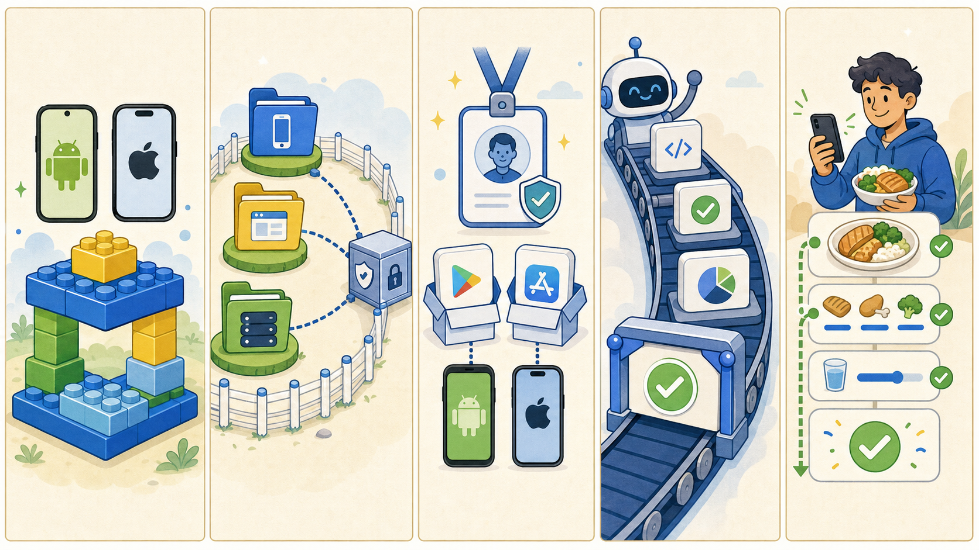
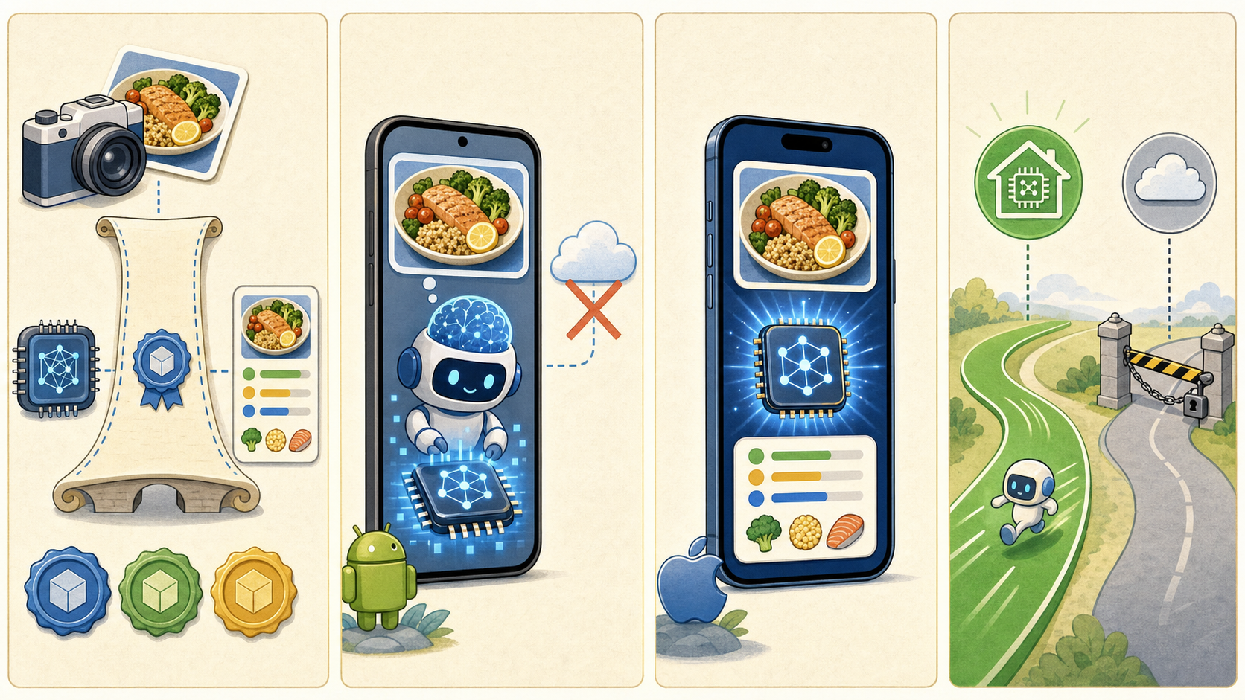
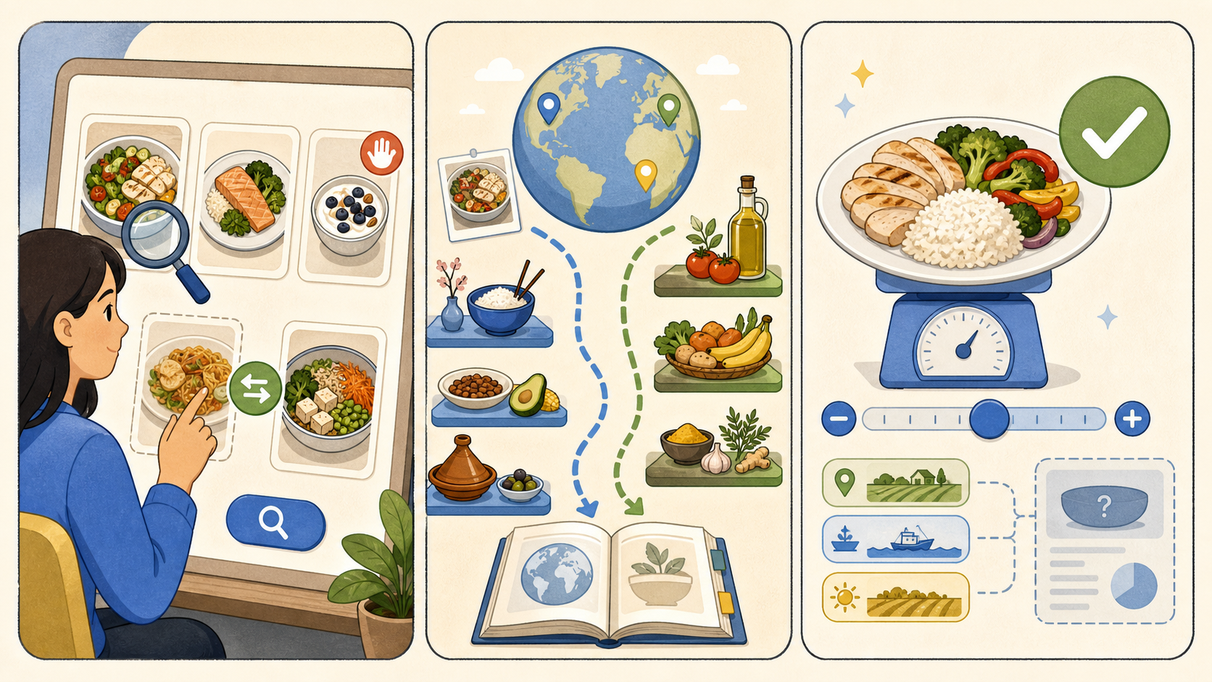
SUPERNUTRITION
AI nutritionist
22 stories.
One clear journey.
From a trusted mobile foundation to a photo-based nutrition result.
6 epics · 22 stories · 1 flow
SUPERNUTRITION · AI NUTRITIONIST
01 / 30
Notes:
Open with the complete story arc: the deck is a visual map of all implementation stories, not a detailed specification.
[Sources]
- /Users/aj/workspace_ai/SuperNutrition/_bmad-output/planning-artifacts/epics.md
- /Users/aj/workspace_ai/SuperNutrition/_bmad-output/planning-artifacts/architecture/architecture-SuperNutrition-2026-07-26/ARCHITECTURE-SPINE.md
- Generated storyboard panel: generated storyboard strips epic-e1.png, epic-e3.png, epic-e5.png

Slide 2
E1
Foundation & product shell
Make the repo safe to build on
5 stories
E1.1
E1.2
E1.3
E1.4
E1.5
SUPERNUTRITION · AI NUTRITIONIST
02 / 30
Notes:
Epic overview for E1: Foundation & product shell.
[Sources]
- /Users/aj/workspace_ai/SuperNutrition/_bmad-output/planning-artifacts/epics.md
- /Users/aj/workspace_ai/SuperNutrition/_bmad-output/planning-artifacts/architecture/architecture-SuperNutrition-2026-07-26/ARCHITECTURE-SPINE.md
- Generated storyboard panel: generated storyboard epic-e1.png

Slide 3

E2
Capture & photo preparation
Get one safe photo into the flow
3 stories
E2.1
E2.2
E2.3
SUPERNUTRITION · AI NUTRITIONIST
03 / 30
Notes:
Epic overview for E2: Capture & photo preparation.
[Sources]
- /Users/aj/workspace_ai/SuperNutrition/_bmad-output/planning-artifacts/epics.md
- /Users/aj/workspace_ai/SuperNutrition/_bmad-output/planning-artifacts/architecture/architecture-SuperNutrition-2026-07-26/ARCHITECTURE-SPINE.md
- Generated storyboard panel: generated storyboard epic-e2.png

Slide 4
E3
Shared inference & local engines
Keep analysis local when possible
4 stories
E3.1
E3.2
E3.3
E3.4
SUPERNUTRITION · AI NUTRITIONIST
04 / 30
Notes:
Epic overview for E3: Shared inference & local engines.
[Sources]
- /Users/aj/workspace_ai/SuperNutrition/_bmad-output/planning-artifacts/epics.md
- /Users/aj/workspace_ai/SuperNutrition/_bmad-output/planning-artifacts/architecture/architecture-SuperNutrition-2026-07-26/ARCHITECTURE-SPINE.md
- Generated storyboard panel: generated storyboard epic-e3.png

Slide 5
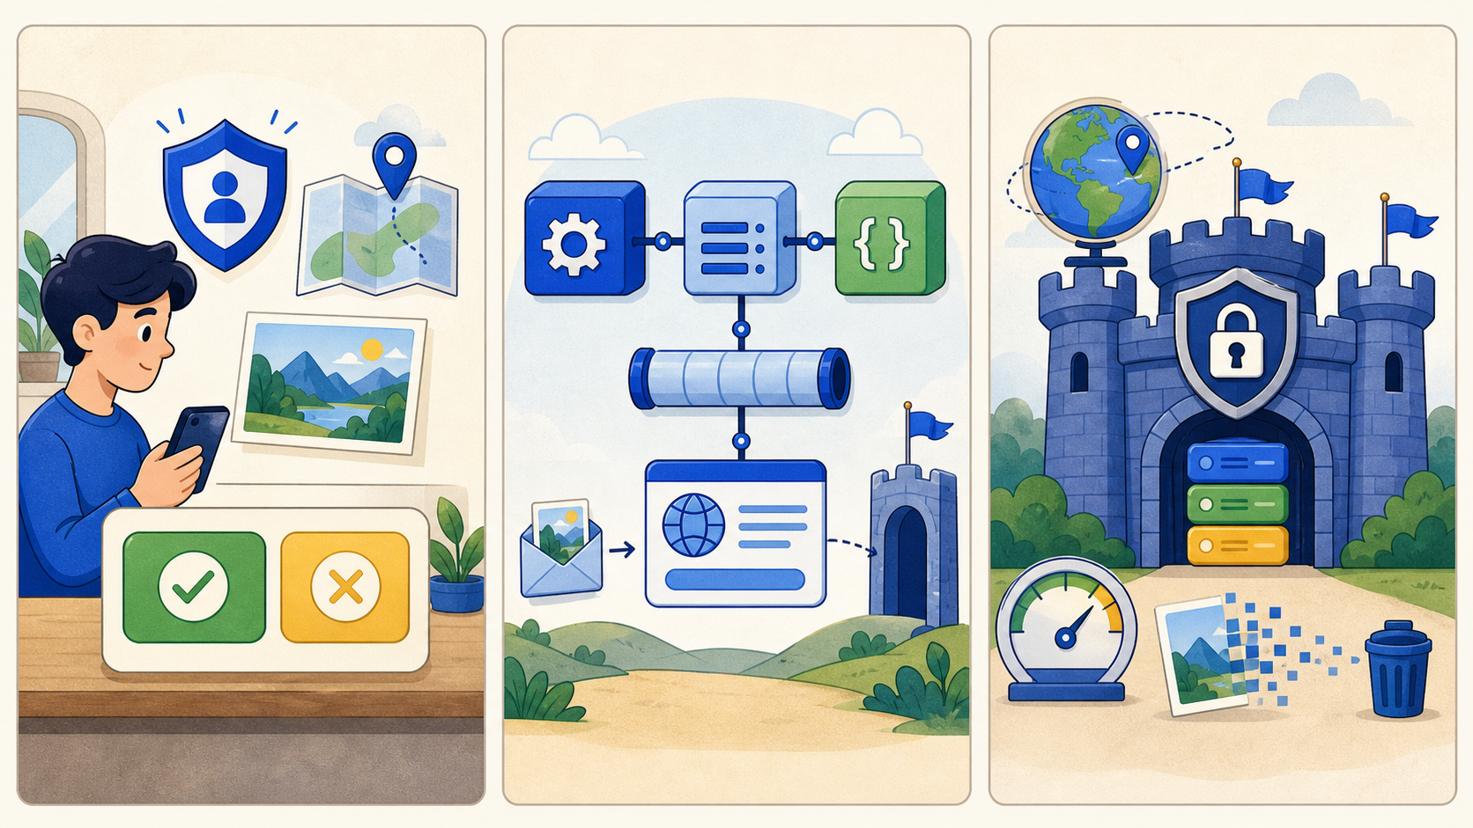
E4
Remote inference & consent
Make upload explicit and bounded
3 stories
E4.1
E4.2
E4.3
SUPERNUTRITION · AI NUTRITIONIST
05 / 30
Notes:
Epic overview for E4: Remote inference & consent.
[Sources]
- /Users/aj/workspace_ai/SuperNutrition/_bmad-output/planning-artifacts/epics.md
- /Users/aj/workspace_ai/SuperNutrition/_bmad-output/planning-artifacts/architecture/architecture-SuperNutrition-2026-07-26/ARCHITECTURE-SPINE.md
- Generated storyboard panel: generated storyboard epic-e4.png

Slide 6
E5
Confirmation & grounded nutrition
Turn evidence into a trusted result
3 stories
E5.1
E5.2
E5.3
SUPERNUTRITION · AI NUTRITIONIST
06 / 30
Notes:
Epic overview for E5: Confirmation & grounded nutrition.
[Sources]
- /Users/aj/workspace_ai/SuperNutrition/_bmad-output/planning-artifacts/epics.md
- /Users/aj/workspace_ai/SuperNutrition/_bmad-output/planning-artifacts/architecture/architecture-SuperNutrition-2026-07-26/ARCHITECTURE-SPINE.md
- Generated storyboard panel: generated storyboard epic-e5.png

Slide 7
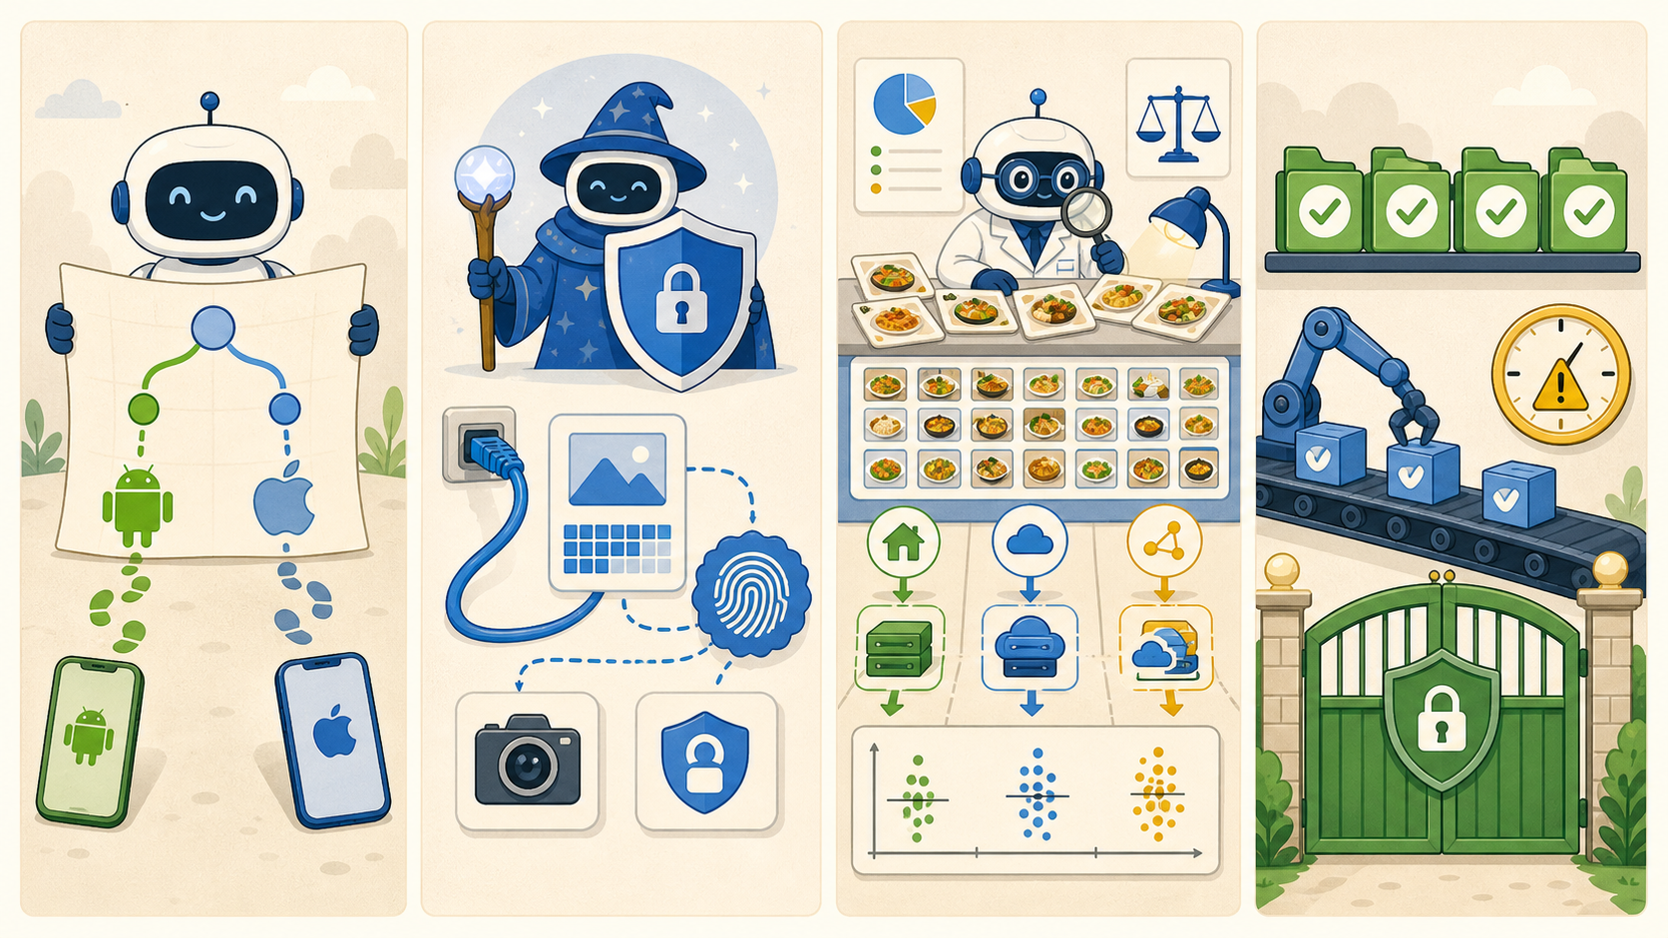
E6
Journey evidence & evaluation
Prove the flow on every platform
4 stories
E6.1
E6.2
E6.3
E6.4
SUPERNUTRITION · AI NUTRITIONIST
07 / 30
Notes:
Epic overview for E6: Journey evidence & evaluation.
[Sources]
- /Users/aj/workspace_ai/SuperNutrition/_bmad-output/planning-artifacts/epics.md
- /Users/aj/workspace_ai/SuperNutrition/_bmad-output/planning-artifacts/architecture/architecture-SuperNutrition-2026-07-26/ARCHITECTURE-SPINE.md
- Generated storyboard panel: generated storyboard epic-e6.png

Slide 8
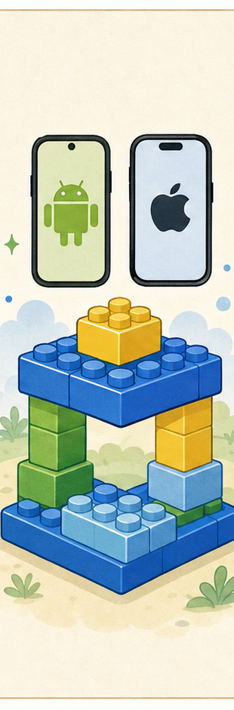
E1
E1.1
Activate the mobile KMP scaffold
SHIPS
Pinned Android + iOS roots
DONE WHEN
Thin hosts + bootstrap proof
FLOW
Pin tuple
Prove hosts
SUPERNUTRITION · AI NUTRITIONIST
08 / 30
Notes:
Story E1.1: Activate the mobile KMP scaffold. Visual summary is intentionally concise; the full acceptance criteria remain authoritative in epics.md.
[Sources]
- /Users/aj/workspace_ai/SuperNutrition/_bmad-output/planning-artifacts/epics.md
- /Users/aj/workspace_ai/SuperNutrition/_bmad-output/planning-artifacts/architecture/architecture-SuperNutrition-2026-07-26/ARCHITECTURE-SPINE.md
- Generated storyboard panel: E1-panel-1.png

Slide 9
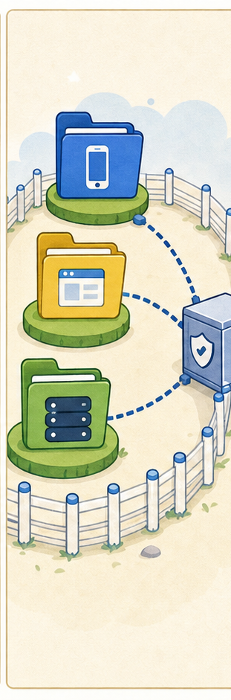
E1
E1.2
Enforce monorepo boundaries and contracts
SHIPS
Fenced product roots
DONE WHEN
Contract matrix + policy inventory
FLOW
Fence roots
Test contracts
SUPERNUTRITION · AI NUTRITIONIST
09 / 30
Notes:
Story E1.2: Enforce monorepo boundaries and contracts. Visual summary is intentionally concise; the full acceptance criteria remain authoritative in epics.md.
[Sources]
- /Users/aj/workspace_ai/SuperNutrition/_bmad-output/planning-artifacts/epics.md
- /Users/aj/workspace_ai/SuperNutrition/_bmad-output/planning-artifacts/architecture/architecture-SuperNutrition-2026-07-26/ARCHITECTURE-SPINE.md
- Generated storyboard panel: E1-panel-2.png

Slide 10

E1
E1.3
Establish product identity metadata
SHIPS
One identity manifest
DONE WHEN
SuperNutrition labels stay aligned
FLOW
Set identity
Match stores
SUPERNUTRITION · AI NUTRITIONIST
10 / 30
Notes:
Story E1.3: Establish product identity metadata. Visual summary is intentionally concise; the full acceptance criteria remain authoritative in epics.md.
[Sources]
- /Users/aj/workspace_ai/SuperNutrition/_bmad-output/planning-artifacts/epics.md
- /Users/aj/workspace_ai/SuperNutrition/_bmad-output/planning-artifacts/architecture/architecture-SuperNutrition-2026-07-26/ARCHITECTURE-SPINE.md
- Generated storyboard panel: E1-panel-3.png

Slide 11
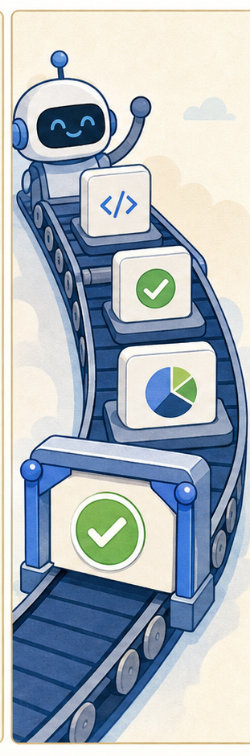
E1
E1.4
Establish repository quality gates
SHIPS
Read-only checks + push CI
DONE WHEN
85% coverage; no green skips
FLOW
Run checks
Block gaps
SUPERNUTRITION · AI NUTRITIONIST
11 / 30
Notes:
Story E1.4: Establish repository quality gates. Visual summary is intentionally concise; the full acceptance criteria remain authoritative in epics.md.
[Sources]
- /Users/aj/workspace_ai/SuperNutrition/_bmad-output/planning-artifacts/epics.md
- /Users/aj/workspace_ai/SuperNutrition/_bmad-output/planning-artifacts/architecture/architecture-SuperNutrition-2026-07-26/ARCHITECTURE-SPINE.md
- Generated storyboard panel: E1-panel-4.png

Slide 12
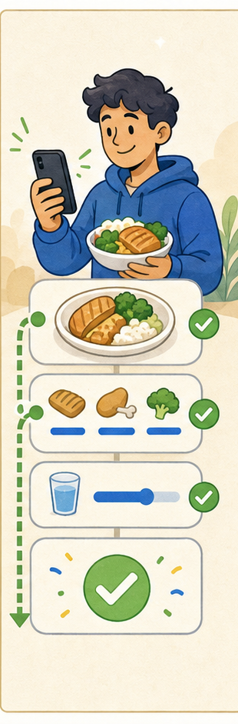
E1
E1.5
Establish the low-friction interaction policy
SHIPS
Defaults + interaction budget
DONE WHEN
Shortest safe path is encoded
FLOW
Prefill
Keep control
SUPERNUTRITION · AI NUTRITIONIST
12 / 30
Notes:
Story E1.5: Establish the low-friction interaction policy. Visual summary is intentionally concise; the full acceptance criteria remain authoritative in epics.md.
[Sources]
- /Users/aj/workspace_ai/SuperNutrition/_bmad-output/planning-artifacts/epics.md
- /Users/aj/workspace_ai/SuperNutrition/_bmad-output/planning-artifacts/architecture/architecture-SuperNutrition-2026-07-26/ARCHITECTURE-SPINE.md
- Generated storyboard panel: E1-panel-5.png

Slide 13

E2
E2.1
Implement camera and picker bridges
SHIPS
Capture or import one photo
DONE WHEN
Permission recovery has a way out
FLOW
Open camera
Recover
SUPERNUTRITION · AI NUTRITIONIST
13 / 30
Notes:
Story E2.1: Implement camera and picker bridges. Visual summary is intentionally concise; the full acceptance criteria remain authoritative in epics.md.
[Sources]
- /Users/aj/workspace_ai/SuperNutrition/_bmad-output/planning-artifacts/epics.md
- /Users/aj/workspace_ai/SuperNutrition/_bmad-output/planning-artifacts/architecture/architecture-SuperNutrition-2026-07-26/ARCHITECTURE-SPINE.md
- Generated storyboard panel: E2-panel-1.png

Slide 14

E2
E2.2
Normalize and quality-check Photo Input
SHIPS
Safe, equivalent photo bytes
DONE WHEN
Orientation + metadata are clean
FLOW
Normalize
Scrub
SUPERNUTRITION · AI NUTRITIONIST
14 / 30
Notes:
Story E2.2: Normalize and quality-check Photo Input. Visual summary is intentionally concise; the full acceptance criteria remain authoritative in epics.md.
[Sources]
- /Users/aj/workspace_ai/SuperNutrition/_bmad-output/planning-artifacts/epics.md
- /Users/aj/workspace_ai/SuperNutrition/_bmad-output/planning-artifacts/architecture/architecture-SuperNutrition-2026-07-26/ARCHITECTURE-SPINE.md
- Generated storyboard panel: E2-panel-2.png

Slide 15
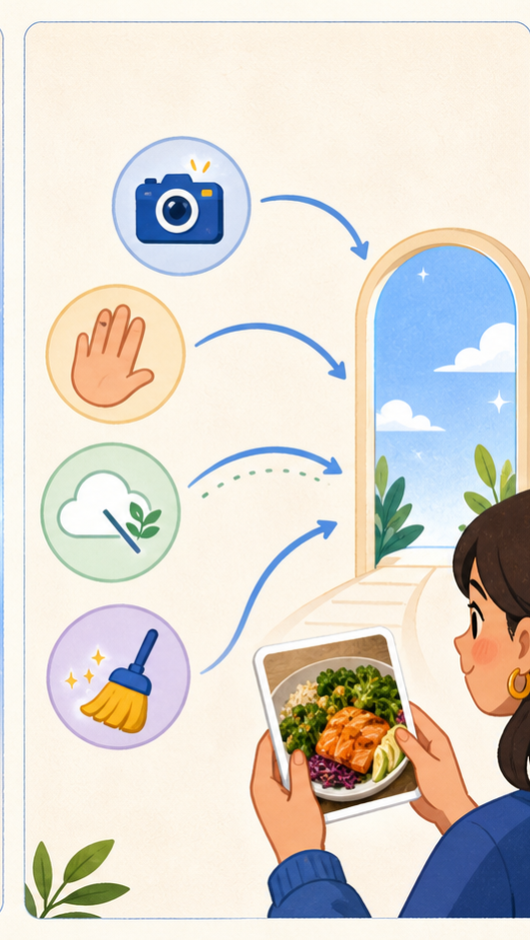
E2
E2.3
Implement capture recovery and session cleanup
SHIPS
Retake / cancel / offline recovery
DONE WHEN
No stale result or retained bytes
FLOW
Recover
Clean
SUPERNUTRITION · AI NUTRITIONIST
15 / 30
Notes:
Story E2.3: Implement capture recovery and session cleanup. Visual summary is intentionally concise; the full acceptance criteria remain authoritative in epics.md.
[Sources]
- /Users/aj/workspace_ai/SuperNutrition/_bmad-output/planning-artifacts/epics.md
- /Users/aj/workspace_ai/SuperNutrition/_bmad-output/planning-artifacts/architecture/architecture-SuperNutrition-2026-07-26/ARCHITECTURE-SPINE.md
- Generated storyboard panel: E2-panel-3.png

Slide 16
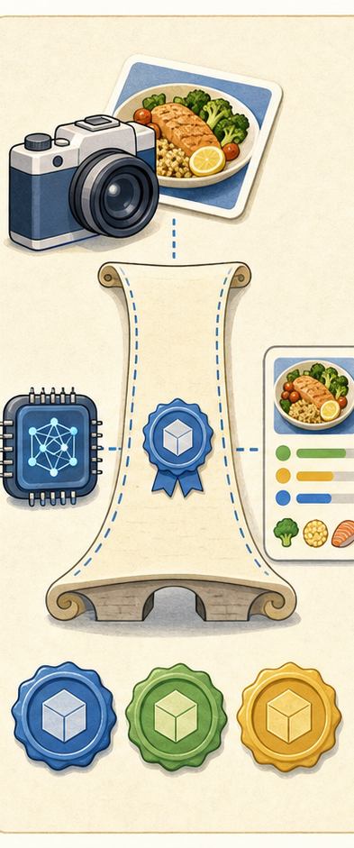
E3
E3.1
Freeze contract-v1 inference ports
SHIPS
Shared request + candidate types
DONE WHEN
Fixtures; no nutrition in engines
FLOW
Define
Freeze
SUPERNUTRITION · AI NUTRITIONIST
16 / 30
Notes:
Story E3.1: Freeze contract-v1 inference ports. Visual summary is intentionally concise; the full acceptance criteria remain authoritative in epics.md.
[Sources]
- /Users/aj/workspace_ai/SuperNutrition/_bmad-output/planning-artifacts/epics.md
- /Users/aj/workspace_ai/SuperNutrition/_bmad-output/planning-artifacts/architecture/architecture-SuperNutrition-2026-07-26/ARCHITECTURE-SPINE.md
- Generated storyboard panel: E3-panel-1.png

Slide 17

E3
E3.2
Implement local Android inference
SHIPS
On-device Android analysis
DONE WHEN
Zero photo network traffic
FLOW
Load model
Infer local
SUPERNUTRITION · AI NUTRITIONIST
17 / 30
Notes:
Story E3.2: Implement local Android inference. Visual summary is intentionally concise; the full acceptance criteria remain authoritative in epics.md.
[Sources]
- /Users/aj/workspace_ai/SuperNutrition/_bmad-output/planning-artifacts/epics.md
- /Users/aj/workspace_ai/SuperNutrition/_bmad-output/planning-artifacts/architecture/architecture-SuperNutrition-2026-07-26/ARCHITECTURE-SPINE.md
- Generated storyboard panel: E3-panel-2.png

Slide 18
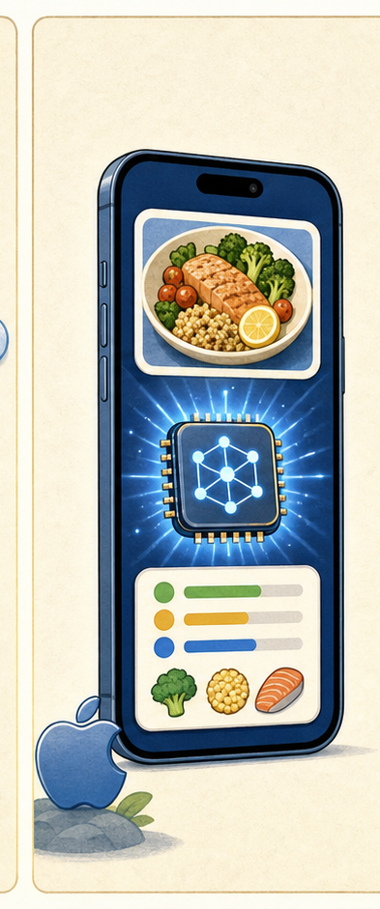
E3
E3.3
Implement local iOS inference
SHIPS
On-device iOS analysis
DONE WHEN
Same evidence vocabulary
FLOW
Load model
Infer local
SUPERNUTRITION · AI NUTRITIONIST
18 / 30
Notes:
Story E3.3: Implement local iOS inference. Visual summary is intentionally concise; the full acceptance criteria remain authoritative in epics.md.
[Sources]
- /Users/aj/workspace_ai/SuperNutrition/_bmad-output/planning-artifacts/epics.md
- /Users/aj/workspace_ai/SuperNutrition/_bmad-output/planning-artifacts/architecture/architecture-SuperNutrition-2026-07-26/ARCHITECTURE-SPINE.md
- Generated storyboard panel: E3-panel-3.png

Slide 19
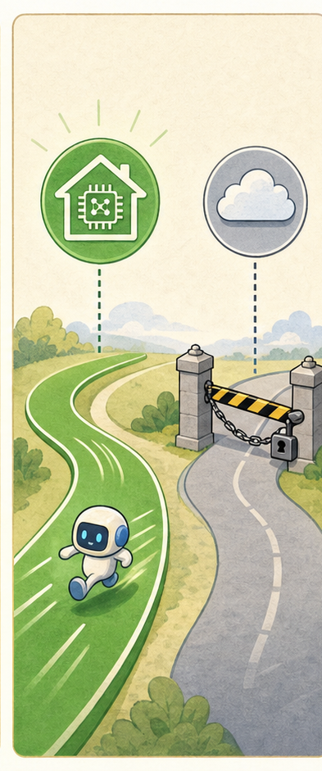
E3
E3.4
Integrate deterministic local-first routing
SHIPS
Bounded route policy
DONE WHEN
Remote only when it can help
FLOW
Try local
Escalate
SUPERNUTRITION · AI NUTRITIONIST
19 / 30
Notes:
Story E3.4: Integrate deterministic local-first routing. Visual summary is intentionally concise; the full acceptance criteria remain authoritative in epics.md.
[Sources]
- /Users/aj/workspace_ai/SuperNutrition/_bmad-output/planning-artifacts/epics.md
- /Users/aj/workspace_ai/SuperNutrition/_bmad-output/planning-artifacts/architecture/architecture-SuperNutrition-2026-07-26/ARCHITECTURE-SPINE.md
- Generated storyboard panel: E3-panel-4.png

Slide 20

E4
E4.1
Implement remote consent and transfer states
SHIPS
Clear upload choice
DONE WHEN
Pre-transfer cancel sends zero bytes
FLOW
Explain
Consent
SUPERNUTRITION · AI NUTRITIONIST
20 / 30
Notes:
Story E4.1: Implement remote consent and transfer states. Visual summary is intentionally concise; the full acceptance criteria remain authoritative in epics.md.
[Sources]
- /Users/aj/workspace_ai/SuperNutrition/_bmad-output/planning-artifacts/epics.md
- /Users/aj/workspace_ai/SuperNutrition/_bmad-output/planning-artifacts/architecture/architecture-SuperNutrition-2026-07-26/ARCHITECTURE-SPINE.md
- Generated storyboard panel: E4-panel-1.png

Slide 21
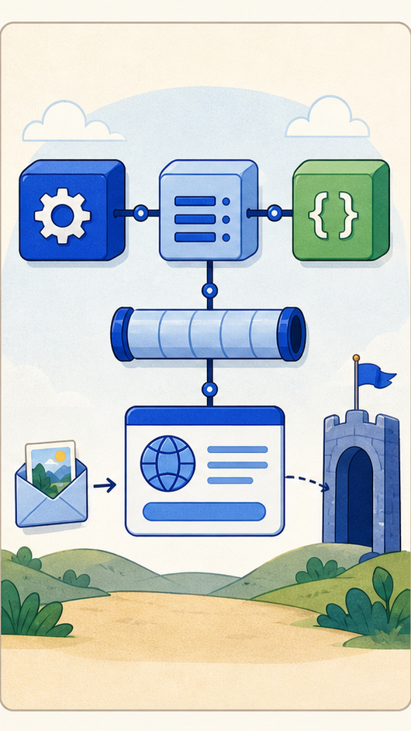
E4
E4.2
Implement the remote mobile adapter
SHIPS
Ktorfit API over Ktor
DONE WHEN
Bounded, redacted, idempotent transfer
FLOW
Generate API
Upload safely
SUPERNUTRITION · AI NUTRITIONIST
21 / 30
Notes:
Story E4.2: Implement the remote mobile adapter. Visual summary is intentionally concise; the full acceptance criteria remain authoritative in epics.md.
[Sources]
- /Users/aj/workspace_ai/SuperNutrition/_bmad-output/planning-artifacts/epics.md
- /Users/aj/workspace_ai/SuperNutrition/_bmad-output/planning-artifacts/architecture/architecture-SuperNutrition-2026-07-26/ARCHITECTURE-SPINE.md
- Generated storyboard panel: E4-panel-2.png

Slide 22

E4
E4.3
Implement the first-party gateway boundary
SHIPS
Provider isolation + policy gate
DONE WHEN
No durable raw photos
FLOW
Validate
Dispose
SUPERNUTRITION · AI NUTRITIONIST
22 / 30
Notes:
Story E4.3: Implement the first-party gateway boundary. Visual summary is intentionally concise; the full acceptance criteria remain authoritative in epics.md.
[Sources]
- /Users/aj/workspace_ai/SuperNutrition/_bmad-output/planning-artifacts/epics.md
- /Users/aj/workspace_ai/SuperNutrition/_bmad-output/planning-artifacts/architecture/architecture-SuperNutrition-2026-07-26/ARCHITECTURE-SPINE.md
- Generated storyboard panel: E4-panel-3.png

Slide 23
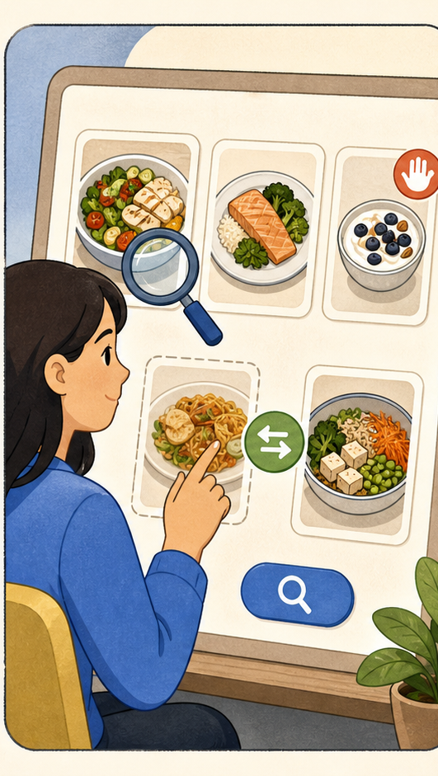
E5
E5.1
Implement Candidate review and correction
SHIPS
Inspect / remove / replace / search
DONE WHEN
User remains the authority
FLOW
Review
Confirm
SUPERNUTRITION · AI NUTRITIONIST
23 / 30
Notes:
Story E5.1: Implement Candidate review and correction. Visual summary is intentionally concise; the full acceptance criteria remain authoritative in epics.md.
[Sources]
- /Users/aj/workspace_ai/SuperNutrition/_bmad-output/planning-artifacts/epics.md
- /Users/aj/workspace_ai/SuperNutrition/_bmad-output/planning-artifacts/architecture/architecture-SuperNutrition-2026-07-26/ARCHITECTURE-SPINE.md
- Generated storyboard panel: E5-panel-1.png

Slide 24
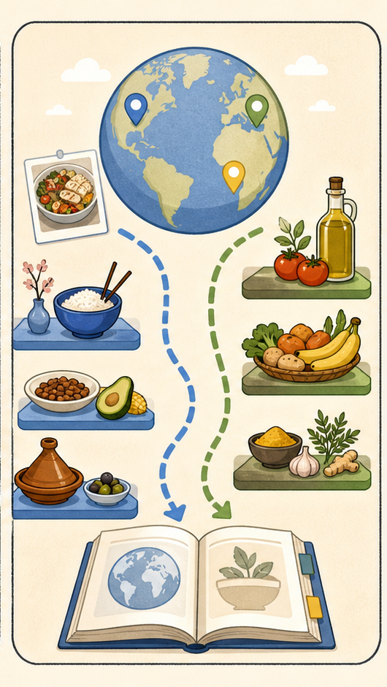
E5
E5.2
Implement country-aware nutrition catalog selection
SHIPS
Catalog ≠ processing region
DONE WHEN
Change invalidates mapped result
FLOW
Choose catalog
Re-map
SUPERNUTRITION · AI NUTRITIONIST
24 / 30
Notes:
Story E5.2: Implement country-aware nutrition catalog selection. Visual summary is intentionally concise; the full acceptance criteria remain authoritative in epics.md.
[Sources]
- /Users/aj/workspace_ai/SuperNutrition/_bmad-output/planning-artifacts/epics.md
- /Users/aj/workspace_ai/SuperNutrition/_bmad-output/planning-artifacts/architecture/architecture-SuperNutrition-2026-07-26/ARCHITECTURE-SPINE.md
- Generated storyboard panel: E5-panel-2.png

Slide 25
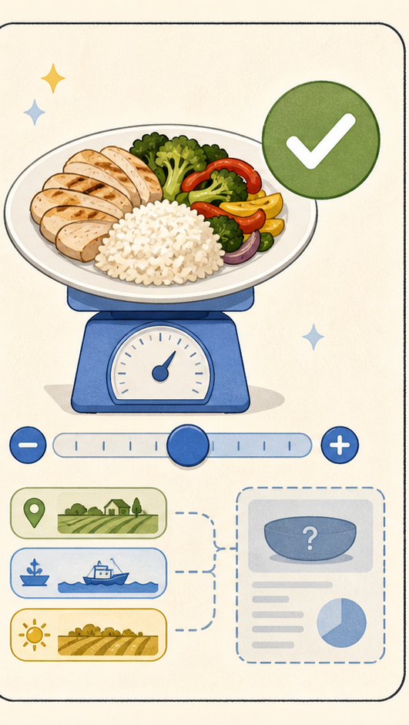
E5
E5.3
Implement serving confirmation and grounded result
SHIPS
Portion + assumptions
DONE WHEN
No ungrounded nutrition numbers
FLOW
Set serving
Ground result
SUPERNUTRITION · AI NUTRITIONIST
25 / 30
Notes:
Story E5.3: Implement serving confirmation and grounded result. Visual summary is intentionally concise; the full acceptance criteria remain authoritative in epics.md.
[Sources]
- /Users/aj/workspace_ai/SuperNutrition/_bmad-output/planning-artifacts/epics.md
- /Users/aj/workspace_ai/SuperNutrition/_bmad-output/planning-artifacts/architecture/architecture-SuperNutrition-2026-07-26/ARCHITECTURE-SPINE.md
- Generated storyboard panel: E5-panel-3.png

Slide 26
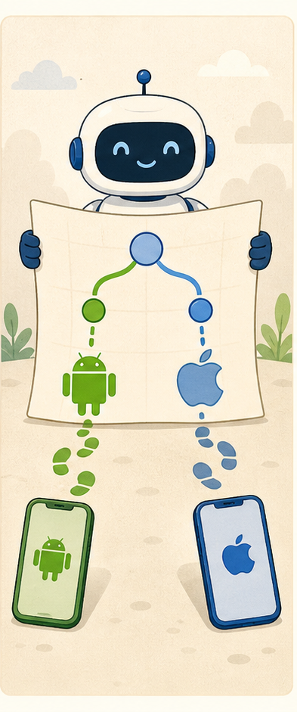
E6
E6.1
Build the shared UI journey DSL
SHIPS
One logical flow; two platforms
DONE WHEN
Same journey definitions run twice
FLOW
Define once
Run twice
SUPERNUTRITION · AI NUTRITIONIST
26 / 30
Notes:
Story E6.1: Build the shared UI journey DSL. Visual summary is intentionally concise; the full acceptance criteria remain authoritative in epics.md.
[Sources]
- /Users/aj/workspace_ai/SuperNutrition/_bmad-output/planning-artifacts/epics.md
- /Users/aj/workspace_ai/SuperNutrition/_bmad-output/planning-artifacts/architecture/architecture-SuperNutrition-2026-07-26/ARCHITECTURE-SPINE.md
- Generated storyboard panel: E6-panel-1.png

Slide 27
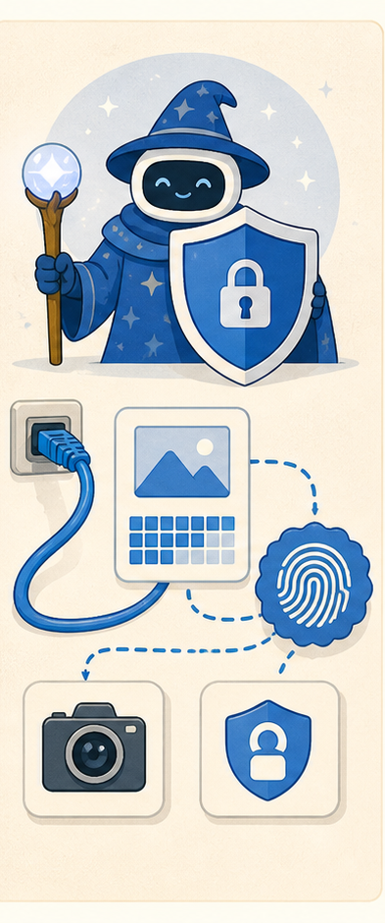
E6
E6.2
Add privacy/network and native-gap oracles
SHIPS
Binary-bound evidence
DONE WHEN
UI green cannot hide native failure
FLOW
Observe
Bind proof
SUPERNUTRITION · AI NUTRITIONIST
27 / 30
Notes:
Story E6.2: Add privacy/network and native-gap oracles. Visual summary is intentionally concise; the full acceptance criteria remain authoritative in epics.md.
[Sources]
- /Users/aj/workspace_ai/SuperNutrition/_bmad-output/planning-artifacts/epics.md
- /Users/aj/workspace_ai/SuperNutrition/_bmad-output/planning-artifacts/architecture/architecture-SuperNutrition-2026-07-26/ARCHITECTURE-SPINE.md
- Generated storyboard panel: E6-panel-2.png

Slide 28
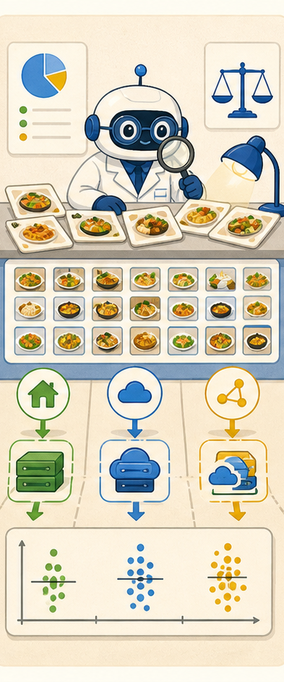
E6
E6.3
Establish the evaluation corpus and route baselines
SHIPS
Local / remote / hybrid baselines
DONE WHEN
G-5 thresholds before confidence routing
FLOW
Measure
Set gates
SUPERNUTRITION · AI NUTRITIONIST
28 / 30
Notes:
Story E6.3: Establish the evaluation corpus and route baselines. Visual summary is intentionally concise; the full acceptance criteria remain authoritative in epics.md.
[Sources]
- /Users/aj/workspace_ai/SuperNutrition/_bmad-output/planning-artifacts/epics.md
- /Users/aj/workspace_ai/SuperNutrition/_bmad-output/planning-artifacts/architecture/architecture-SuperNutrition-2026-07-26/ARCHITECTURE-SPINE.md
- Generated storyboard panel: E6-panel-3.png

Slide 29
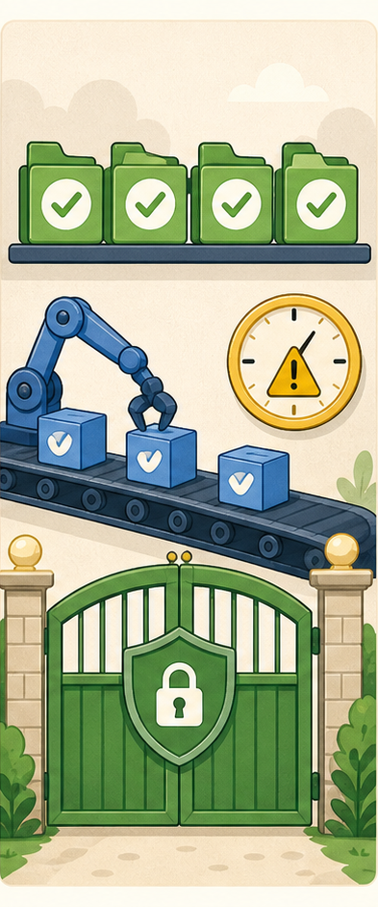
E6
E6.4
Maintain the quality and release evidence gates
SHIPS
Freshness-aware CI gate
DONE WHEN
Stale or missing evidence blocks release
FLOW
Check evidence
Release
SUPERNUTRITION · AI NUTRITIONIST
29 / 30
Notes:
Story E6.4: Maintain the quality and release evidence gates. Visual summary is intentionally concise; the full acceptance criteria remain authoritative in epics.md.
[Sources]
- /Users/aj/workspace_ai/SuperNutrition/_bmad-output/planning-artifacts/epics.md
- /Users/aj/workspace_ai/SuperNutrition/_bmad-output/planning-artifacts/architecture/architecture-SuperNutrition-2026-07-26/ARCHITECTURE-SPINE.md
- Generated storyboard panel: E6-panel-4.png

Slide 30
The finish line is a trusted meal scan
Capture → understand → confirm → ground
Every epic removes one kind of uncertainty. Together they make the simplest safe path the default.
E1
E2
E3
E4
E5
E6
foundation
capture
local
remote
ground
prove
SuperNutrition: AI nutritionist
SUPERNUTRITION · AI NUTRITIONIST
30 / 30
Notes:
Close by restating the product flow. The story set is complete when the path is easy for the user and provable for the team.
[Sources]
- /Users/aj/workspace_ai/SuperNutrition/_bmad-output/planning-artifacts/epics.md
- /Users/aj/workspace_ai/SuperNutrition/_bmad-output/planning-artifacts/architecture/architecture-SuperNutrition-2026-07-26/ARCHITECTURE-SPINE.md

