Slide 1




Hello

Slide 2

??
UI toolkit for building beautiful,
natively compiled applications for mobile, web, and desktop from a single codebase,
written in Dart.
An open-source toolkit, made by
flutter.dev

Slide 3
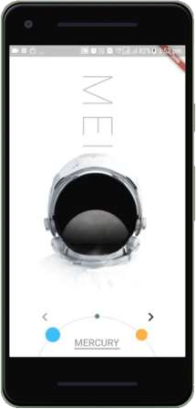
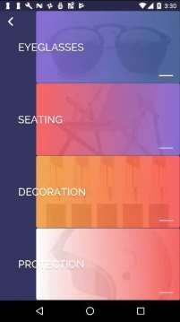
Beautiful
No compromises for UI design
flutter.dev

Slide 4

Control every pixel Never say no to your “designer” Rich palette of tools
flutter.dev

Slide 5
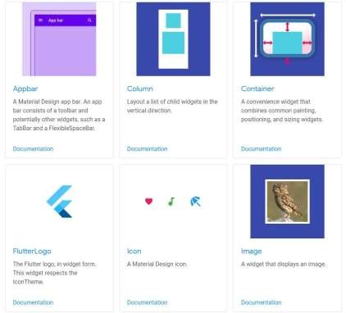
The power of widgets
Everything is a widget!!
https://flutter.dev/docs/development/ui/widgets

Slide 6

Row(
Declarative layout
Create layout by declaring intent
mainAxisAlignment: MainAxisAlignment.center, crossAxisAlignment: CrossAxisAlignment.center, children: [
Text(
'Hello', style:Theme.of(context).textTheme.headline3),
Padding(
padding: const EdgeInsets.all(8.0), child: FlutterLogo(size: 100),
),
]
Flutter figures out the “how”
)

Slide 7
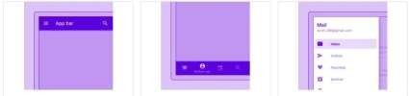
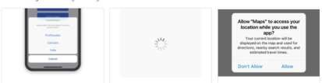
Beautiful widgets
Material Components widgets
Cupertino (iOS-style) widgets

Slide 8
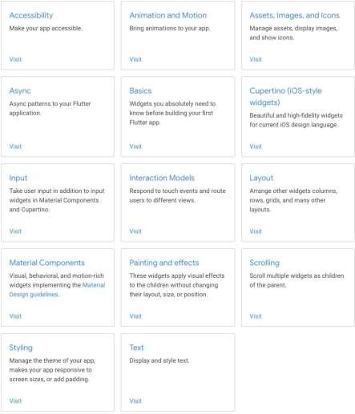
Layout - related Widgets
Single-child layout widgets
(Container, Center, Expanded, Padding)
Multi-child layout widgets (Column, Row, ListView, Stack)
Structural Widgets
(Buttons, Icons, Text, Image) Animation & motion Widgets: Styling widgets
Scrolling widgets
…..
Material component Widgets Cupertino widgets
flutter.dev

Slide 9
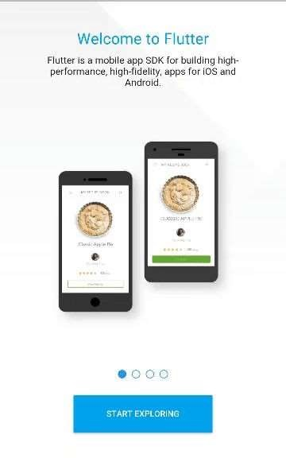
Fast
High velocity development
+ Native performance

Slide 10
Graphics engine Skia 2D 60fps, GPU accelerated
Compiled to native machine code
flutter.dev

Slide 11

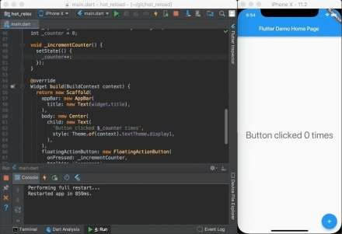
Productive
Develop while your app is running

Slide 12
Paint your app to life
Hot Reload & Hot Restart
Revolutionary capabilities for developers and designers

Slide 13


One language
Dart Since 2011
made by

Slide 14
Dart
Client -optimized OOP language for fast apps in any platform
Dart js compiler
Just in time and Ahead of time compilation

Slide 15


Stateful hot reload Syntax simplicity
‘to -native’ compilation

Slide 16
is Unique?
Why

Slide 17
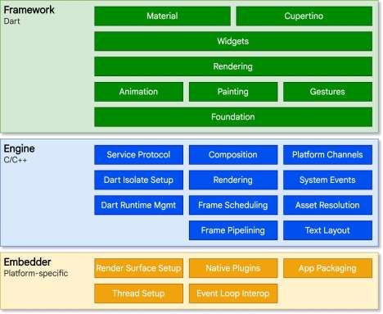
Architecture overview
flutter.dev

Slide 18
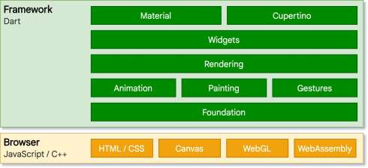
Web
flutter.dev

Slide 19
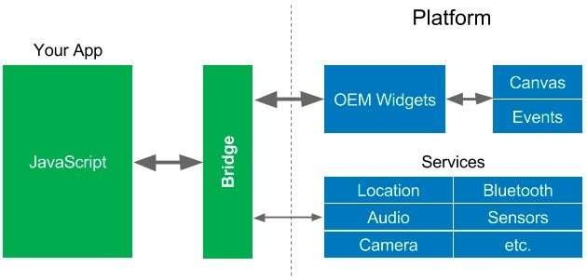
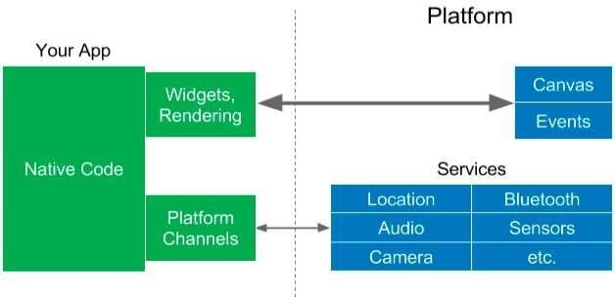

vs

Slide 20
Plugins/Packages

Slide 21
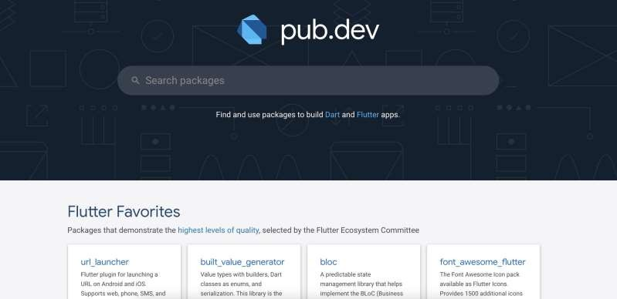

Slide 22
is Awesome?
Why

Slide 23
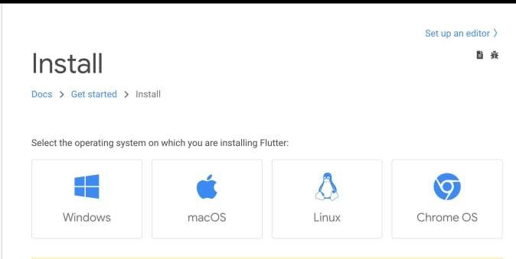
Set up
https://flutter.dev/docs/get-started/install

Slide 24


IDE Support
flutter.dev/docs/get-started/editor

Slide 25
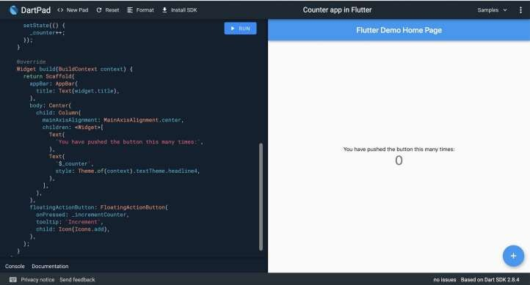
dartpad.dev

Slide 26
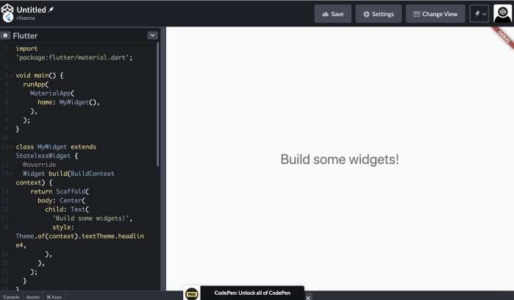
codepen.io

Slide 27
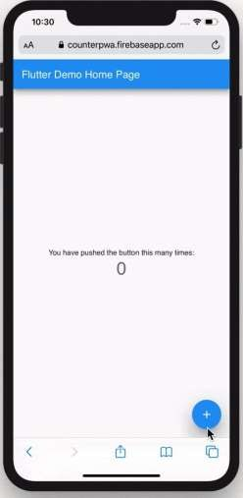
app

Slide 28
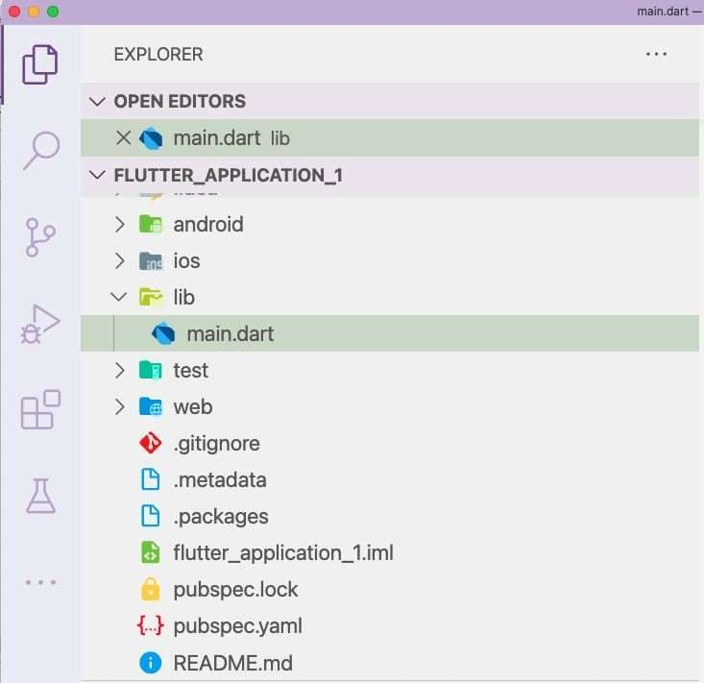

Slide 29
void main() { runApp(MyApp());
}

Slide 30
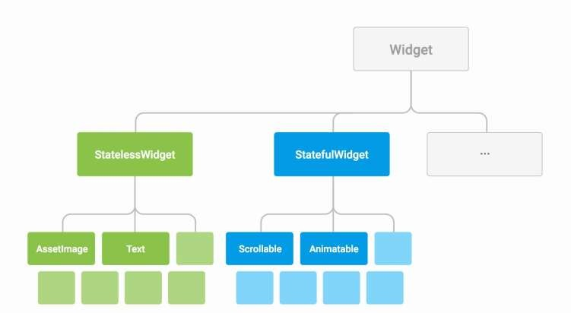

Slide 31
Input Data
Data can change (externally)
Stateless widget
Widget
Gets (re)- rendered when
Input Data changes
Renders UI

Slide 32
class MyApp extends StatelessWidget { @override
Widget build(BuildContext context) { return MaterialApp(
title: 'Flutter Demo', theme: ThemeData(
primarySwatch: Colors.blue,
),
home: MyHomePage(title: 'Flutter Demo Home Page'),
);
}
}

Slide 33
Input Data
Data can change (externally)
Stateful widget
Widget
Internal State
Gets (re)- rendered when
Input Data
or local State changes
Renders UI

Slide 34
class MyHomePage extends | StatefulWidget | {
MyHomePage({Key key, final String title; | this.title}) : | super(key: | key);
@override
_MyHomePageState createState() => _MyHomePageState();
}

Slide 35
class _MyHomePageState extends State<MyHomePage>{ int _counter = 0;
void _incrementCounter() { setState(() {
_counter++;
});
}
.
.
.

Slide 36
Widget build(BuildContext context) { return Scaffold(
appBar: AppBar(title: Text(widget.title)), body: Center(
child: Column(
mainAxisAlignment: MainAxisAlignment.center, children: <Widget>[
Text(
'You have pushed the button this many times:',
),
Text( '$_counter',
style: Theme.of(context).textTheme.headline4,
),
],
)),
floatingActionButton: FloatingActionButton( onPressed: _incrementCounter,
tooltip: 'Increment', child: Icon(Icons.add),
), );
}

Slide 37
Demo

Slide 38

Recap

Slide 39

Great looking and fast Apps

Slide 40


One codebase on every screen

Slide 41





flutter build android [--release] flutter build ios [--release] flutter build linux [--release] flutter build macos [--release] flutter build windows [--release] flutter build web [--release]
flutter.dev/desktop flutter.dev/web

Slide 42
Getting started with

Slide 43
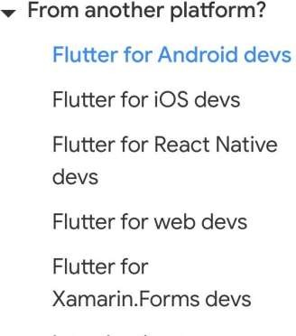
flutter.dev/docs/get-started/flutter- for/android-devs

Slide 44
- Checkout examples
Watch Flutter videos/courses
Read Flutter documentations
Play and practice
Find a friend to learn with
Newbie

Slide 45
Dart code lab
Tour of dart
Dart video tutorials

Slide 46

Flutter docs / blogs
flutter.dev
flutter.faq
flutter.community
flutter.medium

Slide 47

- flutter.showcases
codepen.io/flutter
itsallwidgets.com
latest codelabs
- fluttergems.dev
Coding GIF by Memecandy from giphy.com

Slide 48

The Flutter boring show
Widget of the week
Flutter in focus

Slide 49
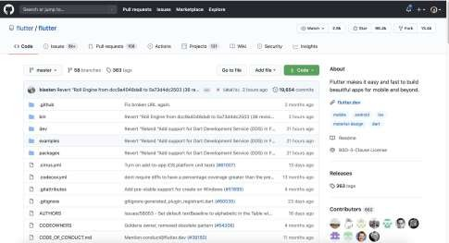
Open Everything is free 100% community contribution
github.com/flutter/

Slide 50
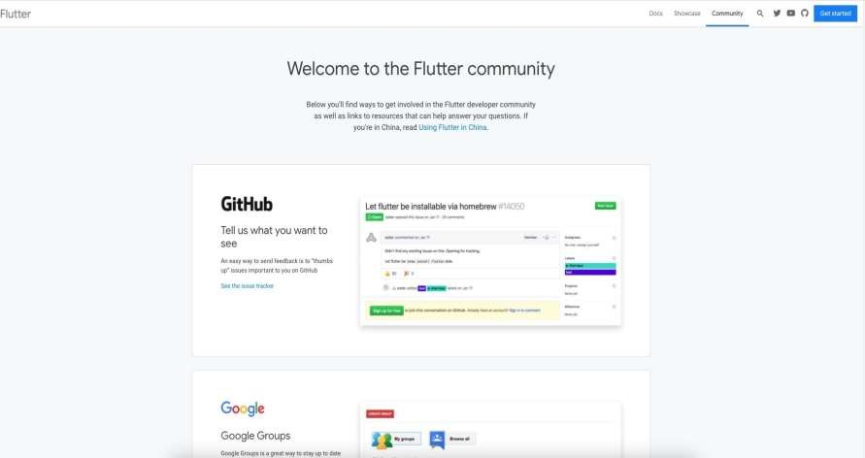
flutter.dev/community

Slide 51

World-wide community of people whose gender identity is either female or non-binary
flutteristas.org

Slide 52
Any questions?

