Slide 1
APPLICATION LAYER AND Domen Driven Design in programming language C#
Speaker : Nikola Ajdukovic

Slide 2
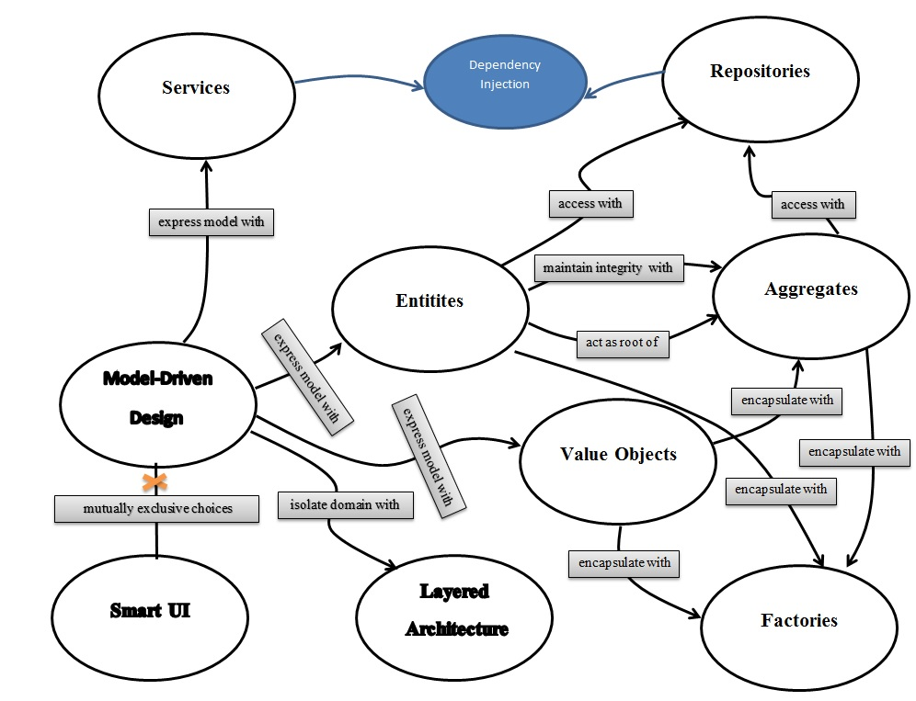

Slide 3
EVERY APPLICATION CONTAINS
Functionality
Data

Slide 4
Functionality of application
Application services
Domain services

Slide 5
DATA of application
Models
DTOes(Data Transfer Objects)
Entities

Slide 6
Application services
Application services are responsible for implementing features of application
One method of application service is equal one feature of apllication

Slide 7
DOMAIN services
Domain service is responsible for implementing business logic related to one entity type
One method of domain service is equal procesing one operation toward one entity type

Slide 8
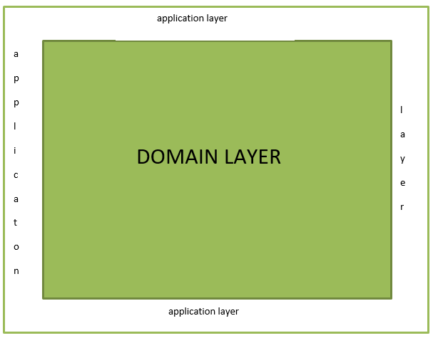

Slide 9
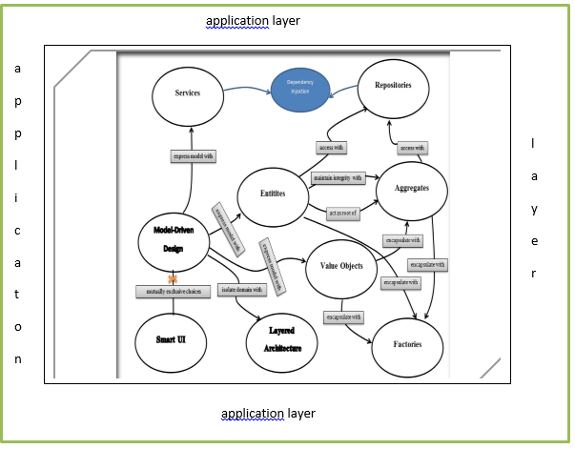

Slide 10
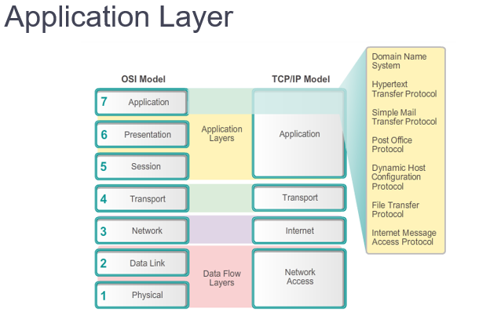

Slide 11
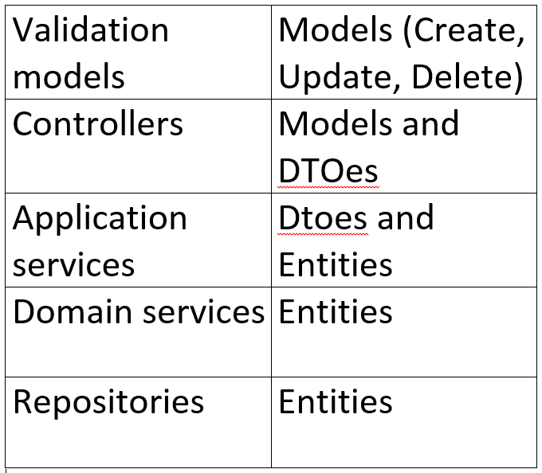

Slide 12
Validation (fluent validation)
Models
Application services
DTO (data transfer object)
Domain services
Entities

Slide 13
Validation (attribute)
[input data] => models
[output data] => dtoes
Controllers
Application services (private members of controllers)

Slide 14
Controllers
[input data] => dtoes
[output data] => entities
Application services
Domain services (private members of application services)

Slide 15
Domain services
[input data] => entities
Domain services
Repositories (private members of domain services)

Slide 16
CQRS(Command Query Responsibility Segregation) PATTERN
The principle states that a well designed object should have methods that are either commands or queries

Slide 17
CQRS(Command Query Responsibility Segregation) PATTERN
A command changes the state of an object, but does not return any data
A query returns data and does not change any state

Slide 18
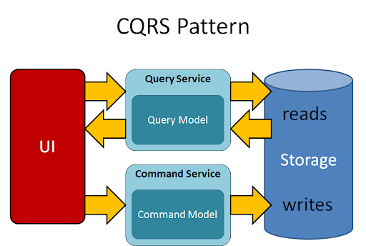

Slide 19
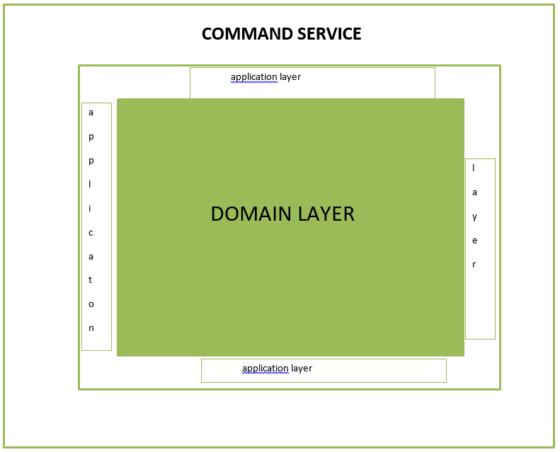

Slide 20
QUERY IN CQRS PATTERN
A query returns data and does not change any state
A query does not change any state => no business logic
=> no domain layer
=> no domain driven design

Slide 21
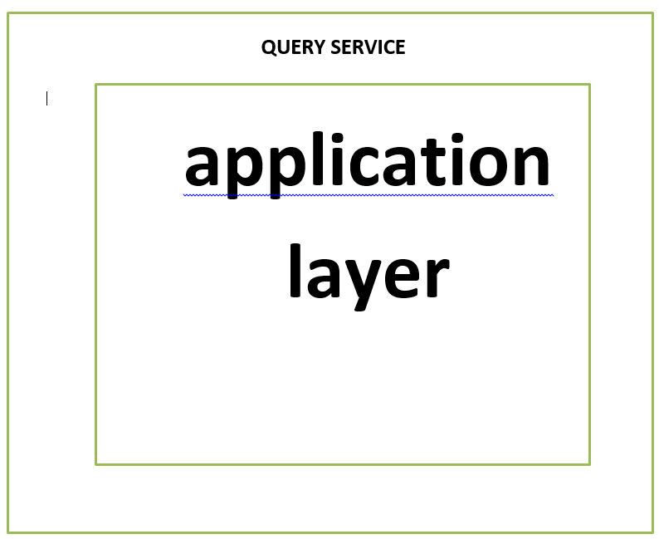

Slide 22
Entities and Value Objects
Entities have id and they are mutable
Value Objects have not id and they are immutable
Entities have their tables in the database
Value Objects have not their tables in the database
Value Objects cannot exist without and entity

Slide 23
Be careful of too many value object types

Slide 24
Add value object types as you need them(not before)

Slide 25
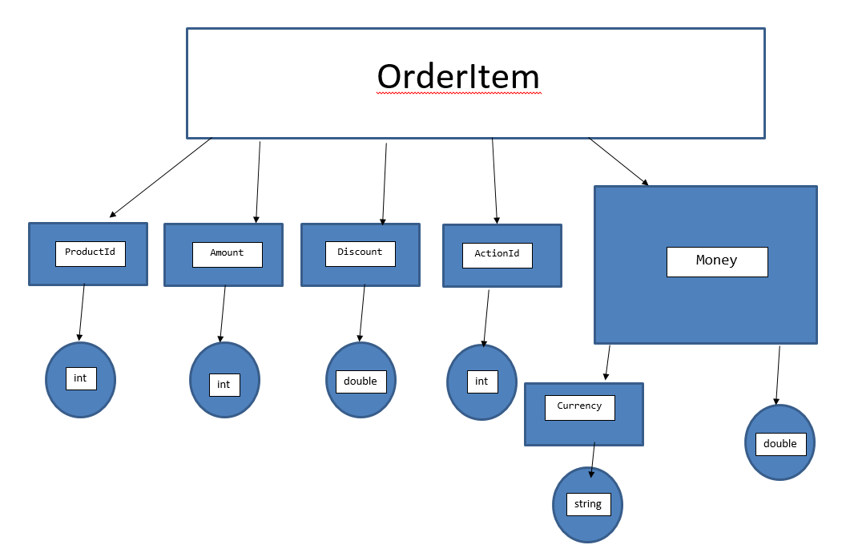

Slide 26
QUESTIONS ?
Thank you for your attention
The end

