Slide 1

Research Computing Services
Introduction to Python
for non-programmers
Janna Nugent: janna.nugent@northwestern.edu
http://bit.ly/intro-python-2018

Slide 2

What we’ve covered so far:
First Session
Why Python
Running Python
Python as a calculator
Variables
Strings
Types
Indexing & Slicing
Lists
If statements
boolean values & expressions
Second Session
Jupyter
Loops - for, pass, while, range, break,
continue
Dictionaries
Tuples
Sets
Functions

Slide 3
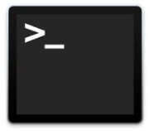
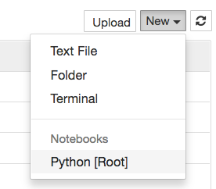

Let’s get started: Jupyter (mac)
Open Terminal
type “jupyter notebook”
New -> Python [Root]
quit: Use Control-C to stop this server and shut down all kernels (twice to skip confirmation).

Slide 4
Let’s get started: Jupyter (PC)
Open: Installed as a program - click on the icon
New -> Python [Root]

Slide 5

Functions
Also called “subprograms”, a function is a block of organized, reusable code that is used to perform a single, related action.
Each subprogram has a single entry point
The calling program is suspended during execution of the called subprogram
Control always returns to the caller when the called subprogram’s execution terminates
Functions you’ve already used: print(), len(), type()

Slide 6
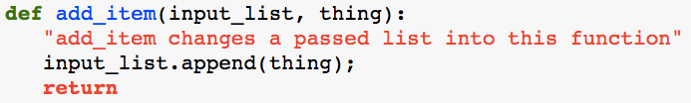

Writing Functions
“Behold, this is a function definition: from here on out when you see this name, it means do this function”
Parameters passed in to the function
do
End of function definition. May include value to return.
Documentation for your function, access via add_item?? or help(add_item)
Must be indented 4 spaces

Slide 7
Functions
All parameters in the Python language are passed by reference.
Pass the parameter by sending the memory address it’s located at in RAM
Pass a copy of the parameter
Java, C

Slide 8
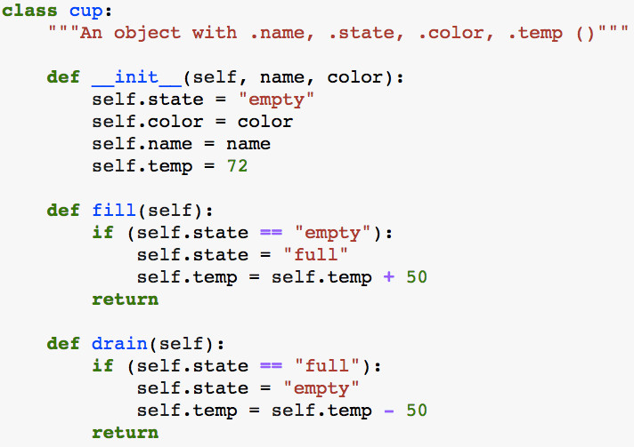
Object attributes and methods
“nouns”
“verbs”
attributes
methods

Slide 9
Opening Files: IDE
An integrated development environment (IDE) is a software suite that consolidates the basic tools developers need to write and test software. Typically, an IDE contains a code editor, a compiler or interpreter and a debugger that the developer accesses through a single graphical user interface (GUI).
At the command line type: “spyder”

Slide 10
Solving Problems
“The most common mistake I see when conducting interviews or watching someone try to solve a programming problem is they try to start writing code as soon as possible.
You must resist this urge.
You really want to make sure you take enough time to understand the problem completely before attempting to solve it.”
-Matt Sonmez
https://simpleprogrammer.com/2011/01/08/solving-problems-breaking-it-down/

Slide 11
Opening Files: IDE
Research Question:
Is the number of jobs on Quest trending upward, downward or staying flat?

Slide 12
Opening Files: IDE
The Problem:
The number of jobs is recorded every 15 minutes, except sometimes it isn’t - how to get average job numbers per day when the sample size is different every day?

Slide 13
Opening Files: IDE
The solution:
Write a python program that:
Pulls data from the total_jobs.dat file
Calculates the average number of jobs for each day
Plot to see trends

Slide 14
Opening Files: IDE
Pseudocode:
Open the data file

Slide 15
Opening Files: IDE
Pseudocode:
Open the data file
for each line of data:

Slide 16
Opening Files: IDE
Pseudocode:
Open the data file
for each line of data:
get the current day

Slide 17
Opening Files: IDE
Pseudocode:
Open the data file
for each line of data:
get the current day
get the number of jobs

Slide 18
Opening Files: IDE
Pseudocode:
Open the data file
for each line of data:
get the current day
get the number of jobs
if the current day is still the day from the last record:

Slide 19
Opening Files: IDE
Pseudocode:
Open the data file
for each line of data:
get the current day
get the number of jobs
if the current day is still the day from the last record:
add the # of jobs to the total # of jobs for the day

Slide 20
Opening Files: IDE
Pseudocode:
Open the data file
for each line of data:
get the current day
get the number of jobs
if the current day is still the day from the last record:
add the # of jobs to the total # of jobs for the day
increment the number of job samples for the day

Slide 21
Opening Files: IDE
Pseudocode:
Open the data file
for each line of data:
get the current day
get the number of jobs
if the current day is still the day from the last record:
add the # of jobs to the total # of jobs for the day
increment the number of job samples for the day
elif the current day has changed from the last record:

Slide 22
Opening Files: IDE
Pseudocode:
Open the data file
for each line of data:
get the current day
get the number of jobs
if the current day is still the day from the last record:
add the # of jobs to the total # of jobs for the day
increment the number of job samples for the day
elif the current day has changed from the last record:
calculate the average number of jobs for the day

Slide 23
Opening Files: IDE
Pseudocode:
Open the data file
for each line of data:
get the current day
get the number of jobs
if the current day is still the day from the last record:
add the # of jobs to the total # of jobs for the day
increment the number of job samples for the day
elif the current day has changed from the last record:
calculate the average number of jobs for the day
put the ave for the day into a list

Slide 24
Opening Files: IDE
Pseudocode:
Open the data file
for each line of data:
get the current day
get the number of jobs
if the current day is still the day from the last record:
add the # of jobs to the total # of jobs for the day
increment the number of job samples for the day
elif the current day has changed from the last record:
calculate the average number of jobs for the day
put the ave for the day into a list
reset the variables for the next iteration

Slide 25
Opening Files: IDE
https://matplotlib.org/users/pyplot_tutorial.html

Slide 26

Importing Packages

Slide 27
Many Data Science libraries are available for Python, and they are easy to install (using pip):
DataFrame- Pandas
Machine Learning- scikitlearn
Statistics- Scipy
Arrays- Numpy
Plots- matplotlib
Science- anaconda distribution
DataScrapping- BeautifulSoup
FetchUrldetails- urllib

Slide 28
Installing Packages
Use “pip”:
In Jupiter notebooks or console:
!pip install <package_name>
on the command line:
pip install <package_name>

Slide 29
Package Documentation
help(<package_name>)
or
<package_name>??
also
google <package_name>

Slide 30
Solving Problems
Some approaches aren’t good ideas
my_list=[1,2,3…n]
for number in my_list:
n times
2
for number on my_list:
n times
for number on my_list:
3
n times
for number on my_list:
4
n times
for number on my_list:
5
n = 20,000
n times
n = 400,000,000
2
3
n = 8,000,000,000,000
4
n = 160,000,000,000,000,000
5
n = 3,200,000,000,000,000,000,000,000

Slide 31
Research Computing Services
Introduction to Python
for non-programmers
Janna Nugent: janna.nugent@northwestern.edu
http://bit.ly/intro-python-2018

