Slide 1
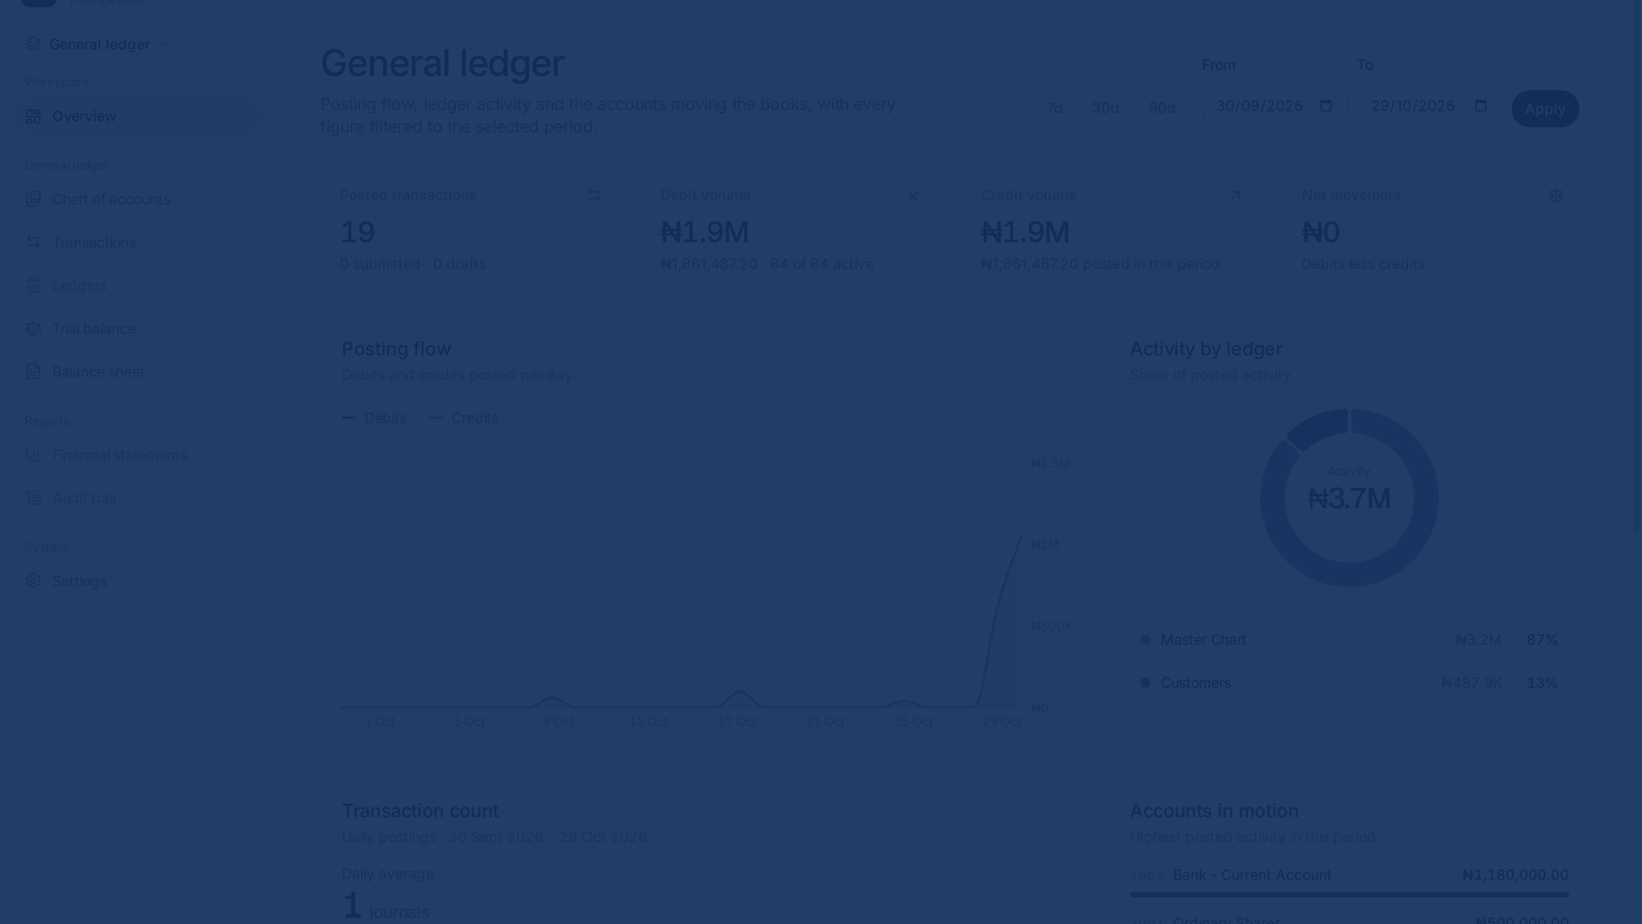


One system. Two sides.
Balanced books.
SIWES PRESENTATION
MFB Core System
DAMS Micro: a double-entry accounting and loan management system.
PRESENTED BY
MATRIC NUMBER
DEPARTMENT
Aje Damilola
230591336
Computer Science
INSTITUTION
PLACEMENT ORGANISATION
SIWES PERIOD
Lagos State University (LASU)
Golden Edge Softech
March – September 2026
Built with Laravel 13 · PostgreSQL · React 19 and Inertia · Tailwind CSS 4
Notes:
My name is Aje Damilola, and my matric number is 230591336. This is my SIWES presentation on DAMS Micro, an accounting and loan-management prototype inspired by the backend work I did during my placement. I will first explain that real asset-management project, then show how I applied its engineering and accounting lessons in my own system.

Slide 2






MY INDUSTRIAL EXPERIENCE
I worked on the backend of a real investment platform
At Golden Edge Softech, I contributed to a project for an asset management firm that manages investments for its customers.
Backend development
I built the rules behind financial actions.
PLATFORM COVERAGE
One backend, five financial areas
My Laravel work focused on the services, validations and database operations behind customer investments and accounting workflows.
General ledger
Fixed assets
Investments
Treasury placements
PLACEMENT
ROLE
Golden Edge Softech
Backend Developer · Laravel
Loans
Loans showed me how one event can affect schedules, customer balances and the ledger at the same time.
SIWES Presentation · Aje Damilola
02 / 15
Notes:
I completed my placement at Golden Edge Softech, where I worked on the Laravel backend of a project for an asset management firm. The firm manages investments for its customers, so the platform covered financial areas including the general ledger, fixed assets, investments, treasury placements and loans. My role involved the server-side rules, validations and database operations behind those workflows. Loans were especially important to me because they later inspired this SIWES project.

Slide 3



FROM EXPERIENCE TO PROJECT
What I learned became the blueprint for DAMS Micro
I applied both the engineering patterns and the accounting principles I encountered during my placement.
Code-wise
Accounting-wise
Keep business rules in focused Laravel services.
Every transaction follows debit and credit rules.
Use database transactions for all-or-nothing financial actions.
Account types determine their normal balance.
Validate workflows before changing balances or status.
The chart of accounts gives every posting a home.
Test money paths and make important actions traceable.
The trial balance checks that total debits equal credits.
Workplace experience → DAMS Micro prototype
Loans inspired the project; the general ledger made every action accountable.
SIWES Presentation · Aje Damilola
03 / 15
Notes:
My SIWES project was a chance to apply what I learned rather than reproduce the production system. Code-wise, I used Laravel services, database transactions, validation and tests to make financial actions safe and traceable. Accounting-wise, I applied debit and credit rules, normal balances, account types, the chart of accounts and the trial balance. Loans inspired the prototype, while the general ledger became the accounting backbone that connects every action.

Slide 4




THE PROBLEM
Manual workflows can make reconciliation harder
DAMS Micro explores the risk of keeping loan activity, journals and business dates in separate routines.
Balancing depends on manual checks
Loan trackers live outside the ledger
Day-end is a manual routine
Unposted work can be overlooked when the business date changes.
Without posting controls, an incomplete or mistyped entry can go unnoticed.
Separate records increase the risk of missed interest, fees and repayments.
Control gap
Reconciliation gap
Audit gap
The result: more reconciliation work and less confidence in financial reports.
SIWES Presentation · Aje Damilola
04 / 15
Notes:
This slide describes the control risks that DAMS Micro is designed to address; it is not a claim about my placement organisation. When loan records, journal entries and date controls are handled separately, people must reconcile them manually. The prototype turns those checks into explicit application rules.

Slide 5
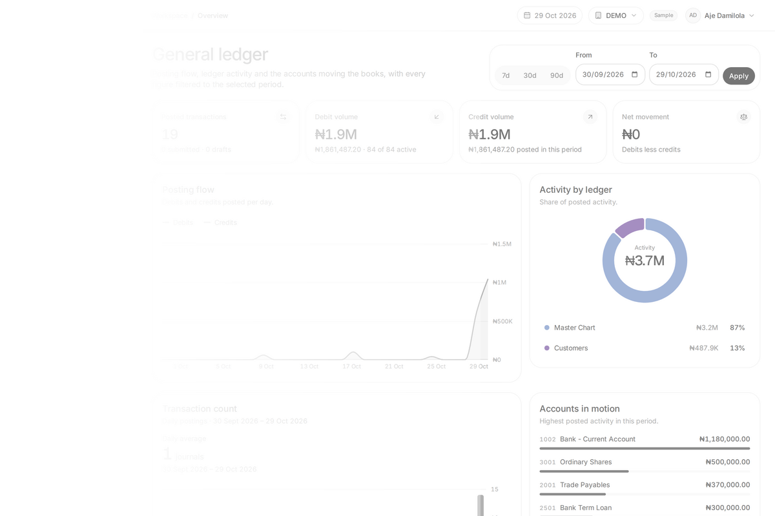

THE SOLUTION
Every workflow follows one path into the books
DAMS Micro turns a loan event or manual journal into validated entries, then posts them once to the general ledger.
ONE POSTING PATH
01
02
03
Capture the event
Validate and map
Post once
A loan action or manual journal starts the workflow.
Laravel applies the account mapping and checks that debits equal credits.
The same entries feed account statements, the trial balance and financial reports.
Loan operations and manual journals share the same accounting core; corrections use reversals rather than silent edits.
SIWES Presentation · Aje Damilola
05 / 15
Notes:
DAMS Micro uses one posting path. A loan event or manual journal is captured, Laravel applies the configured account mapping, and the posting service verifies that total debits equal total credits. The entries are then posted once to the general ledger, where they feed statements, the trial balance and reports. This keeps lending and accounting connected without duplicating the books.

Slide 6





SYSTEM ARCHITECTURE
Posting rules belong on the server, not the screen
The interface collects input. Server-side services validate and post the accounting entries.
USERS
Admin
Accountant
Credit Manager
Auditor
People the system supports
APPLICATION
Laravel 13
PHP 8.4
React 19
Inertia v3
Tailwind 4
Server-driven pages and actions
ACCOUNTING ENGINE
Journal posting
Balance resolution
Accruals & schedules
Operation → GL mapping
Balance snapshots
Every balance-changing rule
DATABASE
PostgreSQL
Companies
Ledgers
Journals
Loans
The durable record
Requests flow through server-side validation before accounting services update the ledger.
SIWES Presentation · Aje Damilola
06 / 15
Notes:
For the DAMS Micro prototype, I built the Laravel backend that handles workflow rules, journal posting and balance changes. React and Inertia present the interface, while PostgreSQL stores the durable record. Keeping accounting rules on the server prevents the screen from becoming the source of financial decisions.

Slide 7
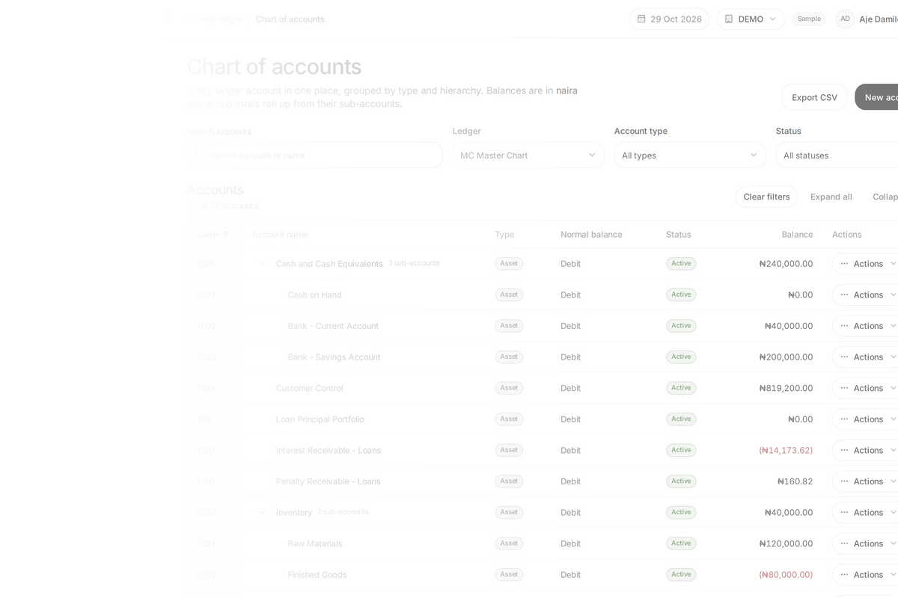



ACCOUNTING BACKBONE
The chart stays small while
customer detail stays traceable
A control account holds the summary; the customer subledger holds the individual balances behind it.
ONE HIERARCHY, TWO LEVELS OF DETAIL
Chart of accounts
Groups the company's assets, liabilities, equity, revenue and expenses.
1100 Customer Control
A summary account whose balance equals the total of all customer accounts.
Customer subledger
Stores each customer's movements and balance without crowding the main chart.
Only leaf accounts accept postings. Control accounts receive totals, not direct entries.
SIWES Presentation · Aje Damilola
07 / 15
Notes:
The chart of accounts provides the financial structure. Customer Control is a control account: its balance summarises all customer accounts, while the customer subledger preserves each person's detailed movements. This keeps the main chart manageable and the detail traceable. Only leaf accounts accept postings, so the control account receives totals rather than direct journal entries.

Slide 8

TRANSACTION FLOW
A journal must balance before it reaches the ledger
The posting service rejects an entry when total debits and total credits do not match.
BALANCED JOURNAL
Posted
ILLUSTRATIVE LOAN DISBURSEMENT
₦200,000 leaves the bank
Account
Debit
Credit
The same amount becomes a loan receivable from the customer.
Loan receivable
₦200,000.00
—
01
Account mapping converts the business event into journal lines.
Bank account
—
₦200,000.00
Total
₦200,000.00
₦200,000.00
02
The service totals both sides and blocks an imbalance.
03
Posted entries update their accounts and running balances together.
Debit ₦200,000 = Credit ₦200,000
Debit the loan asset; credit the bank asset. Corrections use reversals rather than editing posted history.
SIWES Presentation · Aje Damilola
08 / 15
Notes:
This simplified example shows the economic event before the software rule. When a 200,000 naira loan is disbursed, the organisation gains a loan receivable, so that asset is debited. Cash leaves the bank, so the bank asset is credited. The posting service checks that both sides equal 200,000 naira before writing the entries and their running balances together.

Slide 9

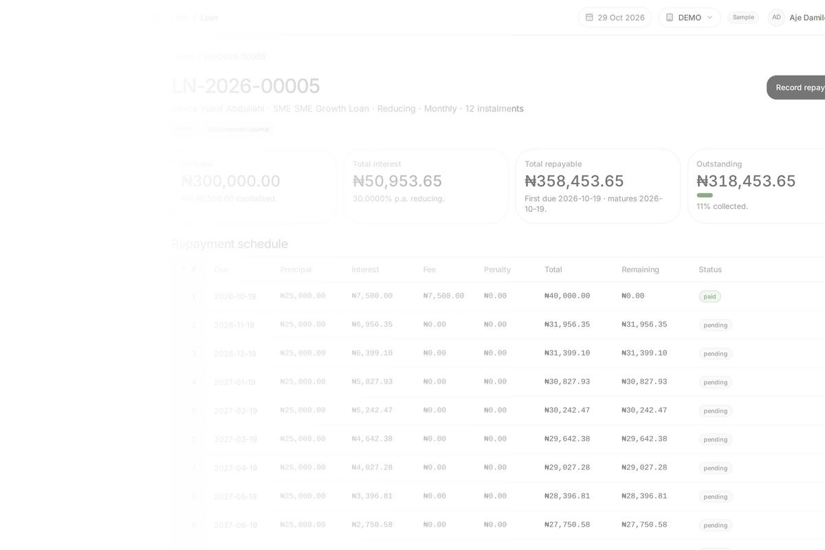
LOAN MANAGEMENT
Loan schedules connect what is due with what is paid
Product settings define interest and fees. Repayment schedules make each instalment visible.
Book
Approve
Disburse
Repay
Close
Accrual separates earning from collection
Accrual records interest when it is earned, even before the borrower pays.
Dr
Cr
Interest receivable
Interest income
Asset: interest still owed
Revenue: interest earned
One schedule, a clear repayment history
Track principal, interest, fees and penalties separately.
See each instalment's due amount and remaining balance.
Follow loan activity back to its journal entries.
Interest accrual runs separately from the Advance Day action.
SIWES Presentation · Aje Damilola
09 / 15
Notes:
The loan workflow covers customer and KYC records, product selection, booking, approval, disbursement, repayment, and closure. The loan-detail screenshot shows this lifecycle in the application. Interest accrual is a separate command; it is not performed automatically when the business date advances. Next, I will show the business-date control itself.

Slide 10
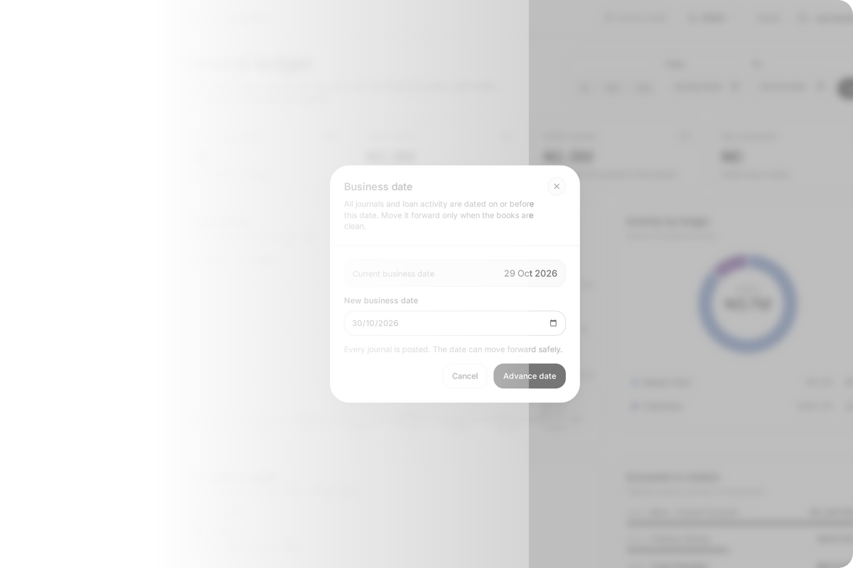

BUSINESS-DATE CONTROL
Advance Day moves the financial clock safely
It checks for unresolved journals, carries balances forward and changes the date in one transaction.
01
Clear the queue
Draft and submitted journals must be resolved, and the target date must be later.
02
Snapshot balances
Lock the business date and carry every leaf-account balance to the selected date.
03
Advance or roll back
All changes succeed together. If one step fails, the database keeps the previous day.
Boundary: this moves the date and balances only. Interest accrual runs separately.
SIWES Presentation · Aje Damilola
10 / 15
Notes:
The business date is the system's financial clock. Advance Day first checks that draft and submitted journals have been resolved and that the target date is later. It then locks the date, snapshots every leaf-account balance and advances the date in one database transaction. Every step succeeds together or the system rolls back. Interest accrual remains a separate process.

Slide 11



KEY DESIGN DECISIONS
Three decisions keep posted balances traceable
Each decision favors a clear audit trail over hidden convenience.
DECISION 01
DECISION 02
DECISION 03
Out of scope
Store balance_after
Reverse; never rewrite history
Keep external settlement out of scope
Statements can read the latest posted balance without replaying the full ledger.
Posted mistakes are corrected with linked reversals, preserving what happened.
The prototype records internal accounting events but does not connect to a payment rail.
Trade-off: backdated entries require an ordered rebuild.
Result: the audit trail remains visible and explainable.
Boundary: settlement integration remains future work.
The principle: keep balances traceable and be explicit about what the system does not do.
SIWES Presentation · Aje Damilola
11 / 15
Notes:
I made three explicit design choices. First, each posted entry stores its resulting balance so statements stay fast, with an ordered rebuild for backdated changes. Second, posted history is never silently edited; corrections use linked reversals. Third, the prototype records internal accounting events but does not connect to an external payment network.

Slide 12
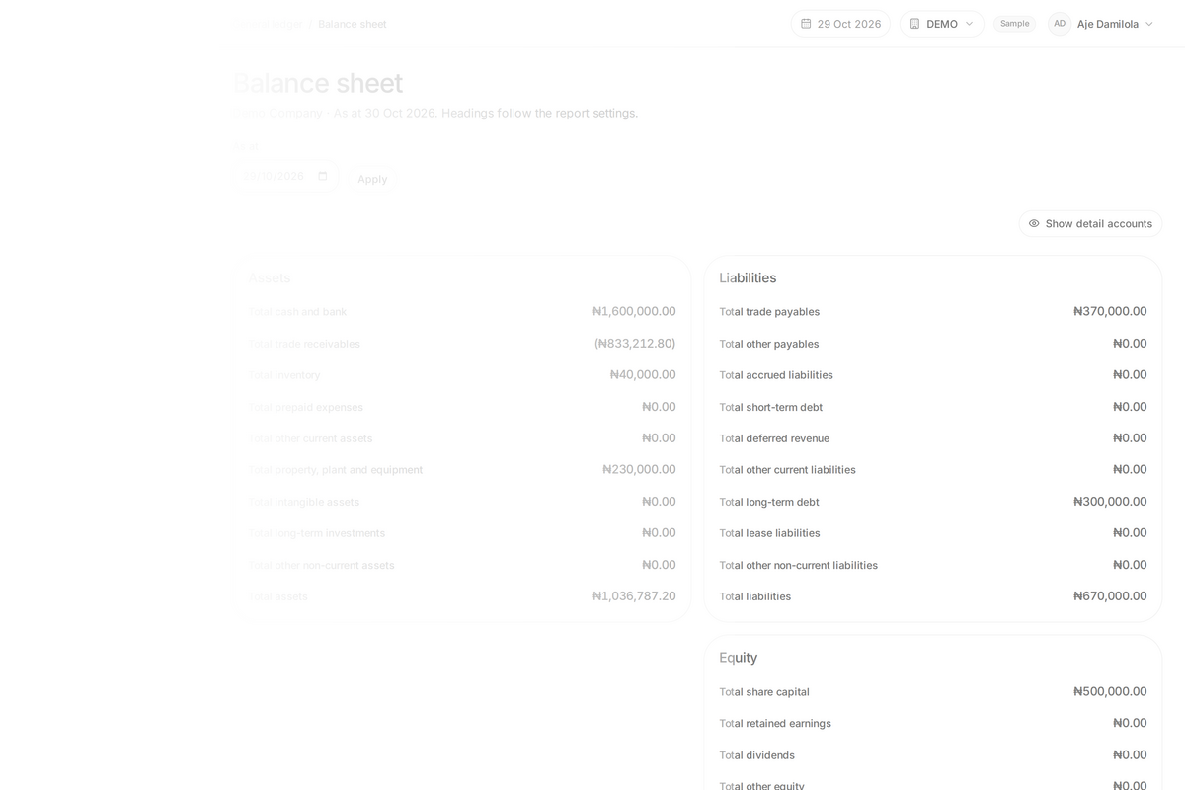

REPORTS FROM THE WORKING SYSTEM
Reports turn ledger entries into control checks
The key result stays readable; the full application capture remains available for inspection.
Balance sheet
Trial balance
Chart of accounts
BALANCE SHEET
Assets = liabilities + equity
₦1,036,787.20
₦670,000.00 liabilities + ₦366,787.20 equity
The statement balances at 30 October 2026.
Balanced totals are a control check, not proof that every account was chosen correctly.
SIWES Presentation · Aje Damilola
12 / 15
Notes:
These reports turn posted ledger entries into reviewable controls. The balance sheet shows assets of 1,036,787.20 naira, matched by 670,000 naira in liabilities and 366,787.20 naira in equity. The trial balance shows 2,130,160.82 naira on both sides with zero difference. Those results confirm arithmetic balance, but they do not prove that every business event was classified correctly.

Slide 13
CHALLENGES AND FIXES
Three accounting risks shaped the implementation
Each risk led to a specific control, rather than another manual workaround.
RISK
CONTROL
01
Reverse the mistake, then rebuild in date order
Corrections can disturb later running balances
Posted history remains intact while later balances are recalculated.
RISK
CONTROL
02
Use a control account with a customer subledger
Customer detail can overwhelm the main chart
The chart keeps one summary while individual balances stay traceable.
RISK
CONTROL
03
Block the change and advance atomically
The date could advance with unresolved journals
Either every balance snapshot and date change succeeds, or none does.
SIWES Presentation · Aje Damilola
13 / 15
Notes:
Three implementation risks became explicit controls. Running balances can drift after a backdated correction, so the system uses reversals and an ordered rebuild. Customer detail can overwhelm the chart, so a control account summarises a separate subledger. The business date must not move with unresolved journals, so the change is blocked and completed atomically.

Slide 14



SKILLS AND CONCLUSION
The result was more than a working prototype
I learned to connect backend engineering, accounting controls and clear communication.
Engineering
Accounting
Communication
I built Laravel services that validate workflows and post financial entries safely.
I translated debit, credit, normal-balance and reconciliation rules into code.
I documented the system for accountants and learned to explain technical trade-offs clearly.
What I would improve next
RECOMMENDATION
External-settlement design
Day-end audit logging
More reconciliation tests
Resolve unposted journals and run required processes before advancing the business date.
Build for clarity. Post with controls. Keep every balance traceable.
SIWES Presentation · Aje Damilola
14 / 15
Notes:
The main outcome was learning to connect three disciplines. I used backend engineering to make workflows safe, accounting knowledge to define correct postings and controls, and communication skills to document the system for its users. The prototype still has clear limits: external settlement, stronger audit logging and broader reconciliation tests remain future work.

Slide 15



SIWES · MARCH – SEPTEMBER 2026
Thank you.
Every naira, both sides.
Questions?
MFB Core System · double-entry accounting and lending core.
Debits
₦50,000.00
Aje Damilola · 230591336
Credits
₦50,000.00
Computer Science · Lagos State University
Difference
₦0.00
SIWES Presentation · Aje Damilola
15 / 15
Notes:
Thank you for listening. This project helped me connect software engineering with accounting controls, loan workflows and financial reporting. I welcome questions about the accounting model, the implementation choices or what I would improve next.

