Slide 1
Some Basic Combinatorial Optimization Algorithms
Ahmed Jedda

Slide 2
Optimization
You are give a set, find the solution with minimum cost (maximum score) (with some or no constraints).
Examples:
Find the minimum of the set S = {4, 1, 3, 6};
Find the x that minimizes f(x) for x in R (or, find the minimum of the set S = {f(x) = x^2 : x in R}.
Find x={x1, …, xn} of n features that minimizes the Loss(y, f(x)).
Find the minimum path in a graph between two nodes.

Slide 3
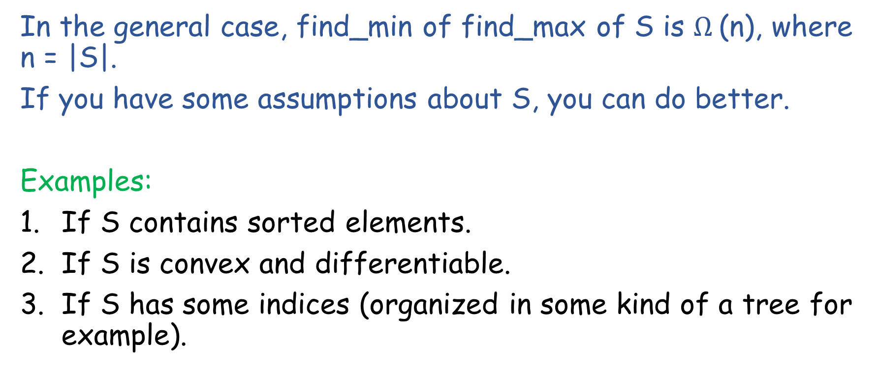
Optimization
In the general case, find_min of find_max of S is $Ω$(n), where n = |S|.
If you have some assumptions about S, you can do better.
Examples:
If S contains sorted elements.
If S is convex and differentiable.
If S has some indices (organized in some kind of a tree for example).

Slide 4
Optimization
Sometimes you don’t know the elements of S.
You want to generate them first!
Example: x1, x2, x3 are your features, and xi is either 0 or 1. Find the maximum f(x1, x2, x3), where f : {0,1}^3 -> R.
Approach:
Evaluate f(0,0,0), f(0,0,1), f(0,1,0), f(0,1,1), …., f(1,1,1).
Find the maximum

Slide 5
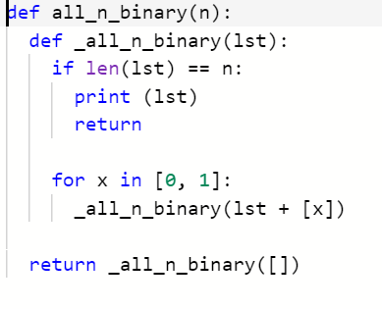
How to generate all n-binary numbers? Backtracking
This will print:
[0, 0, 0]
[0, 0, 1]
..
..
[1, 1, 1]

Slide 6
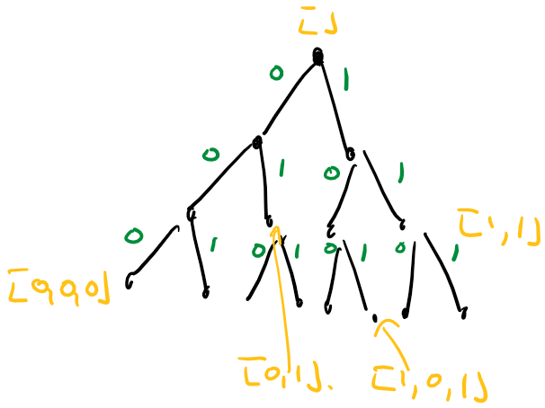
The search tree (space)

Slide 7
Toward a general backtracking algorithm.
With some more examples

Slide 8
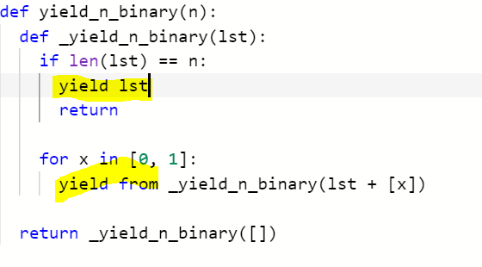
Let’s re-write it as a generator.
Call as: [x for x in yield_n_binary(3)]
.. Or: max([f(x) for x in yield_n_binary(3)])

Slide 9
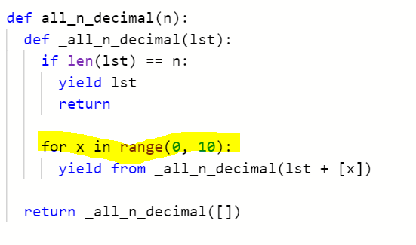
What about n-decimal?
Can you guess how the search tree looks like?
[x for x in yield_n_decimal(2)][:3]
=> [[0,0], [0,1], [0,2]]

Slide 10
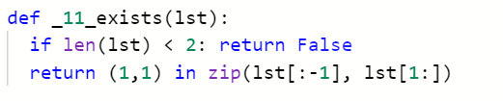
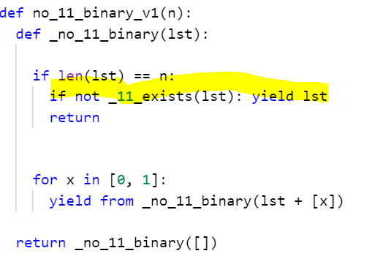
More constraints, more fun. All n-binary without sequence 11

Slide 11
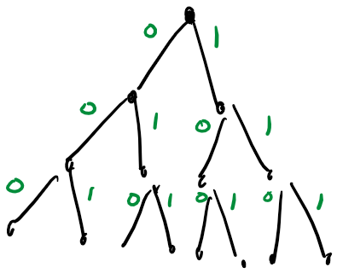
More constraints, more fun. All n-binary without sequence 11
Never yielded. Wrong solutions.

Slide 12
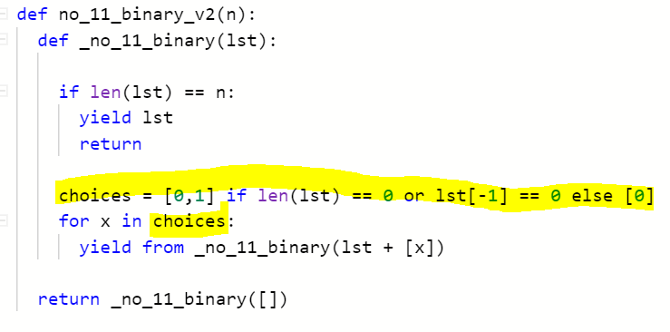
All n-binary without sequence 11 (Can we be smarter her?)
We visit less paths in the search tree!

Slide 13
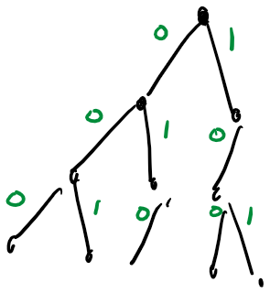
All n-binary without sequence 11 (Can we be smarter her?)
We visit less paths in the search tree!

Slide 14
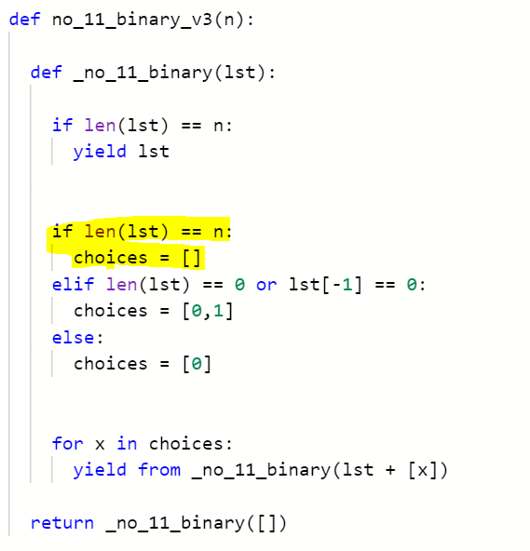
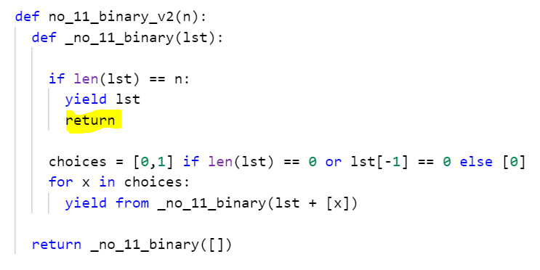
Some refactoring, one more step toward goal

Slide 15
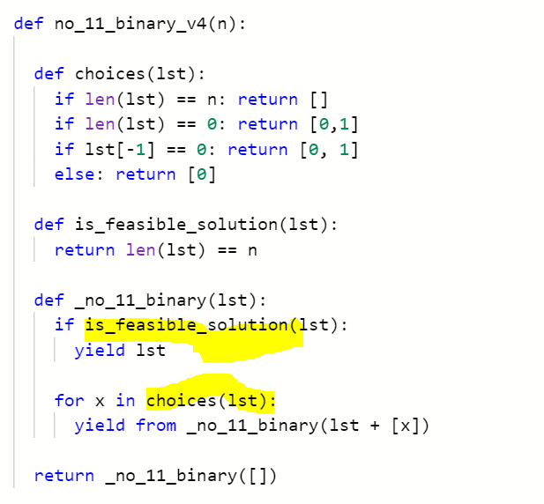
A Generalized Recursive Backtracking Algorithm (or, framework)
When solving a problem using backtracking:
Follow this general algorithm,
Implement choices(lst)
Implement is_feasible_solution(lst)
Some definitions:
1. lst at any point is called a solution.
2. lst + [x] is an extension of lst.

Slide 16
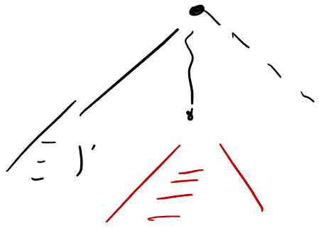



A Generalized Recursive Backtracking Algorithm (or, framework)
Note: choices(lst) controls the paths to follow in the search tree subrooted at lst[-1].
lst
lst[-1]
choices(lst)

Slide 17
How Backtracking algorithms execution time is measured? It depends on:
The number of nodes visited in the tree.
The time complexity of choices(lst).
The time complexity of is_feasible_solution(lst)

Slide 18
How Backtracking algorithms execution time is measured? It depends on:
The number of nodes visited in the tree.
The time complexity of choices(lst).
The time complexity of is_feasible_solution(lst)
Number of nodes is dominant. Thus, we need to reduce the number visited.
i.e., Pruning: Smarter Solutions Extensions (choices(lst))

Slide 19
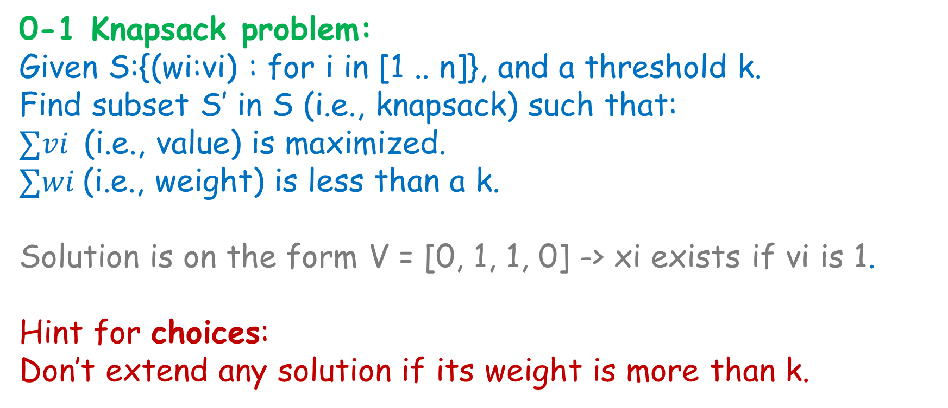
More realistic examples (with pruning)
0-1 Knapsack problem:
Given S:{(wi:vi) : for i in [1 .. n]}, and a threshold k.
Find subset S’ in S (i.e., knapsack) such that:
$∑vi$(i.e., value) is maximized.
$∑wi$(i.e., weight) is less than a k.
Solution is on the form V = [0, 1, 1, 0] -> xi exists if vi is 1.
Hint for choices:
Don’t extend any solution if its weight is more than k.

Slide 20
More realistic examples (with pruning)
Maximum Clique.
Given a graph G = (V,E). Find the clique with maximum number of nodes in it.
(A clique is a graph where every node is a neighbor to every other).
Solution is on the form S = (v1, … vk).
Hint for choices:
A node v in choices([x1 .. xk]) is a neighbor to every node in [x1 … xk].
(This also means that [x1 .. xk] is a clique!)
Also : if (v1, v2) in solution, then don’t visit (v2, v1).

Slide 21
More realistic examples (with pruning)
Maximum Clique.
Given a graph G = (V,E). Find the clique with maximum number of nodes in it.
(A clique is a graph where every node is a neighbor to every other).
Is this old-fashioned and useless? No.
Maximum cliques can be used to find highly correlated groups (i.e., clusters).
It is also useful in social networks analysis,
and many other

Slide 22
Let’s focus on optimization now. Branch-And-Bound.
Best score so far is Cm
Upper bound for unvisited path is Uc.
Before traversing a path, can you get an upper bound of the maximum score you will get?

Slide 23
Let’s focus on optimization now. Branch-And-Bound.
Best score so far is Cm
Upper bound for unvisited path is Uc.
If Uc <= Cm -> Just skip this path.

Slide 24
Let’s focus on optimization now. Branch-And-Bound.
Upper bound for unvisited path is Uc.
If traversed, and then found a solution with cost Uc, then no need to continue in that path.

Slide 25
The upper bound is not a guess! How to find it?
Example from Maximum Clique.
In the graph G = (V,E), the maximum clique cannot be largen than |V|.
This is an upper bound (but not that useful!).

Slide 26
The upper bound is not a guess! How to find it?
Example from Maximum Clique.
Let’s assume that the current solution is S = [v3, v7, v10] .. You can extend it with C = [v11, v25, v30, v42, v55, v65].
Note: [v3, v7, v10] is already a clique.
The maximum clique you can get with the extension C is 3 + |C| = 9.
|S| + |C| is an upper bound.

Slide 27
The upper bound is not a guess! How to find it?
Example from Maximum Clique (one more smarter solution)
Let’s assume that the current solution is S = [v3, v7, v10] .. You can extend it with C = [v11, v25, v30, v42, v55, v65].
Your maximum clique cannot be larger than |S| + Colors[C].
Colors[C] -> Run a greedy coloring algorithm on the spanning graph G[C], and return the number of colors.
Why the maximum clique cannot be larger than the number of colors X? (if there is a clique of size X, then each node will have different color).

Slide 28
How to reach the solution faster?
One additional note:
in Branch-And-Bound, you don’t need to traverse the tree in Depth-First.
In this case, you should use a priority-queue in the backtracking algorithm
Reminder: we were using the function call stack to implement backtracking

Slide 29
How to reach the solution faster? Heuristics

Slide 30
How to reach the solution faster?
Why use a tree? Use a different type of graphs instead.
Create a graph G = (V, E) as follows.
Each solution v is a vertex.
Each solution v has a set of neighbors N(v)
Example: find the maximum of f(0,0,0), f(0,0,1) …
How to set the neighborhoods?

Slide 31
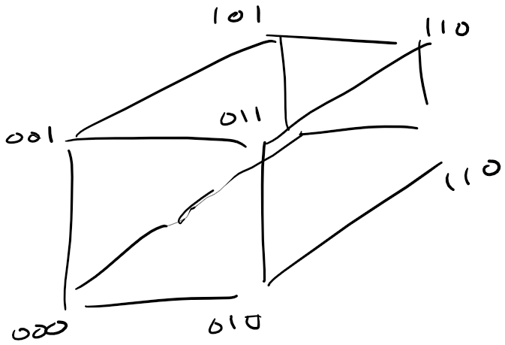
How to reach the solution faster?
Why use a tree? Use a different type of graphs instead.
Create a graph G = (V, E) as follows.
Each solution v is a vertex.
Each solution v has a set of neighbors N(v)
Example: find the maximum of f(0,0,0), f(0,0,1) …
N(v) = {u : hamming_distance(u,v) = 1}

Slide 32
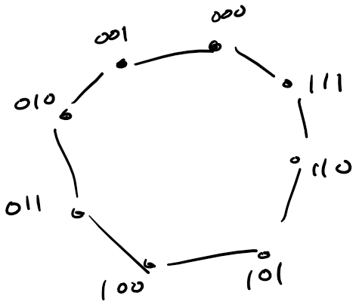
How to reach the solution faster?
Why use a tree? Use a different type of graphs instead.
Create a graph G = (V, E) as follows.
Each solution v is a vertex.
Each solution v has a set of neighbors N(v)
Example: find the maximum of f(0,0,0), f(0,0,1) …
N(v) = {u: |(u-v) mod n|=1}

Slide 33
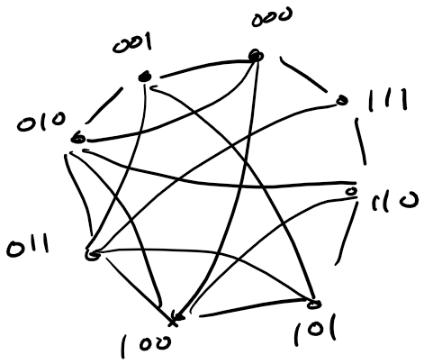
How to reach the solution faster?
Why use a tree? Use a different type of graphs instead.
Create a graph G = (V, E) as follows.
Each solution v is a vertex.
Each solution v has a set of neighbors N(v)
Example: find the maximum of f(0,0,0), f(0,0,1) …
You are only limited by your imagination!

Slide 34
The solutions as a graph. How is that useful?
Start with an initial solution v0 in step 0. (could be random for example)
At any given step i-1:
1. Find a better solution in vi = N(v_{i-1}).
2. Continue until no better solution is found.
Hill Climbing
Could you think of a similar algorithm in ML?

Slide 35
The solutions as a graph. How is that useful?
1. Find a better solution in vi = N(v_{i-1}).
Should it always be the best solution in the neighborhood?
What about any solution? (perhaps randomly selected)
What about the non-feasible solutions in the neighborhood?
Will you always find the best solution?

Slide 36
The solutions as a graph. How is that useful?
1. Find a better solution in vi = N(v_{i-1}).
Should it always be the best solution in the neighborhood?
What about any solution? (perhaps randomly selected)
What about the non-feasible solutions in the neighborhood?
Will you always find the best solution?
Can be expensive if N is large.
Can be infeasible
You can stop, or just try again.
No. But you can try with a different initial solution (only local minima are guaranteed eventually).

Slide 37
The solutions as a graph. How is that useful?
1. Find a better solution in vi = N(v_{i-1}).
Will you always find the best solution?
How to pick the initial solution?
Any other methods?
No. But you can try with a different initial solution (only local minima are guaranteed eventually).
Randomly?
What about some alternation of the best solution already found? (Genetic Algorithms)

Slide 38
The solutions as a graph. How is that useful?
2. Continue until no better solution is found.
Some algorithms will accept a less preferable solution with some probability. (Simulated Annealing).
Why? To avoid being stuck in a local minima!
The probability depends on:
|c(i) – c(i-1)|, and
the number of iterations.

Slide 39
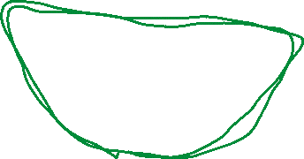


The solutions as a graph. How is that useful?
2. Continue until no better solution is found.
What happens if you don’t pick the best solution always? Cycles!
How to solve it? The same way you avoid cycles in any graph traversal algorithm:
Don’t visit any of the visited nodes (best solution)
Don’t visit any of the last k-visited nodes (heuristic). (Taboo list, in Taboo Search).

Slide 40
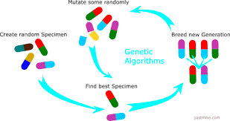
Some ideas used by Genetic Algorithms
These ideas already mentioned in this presentation.
Repeat the experiment many times:
Start with a population of m solutions, pick the best.
Repeat the same step k times.
Mutation -> how to find neighbors of a solution. (they call it, preserve population diversity, we call it neighborhoods).
Creating a solution from two or more solutions. (I don’t recall seeing this in other algorithms).

