Slide 1
APCT:
All Purpose Customer Tracker
Sprint #2
Sagar Tailor, Andrew Edillo, Chad Schulte, Evan Kennedy, Kip Tucker, Richard Clemence

Slide 2
Project Description
Create a IoT camera solution for in store tracking and analytics for customer behaviour. Support the solution by providing a website where Store owners can administer a single or aggregation of store locations by allowing creation of store layouts and picking area of interest for surveillance and analysis dashboarding for decision making.
Notes:
Richard

Slide 3
Sprint 2 Accomplishments
Access control
Registration
Login/Logout
Email verification
User management/access control
UI Mockup
Server + Website setup
Hardware acquisition
Beginning of store layout
Notes:
Kip

Slide 4
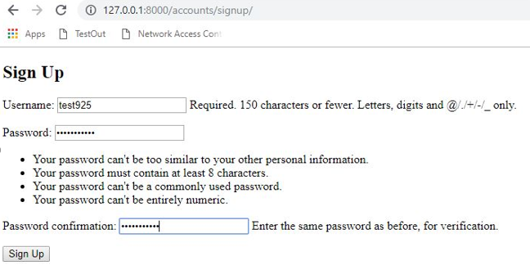
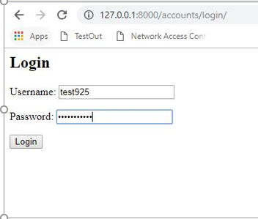
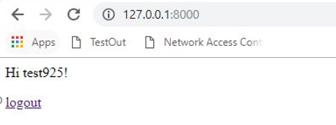
Website Registration/Login
Notes:
Evan

Slide 5
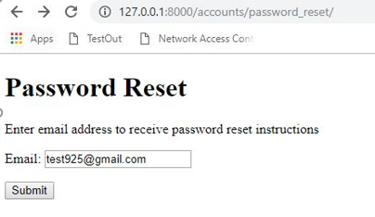
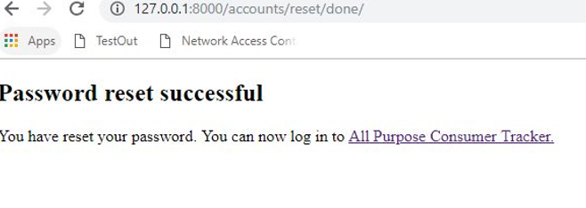
Website Password Reset
Notes:
Evan

Slide 6
User Stories
As a customer, I can create an account in order to access the website.
As a customer, I can access the website with my account to view the statistics and data based on the information captured by the store cameras.
As a store owner, I can create and edit store floor plans.
As a store owner, I can add and change camera placements around the store.
As a store owner, I can use the store cameras to count the number of customers my store sees per day.
As a store owner, I can use the store cameras to monitor customer behavior and to better understand where customers spend their time the most.
As a store owner, I use use the data from the image/video analysis to determine which items are the most popular.
As an administrator, I can create accounts for each of the store owners.
As an administrator, I can view and customize the statistics and data based on the information captured by the store cameras.
Notes:
Chad

Slide 7
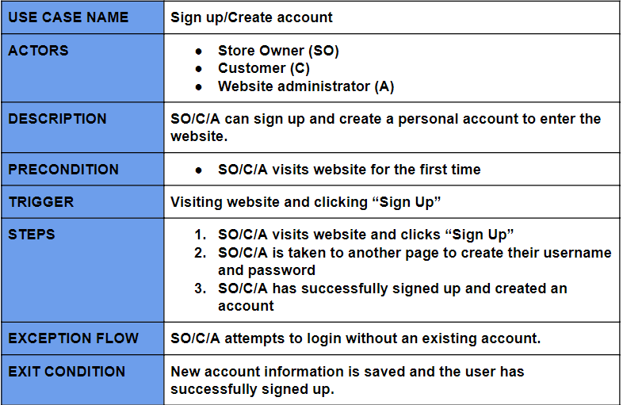
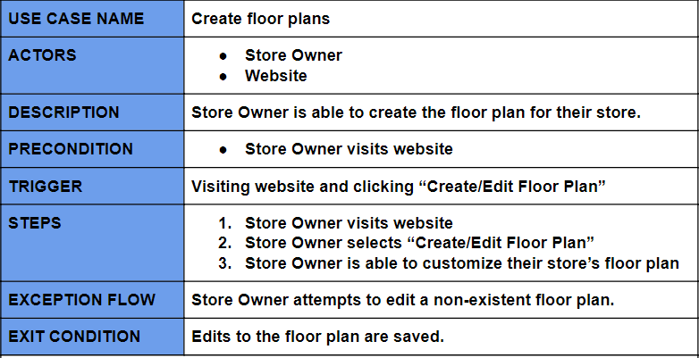
Use cases
Notes:
Chad

Slide 8
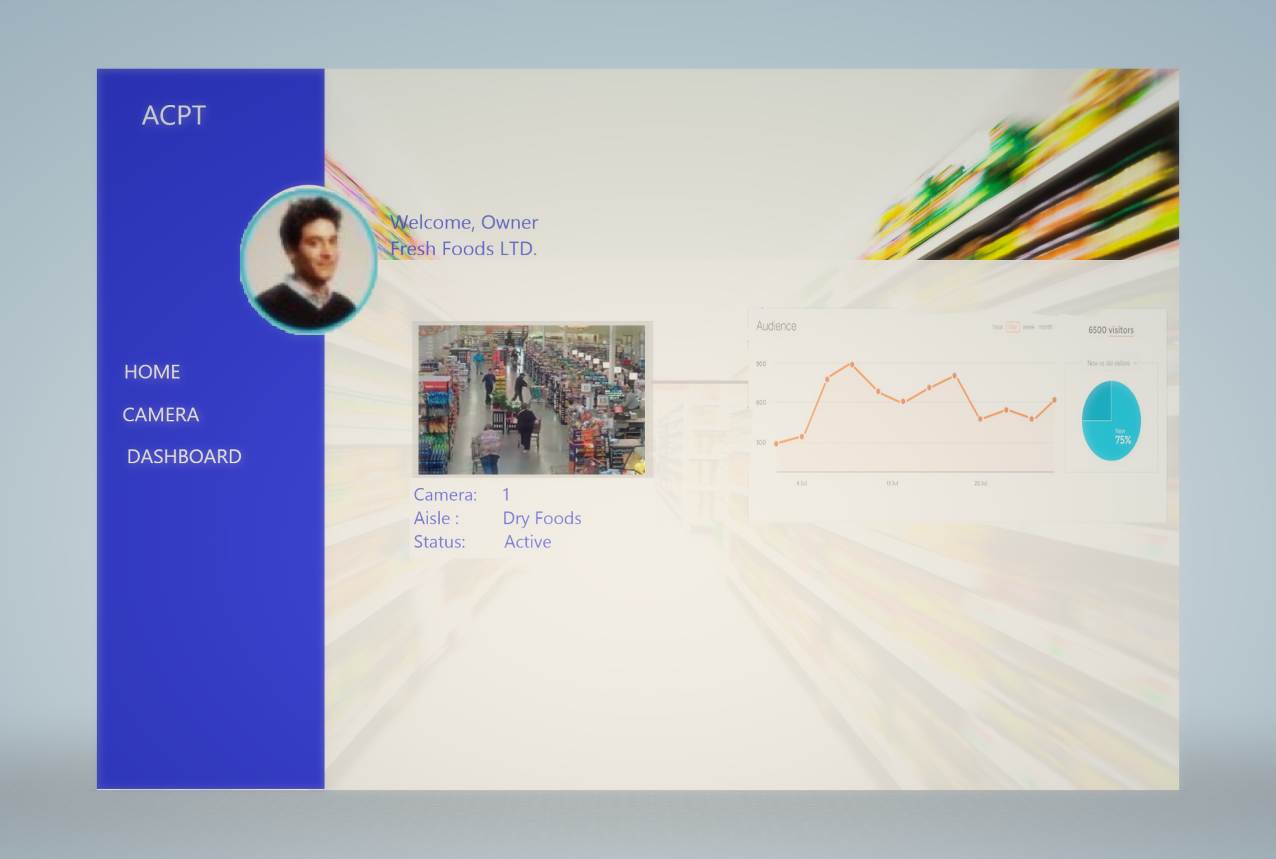
UI Mock up
Notes:
Sagar

Slide 9
DJANGO stack running on Google Cloud instance (Debian)
IP: http://104.198.191.49/

Slide 10
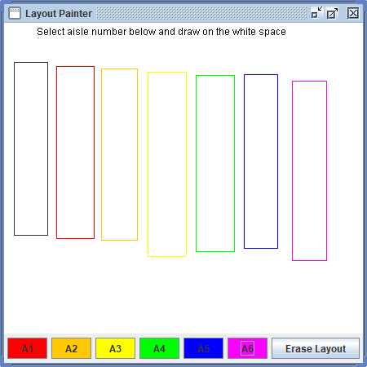
Brief Store Layout Demo
Coded in Java
Will be ported over as a web application via AjaxSwing
Notes:
Andrew

Slide 11
Project Plan - Next Sprint (Sprint #3)
Web interface
User access stories
Complete Store Layout user submission software
Hardware setup and configuration
Notes:
Kip

