Slide 1
Project Description
Create a IoT camera solution for in store tracking and analytics for customer behaviour. Support the solution by providing a website where Store owners can administer a single or aggregation of store locations by allowing creation of store layouts and picking area of interest for surveillance and analysis dashboarding for decision making.
Notes:
Sagar

Slide 2
Sprint 3 Accomplishments
Camera + Pi setup (on Raspberry Pi)
User access stories
Store Layout user submission software
Static web pages, URL routing.
Notes:
Kip

Slide 3
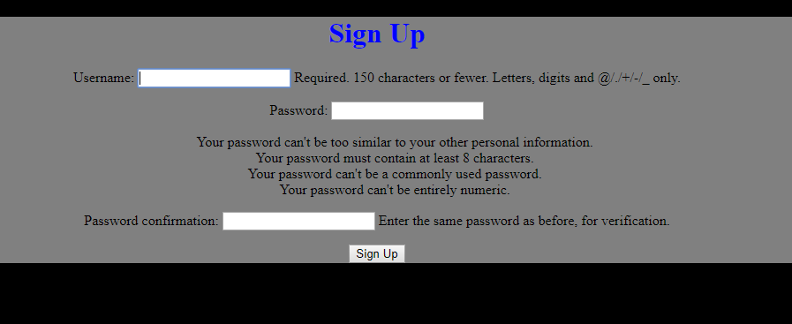
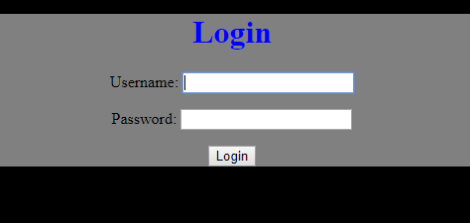
Notes:
Kip

Slide 4
Cloud Server
http://104.197.146.254/
Notes:
Sagar

Slide 5
Risks and Challenges
Risks and Challenges
Getting everyone to meet in person (conflicting schedules, etc.)
Code compilation issues
Learning how to use the Django framework
Tracking software reliant on video feed, not still images
New requirement being to set up cameras to store video data, not just image data for customer tracking
Notes:
Evan

Slide 6
User Stories
As a customer, I want to access the website with my account to view the general statistics and data based on the information captured by the store cameras.
As a store owner, I want to create and edit store floor plans that reflect my own store.
As a store owner, I want to register cameras with specific locations/aisles.
As a store owner, I want to use the in-store cameras to count the number of customers my store sees per day.
As a store owner, I want to use the store cameras to monitor customer behavior and to better understand where customers spend their time the most.
As a store owner, I want to view the in-store camera stream.
As a store owner, I want to use the data from the image/video analysis to determine which items are the most popular.
As an administrator, I want to view and customize the statistics and data based on the information captured by the store cameras.
As an administrator, I want to choose what data is shown on the website for customers/store owners to view.
Notes:
Chad

Slide 7
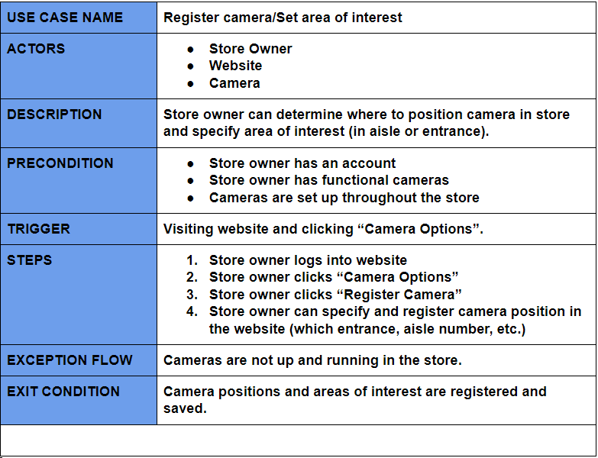
Use Case
Notes:
Chad

Slide 8
Brief Camera Demonstration
Hardware setup - showing camera works
Notes:
Rick

Slide 9
Next Sprint Objectives (Sprint #4)
Configure tracking software on the cameras
Finalize then publish the store layout software to website
Connecting cameras to cloud server
Connecting and configuring the second camera
Adding Dynamic pages onto Cloud website
Beginning work on customer statistics and profile building
Notes:
Andrew

Slide 10
Thank you!

