Slide 1
SEMGREP

Slide 2
What is Semgrep?
Semgrep is a powerful static code analysis tool designed for detecting and preventing software vulnerabilities and code quality issues early in the development process.

Slide 3
Why Use Semgrep?
Improve code quality
Find and fix security vulnerabilities
Enforce coding standards
Enhance overall software reliability

Slide 4
Installation on Windows (Using WSL)
Semgrep can be installed on Windows using Windows Subsystem for Linux (WSL)
for a native experience.

Slide 5
Features
Semgrep offers a range of powerful features:
Language Support: Python, JavaScript, Java, Go, and more.
Custom Rules: Create rules tailored to your project.
Multiple Matchers: Control how Semgrep matches patterns.
Suppressions: Ignore or annotate specific findings.
CI/CD Integration: Seamlessly integrate into your development workflow.

Slide 6
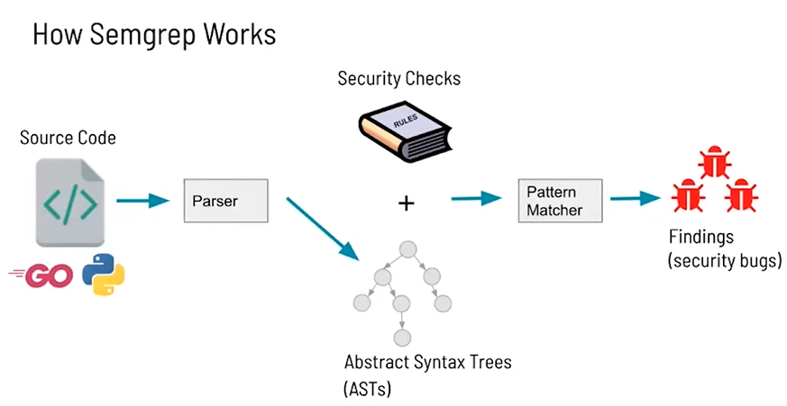

Slide 7
Pre-built Rules
Semgrep provides a library of pre-built rules for common issues.
Examples:
Security: CWE, OWASP Top 10
Code Quality: PEP8, Go Vet, ESLint
Framework-specific: Django, React, Angular

Slide 8
Writing Rules
Running rules locally
Ephemeral rules
semgrep -e '$X == $X' --lang=py PATH/TO/SRC
Yaml
semgrep scan --config PATH/TO/MYRULE.YAML
Ellipses
Meta variables

Slide 9
Running Semgrep
Use the semgrep command in your WSL terminal to scan your codebase. semgrep scan --config=auto
Supports various output formats (JSON, SARIF, etc.).
Easily integrate into CI/CD pipelines.

Slide 10
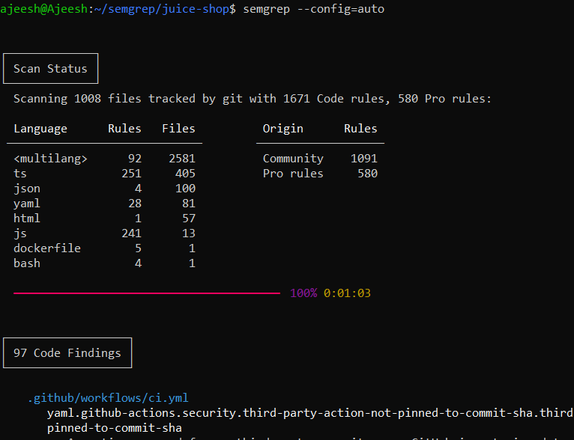
Example Output

Slide 11
