Slide 1
SEMGREP

Slide 2
What is Semgrep?
Semgrep is a powerful static code analysis tool designed for detecting and preventing software vulnerabilities and code quality issues early in the development process.

Slide 3
Why Use Semgrep?
Improve code quality
Find and fix security vulnerabilities
Enforce coding standards
Enhance overall software reliability

Slide 4
Semgrep ecosystem Products
Semgrep –semgrep OSS engine
Semgrep code with Semgrep Cloud Platform
Semgrep Supply chain

Slide 5
Semgrep OSS Engine on Windows Locally (Using WSL)
Semgrep can be installed on Windows using Windows Subsystem for Linux (WSL)
for a native experience.
semgrep login && semgrep ci
semgrep scan --config=auto

Slide 6
Semgrep code with Semgrep Cloud Platform
Sorting, filtering, triaging, and remediating security issues.
Enforcing coding standards through the creation of custom rules.
Preventing insecure code from reaching production

Slide 7
Features
Semgrep offers a range of powerful features:
Language Support: Python, JavaScript, Java, Go, and more.
Custom Rules: Create rules tailored to your project.
Multiple Matchers: Control how Semgrep matches patterns.
Suppressions: Ignore or annotate specific findings.
CI/CD Integration: Seamlessly integrate into your development workflow.

Slide 8
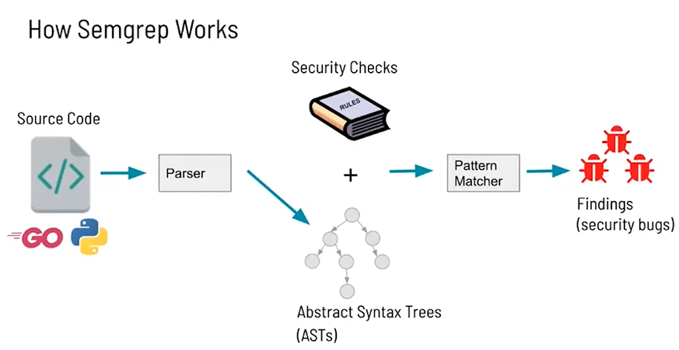

Slide 9
Pre-built Rules
Semgrep provides a library of pre-built rules for common issues.
Community rules
Third-party rules
Private rules
Pro rules

Slide 10
Writing Rules - locally
Running rules locally
Ephemeral rules
semgrep -e '$X == $X' --lang=py PATH/TO/SRC
Yaml
semgrep scan --config PATH/TO/MYRULE.YAML
Ellipses(…)
Meta variables($X)

Slide 11
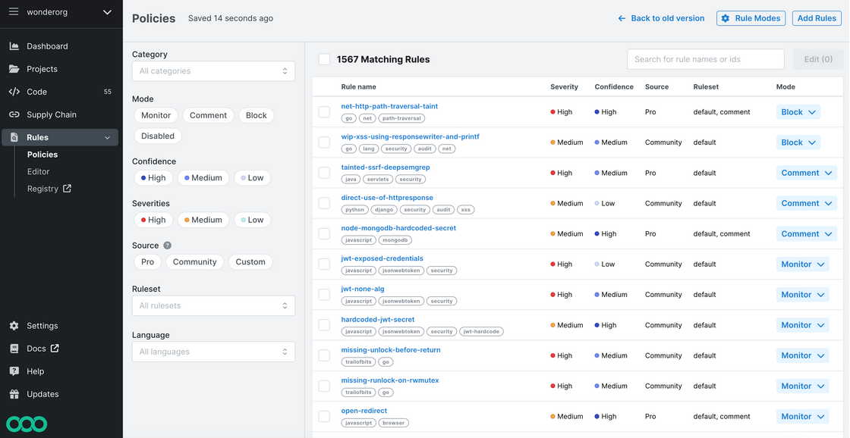
Writing rules –in SCP

Slide 12
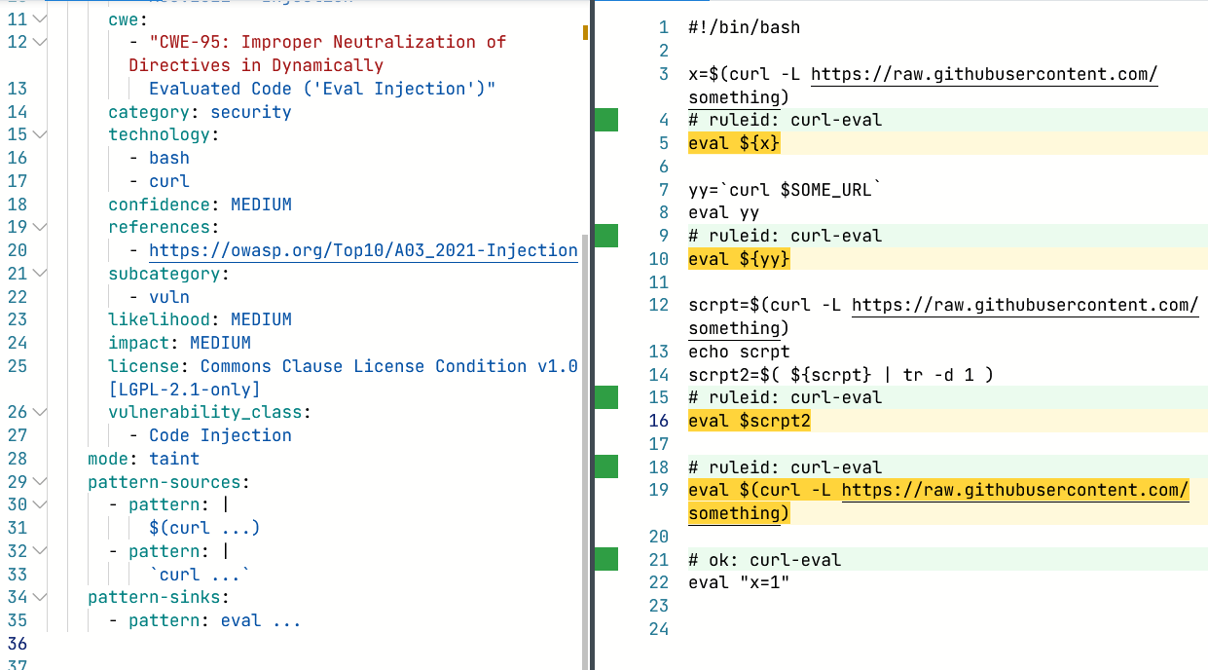
Pattern Example 1

Slide 13
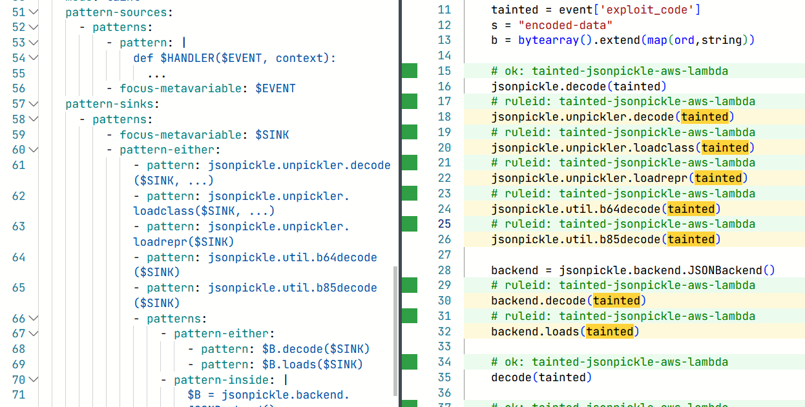
Pattern Example2
python.aws-lambda.deserialization.tainted-jsonpickle-aws-lambda.

Slide 14
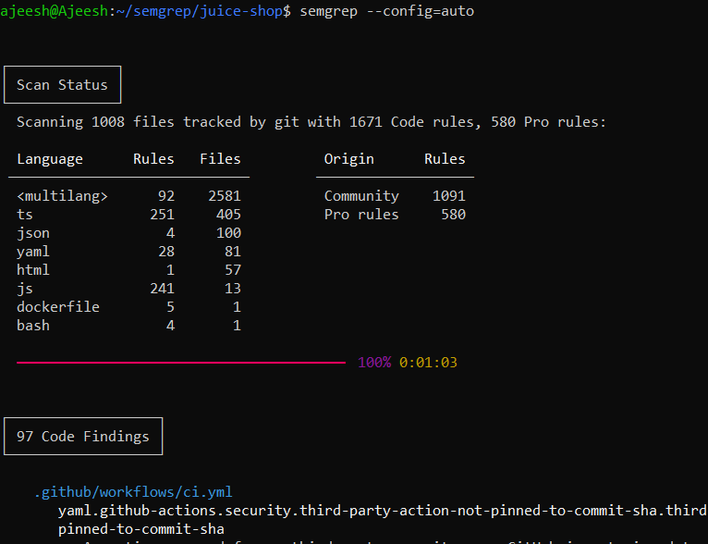
Example Output

Slide 15
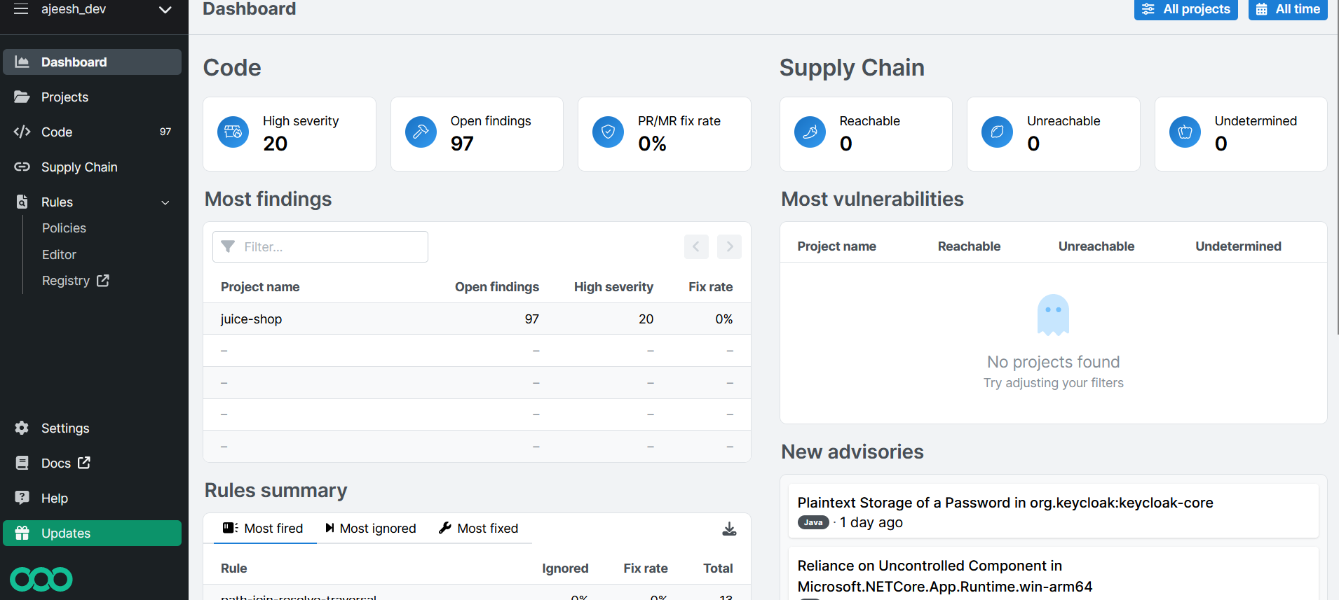
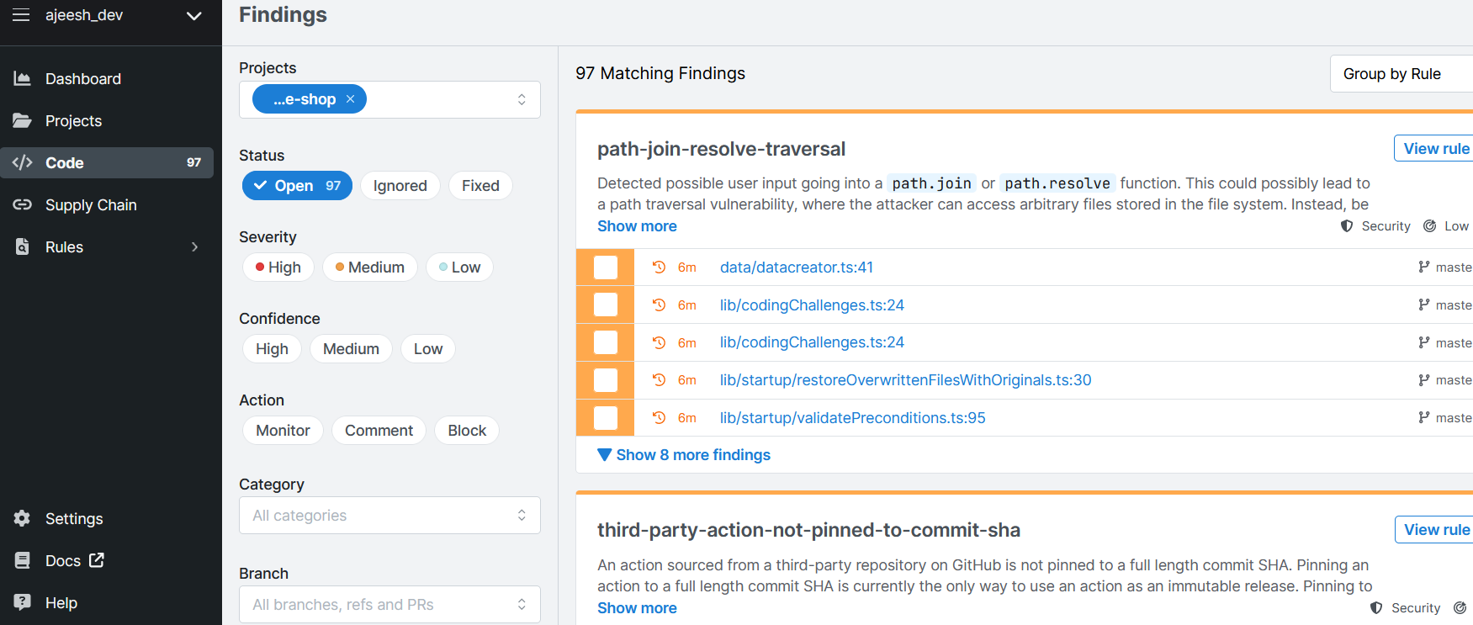

Slide 16
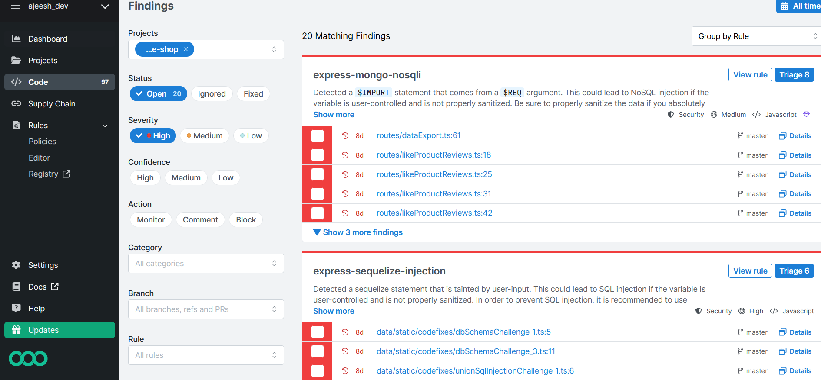

Slide 17
Benefits
Rules look like the code you already write; no abstract syntax trees, regex
Semgrep supports user-defined autofixes
Semgrep focuses on speed and ease-of-use

Slide 18
Limitations
Less number of language support
Less number of prebuilt rules
Semgre OSS engine vs Semgrep Cloud Platform

Slide 19
Q&A

