Slide 1

EVENT INTELLIGENCE
Analytics Platform
From raw event data → Python cleaning → SQL analysis → Power BI insights
AJEET KUMAR
Data Analyst / Data Science Aspirant

Slide 2
Project Objective
01
A real-world analytics workflow for event data
• Inspect and understand 10 interconnected event datasets.
• Identify missing values, duplicates, invalid values, outliers and relationship issues.
• Create clean, analysis-ready relational data using Python.
• Answer 50 business questions using MySQL and analytical SQL.
• Build interactive Power BI dashboards for customers, bookings, payments and events.
• Turn operational data into clear business metrics and visual insights.
RELATIONAL TABLES
10
Customers → Events → Tickets → Bookings → Payments → Attendance + master data
SQL BUSINESS QUESTIONS
50
From basic aggregation to ranking and running totals
ANALYTICS STACK
Python • MySQL • Power BI
Pandas, NumPy, Matplotlib, Seaborn, SQL and dashboarding
EVENT INTELLIGENCE PLATFORM • Ajeet Kumar 02

Slide 3
Data Model & Project Architecture
02
The project keeps the relational structure instead of flattening everything into one table
CUSTOMERS
BOOKINGS
TICKETS
EVENTS
EVENT CATEGORIES
VENUES
ORGANIZERS
PAYMENTS
ATTENDANCE
WEATHER
FACT-LIKE TABLES
Bookings • Payments • Tickets • Attendance
Transaction and activity records
MASTER / DIMENSIONS
Customers • Events • Venues • Organizers
Descriptive business entities
ANALYTICS FLOW
Python → MySQL → Power BI
Clean → query → visualize
EVENT INTELLIGENCE PLATFORM • Ajeet Kumar 03

Slide 4
Data Quality & Cleaning Scope
03
The raw data was intentionally treated like imperfect real-world data
Missing values
Handled using suitable numeric/text strategies
Duplicates
Removed duplicate rows and duplicate business keys where appropriate
Invalid numeric values
Checked ages, prices, discounts and measurements
Categorical consistency
Standardized capitalization, spacing and category labels
Dates & chronology
Standardized dates and checked logical time sequences
PK / FK integrity
Validated keys and handled orphan foreign-key records
Business rules
Validated status, payment/refund and domain constraints
EVENT INTELLIGENCE PLATFORM • Ajeet Kumar 04

Slide 5
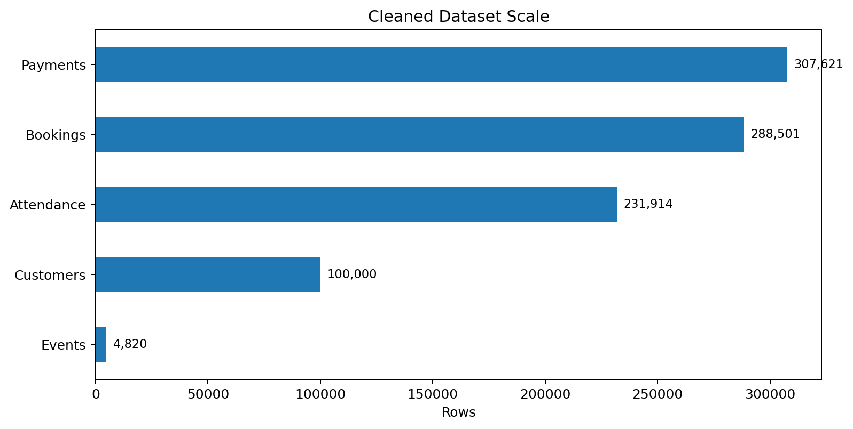
Python: Data Cleaning Workflow
04
Pandas + NumPy + Matplotlib + Seaborn
01
LOAD
10 raw CSV tables
02
AUDIT
shape • dtypes • nulls • duplicates
03
CLEAN
missing • invalid • duplicate • category fixes
04
VALIDATE
PK/FK • business rules • chronology
05
SAVE
10 cleaned CSV files
06
EDA
univariate • bivariate • correlation
PYTHON CLEANING EXAMPLE
# duplicate check
df.duplicated().sum()
# missing values
df.isna().sum()
# standardize text
df["city"] = (
df["city"].astype(str)
.str.strip()
.str.title()
)
# save cleaned table
df.to_csv(clean_path, index=False)
ACTUAL PROJECT DATA SCALE
EVENT INTELLIGENCE PLATFORM • Ajeet Kumar 05

Slide 6
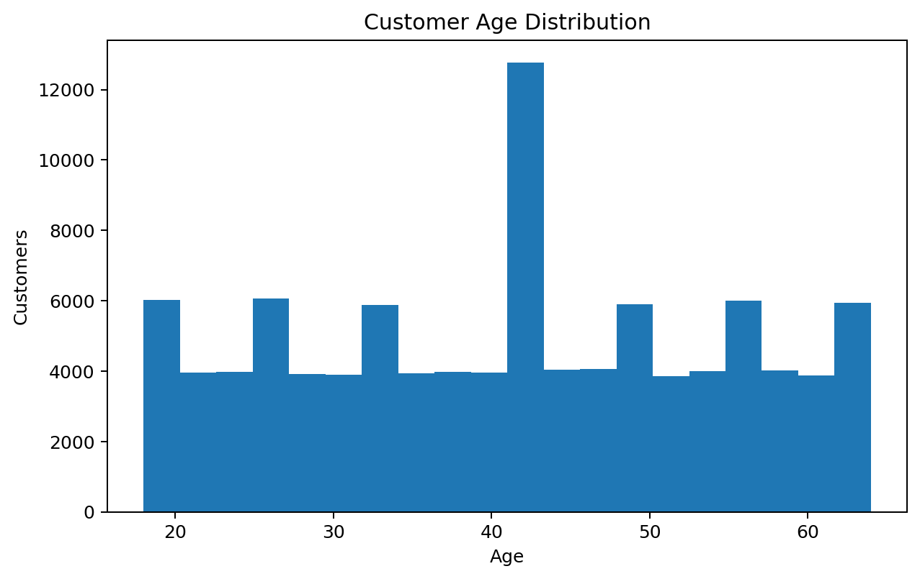
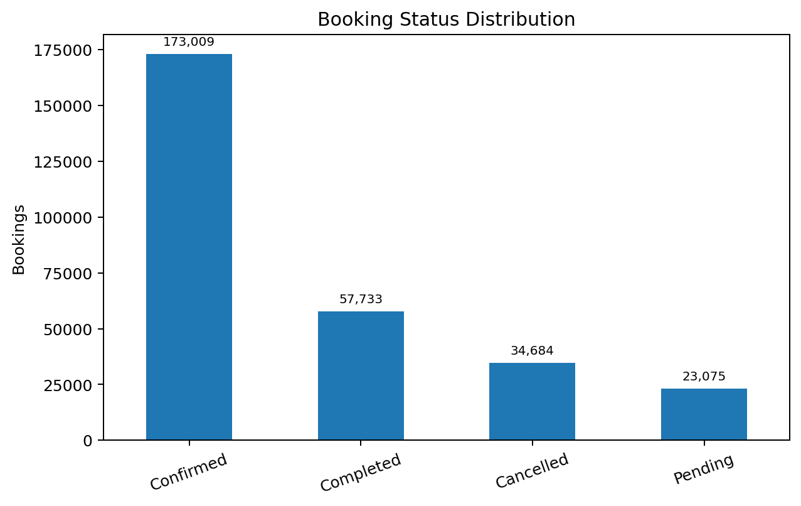
Python: Exploratory Data Analysis
05
EDA was used to understand distributions and operational patterns before dashboarding
CUSTOMER AGE
BOOKING STATUS
DATASET SCALE
• Distribution checks help identify unusual ranges and concentration.
• Categorical frequency analysis highlights booking and customer patterns.
• The cleaned relational data was then ready for SQL analysis and Power BI.
EVENT INTELLIGENCE PLATFORM • Ajeet Kumar 06

Slide 7
SQL Analysis: 50 Business Questions
06
MySQL was used as the relational analysis layer
Customer Analysis
Q1–Q5
customers • city • gender • age
Event Analysis
Q6–Q10
events • categories • ticket price • organizers
Venue Analysis
Q11–Q13
venues • capacity • cities
Booking Analysis
Q14–Q18
bookings • status • channel • monthly trend
Ticket Analysis
Q19–Q23
ticket type • seat category • discount
Revenue & Payments
Q24–Q28
revenue • payment status • methods • top events
Category Performance
Q29–Q30
category revenue • revenue share
Customer Behaviour
Q31–Q34
repeat customers • segments • age groups
Attendance
Q35–Q37
status • attendance • attendance rate
Advanced / Organizer
Q38–Q50
ranking • CTE • running total • conversion
EVENT INTELLIGENCE PLATFORM • Ajeet Kumar 07

Slide 8
SQL: Core Commands & Analytical Patterns
07
Examples taken from the Event Intelligence SQL workflow
AGGREGATION + GROUP BY
-- monthly booking trend
SELECT
DATE_FORMAT(booking_date,'%Y-%m') AS month,
COUNT(*) AS total_bookings
FROM bookings
GROUP BY month
ORDER BY month;
CTE + DENSE_RANK()
-- top 3 events in each category
WITH ranked_events AS (
SELECT event_id, category_id,
revenue,
DENSE_RANK() OVER(
PARTITION BY category_id
ORDER BY revenue DESC
) AS rn
FROM event_revenue
)
SELECT *
FROM ranked_events
WHERE rn <= 3;
WINDOW FUNCTION
-- monthly revenue + running total
SELECT
month,
revenue,
SUM(revenue) OVER(
ORDER BY month
) AS running_revenue
FROM monthly_revenue;
HAVING + BUSINESS RULE
-- customer booking count
SELECT customer_id,
COUNT(booking_id) AS bookings
FROM bookings
GROUP BY customer_id
HAVING COUNT(booking_id) > 1
ORDER BY bookings DESC;
EVENT INTELLIGENCE PLATFORM • Ajeet Kumar 08

Slide 9
MySQL: Relational Data Layer
08
Primary keys and foreign keys preserve the business relationships
SCHEMA EXAMPLE
CREATE DATABASE IF NOT EXISTS event_intelligence;
USE event_intelligence;
CREATE TABLE events (
event_id INT NOT NULL,
category_id INT,
venue_id INT,
organizer_id INT,
event_date DATE,
base_ticket_price DECIMAL(12,2),
event_status VARCHAR(100),
PRIMARY KEY (event_id),
FOREIGN KEY (category_id)
REFERENCES event_categories(category_id),
FOREIGN KEY (venue_id)
REFERENCES venues(venue_id),
FOREIGN KEY (organizer_id)
REFERENCES organizers(organizer_id)
);
RELATIONSHIP
Customers → Bookings
Customer behaviour and booking analysis
RELATIONSHIP
Bookings → Payments
Revenue and payment analysis
RELATIONSHIP
Tickets → Events
Ticket pricing and event performance
RELATIONSHIP
Events → Venue / Organizer / Category
Operational and event analysis
EVENT INTELLIGENCE PLATFORM • Ajeet Kumar 09

Slide 10
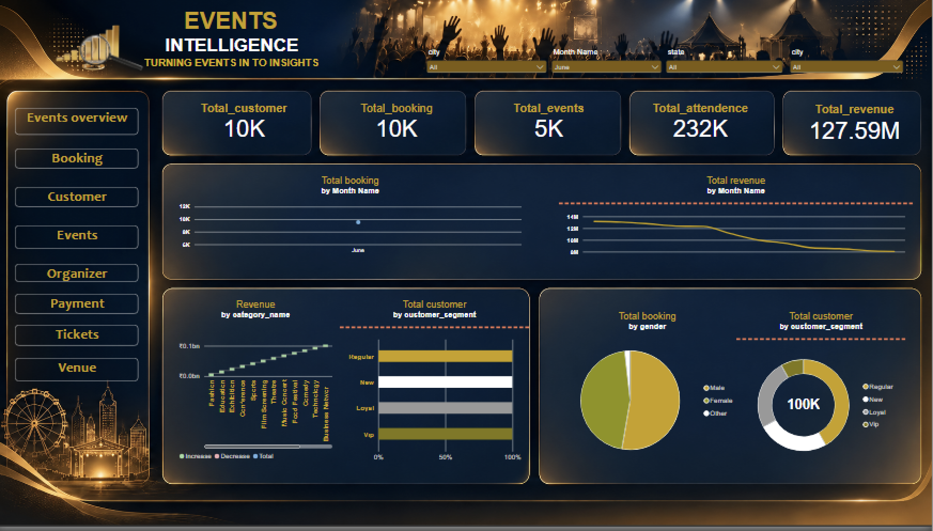
Power BI: Executive Overview
09
Interactive dashboard built from the relational analytics layer
EVENT INTELLIGENCE PLATFORM • Ajeet Kumar 10

Slide 11
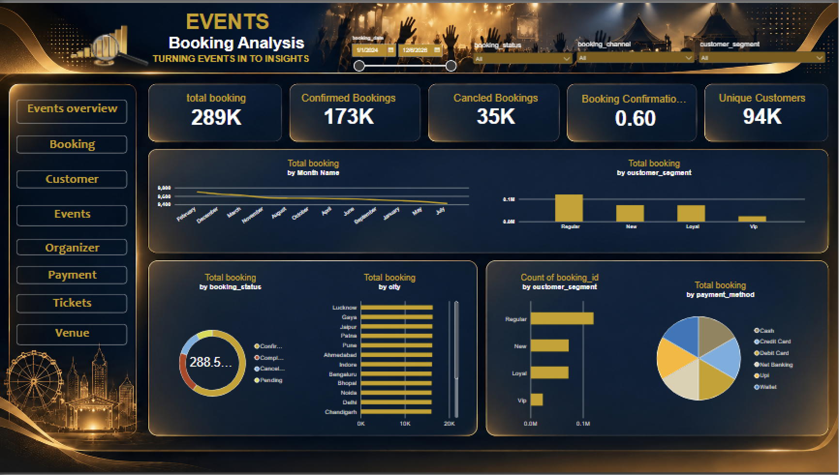
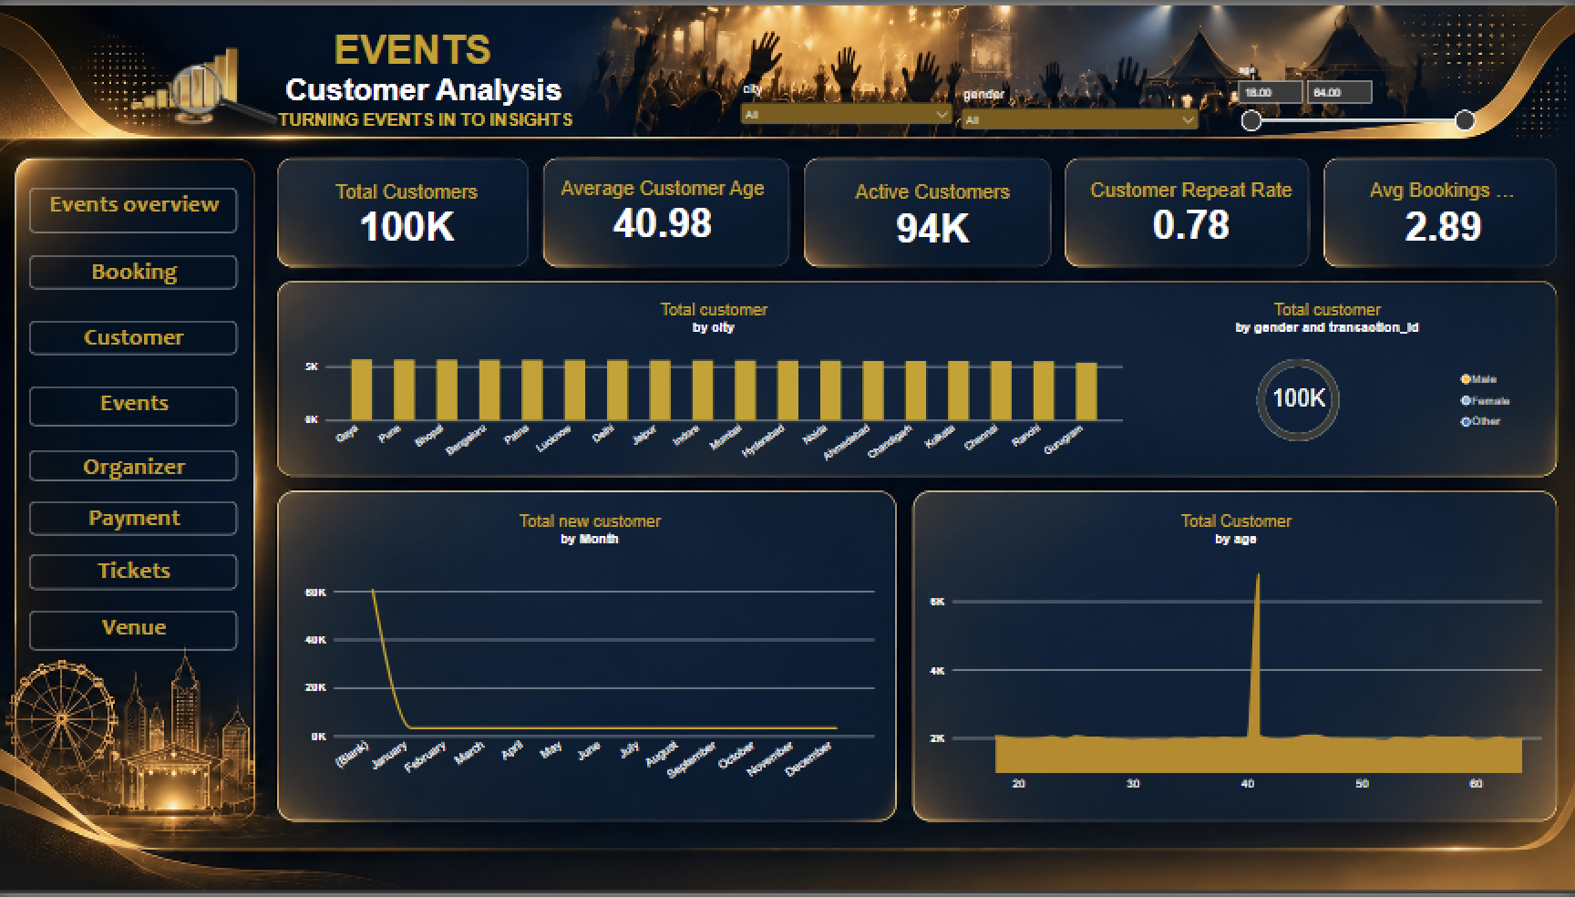
Power BI: Booking & Customer Analytics
10
KPIs, trends, segments, cities and booking behaviour
EVENT INTELLIGENCE PLATFORM • Ajeet Kumar 11

Slide 12
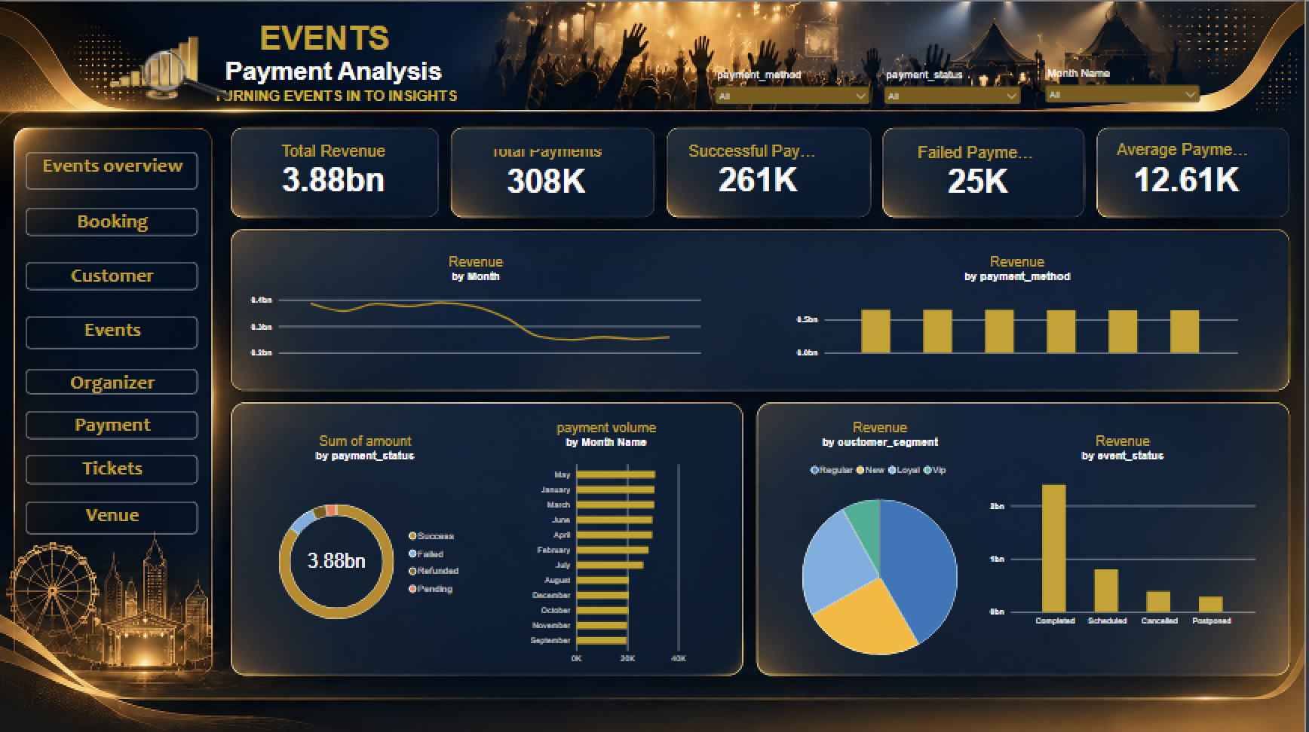
Power BI: Payment Analytics
11
Revenue, payment status, methods, monthly volume and customer segments
EVENT INTELLIGENCE PLATFORM • Ajeet Kumar 12

Slide 13
Dashboard KPI Snapshot
12
Representative values visible in the completed Power BI pages
Customers
100K
Power BI dashboard snapshot
Bookings
289K
Power BI dashboard snapshot
Events
5K
Power BI dashboard snapshot
Attendance
232K
Power BI dashboard snapshot
Overview Revenue
127.59M
Power BI dashboard snapshot
Payment Transactions
308K
Power BI dashboard snapshot
Successful Payments
261K
Power BI dashboard snapshot
Failed Payments
25K
Power BI dashboard snapshot
Unique Customers
94K
Power BI dashboard snapshot
Confirmation Rate
0.60
Power BI dashboard snapshot
• Note: payment transaction value and overview revenue are separate dashboard measures with different definitions.
EVENT INTELLIGENCE PLATFORM • Ajeet Kumar 13

Slide 14
What the Project Delivers
13
A complete analytics pipeline rather than a single dashboard
DATA QUALITY
Raw event data is audited and converted into analysis-ready tables.
RELATIONAL ANALYSIS
MySQL preserves table relationships and supports business questions.
ANALYTICAL SQL
Aggregation, joins, CTEs, subqueries and window functions are demonstrated.
BUSINESS VIEW
Customer, booking, event, payment and attendance metrics are presented together.
INTERACTIVE REPORTING
Power BI provides slicers, KPIs, trends and cross-page navigation.
PORTFOLIO READY
The workflow can be documented in GitHub with notebook, SQL, report and screenshots.
EVENT INTELLIGENCE PLATFORM • Ajeet Kumar 14

Slide 15
Technology Stack & GitHub Structure
14
Everything is organized as an end-to-end portfolio project
PYTHON
Pandas • NumPy
Cleaning + EDA
VISUALIZATION
Matplotlib • Seaborn
Charts + exploration
DATABASE
MySQL
Relational analysis
BI
Power BI
Interactive reporting
GITHUB STRUCTURE
Event_Intelligence/
├── README.md
├── notebooks/
│ └── 01_Event_Intelligence_Data_Cleaning.ipynb
├── sql/
│ └── event_intelligence.sql
├── powerbi/
│ └── Event_Intelligence_Report/
├── images/
│ └── dashboard screenshots
├── data/
│ └── documentation
└── requirements.txt
• Professional README
• Python cleaning / EDA notebook
• SQL schema + 50 business questions
• Power BI report package
• Dashboard screenshots
• Setup and documentation
EVENT INTELLIGENCE PLATFORM • Ajeet Kumar 15

Slide 16
THANK YOU
Event Intelligence Platform
Ajeet Kumar • Data Analyst / Data Science Aspirant
PYTHON
Cleaning + EDA
MYSQL
50 Questions
POWER BI
Interactive Dashboard
EVENT INTELLIGENCE PLATFORM • Ajeet Kumar 16

