Slide 1

Machine Learning Hackathon CG 2022
Team Name- Manihor
Team Leader Name- Ajeet Singh
Team Leader Email Address- mailtoajeet@gmail.com

Slide 2
Problem Description: Phishing Detection
To detect whether a website is a phishing website based on its 30 features
Each of the website has an associated unique numeric key.
Each of the 30 features of website has values -1, 0, 1 where
1 represents the legitimate
0 represents suspicious
-1 represents phishing
We have given 8955 training records to train and validate the model.
The field Result is the response of the model with values 1 representing a legitimate website and -1 representing phishing website.

Slide 3
Solution proposed and description:
The proposed model is Random Forest Classifier with below hyperparameters.
n_estimators = 250 (The number of trees in the forest)
max_depth = 16 (maximum depth of the tree)
All other hyperparameters of the model were used as default.
The training data were splitted into train and test data in ratio of 80:20 respectively.
The model was trained on the train data and validated against the test data.
Cross validation with 10 splits were performed during training for estimate of out-of-sample accuracy.
The most important 25 variables were selected which were contributing almost 99% in the predictive ability of the model.
The achieved accuracy with all features used was 0.960469 and with 25 most important features was 0.973199.

Slide 4
Technology/Tool Stack Used:
Python - Sci-Kit Learn, Keras/Tensorflow, Numpy, Pandas, Seaborn, Matplotlib
Jupyter Notes

Slide 5
Approach:
The response variable “Result” is a categorical variable with two values -1 and 1. Thus, it is a Classification Problem.
The popular models for classification problems are - Logistic Regression, SVM, Decision Trees, Random Forest.
The number of records in dataset is around 9000. The data does not looks large enough to train a dense NN model. On training and validation of Sequential Dense Classification Neural Network, the achieved accuracy was 0.54 which is not good enough.
The correlation data between features and Result shows that there are many features which have almost no correlation with the response value. We can apply Feature extraction methods like PCA, Factor Analysis to select significant variables contributing in the estimation of response variable.
The method SVD was not used as data was not sparse. LDA was not the preferred choice as this is not a multiclass classification problem.

Slide 6
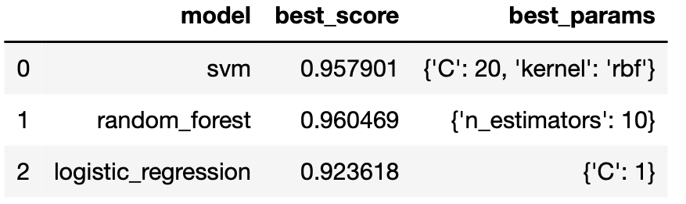
Approach:
Used Grid Search to select the best model with their hyperparameters from Logistic Regression, SVM, Random Forest.
Used cross validation method with 5 splits to calculate the accuracy of each model.
The best model is Random forest with hyperparameter n_estimators (number of trees) = 10 and have accuracy score of 0.960469.
Running Gradient Boosting Algorithm (GradientBoostingClassifier) does not improved the accuracy. Achieved accuracy score was 0.941038

Slide 7
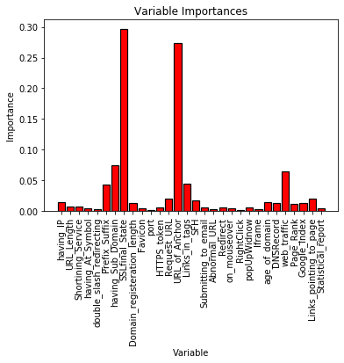
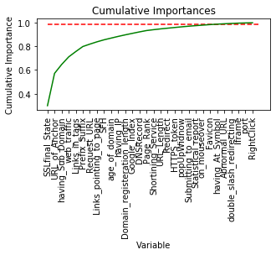
Approach:
So, we decided to use Random Forest Classifier.
Next step is to select the important features which are significantly contributing in the Random Forest Classifier model.
Using PCA (Accuracy: 0.959 with 26 features) and Factor Analysis method (Accuracy: 0.966 with 23 features) but does not looks to improve the accuracy of the model.
We selected 25 important variables (ignoring remaining 5) which were contributing almost 99% in the predictive model.

Slide 8
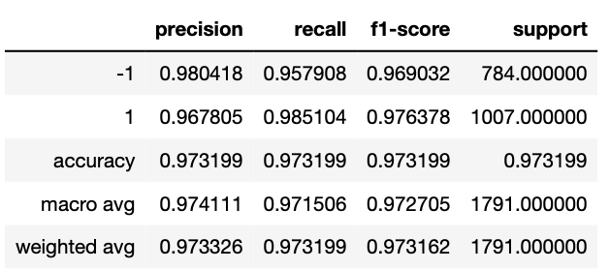
Approach:
Running on 25 important features improved the accuracy of Random Forest Classifier model from 0.960469 to 0.969291
We will use Grid Search to tune other hyperparameters like “max_depth” to improve the model. We have excluded below hyperparameters as they took long time to run and have not improved the accuracy score. These hyperparameters were set to default.
"min_samples_split"
"min_samples_leaf"
"max_features"
The best hyperparameters was 'max_depth': 16, 'n_estimators': 250 with accuracy score of 0.971524.
Final Model - Random Forest Classifier with n_estimators = 250 and max_depth = 16.

Slide 9
Execution Demo(Video/Screenshots) of the solution:
Not able to upload the Video on Submission Window. So, I am sharing the google drive link to share the demo video.
https://drive.google.com/file/d/13WlcdxqJRP3ldhE6wwb7_hqeH1ujVj2O/view?usp=sharing

Slide 10
Source code as ZIP or Github URL:

Slide 11
THANK YOU

