Slide 1
Agenda for Discussion
Understanding of syllabus for Python
Understand Learners Background
Introduction to Python Language
Python installation and setup development environment for python
Python History
Important of programming Basics of Python
Python Keywords and Indentation
Comments
Python Basic Data Types
Python Variables

Slide 2
History of Python
1980s: Guido van Rossum, a Dutch programmer, worked on ABC language at CWI (Centrum Wiskunde & Informatica).
February 1991: Python 0.9.0 was released, featuring functions, exception handling, and core data types (lists, dicts, strings).
1994: Python 1.0 was officially released with modules, classes, and built-in exception handling.
2000: Python 2.0 introduced list comprehensions and garbage collection using reference counting.
2008: Python 3.0 was released, breaking backward compatibility but improving Unicode support and syntax.
2010: Python 2 was officially deprecated, encouraging migration to Python 3.
2020: Python 2.x support ended on January 1, marking full adoption of Python 3.
Present (2024-2025): Python dominates AI, ML, data science, web development, and automation

Slide 3
Understanding of Python Interpreter
Online Python Interpreter – Google Colab Python3 Interpreter
Offline Python Interpreter – VS code,Pycharm,Spider,Miniconda

Slide 4
Introduction to Python Environment using Google Colab Environment
Google colab notebook -https://colab.research.google.com/notebooks/intro.ipynb

Slide 5
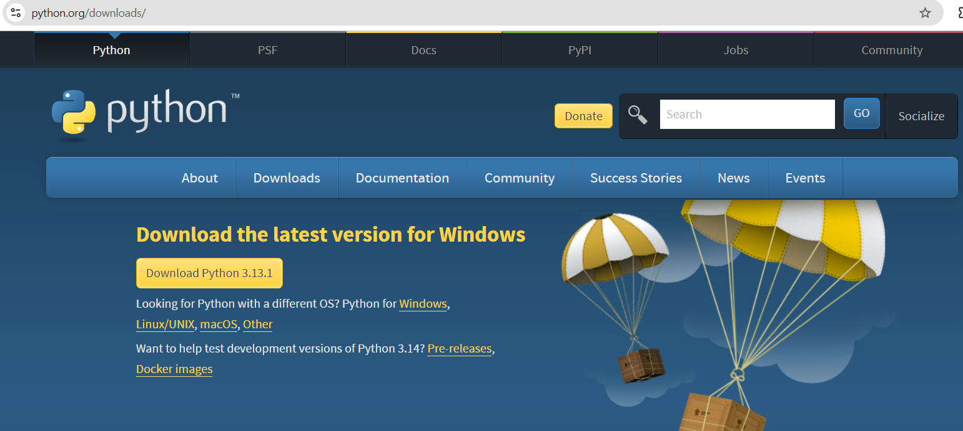
How to install Python
Link: https://www.python.org/

Slide 6
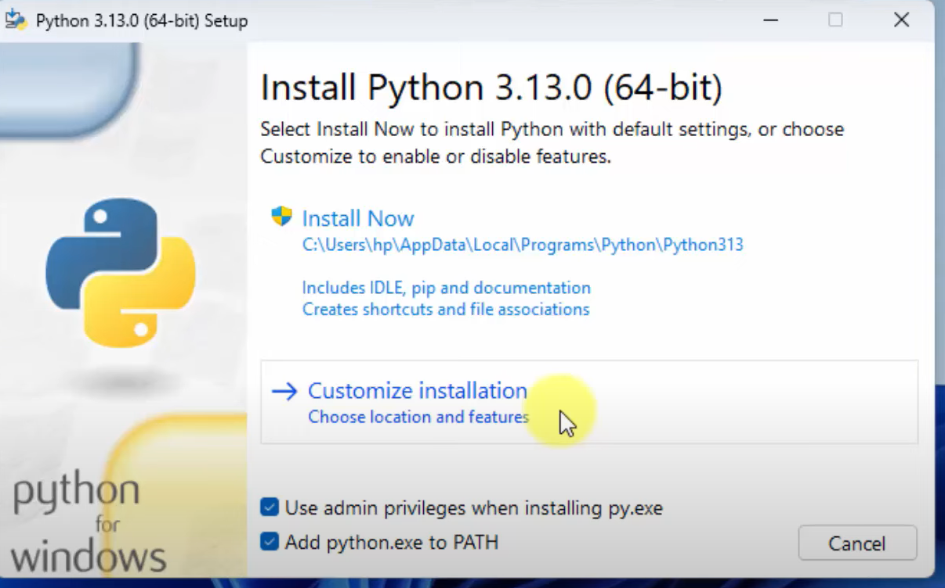
How to install Python

Slide 7
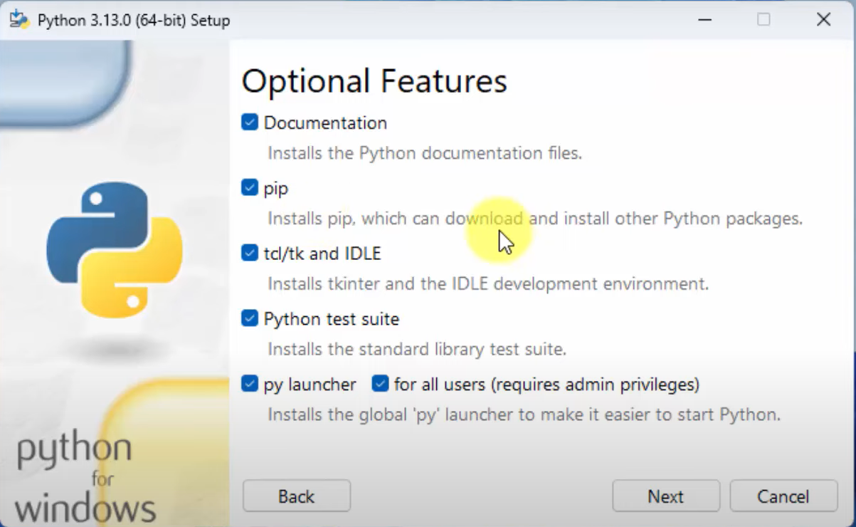
How to install Python

Slide 8
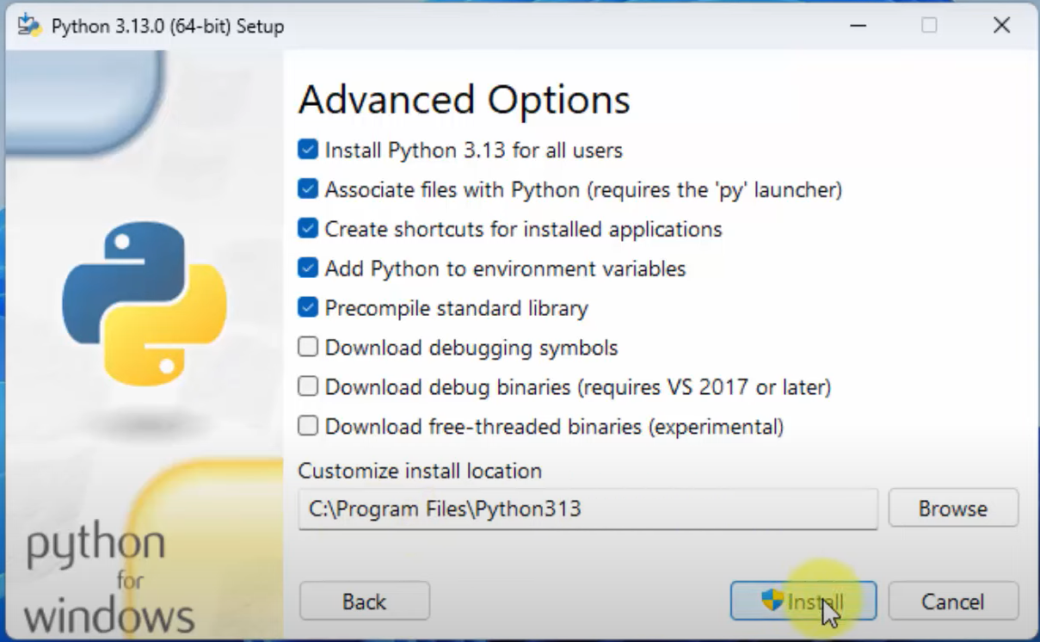
How to install Python

Slide 9
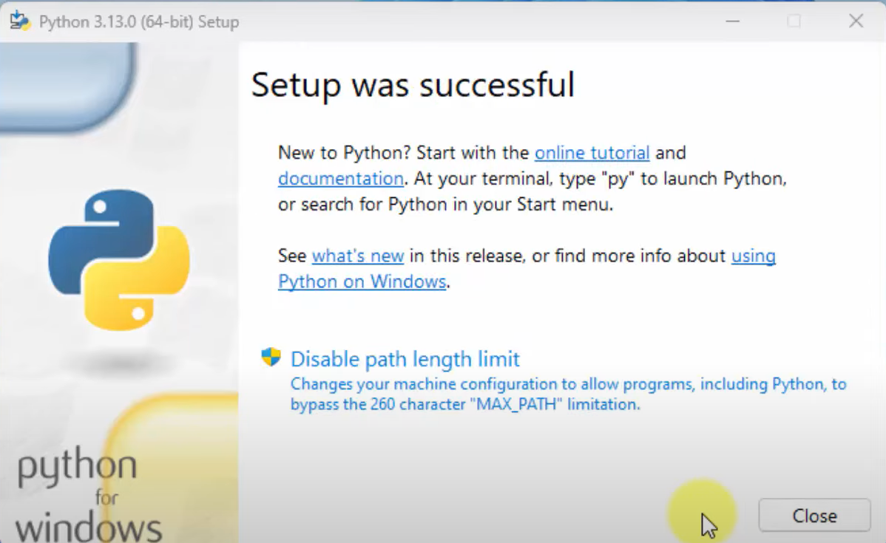
How to install Python

Slide 10
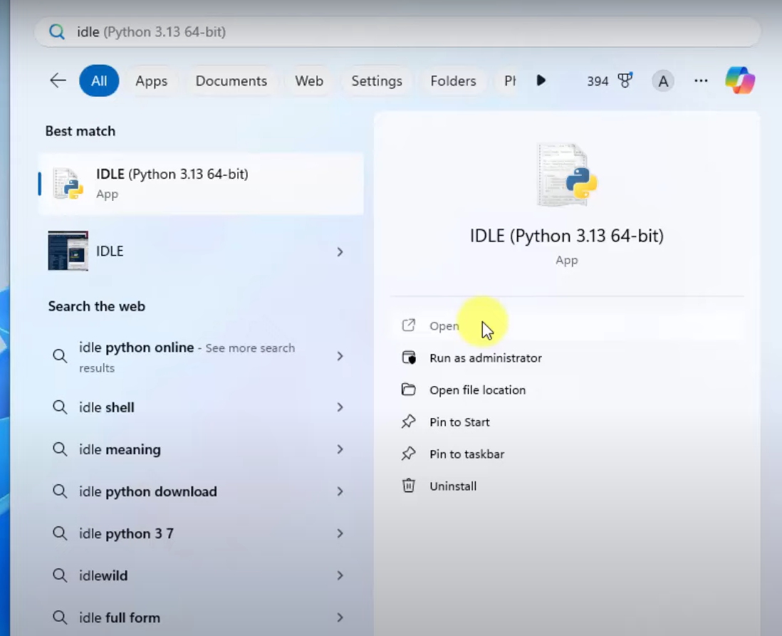
How to install Python

Slide 11
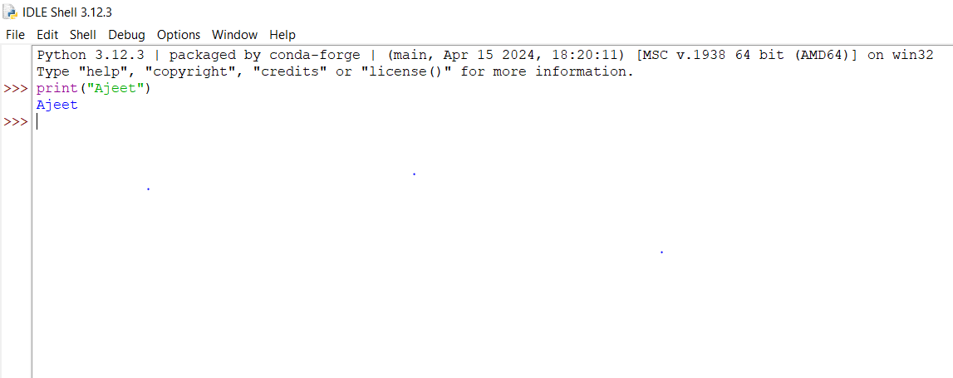

Slide 12
Features of python languages
Easy to learn, read and understand and it's syntax is similar to English like language
Extensive Libraries support provides (os,math,Pandas,numpy, sci-kit learn, tensorflow,keras)
Portable languages -Platform-Independent: Works on multiple OS (Windows, Linux, macOS).
Interpreted Language: Executes code line-by-line.
Dynamically Typed: No need to declare variable types explicitly.
Object-Oriented: Supports classes, objects, and inheritance.
Open Source: Free to use and modify.
High level language

Slide 13
Variables in pythons
While defining names as variables in python there are several rule to define it
1.Varible name must starts with alphabets(A-Z, a-z)
2.Variable name contain alphanumeric char(A-Z,a-z,0-9)
3.Varible name cannot starts with numbers and cannot use space in variables
4.Variables name are case sensitive
5.Varibales names cannot contains special characters except underscore(_)(@#$%&...)
6.Variable names cannot use the reserved keywords(True, False, import, if, else)
7.Do not use the built in functions name as variables names (print, help, sum, min,max.....)

Slide 14
Data Types
Numeric : int, float, complex
Text : str
Sequence : list , tuple, range
Set: set, frozen set
Mapping : dict(dictionary)[ key and pair values]
Boolean : bool (True & False)
Binary : bytes

Slide 15
Integer data type
Whole Numbers
+ve or -ve
Without decimal numbers
For examples: (5, -3)

Slide 16
Float Data Type
+ve or –ve
with decimal numbers
For example: (3.14, -0.01)

Slide 17
Complex Data Type
Contains Real and Imaginary Part
var(a) = real(3) + imaginary(4j)
For example: 2+3j

Slide 18
Python Casting
change data type of variables
specify variable type
1. int to float e.g. Float(5) --→ 5.0
2. float to int e.g. Int(3.9) --→ 3
3. int to complex e.g. Complex(4)--→4+0j
4.float to complex e.g. Complex(3.5)--→3.5+0j

Slide 19
Introduction to Strings
What is a String?
A sequence/collection of characters enclosed in quotes.
Types of Quotes:
Single quotes: 'Hello'
Double quotes: "Hello"
Triple quotes: '''Multi-line string''' or """Multi-line string”””
Note:
We can not use single quote inside single quote
We can not use double quote inside double quote
string is immutable data type immutable = we cannot perform any changes Once string is created we can not change it

Slide 20
Basic String Operations
Concatenation: Combine strings using +
greeting = "Hello"
name = "Alice"
Output: message = “Hello, Alice”
Repetition: Repeat strings using *.
line = "-"
output: line = “-----------------------”
Length: Use len() to find the number of characters.
text = "Python“
output: len(text) = 6

Slide 21
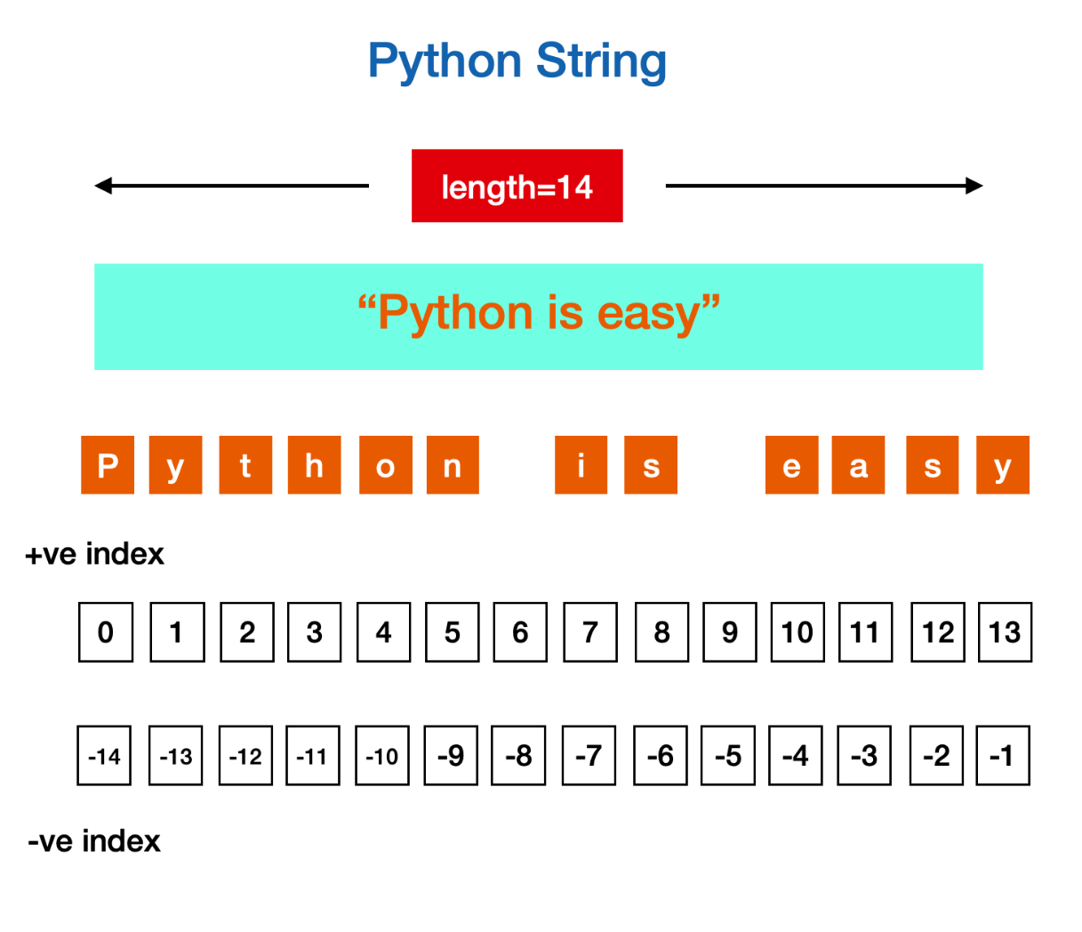
String Indexing

Slide 22
String Indexing and Slicing
Indexing: Access characters using their position (starts from 0).
text = "Python"
Access/Find first char? # Output: P
Access/find last char? # Output: n
Slicing: Extract substrings using [start: end].
text = "Python Programming"
print(text[0:6]) # Output: Python
print(text[7:]) # Output: Programming

Slide 23
Common String Methods
upper(): Converts to uppercase.
Input = "hello“
Output: “HELLO”
lower(): Converts to lowercase.
Input = "HELLO“”
Output: hello
strip(): Removes leading and trailing whitespace.
Input = " hello "
Output: hello
replace(): Replaces a substring.
Input "hello“ Output: “cello”

Slide 24
split(): Splits the string into a list of substrings.
Input:"abc“ Output: ['a', 'b', 'c']
join(): Joins a list of strings into one string.
Input ['a', 'b', 'c'])) Output: “abc”
find(): Finds the index of a substring.
input "hello“ Index of h?e?l?o? Output: 1,2,3,.etc.
startswith(): Checks if the string starts with a substring.
Input "hello“ startswith h? # Output: True
endswith(): Checks if the string ends with a substring.
Input "hello“ endswith o? # Output: True
Reversing a String: Use slicing to reverse a string.
text = "Python“ output: # Output: nohtyP

Slide 25
String Methods Python provides many built-in methods to manipulate strings. Here are some commonly used ones:
Method | Description | Example
upper() | Converts the string to uppercase | "hello".upper() → "HELLO"
lower() | Converts the string to lowercase | "HELLO".lower() → "hello"
strip() | Removes leading and trailing whitespace | " hello ".strip() → "hello"
replace() | Replaces a substring with another | "hello".replace("h", "j") → "jello"
split() | Splits the string into a list of substrings | "a,b,c".split(",") → ["a", "b", "c"]
join() | Joins a list of strings into one string | ",".join(["a", "b", "c"]) → "a,b,c"
find() | Finds the index of a substring | "hello".find("e") → 1
startswith() | Checks if the string starts with a substring | "hello".startswith("he") → True
endswith() | Checks if the string ends with a substring | "hello".endswith("lo") → True

Slide 26
Practice Exercises
Convert a string to uppercase and lowercase.
Remove leading and trailing spaces from a string.
Replace all occurrences of a substring in a string.
Split a string into a list of words.
Join a list of words into a single string.
Find the index of a substring in a string.
Check if a string starts or ends with a specific substring.
Reverse a string.
Count the number of vowels in a string.
Replace spaces with underscores.
Check if a string is a palindrome.

