Slide 1
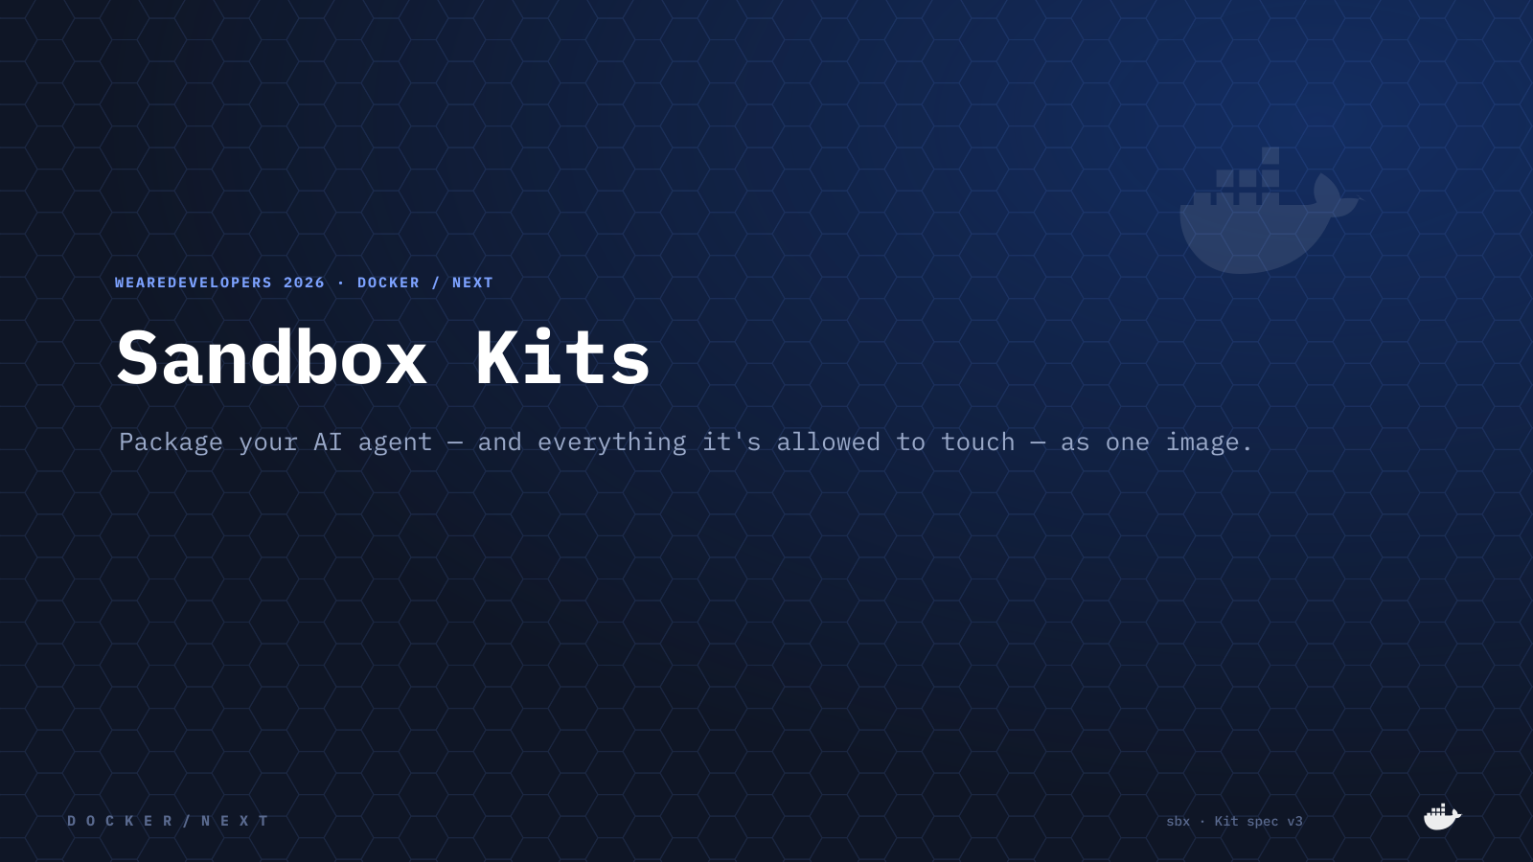
Notes:
Welcome. For the next 40 minutes: one simple idea. You can package an AI agent — and everything it's allowed to touch — as a single Docker image. That's a Sandbox Kit.

Slide 2
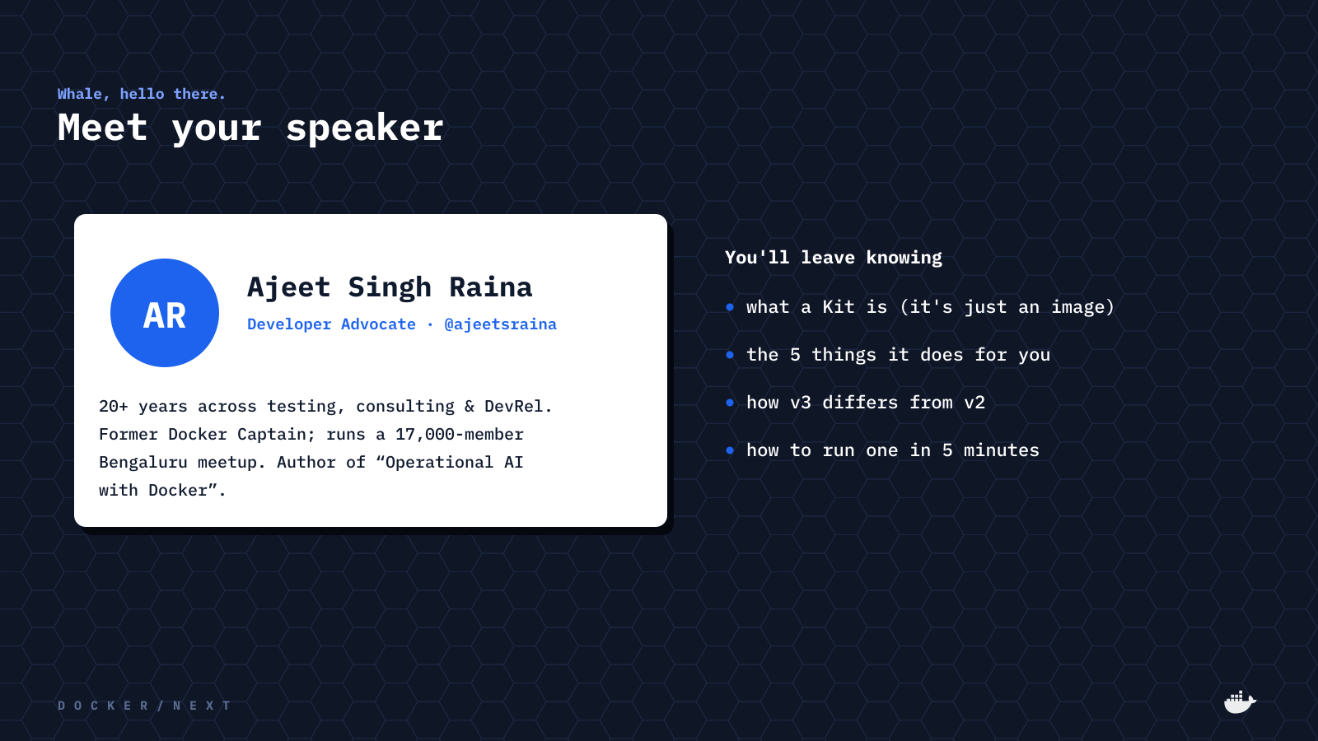
Notes:
Quick hello — I'm Ajeet, a Developer Advocate. By the end you'll know what a Kit is, the five things it does for you, how v3 differs from v2, and how to run one in five minutes.

Slide 3
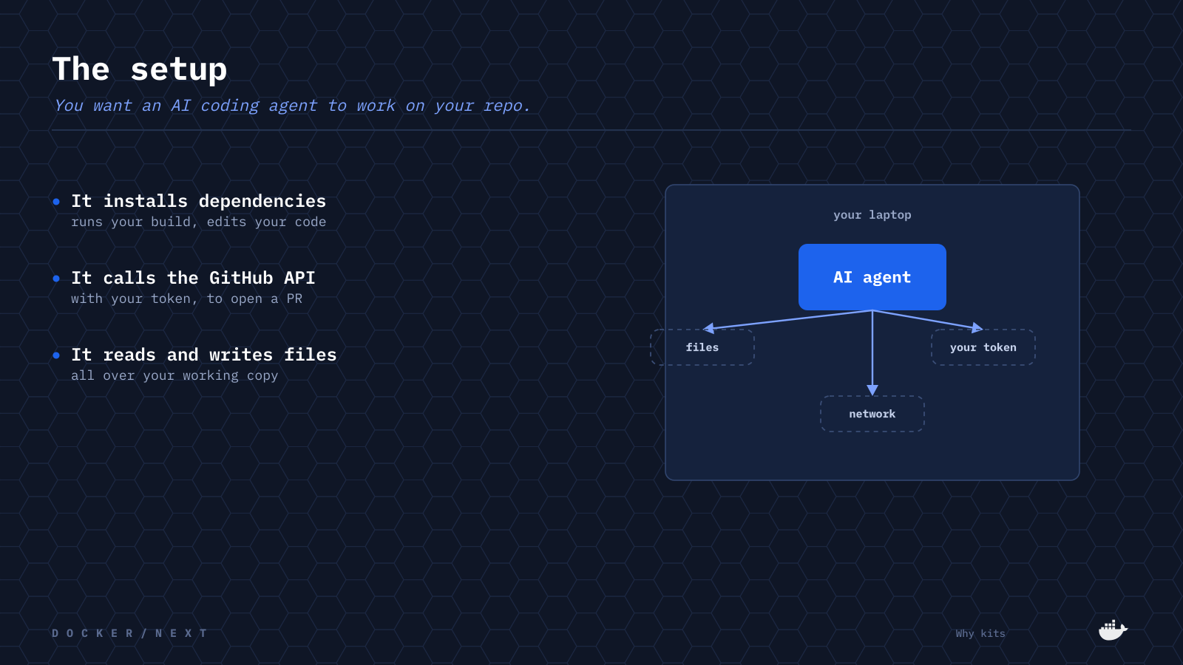
Notes:
Picture the thing we all want right now: an AI coding agent working on your repo. It installs dependencies and runs your build, it calls the GitHub API with your token to open a PR, and it reads and writes files all over your working copy. Useful — and that's the point.

Slide 4
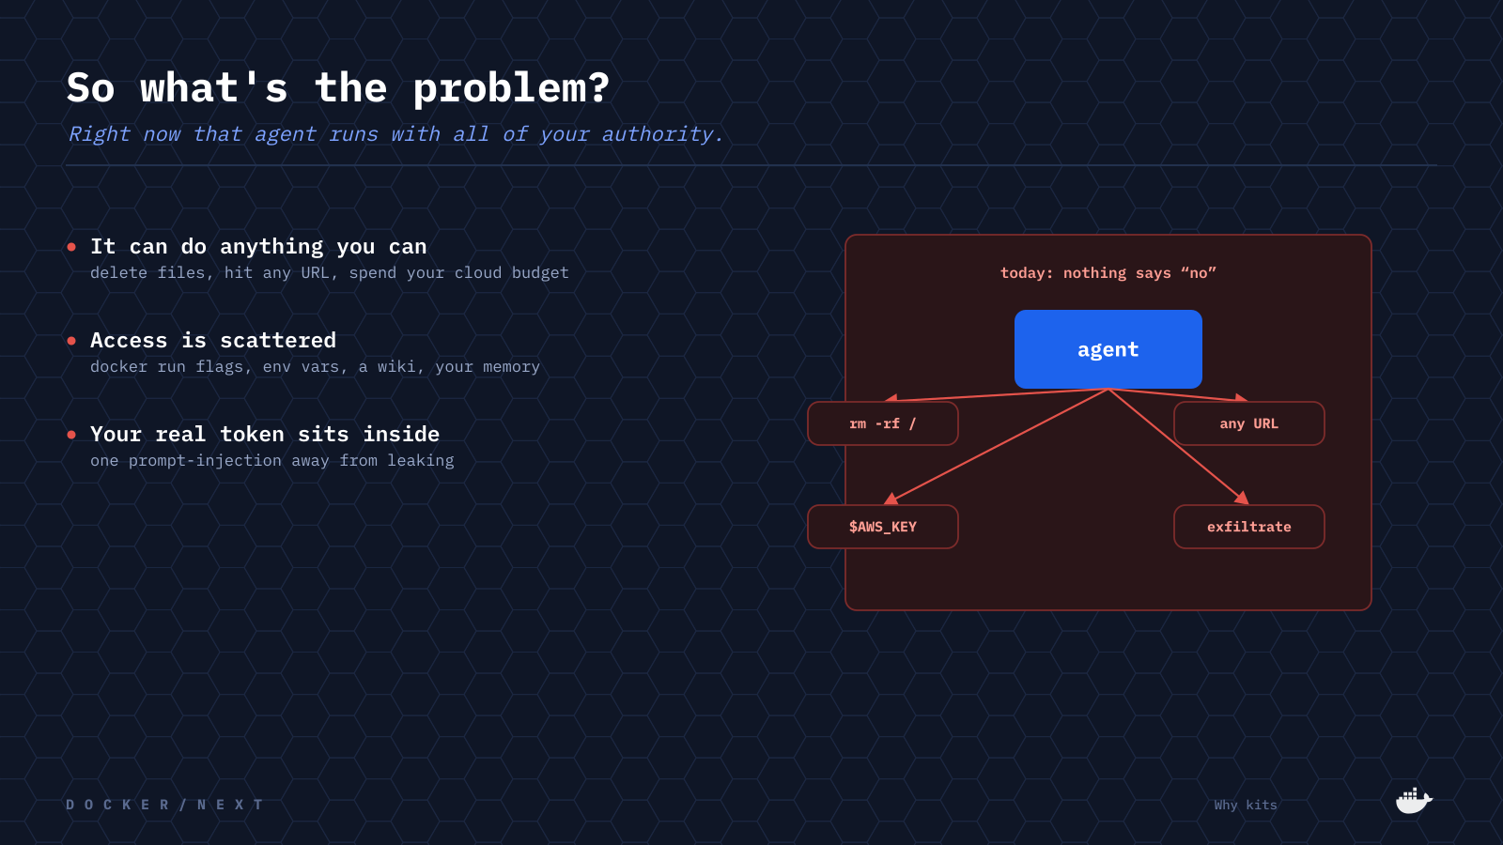
Notes:
Here's the catch. That agent runs with all of your authority — it can delete files, hit any URL, spend your cloud budget. The access it needs is scattered across docker run flags, env vars, a wiki, and your memory. And your real token is sitting right inside the container, one prompt-injection away from leaking. Nothing says what it should NOT do.

Slide 5
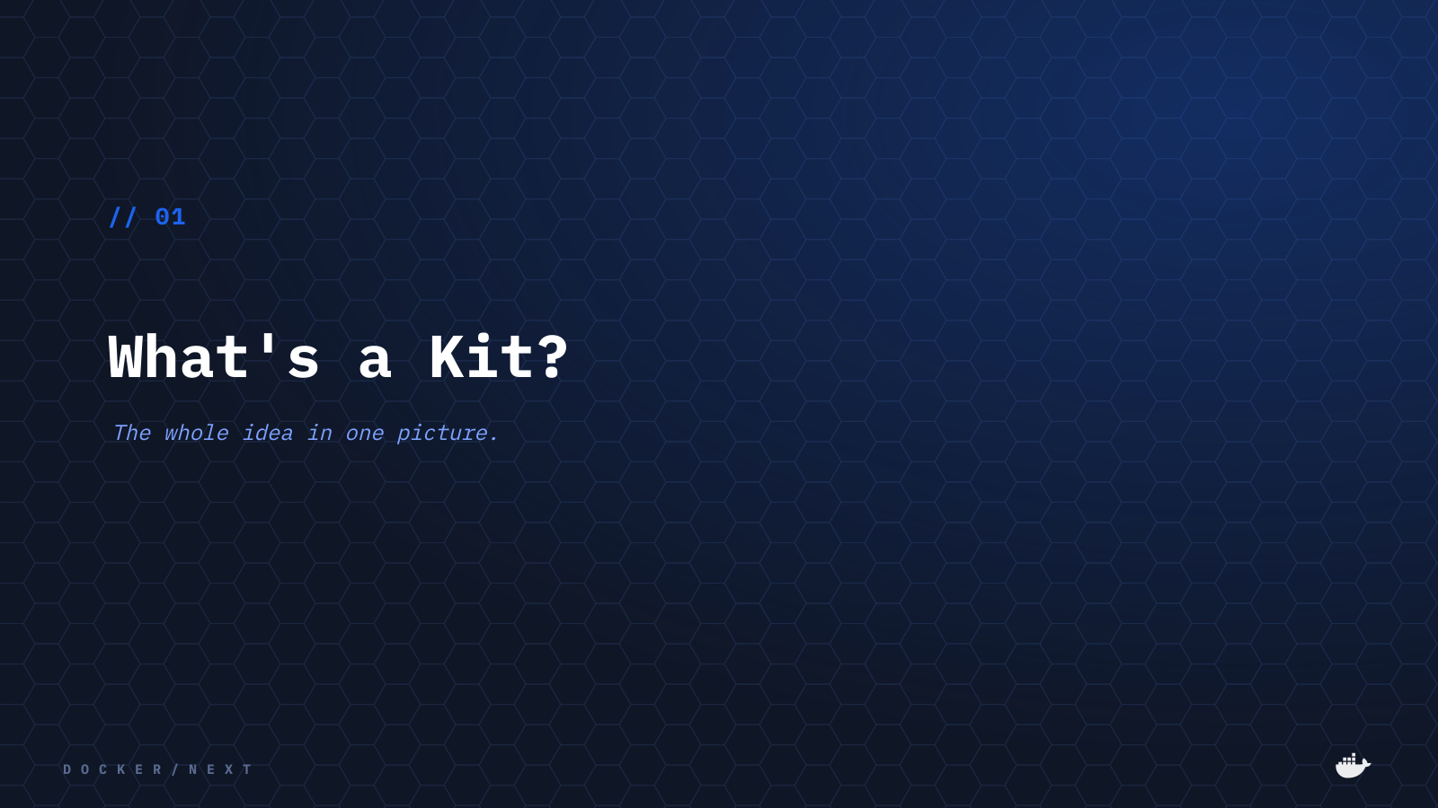
Notes:
So let's fix that. What's a Kit? The whole idea fits in one picture.

Slide 6
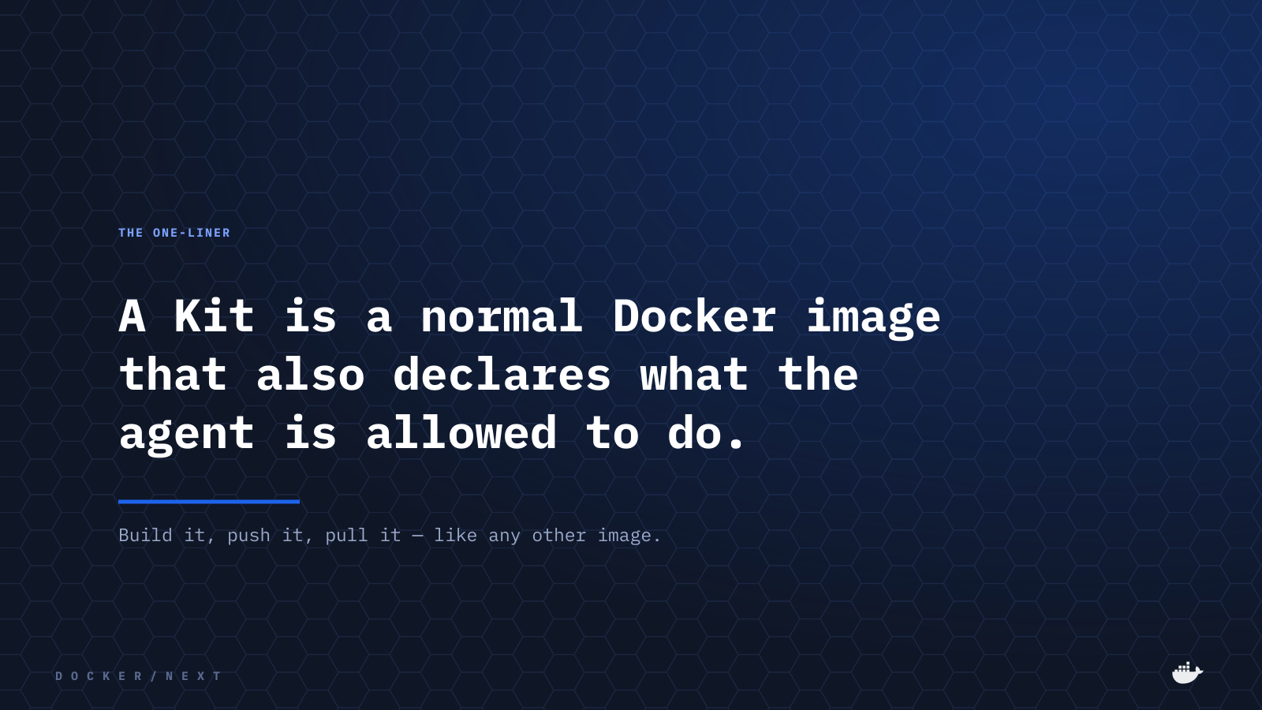
Notes:
This is the one-liner to remember. A Kit is a normal Docker image that also declares what the agent is allowed to do. You build it, push it, and pull it like any other image.

Slide 7
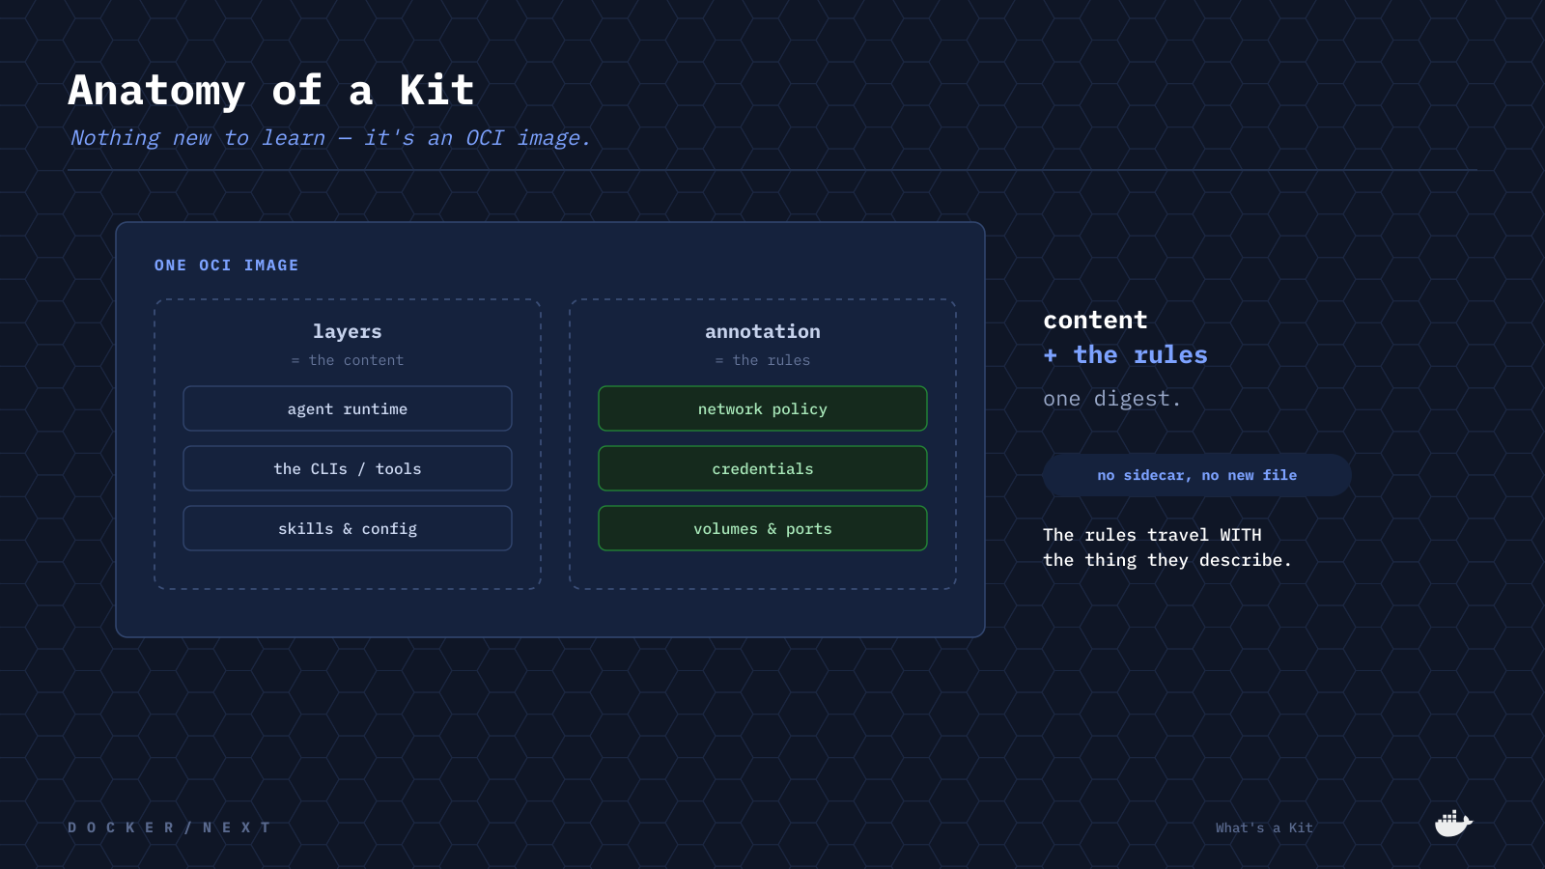
Notes:
There's nothing new to learn, because it's just an OCI image. The layers carry the content — the agent, the tools, the config. A manifest annotation carries the rules — network policy, credentials, volumes. Content plus rules, one digest, and the rules travel with the thing they describe. No sidecar, no second file.

Slide 8
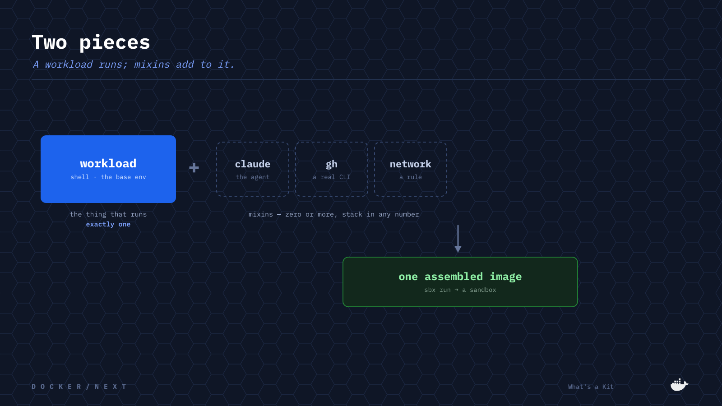
Notes:
A Kit comes in two flavours. A workload is the thing that runs — the base environment, like a shell — and you get exactly one. Mixins add to it: the Claude agent, a real CLI like gh, a network rule. Zero or more, stacked in any number. Together they assemble into one image that sbx runs as a sandbox.

Slide 9
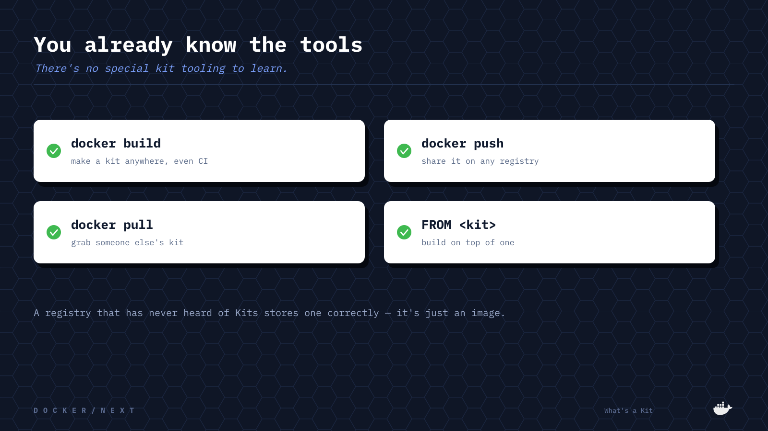
Notes:
And because it's just an image, you already know the tools. docker build makes a kit anywhere, even in CI. docker push shares it on any registry. docker pull grabs someone else's. You can even FROM one. A registry that's never heard of Kits stores it correctly.

Slide 10
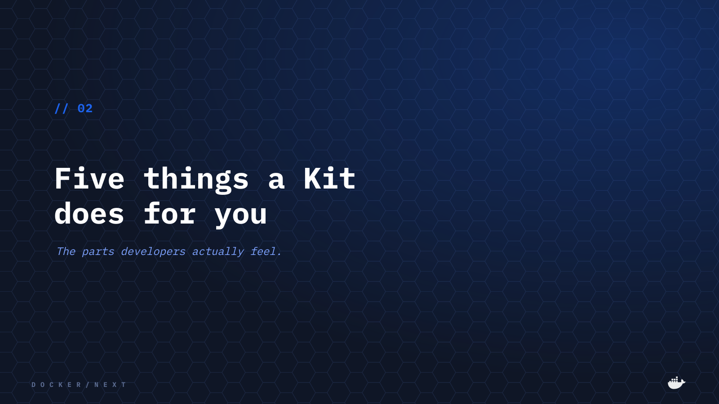
Notes:
Now the part developers actually feel — five concrete things a Kit does for you.

Slide 11
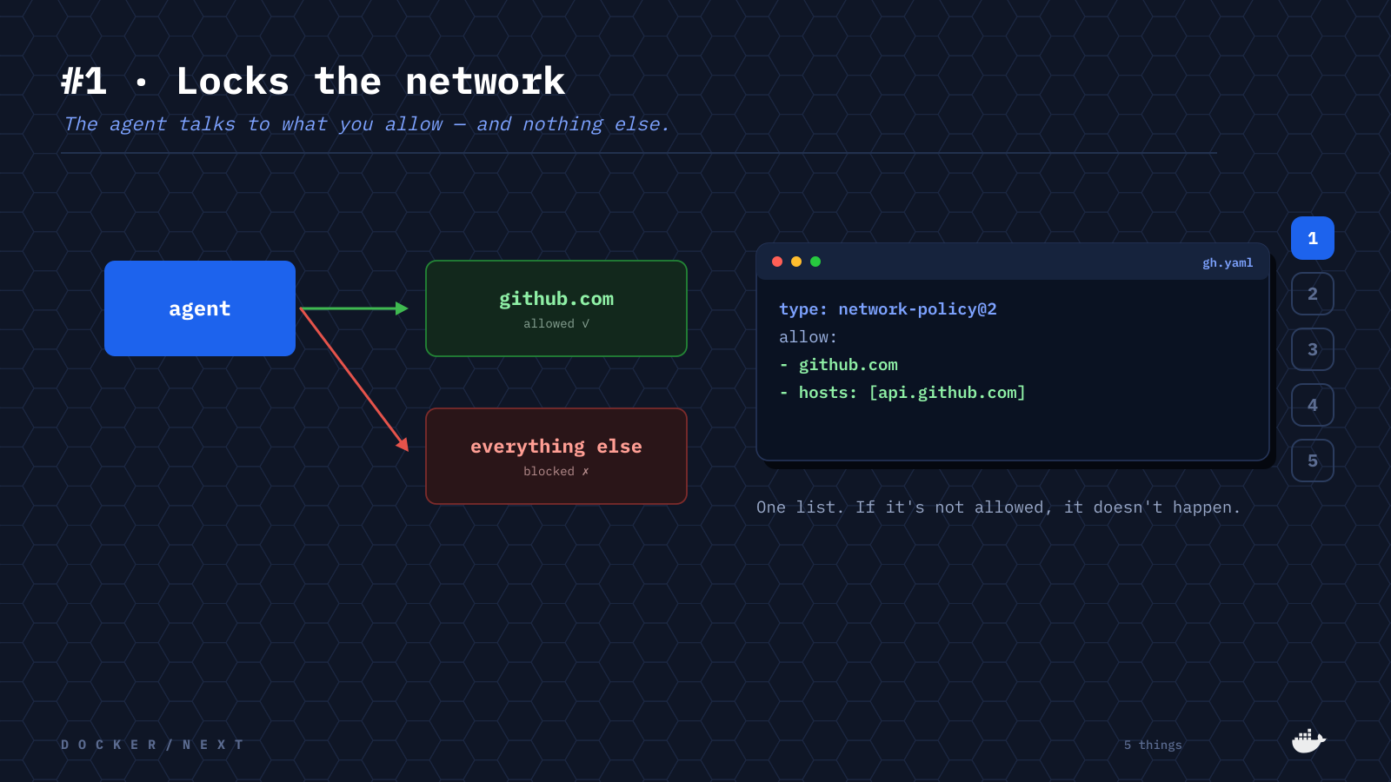
Notes:
Number one: it locks the network. The agent talks to what you allow — github.com — and everything else is simply blocked. It's one list in the descriptor. If it isn't allowed, it doesn't happen.

Slide 12
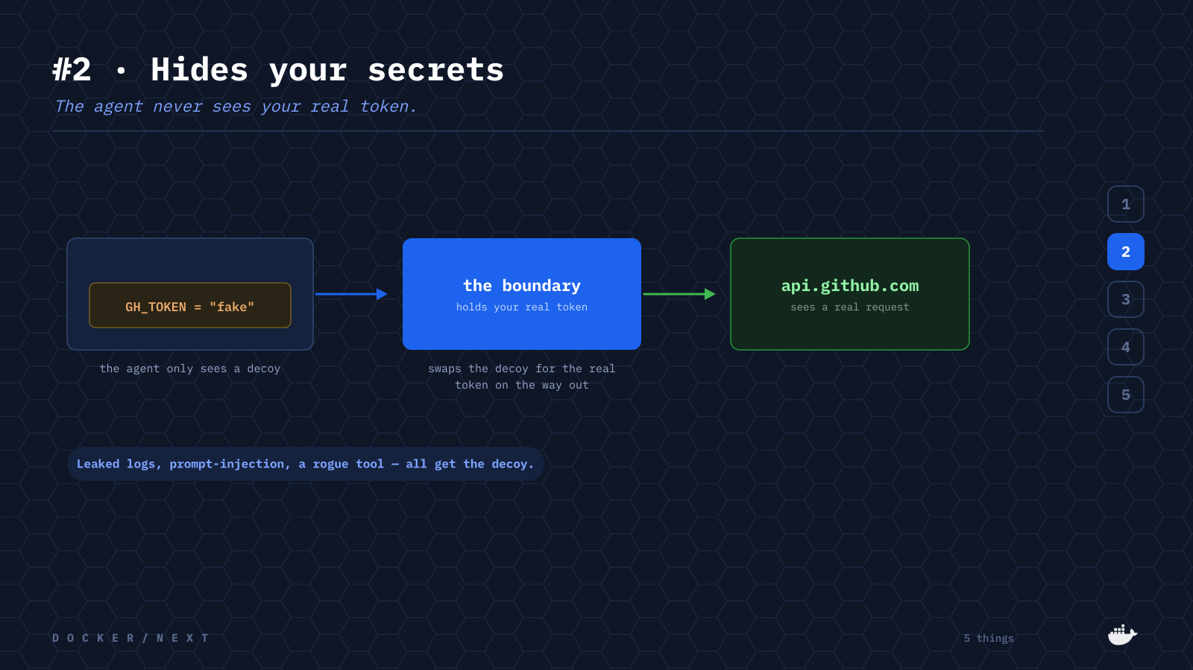
Notes:
Number two, and my favourite: it hides your secrets. Inside the sandbox the agent only ever sees a decoy token. The real token lives at the boundary, which swaps the decoy for the real value on the way out — so api.github.com sees a real request, but leaked logs, prompt-injection, or a rogue tool all get the fake.

Slide 13
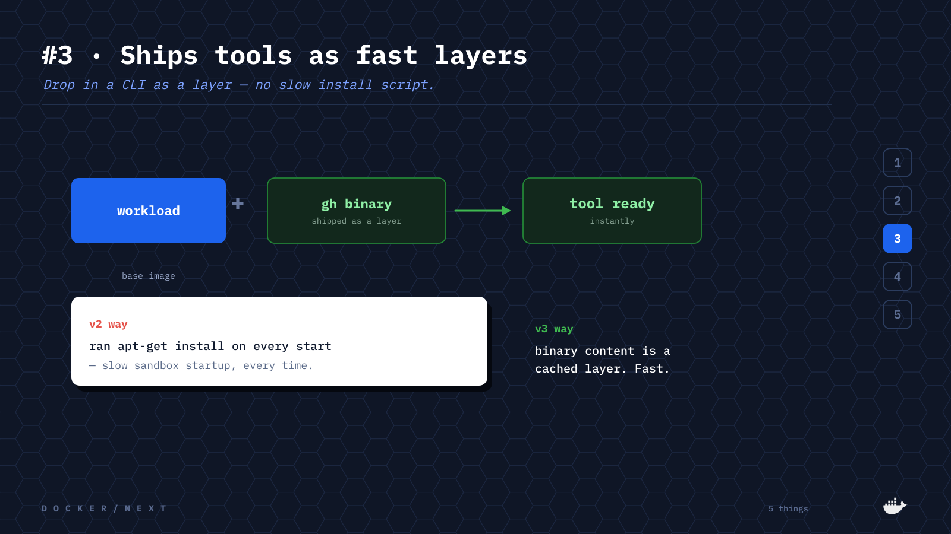
Notes:
Number three: it ships tools as fast layers. Want the GitHub CLI? It's dropped in as a cached layer — instantly ready. In v2, mixins ran apt-get on every start, which made startup slow every single time. In v3 it's just a layer.

Slide 14
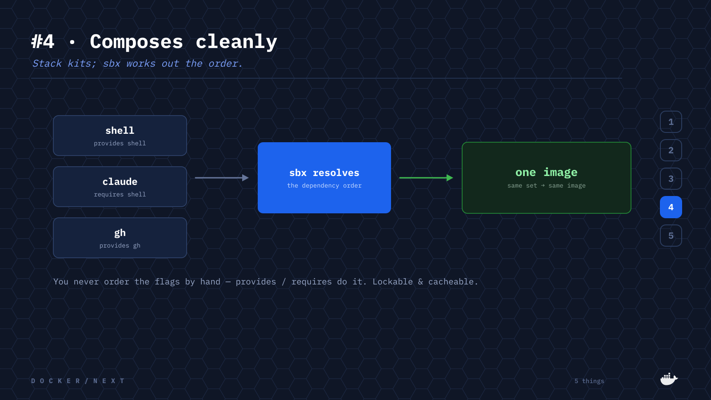
Notes:
Number four: it composes cleanly. Stack a shell, Claude, and gh; each declares what it provides and requires, and sbx works out the order. You never order flags by hand, and the same set always produces the same image — lockable and cacheable.

Slide 15
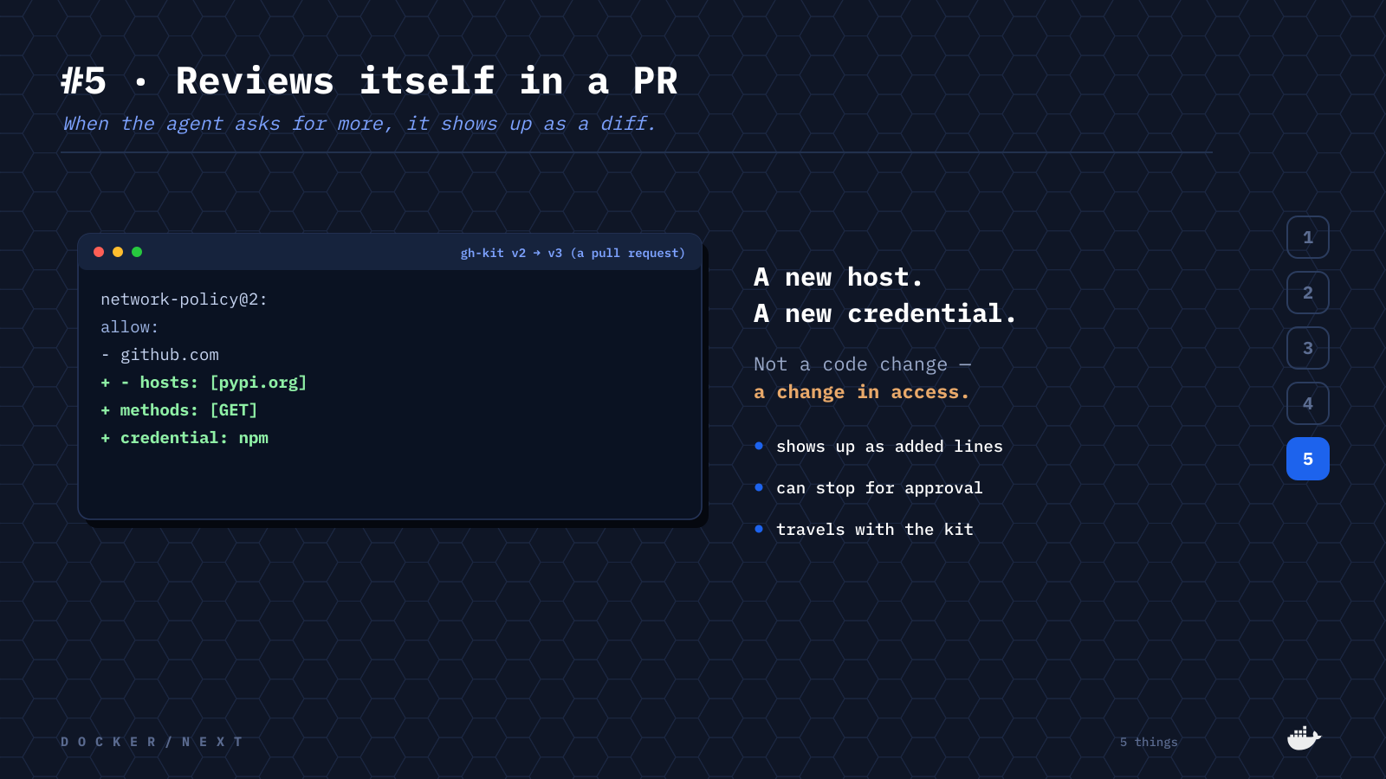
Notes:
Number five: it reviews itself. When the next version wants a new host or a new credential, that shows up as added lines in a pull request. It's not a code change — it's a change in access — so it can stop for approval, and it travels with the kit.

Slide 16
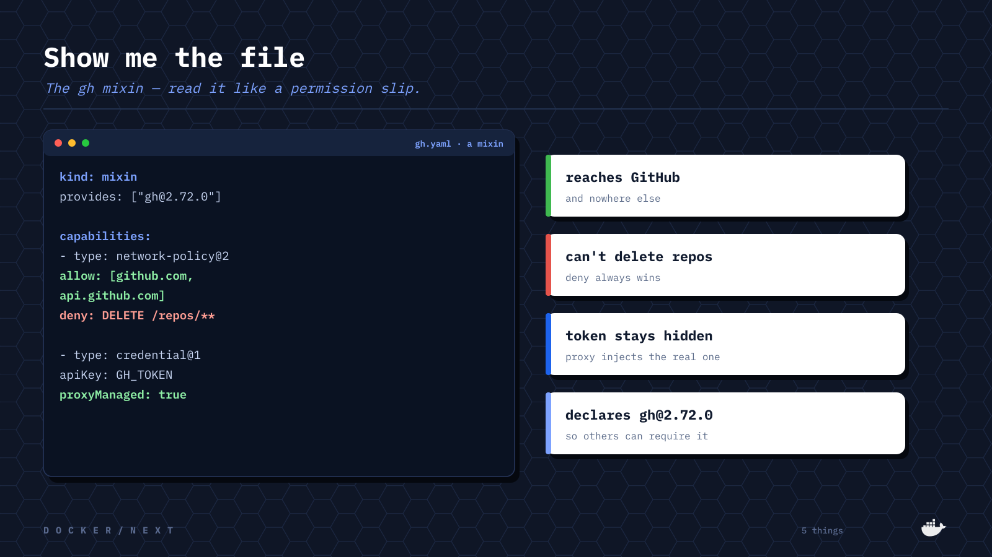
Notes:
Here's a real one — the gh mixin, read like a permission slip. It reaches GitHub and nowhere else, it can't delete repos because deny always wins, the token stays hidden behind the proxy, and it declares gh@2.72.0 so other kits can require it. That's the whole contract, in one readable file.

Slide 17
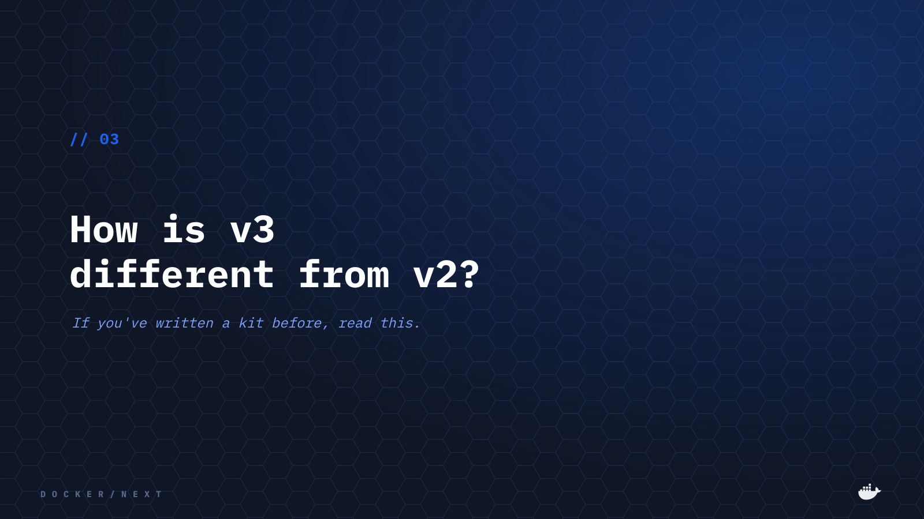
Notes:
If you've written a kit before, this next part is for you — how v3 differs from v2.

Slide 18
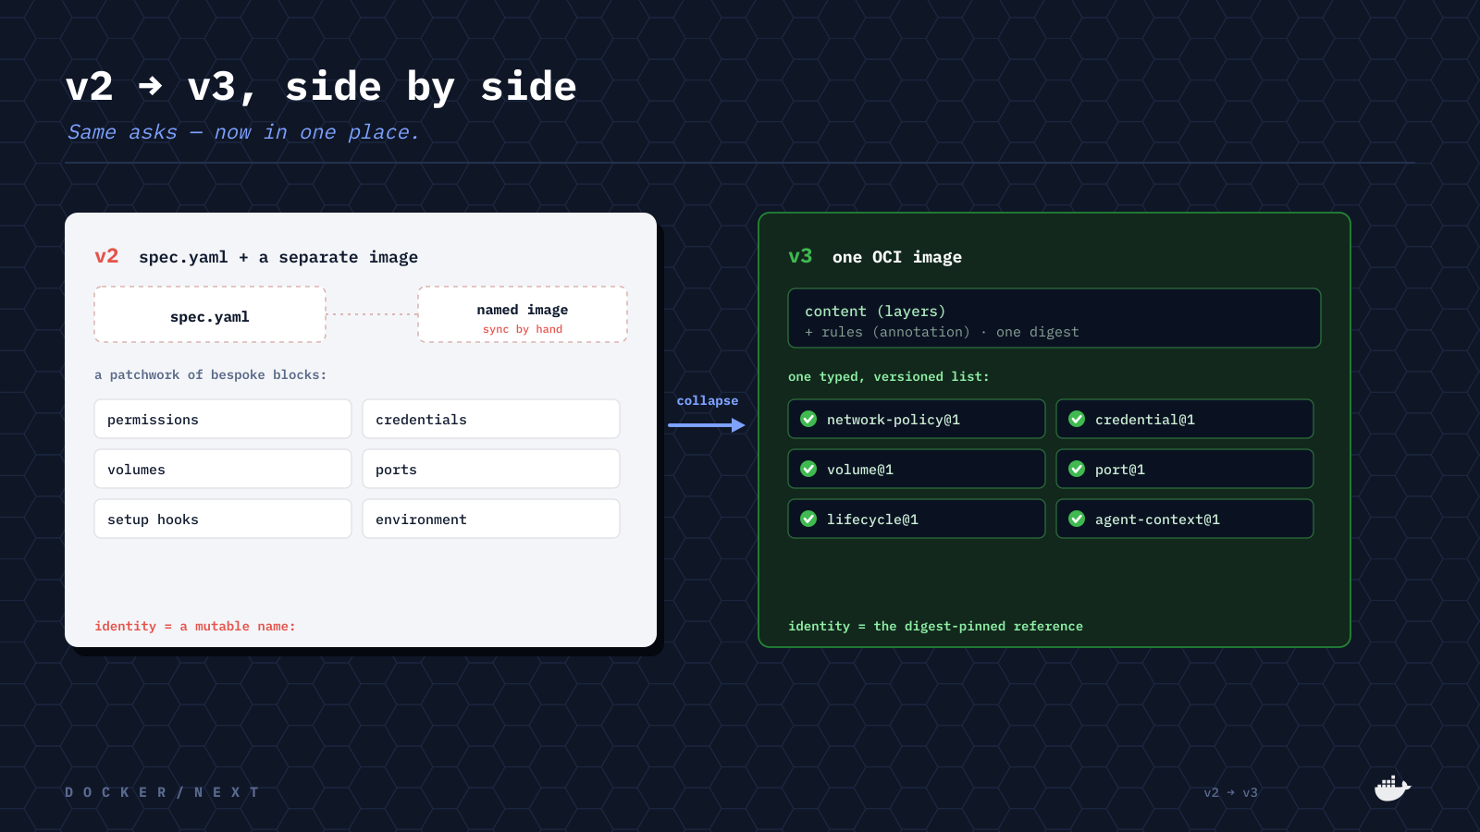
Notes:
Side by side. A v2 kit was a spec.yaml plus a separately-built image you kept in sync by hand, with a patchwork of bespoke blocks — permissions, credentials, volumes, ports, setup hooks, environment — and identity was a mutable name. v3 collapses all of it into one OCI image and one typed, versioned capabilities list, with identity as the digest-pinned reference. Same asks, now in one place.

Slide 19
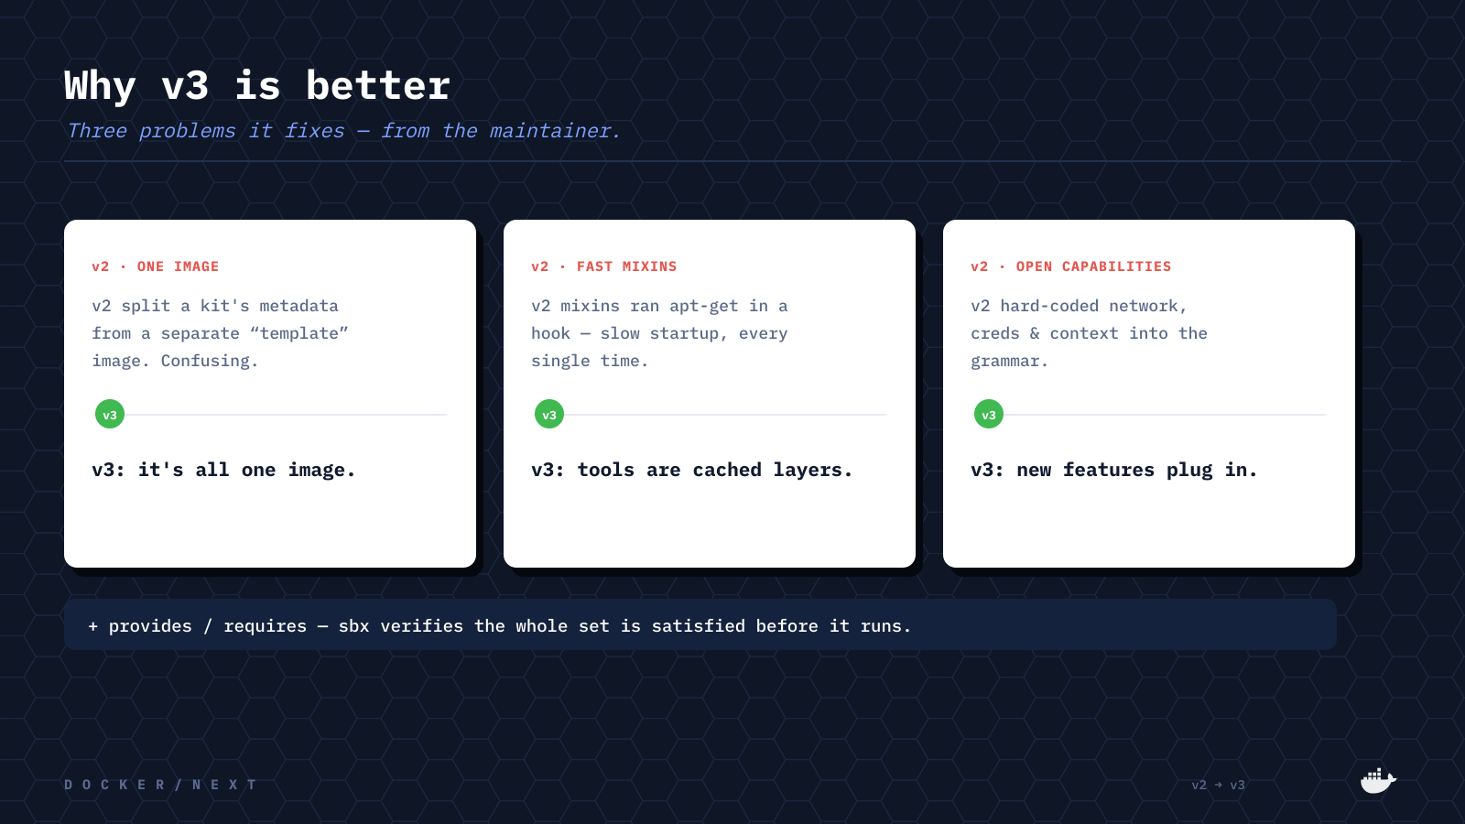
Notes:
Why is that better? Three problems, straight from the maintainer. One: v2 split a kit's metadata from a separate 'template' image — confusing; v3 is all one image. Two: v2 mixins ran apt-get in a hook — slow; v3 tools are cached layers. Three: v2 hard-coded network, creds and context into the grammar; v3 lets new capabilities plug in. Plus provides/requires, so sbx verifies the whole set before it runs.

Slide 20
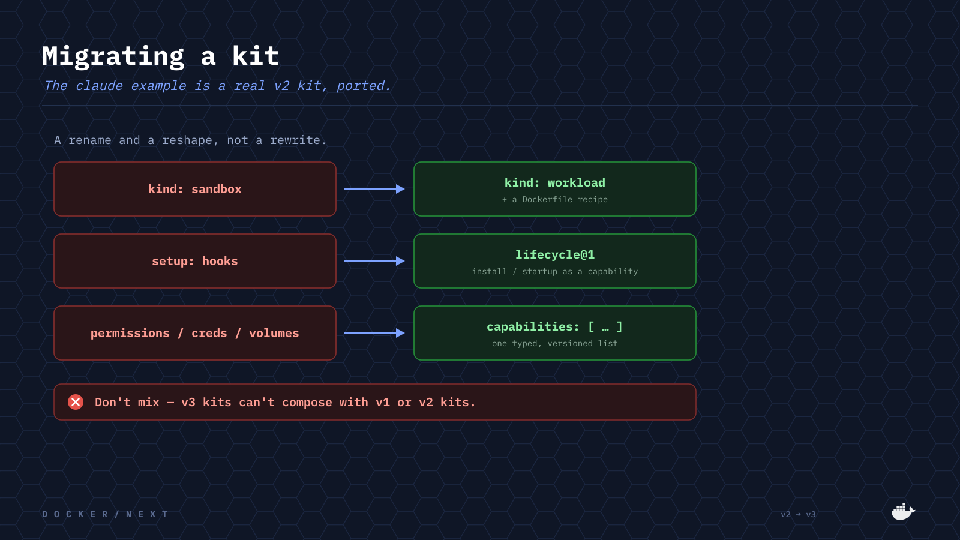
Notes:
Migrating is a rename and a reshape, not a rewrite. kind: sandbox becomes kind: workload with a Dockerfile recipe. setup hooks become the lifecycle capability. permissions, credentials and volumes become one capabilities list. One caveat: don't mix — v3 kits can't compose with v1 or v2. The claude example in the repo is a real v2 kit, ported.

Slide 21
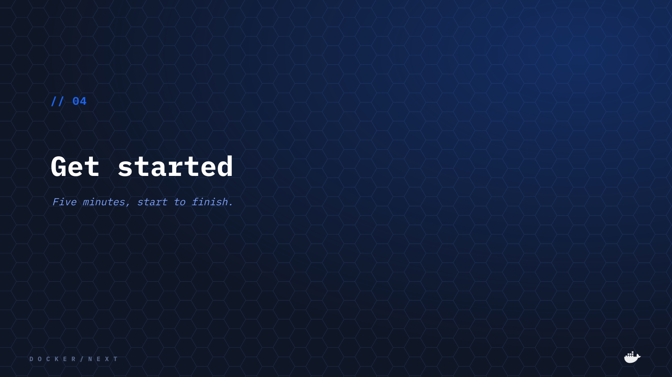
Notes:
Let's actually run one. Five minutes, start to finish.

Slide 22
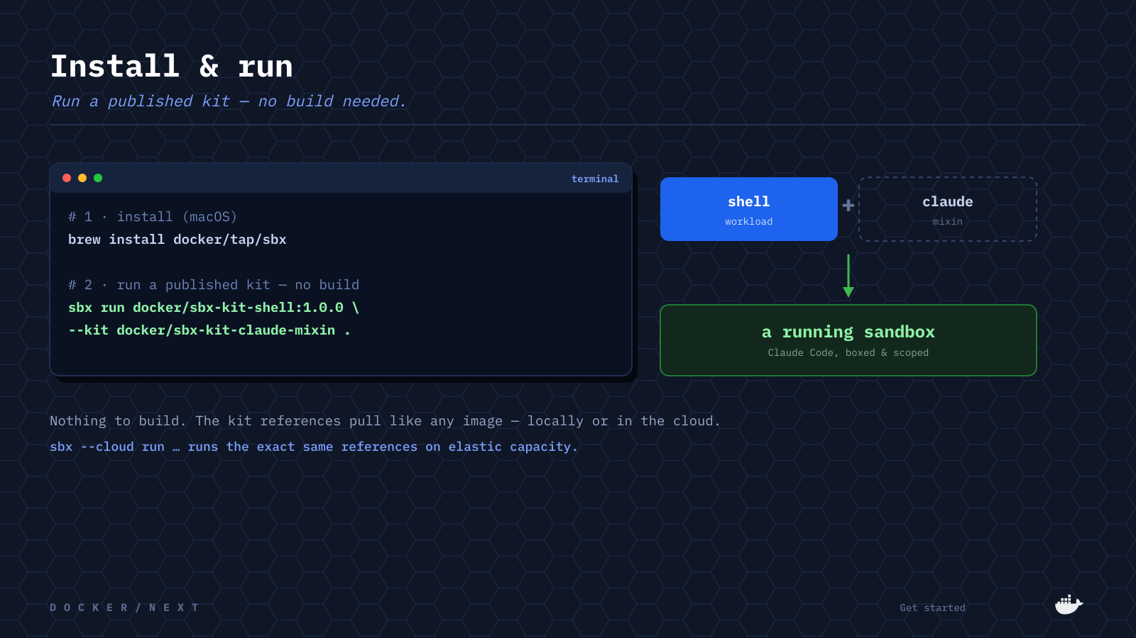
Notes:
Install sbx with brew. Then run a published kit — no build needed: a shell workload with the Claude mixin overlaid, and you've got Claude Code, boxed and scoped. The exact same references run in the cloud with sbx --cloud.

Slide 23
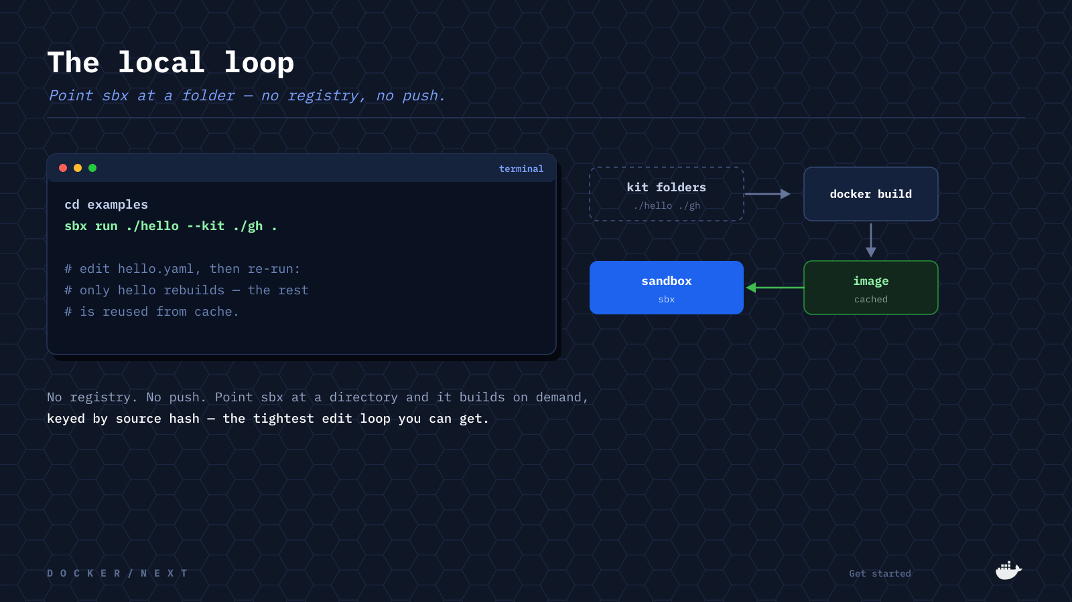
Notes:
For authoring, there's the local loop. Point sbx at the kit folders — no registry, no push — and it builds on demand, keyed by source hash. Edit hello.yaml, re-run, and only hello rebuilds; the rest is reused from cache. It's the tightest edit loop you can get.

Slide 24
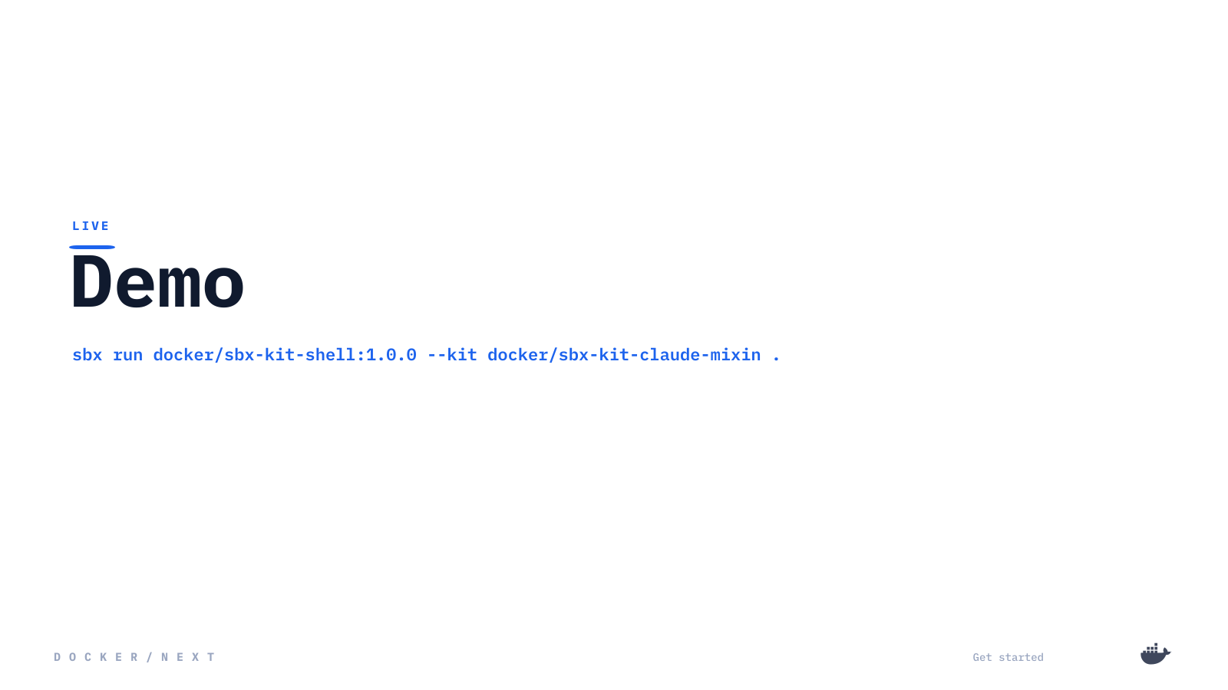
Notes:
Let's see it live. [Run: sbx run docker/sbx-kit-shell:1.0.0 --kit docker/sbx-kit-claude-mixin . — show the sandbox come up, the agent working, and the network/credential boundary in action.]

Slide 25
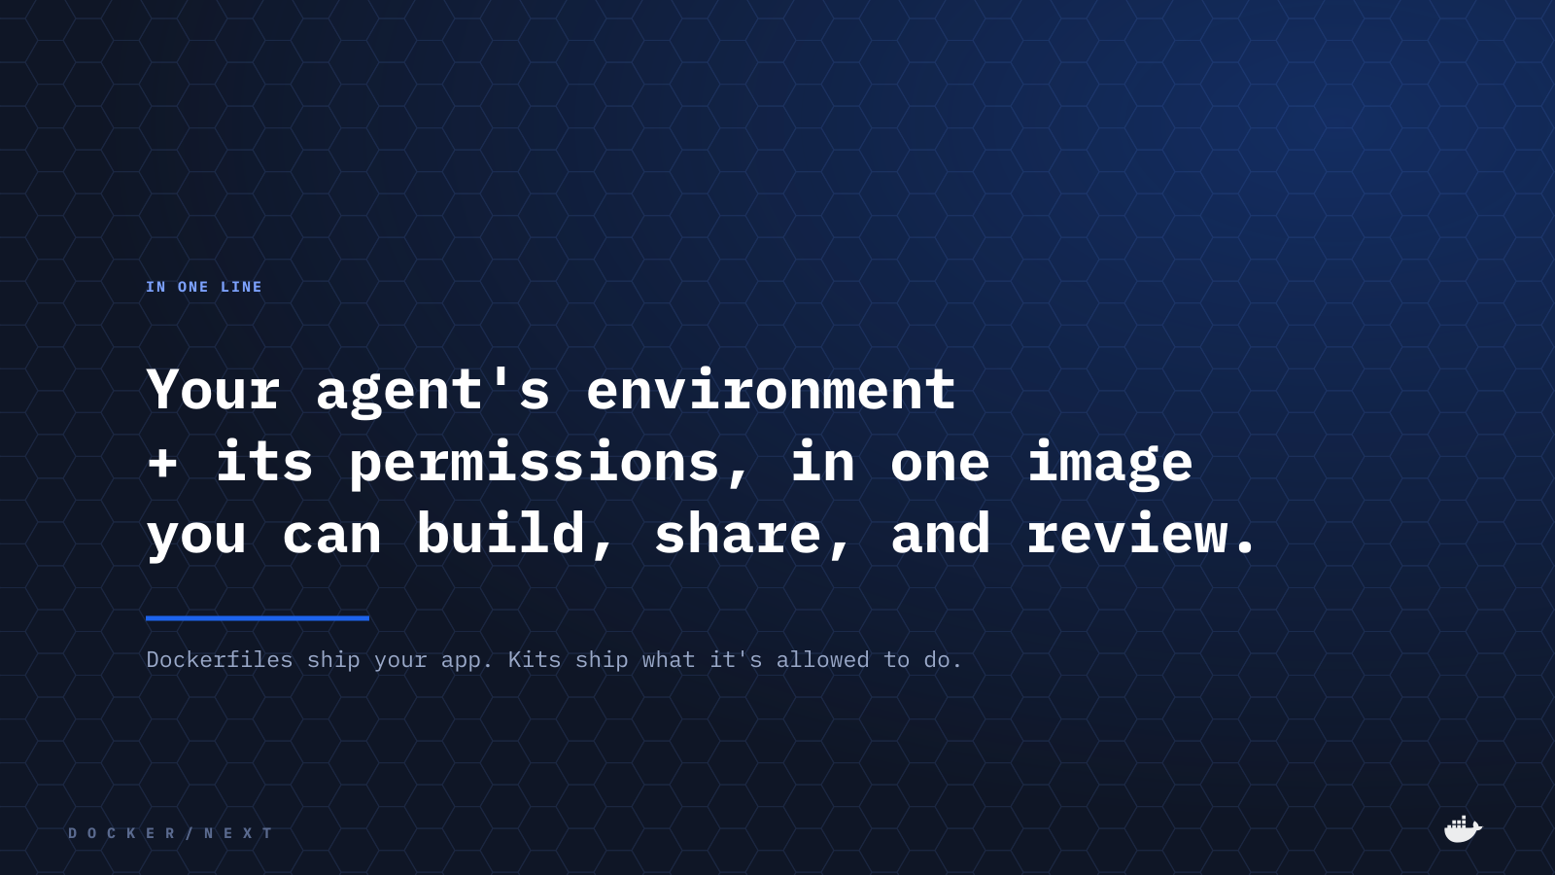
Notes:
To wrap: your agent's environment plus its permissions, in one image you can build, share, and review. Dockerfiles ship your app; Kits ship what it's allowed to do.

Slide 26
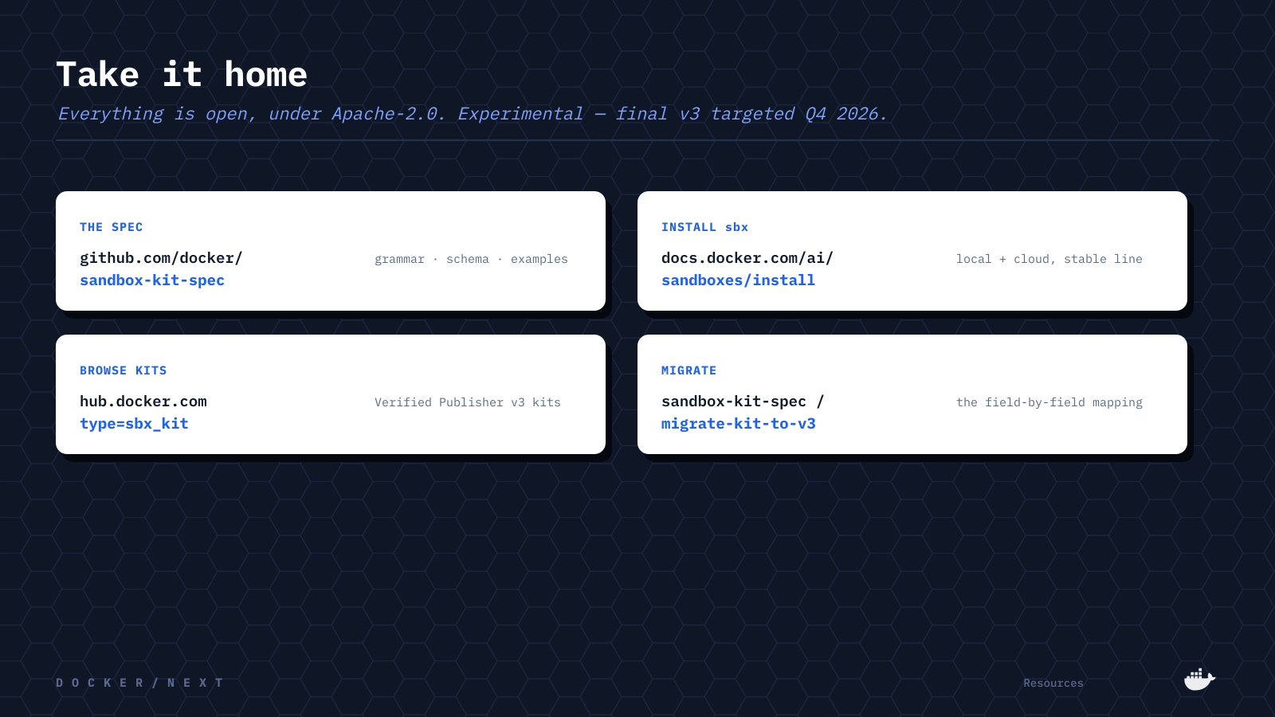
Notes:
Everything's open under Apache-2.0: the spec and examples in docker/sandbox-kit-spec, install docs on Docker Docs, Verified Publisher kits on Docker Hub, and a field-by-field v2 to v3 mapping. It's experimental, with a final v3 targeted for Q4 2026 — so try it and open issues.

Slide 27
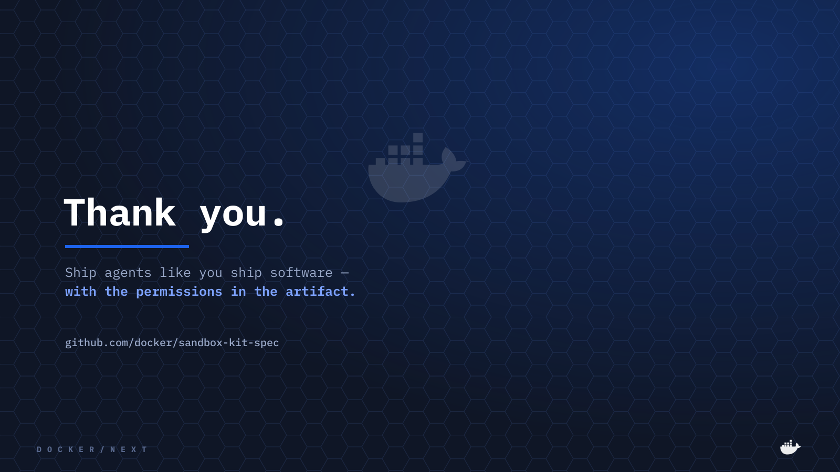
Notes:
Thank you. Ship agents like you ship software — with the permissions in the artifact. Happy to take questions.

