Slide 1

B.TECH PROJECT
(2016)
TITLE:“VOICE MAIL SYSTEM”
UNDER GUIDANCE OF: Er. Shubhendra Singh
Compiled By: ajeet singh
CSJMA12001390123
DURGESH KUMAR SHARMA
CSJMA12001390128
ALLPPT.com _ Free PowerPoint Templates, Diagrams and Charts

Slide 2
CONTENT
ABSTRACT……………………………………………………………..
INTODUCTION………………………………………………………….
USER INTERFACE. …………………………………………………….
CONCLUSION……………………………………………………………

Slide 3
ABSTACT
The idea behind the project is to provide a chat system to the users so
that they can send recorded voice as well as text messages and
Attachments . It has several user-interface modules through which usercan change password, coverphoto, profile picture also .

Slide 4
INTRODUCTION
It has basically some important modules and these are Register, log-in, user profile, inbox, sent mail, setting, recover password, logout ,
contact us ,about us ,compose mail clicking on these links related window will pop-up. Users need to have do login before doing any thing ,if user is new then he has to register himself .Then user can any thing which is defined by “Voice Mail System”.

Slide 5
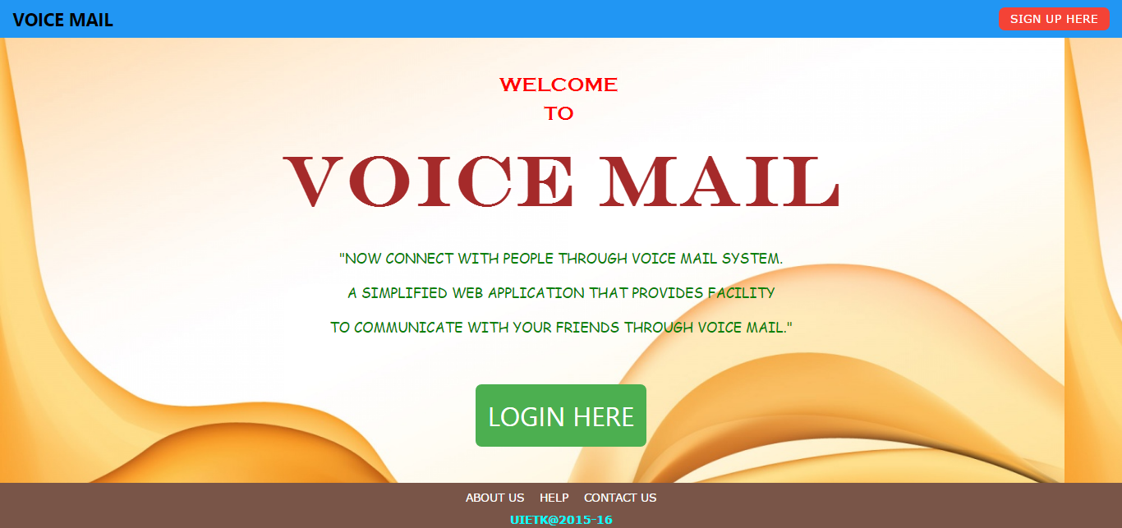
USER-INTERFACE

Slide 6
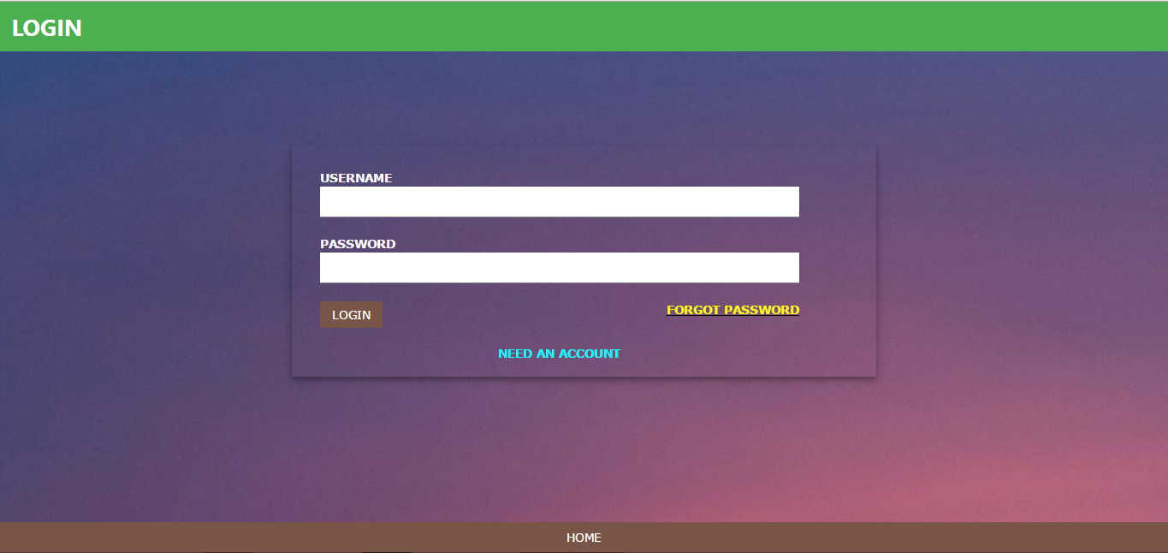
Login.jsp

Slide 7
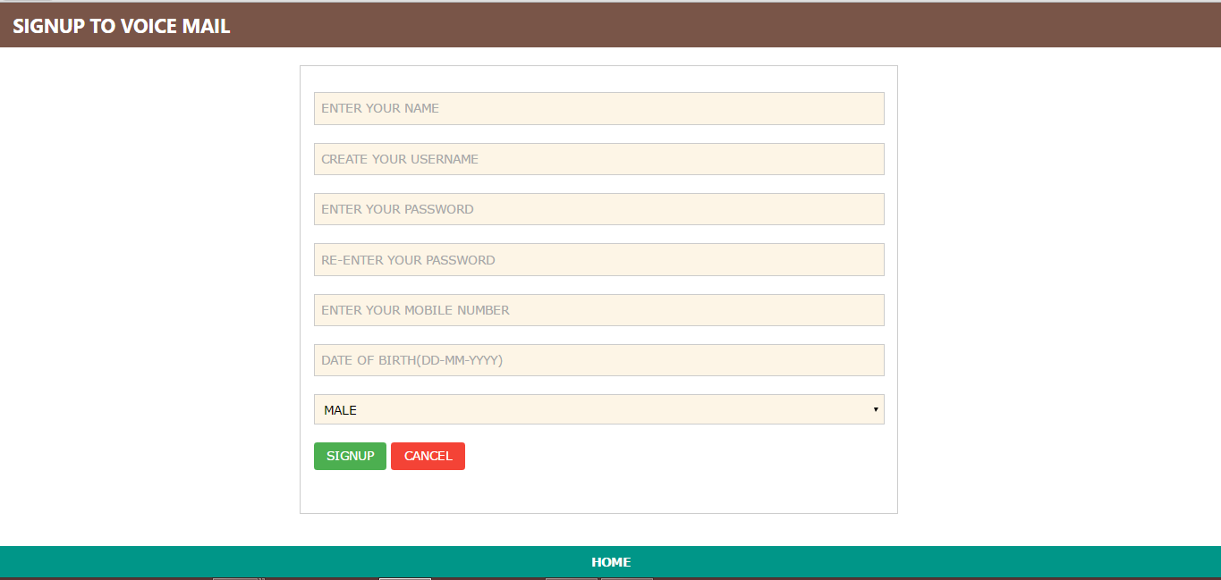
Post.jsp

Slide 8
Advice.jsp

Slide 9
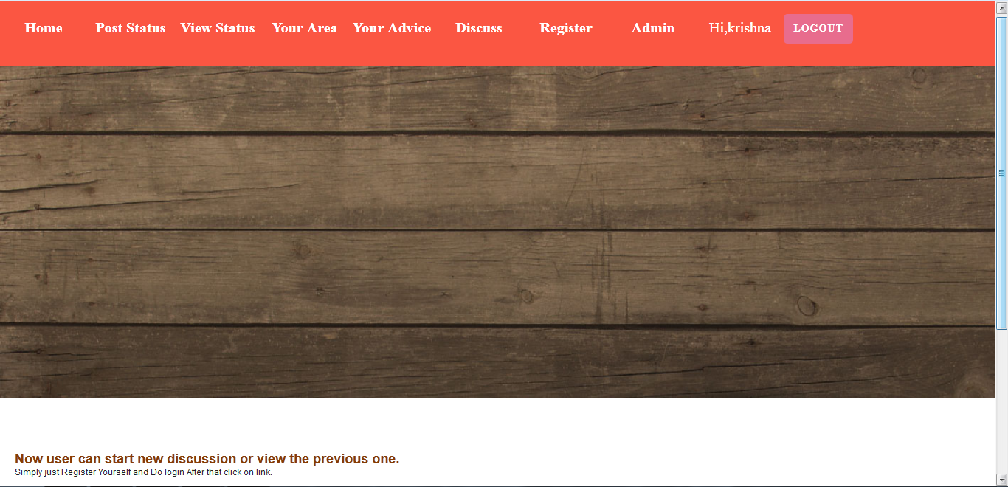

Discuss.jsp

Slide 10
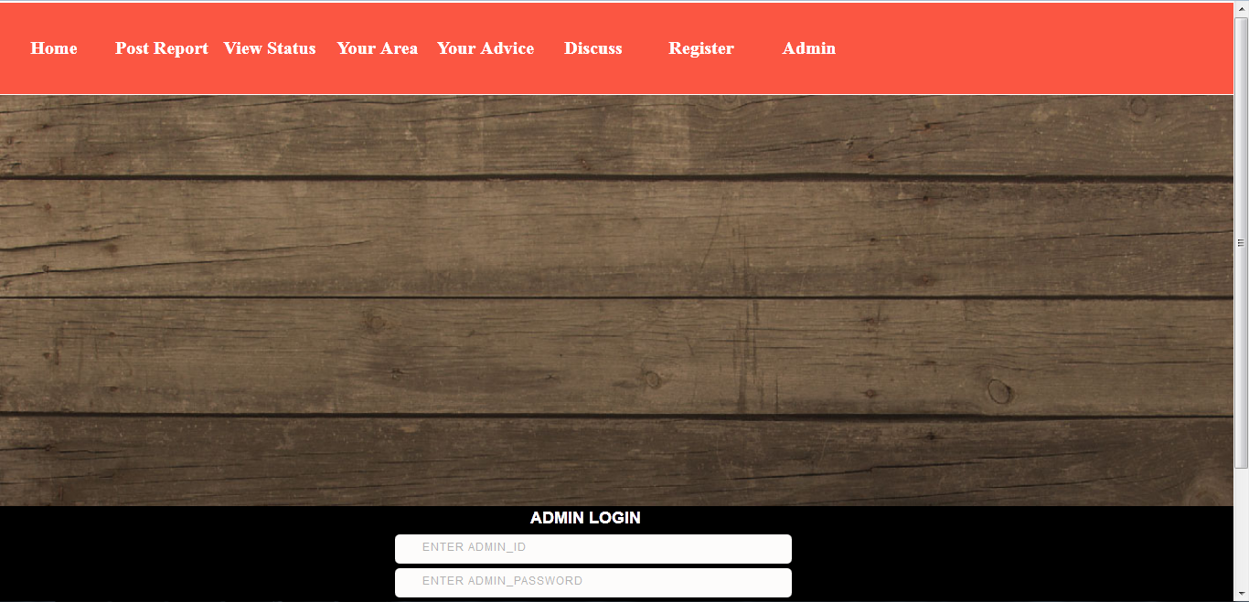
Admin.jsp

Slide 11
CONCLUSION
The “Voice Mail System” have been developed by using advanced java, html, css , javascript , ajax , jquery and oracle 11.2g with the goal of meet the objective of voice chat .It provide a free platform to those peoples who want to chat with their clients, office people or an organization.

