Slide 1
Effective analysis and diagnosis of Liver disorder using clustering and association rules in data mining

Slide 2
The aim of the project is to do a
“comparative study of different data mining Algorithms and determining higher accuracy”.
With the medical parameters of enough number of patients and the non-patients, it is possible to predict how likely it is for a person to be suffering from a Liver disorder.
The challenge is thus to predict which of the tests are likely to turn positive on the Liver disorder detection test and which ones negative.

Slide 3
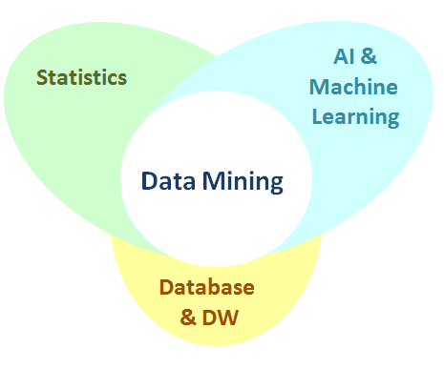
What is Data Mining?
Data Mining is about explaining the past and predicting the future by means of data analysis. Data mining is a multi-disciplinary field which combines statistics, machine learning, artificial intelligence and database technology.
Steps of Data Mining
1.Data Integration
2.Data Selection
3.Data Cleaning
4.Data Transformation
5.Data Mining
6.Pattern Evaluation
7.Use of Discovered Knowledge

Slide 4
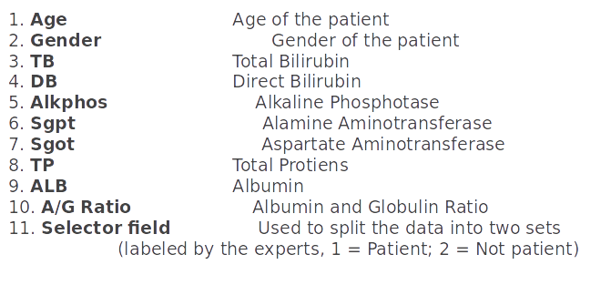
Attributes in Data

Slide 5
Data Cleaning
Data Should be cleaned to remove redundancy in result.
Data is cleansed through processes such as :
1.Checking for missing values
2.filling in missing values
3.Smoothing the noisy data
4.resolving the inconsistencies in the data.

Slide 6
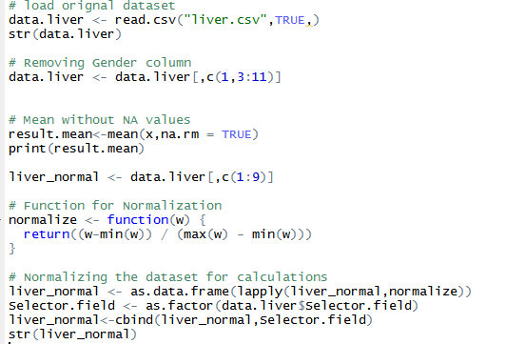

Slide 7
Data
Visualization

Slide 8
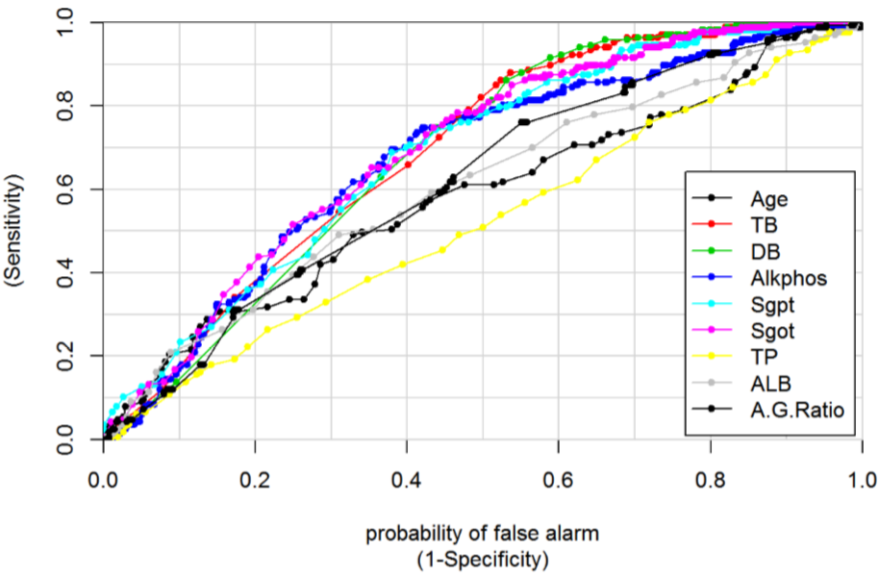

Slide 9
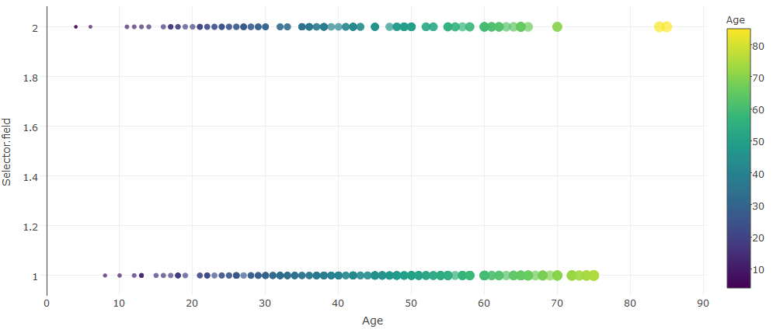
Patient’s According to Age

Slide 10
Algorithms…
Implementaion.

Slide 11
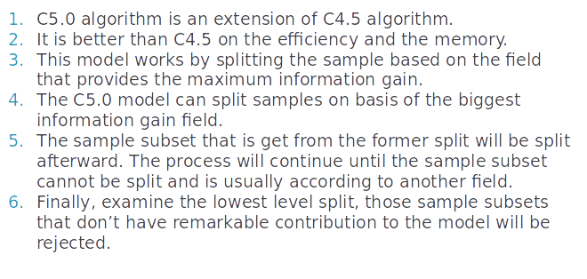
C5.0 Algorithm

Slide 12
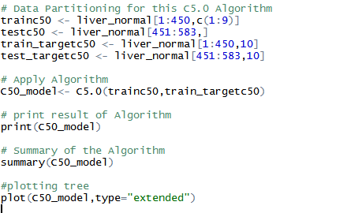
C5.0 Algorithm Snippet

Slide 13
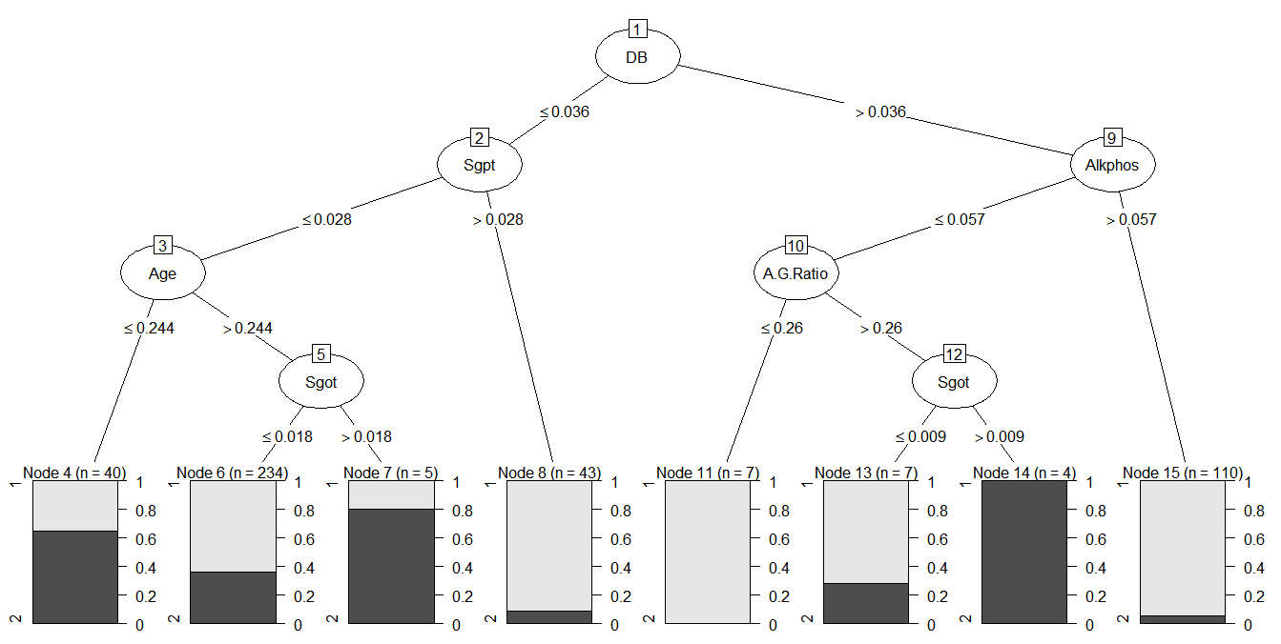

Slide 14
Boosting in C5.0 Algorithm
1.In boosted C5.0 model (either a rule set or a decision tree), you actually create a set of related models.
2.The model rule browser for a boosted C5.0 model shows the list of models at the top level of the hierarchy, along with the estimated accuracy of each model and the overall accuracy of the ensemble of boosted models.
3.To examine the rules or splits for a particular model, select that model and expand it as you would a rule or branch in a single model.

Slide 15
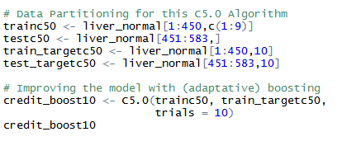
Boosted C5.0 Algorithm Snippet

Slide 16
Random Forest Algorithm
1.Random Forest is an ensemble of decision trees.
2.In Random Forest, we’ve collection of decision trees (so known as “Forest”).
3.To classify a new object based on attributes, each tree gives a classification and we say the tree “votes” for that class.
4.The forest chooses the classification having the most votes (over all the trees in the forest).

Slide 17
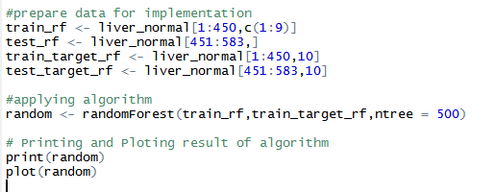
Random Forest Algorithm Snippet

Slide 18
Naïve Bayes’ Classifier
1.Naive Bayes is a simple technique for constructing classifiers: models that assign class labels to problem instances, represented as vectors of feature values, where the class labels are drawn from some finite set.
2.All naive Bayes classifiers assume that the value of a particular feature is independent of the value of any other feature, given the class variable.
3.Naive Bayes classifiers can be trained very efficiently in a supervised learning setting.

Slide 19
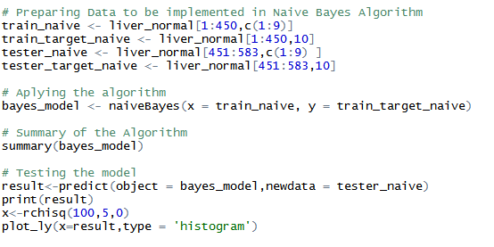
Naïve’ Bayes Code Snippet

Slide 20
KNN (K Nearest Neighbors) Algorithm
1.It can be used for both classification and regression problems.
2.However, it is more widely used in classification problems in the industry.
3.K nearest neighbors is a simple algorithm that stores all available cases and classifies new cases by a majority vote of its k neighbors.

Slide 21
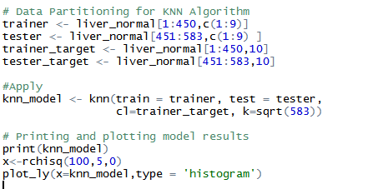
Code Snippet

Slide 22
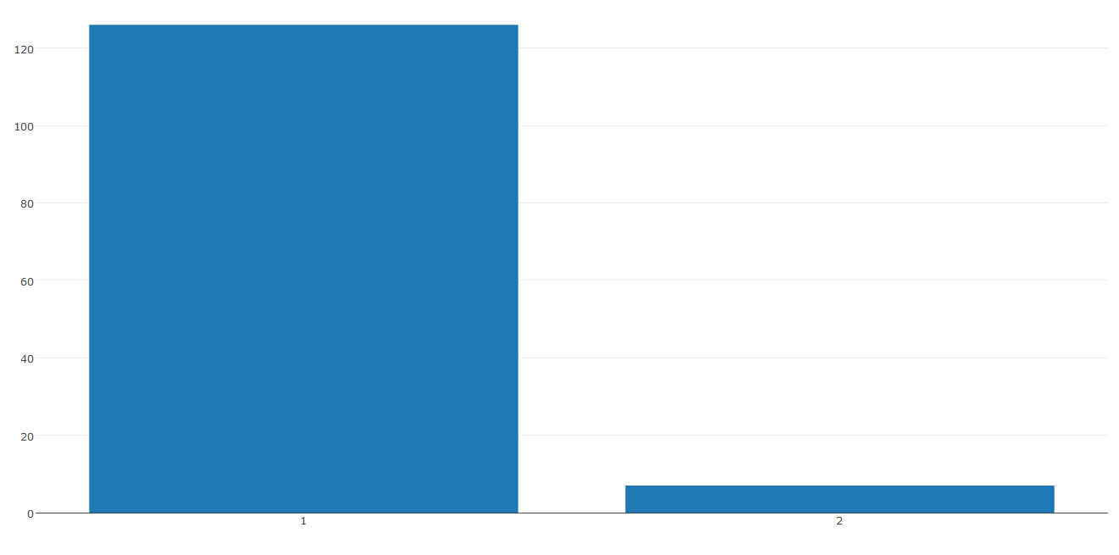

Slide 23
K Means Algorithm
1.It is a type of unsupervised algorithm which solves the clustering problem.
2.Its procedure follows a simple and easy way to classify a given data set through a certain number of clusters (assume k clusters).
3.Data points inside a cluster are homogeneous and heterogeneous to peer groups.

Slide 24
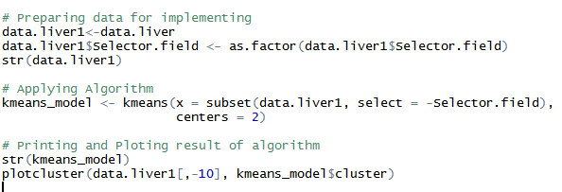
K Means Code Snippet

Slide 25
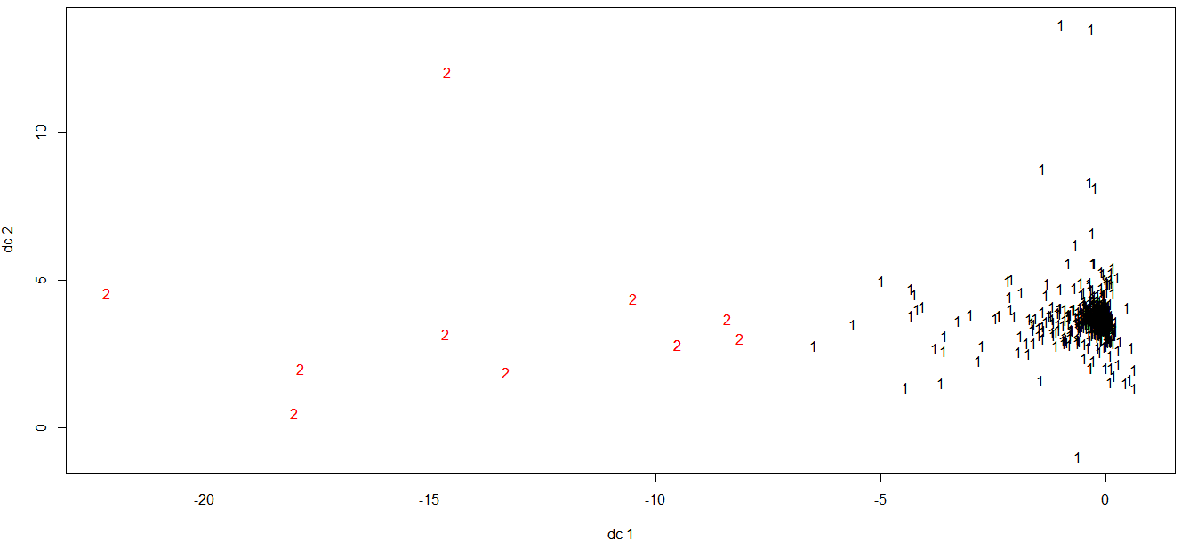

Slide 26
RESULTS

Slide 27
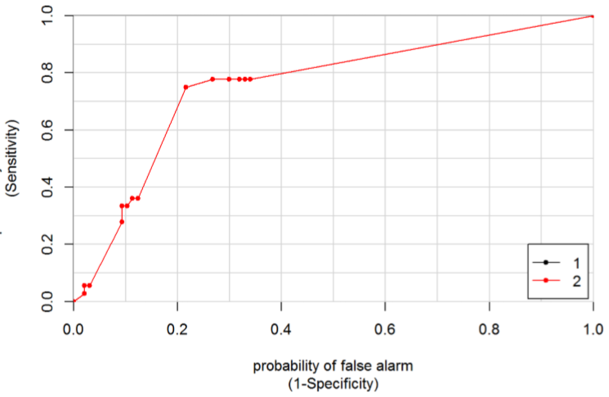
ROC Curve for C5.0 Algorithm

Slide 28
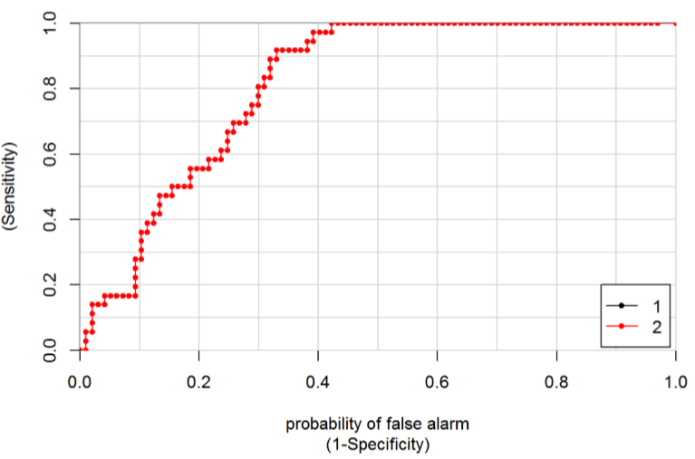
ROC Curve for Naïve’ Bayes Algorithm

Slide 29
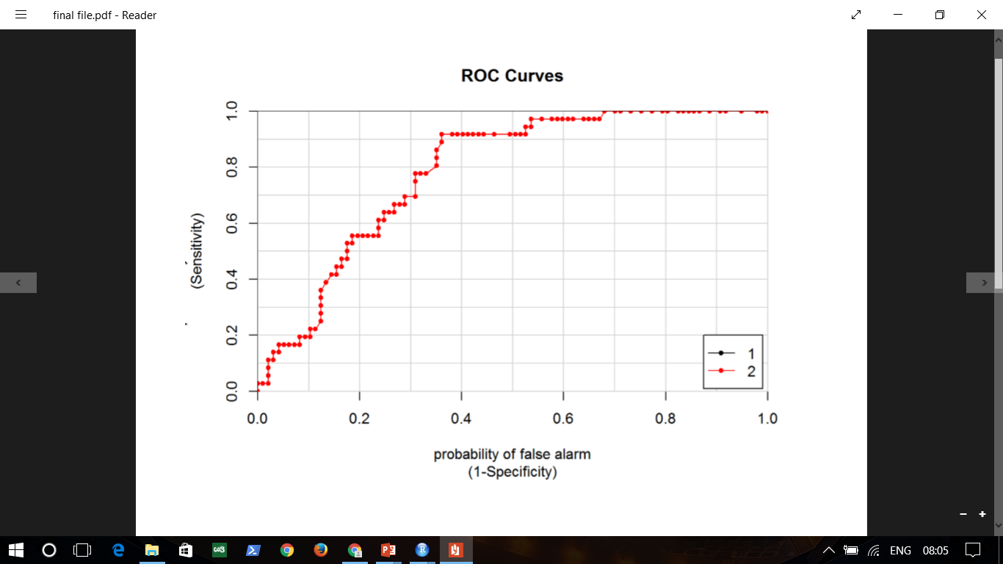
ROC Curve for Random Forest Algorithm

Slide 30
Table to compare data
Algorithm | Accuracy (%) | Precision (%) | Recall (%)
Naïve’ Bayes | 66.17 | 1.00 | 53.61
K Means | 69.47 | 97.36 | 70.80
KNN | 70.68 | 73.38 | 93.81
C5.0 | 71.43 | 93.81 | 73.98
Random Forest | 72.18 | 75.00 | 92.78
Boosted C5.0 | 75.19 | 90.72 | 78.57

Slide 31
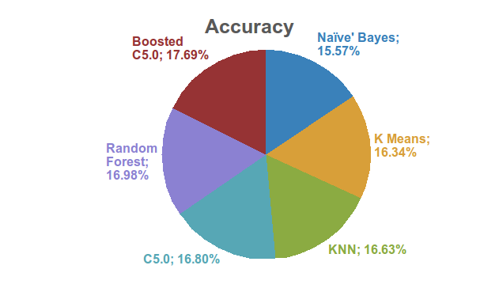

Slide 32
Conclusion...
Boosted C5.0 algorithm gives the best result on this liver patient dataset in our research. It gives Accuracy of 75.19 % .
The accuracy gained by our work is greater than the research paper which we have taken in study.

Slide 33
References...
1.B. V. Ramana, M. S. P. Babu and N. B. Venkateswarlu, Liver Classiﬁcation Using Modiﬁed Rotation Forest. International Journal of Engineering Research and Development, 6(1):17-24, 2012.
2.R. H. Lin, An Intelligent Model for Liver Disease Diagnosis. Artiﬁcial Intelligence in Medicine, 47(1):53-62, 2009.
3.P. Rajeswari and G. Reena, Analysis of Liver Disorder using Data mining Algorithm. Global Journal of Computer Science and Technology, 10(14):48-52, 2010.
4.B. Chen and H. X. Zhang, An Approach of Multiple Classiﬁers Ensemble based on Feature Selection. In Fifth International Conference on Fuzzy Systems and Knowledge Discovery, Vol. 2, pp. 390-394, 2008.

Slide 34
5.S. Karthik, A. Priyadarishini, J. Anuradha and B. K. Tripathy, Classiﬁcation and Rule Extraction using Rough Set for Diagnosis of Liver Disease and Its Types. Advanced Applied Scientiﬁc Research, 2(3):334345, 2011.
6.S. Ansari, I. Shaﬁ, A. Ansari, J. Ahmad and S. I. Shah, Diagnosis of Liver Disease Induced by Hepatitis Virus using Artiﬁcial Neural Networks. In 2011 IEEE International Multitopic Conference (INMIC), pp. 8-12, 2011.
7.A.Frank and A. Asuncion, UCI Machine Learning Repository [http://archive.ics.uci.edu/ml]. Irvine, CA: University of California, School of Information and Computer Science, 2010.
8.ILPD (Indian Liver Patient Dataset) Dataset. UCI Repository of Machine Learning Databases. Available in http://archive.ics.uci.edu/ml/datasets/ILPD, last accessed: 15 December 2012.

