Slide 1
AssemblyAI Voice Agent Hackathon
CareThread
Clinical handoffs with
responsibility intact
Clinical communication simulation using synthetic data
Notes:
CareThread is a browser-based clinical communication simulation for the AssemblyAI hackathon. The visual style does not imply Apple sponsorship, Apple integration or a native Apple application. Synthetic data only. No clinical efficacy claim.

Slide 2
Uncertainty can disappear in a handoff
Sender
Receiver
The scan result is pending.
Discharge is waiting
for the review.
The scan was clear.
The patient is ready
for discharge.
A changed statement needs clarification.
Fictional example. Clinicians determine what is correct.
02
Notes:
This is a fictional communication example, not a treatment recommendation. AHRQ TeamSTEPPS handoff guidance motivates retaining uncertainty, contingencies and acknowledged responsibility. It does not validate this software. Sources: https://www.ahrq.gov/teamstepps-program/curriculum/communication/tools/handoff.html and https://www.ahrq.gov/teamstepps-program/curriculum/communication/tools/checkback.html

Slide 3
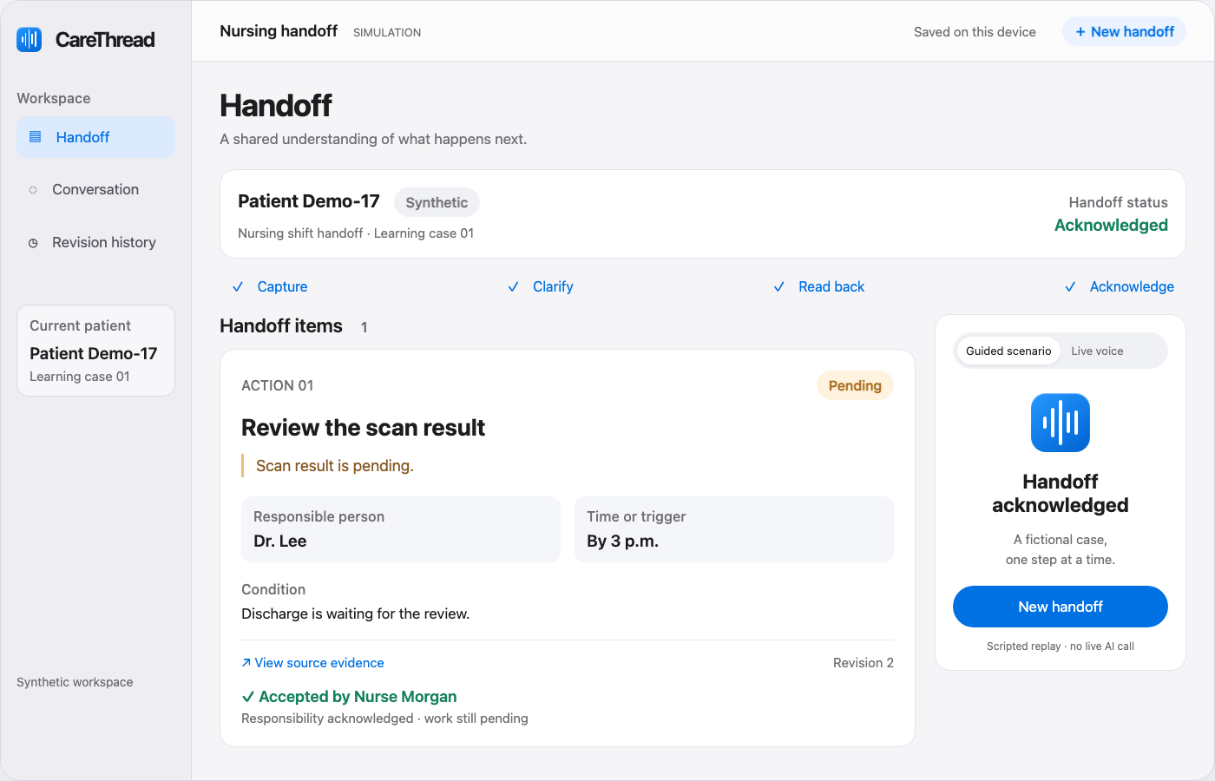
A shared view of unfinished work
The task keeps its owner, timing and source statement.
Pending work.
Named owner.
Stated timing.
Source evidence.
Code-rendered interface illustration · Fictional patient
03
Notes:
React/Remotion illustration based on the implemented CareThread UI. It represents a synthetic handoff whose states were verified in the app. It is not a screenshot or live recording. Source statements, roles, revisions and unknown required fields remain reviewable.
Capture provenance: Code-rendered interface illustration, authored in React and rendered locally by Remotion. Represents the verified synthetic scenario; not a browser screenshot.

Slide 4
Acceptance and completion are separate
Handoff
Clinical work
Accepted
Still pending
The receiver acknowledges
the current revision.
Completion requires a separate
participant report.
A substantive correction clears acceptance of the earlier revision.
04
Notes:
This distinction is implemented in the deterministic state engine. Acknowledgment is not clinical completion. The prototype records participant-reported completion and cannot independently observe physical care. Optional real accepted-state screenshot may replace the native comparison if it supports the final UI design.

Slide 5
AssemblyAI powers speech and planning
01
02
03
Conversation
Proposed changes
Validated record
Voice Agent API
Speech input and spoken replies
LLM Gateway
Structured plans from transcripts
Application rules
Source checks and revision control
Server-held key. Temporary voice tokens. Browser records stay on this device.
05
Notes:
AssemblyAI managed Voice Agent handles speech and replies with tools: []. Each final participant transcript goes through the server-side AssemblyAI LLM Gateway using qwen3.5-4b-32k-fast. The planner proposes JSON actions; deterministic validation checks sources, role, fields and revisions before application. Audio and text are processed by AssemblyAI. IndexedDB stores synthetic records in the same browser. Sources: https://www.assemblyai.com/docs/voice-agents/voice-agent-api/browser-integration and https://www.assemblyai.com/docs/llm-gateway/quickstart. Implementation sources: lib/voice-config.ts, lib/voice-tools.ts and app/api/analyze/route.ts.

Slide 6
Built for handoff practice
Clinical educators
and simulation centers
Review omissions and clarifications
after a handoff exercise.
An institution subscription is
a business hypothesis to test.
Next step: clinician feedback and a measured usability study.
06
Notes:
Clinical educators and simulation centers are the initial customer hypothesis, not existing customers. No market-size, revenue, customer-demand or outcome claim. Usability research should measure understanding, missed issues, false alerts and added time. Clinical deployment needs work beyond this prototype.

Slide 7
What we verified
80
1
automated checks passed
synthetic spoken fixture passed
State, API and lifecycle regressions
Speech to a validated pending task
Browser microphone-device behavior and clinical efficacy remain unvalidated.
07
Notes:
Implementation lead reported 80 passing checks: 78 domain/API checks and two voice lifecycle regressions (late events after reset, role change during analysis). Production build passed after the visual redesign and Vercel deployment is ready. Public synthetic-fixture evidence: docs/evaluation/synthetic-voice-result.json in https://github.com/ajegz/carethread. One generated audio fixture correctly preserved a task, owner, time, condition and pending uncertainty as an unreviewed item, followed by a spoken review request. Three separate Gateway cases covered capture, confirmation and acknowledgment; a rate-limited request passed after a spaced retry. Neither the software count nor the single fixture establishes clinical reliability. No latency benchmark or success percentage is claimed.

Slide 8
CareThread
The next person knows
what is still unfinished.
https://carethread-six.vercel.app
Synthetic clinical communication simulation
08
Notes:
Repository: https://github.com/ajegz/carethread. Verified public application: https://carethread-six.vercel.app. No claim of diagnosis, treatment recommendation, discharge authorization, hospital integration or improved patient outcomes.

